Slide 1
DSP First 2/e
Lecture 5A:
Operations on the Spectrum

Slide 2
License Info for DSPFirst Slides
This work released under a Creative Commons License with the following terms:
Attribution
The licensor permits others to copy, distribute, display, and perform the work. In return, licensees must give the original authors credit.
Non-Commercial
The licensor permits others to copy, distribute, display, and perform the work. In return, licensees may not use the work for commercial purposes—unless they get the licensor's permission.
Share Alike
The licensor permits others to distribute derivative works only under a license identical to the one that governs the licensor's work.
Full Text of the License
This (hidden) page should be kept with the presentation

Slide 3
READING ASSIGNMENTS
This Lecture:
Chapter 3, Section 3-3 (DSP-First 2/e)
Other Reading:
Appendix A: Complex Numbers

Slide 4
LECTURE OBJECTIVES
Operations on a time-domain signal x(t) have a SIMPLE form in the frequency-domain
SPECTRUM Representation has lines at:
Represents Sinusoid with DIFFERENT Frequencies

Slide 5
Recall FREQUENCY DIAGRAM
Used to visualize relationship between frequencies, amplitudes and phases
Plot Complex Amplitude vs. Freq
Complex amplitude
–250
–100
0
100
250
Spectral line
f (in Hz)

Slide 6
GRAPHICAL SPECTRUM
Freq. in rad/s
-7
0
7
ω
AMPLITUDE, PHASE & FREQUENCY are shown

Slide 7
General Spectrum
2M + 1 spectrum components:
At the complex amplitude is
usually, for real x(t)

Slide 8
OPERATIONS on SPECTRUM
Adding DC, or amplitude scaling
Adding two (or more) signals
Time-Shifting
Multiply in frequency by complex exponential
Differentiation of x(t)
Multiply in frequency-domain by (jω)
Frequency Shifting
Multiply in time-domain by sinusoid

Slide 9
Scaling or Adding a constant
Adding DC
Scaling

Slide 10
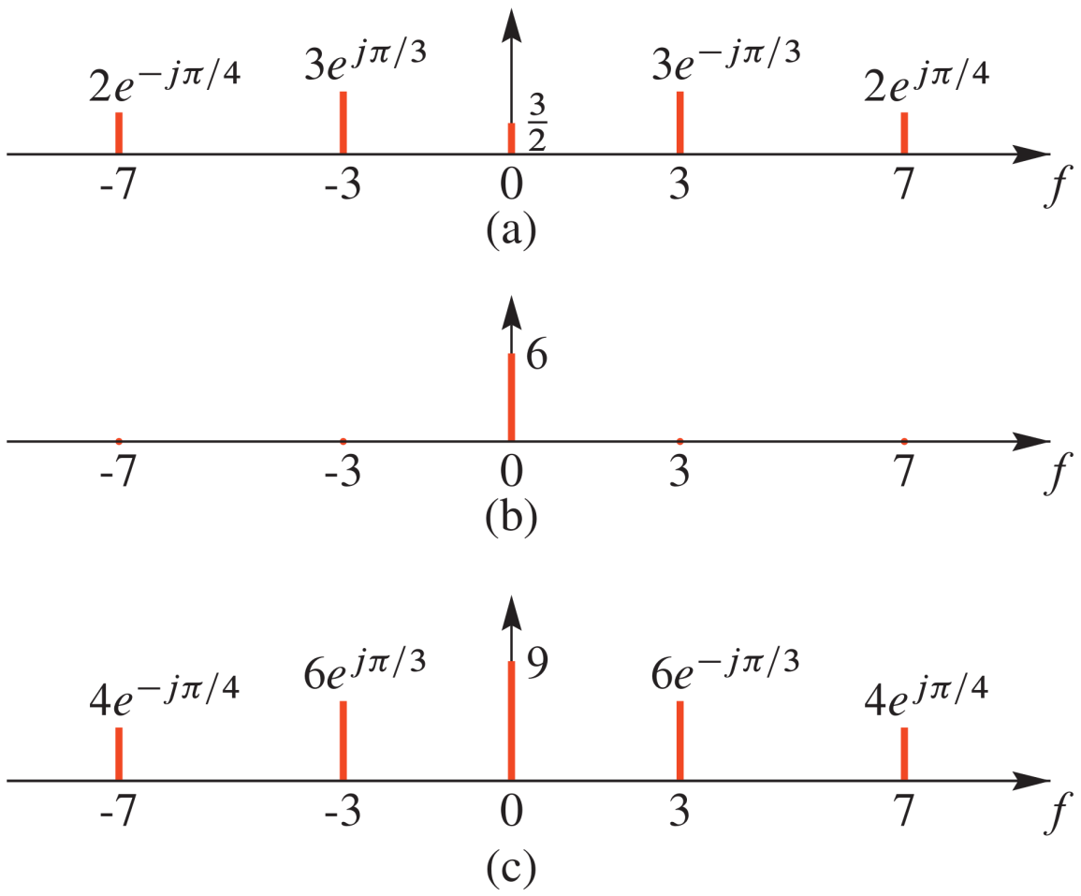
Scaling and Adding a constant

Slide 11
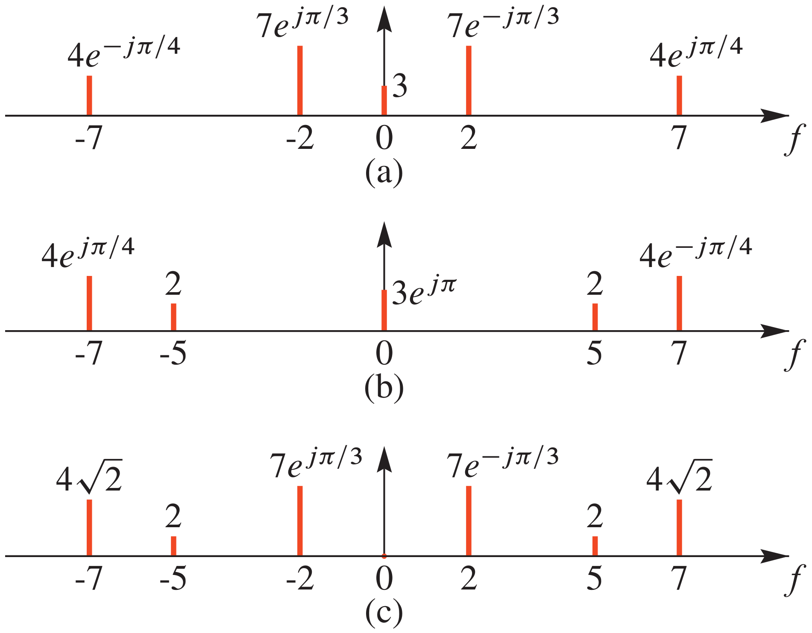
Adding Two Signals (1)
Adding signals with same fundamental
?

Slide 12
Adding Two Signals (2)
Adding signals with same fundamental

Slide 13
Time Shifting x(t)
Time Shifting
Multiply Spectrum complex amplitudes by a complex exponential

Slide 14
Differentiating x(t)
Take derivative of the Signal x(t)
Multiply complex amplitudes by “jω”=“j2πf”

Slide 15
Frequency Shifting x(t)
Multiply x(t) by Complex Exponential ➔Frequency Shifting
Spectrum components shifted:

Slide 16
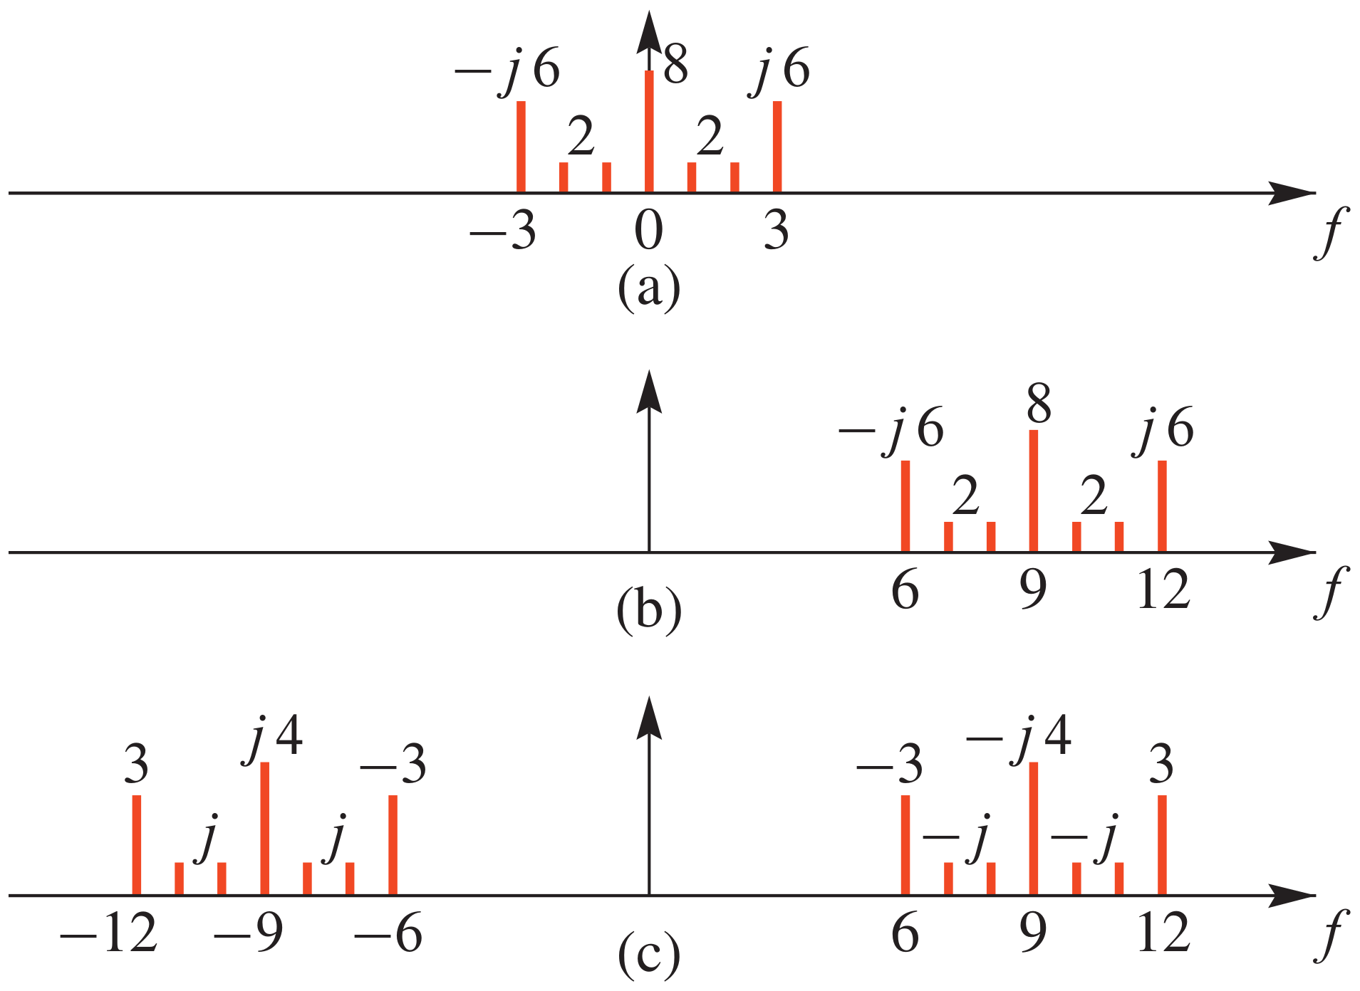
Frequency Shifting x(t)

