Slide 1
DSP First, 2/e
Lecture 7
Fourier Series Analysis

Slide 2
License Info for DSPFirst Slides
This work released under a Creative Commons License with the following terms:
Attribution
The licensor permits others to copy, distribute, display, and perform the work. In return, licensees must give the original authors credit.
Non-Commercial
The licensor permits others to copy, distribute, display, and perform the work. In return, licensees may not use the work for commercial purposes—unless they get the licensor's permission.
Share Alike
The licensor permits others to distribute derivative works only under a license identical to the one that governs the licensor's work.
Full Text of the License
This (hidden) page should be kept with the presentation

Slide 3
READING ASSIGNMENTS
This Lecture:
Fourier Series in Ch 3, Sect. 3-5
Also, periodic signals, Sect. 3-4
Other Reading:
Appendix C: More details on Fourier Series

Slide 4
LECTURE OBJECTIVES
Work with the Fourier Series Integral
ANALYSIS via Fourier Series
For PERIODIC signals: x(t+T₀) = x(t)
Draw spectrum from the Fourier Series coeffs

Slide 5
HISTORY
Jean Baptiste Joseph Fourier
1807 thesis (memoir)
On the Propagation of Heat in Solid Bodies
Heat !
Napoleonic era
http://www-groups.dcs.st-and.ac.uk/~history/Biographies/Fourier.html

Slide 6
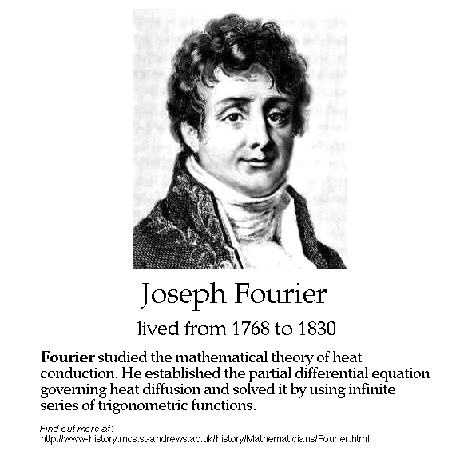

Slide 7
SPECTRUM DIAGRAM
Recall Complex Amplitude vs. Freq
–250
–100
0
100
250
f (in Hz)

Slide 8
Harmonic Signal->Periodic
Sums of Harmonic complex exponentials are Periodic signals
PERIOD/FREQUENCY of COMPLEX EXPONENTIAL:

Slide 9
Notation for Fundamental Frequency in Fourier Series
The k-th frequency is f_{k} = kF₀
Thus, f₀ = 0 is DC
This is why we use upper case F₀ for the Fundamental Frequency

Slide 10
Fourier Series Synthesis
COMPLEX
AMPLITUDE

Slide 11
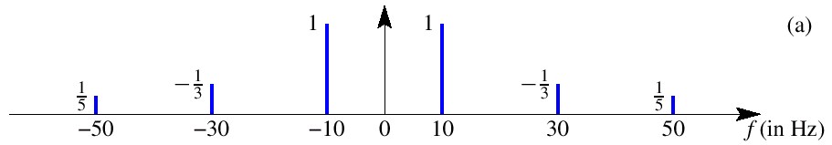
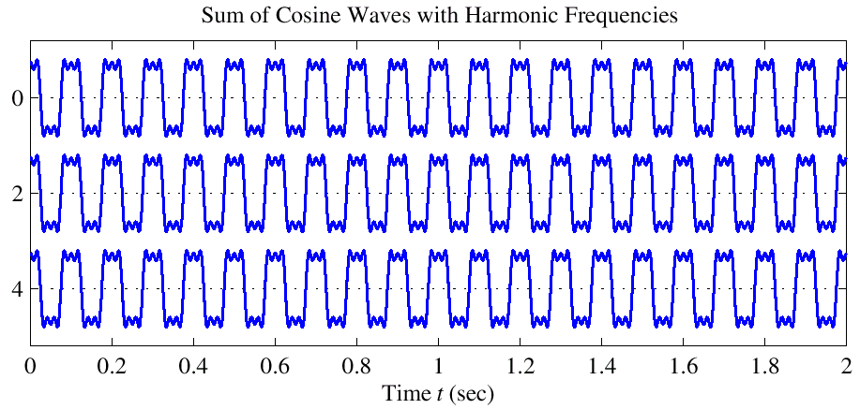
Harmonic Signal (3 Freqs)
a₁
a₃
a₅
T = 0.1

Slide 12
Periodic signals->Harmonic?
Can all periodic signals be written as harmonic signals?
Fourier’s contribution was to postulate the answer is yes
Called Fourier Series
For heat transfer it is easy to solve PDE for sinusoidal sources, but difficult for general sources
Made formal by Dirichlet and Riemann

Slide 13
STRATEGY: x(t) → a_{k}
ANALYSIS
Get representation from the signal
Works for PERIODIC Signals
Measure similarity between signal & harmonic
Fourier Series
Answer is: an INTEGRAL over one period

Slide 14
CALCULUS for complex exp

Slide 15
INTEGRAL Property of exp(j)
INTEGRATE over ONE PERIOD

Slide 16
ORTHOGONALITY of exp(j)

Slide 17
Orthogonal Basis for Signal Decomposition
So, the set of functions
forms the basis for decomposing any periodic signal x(t)
Similar to

Slide 18
3-D Vector Space Analogy
Two vectors:
Similar to
Unit vectors
An arbitrary vector can be expressed as

Slide 19
Fourier Series Integral
Use orthogonality to determine a_{k} from x(t)

Slide 20
Isolate One FS Coefficient

Slide 21
Fourier Series: x(t) → a_{k}
ANALYSIS
Given a PERIODIC Signal
Fourier Series coefficients are obtained via an INTEGRAL over one period
Next, consider a specific signal, the FWRS
Full Wave Rectified Sine

Slide 22
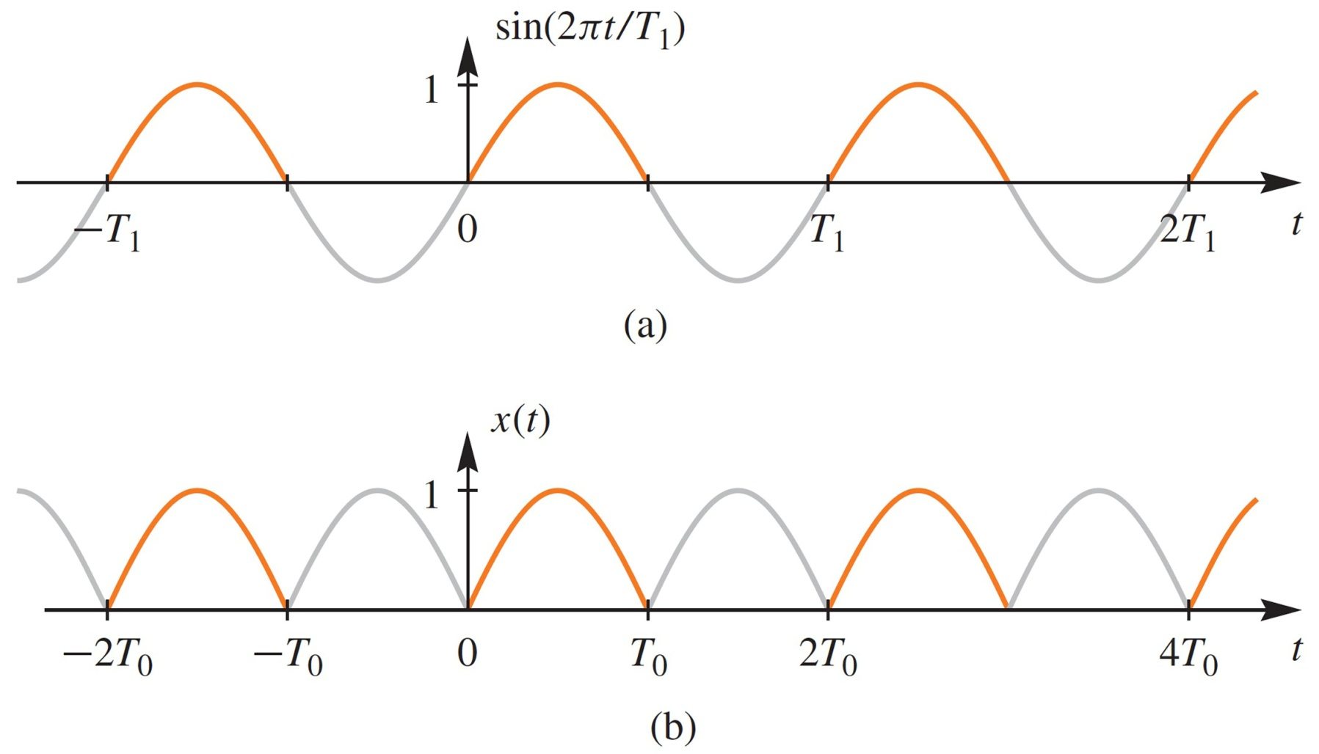
Full-Wave Rectified Sine
Absolute value flips the
negative lobes of a sine wave

Slide 23
Full-Wave Rectified Sine {a_{k}}
Full-Wave Rectified Sine

Slide 24
Full-Wave Rectified Sine {a_{k}}

Slide 25
Fourier Coefficients: a_{k}
a_{k} is a function of k
Complex Amplitude for k-th Harmonic
Does not depend on the period, T₀
DC value is

Slide 26
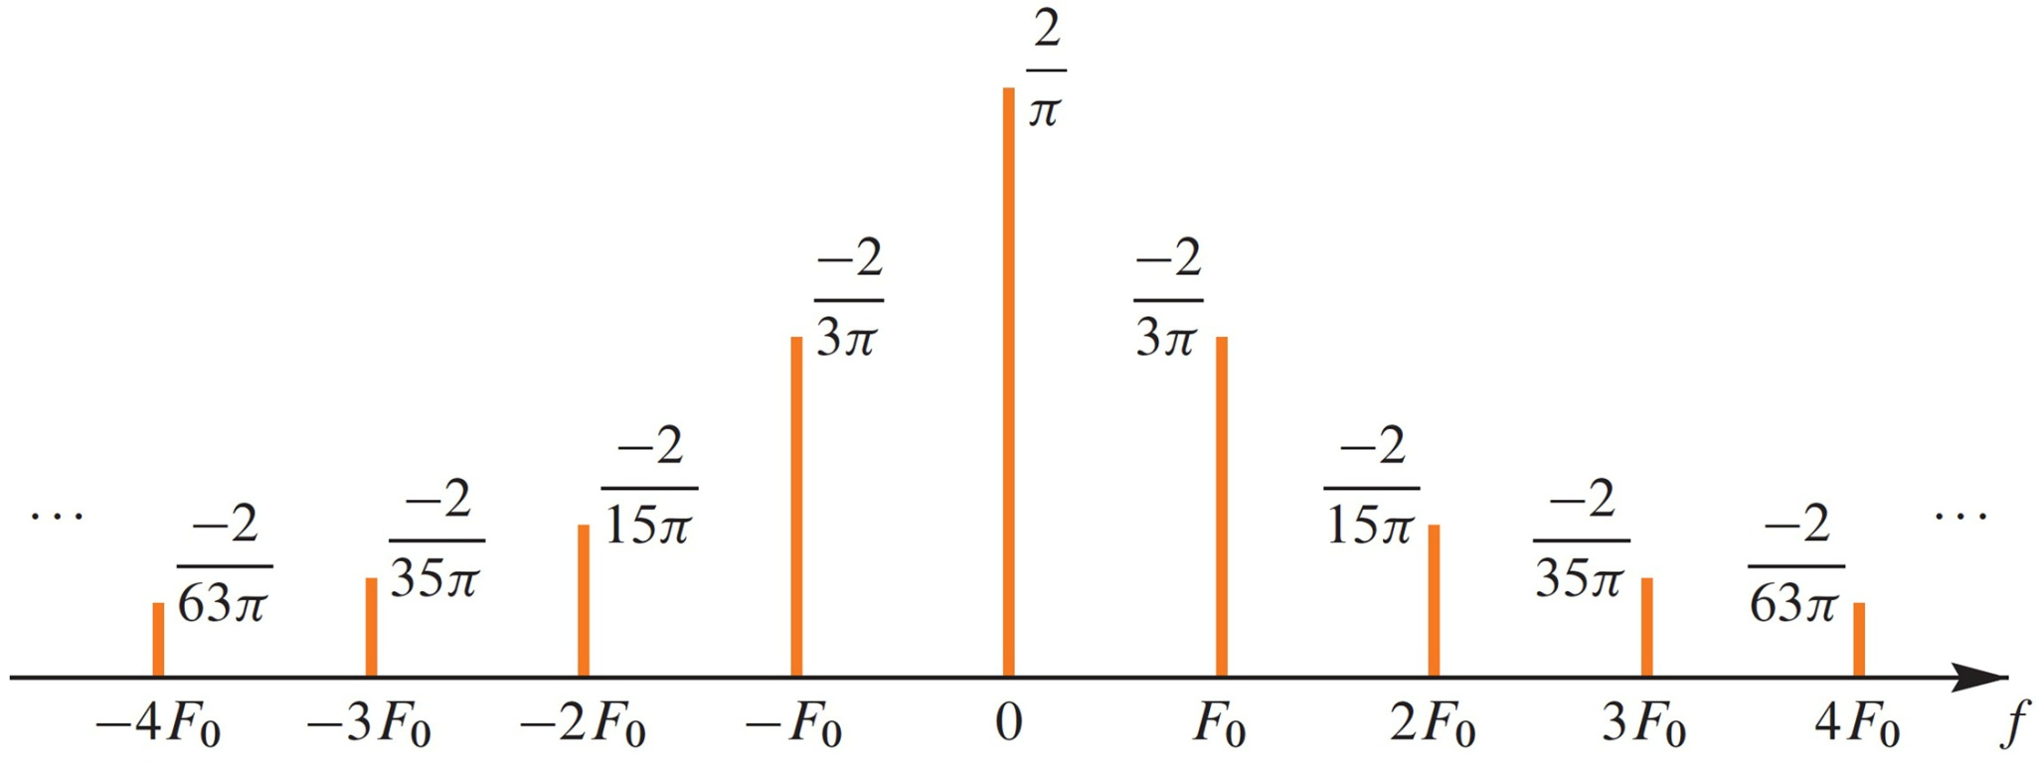
Spectrum from Fourier Series
Plot a for Full-Wave Rectified Sinusoid

Slide 27
Reconstruct From Finite Number of Harmonic Components
Full-Wave Rectified Sinusoid

Slide 28
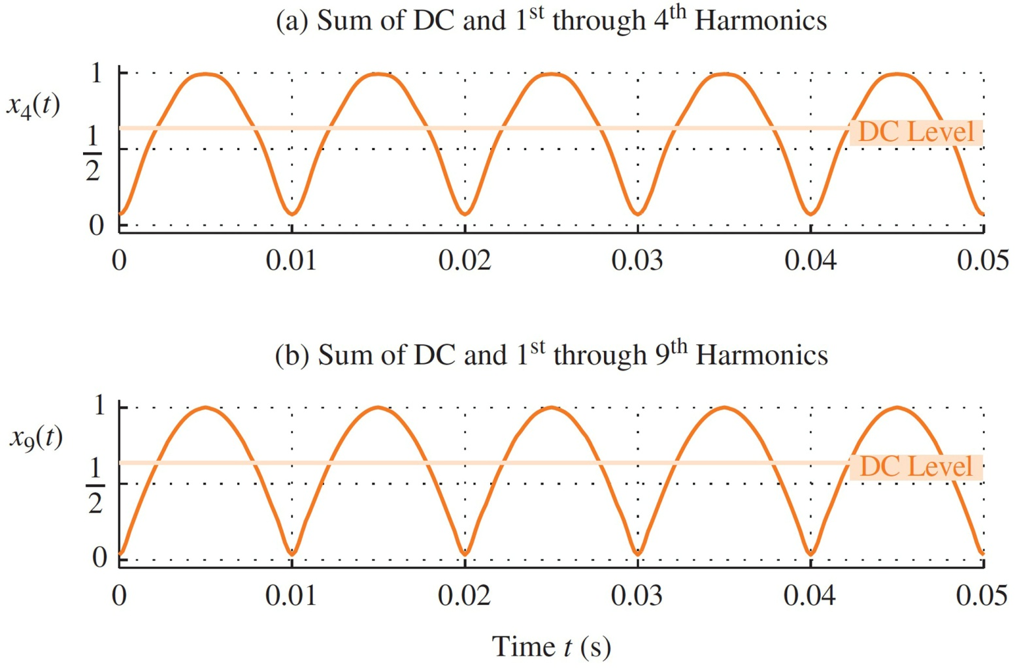
Reconstruct From Finite Number of Spectrum Components
Full-Wave Rectified Sinusoid

Slide 29
EXAMPLE 2: SQUARE WAVE
x(t)
1
–.02
0
.01
.02
0.04
t

Slide 30
FS for a SQUARE WAVE {a_{k}}

Slide 31
DC Coefficient: a₀
x(t)
1
1
t
0
.01
.02
0.04

Slide 32
Fourier Coefficients a_{k}
a_{k} is a function of k
Complex Amplitude for k-th Harmonic
Does not depend on the period, T₀

Slide 33
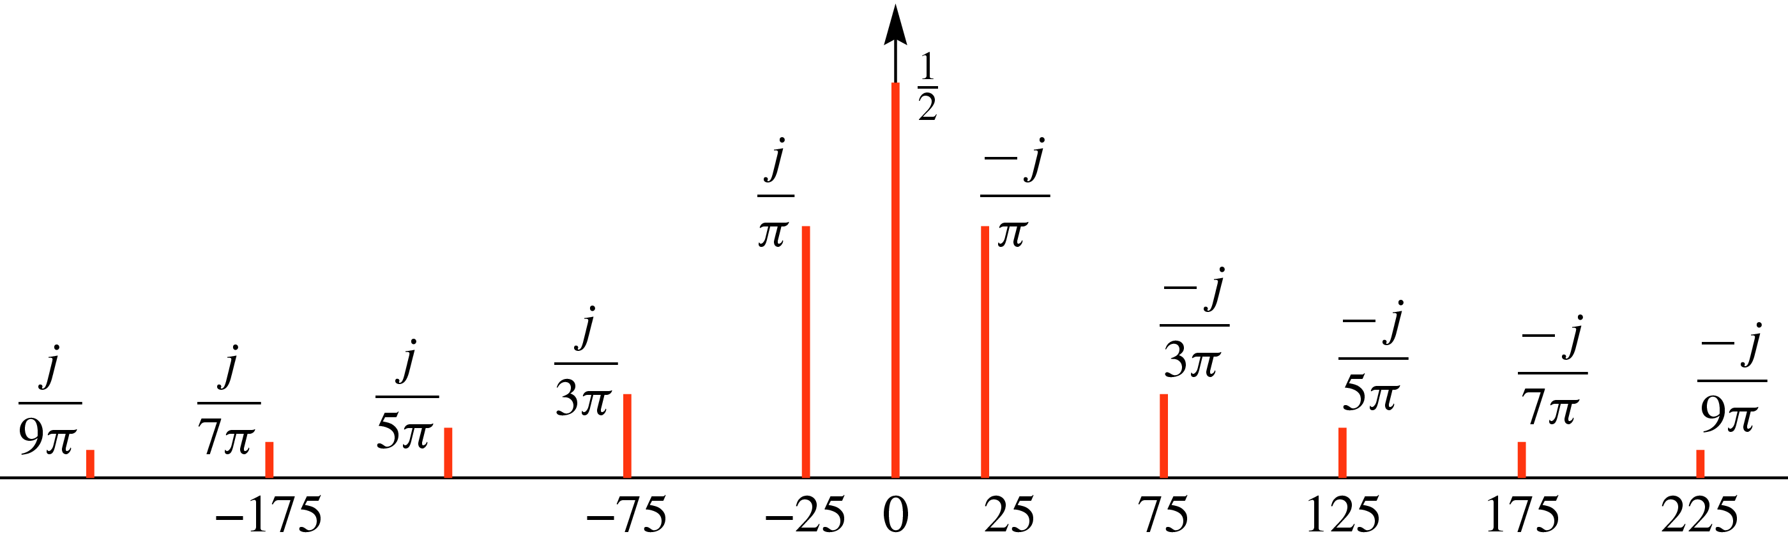
Spectrum from Fourier Series
x(t)
1
1
t
0
.01
.02
0.04

Slide 34

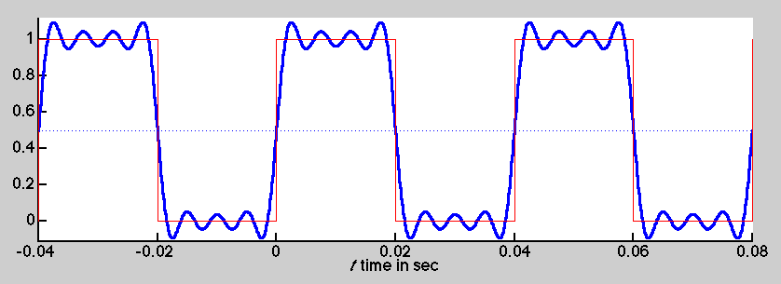
Synthesis: up to 7th Harmonic

Slide 35
Recall Example: Harmonic Signal (3 Freqs)
a₁
a₃
a₅
T = 0.1
What is the difference?
x(t)
1
1
t
0
.01
.02
0.04

Slide 36
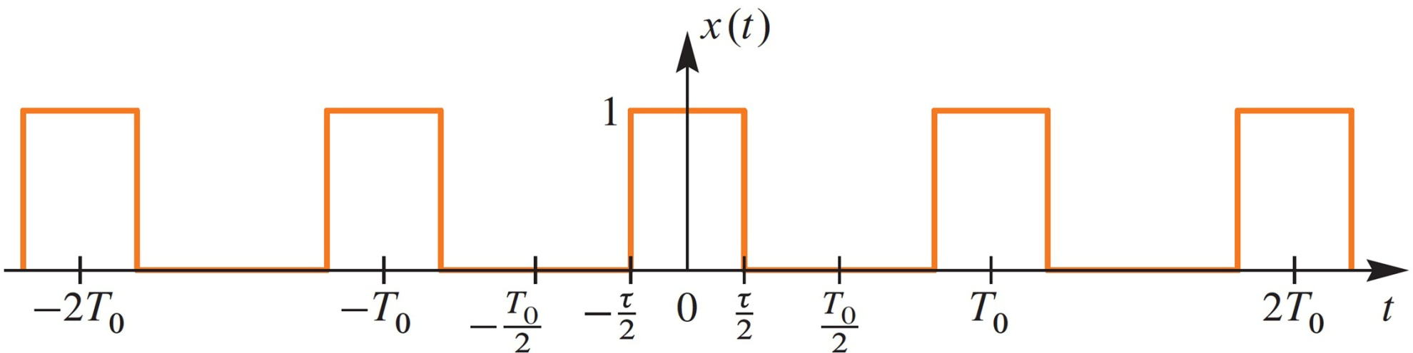
SQUARE WAVE EXAMPLE

Slide 37
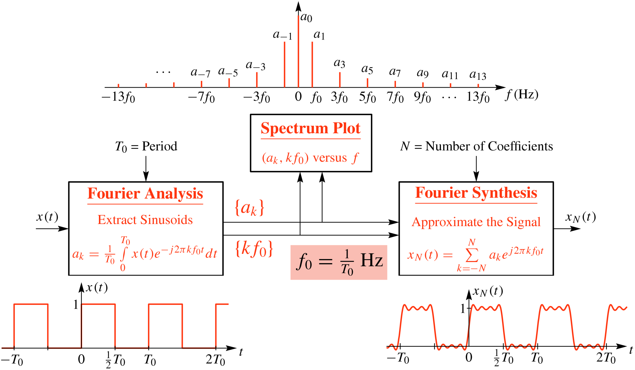
Spectrum & Fourier Series

Slide 38
ORTHOGONALITY of exp(j)
PRODUCT of exp(+j ) and exp(-j )

Slide 39
SYNTHESIS vs. ANALYSIS
SYNTHESIS
Easy
Given (ω_{k},A_{k},φ_{k}) create x(t)
Synthesis can be HARD
Synthesize Speech so that it sounds good
ANALYSIS
Hard
Given x(t), extract (ω_{k},A_{k},φ_{k})
How many?
Need algorithm for computer

Slide 40
STRATEGY 2: x(t) → a_{k}
ANALYSIS
Get representation from the signal
Works for PERIODIC Signals
Fourier Series
Answer is: an INTEGRAL over one period

