Slide 1
DSP First, 2/e
Lecture 7C
Fourier Series Examples:
Common Periodic Signals

Slide 2
License Info for SPFirst Slides
This work released under a Creative Commons License with the following terms:
Attribution
The licensor permits others to copy, distribute, display, and perform the work. In return, licensees must give the original authors credit.
Non-Commercial
The licensor permits others to copy, distribute, display, and perform the work. In return, licensees may not use the work for commercial purposes—unless they get the licensor's permission.
Share Alike
The licensor permits others to distribute derivative works only under a license identical to the one that governs the licensor's work.
Full Text of the License
This (hidden) page should be kept with the presentation

Slide 3
READING ASSIGNMENTS
This Lecture:
Appendix C, Section C-2
Various Fourier Series
Pulse Waves
Triangular Wave
Rectified Sinusoids (also in Ch. 3, Sect. 3-5)

Slide 4
LECTURE OBJECTIVES
Use the Fourier Series Integral
Derive Fourier Series coeffs for common periodic signals
Draw spectrum from the Fourier Series coeffs
a_{k} is Complex Amplitude for k-th Harmonic

Slide 5
Harmonic Signal is Periodic
Sums of Harmonic complex exponentials are Periodic signals
PERIOD/FREQUENCY of COMPLEX EXPONENTIAL:

Slide 6
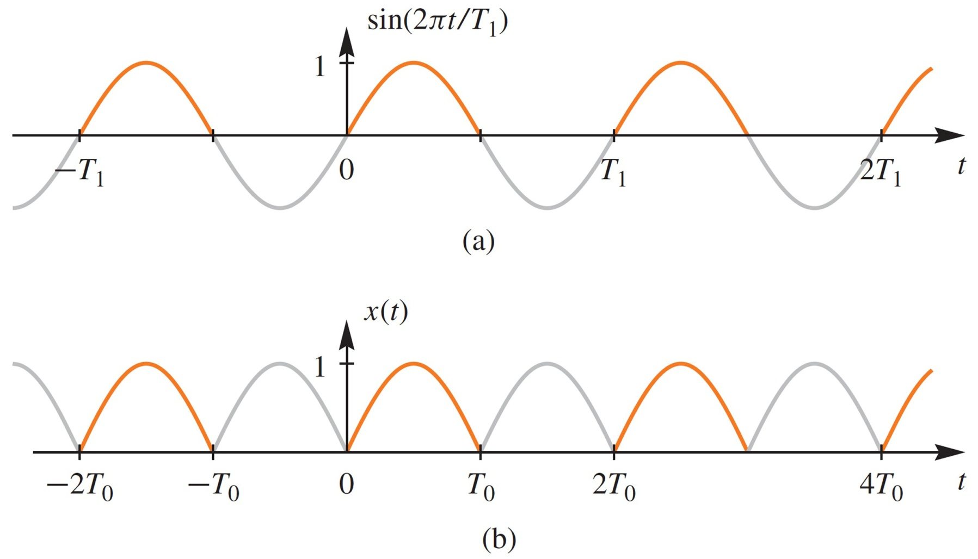
Recall FWRS
Absolute value flips the
negative lobes of a sine wave

Slide 7
FWRS Fourier Integral → {a_{k}}
Full-Wave Rectified Sine

Slide 8
FWRS Fourier Coeffs: a_{k}
a_{k} is a function of k
Complex Amplitude for k-th Harmonic
Does not depend on the period, T₀
DC value is

Slide 9
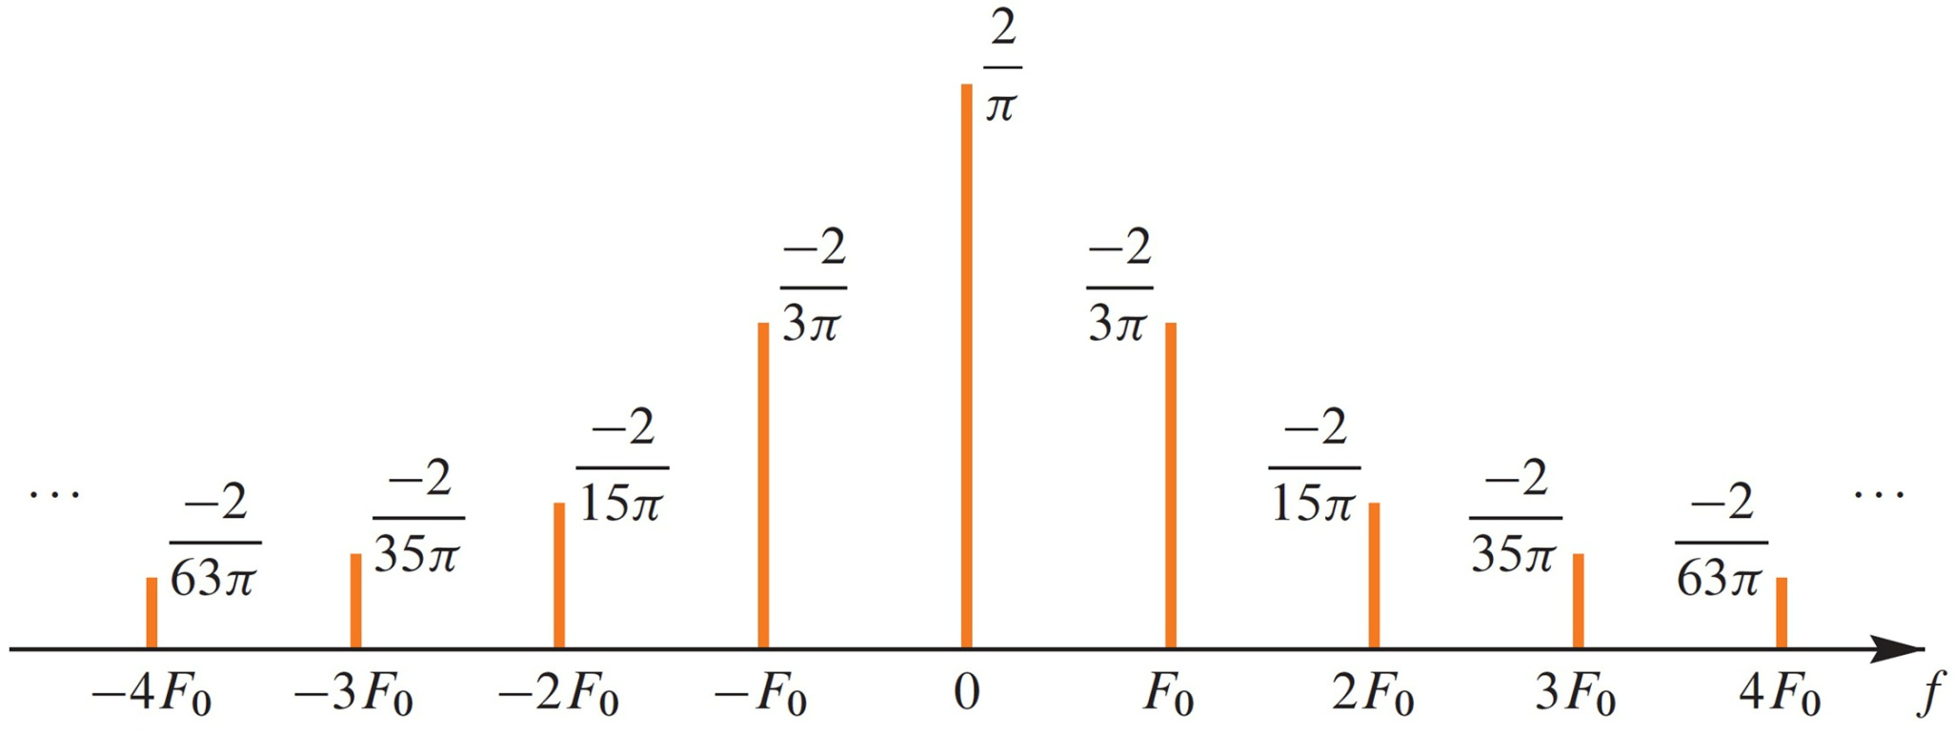
Spectrum from Fourier Series
Plot a for Full-Wave Rectified Sinusoid

Slide 10
Fourier Series Synthesis
HOW do you APPROXIMATE x(t) ?
Use FINITE number of coefficients

Slide 11
Reconstruct From Finite Number of Harmonic Components
Full-Wave Rectified Sinusoid

Slide 12
Full-Wave Rectified Sine {a_{k}}
Plots for N=4 and N=9 are shown next
Excellent Approximation for N=9

Slide 13
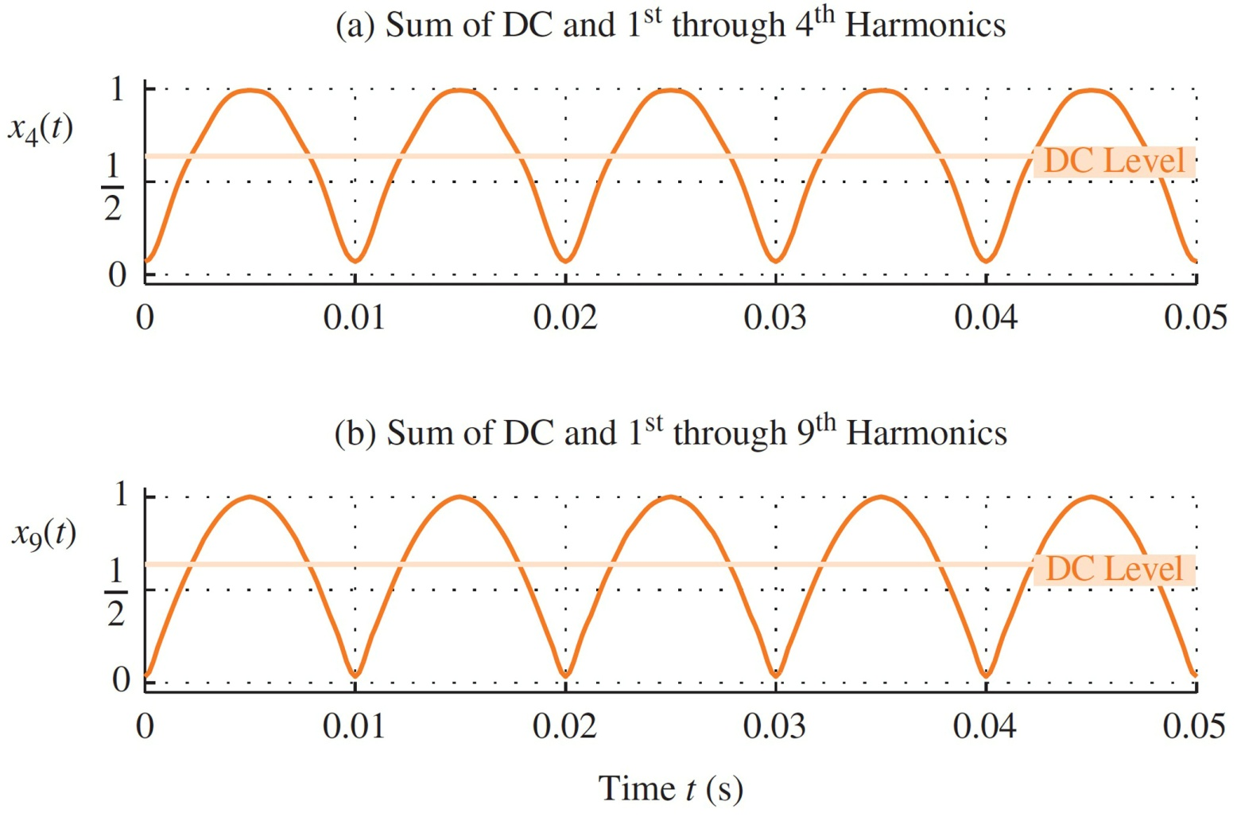
Reconstruct From Finite Number of Spectrum Components
Full-Wave Rectified Sinusoid

Slide 14
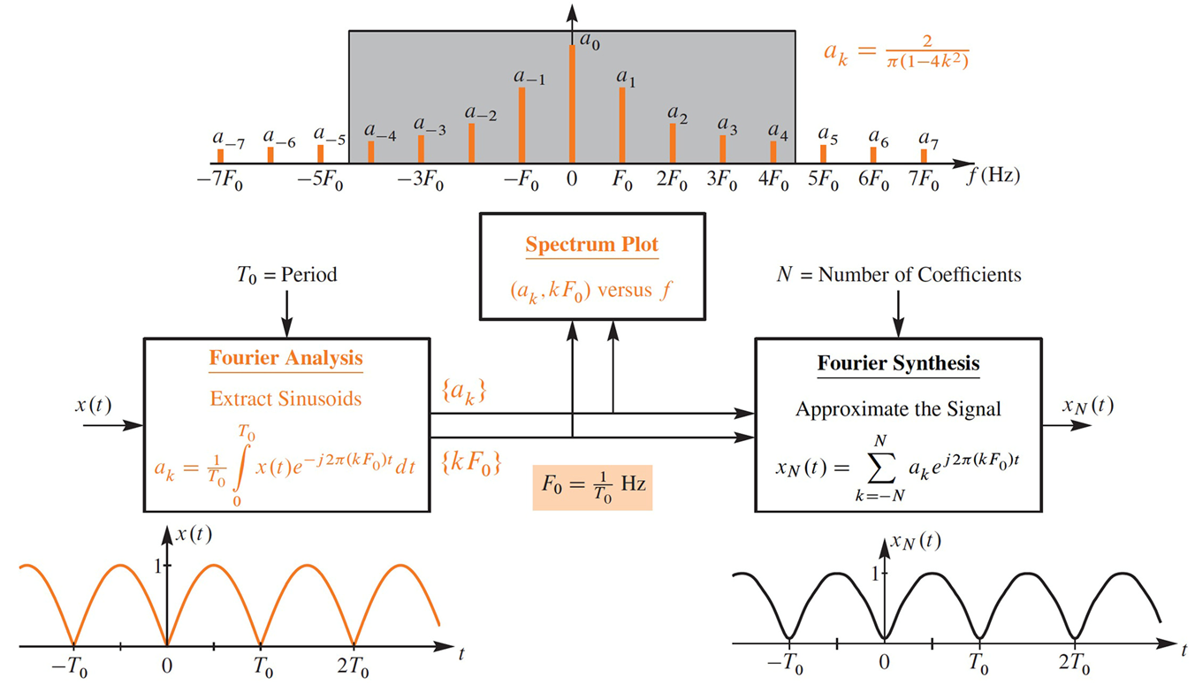
Fourier Series Synthesis

Slide 15
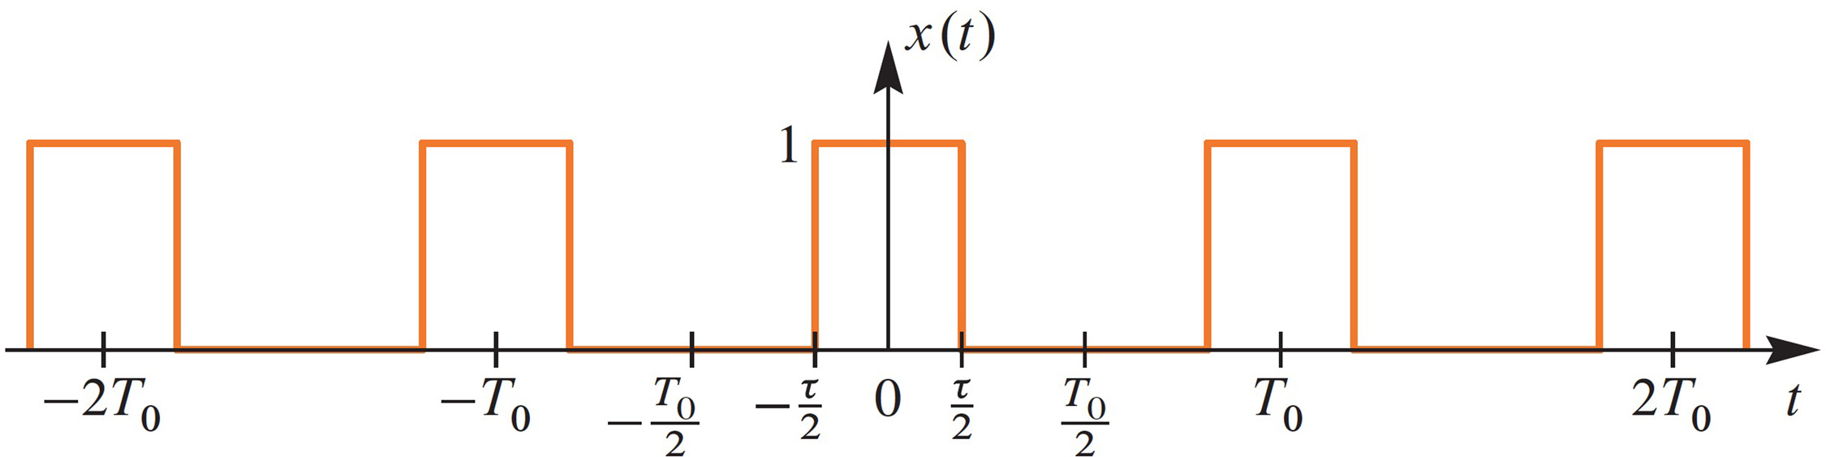
PULSE WAVE SIGNAL GENERAL FORM
Defined over one period
Nonzero DC value

Slide 16
Pulse Wave {a_{k}}
General PulseWave

Slide 17
Pulse Wave {a_{k}} = sinc
PulseWave
Double check the DC coefficient:

Slide 18
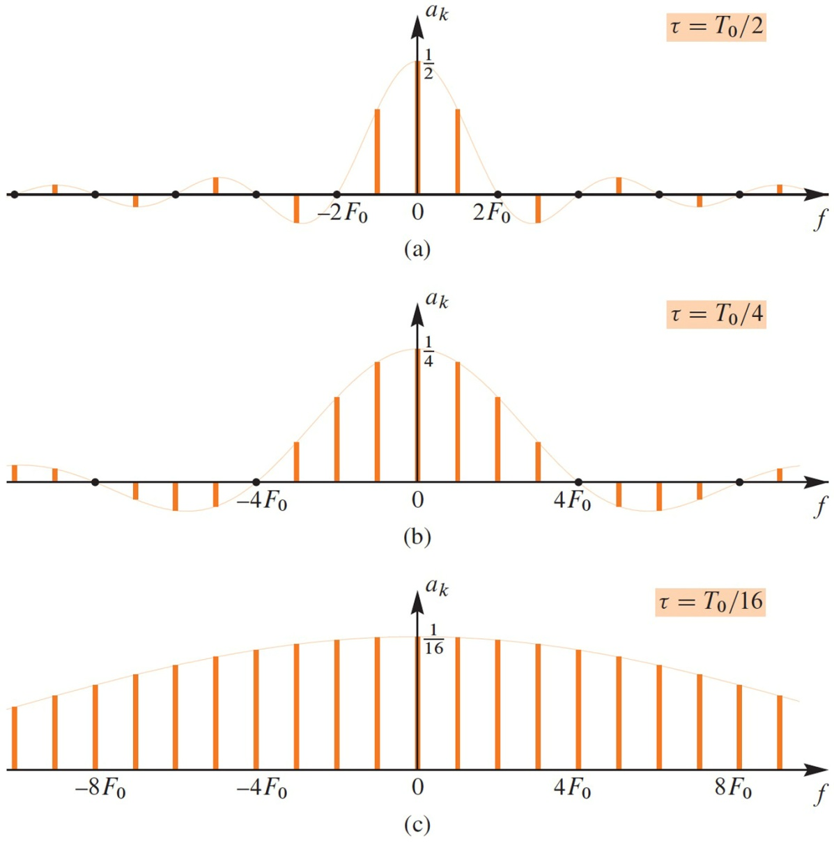
PULSE WAVE SPECTRA

Slide 19
50% duty-cycle (Square) Wave
Thus, a_{k}=0 when k is odd
Phase is zero because x(t) is centered at t=0
different from a previous case
PulseWave starting at t=0

Slide 20
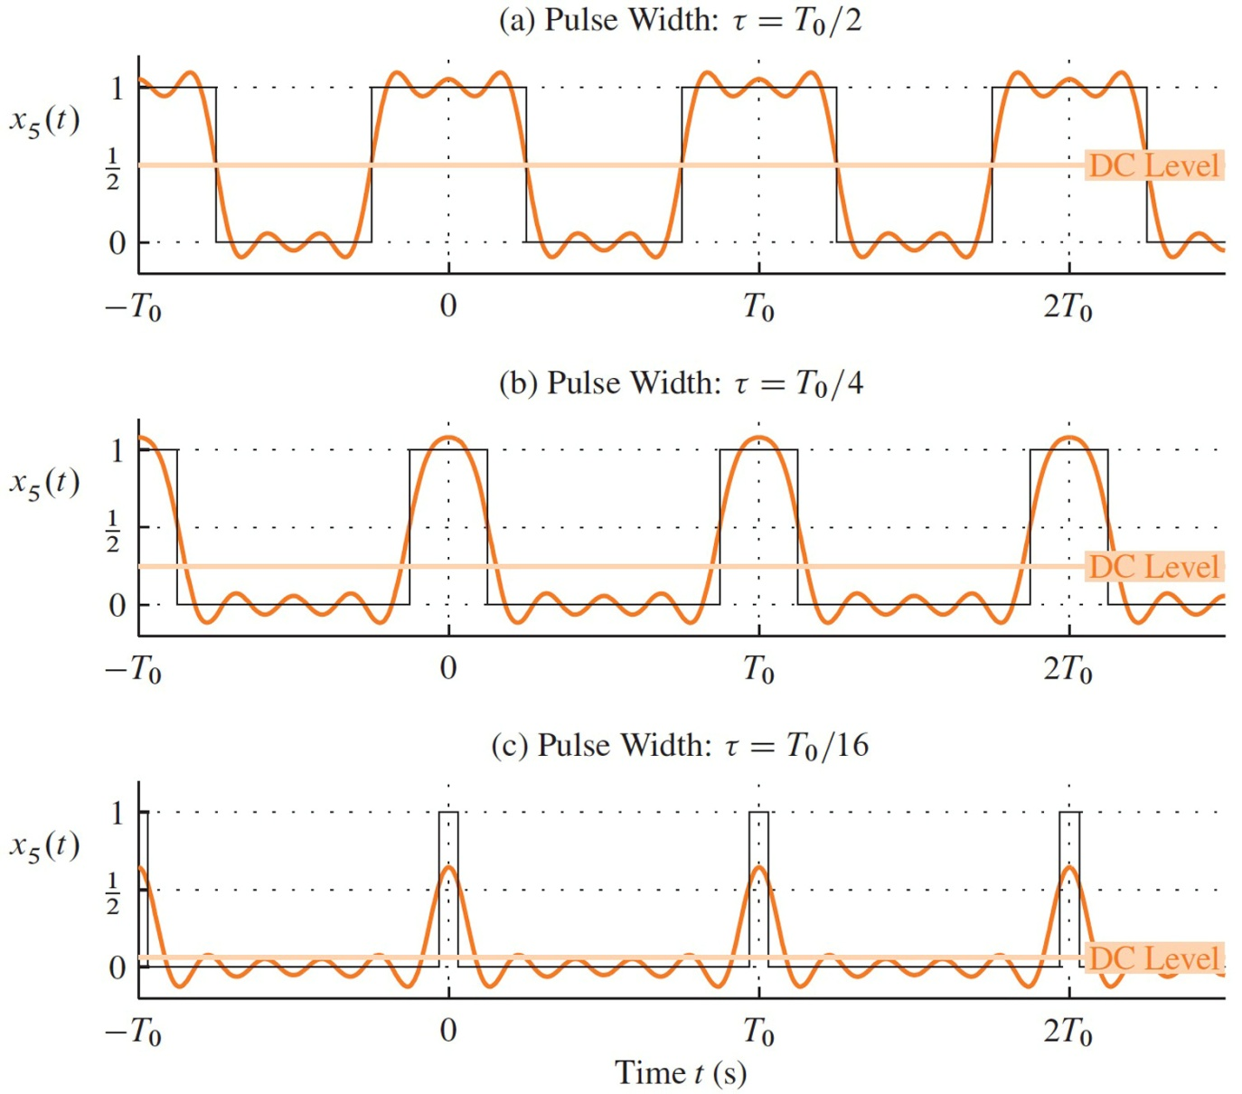
PULSE WAVE SYNTHESIS with first 5 Harmonics

Slide 21
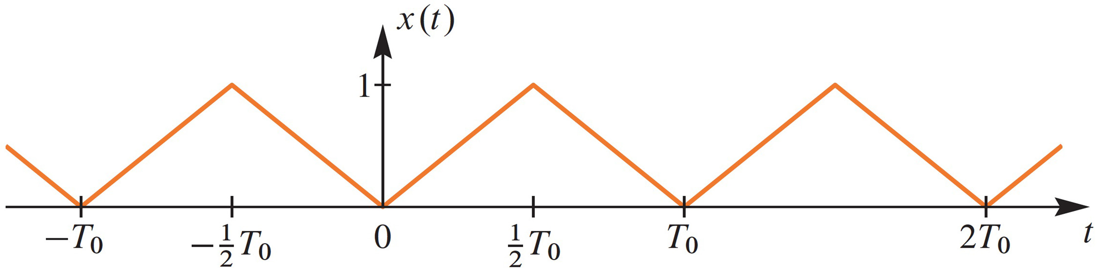
Triangular Wave: Time Domain
Defined over one period
Nonzero DC value

Slide 22
Triangular Wave {a_{k}}
Triangular Wave

Slide 23
Triangular Wave {a_{k}}

Slide 24
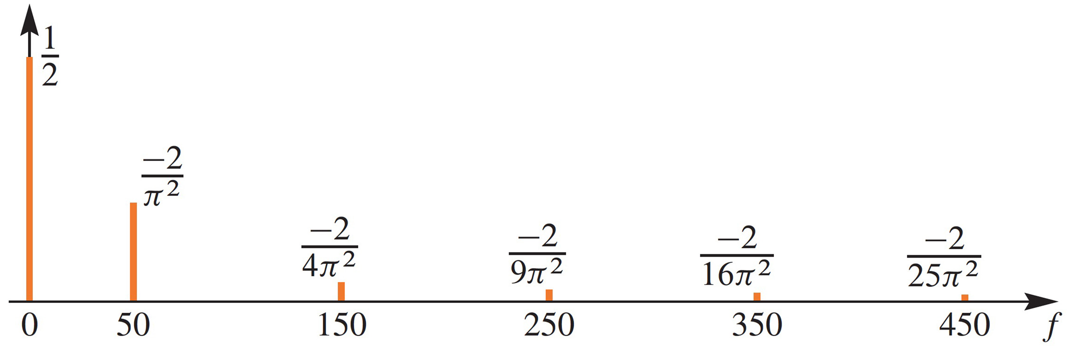
Triangular Wave {a_{k}}
Spectrum, assuming 50 Hz is the fundamental frequency

Slide 25
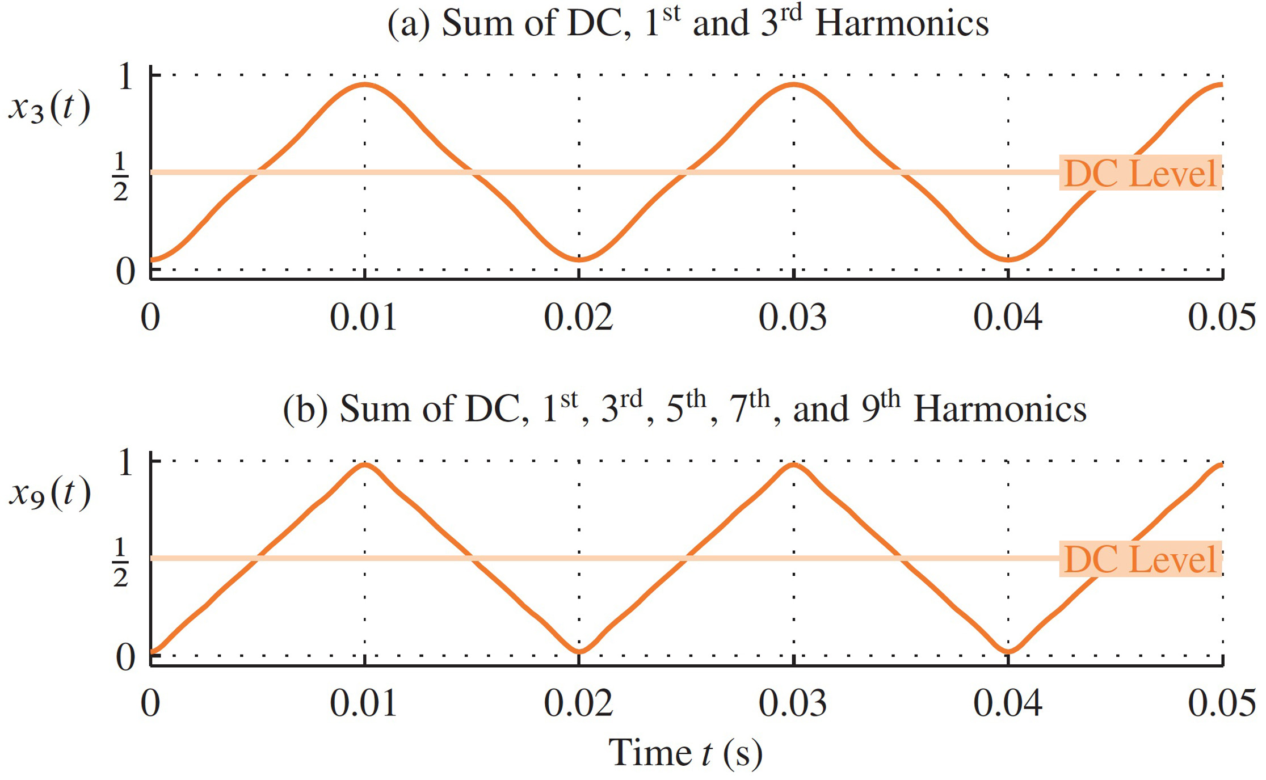
Triangular Wave Synthesis

Slide 26
Full-Wave Rectified Sine {a_{k}}
Full-Wave Rectified Sine

Slide 27
Full-Wave Rectified Sine {a_{k}}

Slide 28
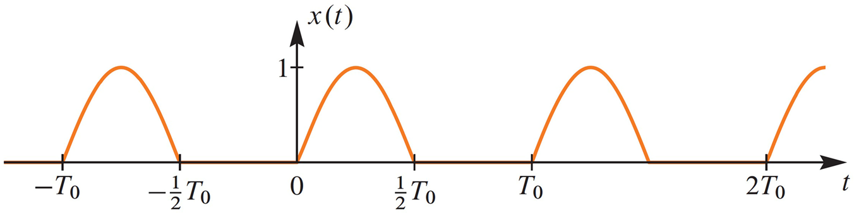
Half-Wave Rectified Sine
Signal is positive half cycles of sine wave
HWRS = Half-Wave Recitified Sine

Slide 29
Half-Wave Rectified Sine {a_{k}}
Half-Wave Rectified Sine

Slide 30
Half-Wave Rectified Sine {a_{k}}

Slide 31
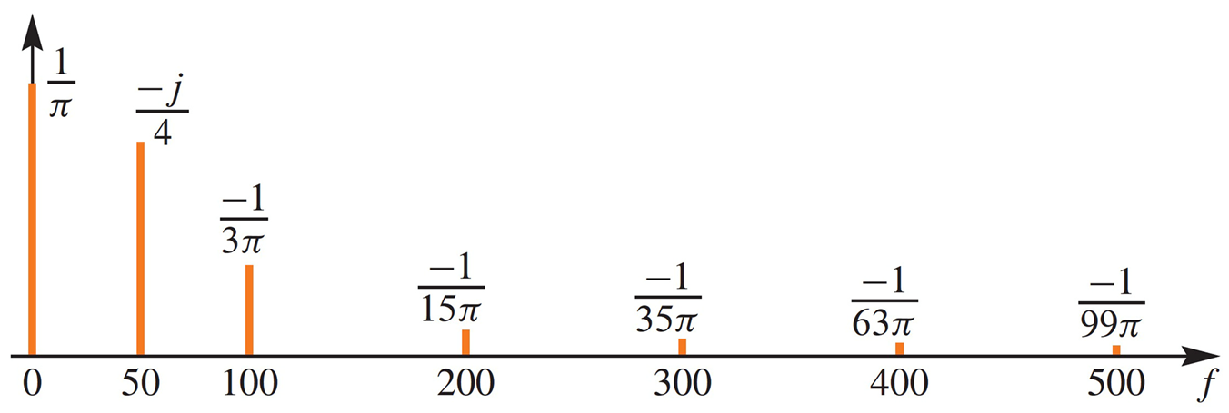
Half-Wave Rectified Sine {a_{k}}
Spectrum, assuming 50 Hz is the fundamental frequency

Slide 32
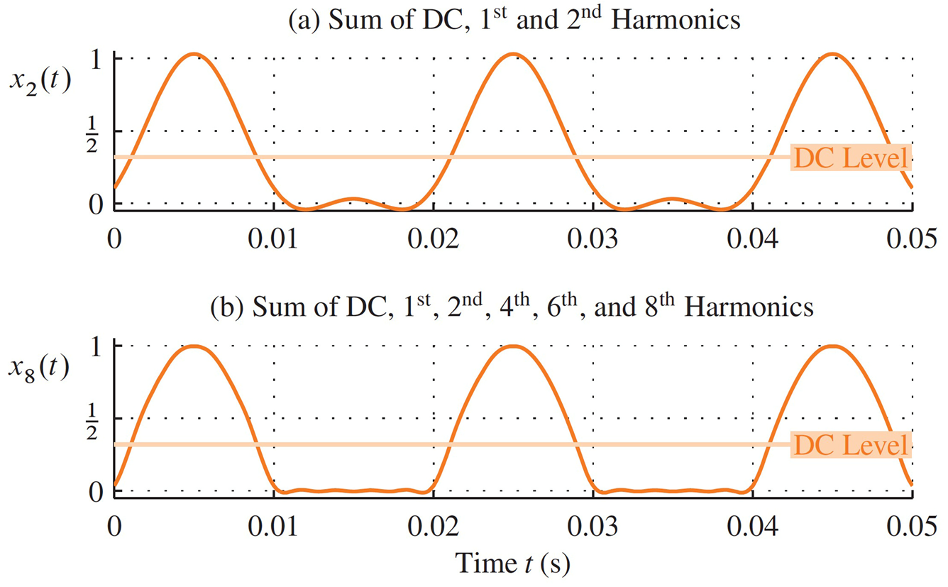
HWRS Synthesis

Slide 33
Fourier Series Demo
MATLAB GUI: fseriesdemo
Shows the convergence with more terms
One of the demos in:
http://dspfirst.gatech.edu/matlab/

Slide 34
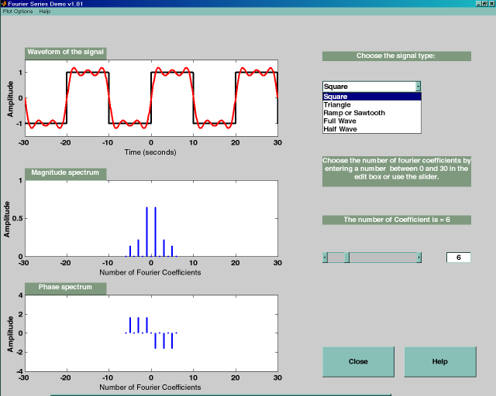
fseriesdemo GUI

