Slide 1
DSP First, 2/e
Lecture 8
Fourier Series & Spectrum

Slide 2
License Info for SPFirst Slides
This work released under a Creative Commons License with the following terms:
Attribution
The licensor permits others to copy, distribute, display, and perform the work. In return, licensees must give the original authors credit.
Non-Commercial
The licensor permits others to copy, distribute, display, and perform the work. In return, licensees may not use the work for commercial purposes—unless they get the licensor's permission.
Share Alike
The licensor permits others to distribute derivative works only under a license identical to the one that governs the licensor's work.
Full Text of the License
This (hidden) page should be kept with the presentation

Slide 3
READING ASSIGNMENTS
This Lecture:
Fourier Series in Ch 3, Sect. 3-5
Other Reading:
Appendix C: More details on Fourier Series

Slide 4
LECTURE OBJECTIVES
Synthesis Summation of Fourier Series
Produces a PERIODIC signal: x(t+T₀) = x(t)
Approximation when N is finite. How good?
SPECTRUM from Fourier Series
a_{k} is Complex Amplitude for k-th Harmonic

Slide 5
Harmonic Signal is Periodic
Sums of Harmonic complex exponentials are Periodic signals
PERIOD/FREQUENCY of COMPLEX EXPONENTIAL:

Slide 6
Fourier Series ANALYSIS
Some thoughts:
Starting from signal, x(t), which frequencies and complex amplitudes are required?
ONLY FOR PERIODIC SIGNALS!
Two possible analysis methods:
1. Read off coefficients from inverse Euler’s
2. Evaluate Fourier series integral
Can plot the spectrum for the Fourier Series
Equally spaced lines at kF₀

Slide 7
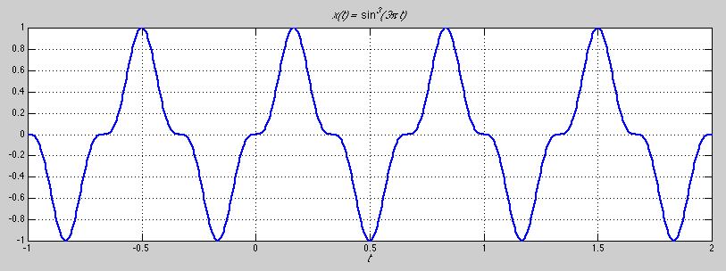
STRATEGY 1:

Slide 8
STRATEGY 1:

Slide 9
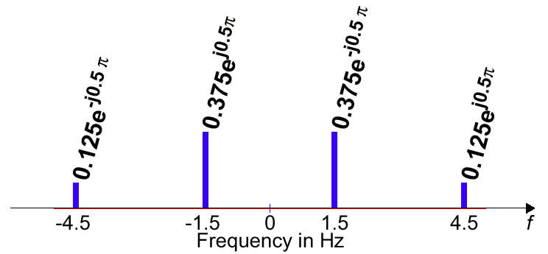
Example
Don’t use the integral,
Analysis just requires
picking the coefficients.

Slide 10
STRATEGY 2: x(t) → a_{k}
ANALYSIS
Get representation from the signal
Works for PERIODIC Signals
Fourier Series
Answer is: an INTEGRAL over one period

Slide 11
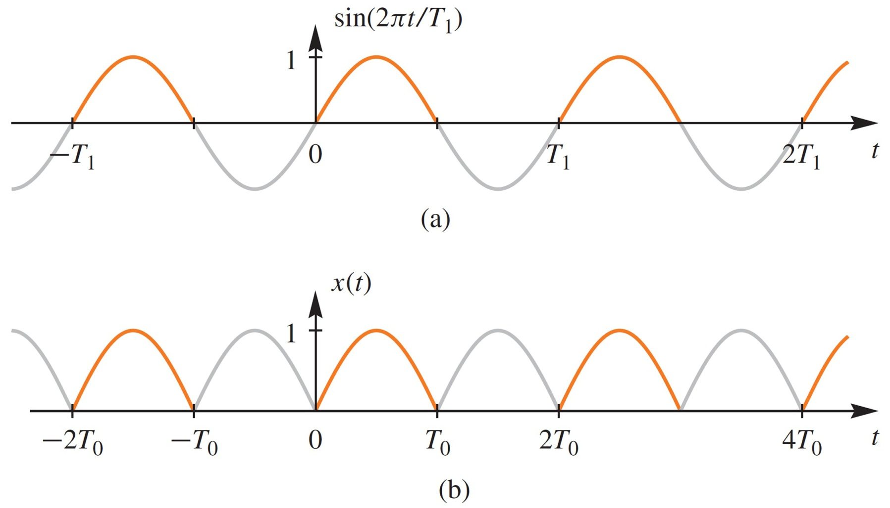
Recall FWRS
Absolute value flips the
negative lobes of a sine wave

Slide 12
FWRS Fourier Integral → {a_{k}}
Full-Wave Rectified Sine

Slide 13
FWRS Fourier Coeffs: a_{k}
a_{k} is a function of k
Complex Amplitude for k-th Harmonic
Does not depend on the period, T₀
DC value is

Slide 14
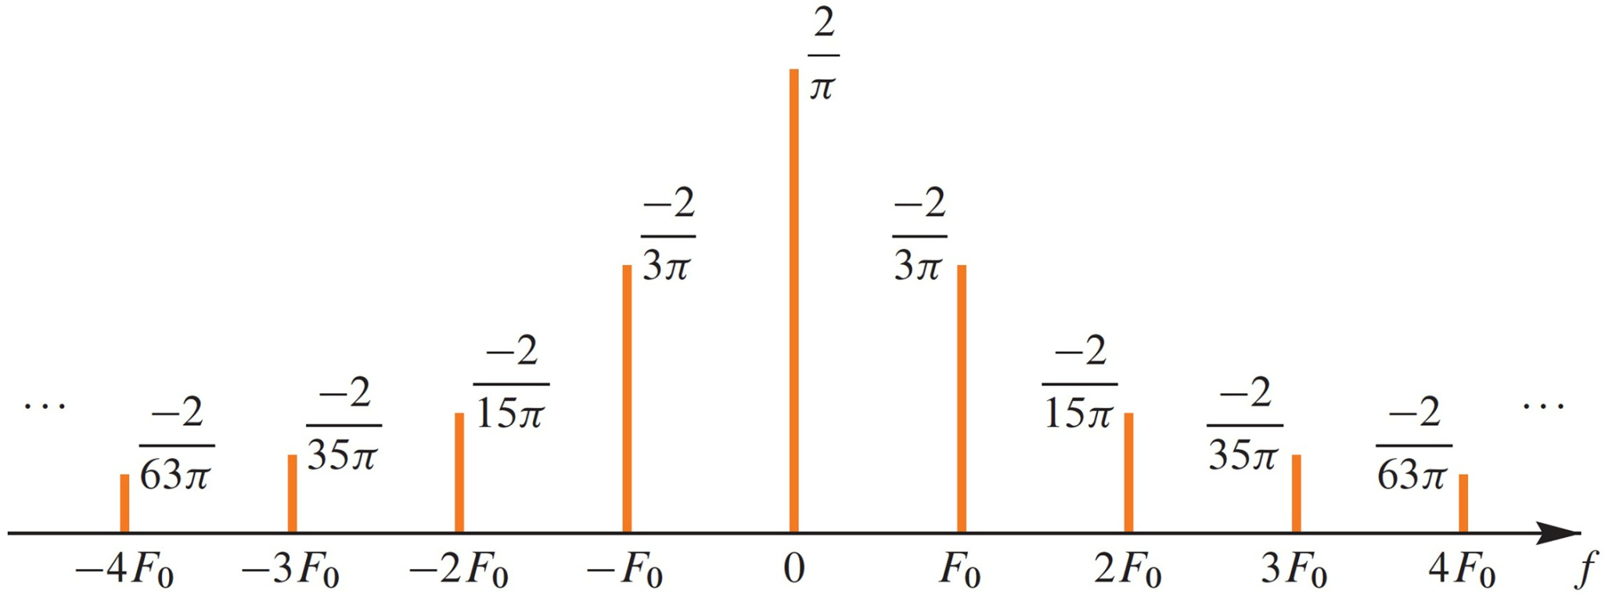
Spectrum from Fourier Series
Plot a for Full-Wave Rectified Sinusoid

Slide 15
Fourier Series Synthesis
HOW well do you APPROXIMATE x(t) ?
Use FINITE number of coefficients

Slide 16
Reconstruct From Finite Number of Harmonic Components
Full-Wave Rectified Sinusoid

Slide 17
Full-Wave Rectified Sine {a_{k}}
Plots for N=4 and N=9 are shown next
Excellent Approximation for N=9

Slide 18
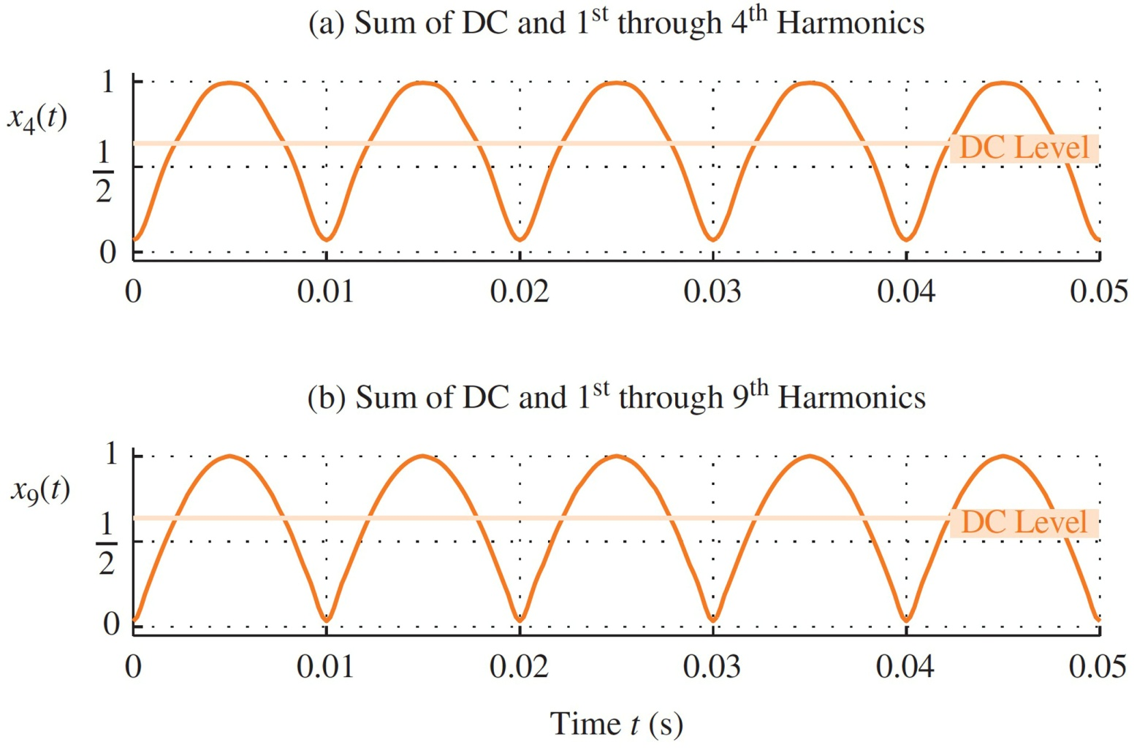
Reconstruct From Finite Number of Spectrum Components
Full-Wave Rectified Sinusoid

Slide 19
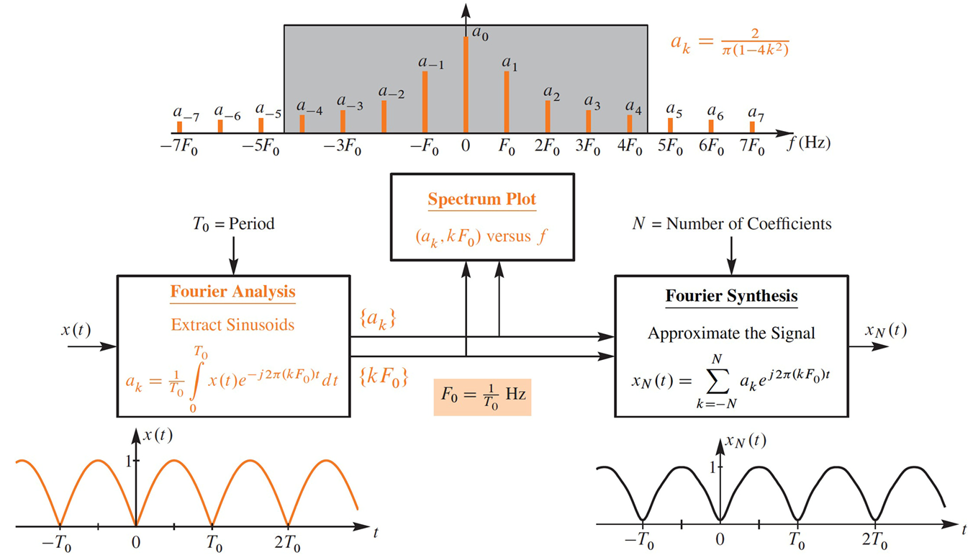
Summary of Fourier Series

Slide 20
SQUARE WAVE EXAMPLE
x(t)
1
–.02
0
.01
.02
0.04
t

Slide 21
FS for a SQUARE WAVE {a_{k}}

Slide 22
DC Coefficient: a₀
x(t)
1
1
t
0
.01
.02
0.04

Slide 23
Square Wave Coeffs: {a_{k}}
Complex Amplitude a_{k} for k-th Harmonic
Does not depend on the period, T₀
DC value is 0.5

Slide 24
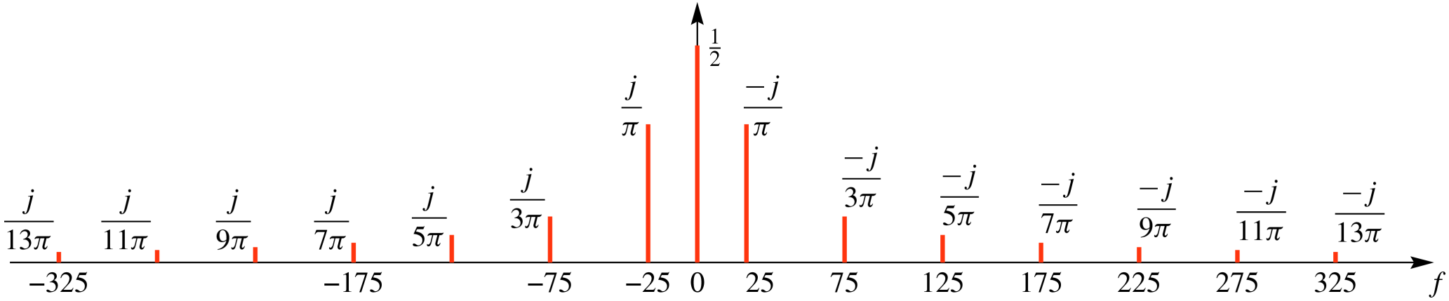
Spectrum from Fourier Series

Slide 25
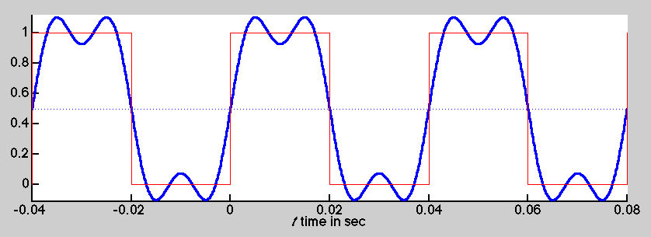
Synthesis: 1st & 3rd Harmonics

Slide 26
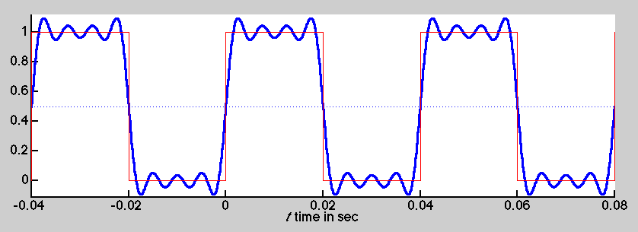
Synthesis: up to 7th Harmonic

Slide 27
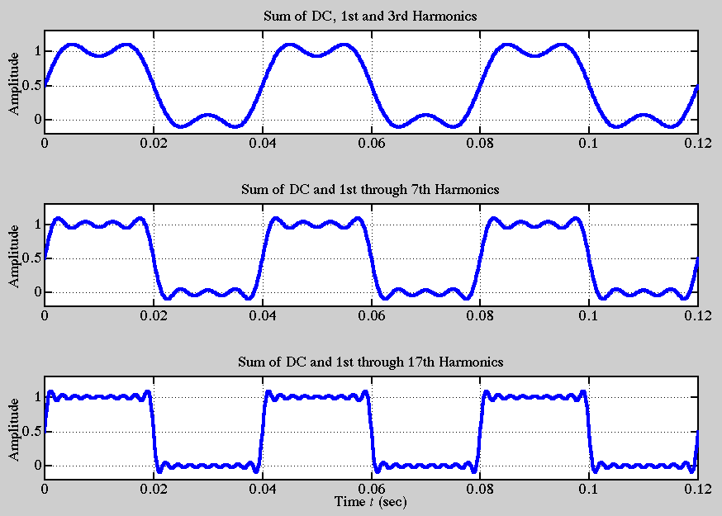
Fourier Synthesis

Slide 28
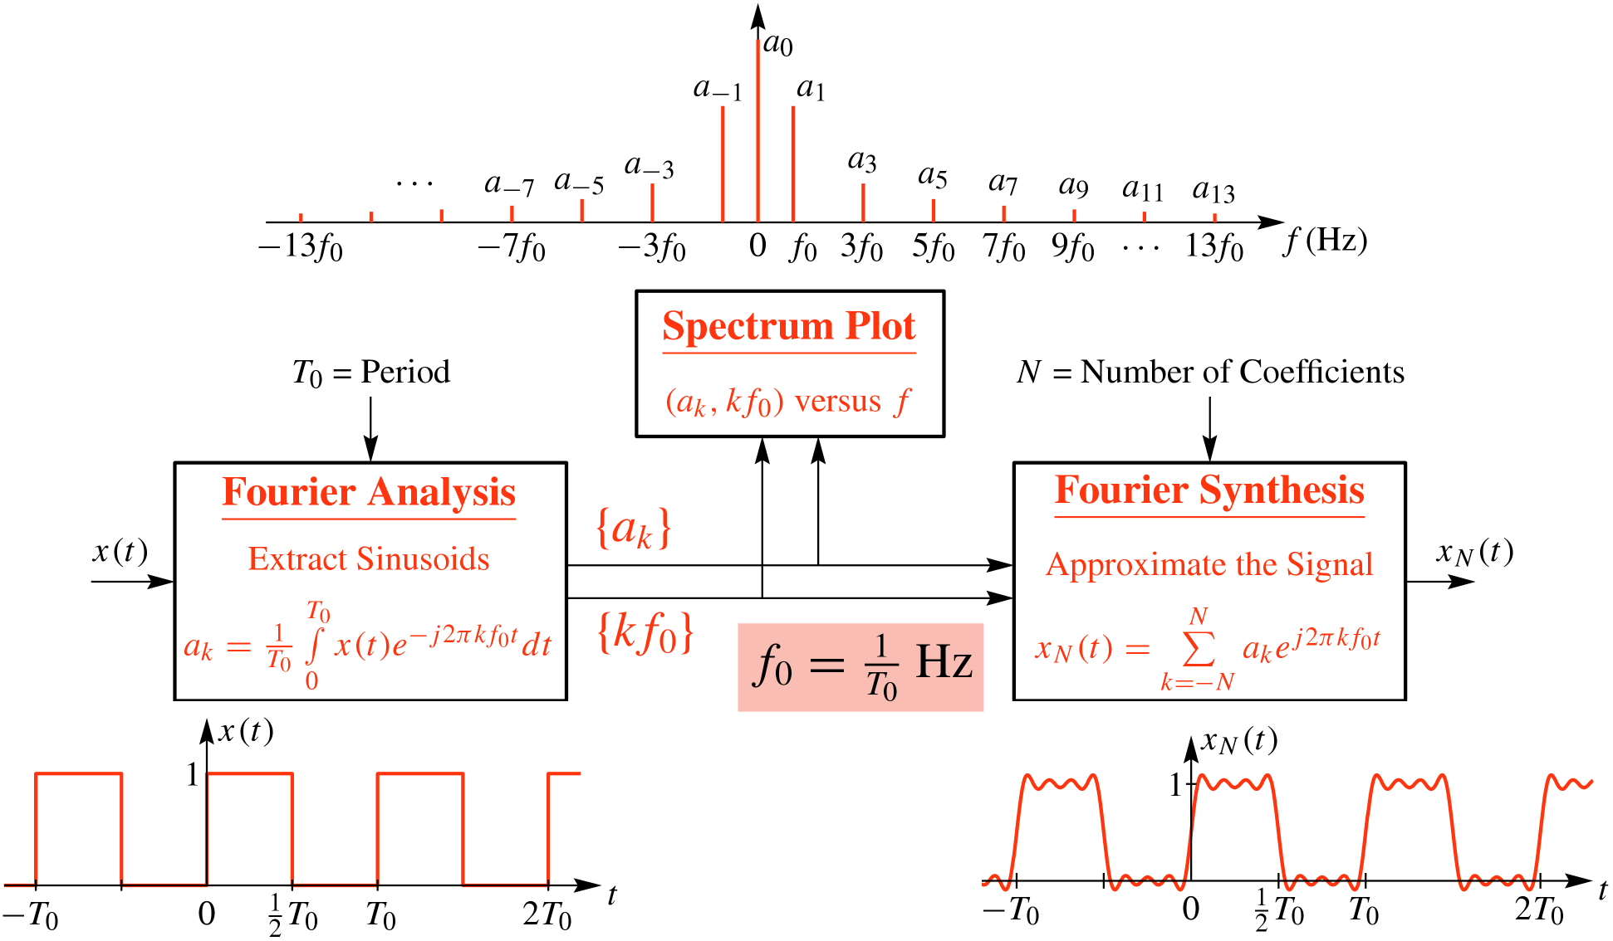
Fourier Series Summary

Slide 29
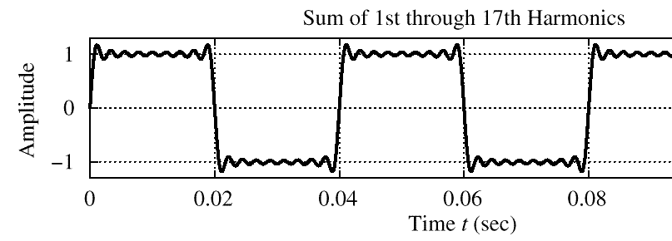
Gibbs’ Phenomenon
Convergence at DISCONTINUITY of x(t)
There is always an overshoot
9% for the Square Wave case

Slide 30
Fourier Series Demos
MATLAB GUI: fseriesdemo
Shows the convergence with more terms
One of the demos in:
http://dspfirst.gatech.edu/matlab/

Slide 31
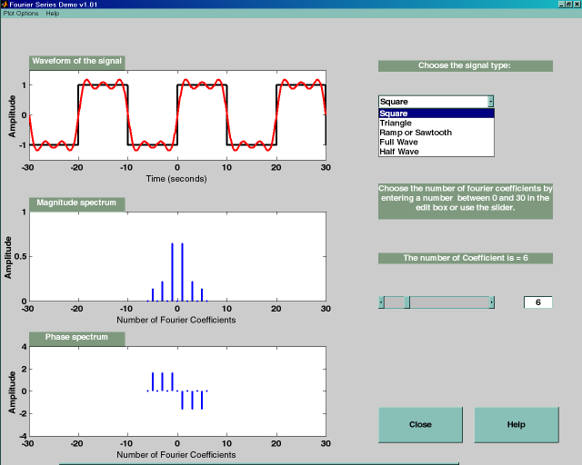
fseriesdemo GUI

Slide 32
Fourier Series Demos
Fourier Series Java Applet
Greg Slabaugh
Interactive
http://users.ece.gatech.edu/mcclella/2025/Fsdemo_Slabaugh/fourier.html
MATLAB GUI: fseriesdemo
One of the demos in:
http://dspfirst.gatech.edu/matlab/

Slide 33
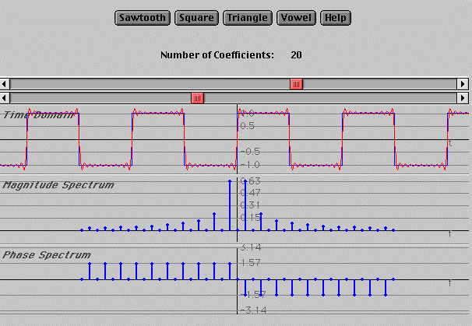
Fourier Series Java Applet

Slide 34
Synthesis: 1st & 3rd Harmonics

Slide 35
Synthesis: up to 7th Harmonic

