Slide 1
DSP First, 2/e
Lecture 9
Sampling & Aliasing

Slide 2
License Info for DSPFirst Slides
This work released under a Creative Commons License with the following terms:
Attribution
The licensor permits others to copy, distribute, display, and perform the work. In return, licensees must give the original authors credit.
Non-Commercial
The licensor permits others to copy, distribute, display, and perform the work. In return, licensees may not use the work for commercial purposes—unless they get the licensor's permission.
Share Alike
The licensor permits others to distribute derivative works only under a license identical to the one that governs the licensor's work.
Full Text of the License
This (hidden) page should be kept with the presentation

Slide 3
READING ASSIGNMENTS
This Lecture:
Chap 4, Sections 4-1 and 4-2
Other Reading:
Recitation: Strobe Demo (Sect 4-5)
Next Lecture: Chap. 4, Sects. 4-3 and 4-4

Slide 4
LECTURE OBJECTIVES
SAMPLING can cause ALIASING
Sampling Theorem
Sampling Rate > 2(Highest Frequency)
Spectrum for digital signals, x[n]
Normalized Frequency
ALIASING

Slide 5
SYSTEMS Process Signals
x(t)
SYSTEM
y(t)
PROCESSING GOALS:
Change x(t) into y(t)
For example, more BASS, pitch shifting
Improve x(t), e.g., image deblurring
Extract Information from x(t)

Slide 6
System IMPLEMENTATION
ANALOG/ELECTRONIC:
Circuits: resistors, capacitors, op-amps
x(t)
ELECTRONICS
y(t)
DIGITAL/MICROPROCESSOR
Convert x(t) to numbers stored in memory
x(t)
A-to-D
x[n]
COMPUTER
y[n]
D-to-A
y(t)

Slide 7
SAMPLING x(t)
SAMPLING PROCESS
Convert x(t) to numbers x[n]
“n” is an integer index; x[n] is a sequence of values
Think of “n” as the storage address in memory
UNIFORM SAMPLING at t = nT_{s}
IDEAL: x[n] = x(nT_{s})
x(t)
C-to-D
x[n]

Slide 8
SAMPLING RATE, f_{s}
SAMPLING RATE (f_{s})
f_{s} =1/T_{s}
NUMBER of SAMPLES PER SECOND
T_{s} = 125 microsec → f_{s} = 8000 samples/sec
UNITS of f_{s} ARE HERTZ: 8000 Hz
UNIFORM SAMPLING at t = nT_{s} = n/f_{s}
IDEAL: x[n] = x(nT_{s})=x(n/f_{s})
x[n]=x(nT_{s})
x(t)
C-to-D

Slide 9
STORING DIGITAL SOUND
x[n] is a SAMPLED SISIGNAL
A list of numbers stored in memory
EXAMPLE: audio CD
CD rate is 44,100 samples per second
16-bit samples
Stereo uses 2 channels
Number of bytes for 1 minute is
2 X (16/8) X 60 X 44100 = 10.584 Mbytes

Slide 10
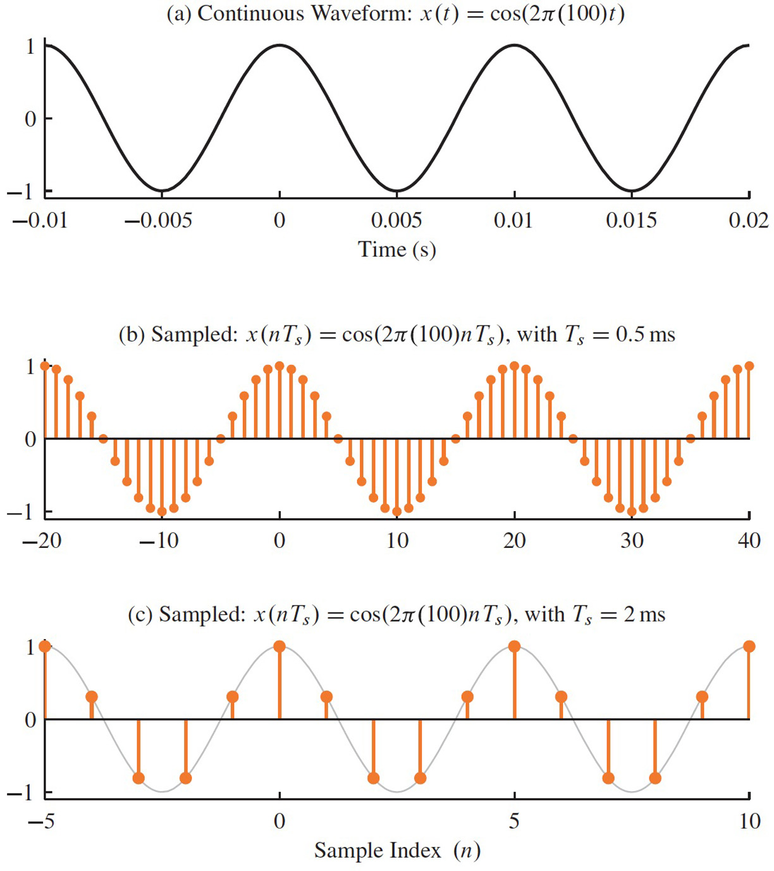
Which one provides the most accurate representation of x(t)?

Slide 11
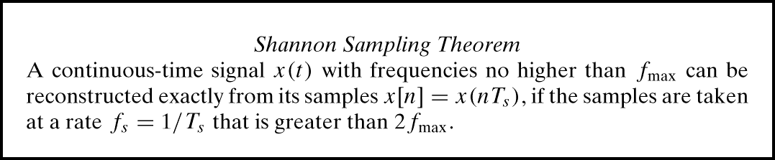
SAMPLING THEOREM
HOW OFTEN DO WE NEED TO SAMPLE?
DEPENDS on FREQUENCY of SINUSOID
ANSWERED by SHANNON/NYQUIST Theorem
ALSO DEPENDS on “RECONSTRUCTION”

Slide 12
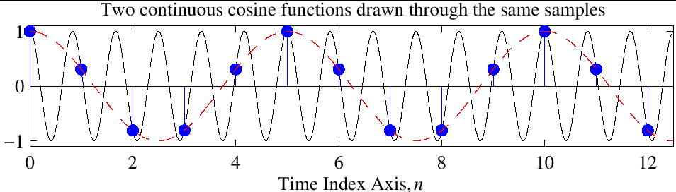
Reconstruction? Which One?
Given the samples, draw a sinusoid through the values
Occam’s razor -> pick lowest frequency sinusoid

Slide 13

Be careful… https://www.youtube.com/watch?v=qgvuQGY946g

Slide 14
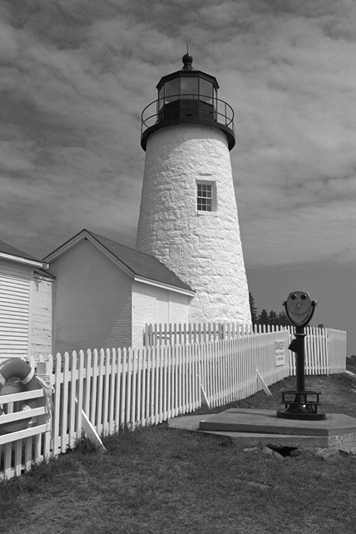

Spatial Aliasing

Slide 15
DISCRETE-TIME SINUSOID
Change x(t) into x[n] DERIVATION
DEFINE DIGITAL FREQUENCY

Slide 16
DIGITAL FREQUENCY
VARIES from 0 to 2π, as f varies from 0 to the sampling frequency
UNITS are radians, not rad/sec
DIGITAL FREQUENCY is NORMALIZED

Slide 17
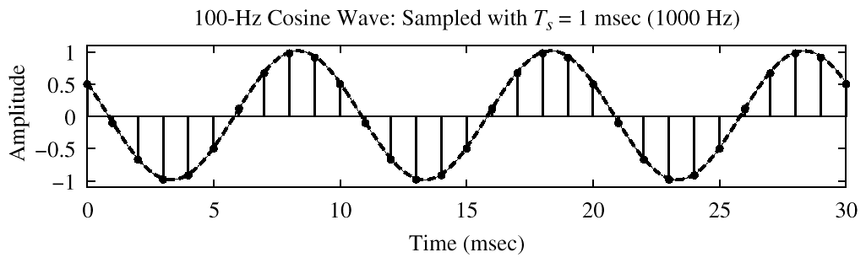
SPECTRUM (DIGITAL)
–0.2π
2π(0.1)

Slide 18
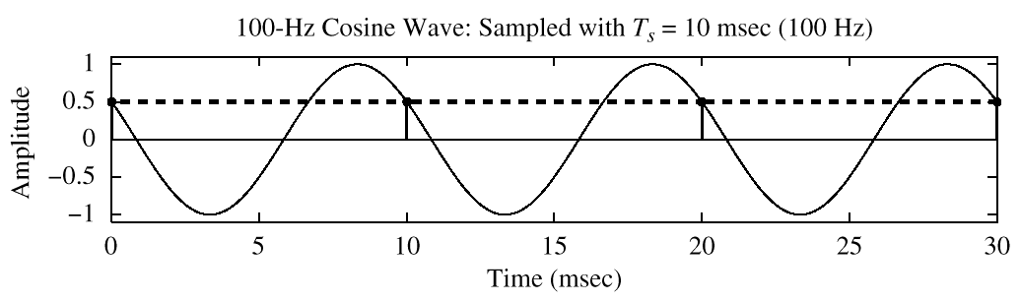
SPECTRUM (DIGITAL) ???
?
–2π
2π(1)
x[n] is zero frequency???

Slide 19
The REST of the STORY
Spectrum of x[n] has more than one line for each complex exponential
Called ALIASING
MANY SPECTRAL LINES
SPECTRUM is PERIODIC with period = 2π
Because

Slide 20
ALIASING DERIVATION
Other Frequencies give the same

Slide 21
ALIASING DERIVATION
Other Frequencies give the same

Slide 22
ALIASING CONCLUSIONS
Adding an INTEGER multiple of f_{s} or –f_{s} to the frequency of a continuous sinusoid x_{c}(t) gives exactly the same values for the sampled signal x[n] = x_{c}(n/f_{s} )
GIVEN x[n], we CAN’T KNOW whether it came from a sinusoid at f_{o} or (f_{o} + f_{s} ) or (f_{o} + 2f_{s} ) …
This is called ALIASING

Slide 23
SPECTRUM for x[n]
PLOT versus NORMALIZED FREQUENCY
INCLUDE ALL SPECTRUM LINES
ALIASES
ADD MULTIPLES of 2π
SUBTRACT MULTIPLES of 2π
FOLDED ALIASES
(to be discussed later)
ALIASES of NEGATIVE FREQS

Slide 24
SPECTRUM (MORE LINES)
–1.8π
–0.2π
2π(0.1)
1.8π

Slide 25
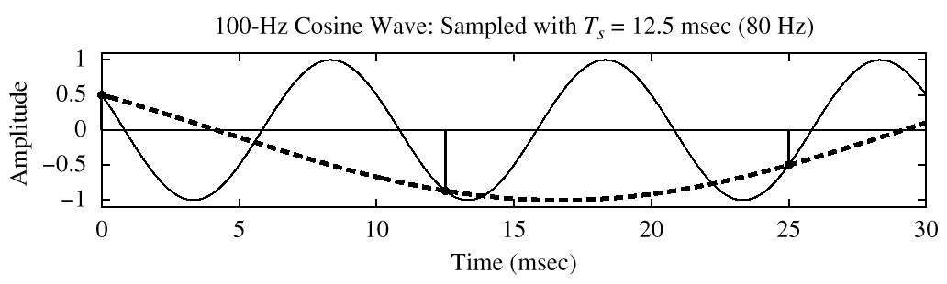
SPECTRUM (ALIASING CASE)
–2.5π
–1.5π
–0.5π
0.5π
1.5π
2.5π

Slide 26
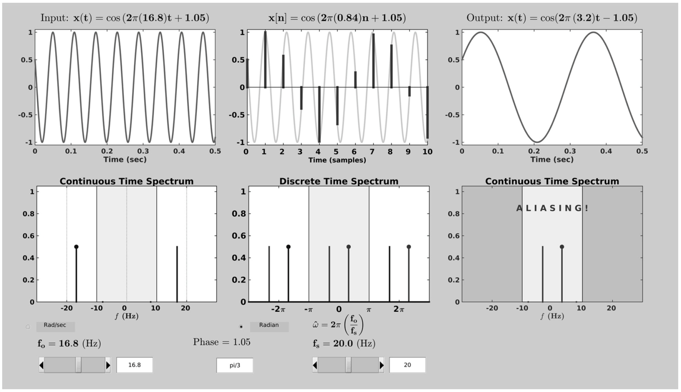
SAMPLING GUI (con2dis)

Slide 27
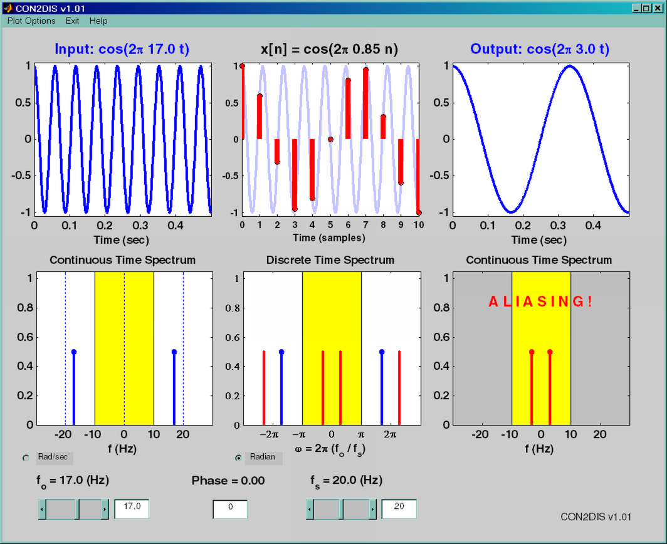
SAMPLING GUI (con2dis)

Slide 28
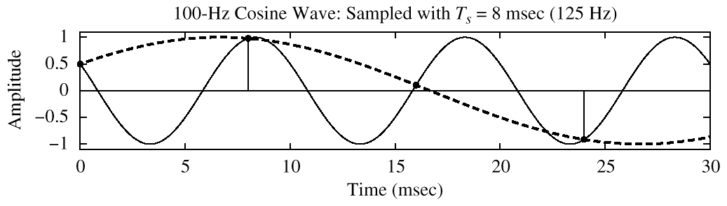
SPECTRUM (FOLDING CASE)
–1.6π
–0.4π
0.4π
1.6π

Slide 29
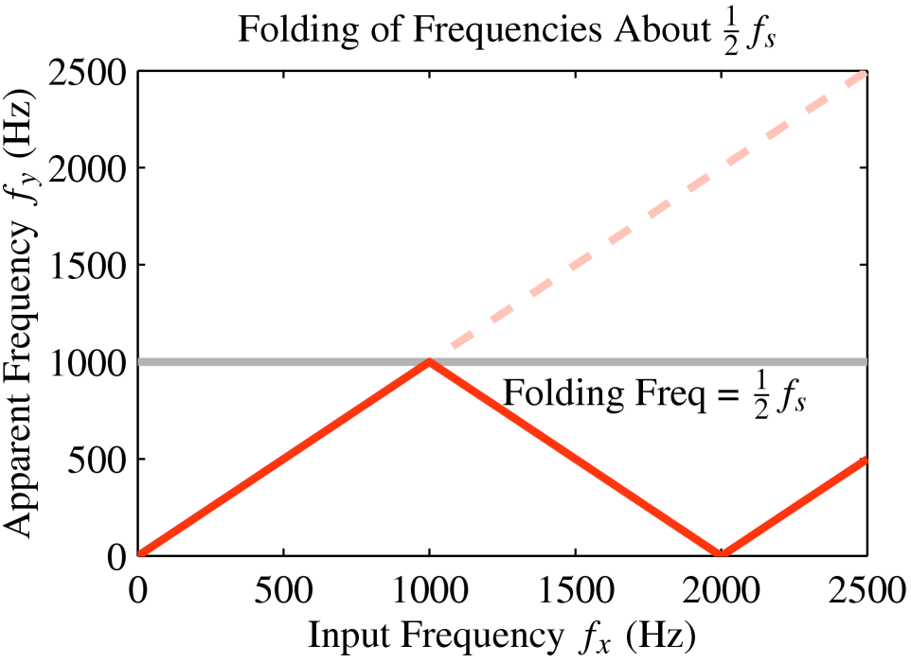
FOLDING DIAGRAM

Slide 30
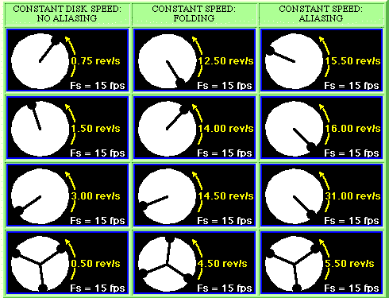
STROBE DEMO (Synthetic)

Slide 31
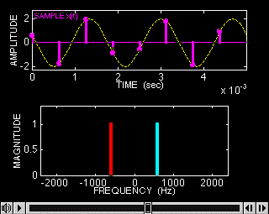
SAMPLING DEMO (Chap. 4)

Slide 32
ALIASING DERIVATION
Other Frequencies give the same

Slide 33
ALIASING DERIVATION–2
Other Frequencies give the same

Slide 34

FOLDING DERIVATION
Negative Freqs can give the same
SAME DIGITAL SIGNAL

Slide 35
FOLDING (a type of ALIASING)
MANY x(t) give IDENTICAL x[n]
CAN’T TELL f_{o} FROM (f_{s}-f_{o})
Or, (2f_{s}-f_{o} ) or, (3f_{s}-f_{o} )
EXAMPLE:
y(t) has 1000 Hz component
SAMPLING FREQ = 1500 Hz
WHAT is the “FOLDED” ALIAS ?

Slide 36
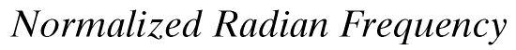
DIGITAL FREQ AGAIN
ALIASING
FOLDED ALIAS

Slide 37
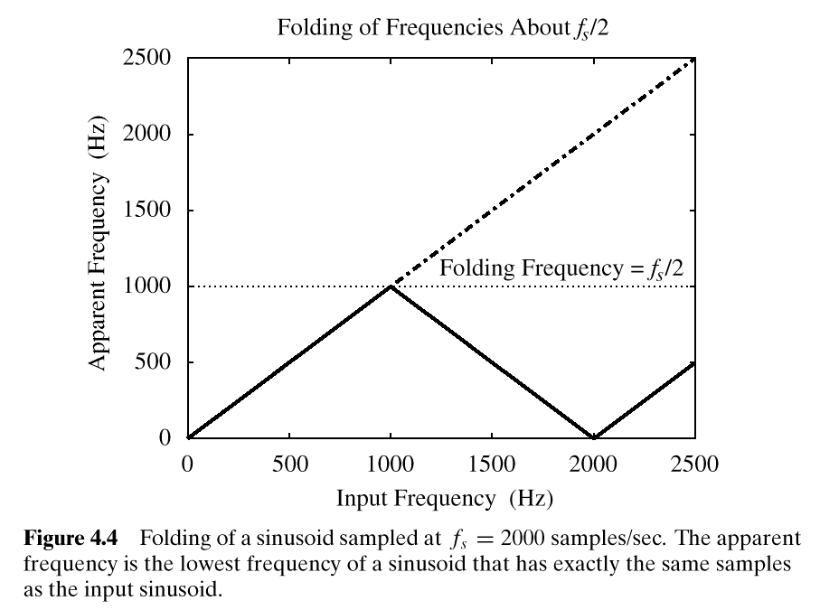
FOLDING DIAGRAM

Slide 38
ALIASING DERIVATION
Other Frequencies give the same

Slide 39

Spatial Aliasing

Slide 40
ALIASING CONCLUSIONS
ADDING f_{s} or 2f_{s} or –f_{s} to the FREQ of x(t) gives exactly the same x[n]
The sample values, x[n] = x(n/ f_{s} )
are EXACTLY THE SAME VALUES
GIVEN x[n], WE CAN’T DISTINGUISH
f_{o} FROM (f_{o} + f_{s} ) or (f_{o} + 2f_{s} )

Slide 41
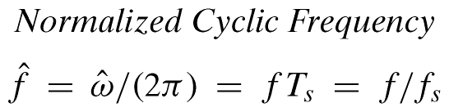
NORMALIZED FREQUENCY
DIGITAL FREQUENCY

