Slide 1
DSP First, 2/e
Lecture 10
Digital to Analog (D-to-A) Conversion

Slide 2
License Info for DSPFirst Slides
This work released under a Creative Commons License with the following terms:
Attribution
The licensor permits others to copy, distribute, display, and perform the work. In return, licensees must give the original authors credit.
Non-Commercial
The licensor permits others to copy, distribute, display, and perform the work. In return, licensees may not use the work for commercial purposes—unless they get the licensor's permission.
Share Alike
The licensor permits others to distribute derivative works only under a license identical to the one that governs the licensor's work.
Full Text of the License
This (hidden) page should be kept with the presentation

Slide 3
READING ASSIGNMENTS
This Lecture:
Chapter 4: Sections 4-3, 4-4
Other Reading:
Recitation: Section 4-5 (Strobe Demo)
Next Lecture: Chapter 5 (beginning)

Slide 4
LECTURE OBJECTIVES
FOLDING: a type of ALIASING
DIGITAL-to-ANALOG CONVERSION is
Reconstruction from samples
SAMPLING THEOREM applies
Smooth Interpolation
Mathematical Model of D-to-A
SUM of SHIFTED PULSES
Linear Interpolation example

Slide 5
SIGNAL TYPES
A-to-D
Convert x(t) to numbers stored in memory
D-to-A
Convert y[n] back to a “continuous-time” signal, y(t)
y[n] is called a “discrete-time” signal
x(t)
A-to-D
x[n]
COMPUTER
y[n]
D-to-A
y(t)

Slide 6
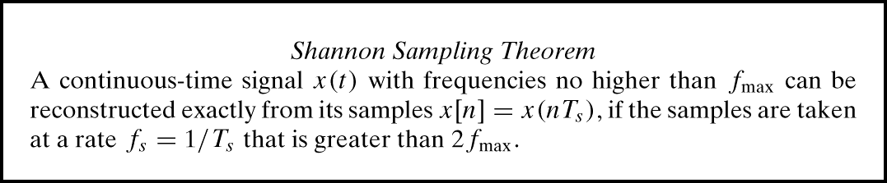
SAMPLING x(t)
UNIFORM SAMPLING at t = nT_{s}
IDEAL: x[n] = x(nT_{s})
x(t)
C-to-D
x[n]

Slide 7
Terminology: NYQUIST RATE
“Nyquist Rate” Sampling
f_{s} > TWICE the HIGHEST Frequency in x(t)
“Sampling above the Nyquist rate”
BANDLIMITED SIGNALS
DEF: HIGHEST FREQUENCY COMPONENT in SPECTRUM of x(t) is finite
NON-BANDLIMITED EXAMPLE
TRIANGLE WAVE is NOT BANDLIMITED

Slide 8
SPECTRUM for x[n]
INCLUDE ALL SPECTRUM LINES
ALIASES
ADD INTEGER MULTIPLES of 2π and −2π
FOLDED ALIASES
ALIASES of NEGATIVE FREQS
PLOT versus NORMALIZED FREQUENCY
i.e., DIVIDE f_{o} by f_{s}

Slide 9
EXAMPLE: SPECTRUM
x[n] = Acos(0.2πn+φ)
FREQS @ 0.2π and −0.2π
ALIASES:
{2.2π, 4.2π, 6.2π, …} & {-1.8π,-3.8π,…}
EX: x[n] = Acos(4.2πn+φ)
ALIASES of NEGATIVE FREQ:
{1.8π,3.8π,5.8π,…} & {-2.2π, -4.2π …}

Slide 10
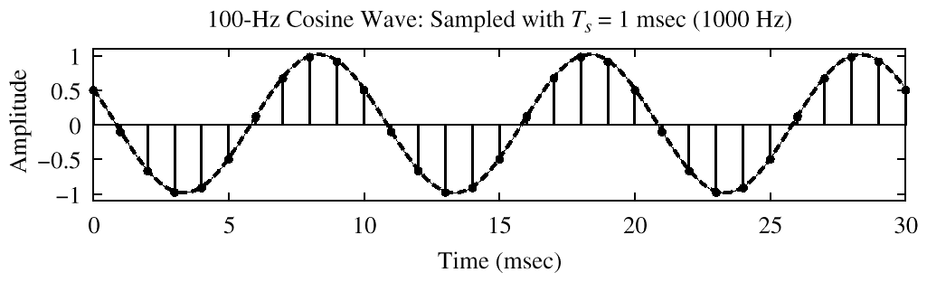
SPECTRUM (MORE LINES)
–1.8π
–0.2π
2π(0.1)
1.8π

Slide 11
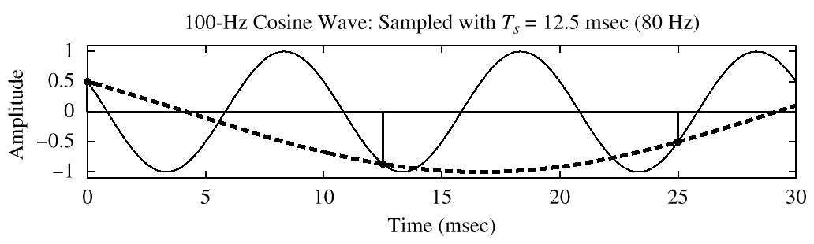
SPECTRUM (ALIASING CASE)
–2.5π
–1.5π
–0.5π
0.5π
1.5π
2.5π

Slide 12
FOLDING (a type of ALIASING)
EXAMPLE: 3 different x(t); same x[n]
900 Hz “folds” to 100 Hz when f_{s}=1kHz

Slide 13
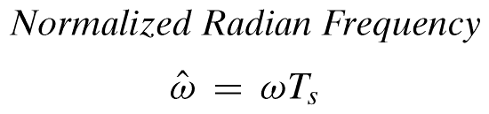
DIGITAL FREQ AGAIN
ALIASING
FOLDED ALIAS

Slide 14
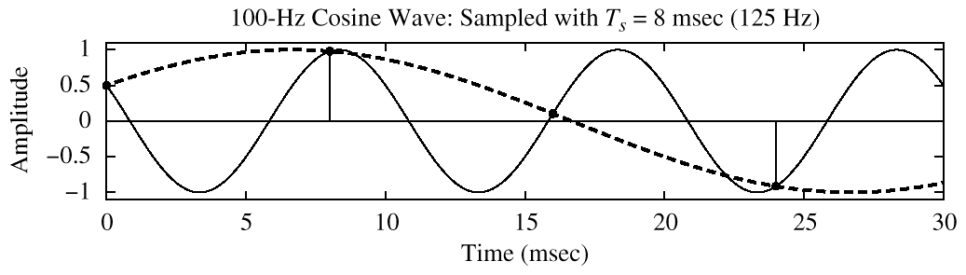
SPECTRUM (FOLDING CASE)
–1.6π
–0.4π
0.4π
1.6π

Slide 15
SPECTRUM Explanation of SAMPLING THEOREM
How do we prevent aliasing?
Guarantee original signal is principal alias:

Slide 16
D-to-A Reconstruction
x(t)
A-to-D
x[n]
COMPUTER
y[n]
D-to-A
y(t)
Create continuous y(t) from y[n]
IDEAL D-to-A:
If you have formula for y[n]
Invert sampling (t=nT_{s}) by n=f_{s}t
y[n] = Acos(0.2πn+φ) with f_{s} = 8000 Hz
y(t) = Acos(0.2π(8000t)+φ) = Acos(2π(800)t+φ)

Slide 17
FREQUENCY DOMAINS
x(t)
A-to-D
x[n]
y[n]
D-to-A
y(t)

Slide 18
D-to-A is AMBIGUOUS !
ALIASING
Given y[n], which y(t) do we pick ? ? ?
INFINITE NUMBER of y(t)
PASSING THRU THE SAMPLES, y[n]
D-to-A RECONSTRUCTION MUST CHOOSE ONE OUTPUT
RECONSTRUCT THE SMOOTHEST ONE
THE LOWEST FREQ, if y[n] = sinusoid

Slide 19
SPECTRUM (ALIASING CASE)
–2.5π
–1.5π
–0.5π
0.5π
1.5π
2.5π

Slide 20
DEMOS from CHAPTER 4
CD-ROM DEMOS
SAMPLING DEMO (con2dis GUI)
Different Sampling Rates
Aliasing of a Sinusoid
STROBE DEMO
Synthetic vs. Real
Television SAMPLES at 30 fps
Sampling & Reconstruction

Slide 21
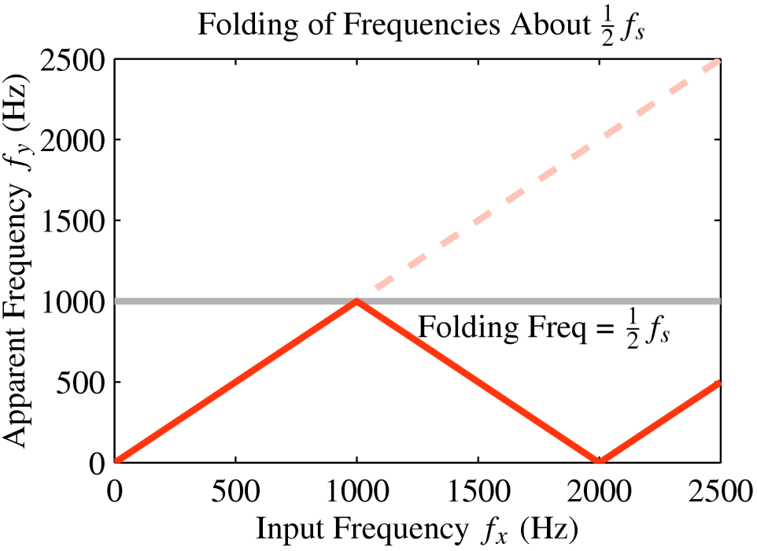
FOLDING DIAGRAM

Slide 22
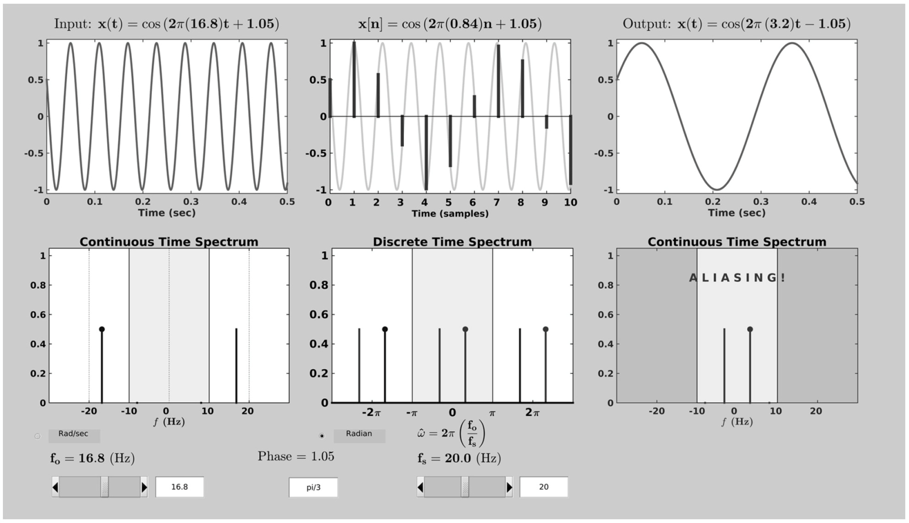
SAMPLING GUI (con2dis)

Slide 23
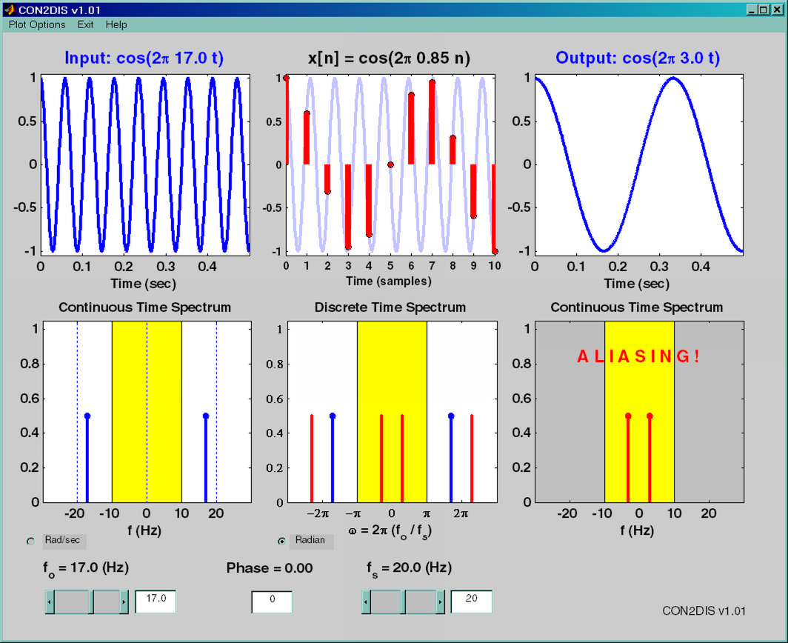
SAMPLING GUI (con2dis)

Slide 24
Reconstruction (D-to-A)
CONVERT STREAM of NUMBERS to x(t)
“CONNECT THE DOTS”
INTERPOLATION
INTUITIVE,
conveys the idea
y[k]
y(t)
t
kT_{s}
(k+1)T_{s}

Slide 25
SAMPLE & HOLD DEVICE
CONVERT y[n] to y(t)
y[k] should be the value of y(t) at t = kT_{s}
Make y(t) equal to y[k] for
kT_{s} -0.5T_{s} < t < kT_{s} +0.5T_{s}
y[k]
STAIR-STEP
APPROXIMATION
y(t)
t
kT_{s}
(k+1)T_{s}

Slide 26
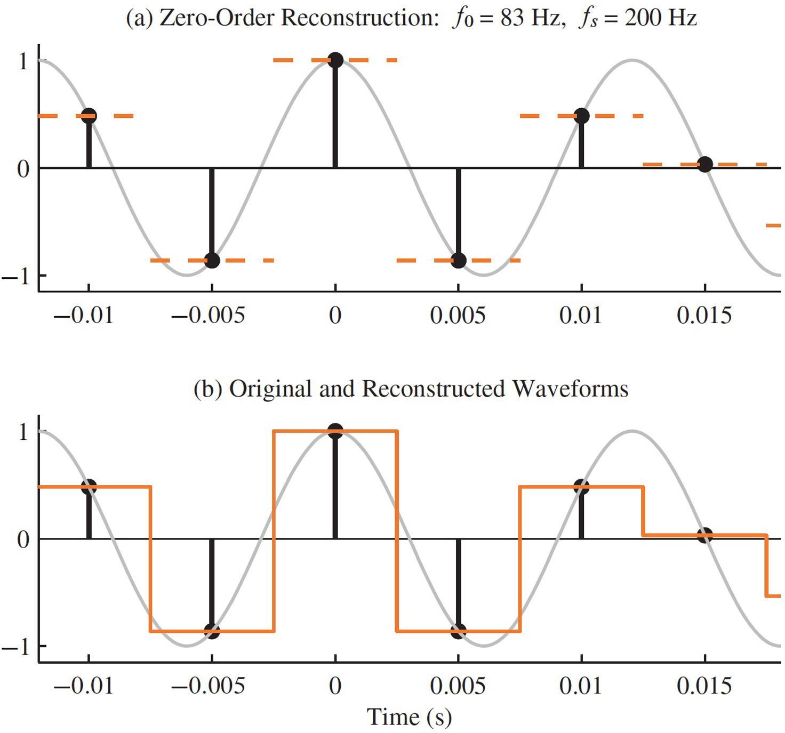
SQUARE PULSE CASE

Slide 27
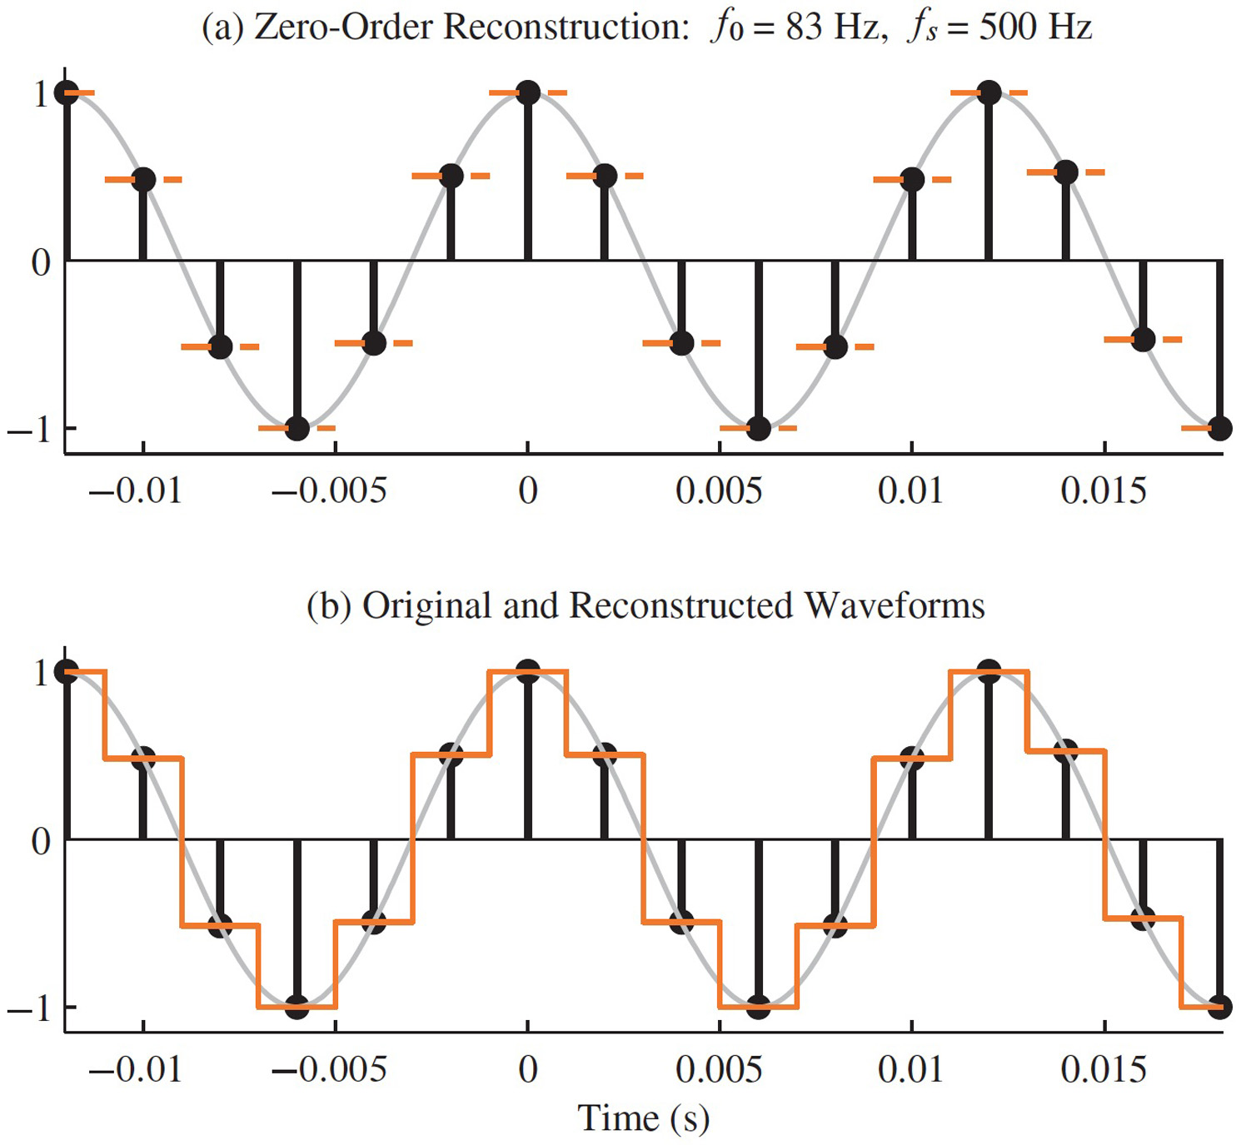
OVER-SAMPLING CASE
EASIER TO
RECONSTRUCT

Slide 28
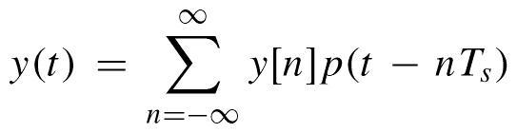
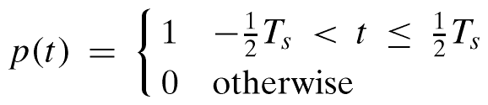
MATH MODEL for D-to-A
SQUARE PULSE:

Slide 29
EXPAND the SUMMATION
SUM of SHIFTED PULSES p(t-nT_{s})
“WEIGHTED” by y[n]
CENTERED at t=nT_{s}
SPACED by T_{s}
RESTORES “REAL TIME”

Slide 30
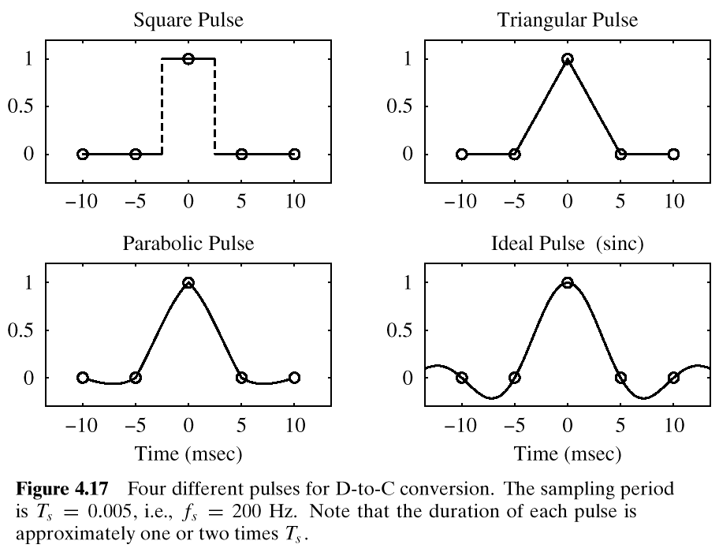
p(t)

Slide 31
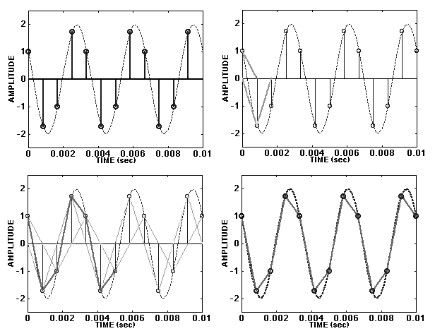
TRIANGULAR PULSE (2X)

Slide 32
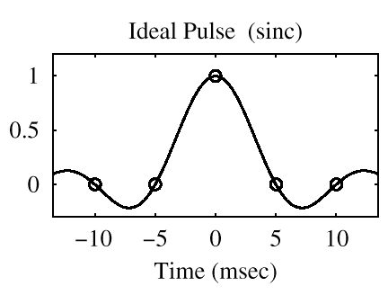
OPTIMAL PULSE ?
CALLED
“BANDLIMITED
INTERPOLATION”

Slide 33
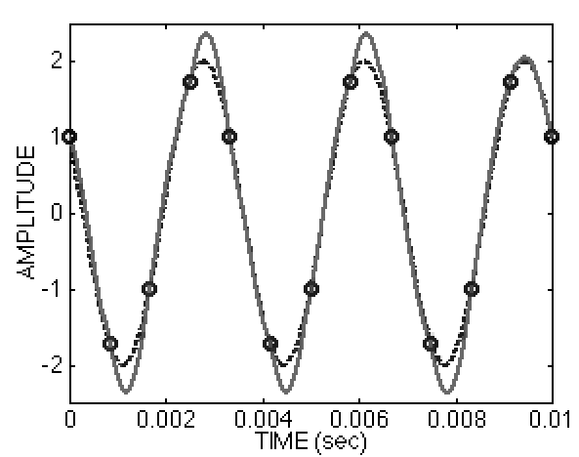
Reconstruct with Ideal (2x)

Slide 34
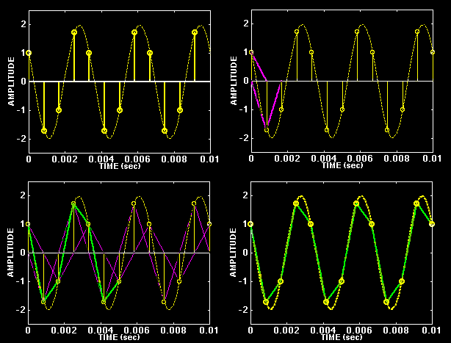
TRIANGULAR PULSE (2X)

Slide 35
OPTIMAL PULSE ?
CALLED
“BANDLIMITED
INTERPOLATION”

Slide 36
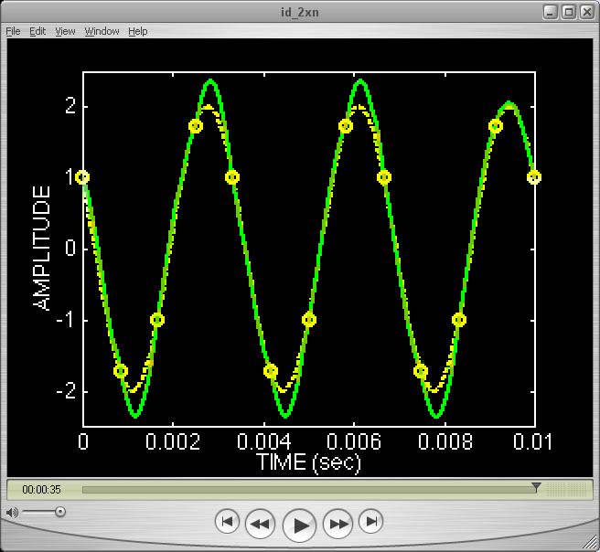
Reconstruct with Ideal (2x)

Slide 37
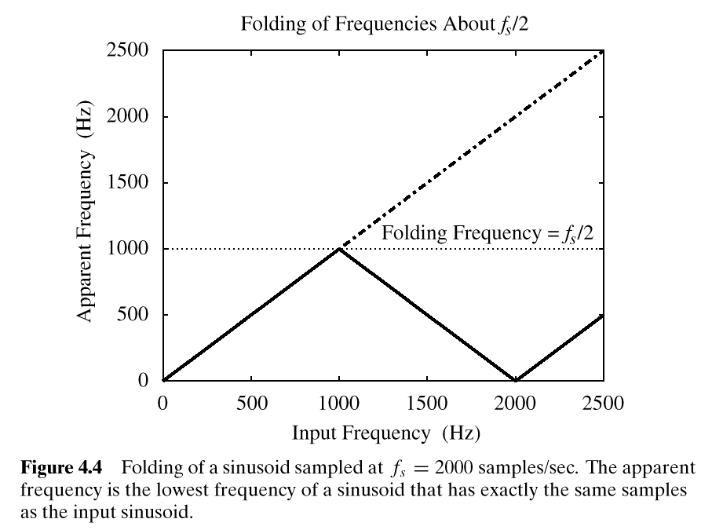
FOLDING DIAGRAM

Slide 38
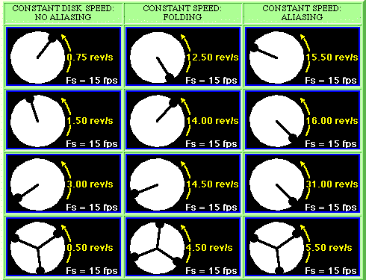
STROBE DEMO (Synthetic)

Slide 39
ALIASING & FOLDING
x(t) = SINUSOID @ f_{o}
SAMPLED SIGNAL: x[n] = x(n/ f_{s} )
ALIASING:
x[n] COULD HAVE COME FROM
(f_{o} + f_{s} )
or (f_{o} - f_{s} )
or (f_{o} + 2f_{s} )
or (f_{o} - 2f_{s} ), etc.
FOLDING:
A type of ALIASING
x[n] COULD BE FROM:
(-f_{o} + f_{s} )
or (-f_{o} - f_{s} )
or (-f_{o} + 2f_{s} )
or (-f_{o} - 2f_{s} ), etc.

Slide 40
D-to-A Reconstruction
x(t)
A-to-D
x[n]
COMPUTER
y[n]
D-to-A
y(t)
Create continuous y(t) from y[n]
REALISTIC CONSTRAINT: SMOOTH y(t)
Use the lowest possible frequency
y[n] is a list of numbers
How fast?
In MATLAB: soundsc(yy,fs)

Slide 41
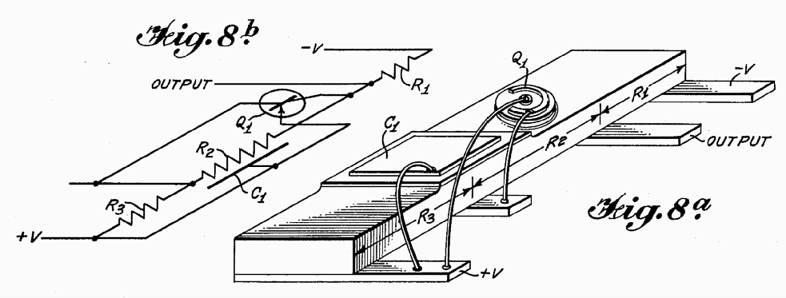
INVENTION of the IC
Integrated Circuit: 1959 by Jack Kilby
http://www.eepatents.com/feature/

Slide 42
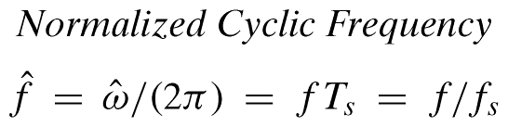
FOUR FREQUENCY AXES
ANALOG FREQUENCY: f, ω
DIGITAL FREQUENCY

Slide 43

FOLDING DERIVATION
Negative Freqs can give the same
SAME DIGITAL SIGNAL

Slide 44
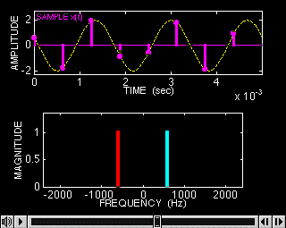
SAMPLING DEMO (Ch. 4)

Slide 45
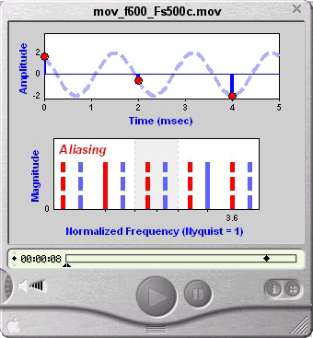
SAMPLING DEMO (Ch. 4)

Slide 46
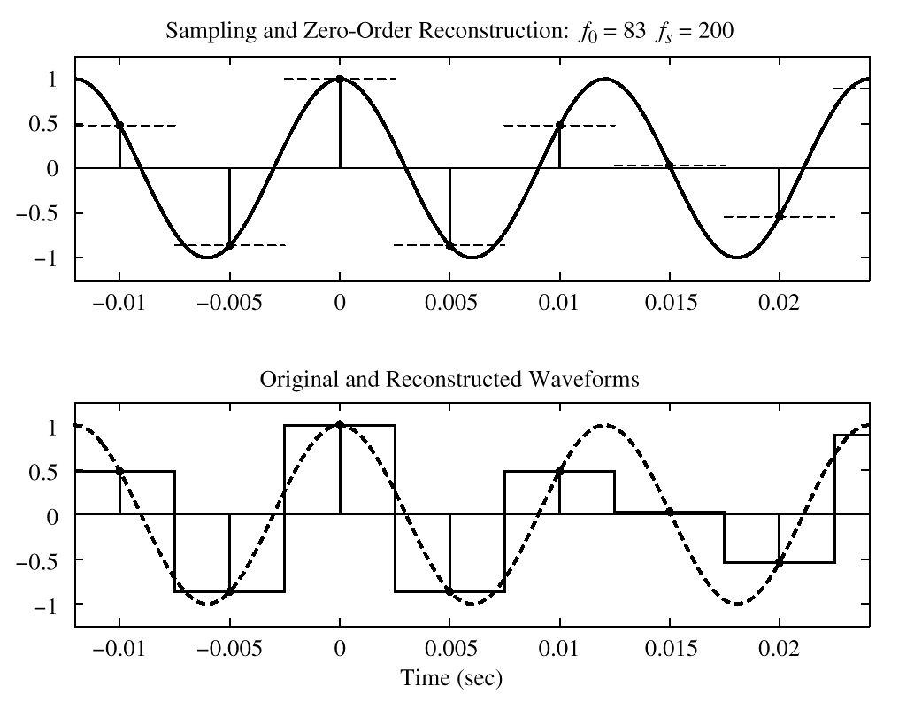
SQUARE PULSE CASE

Slide 47
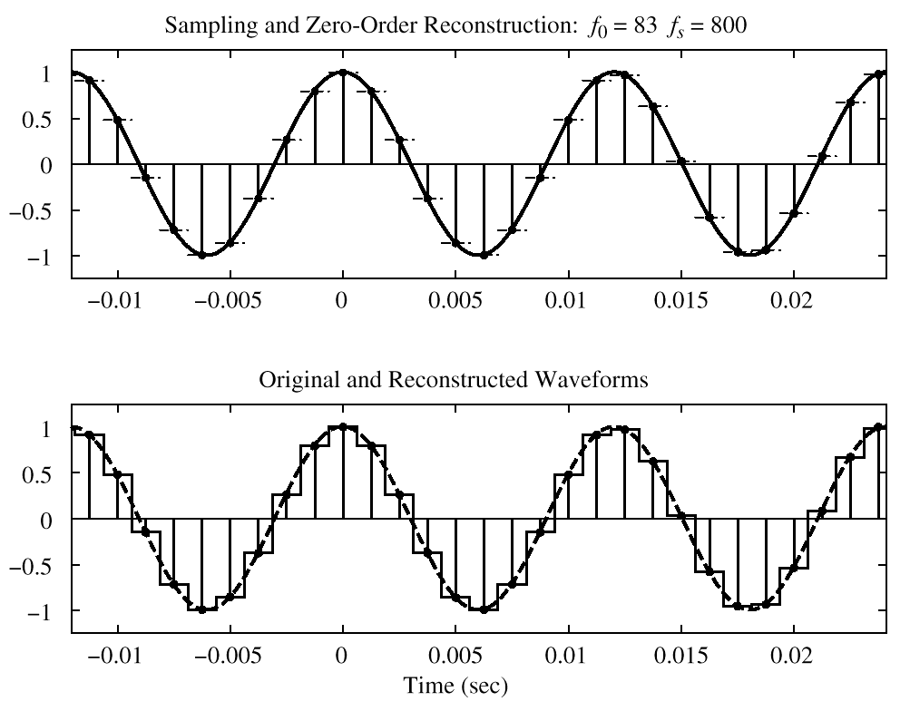
OVER-SAMPLING CASE
EASIER TO RECONSTRUCT

