Slide 1
DSP First, 2/e
Lecture 11
FIR Filtering Intro

Slide 2
License Info for DSPFirst Slides
This work released under a Creative Commons License with the following terms:
Attribution
The licensor permits others to copy, distribute, display, and perform the work. In return, licensees must give the original authors credit.
Non-Commercial
The licensor permits others to copy, distribute, display, and perform the work. In return, licensees may not use the work for commercial purposes—unless they get the licensor's permission.
Share Alike
The licensor permits others to distribute derivative works only under a license identical to the one that governs the licensor's work.
Full Text of the License
This (hidden) page should be kept with the presentation

Slide 3
READING ASSIGNMENTS
This Lecture:
Chapter 5, Sects. 5-1, 5-2, 5-3 & 5-4 (partial)
Other Reading:
Next Lecture: Ch. 5, Sects 5-4, 5-6, 5-7 & 5-8
CONVOLUTION

Slide 4
LECTURE OBJECTIVES
INTRODUCE FILTERING IDEA
Weighted Average
Running Average
FINITE IMPULSE RESPONSE FILTERS
FIR Filters
Show how to compute the output y[n] from the input signal, x[n]

Slide 5
DIGITAL FILTERING
x(t)
A-to-D
x[n]
COMPUTER
y[n]
D-to-A
y(t)
Characterized SIGNALS (Fourier series)
Converted to DIGITAL (sampling)
Today: How to PROCESS them (DSP)?
CONCENTRATE on the COMPUTER
ALGORITHMS, SOFTWARE (MATLAB) and HARDWARE (DSP chips, VLSI)

Slide 6
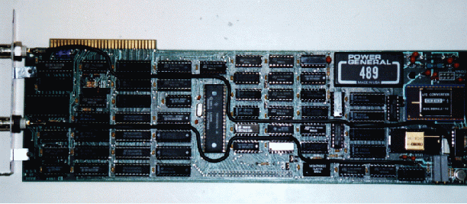
The TMS32010, 1983
First PC plug-in board from Atlanta Signal Processors Inc.

Slide 7
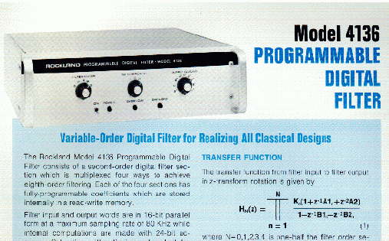
Rockland Digital Filter, 1971
Cost was about the same as the price of a small house.

Slide 8
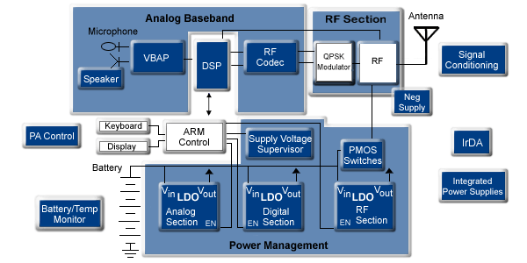
Digital Cell Phone (ca. 2000)
Now, digital cameras and video streaming rely on DSP algorithms

Slide 9
DISCRETE-TIME SYSTEM
OPERATE on x[n] to get y[n]
WANT a GENERAL CLASS of SYSTEMS
ANALYZE the SYSTEM
TOOLS: TIME-DOMAIN & FREQUENCY-DOMAIN
SYNTHESIZE the SYSTEM
x[n]
COMPUTER
y[n]

Slide 10
D-T SYSTEM EXAMPLES
EXAMPLES:
POINTWISE OPERATORS
SQUARING: y[n] = (x[n])²
RUNNING AVERAGE
RULE: “the output at time n is the average of three consecutive input values”
x[n]
SYSTEM
y[n]

Slide 11
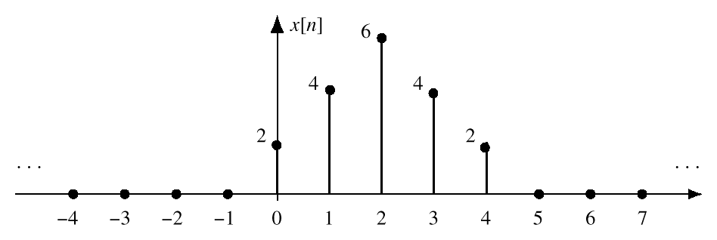
DISCRETE-TIME SIGNAL
x[n] is a LIST of NUMBERS
INDEXED by “n”
STEM PLOT

Slide 12
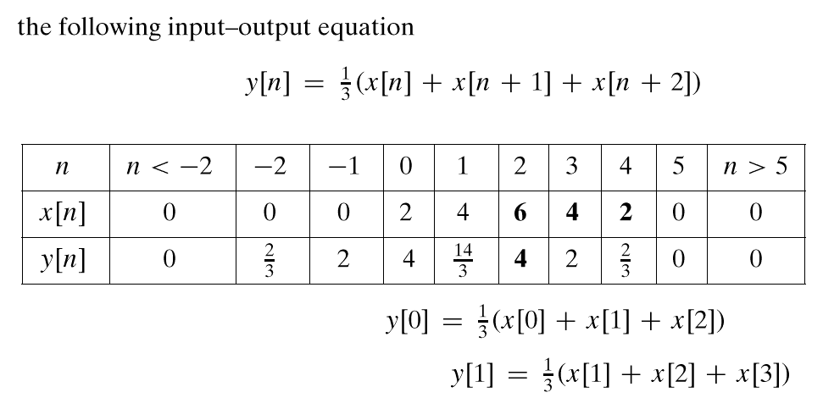
3-PT AVERAGE SYSTEM
ADD 3 CONSECUTIVE NUMBERS
Do this for each “n”
Make a TABLE
n=0
n=1

Slide 13
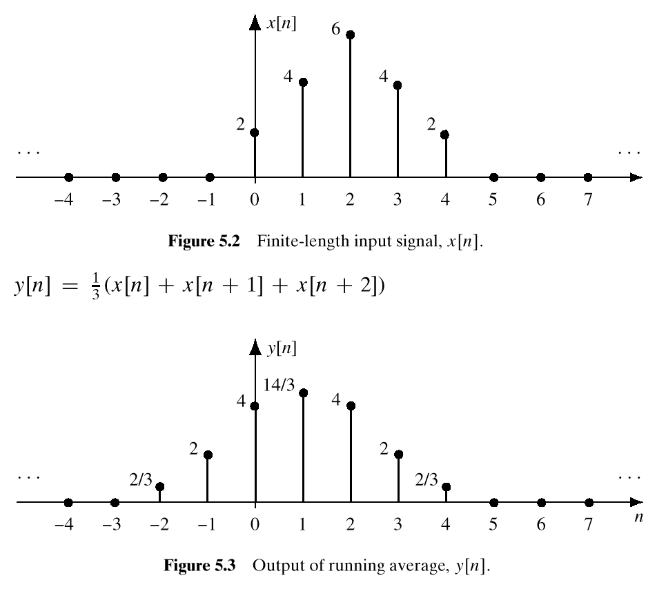
INPUT SIGNAL
OUTPUT SIGNAL

Slide 14
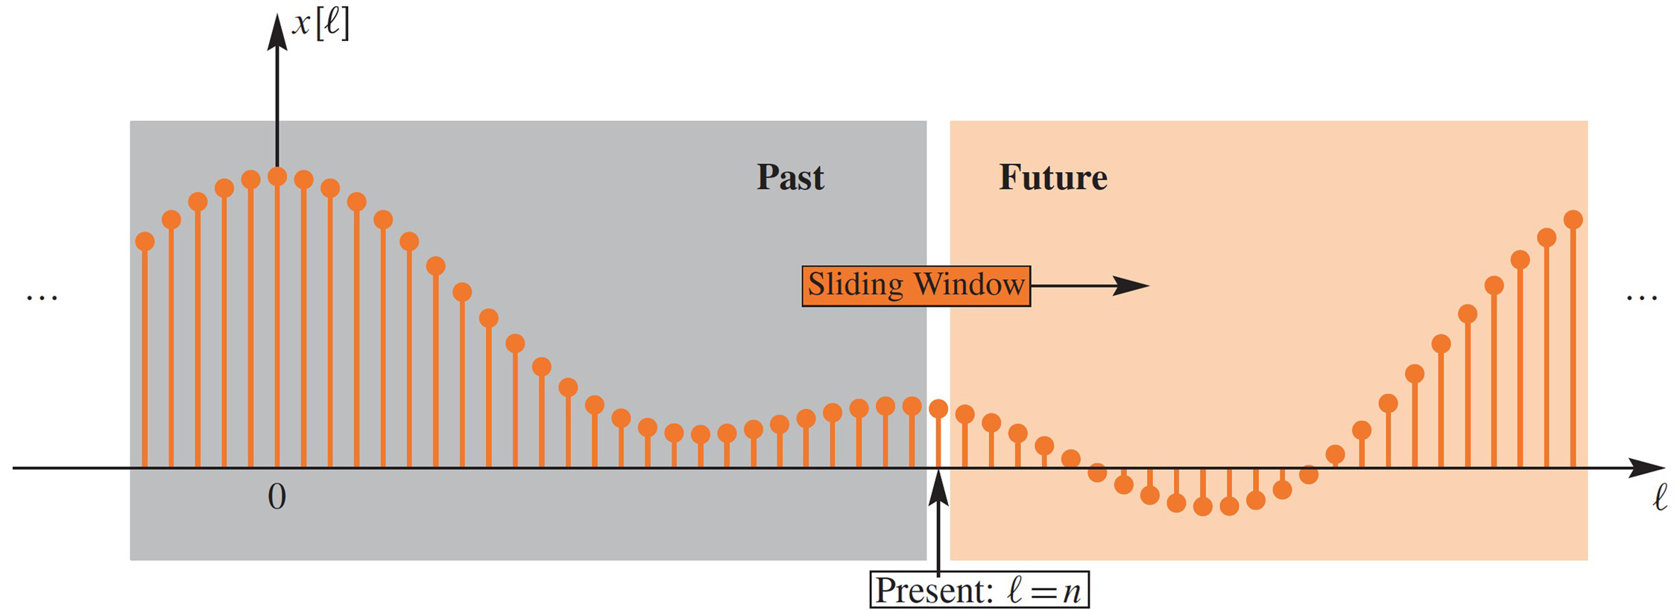
PAST, PRESENT, FUTURE
SLIDE a WINDOW across x[n]
“n” is PRESENT TIME
Figure 5-3 Filter calculation at the present time (ℓ = n) uses values within a sliding window. Gray shading indicates the past (ℓ < n); orange shading, the future (ℓ > n). Here, the sliding window encompasses values from both the future and the past.

Slide 15
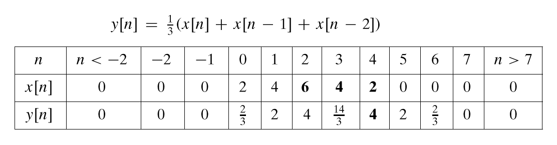
ANOTHER 3-pt AVERAGER
Uses “PAST” VALUES of x[n]
IMPORTANT IF “n” represents REAL TIME
WHEN x[n] & y[n] ARE STREAMS

Slide 16
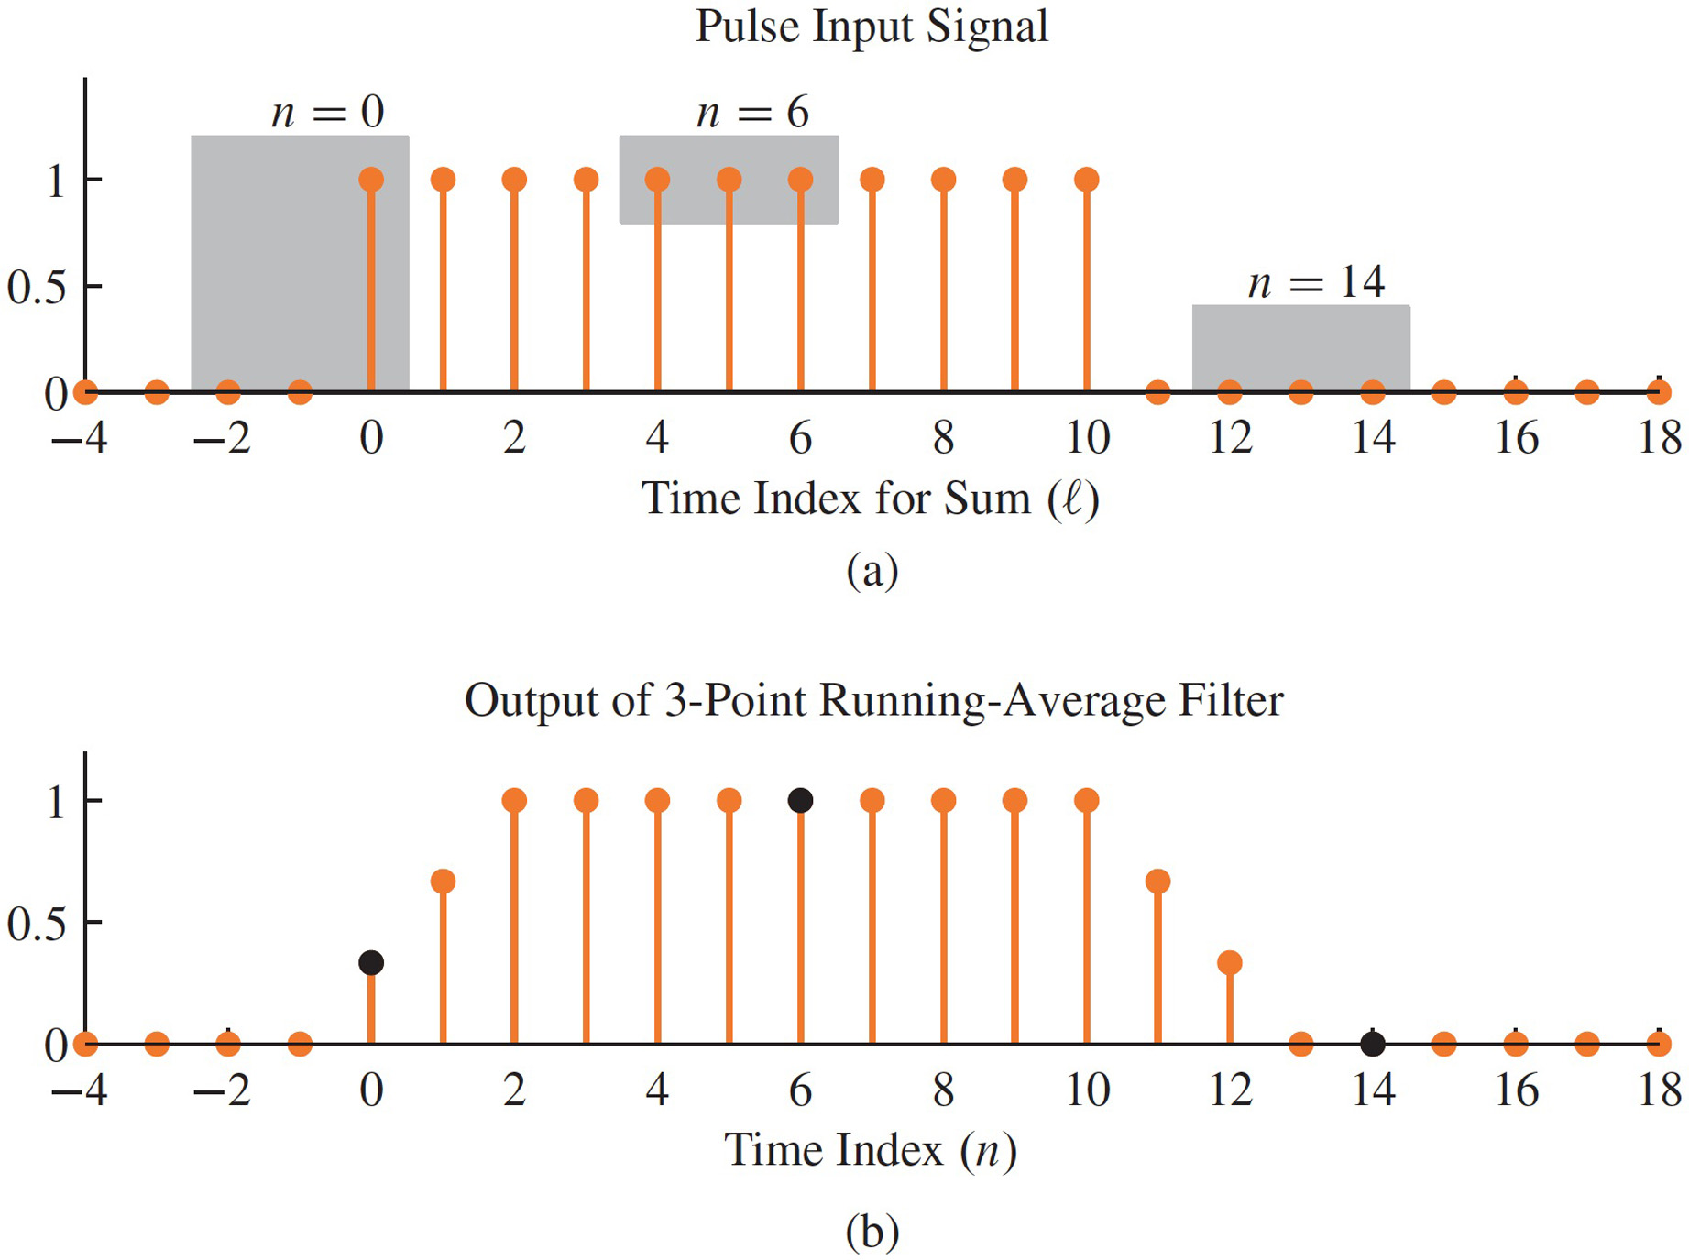
CAUSAL 3-pt AVERAGER

Slide 17
GENERAL CAUSAL FIR FILTER
FILTER COEFFICIENTS {b_{k}}
DEFINE THE FILTER
For example,

Slide 18
GENERAL CAUSAL FIR FILTER
FILTER COEFFICIENTS {b_{k}}
FILTER ORDER is M
FILTER “LENGTH” is L = M+1
NUMBER of FILTER COEFFS is L

Slide 19
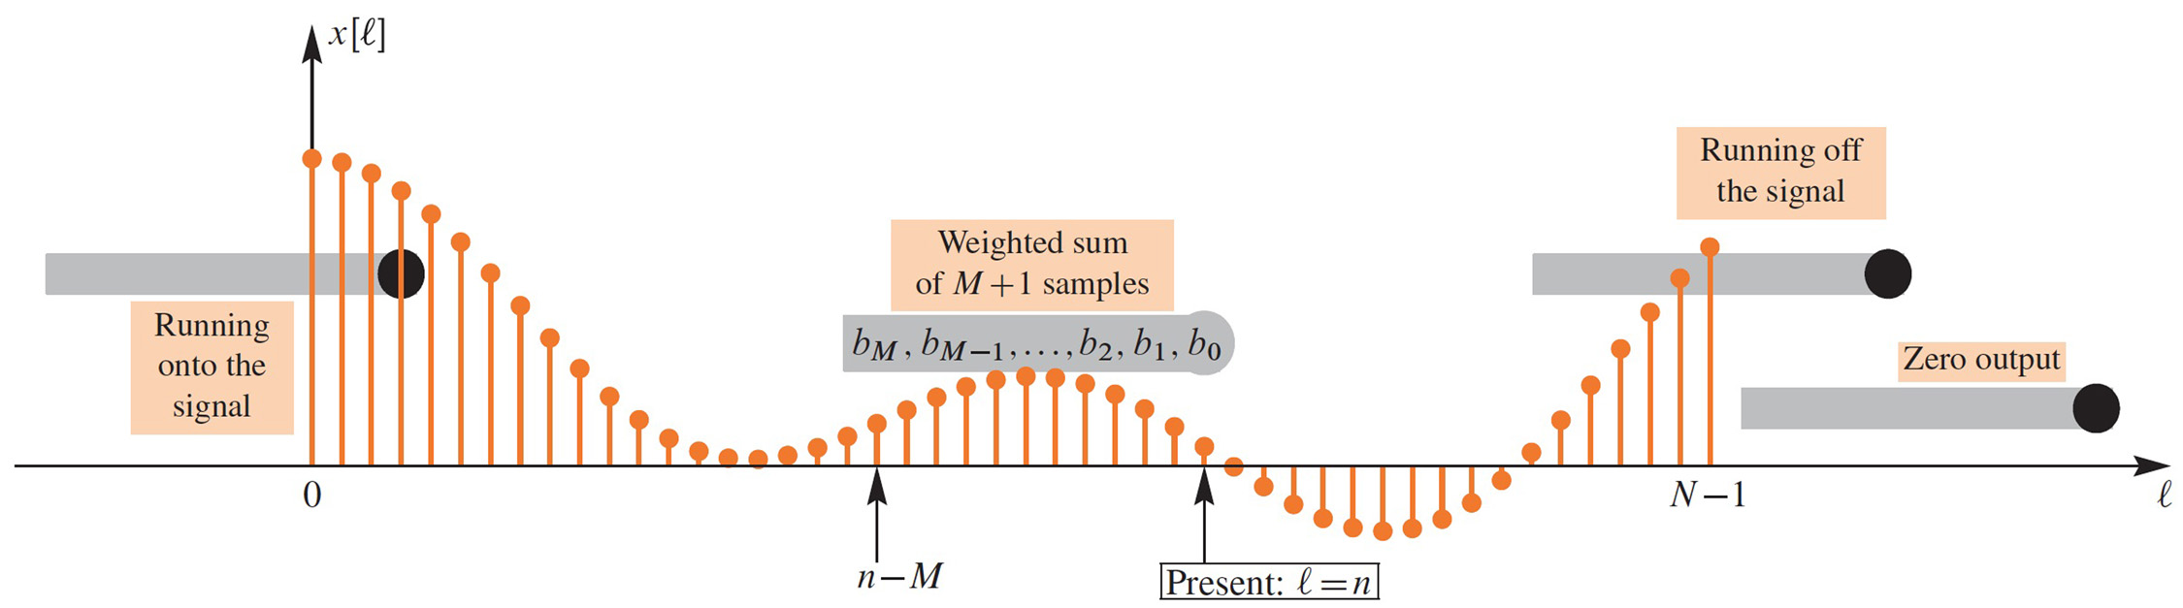
GENERAL CAUSAL FIR FILTER
SLIDE a WINDOW across x[n]
x[n-M]
x[n]

Slide 20
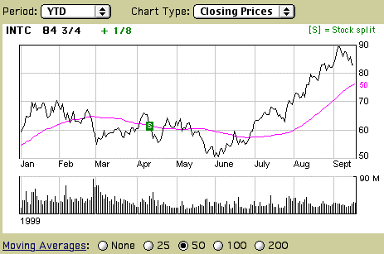
FILTERED STOCK SIGNAL
INPUT
OUTPUT
50-pt Averager

Slide 21
SPECIAL INPUT SIGNALS
x[n] = SINUSOID
x[n] has only one NON-ZERO VALUE
FREQUENCY RESPONSE (LATER)
UNIT-IMPULSE
1
n

Slide 22
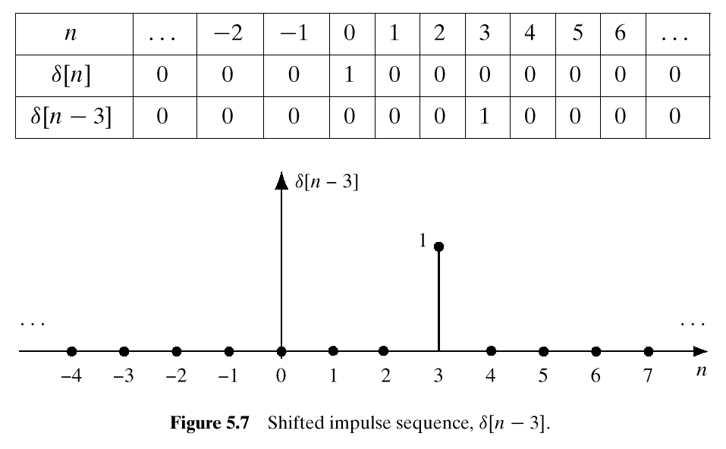
UNIT IMPULSE SIGNAL δ[n]
δ[n] is NON-ZERO
When its argument
is equal to ZERO

Slide 23
Sequence Representation
Example:
0
2
4
6
4

Slide 24
UNIT IMPULSE RESPONSE
FIR filter description usually given in terms of coefficients b_{k}
Can we describe the filter using a SIGNAL instead?
What happens if input is a unit impulse?

Slide 25
Example: 4-pt AVERAGER
CAUSAL SYSTEM: USE PAST VALUES
INPUT = UNIT IMPULSE SIGNAL = δ[n]
OUTPUT is called “IMPULSE RESPONSE”
Denoted h[n]=y[n] when x[n]=δ[n]

Slide 26
Unit Impulse Response

Slide 27
SUM of Shifted Impulses

Slide 28
4-pt Avg Impulse Response
δ[n] “READS OUT” the FILTER COEFFICIENTS
“h” in h[n] denotes
Impulse Response
n=0
NON-ZERO When window overlaps δ[n]
n= –1
1
n=0
n=1
n
n=4
n=5

Slide 29
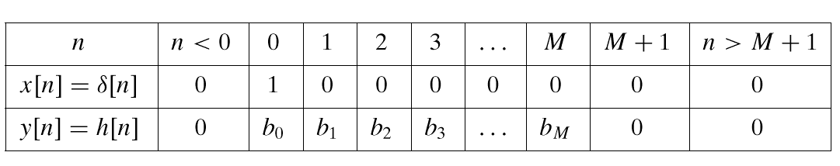
FIR IMPULSE RESPONSE

Slide 30
3 Ways to Represent the FIR filter
Use SHIFTED IMPULSES to write h[n]
1
2
1
2: Plot the values
0
4
n
3: List the values
–1
True for any signal, x[n]

Slide 31
FILTERING EXAMPLE
7-point AVERAGER
Removes cosine
By making its amplitude (A) smaller
3-point AVERAGER
Changes A slightly

Slide 32
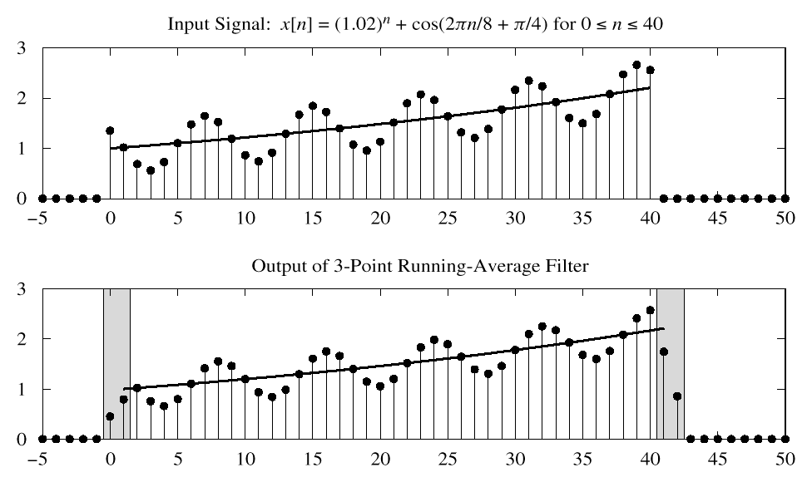
3-pt AVG EXAMPLE
USE PAST VALUES

Slide 33
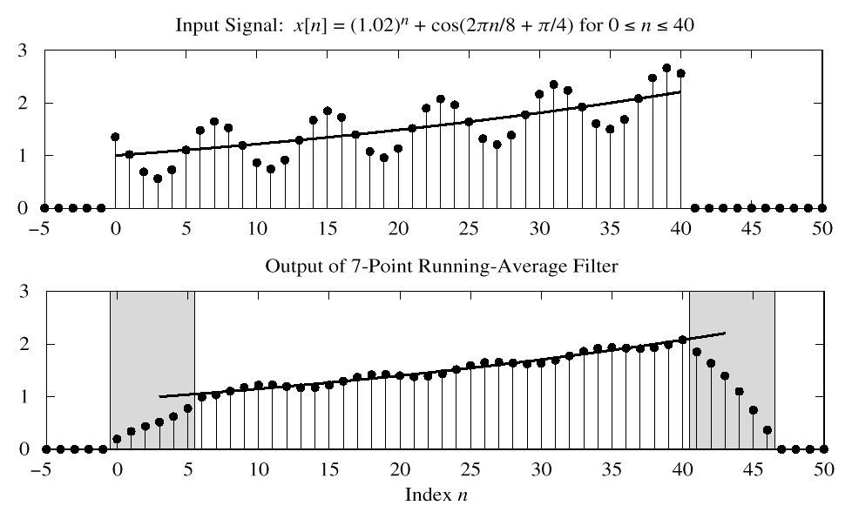
7-pt FIR EXAMPLE (AVG)
CAUSAL: Use Previous
LONGER OUTPUT

Slide 34
MATH FORMULA for x[n]
Use SHIFTED IMPULSES to write x[n]

Slide 35
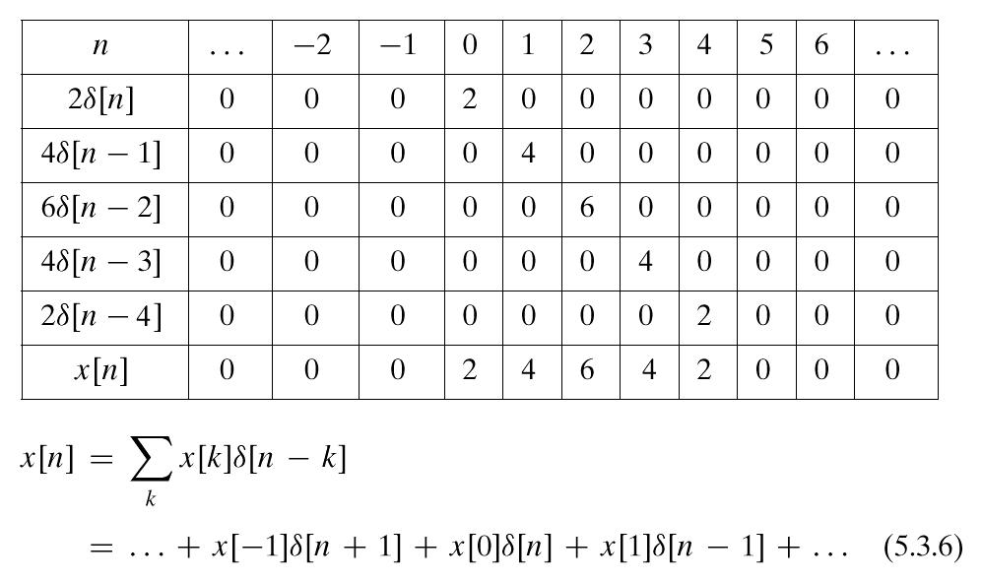
SUM of SHIFTED IMPULSES
This formula ALWAYS works

Slide 36
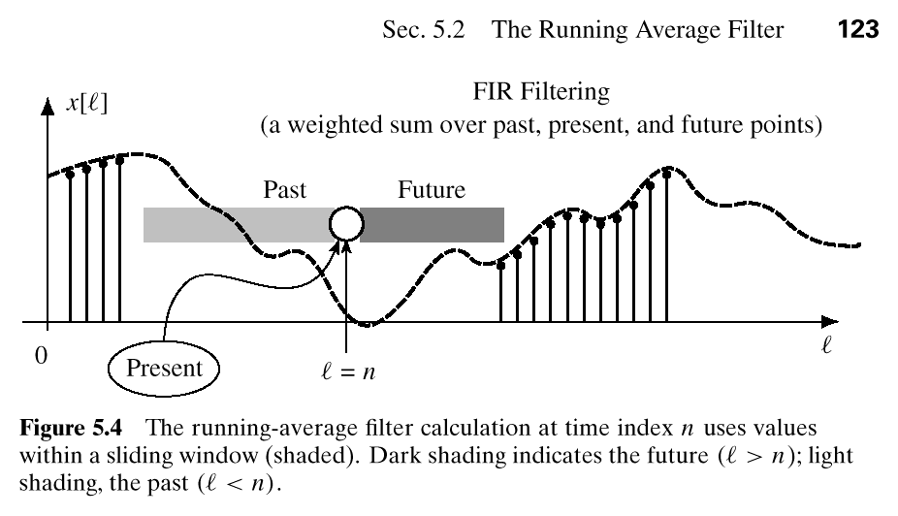
PAST, PRESENT, FUTURE
“n” is TIME

Slide 37
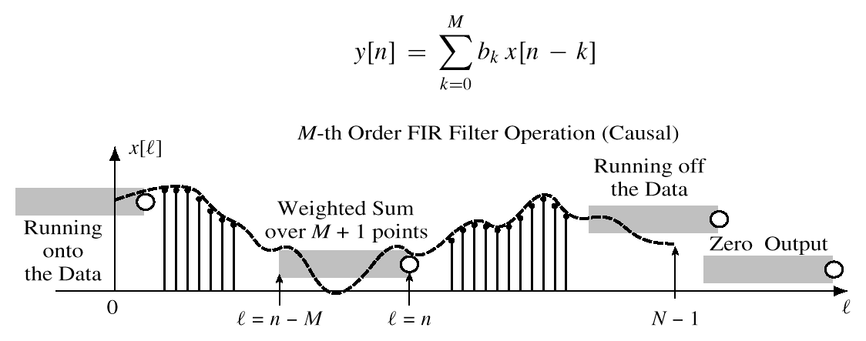
GENERAL CAUSAL FIR FILTER
SLIDE a WINDOW across x[n]
x[n-M]
x[n]

