Slide 1
DSP First, 2/e
Lecture 12
Linearity & Time-Invariance
Convolution

Slide 2
License Info for DSPFirst Slides
This work released under a Creative Commons License with the following terms:
Attribution
The licensor permits others to copy, distribute, display, and perform the work. In return, licensees must give the original authors credit.
Non-Commercial
The licensor permits others to copy, distribute, display, and perform the work. In return, licensees may not use the work for commercial purposes—unless they get the licensor's permission.
Share Alike
The licensor permits others to distribute derivative works only under a license identical to the one that governs the licensor's work.
Full Text of the License
This (hidden) page should be kept with the presentation

Slide 3
READING ASSIGNMENTS
This Lecture:
Chapter 5, Sections 5-4, 5-6, 5-7 & 5-8
Section 5-5 is covered, but not “in depth”
Convolution in Section 5-7 is important

Slide 4
LECTURE OBJECTIVES
GENERAL PROPERTIES of FILTERS
LINEARITY
TIME-INVARIANCE
==> CONVOLUTION
LTI SYSTEMS
BLOCK DIAGRAM REPRESENTATION
Components for Hardware
Connect Simple Filters Together to Build More Complicated Systems

Slide 5
OVERVIEW
IMPULSE RESPONSE,
FIR case: same as
CONVOLUTION
GENERAL:
GENERAL CLASS of SYSTEMS
LINEAR and TIME-INVARIANT
ALL LTI systems have h[n] & use convolution

Slide 6
DIGITAL FILTERING
CONCENTRATE on the FILTER (DSP)
DISCRETE-TIME SIGNALS
FUNCTIONS of n, the “time index”
INPUT x[n]
OUTPUT y[n]
x(t)
A-to-D
x[n]
FILTER
y[n]
D-to-A
y(t)

Slide 7
BUILDING BLOCKS
BUILD UP COMPLICATED FILTERS
FROM SIMPLE MODULES
Ex: FILTER MODULE MIGHT BE 3-pt FIR
x[n]
OUTPUT
y[n]
FILTER
FILTER
+
INPUT
+
FILTER

Slide 8
GENERAL FIR FILTER
FILTER COEFFICIENTS {b_{k}}
DEFINE THE FILTER
For example,

Slide 9
MATLAB for FIR FILTER
yy = conv(bb,xx)
VECTOR bb contains Filter Coefficients
DSP-First: yy = firfilt(bb,xx)
FILTER COEFFICIENTS {b_{k}}
conv2()
for images

Slide 10
SPECIAL INPUT SIGNALS
Later, sinusoid leads to the
FREQUENCY RESPONSE
x[n] = SINUSOID
x[n] has only one NON-ZERO VALUE
UNIT-IMPULSE
1
n

Slide 11
UNIT IMPULSE RESPONSE
FIR filter DIFFERENCE EQUATION is specified by the filter coefficients b_{k}
EQUIVALENCE: can we describe the filter using a SIGNAL instead?

Slide 12
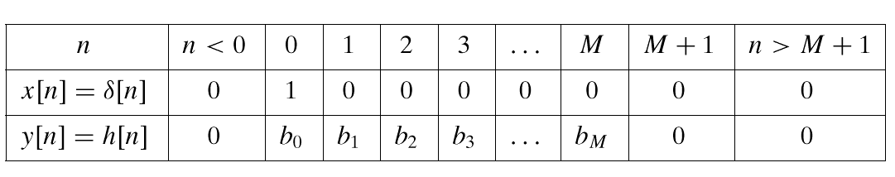
FIR IMPULSE RESPONSE
Impulse response h[k]=b_{k} is, in fact, a SIGNAL description of filter coefficients
Allows us to write CONVOLUTION sum

Slide 13
3 Representations for h[n]
1:
Use SHIFTED IMPULSES to write h[n]
True for any
signal, x[n]
2
1
2: Plot the values
0
4
n
3: List the filter coefficients
–1

Slide 14
POP QUIZ
FIR Filter is “FIRST DIFFERENCE”
y[n] = x[n] - x[n-1]
What are filter coefficients?
Find h[n]

Slide 15
LTI: Convolution Sum
Output = Convolution of x[n] & h[n]
NOTATION:
FIR case:
FINITE LIMITS
Same as b_{k}
FINITE LIMITS

Slide 16
LTI: Convolution Sum
Delay the signal x[n] & then multiply by filter coefficients that come from h[n]

Slide 17
CONVOLUTION Example

Slide 18
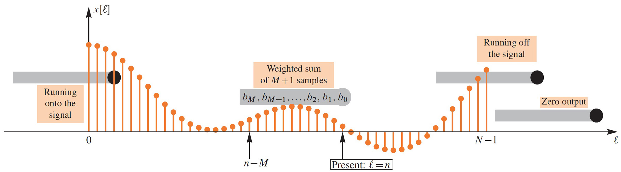
GENERAL CAUSAL FIR FILTER
SLIDE a Length-L WINDOW across x[n]
x[n-M]
x[n]

Slide 19
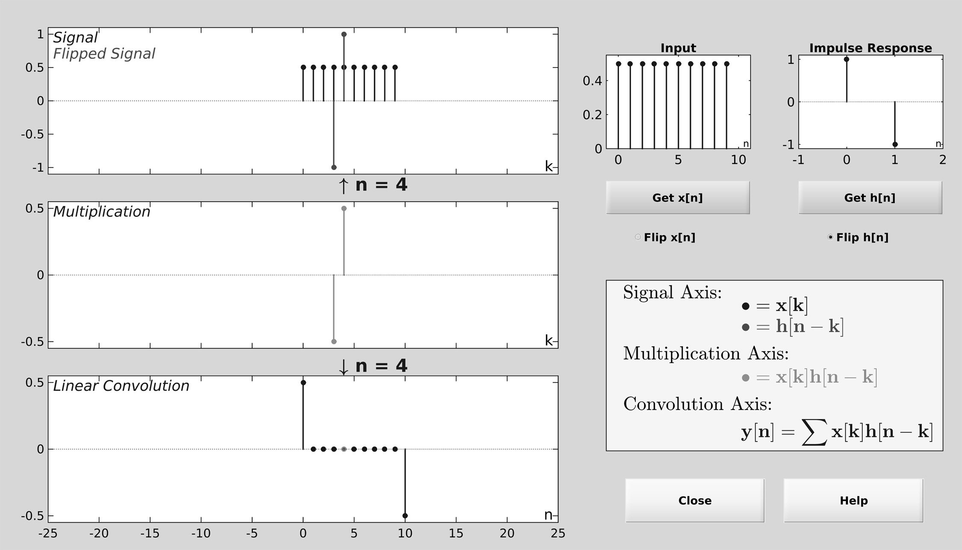
DCONVDEMO: MATLAB GUI

Slide 20
POP QUIZ
FIR Filter is “FIRST DIFFERENCE”
y[n] = x[n] - x[n -1]
Write output as a convolution
Need impulse response
Then, an equivalent way to compute the output:

Slide 21
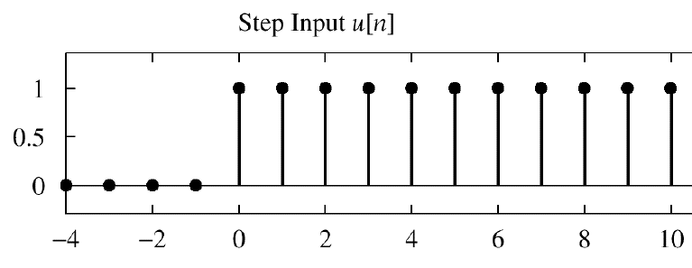
POP QUIZ
FIR Filter is “FIRST DIFFERENCE”
y[n] = x[n] - x[n-1]
INPUT is “UNIT STEP”
Find y[n] ?

Slide 22
HARDWARE STRUCTURES
INTERNAL STRUCTURE of “FILTER”
WHAT COMPONENTS ARE NEEDED?
HOW DO WE “HOOK” THEM TOGETHER?
SIGNAL FLOW GRAPH NOTATION
x[n]
FILTER
y[n]

Slide 23
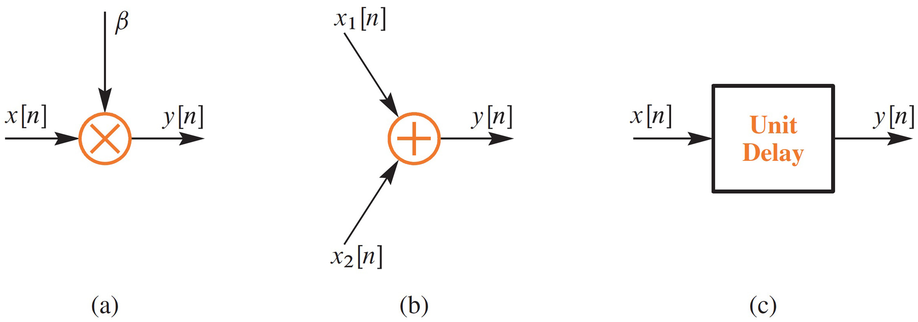
HARDWARE ATOMS
Add, Multiply & Store

Slide 24
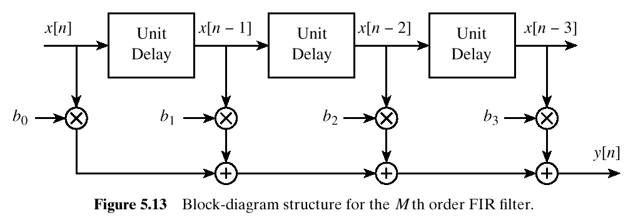
FIR STRUCTURE
Direct Form
SIGNAL
FLOW GRAPH

Slide 25
SYSTEM PROPERTIES
MATHEMATICAL DESCRIPTION
TIME-INVARIANCE
LINEARITY
CAUSALITY
“No output prior to input”
x[n]
SYSTEM
y[n]

Slide 26
TIME-INVARIANCE
IDEA:
“Time-Shifting the input will cause the same time-shift in the output”
EQUIVALENTLY,
We can prove that
The time origin (n=0) is picked arbitrary

Slide 27
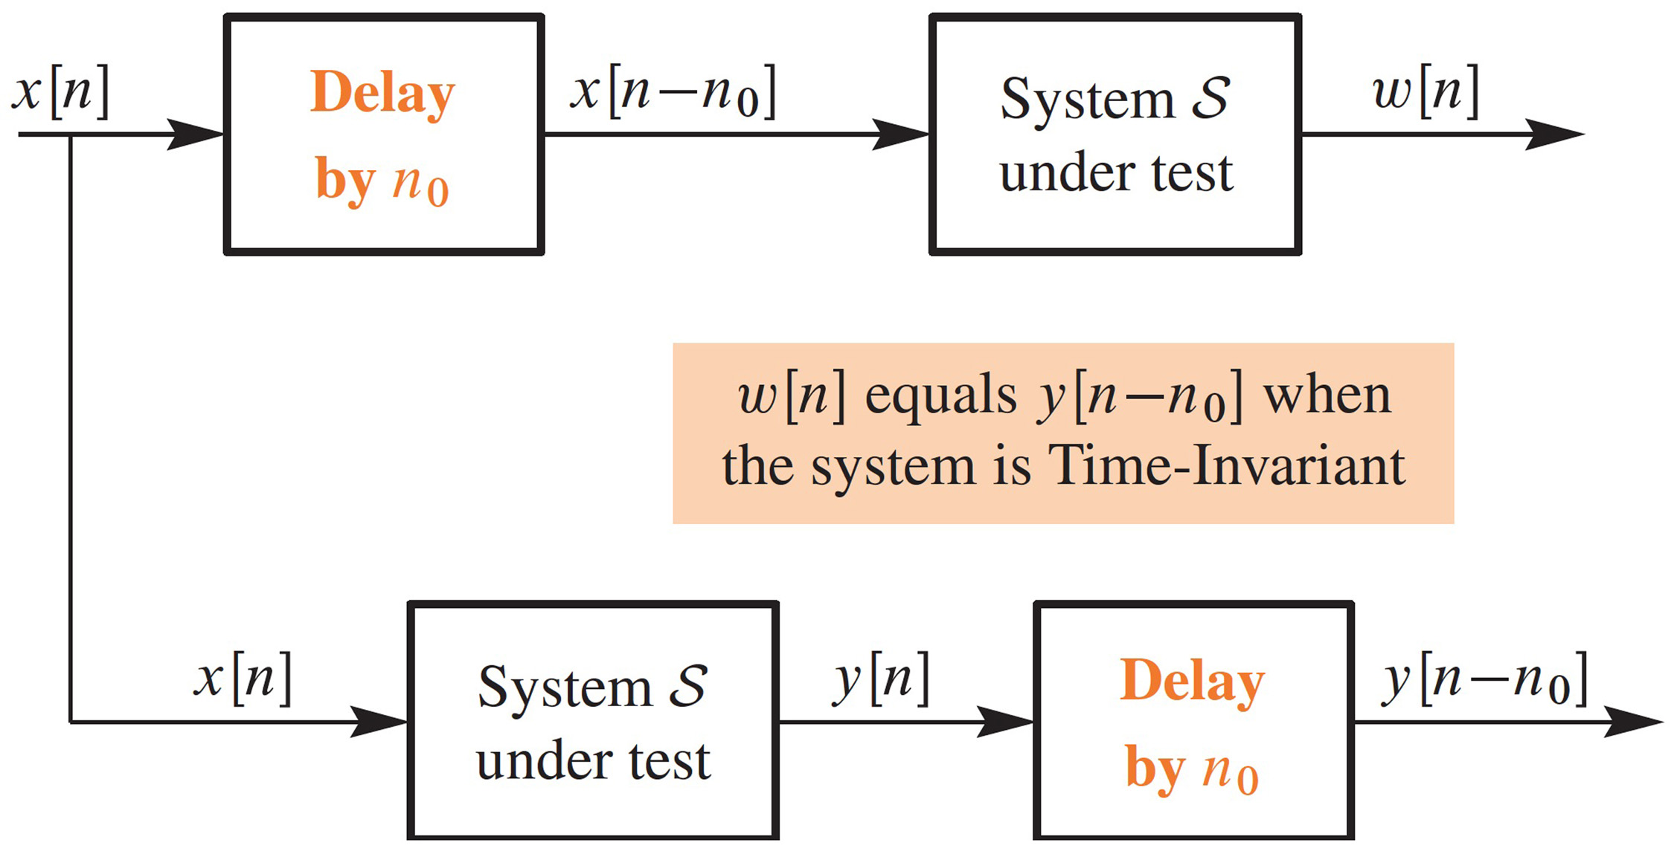
TESTING Time-Invariance

Slide 28
LINEAR SYSTEM
LINEARITY = Two Properties
SCALING
“Doubling x[n] will double y[n]”
SUPERPOSITION:
“Adding two inputs gives an output that is the sum of the individual outputs”

Slide 29
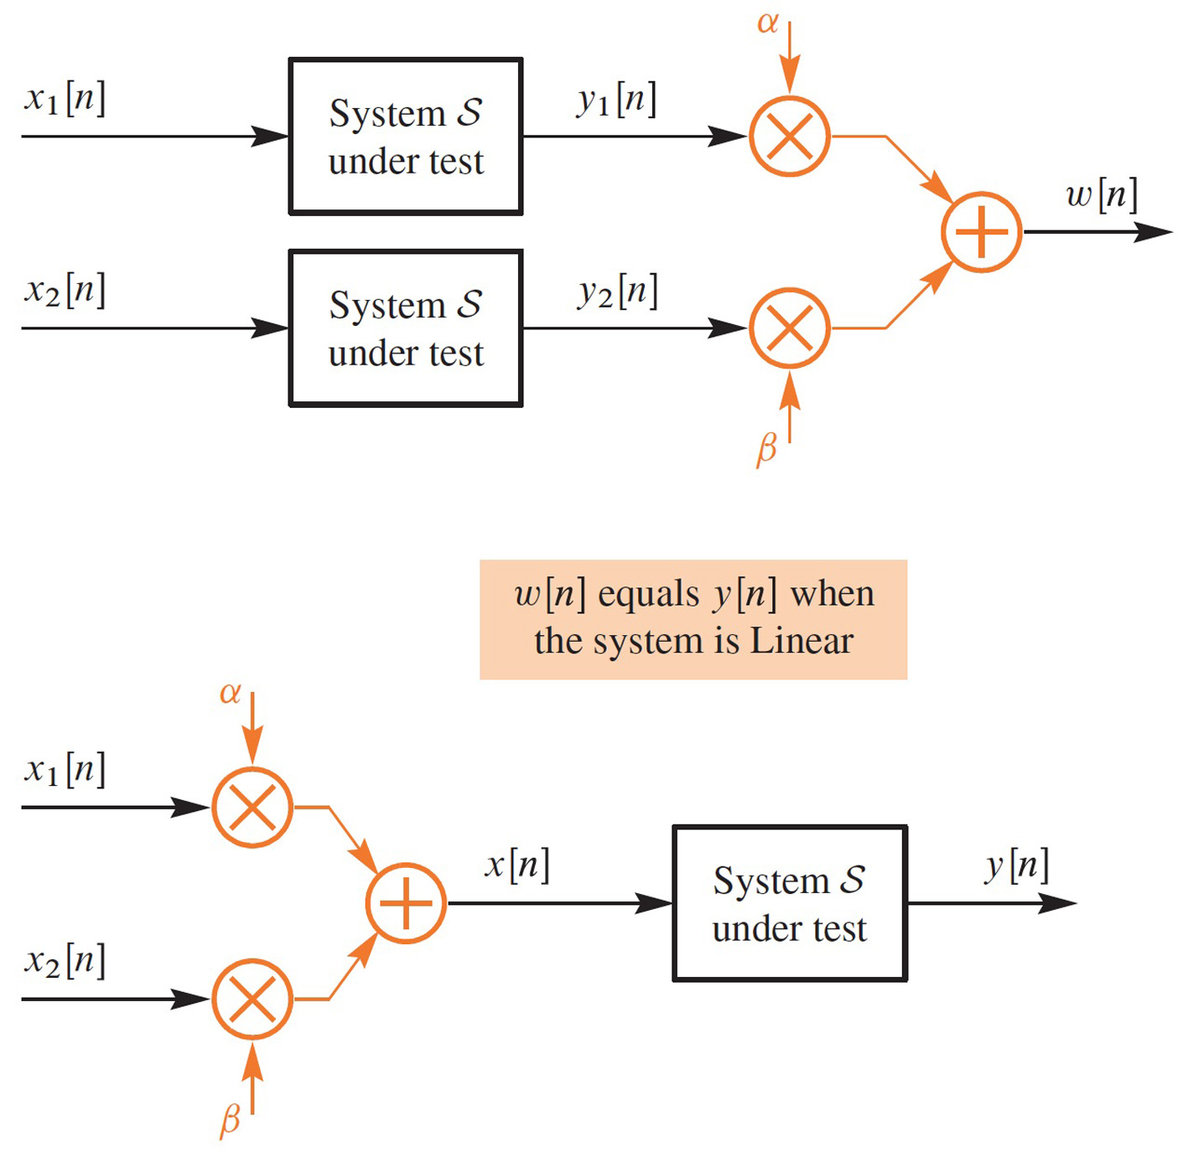
TESTING LINEARITY

Slide 30
LTI SYSTEMS
LTI: Linear & Time-Invariant
COMPLETELY CHARACTERIZED by:
IMPULSE RESPONSE h[n]
CONVOLUTION:
The “rule” defining the system can ALWAYS be re-written as convolution
FIR Example: h[n] is same as b_{k}

Slide 31
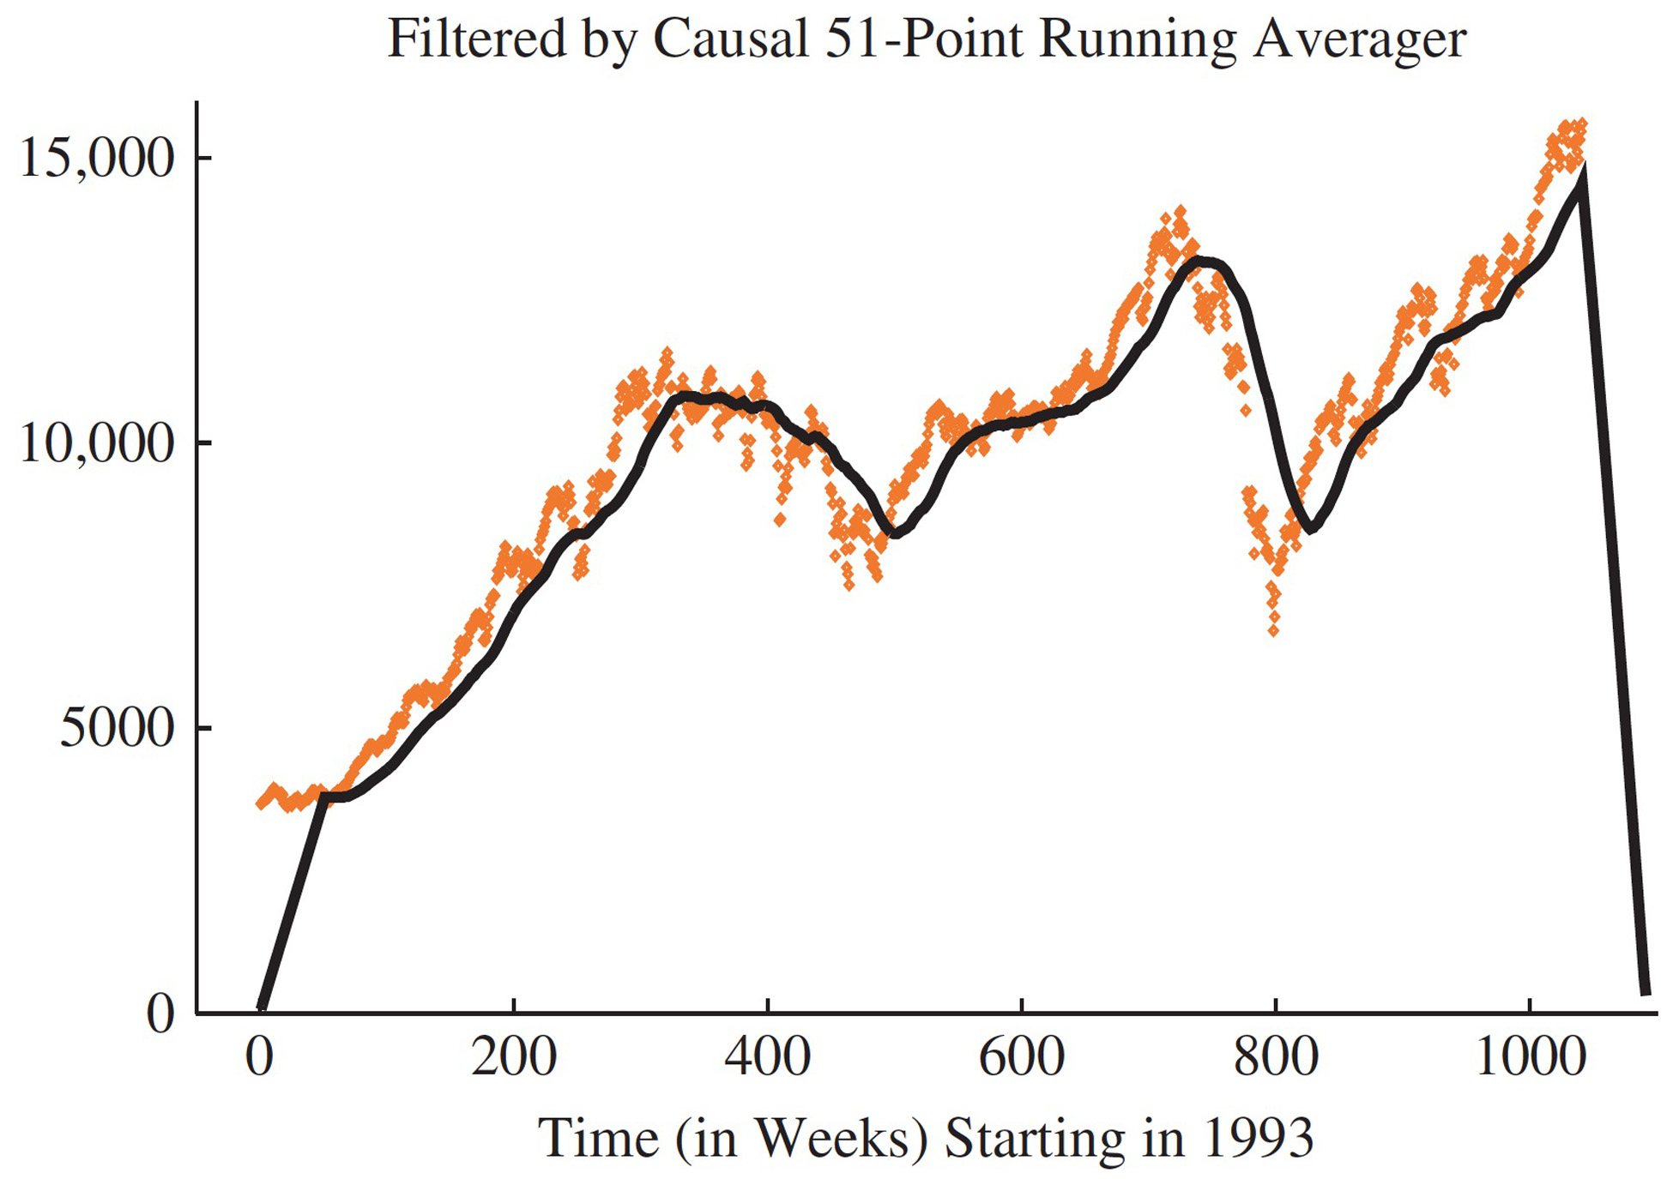
FILTER STOCK PRICES

Slide 32
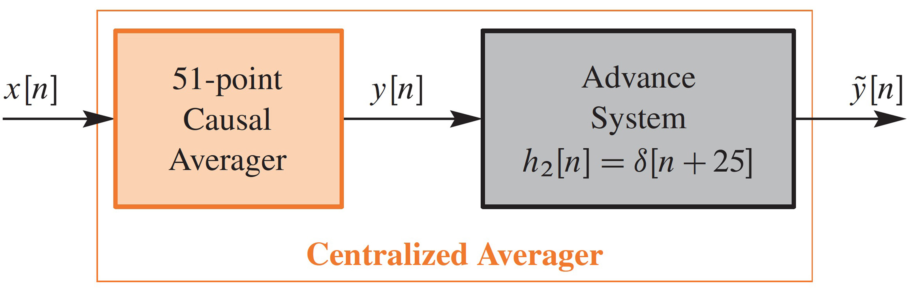
CASCADE SYSTEMS
A second FIR filter compensates for Delay

Slide 33
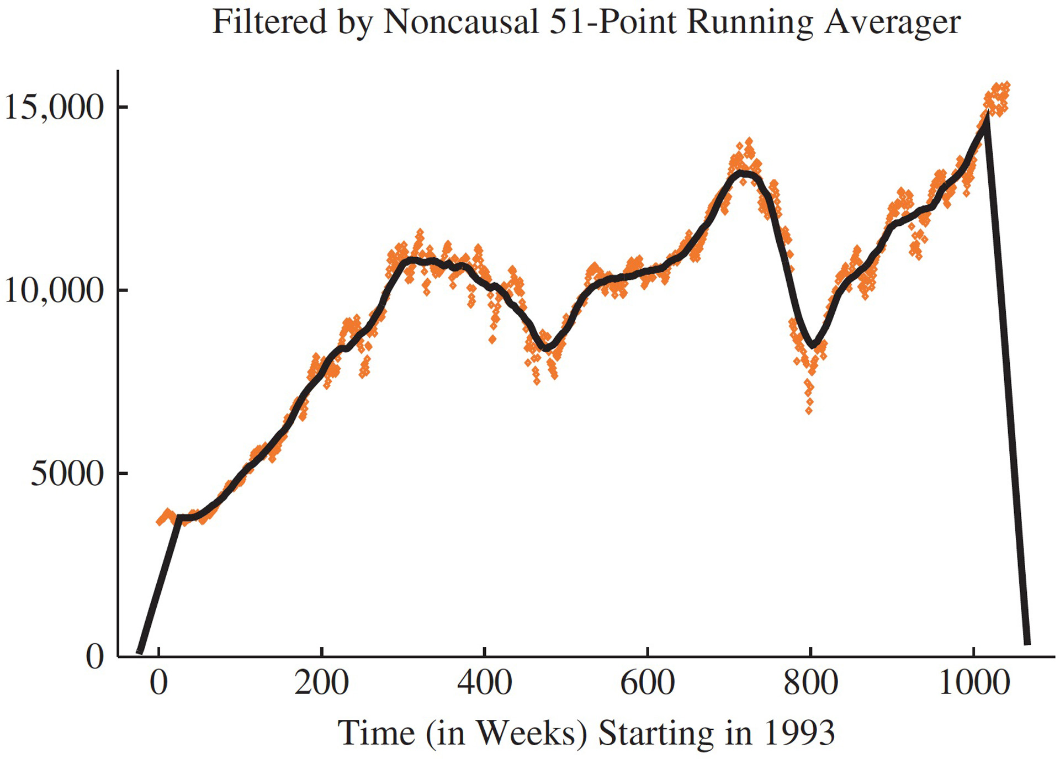
STOCK PRICES FILTERED (2)

Slide 34
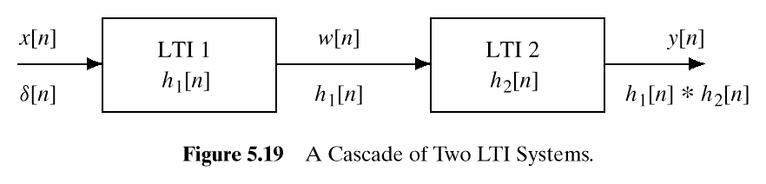
CASCADE SYSTEMS
Does the order of S₁ & S₂ matter?
NO, LTI SYSTEMS can be rearranged !!!
WHAT ARE THE FILTER COEFFS? {b_{k}}
S₁
S₂

Slide 35
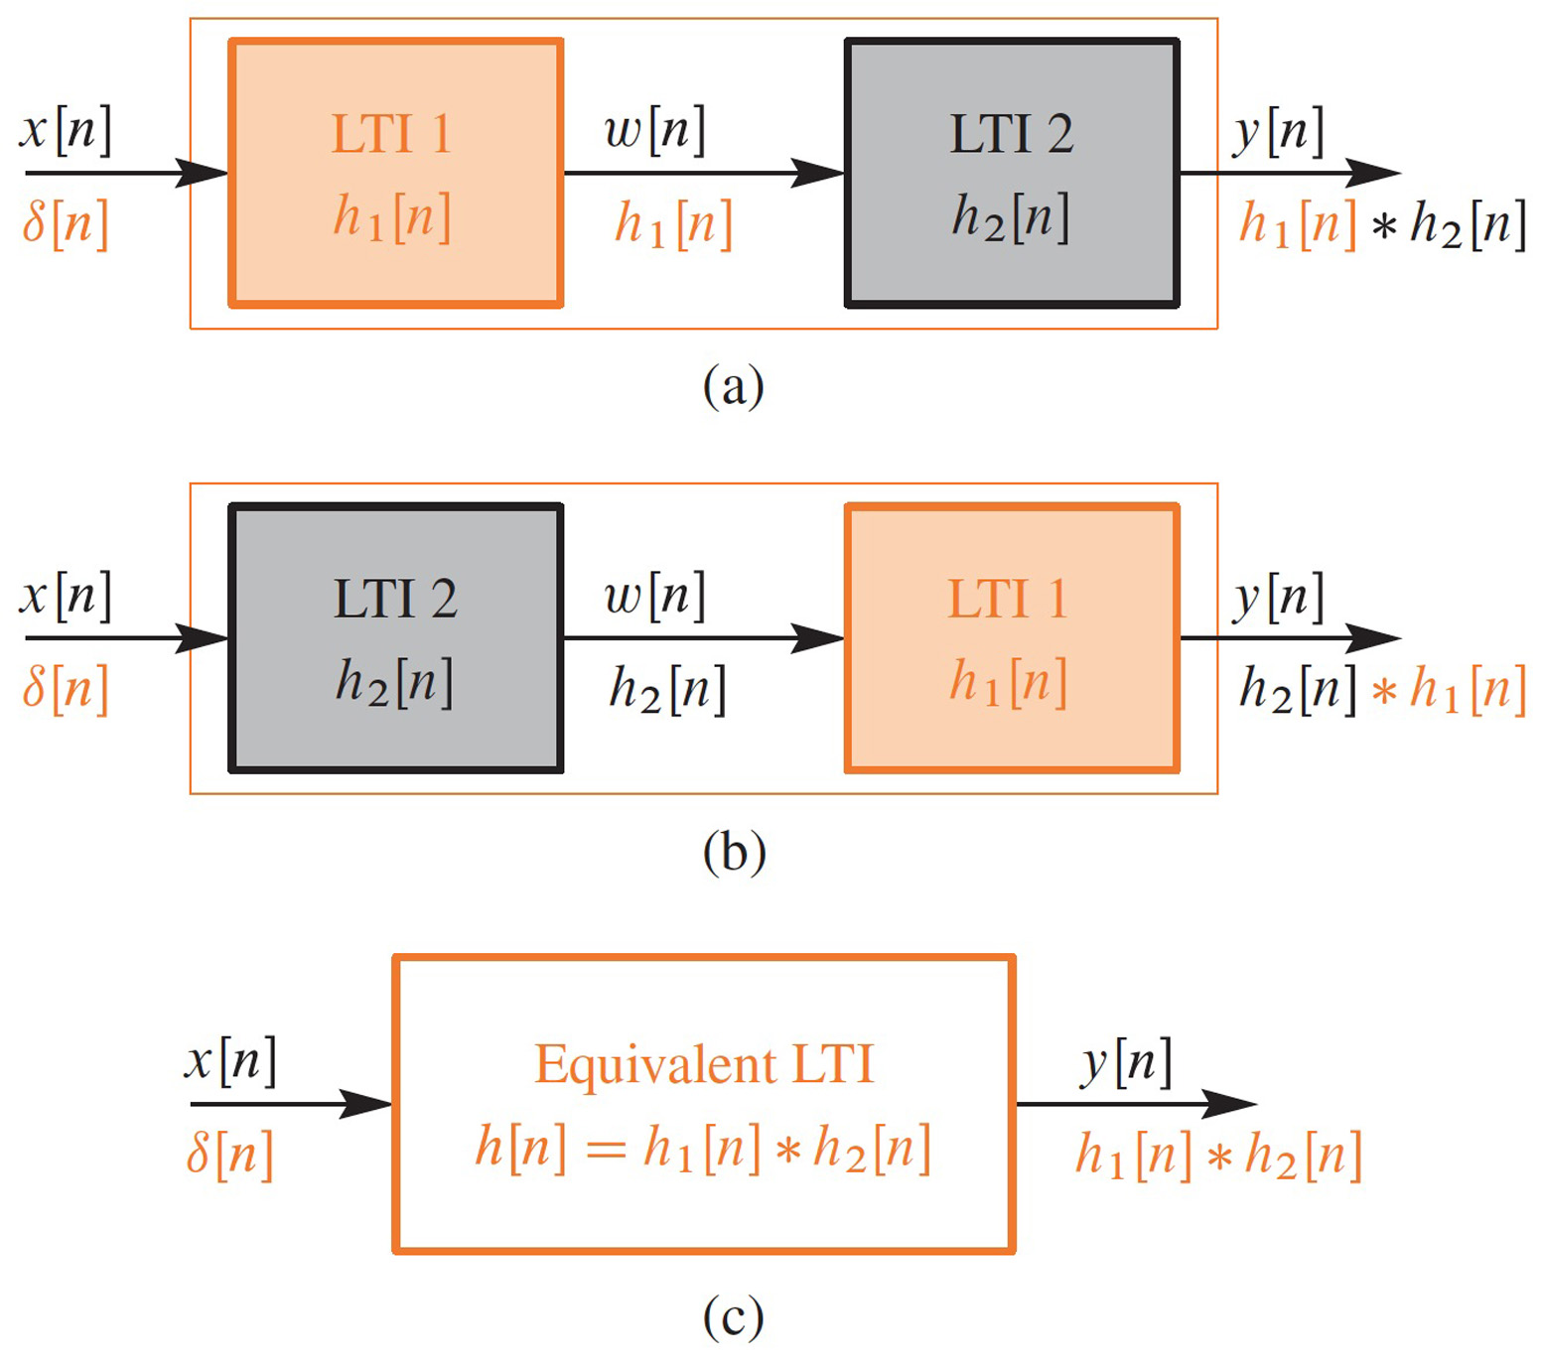
CASCADE EQUIVALENT
Find “overall” h[n] for a cascade ?
S₁
S₂
S₂
S₁

Slide 36
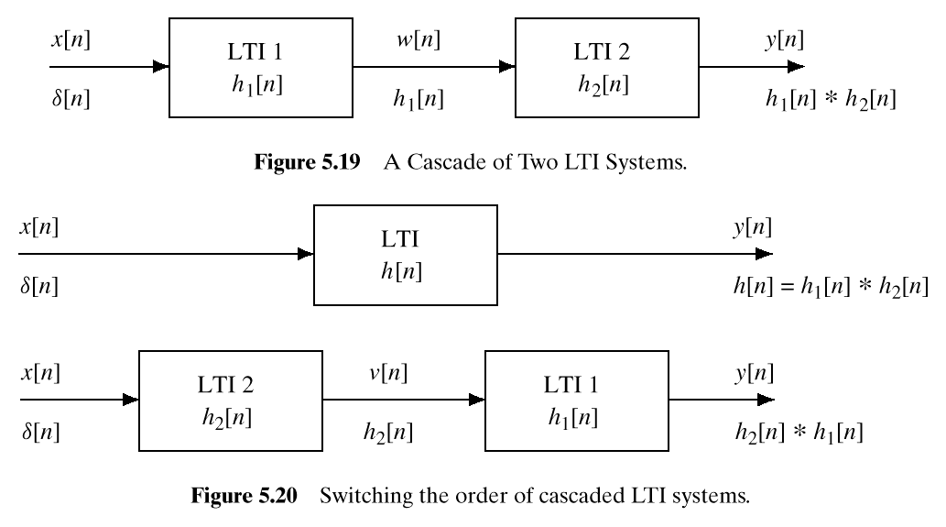
CASCADE EQUIVALENT
Find “overall” h[n] for a cascade ?
S₁
S₂
S₂
S₁

Slide 37
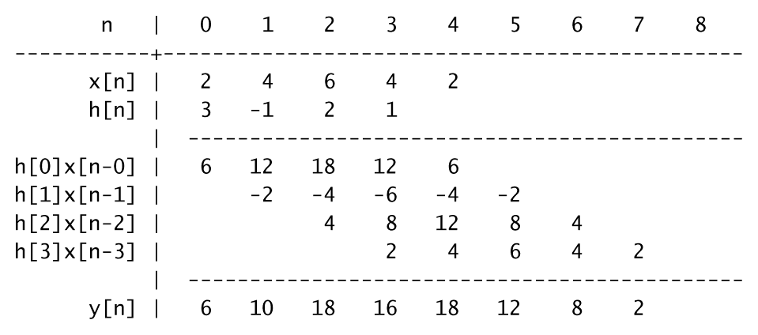
CONVOLUTION Example

Slide 38
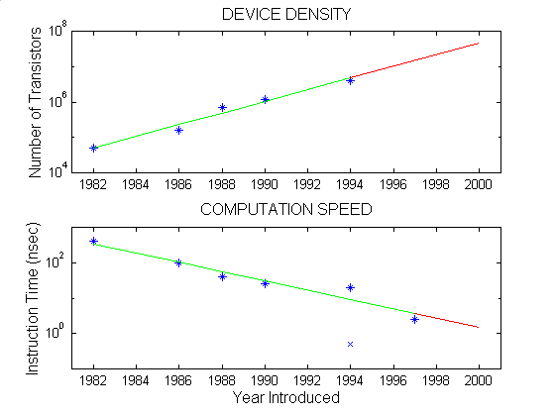
Moore’s Law for TI DSPs
LOG SCALE
Double every
18 months ?

Slide 39
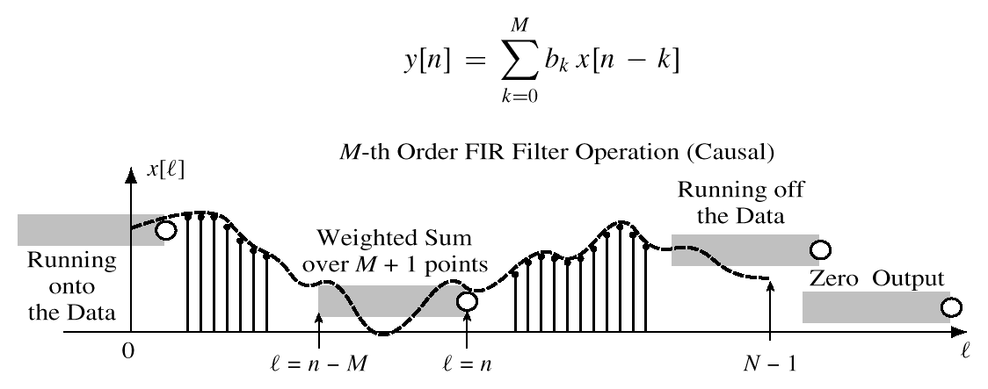
GENERAL FIR FILTER
SLIDE a Length-L WINDOW over x[n]
x[n-M]
x[n]

Slide 40
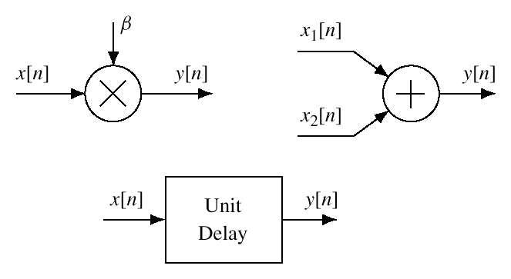
HARDWARE ATOMS
Add, Multiply & Store

Slide 41
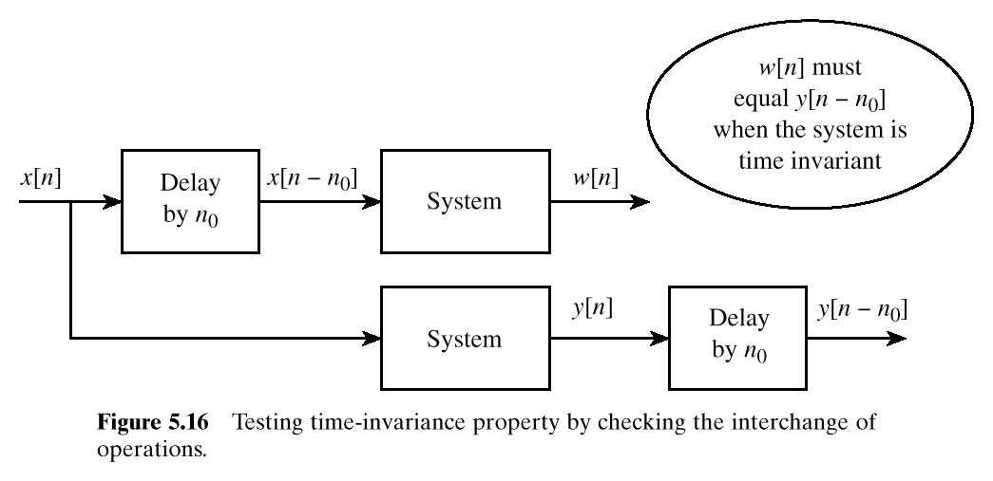
TESTING Time-Invariance

Slide 42
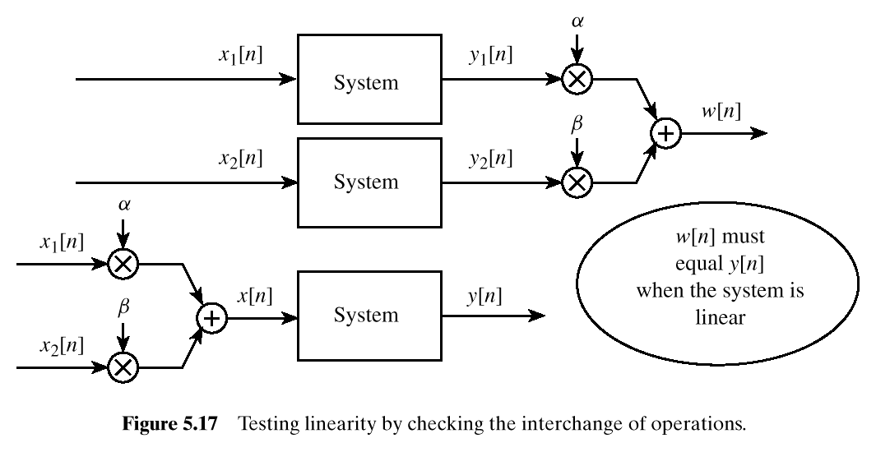
TESTING LINEARITY

Slide 43
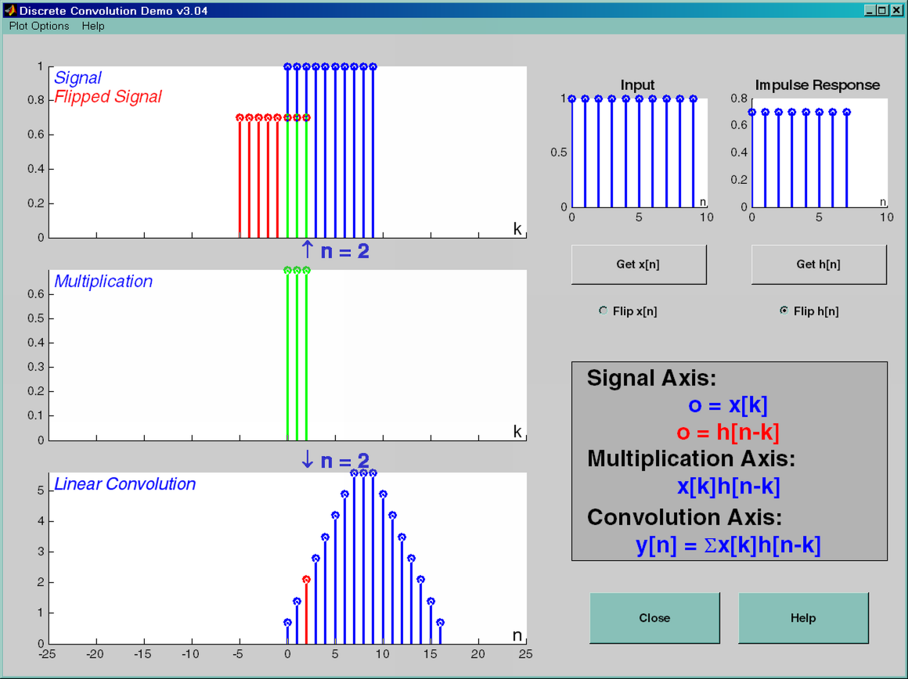
DCONVDEMO: MATLAB GUI

