Slide 1
DSP First, 2/e
Lecture 13
Frequency Response
of FIR Filters

Slide 2
License Info for DSPFirst Slides
This work released under a Creative Commons License with the following terms:
Attribution
The licensor permits others to copy, distribute, display, and perform the work. In return, licensees must give the original authors credit.
Non-Commercial
The licensor permits others to copy, distribute, display, and perform the work. In return, licensees may not use the work for commercial purposes—unless they get the licensor's permission.
Share Alike
The licensor permits others to distribute derivative works only under a license identical to the one that governs the licensor's work.
Full Text of the License
This (hidden) page should be kept with the presentation

Slide 3
READING ASSIGNMENTS
This Lecture:
Chapter 6, Sections 6-1 to 6-5
Other Reading:
Recitation
FREQUENCY RESPONSE EXAMPLES
Next Lecture: Chap. 6, Sects. 6-6, 6-7 & 6-8

Slide 4
LECTURE OBJECTIVES
SINUSOIDAL INPUT SIGNAL
DETERMINE the FIR FILTER OUTPUT
FREQUENCY RESPONSE of FIR
PLOTTING vs. Frequency
MAGNITUDE vs. Freq
PHASE vs. Freq
MAG
PHASE

Slide 5
DOMAINS: Time & Frequency
Time-Domain: “n” = time
x[n] discrete-time signal
x(t) continuous-time signal
Frequency Domain (sum of sinusoids)
Spectrum vs. f (Hz)
ANALOG vs. DIGITAL
Spectrum vs. omega-hat
Move back and forth QUICKLY

Slide 6
LTI SYSTEMS
LTI: Linear & Time-Invariant
COMPLETELY CHARACTERIZED by:
IMPULSE RESPONSE h[n]
CONVOLUTION: y[n] = x[n]*h[n]
The “rule”defining the system can ALWAYS be re-written as convolution
FIR Example: h[n] is same as b_{k}

Slide 7
POP QUIZ
FIR Filter is “FIRST DIFFERENCE”
y[n] = x[n] - x[n-1]
Write output as a convolution
Need impulse response
Then, another way to compute the output:

Slide 8
DIGITAL “FILTERING”
x(t)
A-to-D
x[n]
FILTER
y[n]
D-to-A
y(t)
CONCENTRATE on the SPECTRUM
SINUSOIDAL INPUT
INPUT x[n] = SUM of SINUSOIDS
Then, OUTPUT y[n] = SUM of SINUSOIDS

Slide 9
FILTERING EXAMPLE
7-point AVERAGER
Removes cosine
By making its amplitude (A) smaller
3-point AVERAGER
Changes A slightly

Slide 10
FILTERING EXAMPLES
3-point AVERAGER
7-point AVERAGER

Slide 11
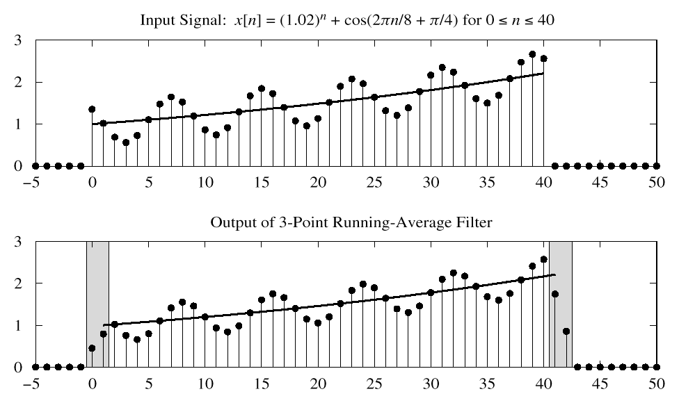
3-pt AVG EXAMPLE
USE PAST VALUES

Slide 12
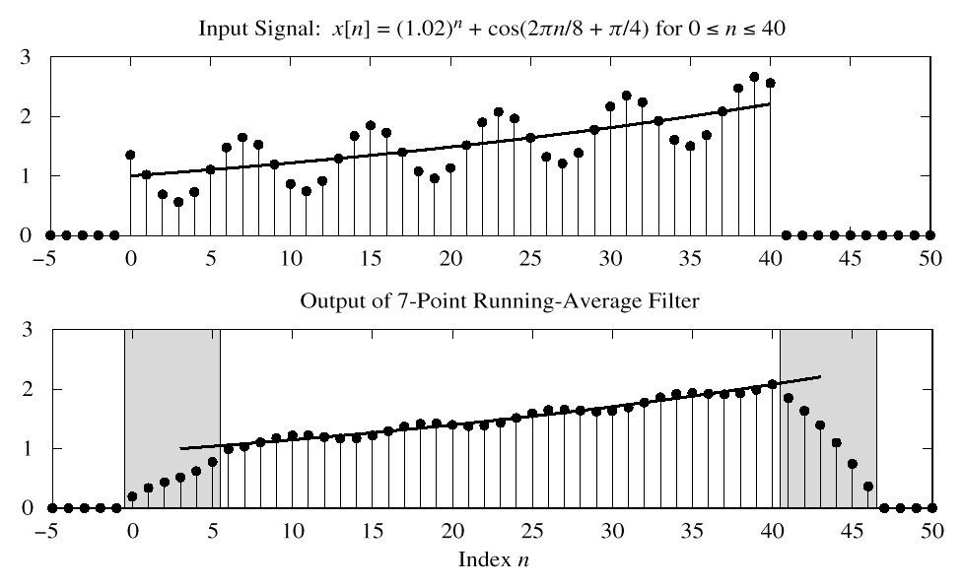
7-pt FIR EXAMPLE (AVG)
CAUSAL: Use Previous
LONGER OUTPUT

Slide 13
SINUSOIDAL RESPONSE
INPUT: x[n] = SINUSOID
OUTPUT: y[n] will also be a SINUSOID
Different Amplitude and Phase
SAME Frequency
AMPLITUDE & PHASE CHANGE
Called the FREQUENCY RESPONSE

Slide 14
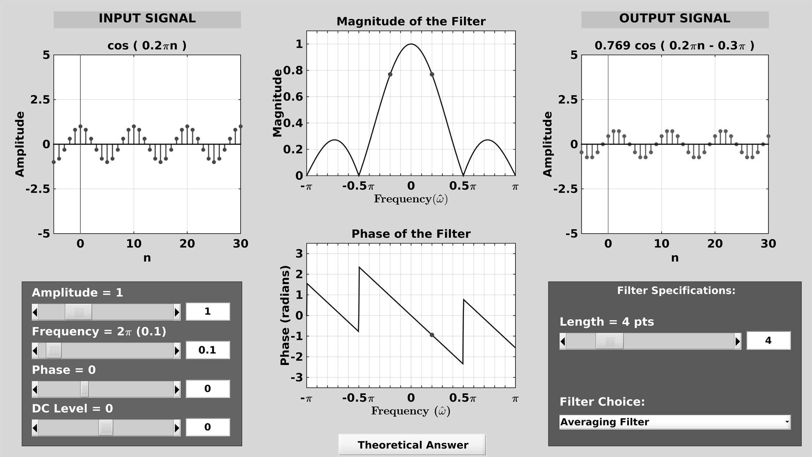
DCONVDEMO: MATLAB GUI

Slide 15
COMPLEX EXPONENTIAL
x[n] is the input signal—a complex exponential
FIR DIFFERENCE EQUATION

Slide 16
COMPLEX EXP OUTPUT
Use the FIR “Difference Equation”

Slide 17
FREQUENCY RESPONSE
At each frequency, we can DEFINE
FREQUENCY
RESPONSE
Complex-valued formula
Has MAGNITUDE vs. frequency
And PHASE vs. frequency
Notation:

Slide 18
EXAMPLE 6.1
EXPLOIT
SYMMETRY

Slide 19
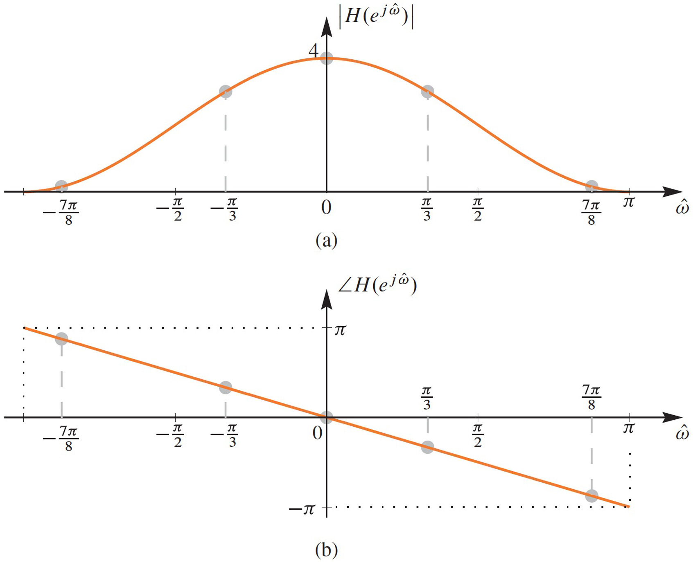
PLOT of FREQ RESPONSE
RESPONSE at π/3

Slide 20
EXAMPLE 6.2
x[n]
y[n]

Slide 21
EXAMPLE 6.2 (answer)

Slide 22
EXAMPLE: COSINE INPUT
x[n]
y[n]

Slide 23
EX: COSINE INPUT
Use
Linearity

Slide 24
EX: COSINE INPUT (ans-2)

Slide 25
MATLAB: FREQUENCY RESPONSE
HH = freqz(bb,1,ww)
VECTOR bb contains Filter Coefficients
SP-First: HH = freekz(bb,1,ww)
FILTER COEFFICIENTS {b_{k}}

Slide 26
LTI SYSTEMS
LTI: Linear & Time-Invariant
COMPLETELY CHARACTERIZED by:
FREQUENCY RESPONSE, or
IMPULSE RESPONSE h[n]
Sinusoid IN -----> Sinusoid OUT
At the SAME Frequency

Slide 27
Time & Frequency Relation
Get Frequency Response from h[n]
Here is the FIR case:
IMPULSE RESPONSE

Slide 28
BLOCK DIAGRAMS
Equivalent Representations
x[n]
y[n]
x[n]
y[n]

Slide 29
UNIT-DELAY SYSTEM
x[n]
y[n]
x[n]
y[n]

Slide 30
FIRST DIFFERENCE SYSTEM
x[n]
y[n]
x[n]
y[n]

Slide 31
DLTI Demo with Sinusoids
FILTER
= y[n]
x[n]

Slide 32
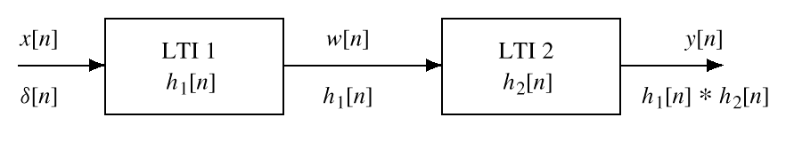
CASCADE SYSTEMS
Does the order of S₁ & S₂ matter?
NO, LTI SYSTEMS can be rearranged !!!
WHAT ARE THE FILTER COEFFS? {b_{k}}
WHAT is the overall FREQUENCY RESPONSE ?
S₁
S₂

Slide 33
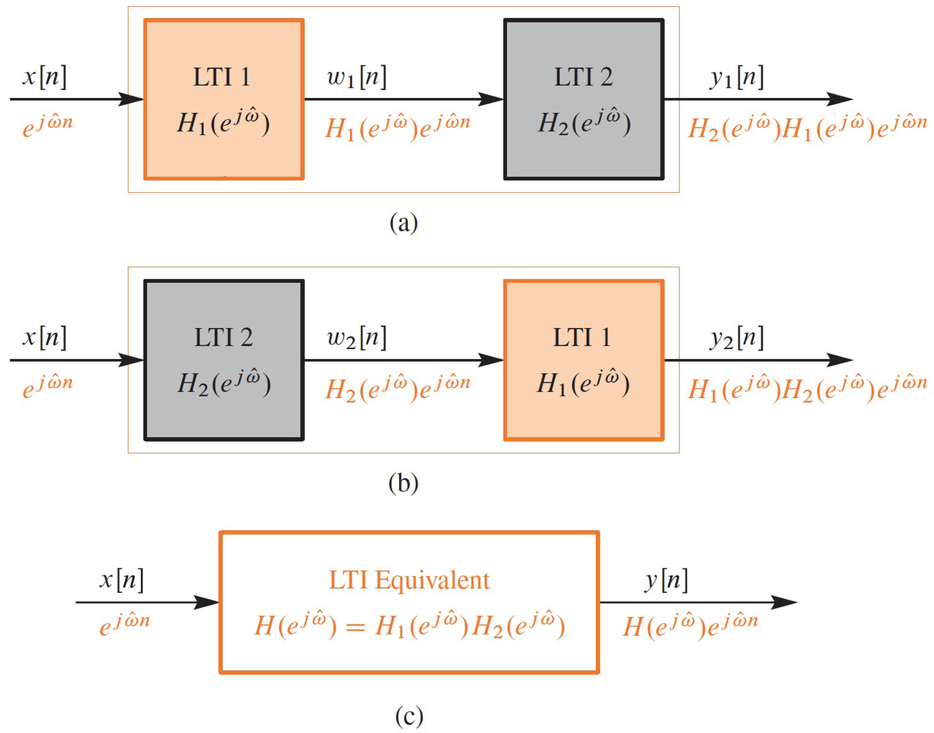
CASCADE EQUIVALENT

Slide 34
CASCADE EQUIVALENT
MULTIPLY the Frequency Responses
x[n]
y[n]
x[n]
y[n]
EQUIVALENT
SYSTEM

Slide 35
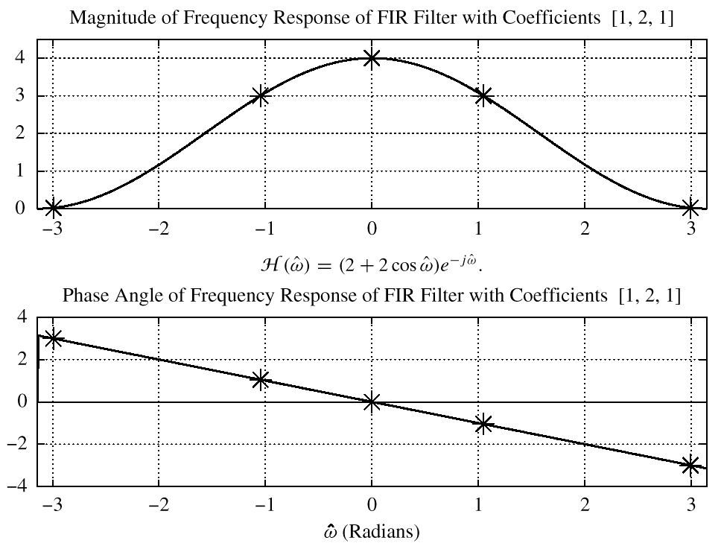
PLOT of FREQ RESPONSE
RESPONSE at π/3

Slide 36
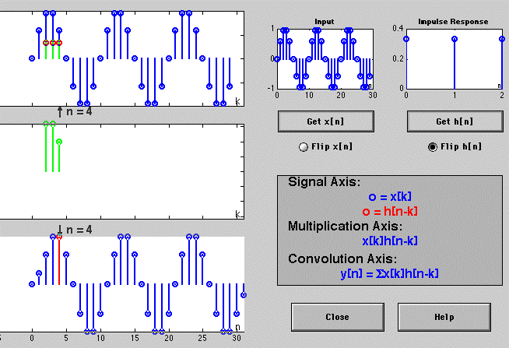
DCONVDEMO: MATLAB GUI

Slide 37
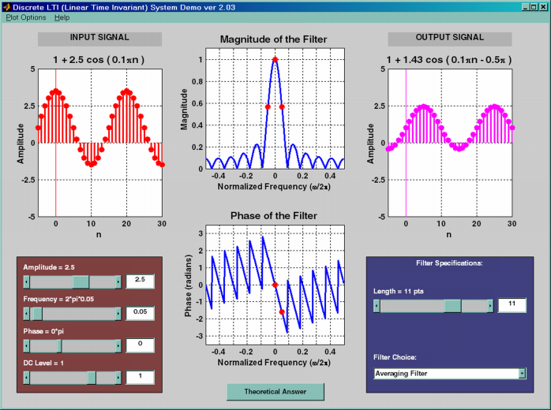
DLTI Demo with Sinusoids
x[n]
y[n]
FILTER

