Slide 1
DSP First, 2/e
Lecture 14
Digital Filtering
of Analog Signals

Slide 2
License Info for DSPFirst Slides
This work released under a Creative Commons License with the following terms:
Attribution
The licensor permits others to copy, distribute, display, and perform the work. In return, licensees must give the original authors credit.
Non-Commercial
The licensor permits others to copy, distribute, display, and perform the work. In return, licensees may not use the work for commercial purposes—unless they get the licensor's permission.
Share Alike
The licensor permits others to distribute derivative works only under a license identical to the one that governs the licensor's work.
Full Text of the License
This (hidden) page should be kept with the presentation

Slide 3
READING ASSIGNMENTS
This Lecture:
Chapter 6, Sections 6-6, 6-7 & 6-8
Next Lecture: Chapter 7 (DTFT)

Slide 4
LECTURE OBJECTIVES
Two Domains: Time & Frequency
Track the spectrum of x[n] thru an FIR Filter: Sinusoid-IN gives Sinusoid-OUT
UNIFICATION: How does the Frequency Response affect x(t) to produce y(t) ?
x(t)
A-to-D
x[n]
y[n]
D-to-A
y(t)
FIR

Slide 5
TIME & FREQUENCY
FIR DIFFERENCE EQUATION is the TIME-DOMAIN

Slide 6
FIRST DIFFERENCE SYSTEM
x[n]
y[n]
x[n]
y[n]

Slide 7
Ex: DELAY by 2 SYSTEM
x[n]
y[n]
x[n]
y[n]

Slide 8
DELAY by 2 SYSTEM
x[n]
y[n]
x[n]
y[n]
k = 2 ONLY

Slide 9
GENERAL DELAY PROPERTY
ONLY ONE
non-ZERO TERM
for k at k = n_{d}

Slide 10
FREQ DOMAIN → TIME ??
START with
x[n]
y[n]
x[n]
y[n]

Slide 11
FREQ DOMAIN --> TIME
EULER’s Formula

Slide 12
PREVIOUS LECTURE REVIEW
SINUSOIDAL INPUT SIGNAL
OUTPUT has SAME FREQUENCY
DIFFERENT Amplitude and Phase
FREQUENCY RESPONSE of FIR
MAGNITUDE vs. Frequency
PHASE vs. Freq
PLOTTING
MAG
PHASE

Slide 13
FREQ. RESPONSE PLOTS
DENSE GRID (ww) from -π to +π
ww = -pi:(pi/100):pi;
HH = freqz(bb,1,ww)
VECTOR bb contains Filter Coefficients
SP-First: HH = freekz(bb,1,ww)

Slide 14
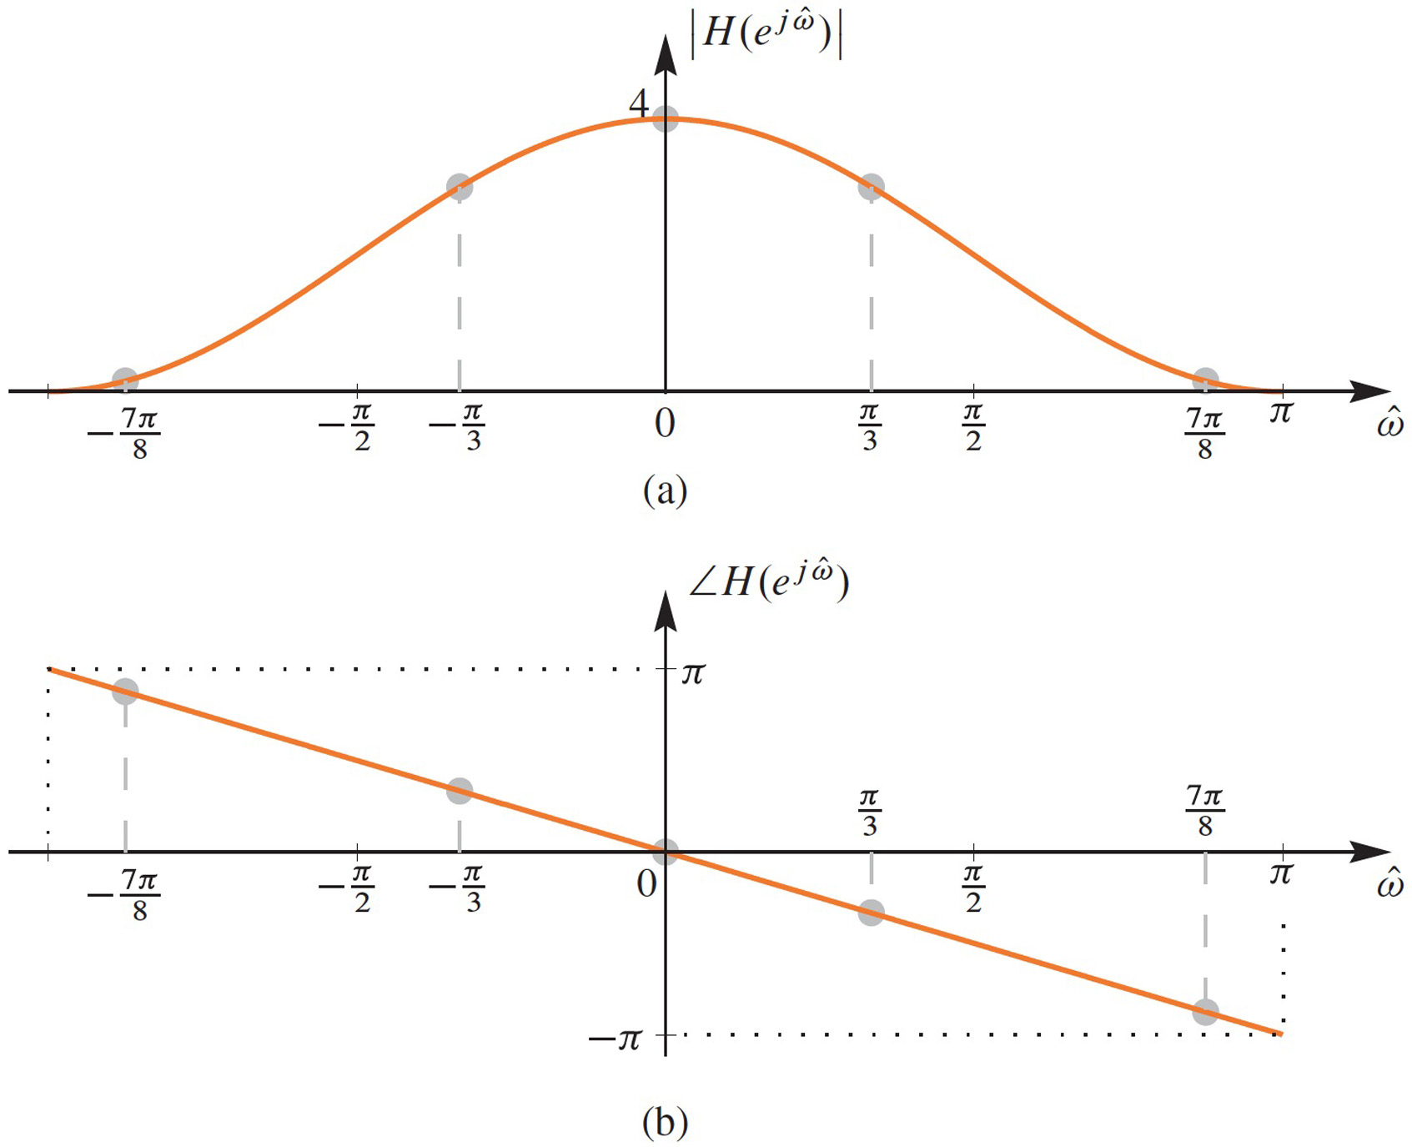
PLOT of FREQ RESPONSE

Slide 15
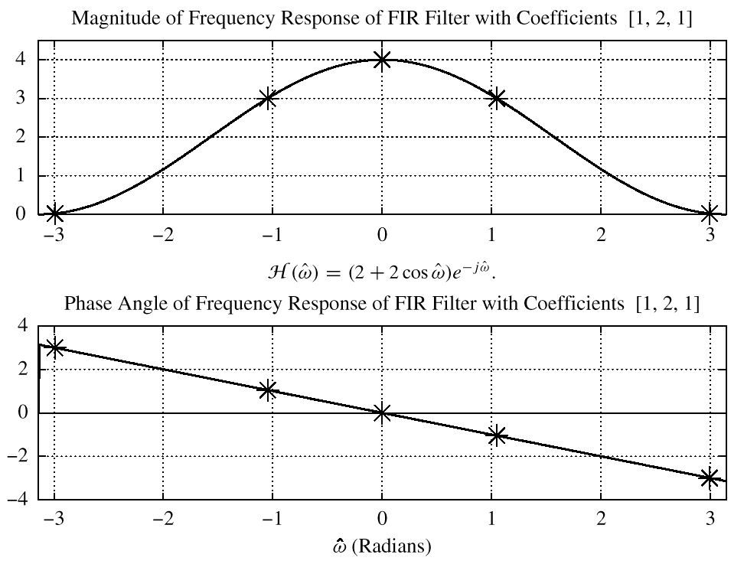
PLOT of FREQ RESPONSE
RESPONSE at π/3

Slide 16
EXAMPLE 6.2
x[n]
y[n]

Slide 17
PLOT of FREQ RESPONSE
RESPONSE at π/3

Slide 18
EXAMPLE 6.2 (answer)

Slide 19
EXAMPLE: COSINE INPUT
x[n]
y[n]

Slide 20
EX: COSINE INPUT (ans-1)

Slide 21
EX: COSINE INPUT (ans-2)

Slide 22
SINUSOID thru FIR
IF
Multiply the Magnitudes
Add the Phases
When b_{k}’s are real valued

Slide 23
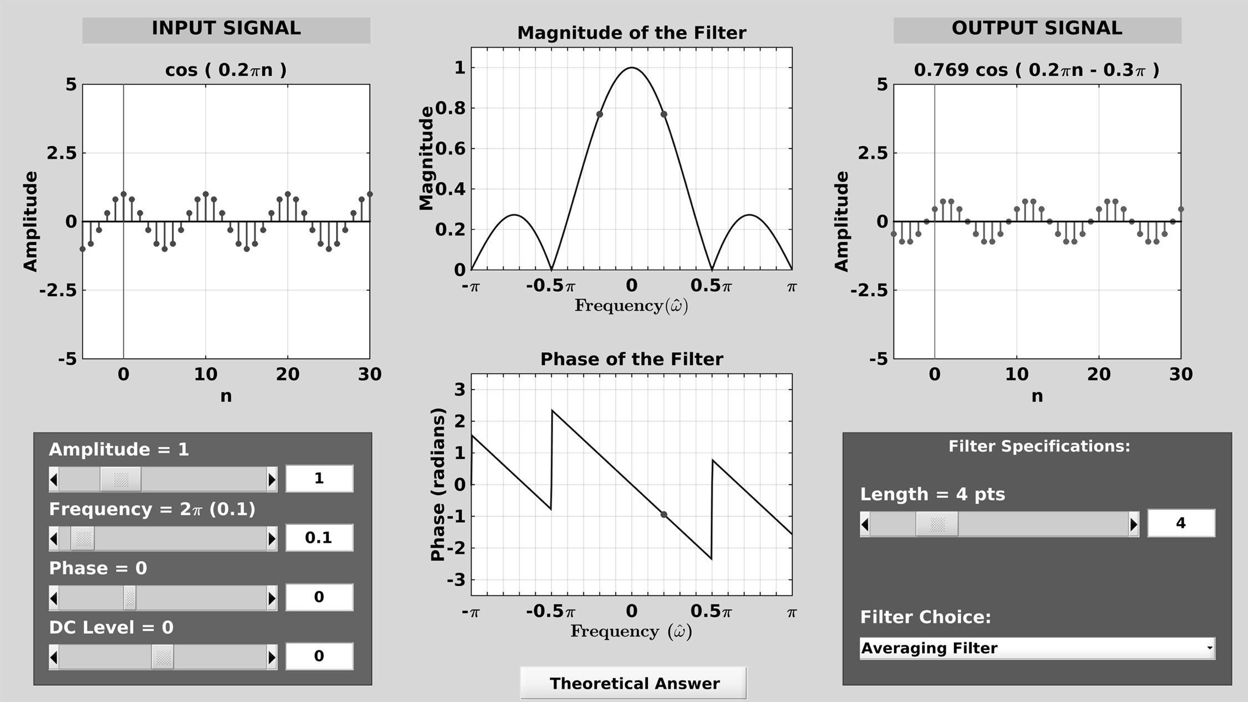
DLTI Demo with Sinusoids
FILTER
= y[n]
x[n]

Slide 24
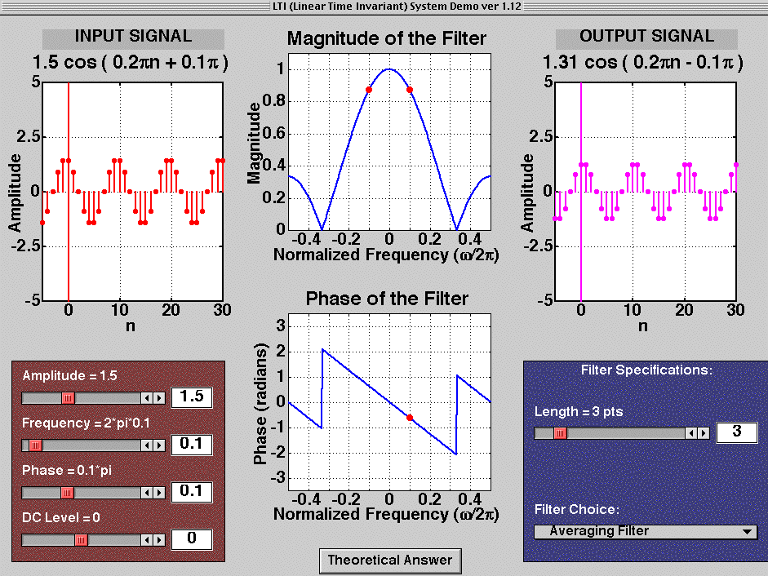
LTI Demo with Sinusoids
y[n]
x[n]
FILTER

Slide 25
DIGITAL “FILTERING”
x(t)
A-to-D
x[n]
y[n]
D-to-A
y(t)
SPECTRUM of x(t) (SUM of SINUSOIDS)
SPECTRUM of x[n] (ALIASING a PROBLEM?)
SPECTRUM y[n] (FIR Gain or Nulls)
Then, OUTPUT y(t) = SUM of SINUSOIDS
Question: how to characterize the effects of a digital filter on the analog signals? Answer: Frequency Scaling

Slide 26
FREQUENCY SCALING
TIME SAMPLING:
IF NO ALIASING:
FREQUENCY SCALING
x(t)
A-to-D
x[n]
y[n]
D-to-A
y(t)

Slide 27
11-pt Running Sum Example
x(t)
A-to-D
x[n]
y[n]
D-to-A
y(t)
250 Hz
25 Hz
?

Slide 28
11-pt AVERAGER Example
x(t)
A-to-D
x[n]
y[n]
D-to-A
y(t)
250 Hz
25 Hz
?

Slide 29
D-A FREQUENCY SCALING
x(t)
A-to-D
x[n]
y[n]
D-to-A
y(t)
TIME SAMPLING:
RECONSTRUCT up to 0.5f_{s}
FREQUENCY SCALING

Slide 30
TRACK the FREQUENCIES
x(t)
A-to-D
x[n]
y[n]
D-to-A
y(t)
250 Hz
25 Hz
0.5π
.05π
0.5π
.05π
250 Hz
25 Hz
Fs = 1000 Hz
NO new freqs

Slide 31
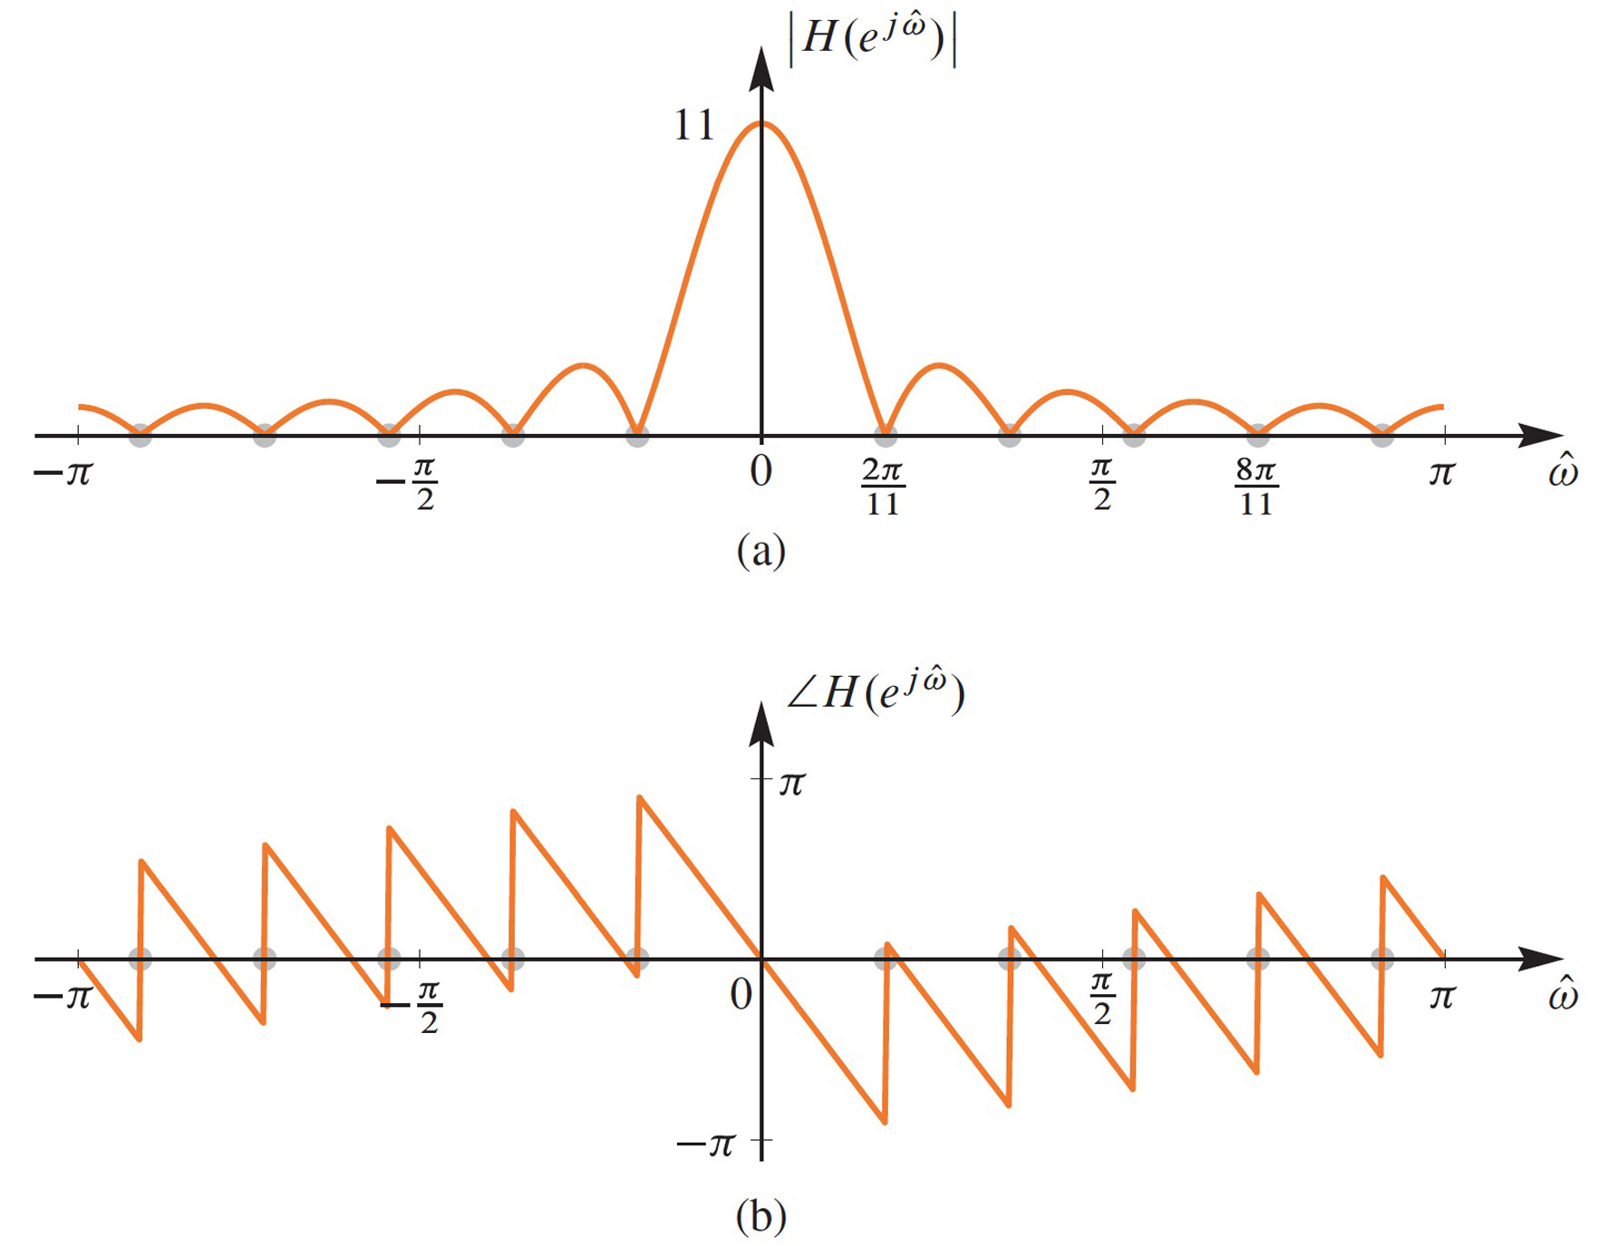
11-pt Running Sum
NULLS or ZEROS

Slide 32
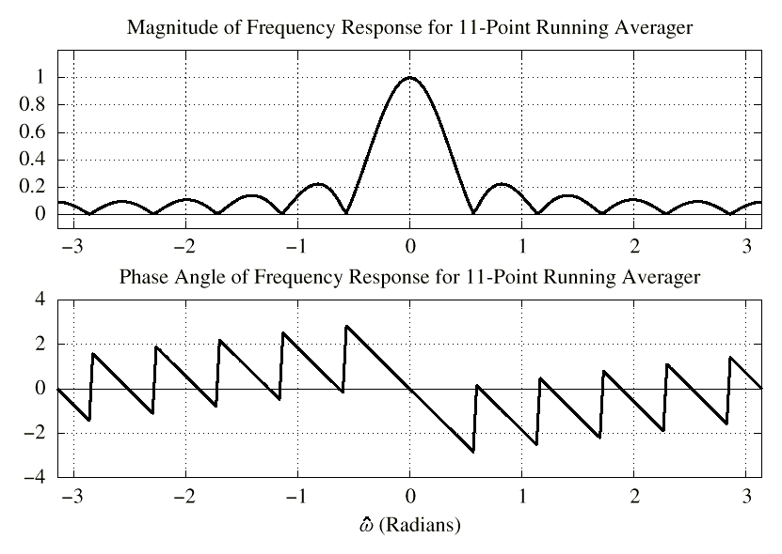
11-pt AVERAGER
NULLS or ZEROS

Slide 33
EVALUATE Freq. Response

Slide 34
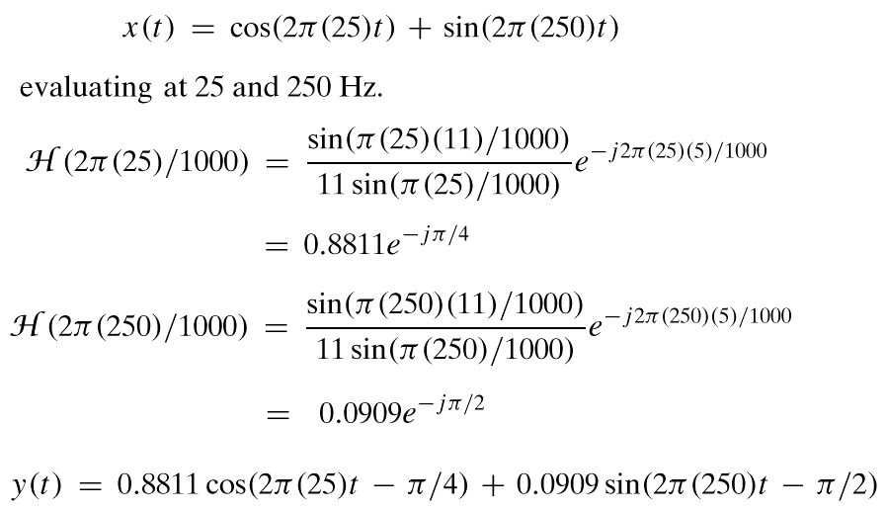
EVALUATE Freq. Response
MAG SCALE
f_{s} = 1000
PHASE CHANGE

Slide 35
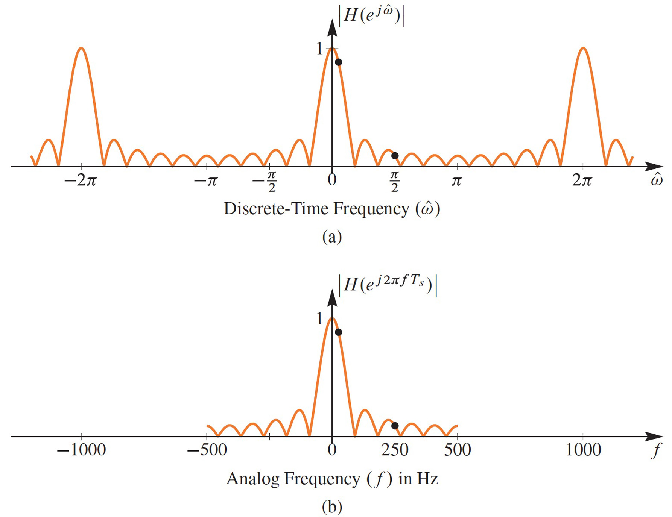
DIGITAL FILTER
EFFECTIVE RESPONSE
LOW-PASS FILTER

Slide 36
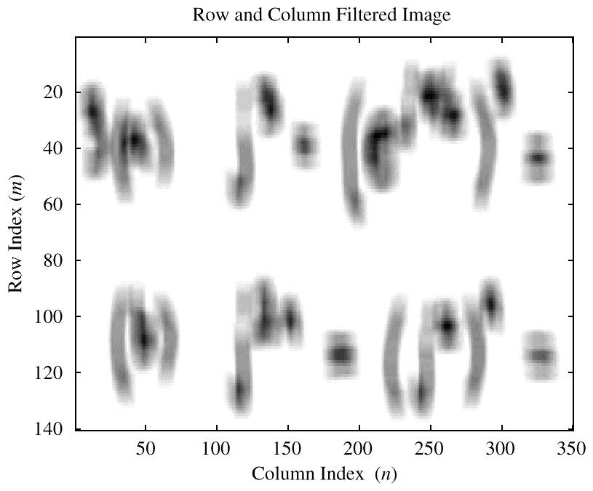
FILTER TYPES
LOW-PASS FILTER (LPF)
BLURRING
ATTENUATES HIGH FREQUENCIES
HIGH-PASS FILTER (HPF)
SHARPENING for IMAGES
BOOSTS THE HIGHS
REMOVES DC
BAND-PASS FILTER
(BPF)

Slide 37
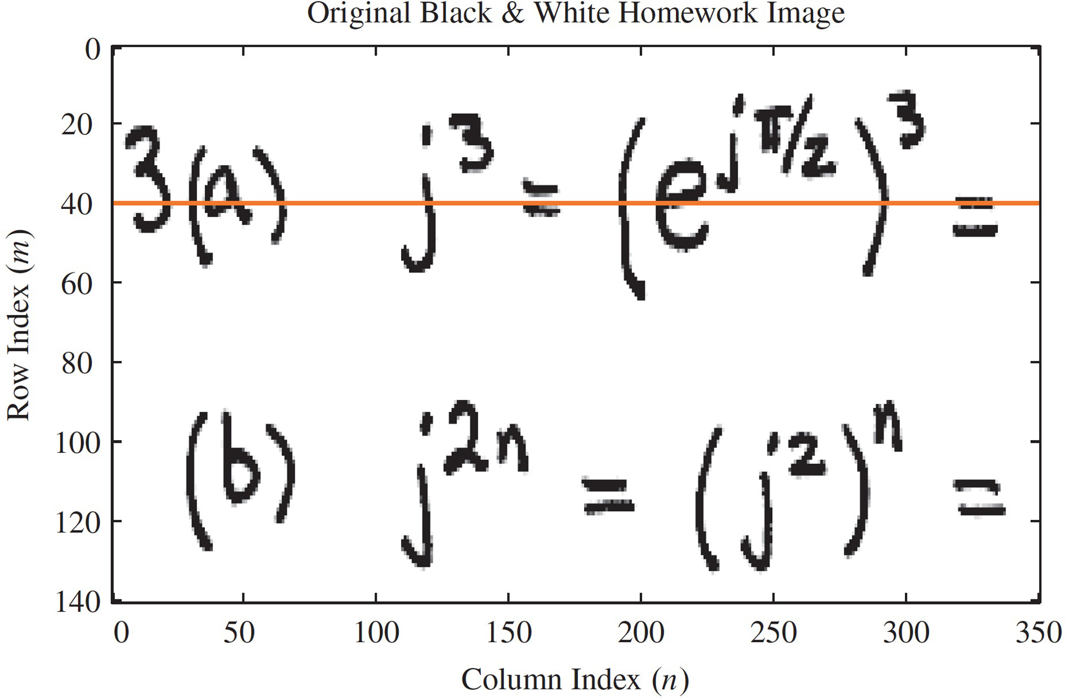
B & W IMAGE

Slide 38
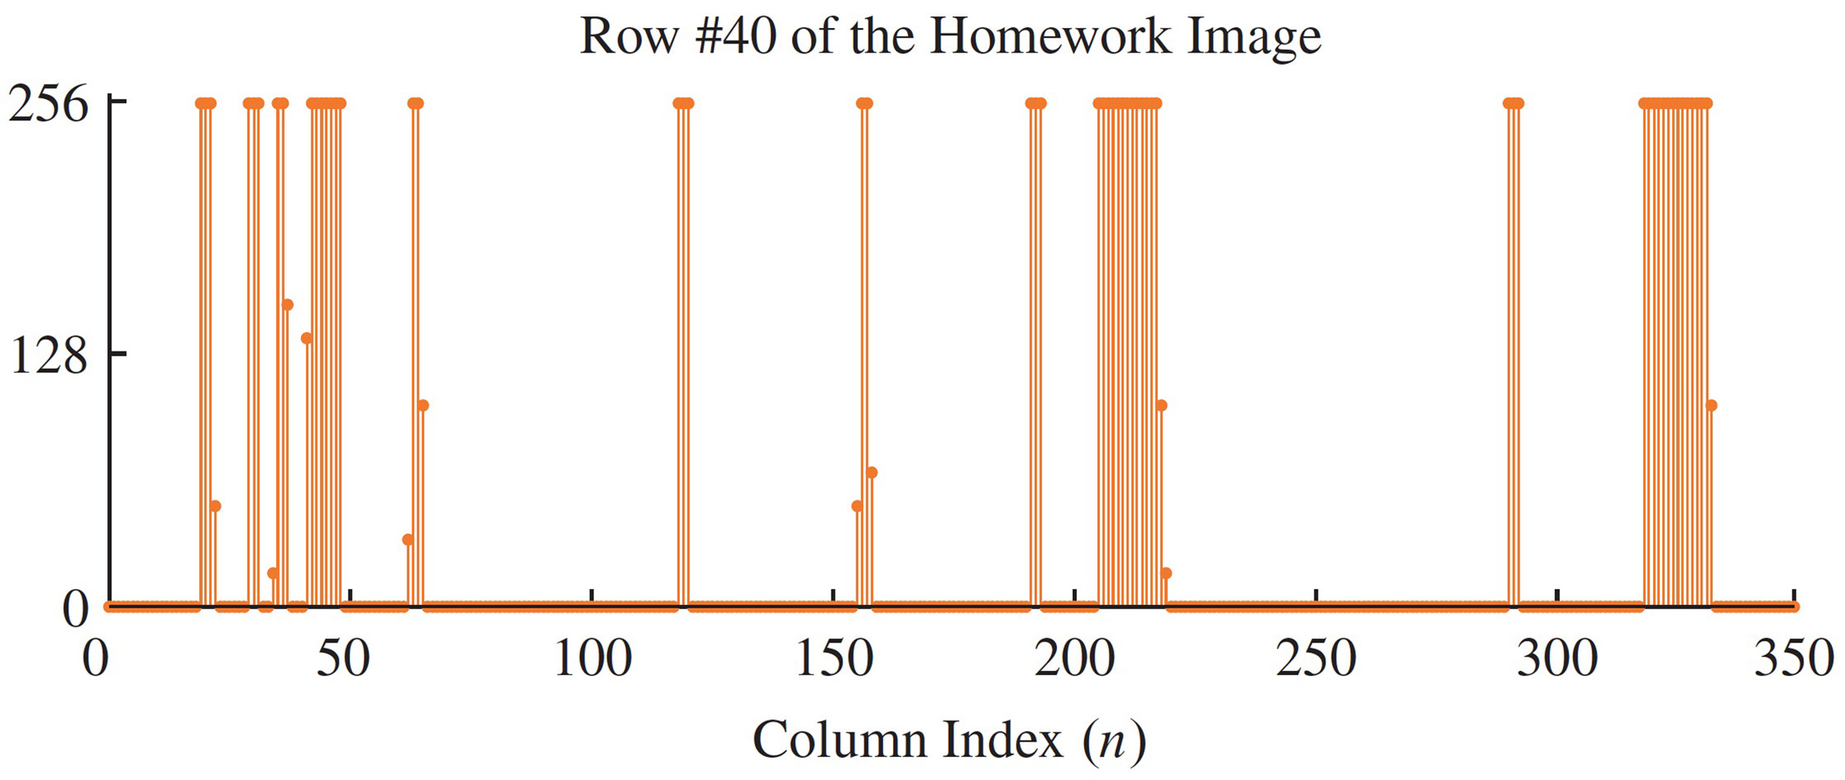
ROW of B&W IMAGE
BLACK = 255
WHITE = 0

Slide 39
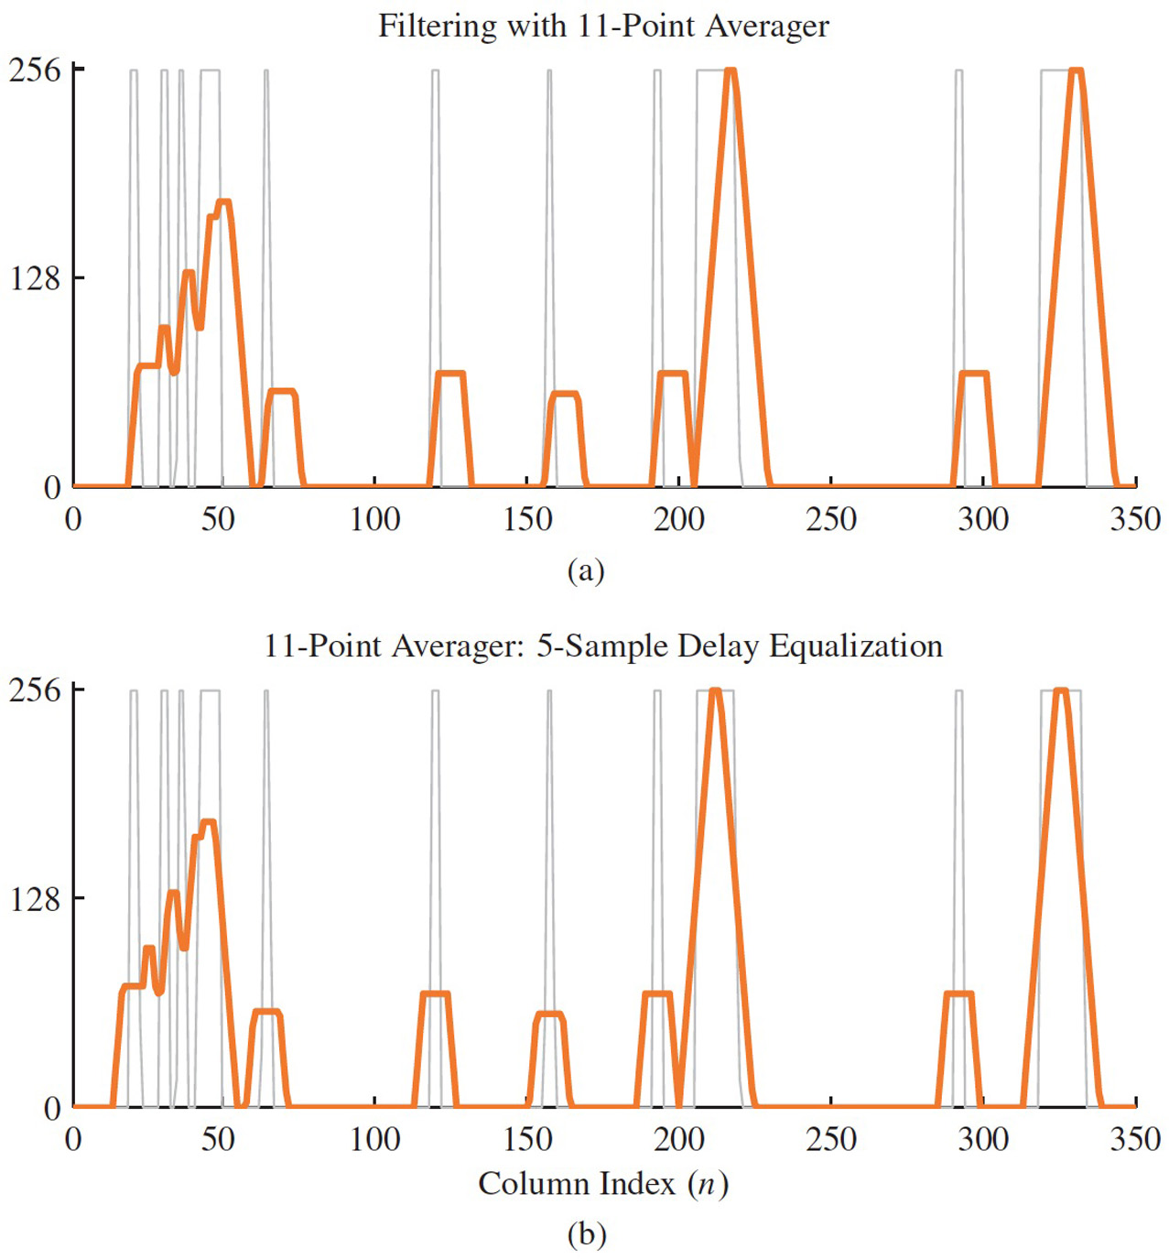
FILTERED ROW of IMAGE
Original is gray
Filtered is orange
DELAY adjusted
by 5 samples

Slide 40
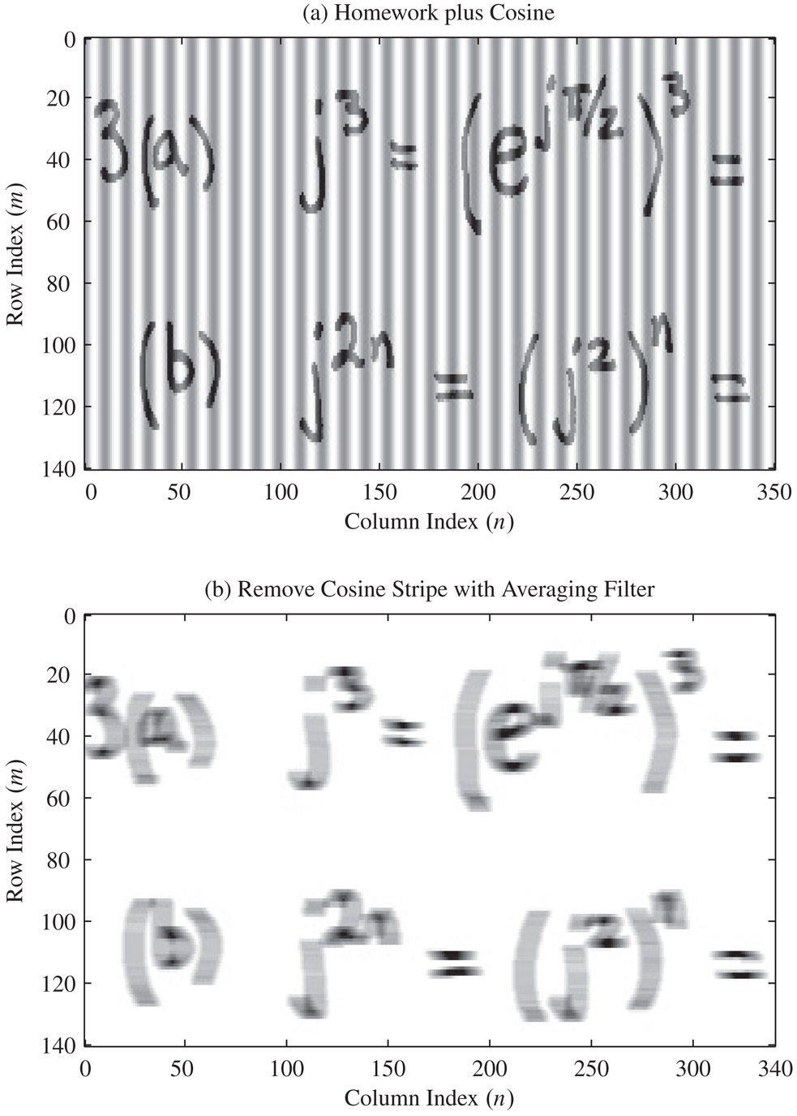
IMAGE with COSINE ADDED
FILTERED
with 11-pt running average
across horizontal dimension
→ yields horizontal blur

Slide 41
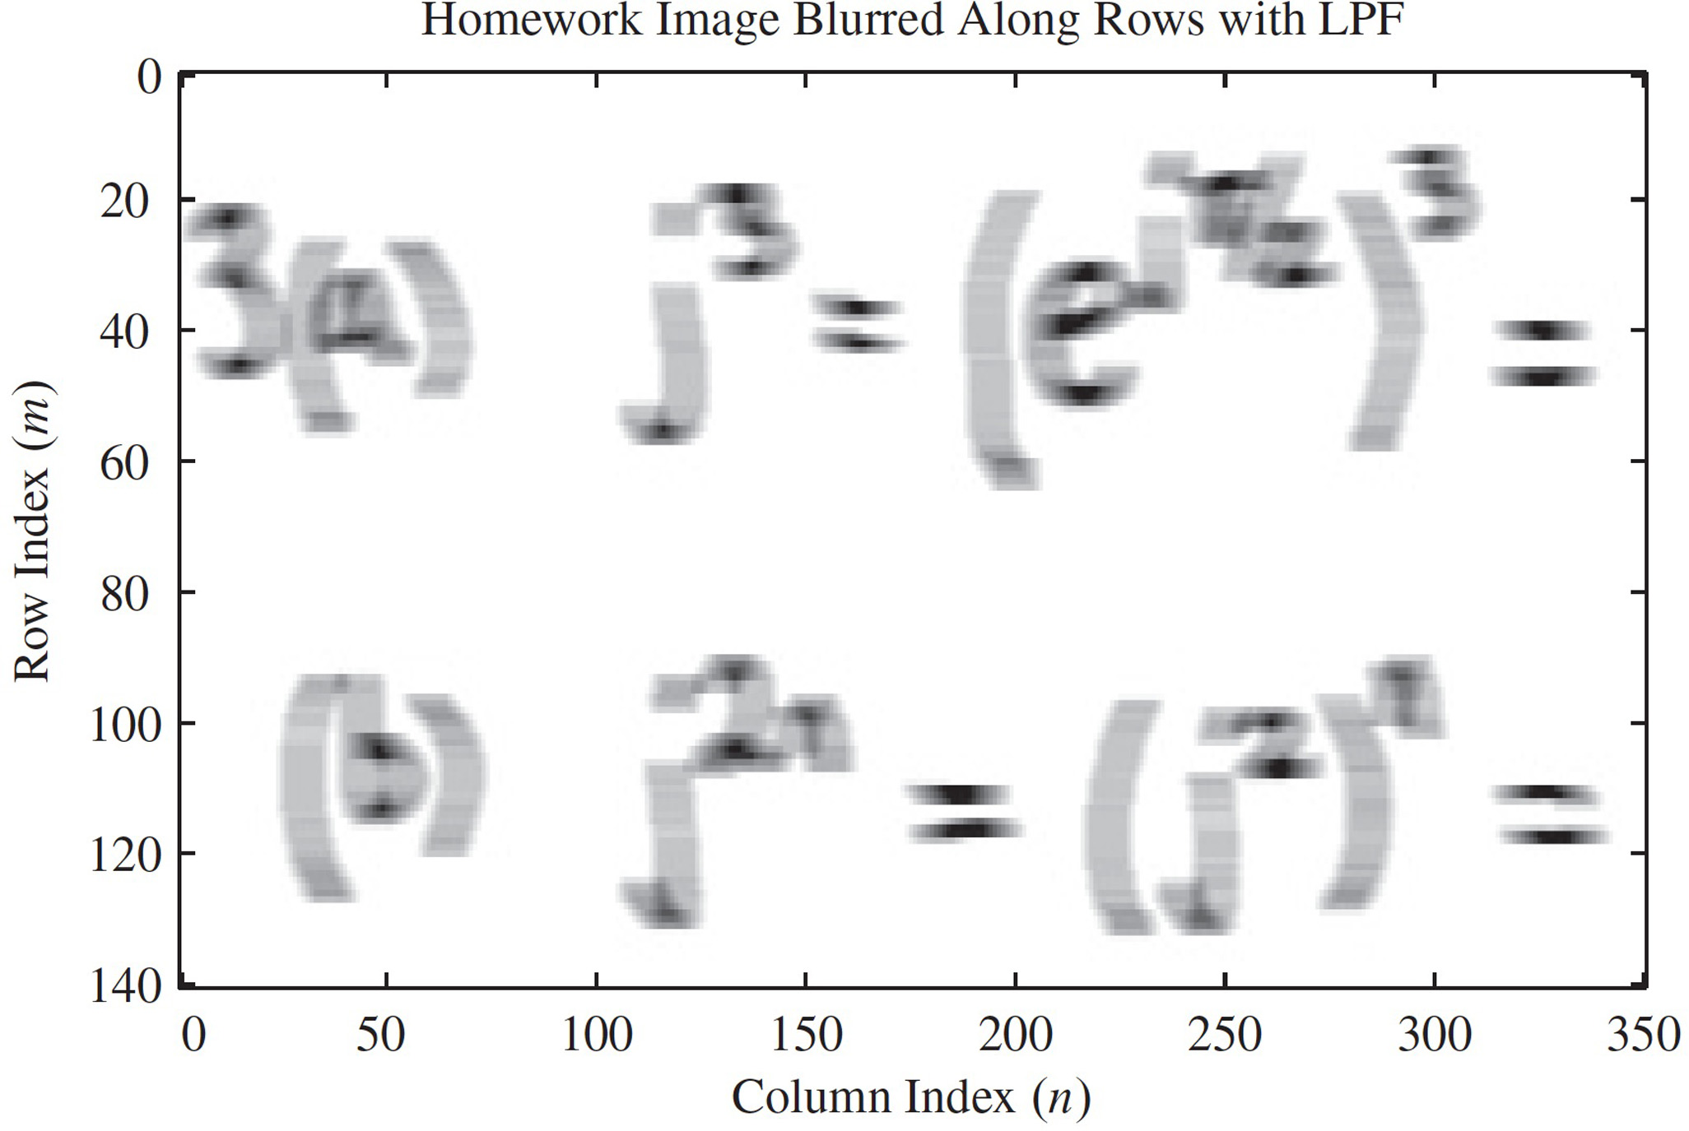
FILTERED B&W IMAGE
Horizonal
Blur only

Slide 42
FILTER ROWS & COLUMNS
Blur in both
dimensions

Slide 43
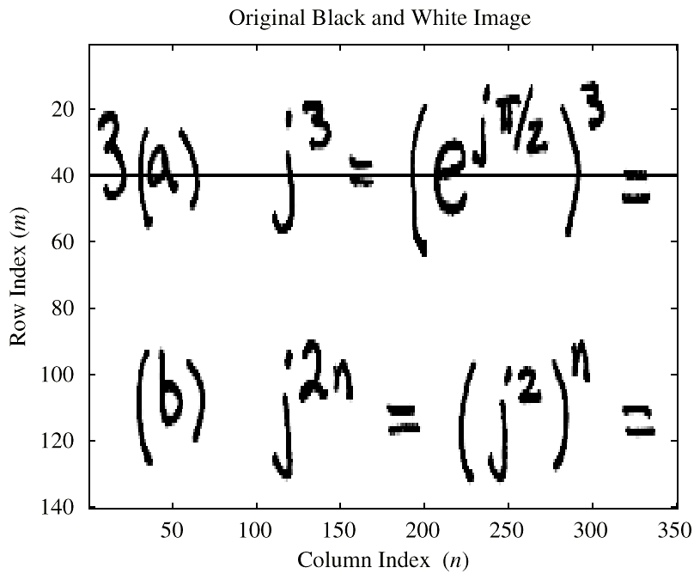
B & W IMAGE

Slide 44
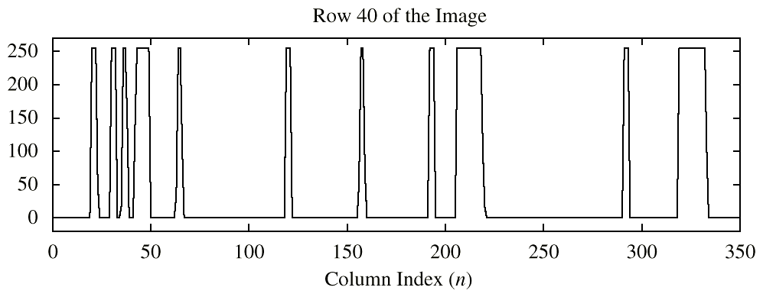
ROW of B&W IMAGE
BLACK = 255
WHITE = 0

Slide 45
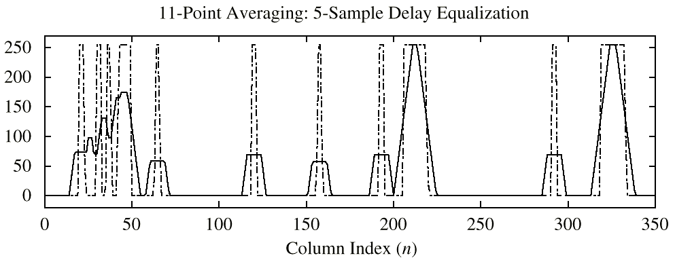
FILTERED ROW of IMAGE
ADJUSTED DELAY by 5 samples

Slide 46
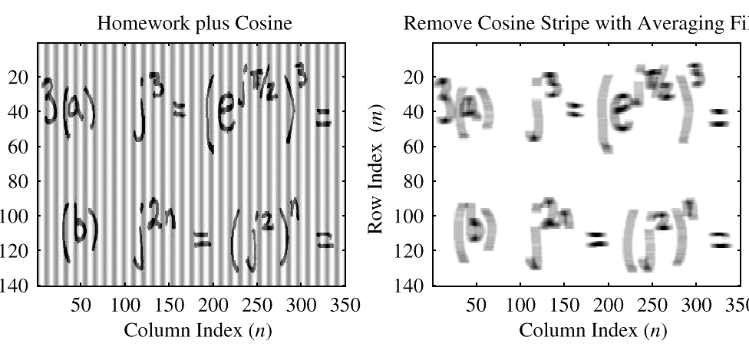
B&W IMAGE with COSINE
FILTERED: 11-pt AVG

Slide 47
FILTERED B&W IMAGE
LPF:
BLUR

Slide 48
EFFECTIVE Freq. Response
Assume NO Aliasing, then
ANALOG FREQ <--> DIGITAL FREQ
So, we can plot:
Scaled Freq. Axis
DIGITAL FILTER
ANALOG FREQUENCY

Slide 49
TIME & FREQ DOMAINS
LTI: Linear & Time-Invariant
COMPLETELY CHARACTERIZED by:
IMPULSE RESPONSE h[n] (time domain)
FREQUENCY RESPONSE
Two DOMAINS: time & frequency
Go back and forth QUICKLY
x[n]
y[n]

Slide 50
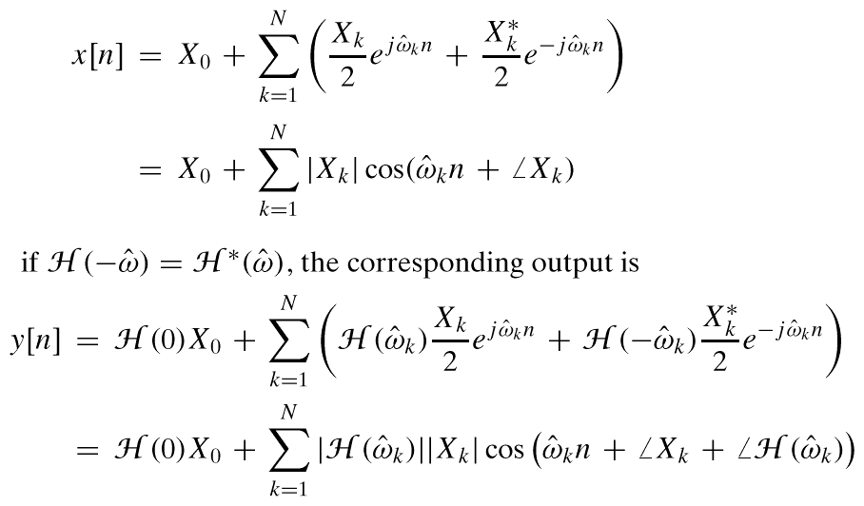
SINUSOID thru FIR
MULTIPLY MAGS
ADD PHASES

Slide 51
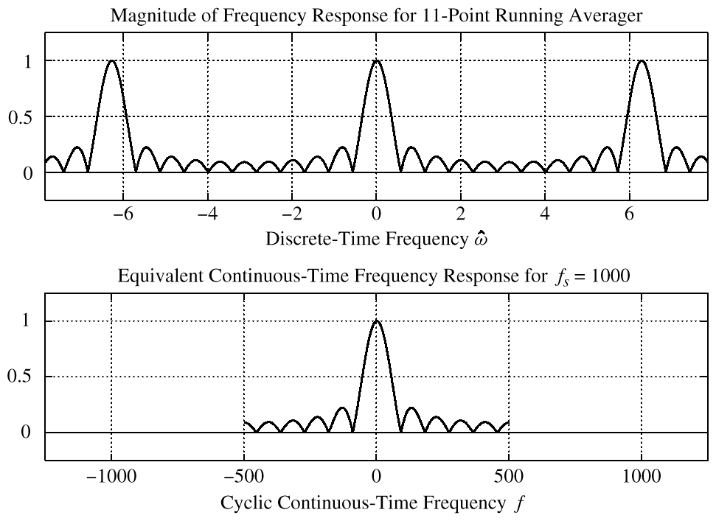
DIGITAL FILTER
EFFECTIVE RESPONSE
LOW-PASS FILTER

