Slide 1
DSP First, 2/e
Lecture 15
DTFT: Discrete-Time Fourier Transform

Slide 2
License Info for DSPFirst Slides
This work released under a Creative Commons License with the following terms:
Attribution
The licensor permits others to copy, distribute, display, and perform the work. In return, licensees must give the original authors credit.
Non-Commercial
The licensor permits others to copy, distribute, display, and perform the work. In return, licensees may not use the work for commercial purposes—unless they get the licensor's permission.
Share Alike
The licensor permits others to distribute derivative works only under a license identical to the one that governs the licensor's work.
Full Text of the License
This (hidden) page should be kept with the presentation

Slide 3
READING ASSIGNMENTS
This Lecture:
Chapter 7, Section 7-1

Slide 4
Lecture Objective
Generalize the Frequency Response
Introduce DTFT, discrete-time Fourier transform, for discrete time sequences that may not be finite or periodic
Establish general concept of “frequency domain” representations and spectrum that is a continuous function of (normalized) frequency – not necessarily just a line spectrum

Slide 5
The Frequency Response
LTI
System

Slide 6
Discrete-Time Fourier Transform
Definition of the DTFT:
Forward DTFT
Inverse DTFT
Always periodic with a period of 2π

Slide 7
What is a Transform?
Change problem from one domain to another to make it easier
Example: Phasors
Solve simultaneous sinusoid equations (hard)
Invert a matrix of phasors (easy)
Has to be invertible
Transform into new domain
Return to original domain (inverse must be unique)

Slide 8
Periodicity of DTFT
For any integer m:
1

Slide 9
Existence of DTFT
Discrete-time Fourier transform (DTFT) exists – provided that the sequence is absolutely-summable
DTFT applies to discrete time sequences, x[n], regardless of length (if x[n] is absolute summable)

Slide 10
DTFT of a Single Sample
Unit Impulse function

Slide 11
Delayed Unit Impulse
Generalizes to the delay property

Slide 12
DTFT of Right-Sided Exponential

Slide 13
Plotting: Magnitude and Angle Form

Slide 14
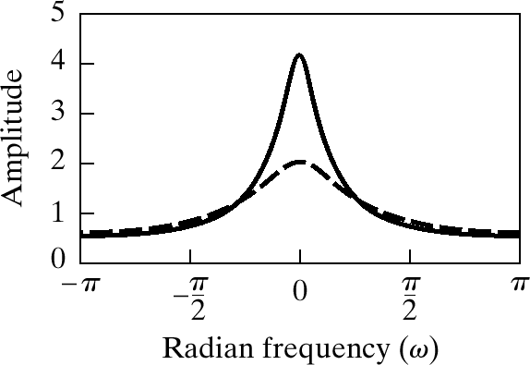
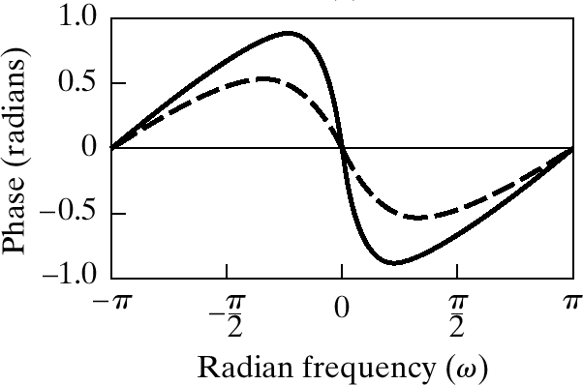
Magnitude and Angle Plots

Slide 15
Inverse DTFT ?

Slide 16
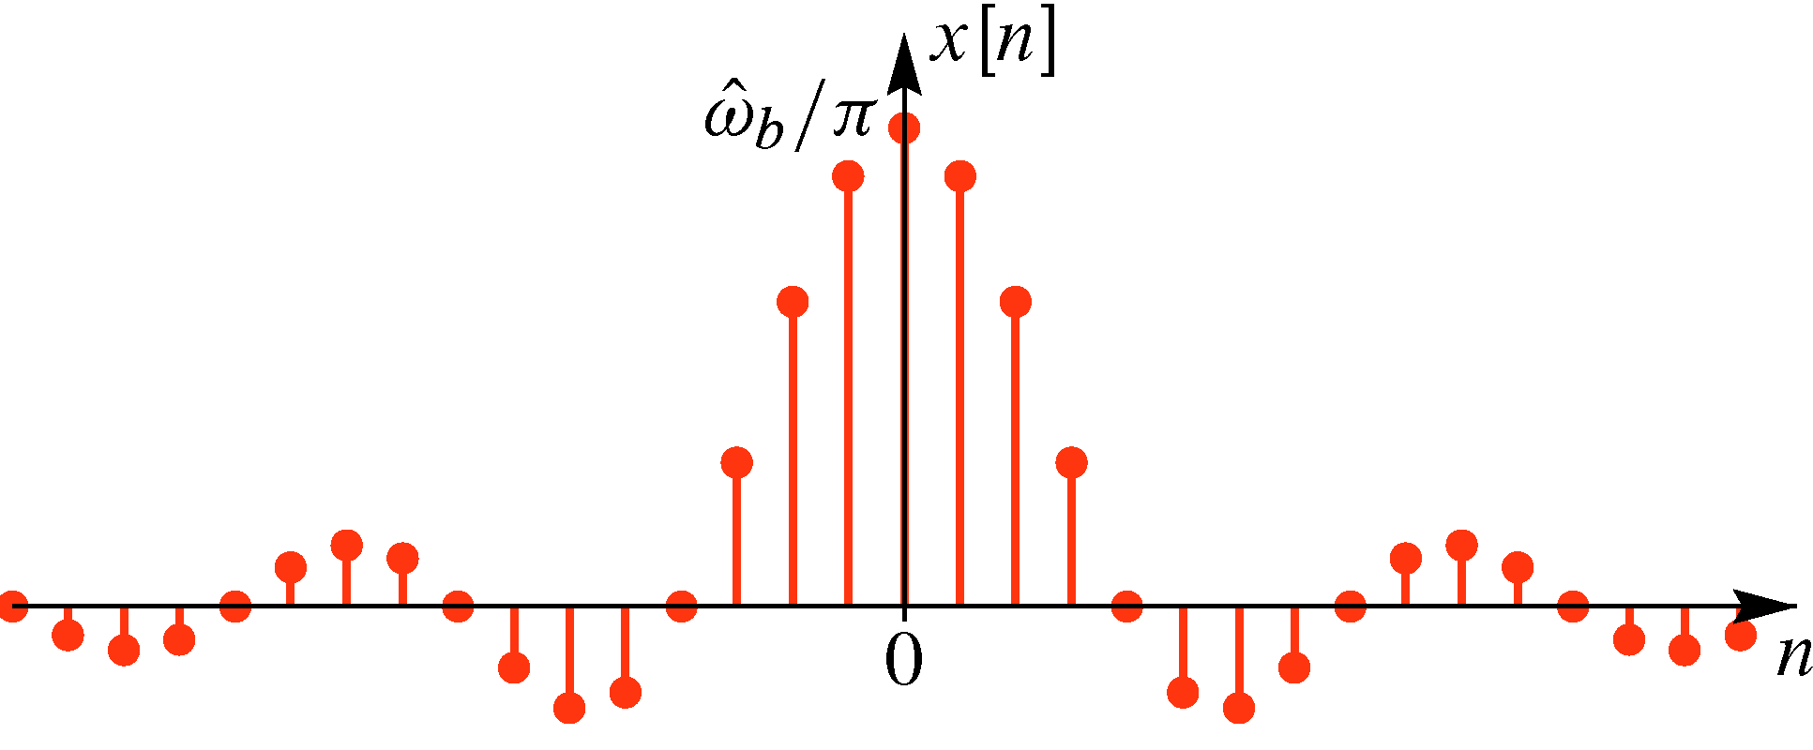
SINC Function:
A “sinc” function or sequence

Slide 17
SINC Function from the inverse DTFT integral
Given a “sinc” function or sequence
Discrete-time Fourier Transform Pair
Consider an ideal band-limited signal:

Slide 18
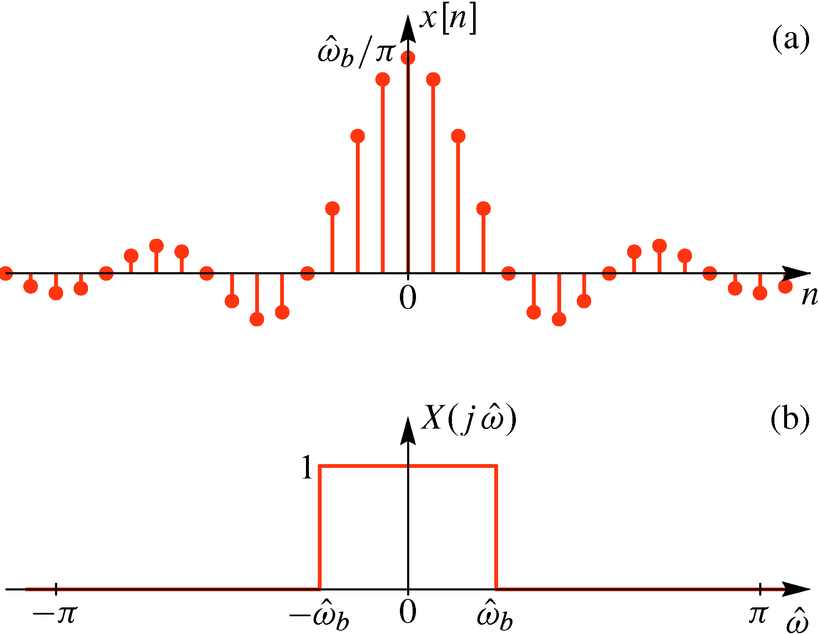
SINC Function – Rectangle DTFT pair

Slide 19
DTFT of Rectangular Pulse
A “rectangular” sequence of length L
Discrete-time Fourier Transform Pair
Dirichlet Function:

Slide 20
Summary of DTFT Pairs
Delayed Impulse
Right-sided
Exponential
sinc function
is Bandlimited

Slide 21
Using the DTFT
The DTFT provides a frequency-domain representation that is invaluable for thinking about signals and solving DSP problems.
To use it effectively you must
know PAIRS: the Fourier transforms of certain important signals
know properties and certain key theorems
be able to combine time-domain and frequency domain methods appropriately

Slide 22
Summary
Discrete-time Fourier Transform (DTFT)
Inverse Discrete-time Fourier Transform

