Slide 1
DSP First, 2/e
Lecture 16
DTFT Properties

Slide 2
License Info for DSPFirst Slides
This work released under a Creative Commons License with the following terms:
Attribution
The licensor permits others to copy, distribute, display, and perform the work. In return, licensees must give the original authors credit.
Non-Commercial
The licensor permits others to copy, distribute, display, and perform the work. In return, licensees may not use the work for commercial purposes—unless they get the licensor's permission.
Share Alike
The licensor permits others to distribute derivative works only under a license identical to the one that governs the licensor's work.
Full Text of the License
This (hidden) page should be kept with the presentation

Slide 3
READING ASSIGNMENTS
This Lecture:
Chapter 7, Sections 7-2 & 7-3
Other Reading:
Recitation: Chapter 7
DTFT EXAMPLES

Slide 4
Lecture Objectives
Properties of the DTFT
Convolution is mapped to Multiplication
Ideal Filters: LPF, HPF, & BPF
Recall:
DTFT is the math behind the general concept of “frequency domain” representations
The spectrum is now a continuous function of (normalized) frequency – not just a line spectrum

Slide 5
Discrete-Time Fourier Transform
Definition of the DTFT:
Forward DTFT
Inverse DTFT
Always periodic with a period of 2π

Slide 6
Summary of DTFT Pairs
Delayed Impulse
Right-sided
Exponential
sinc function
is Bandlimited

Slide 7
Conjugate Symmetry

Slide 8
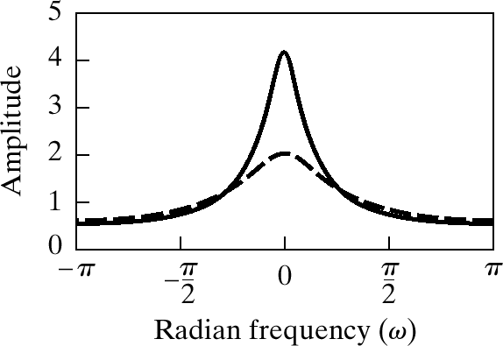
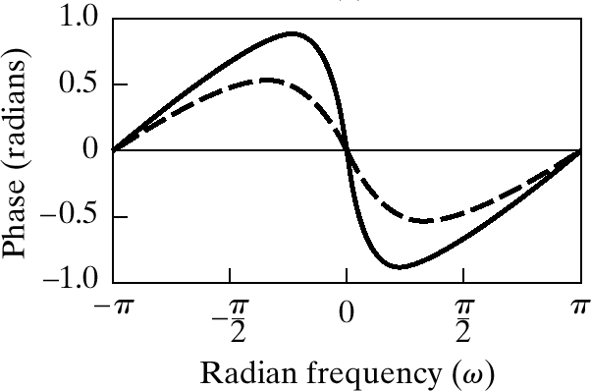
Magnitude and Angle Plots

Slide 9
Properties of DTFT
Linearity
Time-Delay ←→ phase shift
Frequency-Shift ←→ multiply by sinusoid

Slide 10
Linearity (Proof)

Slide 11
Time-Delay Property (Proof)

Slide 12
Use Properties to Find DTFT
Strategy: Exploit Known Transform Pair

Slide 13
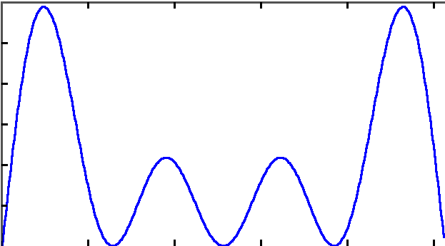
Use Properties to Find DTFT (2)
Strategy:
Exploit Known Transform Pair

Slide 14
Frequency Shift

Slide 15
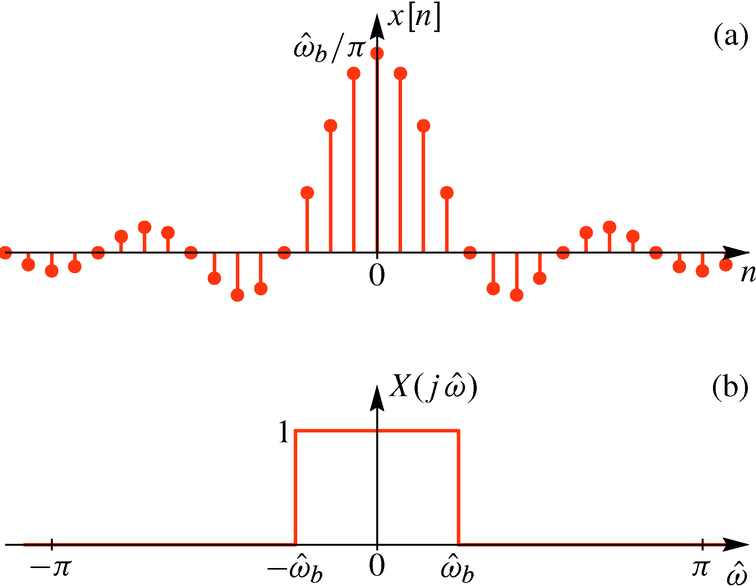
SINC Function – Rectangle DTFT pair

Slide 16
Sinc times sinusoid: find DTFT
Frequency shifting up and down
is done by cosine multiplication
in the time domain

Slide 17
DTFT maps Convolution to Multiplication
LTI
System

Slide 18
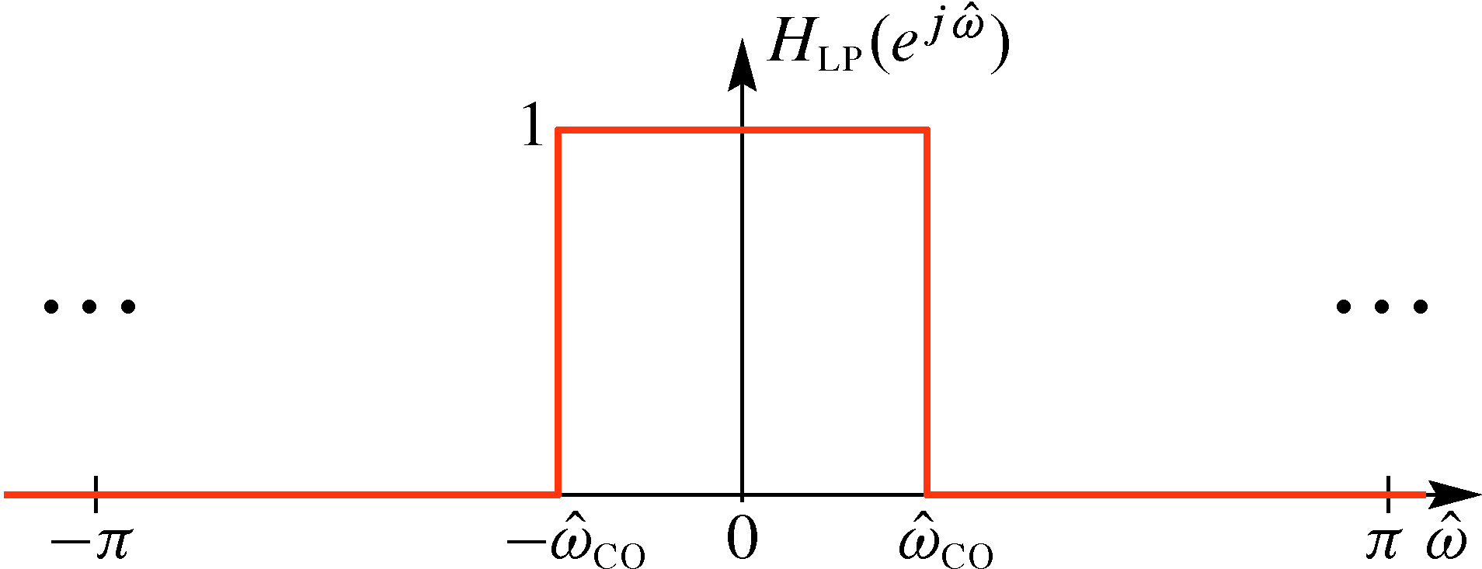
IDEAL LowPass Filter (LPF)
One in the passband
Zero in the stopband
DTFT pair
SINC Function – Rectangle

Slide 19
Filtering with the IDEAL LPF
Find the output when the input is a sinusoid:
Multiply the spectrum of the input
times the DTFT of the filter to get

Slide 20
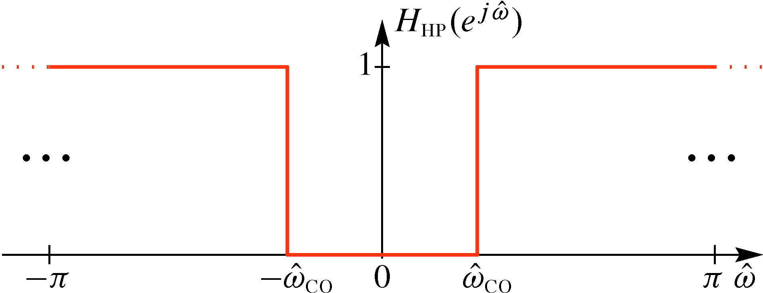
IDEAL HighPass Filter (HPF)
One in the passband
Zero in the stopband
HPF is 1 minus LPF
Inverse DTFT of 1
is a delta

Slide 21
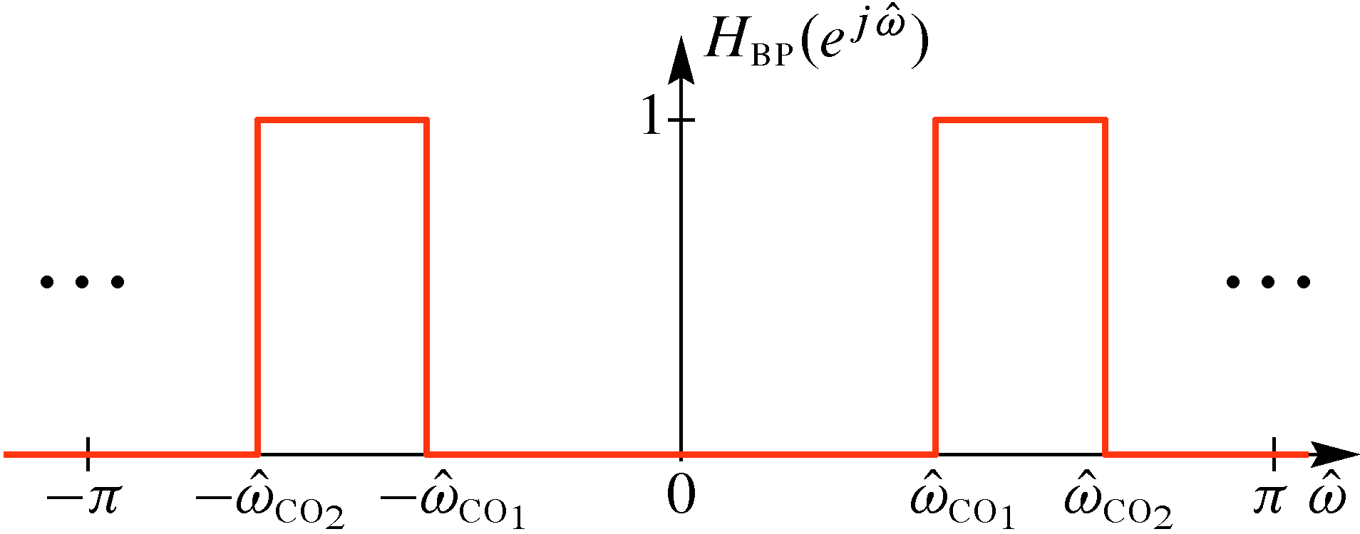
IDEAL BandPass Filter (BPF)
One in the passband
Zero in the 2 stopbands
BPF has two stopbands
Band Reject Filter has
one stopband and two
passbands.
It is one minus BPF

Slide 22
Make IDEAL BPF from LPF
BPF is frequency shifted
version of LPF
Frequency shifting
up and down is done
by cosine multiplication
in the time domain

Slide 23
LPF Example 1: x[n] = sinc
Input bandwidth
Less than
Filter’s passband

Slide 24
LPF Example 2: x[n] = sinc
Filter chops off
Signal bandwidth
Outside of passband

Slide 25
Want to call the DTFT the spectrum
The DTFT provides a frequency-domain representation
The spectrum (Ch. 3) consists of lines at various frequencies , with complex amplitudes
The spectrum represents a signal that is the sum of complex exponentials
In what sense is the DTFT going to give a sum of complex exponentials ?

Slide 26
The Inverse DTFT is “sum” of complex exps
The inverse DTFT is an integral
An integral is a “sum”, i.e., the limit of Riemann sums:
The finite sum consists of cexps at frequencies with complex amplitudes
The limit of these “finite spectra” is the inverse DTFT

Slide 27
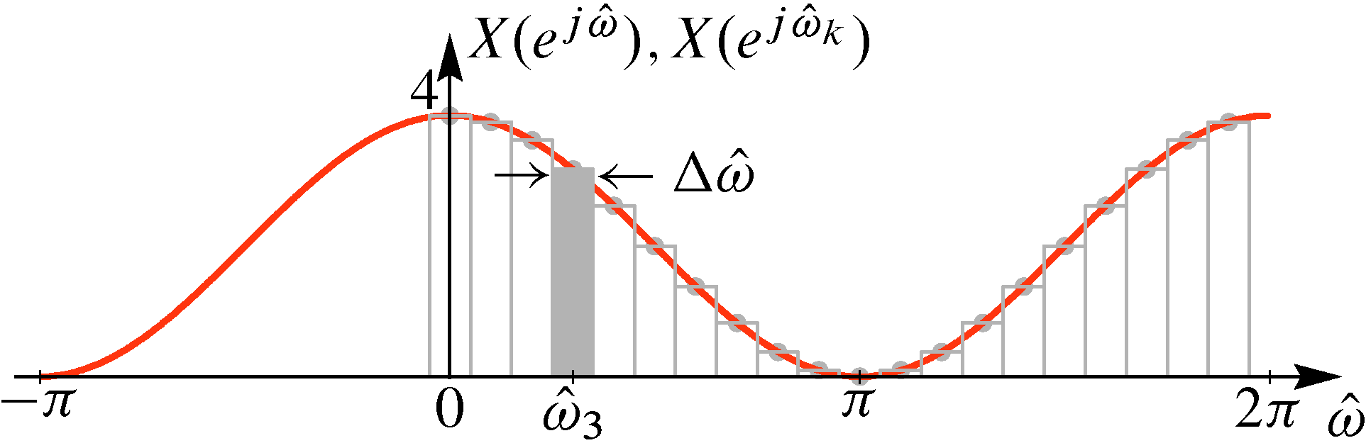
Example: DTFT SAMPLES as a Spectrum
Samples of DTFT are
Proportional to
Height of Spectral Lines

Slide 30
Example: DTFT SAMPLES as a Spectrum
Samples of DTFT
Proportional to
Height of Spectral Lines

Slide 31
Want a Computable Fourier Transform
Take the finite Riemann sum:
Note that
Propose:
This is the inverse Discrete Fourier Transform (IDFT)

Slide 32
The DTFT is the spectrum (2)
The inverse DTFT is an integral
An integral is a “sum”, i.e., the limit of a Riemann sum:
The finite sum consists of lines at frequencies with complex amplitudes
The limit of these “finite spectra” is the inverse DTFT

Slide 33
The DTFT is the spectrum (2)
The inverse DTFT is an integral
An integral is a “sum”, i.e., the limit of a sum
Riemann sum:
The spectrum (Ch. 3) consists of lines at various frequencies , with complex amplitudes
The spectrum represents a signal that is the sum of complex exponentials

Slide 34
Using the DTFT
The DTFT provides a frequency-domain representation that is invaluable for thinking about signals and solving DSP problems.
To use it effectively you must
Know PAIRS: the Fourier transforms of certain important signals
know properties and certain key theorems
be able to combine time-domain and frequency domain methods appropriately

Slide 35
IDEAL BandPass Filter (BPF)
BPF is frequency shifted
version of LPF
Frequency shifting
up and down is done
by cosine multiplication
in the time domain

Slide 36
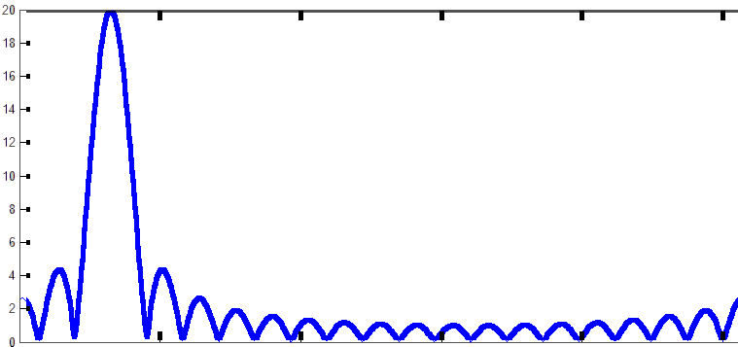
DTFT of a Finite Complex Exponential
Dirichlet Function
0 1 4 6 10 15 19

Slide 37
Evaluating Transform – Example III
A “sinc” function or sequence
Discrete-time Fourier Transform Pair
Consider an ideal band-limited signal:

Slide 39
N-DFT of A Finite Complex Exponential
Dirichlet Function
0 1 4 6 10 15 19

Slide 40
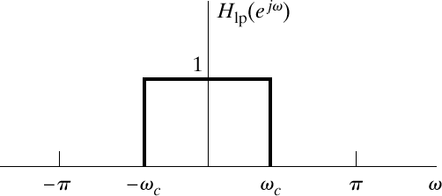
Example 1
Find the output when the input is

Slide 41
Summary
Discrete-time Fourier Transform (DTFT)
Inverse Discrete-time Fourier Transform

Slide 42
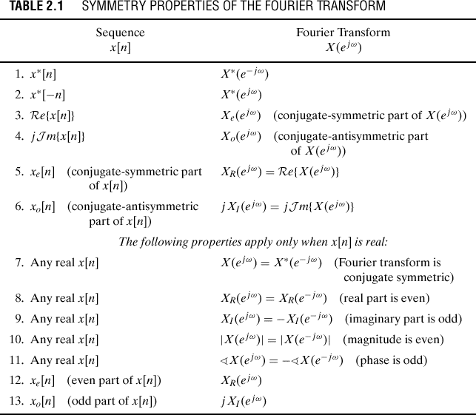

Slide 43
Frequency Response Again
The frequency response function is now seen to be just the DTFT of the impulse response.
Note that stable systems have frequency responses.
Therefore, impulse response = inverse DTFT of the frequency response.

Slide 44
Overview of Lecture 7
Review of definition of DTFT
Importance of theorems
The time-domain convolution theorem
Examples of using the DTFT
Frequency response of cascade and parallel systems

Slide 45
Discrete-Time Fourier Transform
Definition:
Existence of the DTFT:
Forward Transform
Inverse Transform

Slide 46
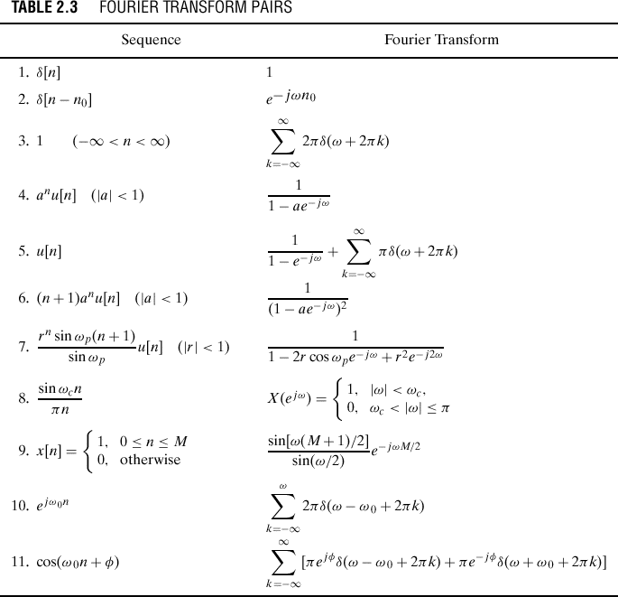
We worked
this one out.
And this
one too.

Slide 47
The Unit Impulse Function
The continuous-variable impulse is defined by the following properties:

Slide 48
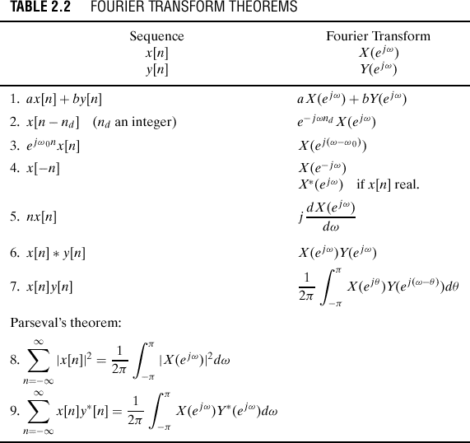

Slide 49
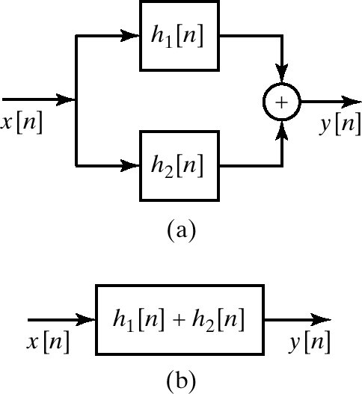
Parallel Combination of LTI Systems

Slide 50
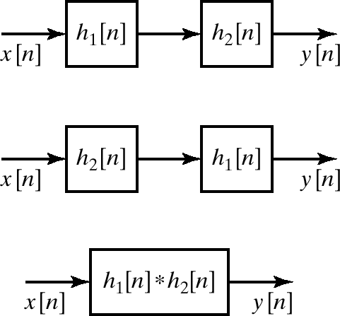
Cascade Connection of LTI Systems

Slide 51
Inverse Systems Again
An inverse system compensates (undoes) the effects of another system.
Problems arise when the frequency response is very small.
LTI
System
Inverse
System

Slide 52
Convolution Theorem
LTI
System

Slide 53
Ideal Lowpass Filter (or Rectangle)

Slide 54
Example 2
Find the output when the input is

