Slide 1
DSP First, 2/e
Lecture 16a
FIR Filter Design via
Windowing

Slide 2
License Info for DSPFirst Slides
This work released under a Creative Commons License with the following terms:
Attribution
The licensor permits others to copy, distribute, display, and perform the work. In return, licensees must give the original authors credit.
Non-Commercial
The licensor permits others to copy, distribute, display, and perform the work. In return, licensees may not use the work for commercial purposes—unless they get the licensor's permission.
Share Alike
The licensor permits others to distribute derivative works only under a license identical to the one that governs the licensor's work.
Full Text of the License
This (hidden) page should be kept with the presentation

Slide 3
READING ASSIGNMENTS
This Lecture:
Chapter 7, Sects 7-3 and 7-4

Slide 4
Lecture Objectives
Approximate ideal filters
Introduce the concept of windowing
Truncate ideal h[n] with a window
Filter specs: ripples & band edges

Slide 5
Windows
Finite-Length signal (L) with positive values
Extractor
Truncator

Slide 6
Window Truncates Ideal h[n]
sinc is inverse DTFT of ideal LPF
Truncate: Multiply sinc by a window
Finite h[n] has length (L) = window length
No easy DTFT. Use zero-padded DFT to get DTFT samples

Slide 7
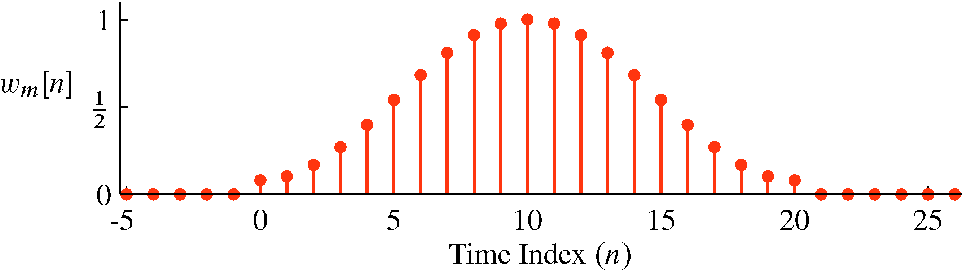
Window Filter Design
Plot of Length-21 Hamming window

Slide 8
Demo of filterdesign GUI
Show filter designs in the following order:
Set fs=2, and cutoff freq = 0.4
Rectangular Window: M=20, M=40, M=200
Show Slide to define passband & stopband
Show Slide with Template for Filter Design Specs
Hamming Window: M=20, M=40
Need to reset cutoff when Window Type is changed.
Hamming Window for L=40 in dB (click Magnitude)
Hamming Window for L=40, zoom in on passband
Hamming Window: M=200
Same for von Hann?

Slide 9
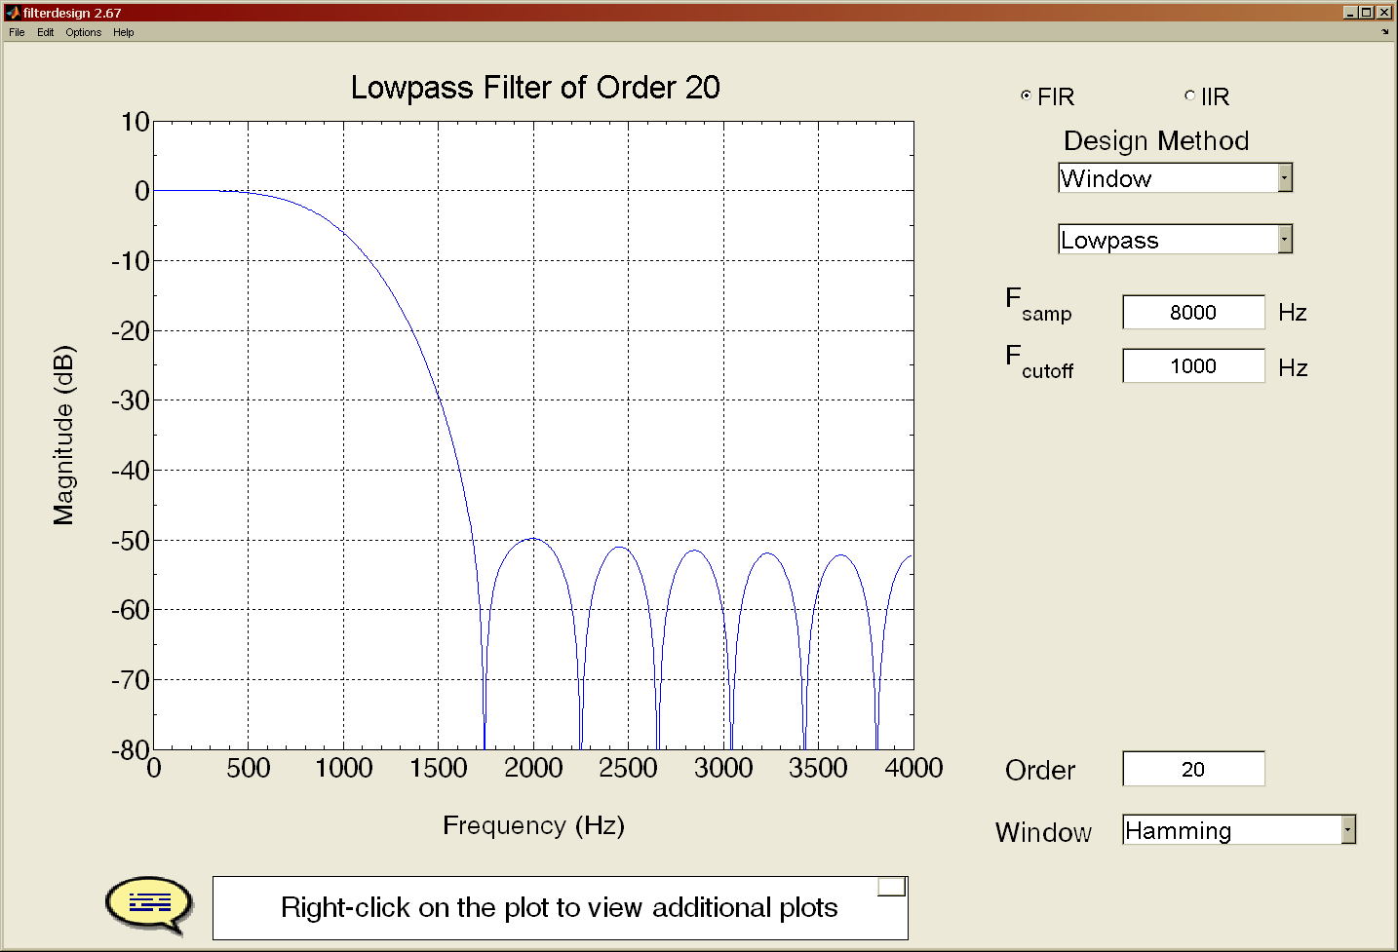
Filter Design GUI
Cutoff Frequency w.r.t. Sampling Rate

Slide 10
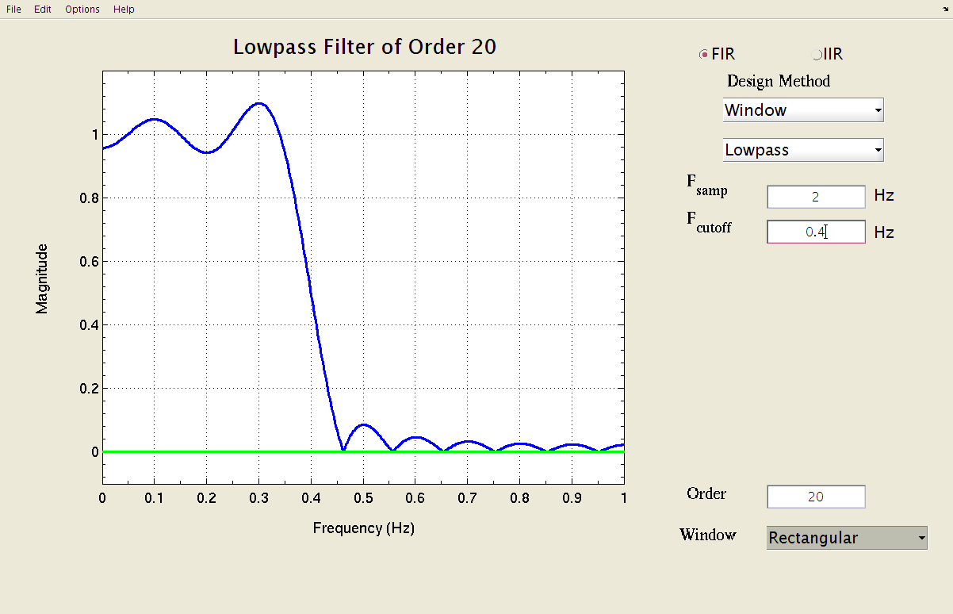
Filter Design via Rectangular Windowing (L=21)
Rectangular Window, L=21 (order M=20)

Slide 11
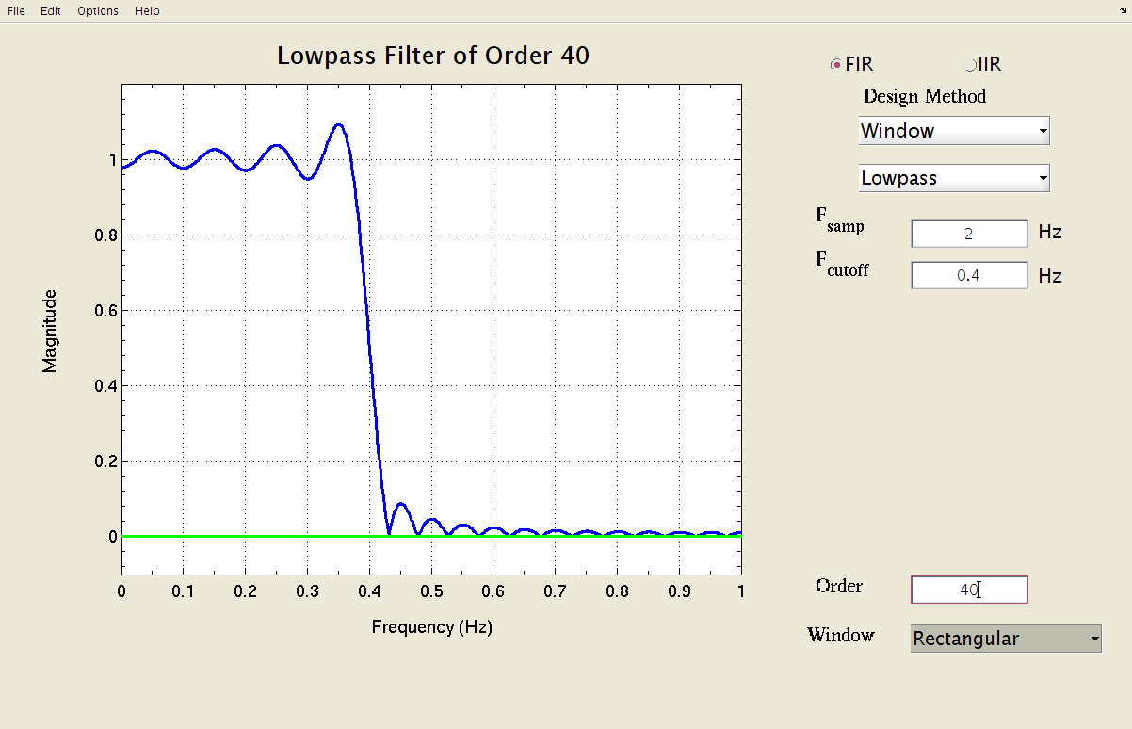
Filter Design via Rectangular Windowing (L=41)
Rectangular Window, L=41 (order M=40)

Slide 12
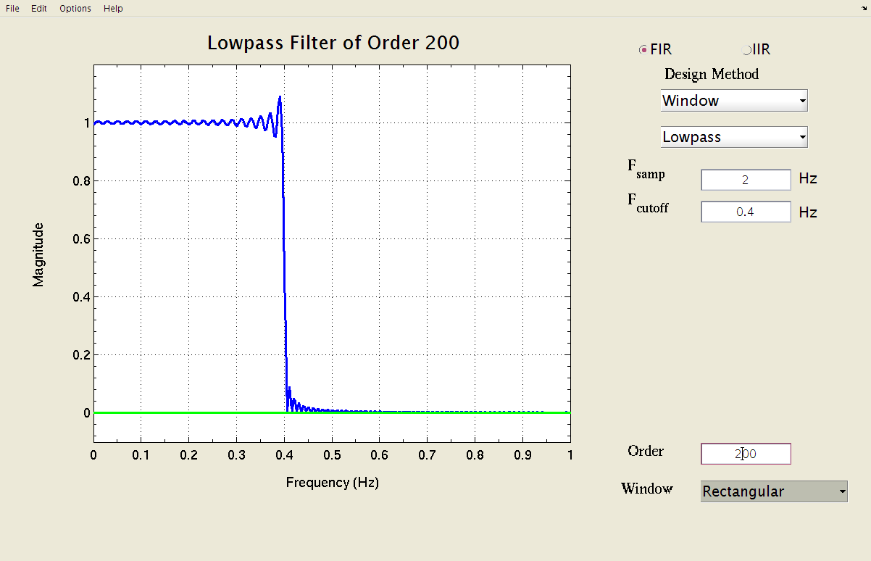
Filter Design via Rectangular Windowing (L=201)
Rectangular Window, L=201 (order M=200)

Slide 13
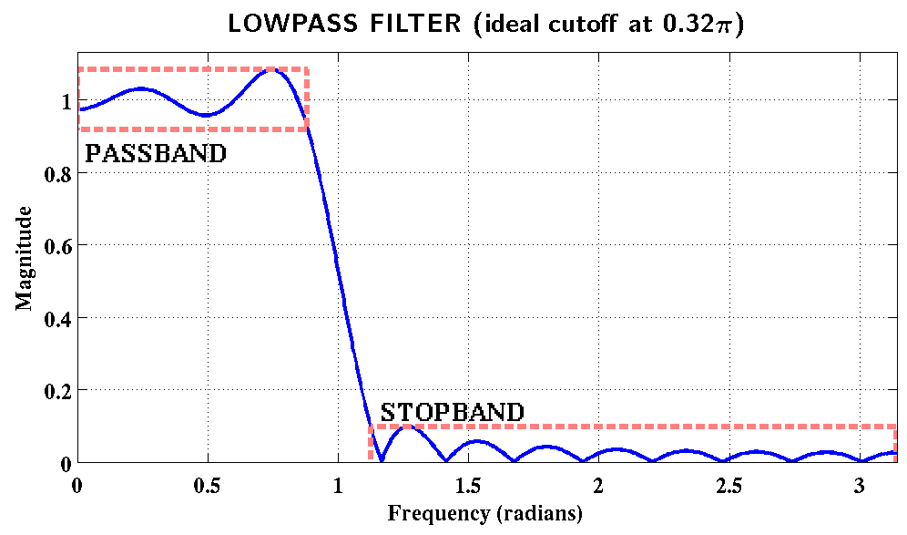
Filter Design: Define Passband & Stopband
Rectangular Window, L=41 (order M=40)

Slide 14
Ripples, Band edges, & Transition Width
Passband Ripple is one plus or minus
Stopband Ripple is less than
Band edges are
Transition Width is
Can’t have it all:
small transition width, small ripples, and
lowest possible order (M)

Slide 15
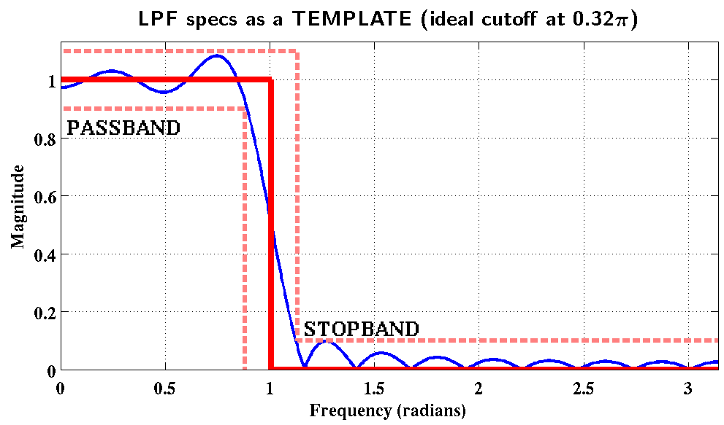
Filter Design: Tolerance Template
Want the actual response inside the template

Slide 16
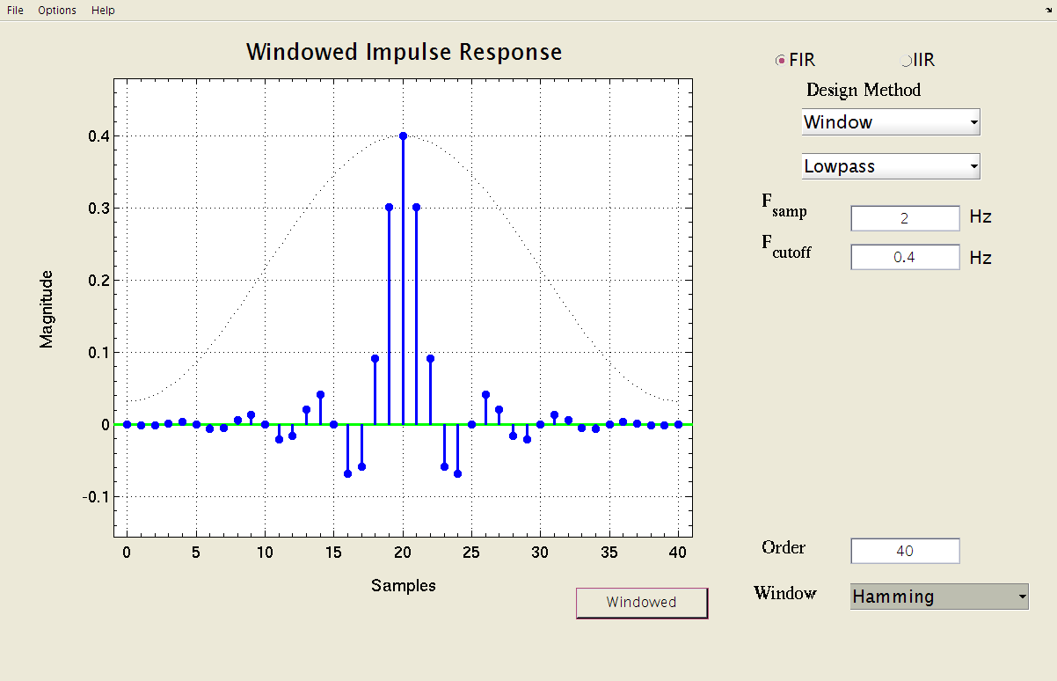
Hamming Window applied to ideal LPF impulse response
Hamming Window, L=41 (order M=40)

Slide 17
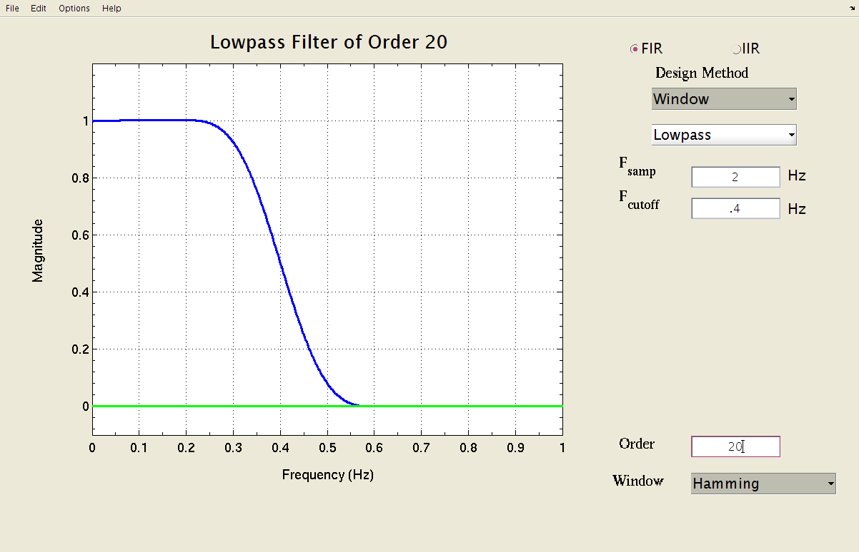
Filter Design with Hamming Window (L=21)
Hamming Window, L=21 (order M=20)
Has ripples, but they are too small to be seen on a linear scale

Slide 18
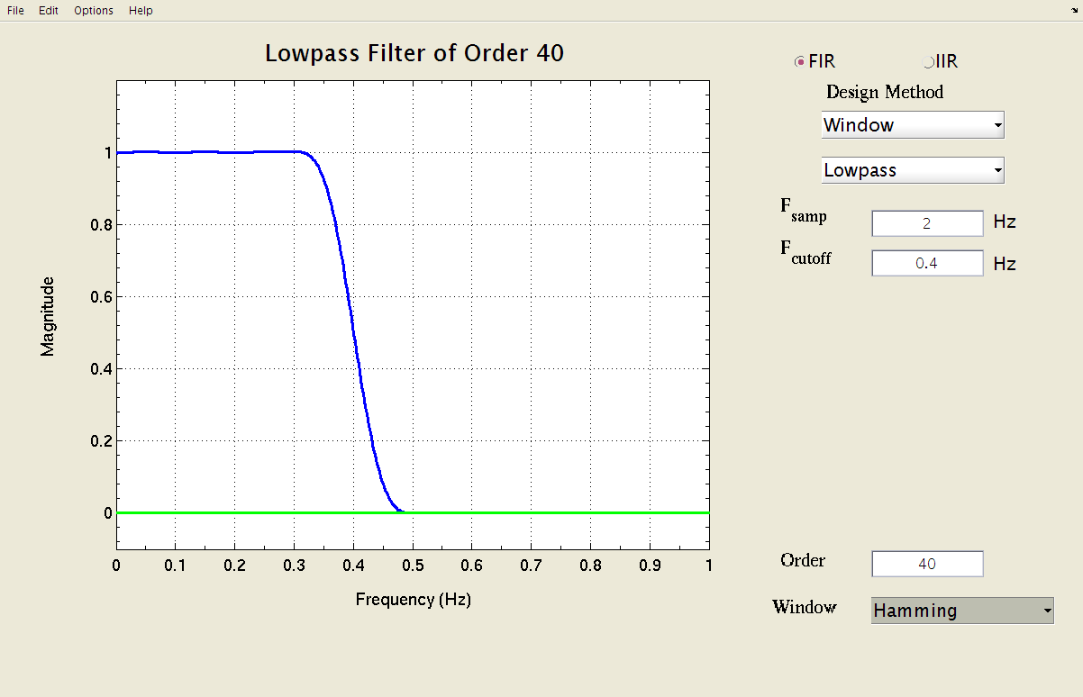
Filter Design with Hamming Window (L=41)
Hamming Window, L=41 (order M=40)
Has ripples, but they are too small to be seen on a linear scale

Slide 19
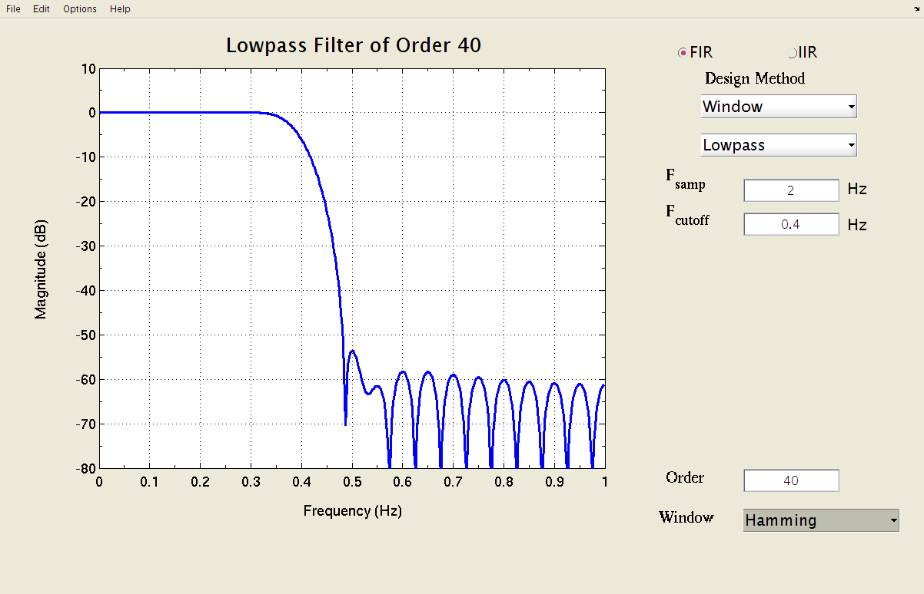
Hamming Window LPF (L=41) Log Magnitude
Hamming Window, L=41 (order M=40)
Now the ripples are visible at -50 to -60 dB

Slide 20
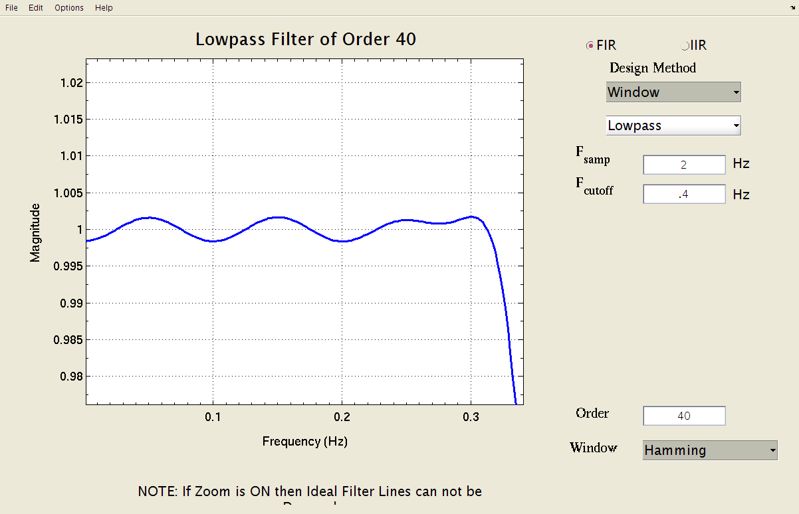
Filter Design: zoom on passband ripples
Hamming Window, L=41 (order M=40)
Passband ripples are less than 0.002

Slide 21
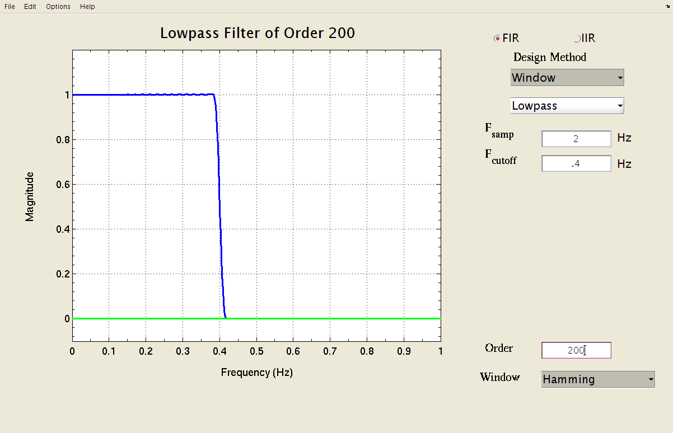
High Order FIR Filter Design with Hamming Window
Hamming Window, L=201 (order M=200)

Slide 22
Hamming FIR Filter Design Ripples and Band Edges
Transition width is inversely proportional to L
Ripples do not change with L
Another window called the Kaiser window can control the ripple height
But passband ripple = stopband ripple
Optimization methods such as PMFIR can control both ripples and the transition width

Slide 24
Hamming Window (Time Domain)
Plot of Length-21 Hamming window

Slide 25
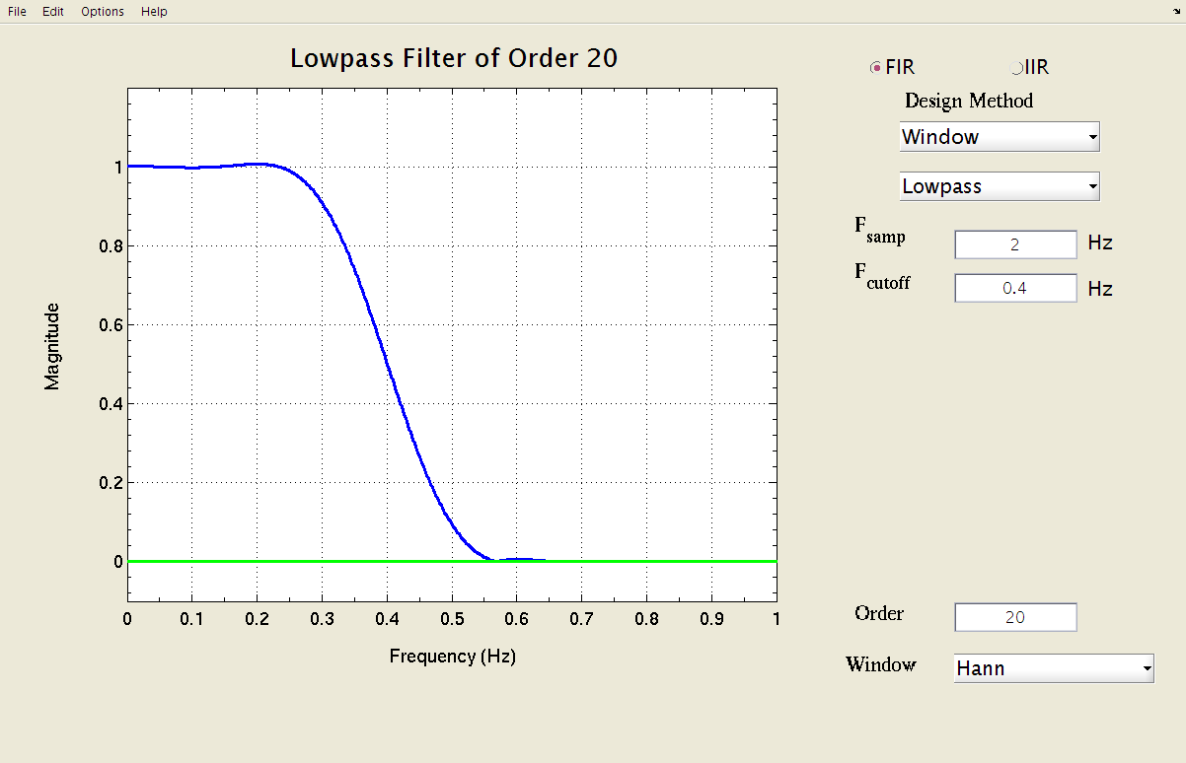
Filter Design via Hann Windowing
Hann Window, L=21 (order M=20)

Slide 26
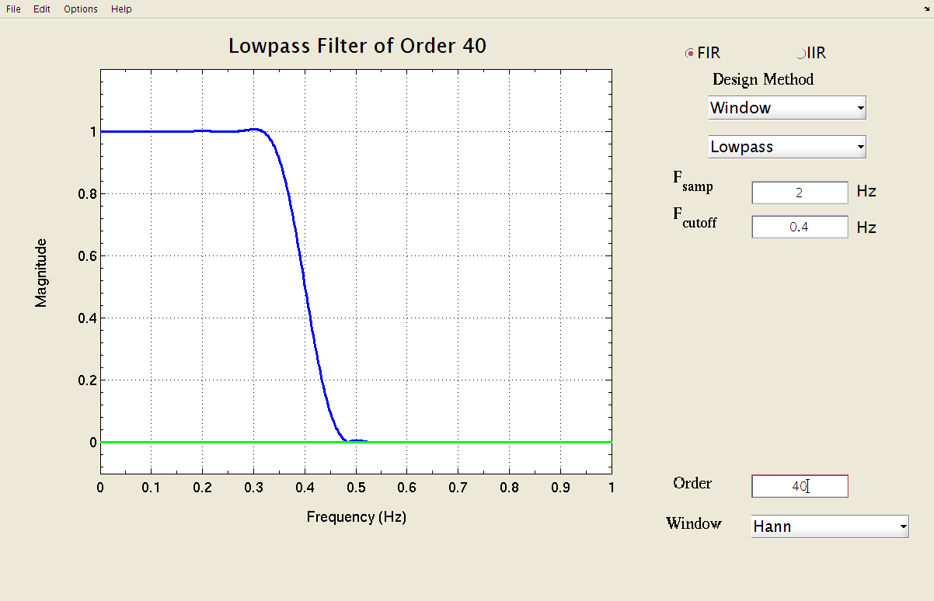
Filter Design via Hann Windowing
Hann Window, L=41 (order M=40)

Slide 27
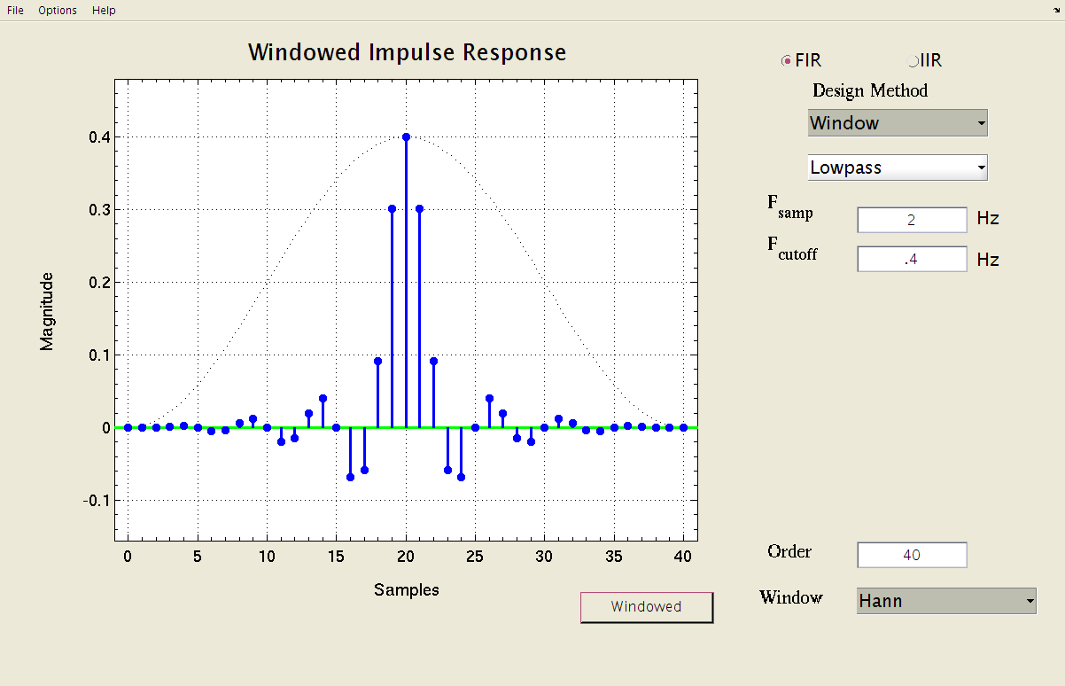
Filter Design via Hann Windowing
Hann Window, L=41 (order M=40)

Slide 28
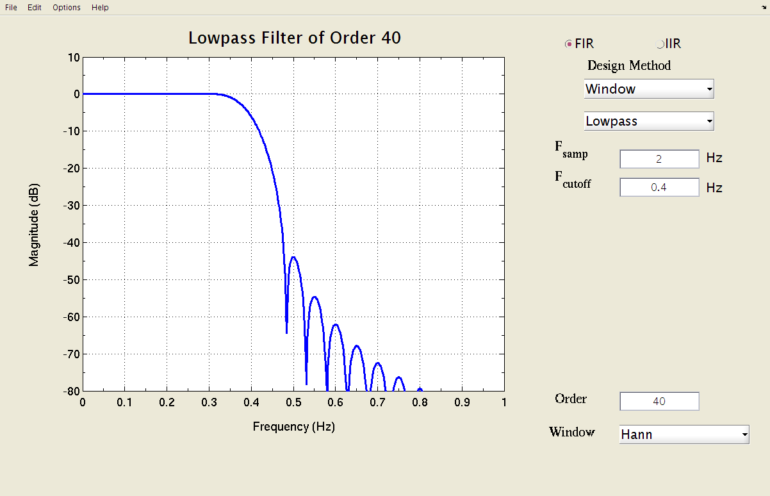
Filter Design: Magnitude in dB
Hann Window, L=41 (order M=40)

Slide 29
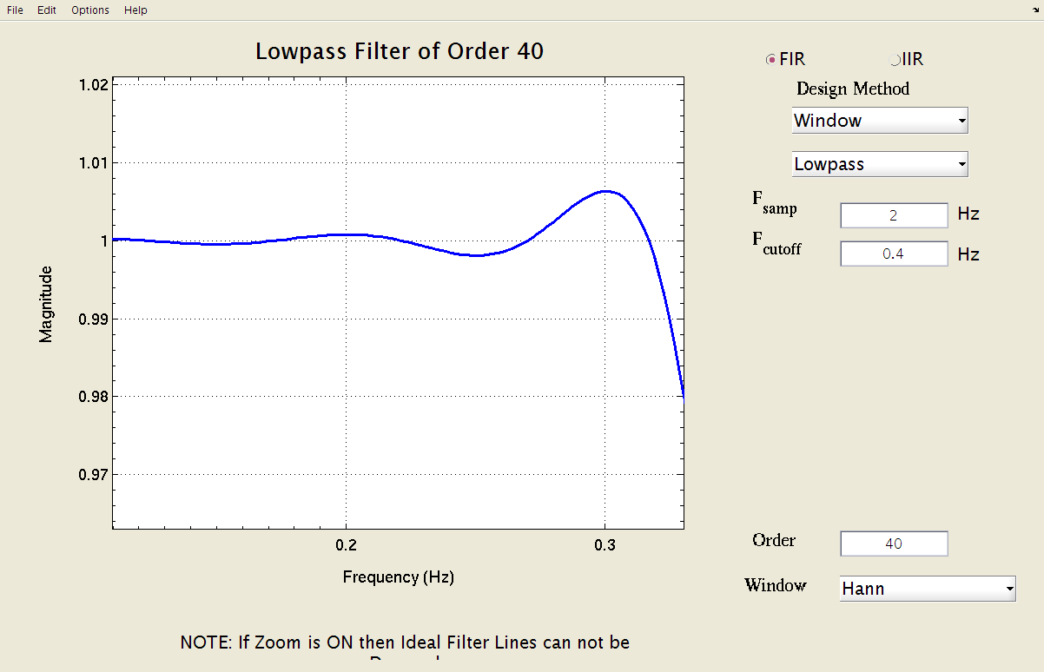
Filter Design: zoom on passband
Hann Window, L=41 (order M=40)

Slide 30

Filter Design via Hann Windowing
Hann Window, L=201 (order M=200)

