Slide 1
DSP First, 2/e
Lecture 17
DFT: Discrete Fourier Transform

Slide 2
License Info for DSPFirst Slides
This work released under a Creative Commons License with the following terms:
Attribution
The licensor permits others to copy, distribute, display, and perform the work. In return, licensees must give the original authors credit.
Non-Commercial
The licensor permits others to copy, distribute, display, and perform the work. In return, licensees may not use the work for commercial purposes—unless they get the licensor's permission.
Share Alike
The licensor permits others to distribute derivative works only under a license identical to the one that governs the licensor's work.
Full Text of the License
This (hidden) page should be kept with the presentation

Slide 3
READING ASSIGNMENTS
This Lecture:
Chapter 8, Sections 8-1, 8-2 and 8-4

Slide 4
LECTURE OBJECTIVES
Discrete Fourier Transform
DFT from DTFT by frequency sampling
DFT computation (FFT)
DFT pairs and properties
Periodicity in DFT (time & frequency)

Slide 5
Sample the DTFT → DFT
Want computable Fourier transform
Finite signal length (L)
Finite number of frequencies
k is the frequency index

Slide 6
Want a Computable INVERSE Fourier Transform
Write the inverse DTFT as a finite Riemann sum:
Note that
Propose:
This is the inverse Discrete Fourier Transform (IDFT)

Slide 7
Inverse DFT when L=N (proof)
Complex exponentials are ORTHOGONAL

Slide 8
Orthogonality of Complex Exponentials
The sequence set:
because ,
and

Slide 9
4-pt DFT: Numerical Example
Take the 4-pt DFT of the following signal

Slide 10
N-pt DFT: Numerical Example
Take the N-pt DFT of the impulse

Slide 11
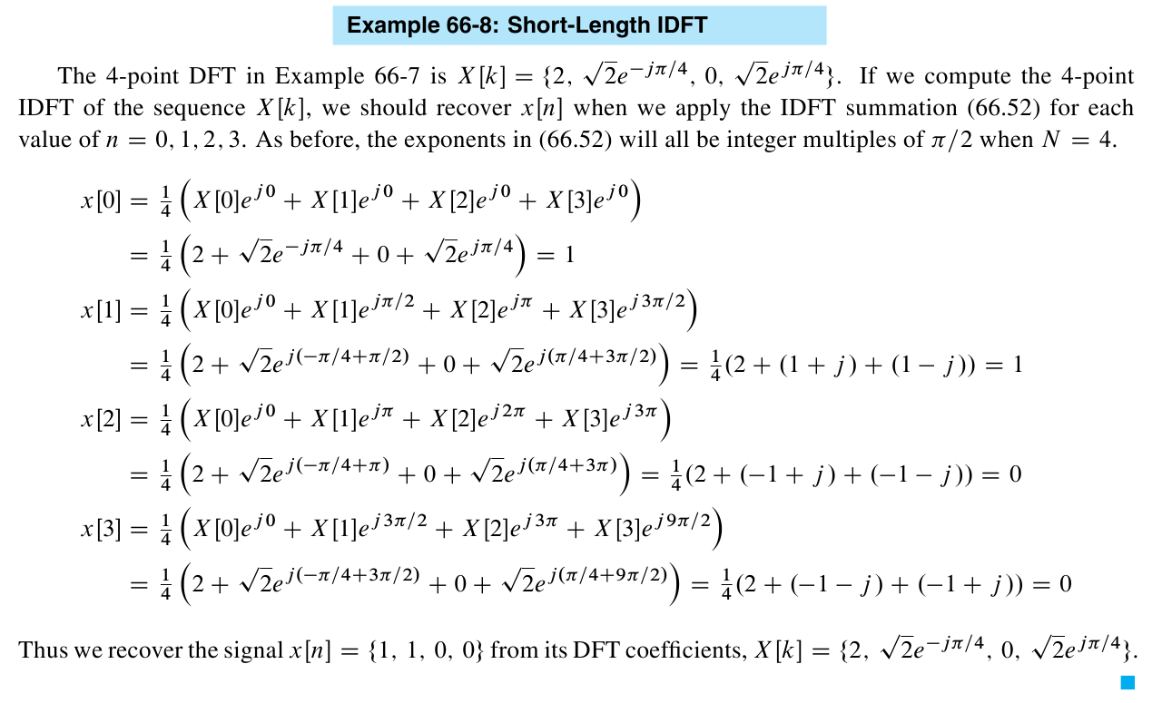
4-pt iDFT: Numerical Example

Slide 12
Matrix Form for N-pt DFT
In MATLAB, NxN DFT matrix is dftmtx(N)
Obtain DFT by X = dftmtx(N)*x
Or, more efficiently by X = fft(x,N)
Fast Fourier transform (FFT) algorithm later
Signal
vector
DFT matrix

Slide 13
FFT: Fast Fourier Transform
FFT is an algorithm for computing the DFT
N log₂N versus N² operations
Count multiplications (and additions)
For example, when N = 1024 = 2¹⁰
≈10,000 ops vs. ≈1,000,000 operations
≈1000 times faster
What about N=256, how much faster?

Slide 14
Zero-Padding gives denser FREQUENCY SAMPLING
Want many samples of DTFT
WHY? to make a smooth plot
Finite signal length (L)
Finite number of frequencies (N)
Thus, we need

Slide 15
Zero-Padding with the FFT
Get many samples of DTFT
Finite signal length (L)
Finite number of frequencies (N)
Thus, we need
In MATLAB
Use X = fft(x,N)
With L=length(x) less than N
Define xpadtoN = [x,zeros(1,N-L)];
Take the N-pt DFT of xpadtoN

Slide 16
DFT periodic in k (frequency domain)
Since DTFT is periodic in frequency, the DFT must also be periodic in k
What about Negative indices and Conjugate Symmetry?

Slide 17
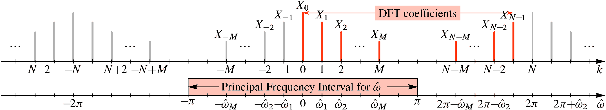
DFT Periodicity in Frequency Index

Slide 18
DFT pairs & properties
Recall DTFT pairs because DFT is sampled DTFT
See next two slides
DFT acts on a finite-length signal, so we can use DTFT pairs & properties for finite signals
Want DFT properties related to computation
And, we will concentrate on one more pair:
DTFT and DFT of finite sinusoid (or cexp)
Length-L signal
N-pt DFT

Slide 19
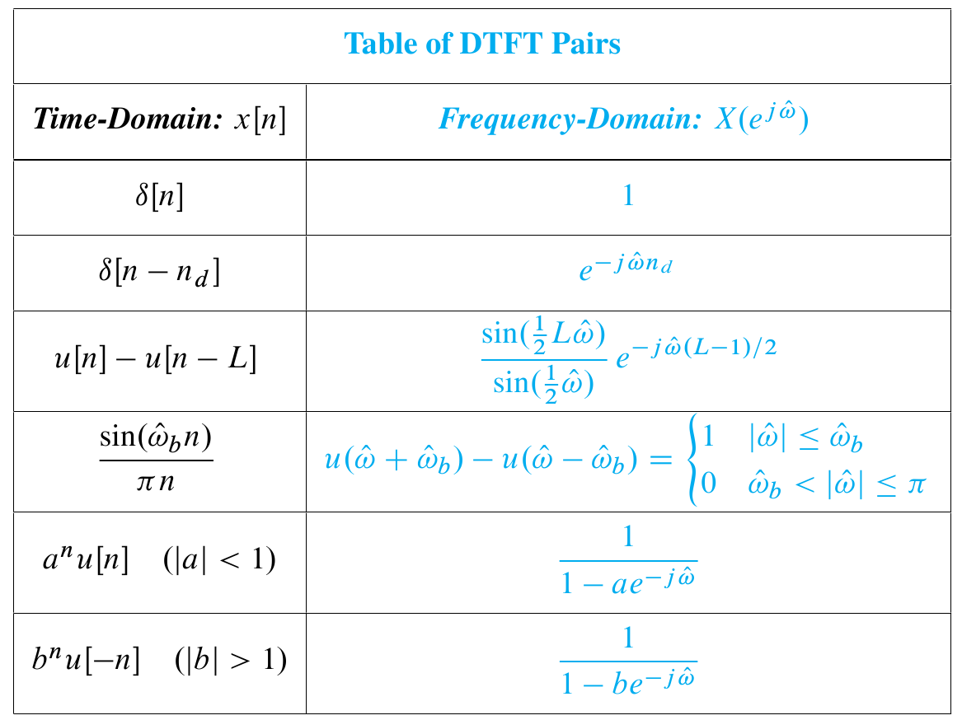
These 3 signals have infinite length

Slide 20
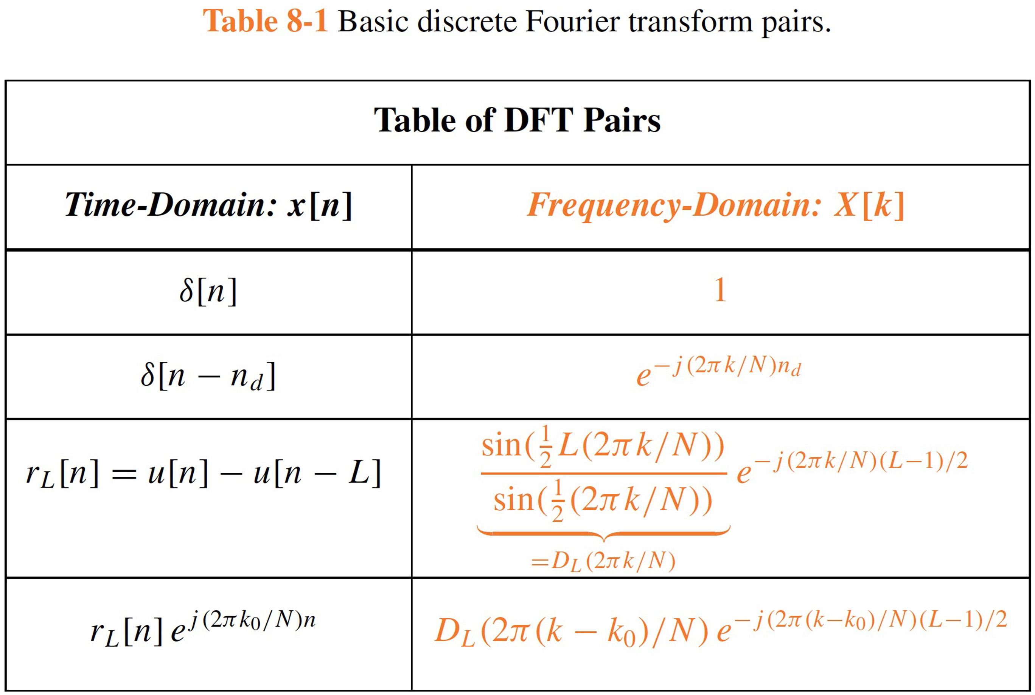
Summary of DTFT Pairs

Slide 21
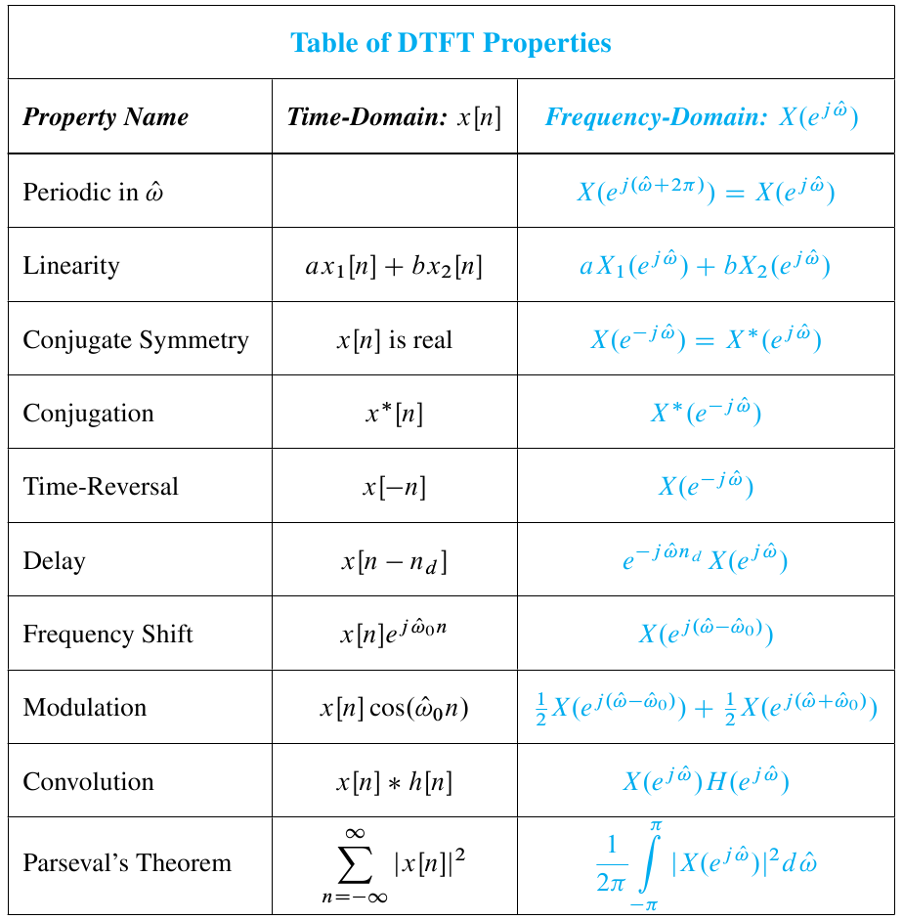
These 3 properties involve circular indexing

Slide 22
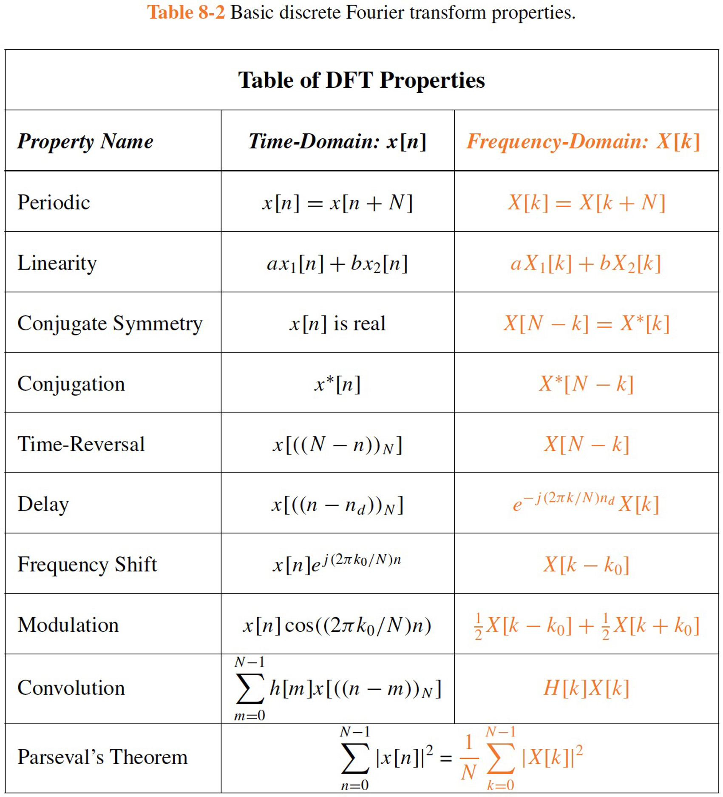

Slide 23
Convolution Property not the same
Almost true for DFT:
Convolution maps to multiplication of transforms
Need a different kind of convolution
CIRCULAR CONVOLUTION
LATER in an advanced DSP course
Likewise, for Time-Shifting
Has to be circular
Because the “n” domain is also periodic

Slide 24
Delay Property of DFT
Recall DTFT property for time shifting:
Expected DFT property via frequency sampling
Indices such as must be evaluated modulo-N because

Slide 25
DTFT of a Length-L Pulse
Know DTFT of finite rectangular pulse
Dirichlet form and a linear phase term
Use frequency-sampling to get DFT

Slide 26
DTFT of a Finite Length Complex Exponential (1)
Know DTFT of finite rectangular pulse
Dirichlet form and a linear phase term
Use frequency-shift property

Slide 27
DTFT of a Finite Length Complex Exponential (2)
Know DTFT, so we can sample in frequency
Thus, the N-point DFT is
Dirichlet Function

Slide 28
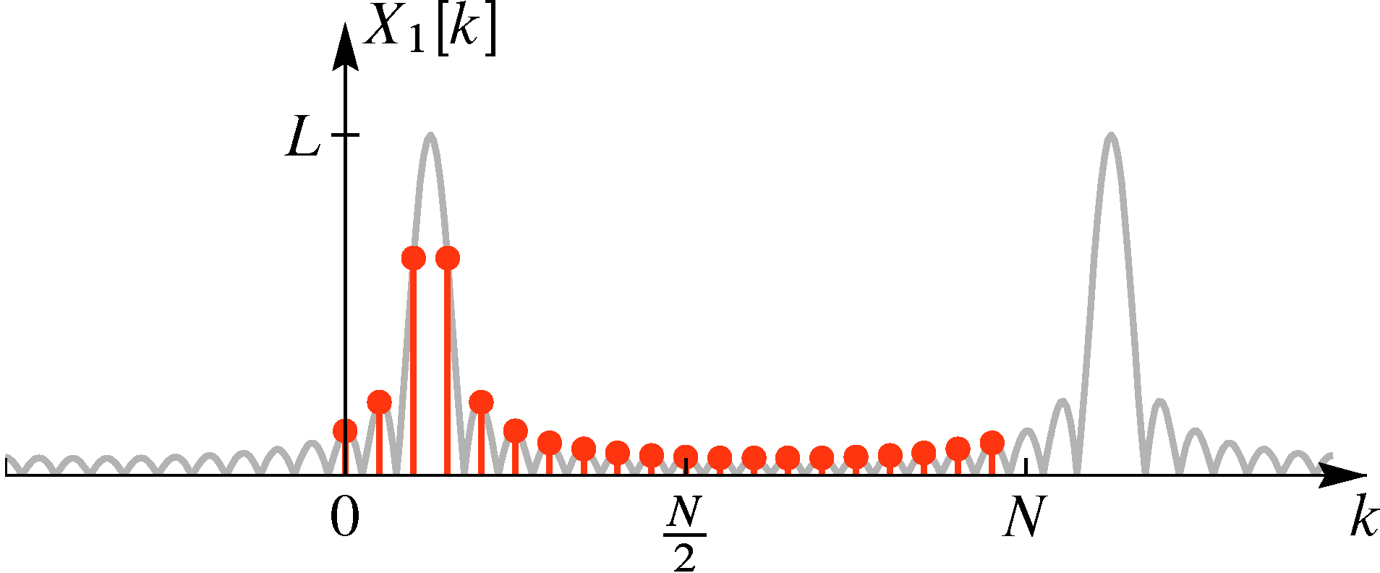
20-pt DFT of Complex Exponential

Slide 29
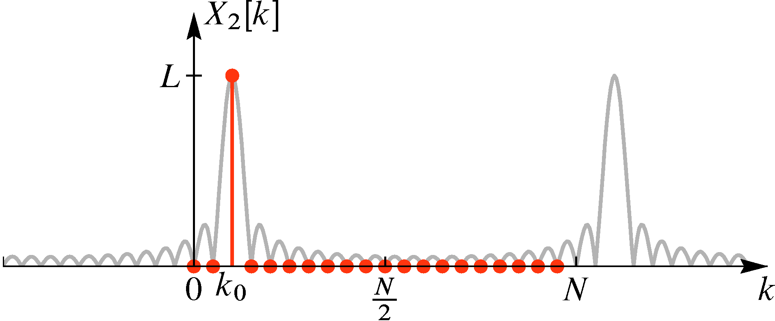
20-pt DFT of Complex Exp: “on the grid”

Slide 30
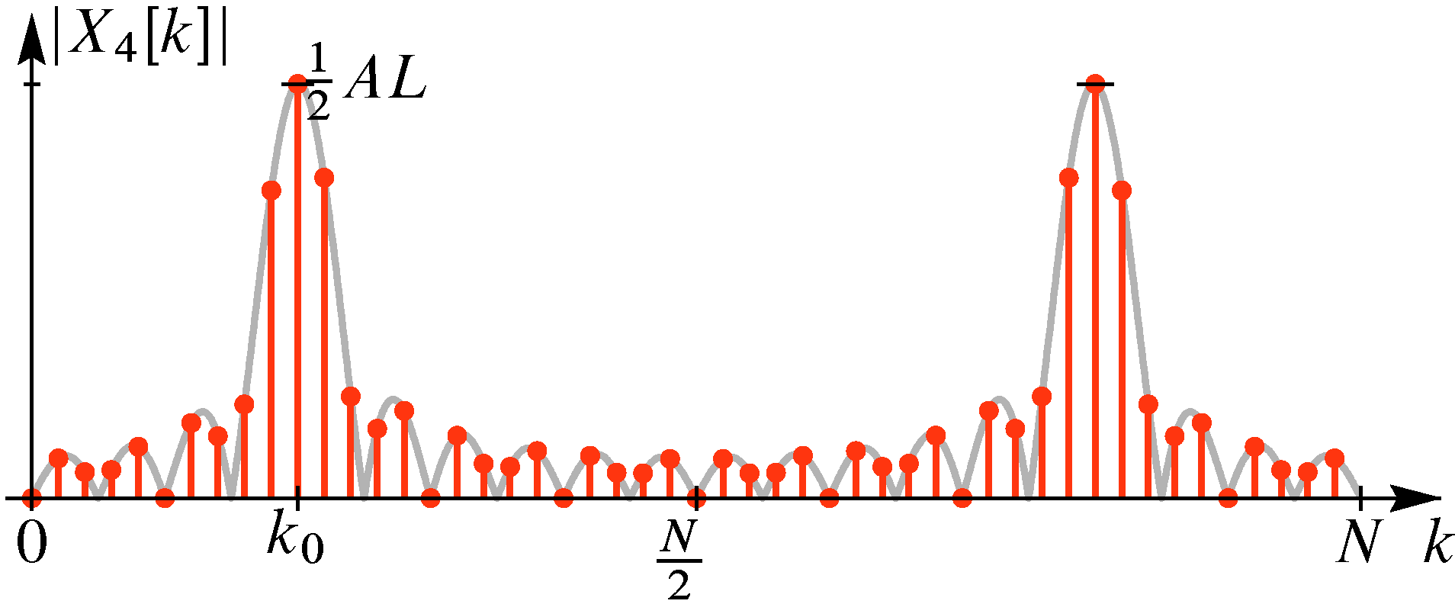
50-pt DFT of Sinusoid: zero padding
?

Slide 31
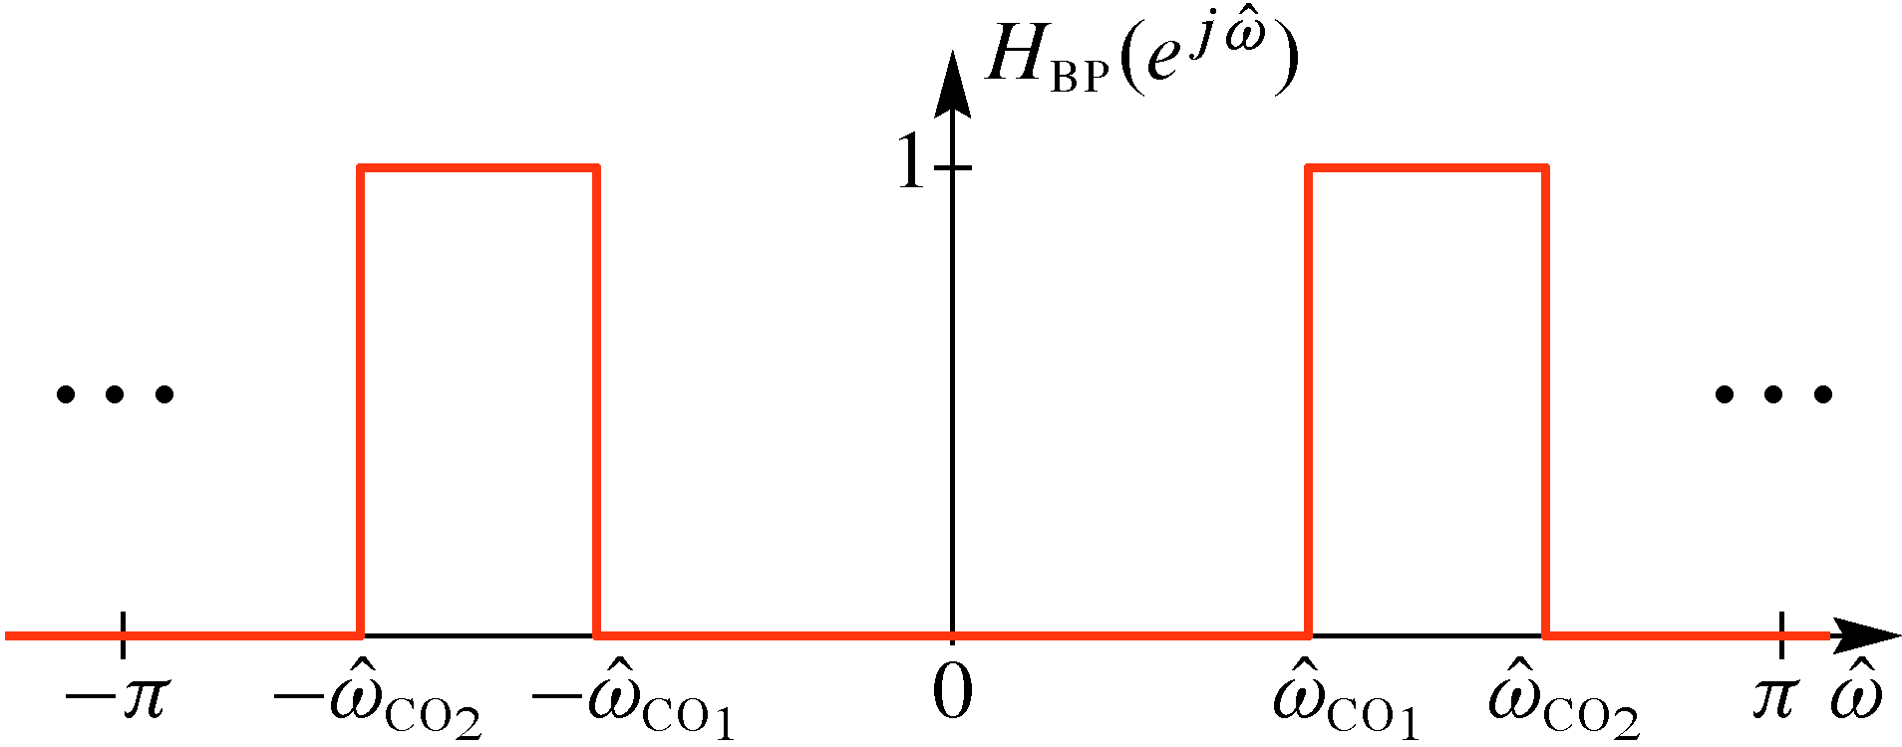
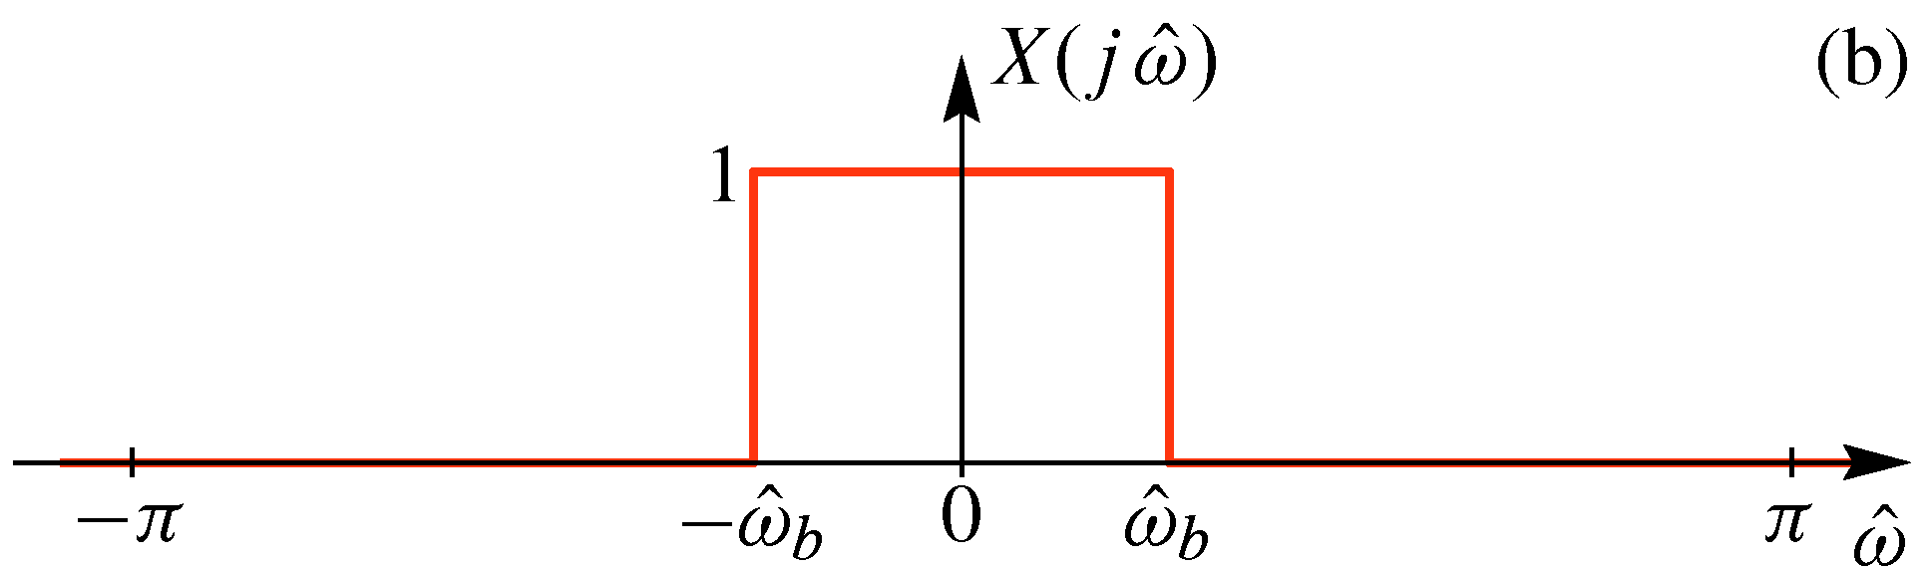
RECALL: BandPass Filter (BPF)
Frequency shifting
up and down is done
by cosine multiplication
in the time domain
BPF is frequency shifted
version of LPF (below)

Slide 32
50-pt DFT of Sinusoid: zero padding
?
Zero-crossings of Dirichlet ?
Thus we have
a simple BPF
Width of Dirichlet ?
Density of frequency samples?

Slide 34
Summary of DTFT Pairs
Delayed Impulse
Right-sided
Exponential
sinc function
is Bandlimited

Slide 35
Example

Slide 36
More Insight about the Example
Assume we have
Sampled at 40 samples/s
For this simple case, you can use Euler’s formula; same results as obtained via DFT

Slide 37
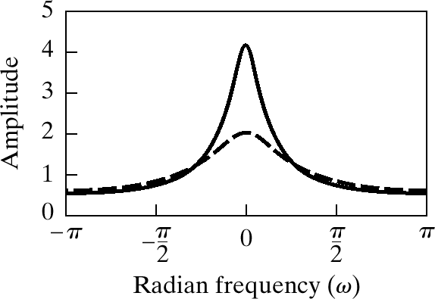
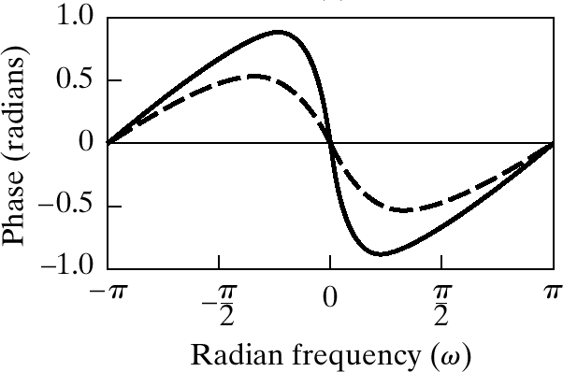
Magnitude is even

Slide 38
DTFT maps Convolution to Multiplication
LTI
System

Slide 39
Want to call the DTFT the spectrum
The DTFT provides a frequency-domain representation
The spectrum (Ch. 3) consists of lines at various frequencies , with complex amplitudes
The spectrum represents a signal that is the sum of complex exponentials
In what sense is the DTFT going to give a sum of complex exponentials ?

Slide 40
The iDTFT is “sum” of complex exps
The inverse DTFT is an integral
An integral is a “sum”, i.e., the limit of Riemann sums:
The finite sum consists of cexps at frequencies with complex amplitudes
The limit of these “finite spectra” is the inverse DTFT

Slide 41
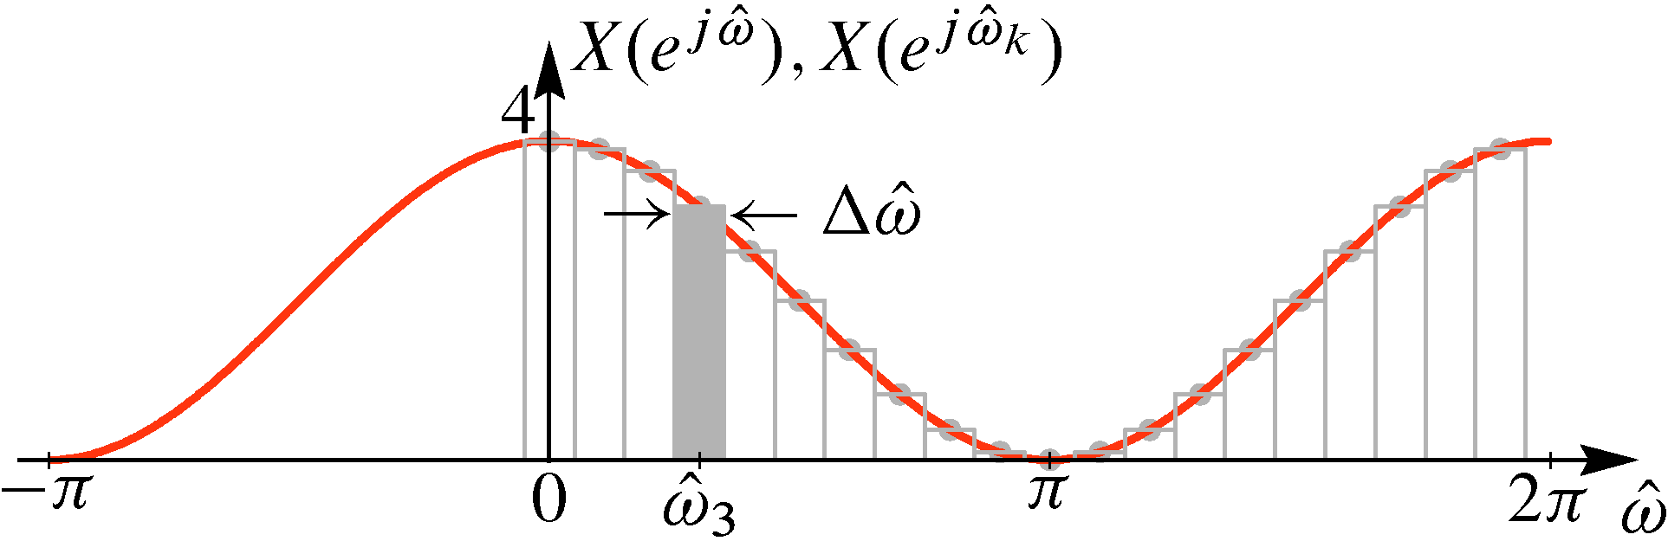
Example: DTFT SAMPLES as a Spectrum
Samples of DTFT
Proportional to
Height of Spectral Lines

Slide 42
Want a Computable Fourier Transform
Take the finite Riemann sum:
Note that
Propose:
This is the inverse Discrete Fourier Transform (IDFT)

Slide 43
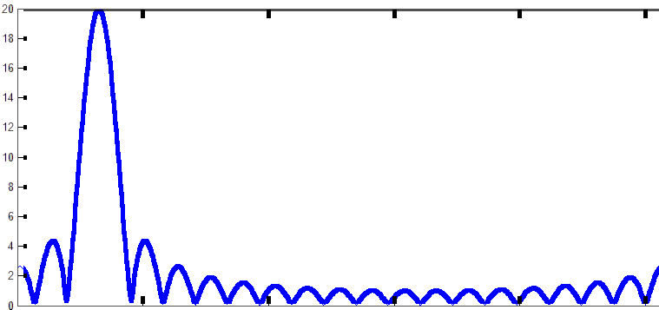
N-DFT of A Finite Complex Exponential
Dirichlet Function
0 1 4 6 10 15 19

Slide 44
The iDTFT is “sum” of complex exps
The inverse DTFT is an integral
An integral is a “sum”, i.e., the limit of Riemann sums:
with
The finite sum consists of cexps at frequencies or with complex amplitudes
The limit of these “finite spectra sum” is the inverse DTFT

Slide 45
Example: DTFT SAMPLES as a Spectrum
Samples of DTFT
Proportional to
Height of Spectral Lines

Slide 46
Want a Computable Fourier Transform
Take the finite Riemann sum:
Note that
Propose the following finite sum:
Above is the inverse Discrete Fourier Transform (IDFT)

Slide 47
The DTFT is the spectrum (1/2)
The inverse DTFT is an integral
An integral is a “sum”, i.e., the limit of a Riemann sum:
The finite sum consists of lines at frequencies with complex amplitudes
The limit of these “finite spectra sum” is the inverse DTFT

Slide 48
The DTFT is the spectrum (2/2)
The iDTFT is an integral
An integral is a “sum”, i.e., the limit of a sum
Riemann sum:
The spectrum (Ch. 3) consists of lines at various frequencies , with complex amplitudes
The spectrum represents a signal that is the sum of cexps ( as fundamental frequency)

