Slide 1
DSP First, 2/e
Lecture 18
DFS: Discrete Fourier Series, and Windowing

Slide 2
License Info for DSPFirst Slides
This work released under a Creative Commons License with the following terms:
Attribution
The licensor permits others to copy, distribute, display, and perform the work. In return, licensees must give the original authors credit.
Non-Commercial
The licensor permits others to copy, distribute, display, and perform the work. In return, licensees may not use the work for commercial purposes—unless they get the licensor's permission.
Share Alike
The licensor permits others to distribute derivative works only under a license identical to the one that governs the licensor's work.
Full Text of the License
This (hidden) page should be kept with the presentation

Slide 3
READING ASSIGNMENTS
This Lecture:
Chapter 8, Sections 8-3, 8-5 & 8-6

Slide 4
LECTURE OBJECTIVES
Discrete Fourier Series for periodic x[n]
DFT of one period with scaling by 1/N gives scaled DFS coefficients
Windowing
extract short sections from long signal

Slide 5
Review
Discrete Fourier Transform (DFT)
DFT is frequency sampled DTFT
For finite-length signals
DFT computation via FFT
FFT of zero-padded signal→more freq samples
Transform pairs & properties (DTFT & DFT)

Slide 6
Comparison: DFT and DTFT
Discrete Fourier Transform (DFT)
Inverse DFT
Discrete-time Fourier Transform (DTFT)
Inverse DTFT

Slide 7
Inverse DFT always makes a periodic signal
Evaluate N-pt IDFT outside of [0,N-1]
Thus the IDFT synthesizes a periodic signal

Slide 8
Fourier Series for Discrete-Time Signal
Given a periodic sequence x[n], how do we write it as a sum of sinusoids (or complex exponentials) ?
Which frequencies? How many? Fundamental ?
Exponentials must have the same period as x[n], which is N. There are only N possible exps.

Slide 9
Discrete Fourier Series Representation (2)
Given the sequence x[n], how do we find a_{k}?
Recall IDFT always synthesizes a periodic x[n]
So, we find a_{k} by taking the
N-pt DFT of one period of x[n]
and then multiplying by 1/N

Slide 10
Discrete Fourier Series (DFS)
Synthesis of a periodic signal x[n] = x[n+N]
Find a_{k} by taking N-pt DFT
of one period of x[n]
and then multiplying by 1/N

Slide 11
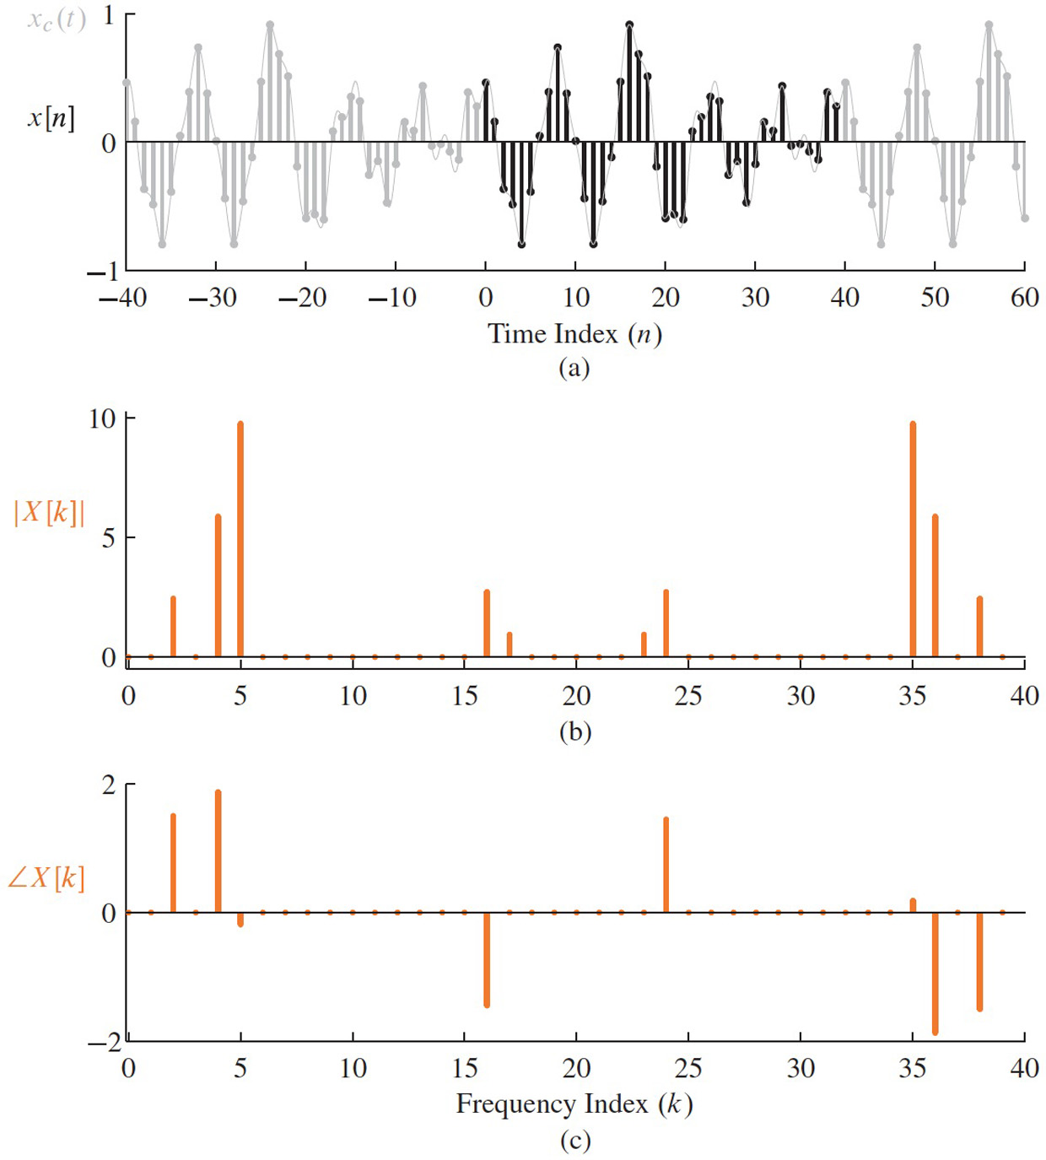
DFT of one period → DFS
Can you get the DFS coeffs from this DFT ?
Figure 8-12 Periodic sequence x[n] in (8.43) and the corresponding 40-point DFT spectrum X[k]. (a) Dark region indicates the 40-point interval (starting at n = 0) taken for analysis. (b) DFT magnitude spectrum. (c) DFT phase spectrum.

Slide 12
DFS Synthesis Example
Recall negative frequencies in high indices for the DFT

Slide 13
How is DFS related to cont-time Fourier Series ?
Fourier Series (from Chap. 3)
Need to obey the Nyquist rate: i.e., band-limited signal
Then sample

Slide 14
How is DFS related to cont-time Fourier Series (2)
Band-limited Fourier Series (from Chap. 3)
Can be sampled to give periodic x[n]
Compare to DFS
Same coefficients

Slide 15
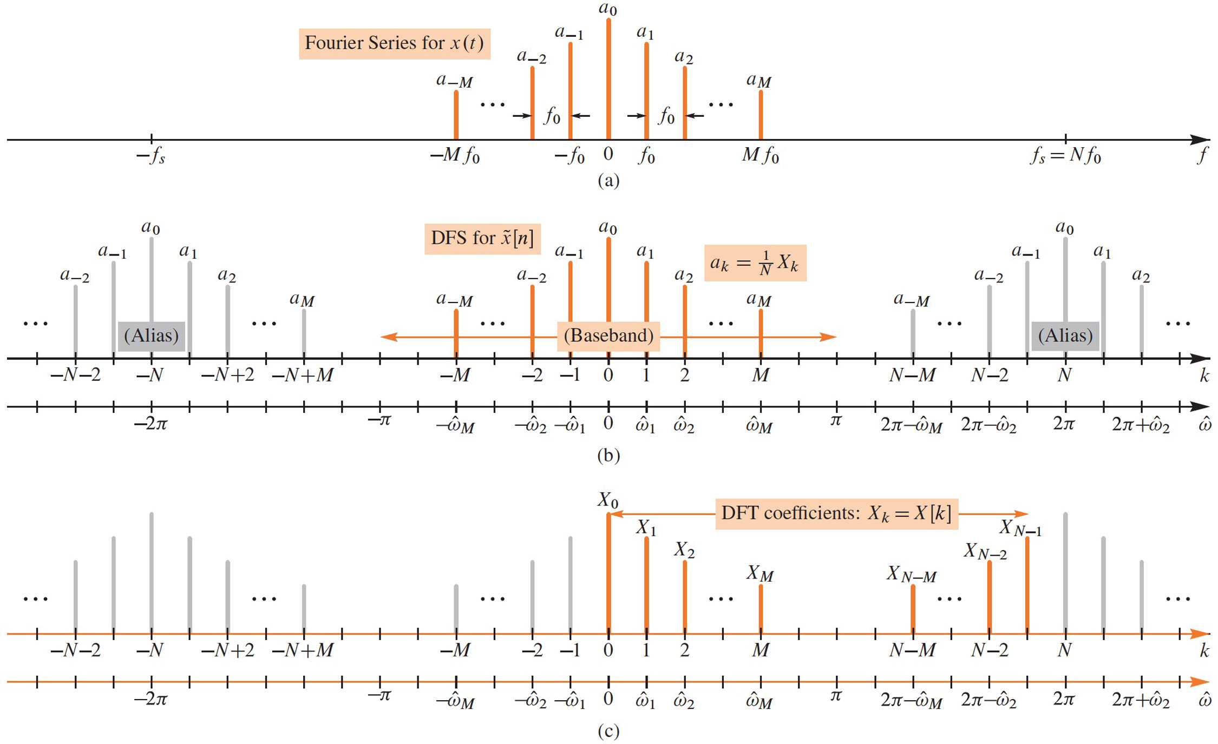
Spectrum Analysis of a Periodic Signal x[n]

Slide 16
Windows
Finite-Length signal (L) with positive values
Extractor
Truncator

Slide 17
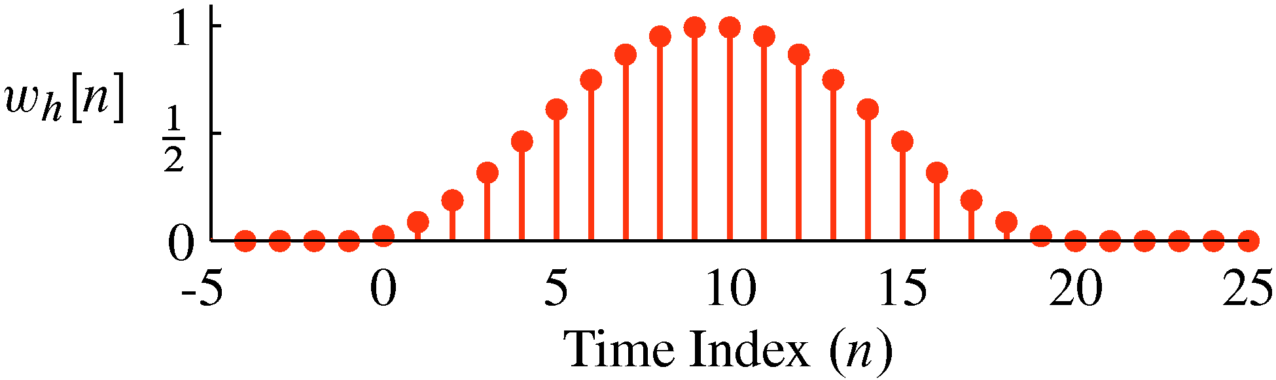
Von Hann Window (Time Domain)
Plot of Length-20 von Hann window

Slide 18
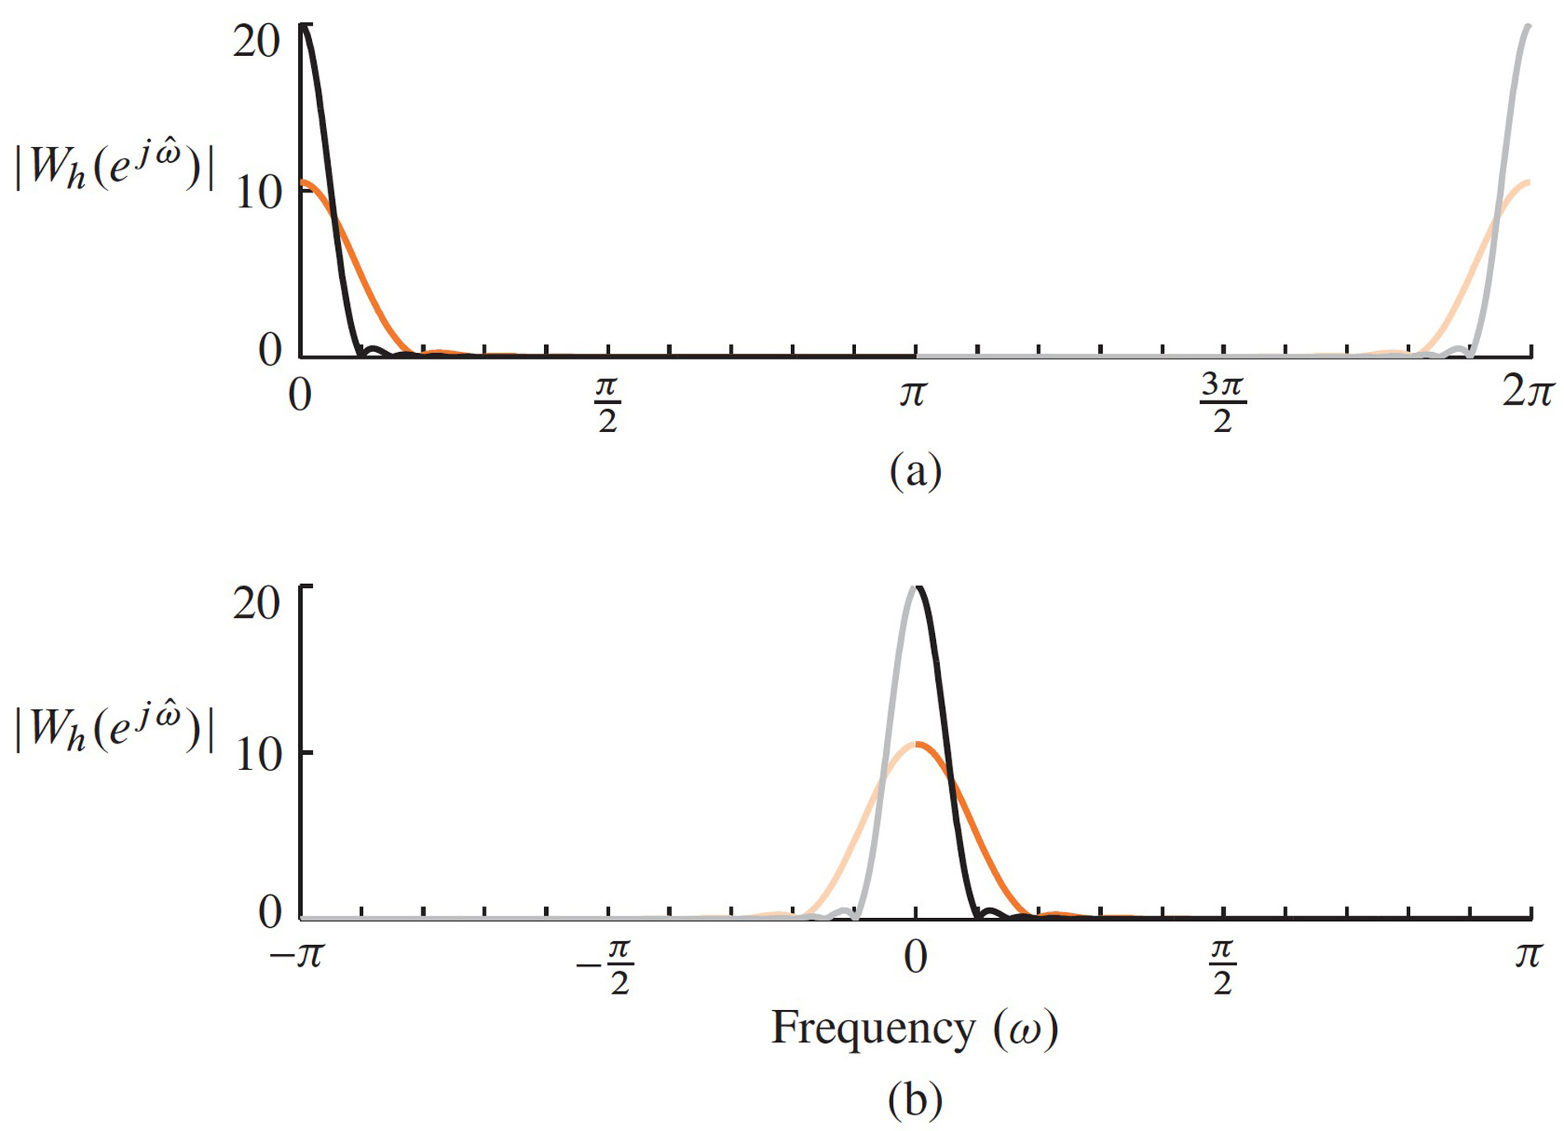
Von Hann Window (Frequency Domain)
DTFT (magnitude) of Length-20 Hann window

Slide 19
Window section of sinusoid, then DFT
Multiply the very long sinusoid by a window
Take the N-pt DFT
Finite number of frequencies (N)
Finite signal length (L) = window length
Expectation: 2 narrow spectrum lines

Slide 20
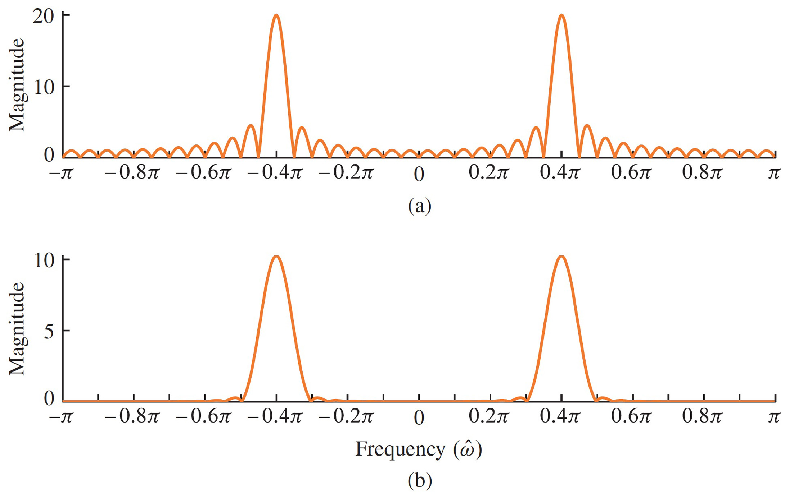
DTFT of Windowed Sinusoid (with different windows)
DTFT (magnitude) of windowed sinusoid
Length-40 Hann window vs Length-40 Rectangular window
UnWeighted
Hann Window

Slide 21
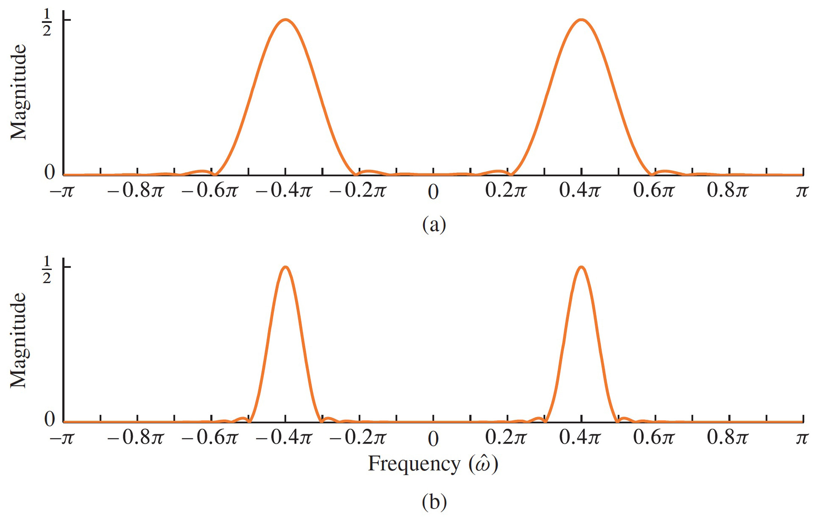
Change Window Length
DTFT (magnitude) of windowed sinusoid.
Length-20 Hann window vs. Length-40 Hann window

Slide 22
Challenge: find DFS for x[n] = sampled Dirichlet
Synthesis of a periodic signal, x[n] = x[n+N]
Find a_{k} by taking N-pt DFT of one period of x[n] and then multiplying by 1/N

