Slide 1
DSP First, 2/e
Lecture 19
Spectrogram: Spectral Analysis via DFT & DTFT

Slide 2
License Info for DSPFirst Slides
This work released under a Creative Commons License with the following terms:
Attribution
The licensor permits others to copy, distribute, display, and perform the work. In return, licensees must give the original authors credit.
Non-Commercial
The licensor permits others to copy, distribute, display, and perform the work. In return, licensees may not use the work for commercial purposes—unless they get the licensor's permission.
Share Alike
The licensor permits others to distribute derivative works only under a license identical to the one that governs the licensor's work.
Full Text of the License
This (hidden) page should be kept with the presentation

Slide 3
READING ASSIGNMENTS
This Lecture:
Chapter 8, Sects. 8-6 & 8-7
Other Reading:
FFT: Chapter 8, Sect. 8-8

Slide 4
LECTURE OBJECTIVES
Spectrogram
Time-Dependent Fourier Transform
DFTs of short windowed sections
Frequency Resolution
To resolve closely spaced spectrum lines
Need long windows

Slide 5
Review & Recall
Discrete Fourier Transform (DFT)
DFT is frequency sampled DTFT
For finite-length signals
DFT computation is actually done via FFT
FFT of zero-padded signal→more freq samples
Transform pairs & properties (DTFT & DFT)

Slide 6
Recall: DFT and DTFT
Discrete Fourier Transform (DFT)
Inverse DFT
Discrete-time Fourier Transform (DTFT)
Inverse DTFT

Slide 7
The Transform Method (DTFT)
To get the output signal y[n], given the input x[n], and the system defined by h[n].
Convolution becomes multiplication of DTFTs

Slide 8
Frequency Response Method
To get the output signal y[n], given the input x[n] is a sinusoid, and the system defined by h[n].
Multiply Magnitudes, Add Phases

Slide 9
DTFT, DFT and DFS are Tools for Analysis
DTFT applies to discrete time-sequences, regardless of length (as long as x[n] is absolutely summable);
Note: sinusoids are not absolutely summable
N-pt DFT of a finite-length sequence is equivalent to sampling the corresponding DTFT on frequency axis at N equally spaced points, without losing any information
Zero-padding when N>L
If the sequence is periodic, and the DFT is performed on one period, the result is a discrete Fourier Series (DFS) which is an exact representation.

Slide 10
Various Situations in Signal Analysis
Signal property does not fluctuate with time
Sampled signal is periodic with known period N₀ – use N₀-pt DFT and get the precise result (DFS)
Sampled signal is aperiodic, or period is unknown, or hard to ascertain precisely.
Signal characteristic is global (for the entire signal)
Finite-Length, e.g., pulse
Infinite-Length: e.g., right-sided exponential
Sampled signal property changes with time
Signal defined by math formulas over intervals
Recorded signal, most likely with changing sinusoidal content, or properties – the most general case
COMMON
CASE →
COMMON
CASE →

Slide 11
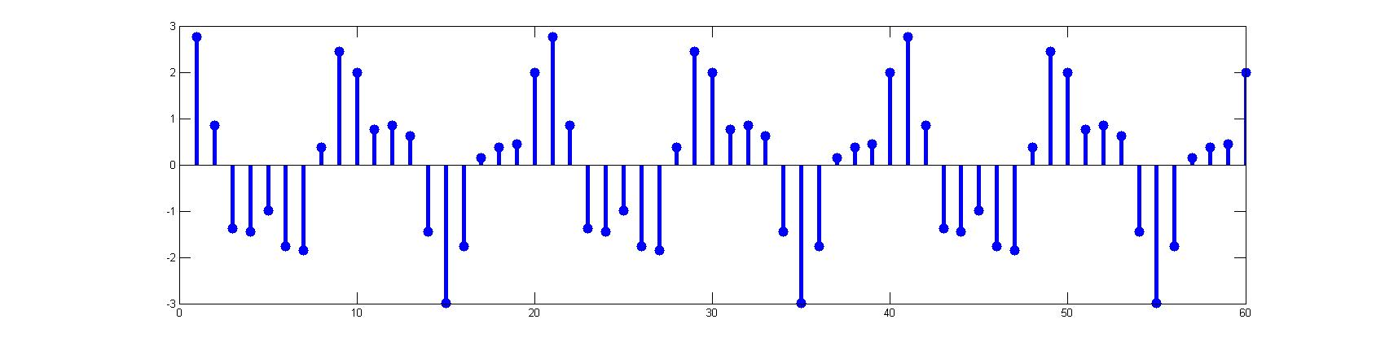
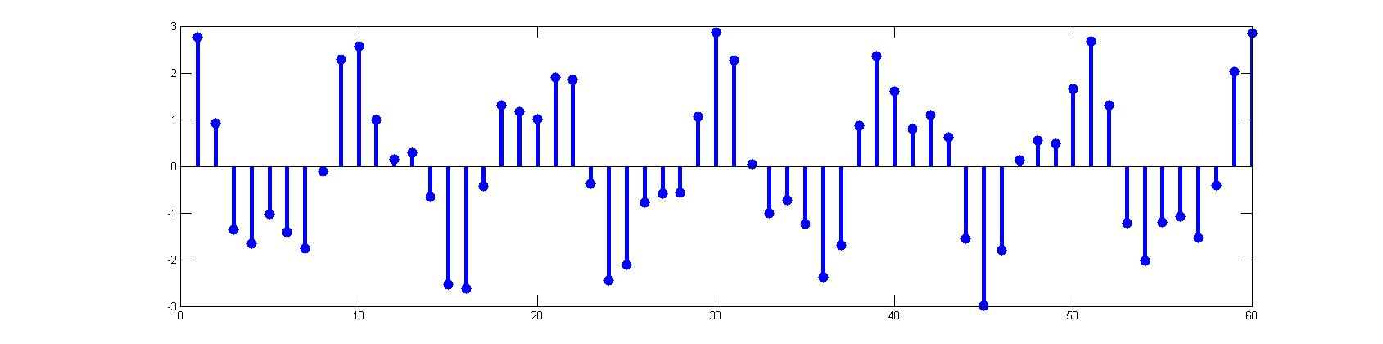
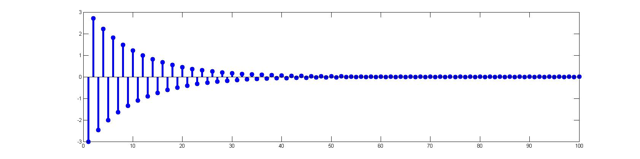
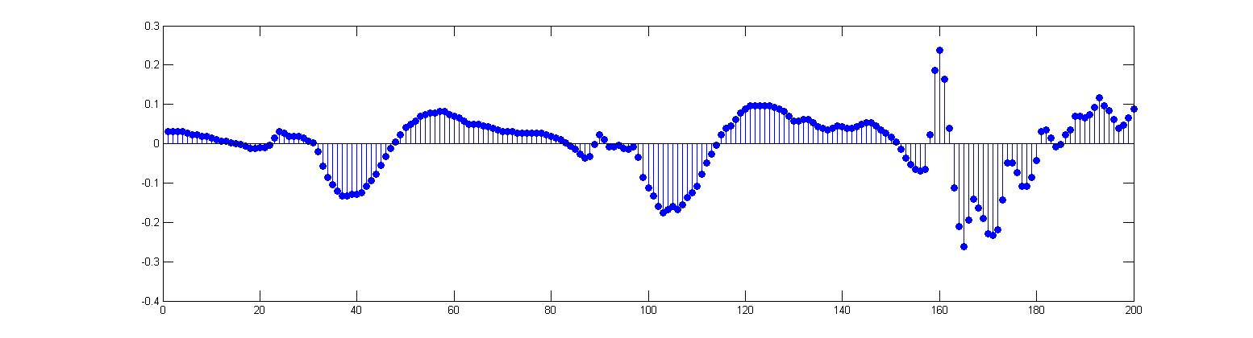
Examples
A.1 Periodic Sequence
A.2 Nonperiodic Sequence
A.3 Global infinite-length sequence
B.2 A general sequence

Slide 12
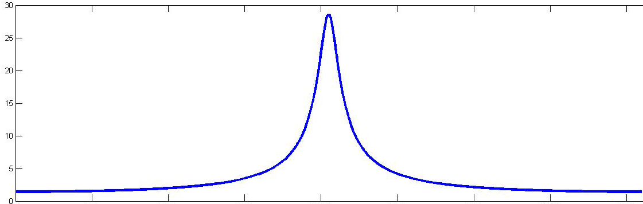
A.3: DTFT gives global spectrum
A.3 sequence from formula
N-pt DFT: approaching DTFT
when N → infinity
More about this later.

Slide 13
When Periodicity Is Not Precise – A.2
Periodicity is imprecise – either not known exactly or impractical to take exactly one period of data; for example:
We take L data points for analysis; actual period is not L (≠20 for the example).
Actual period of sequence

Slide 14
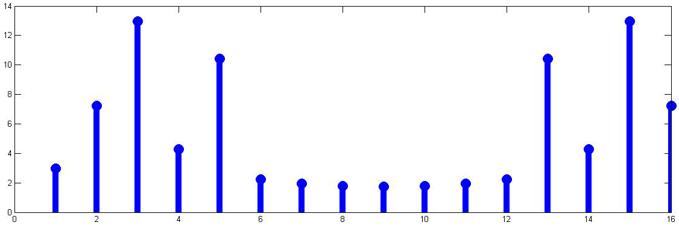
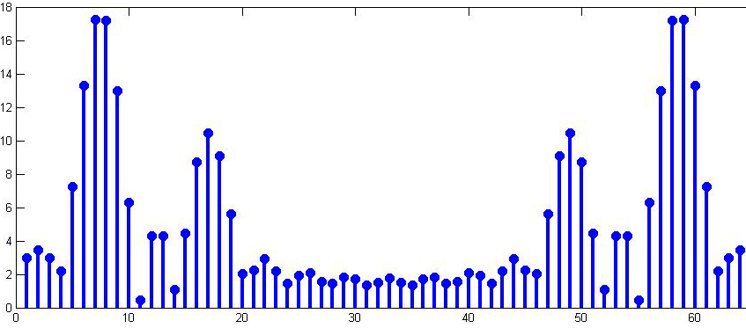
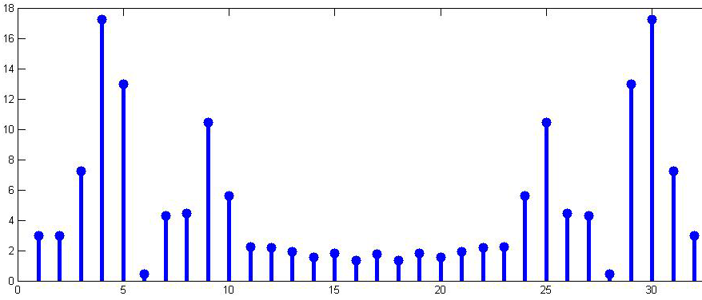
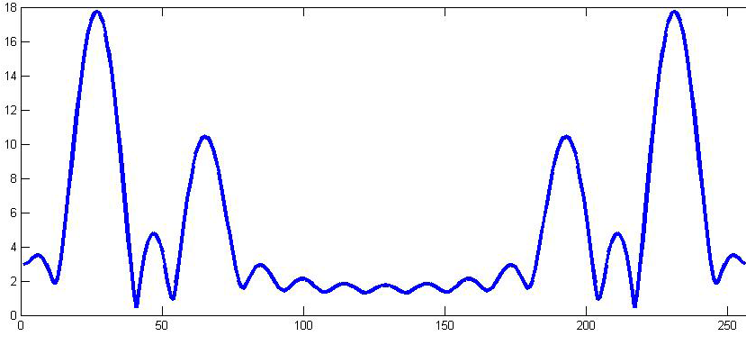
Imprecise Period Example (2)
0 6 16 48 58 63

Slide 15
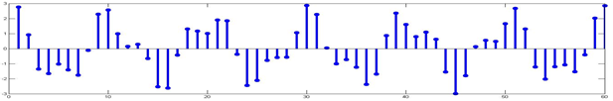
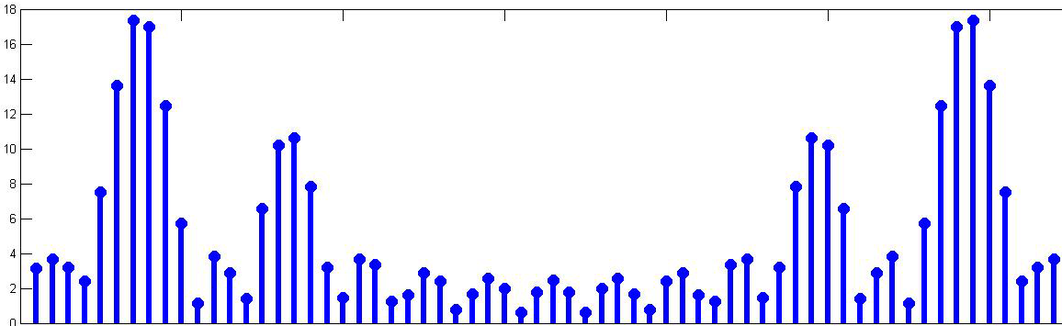
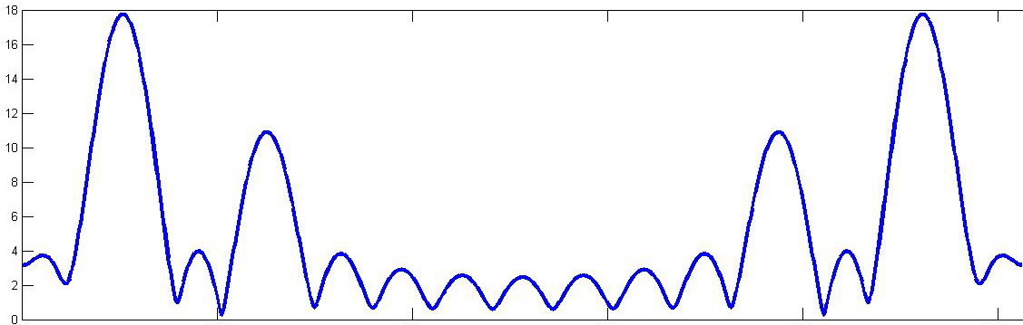
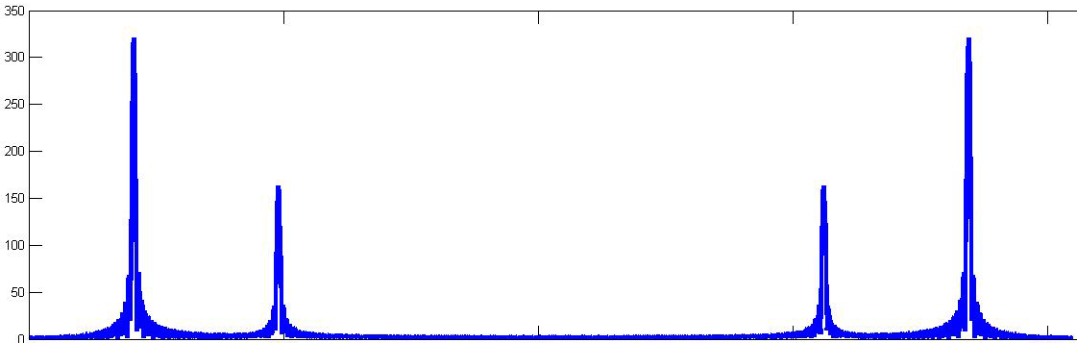
Similar Example – Changing L
0 6 16 48 58 63

Slide 16
Observations
When signal property stays fixed, the longer the section of data (larger L), the sharper the frequency resolution.
The larger the number of points for the DFT, N, the denser the frequency axis sampling.
However, the resolution (or separation) of sinusoids w.r.t. frequency is determined by the data length L, not by length of the N-pt DFT (with zero padding).
When signal properties change with time, there are other considerations that limit the size of L; see case B.

Slide 17
Case B – The General Case
DFT can also be used as a tool for finding the spectral composition of an arbitrary signal:
In general, we observe changing signal properties
Short-time analysis framework
Analyze sequence one block (frame) of data at a time using DFT
Successive blocks of data may overlap
“SPECTROGRAM”

Slide 18
FRAME = WINDOW of DATA
Example of Non-overlapped frames
Data also can be extracted from overlapped frames – overlapped characteristics provide smoother transitions from one frame to next
Denote Number of Overlapping Points as

Slide 19
A very long signal
Four intervals
Four spectrum lines

Slide 20
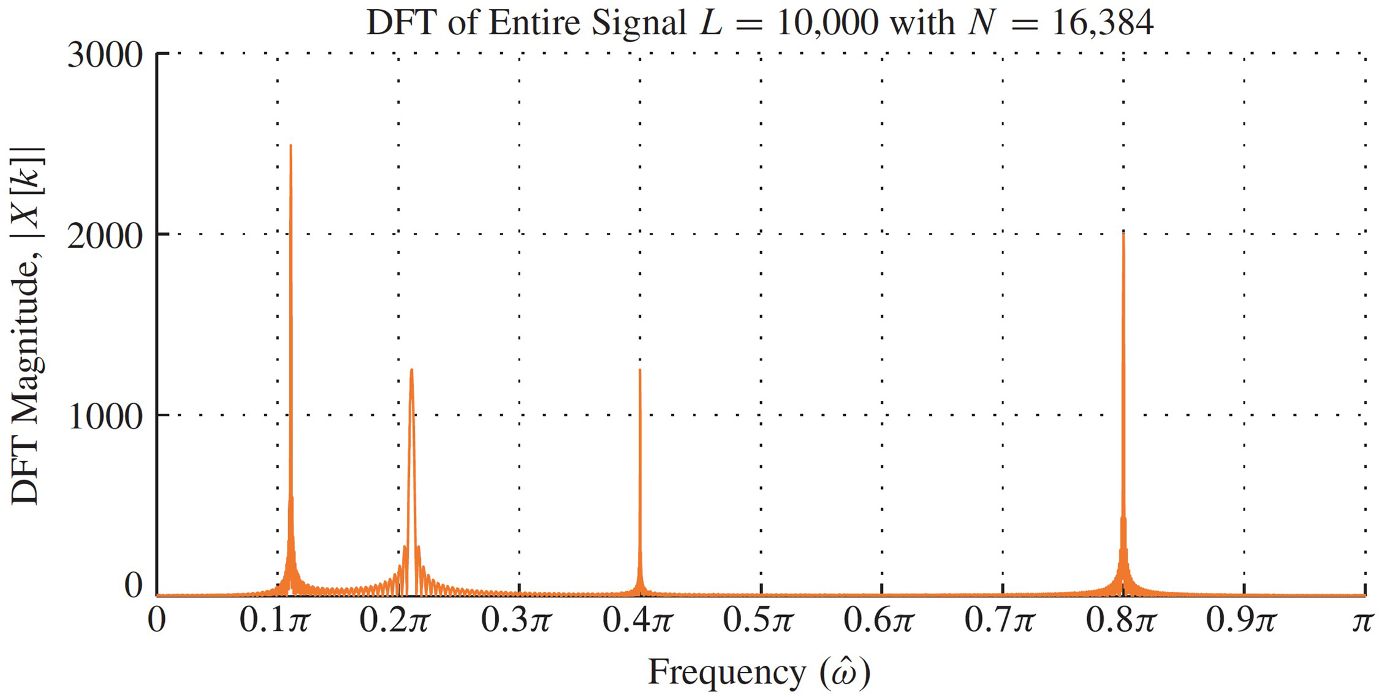
DFT of a very Long Signal (Global)
Length 10,000 signal, 16384-pt DFT

Slide 21
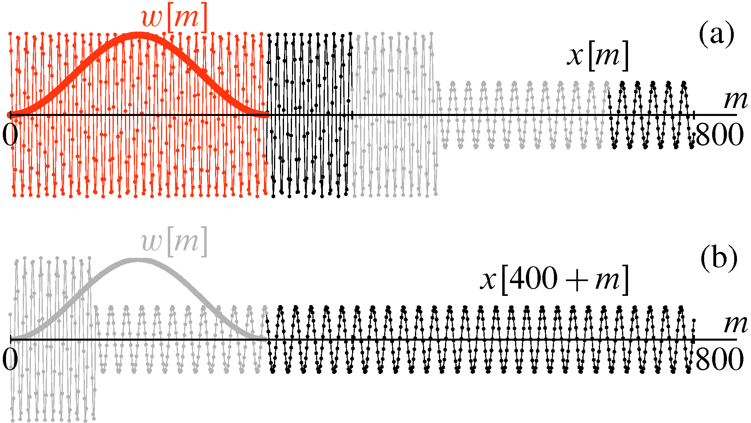
Windowing a Long Signal
Long signal is time-shifted into the domain of the window, [0,300] in this case

Slide 22
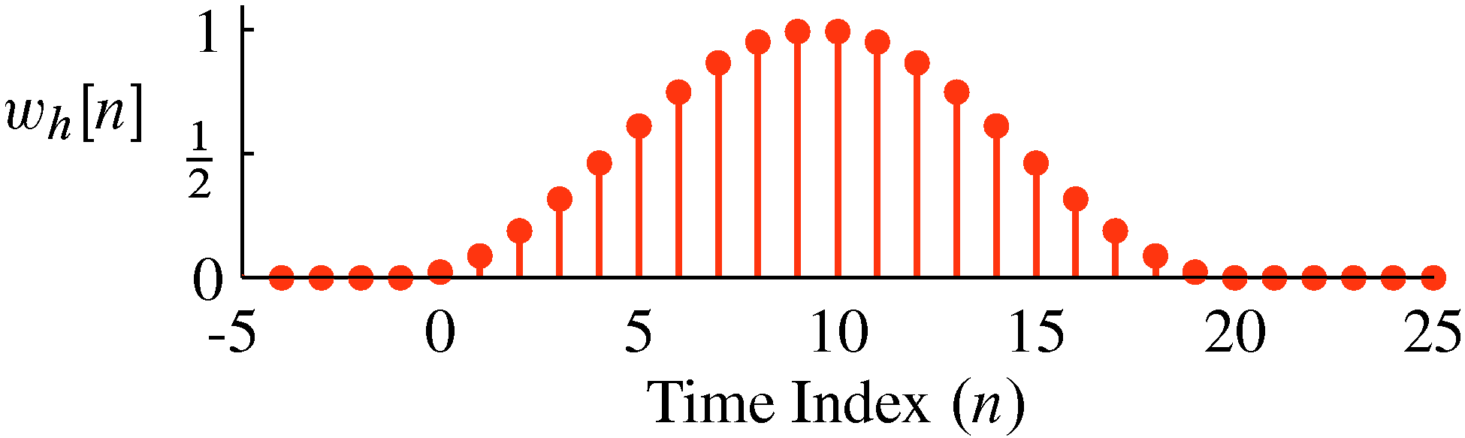
Von Hann Window in Time Domain
Plot of Length-20 von Hann window

Slide 23
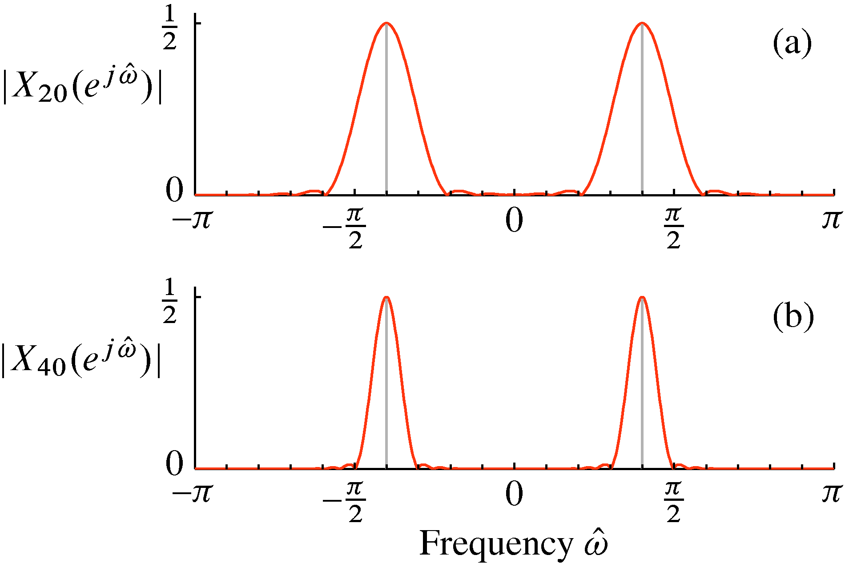
DTFT of Hann Window: Change Length
DTFT (magnitude) of windowed sinusoid.
Length-20 Hann window vs. Length-40 Hann window

Slide 24
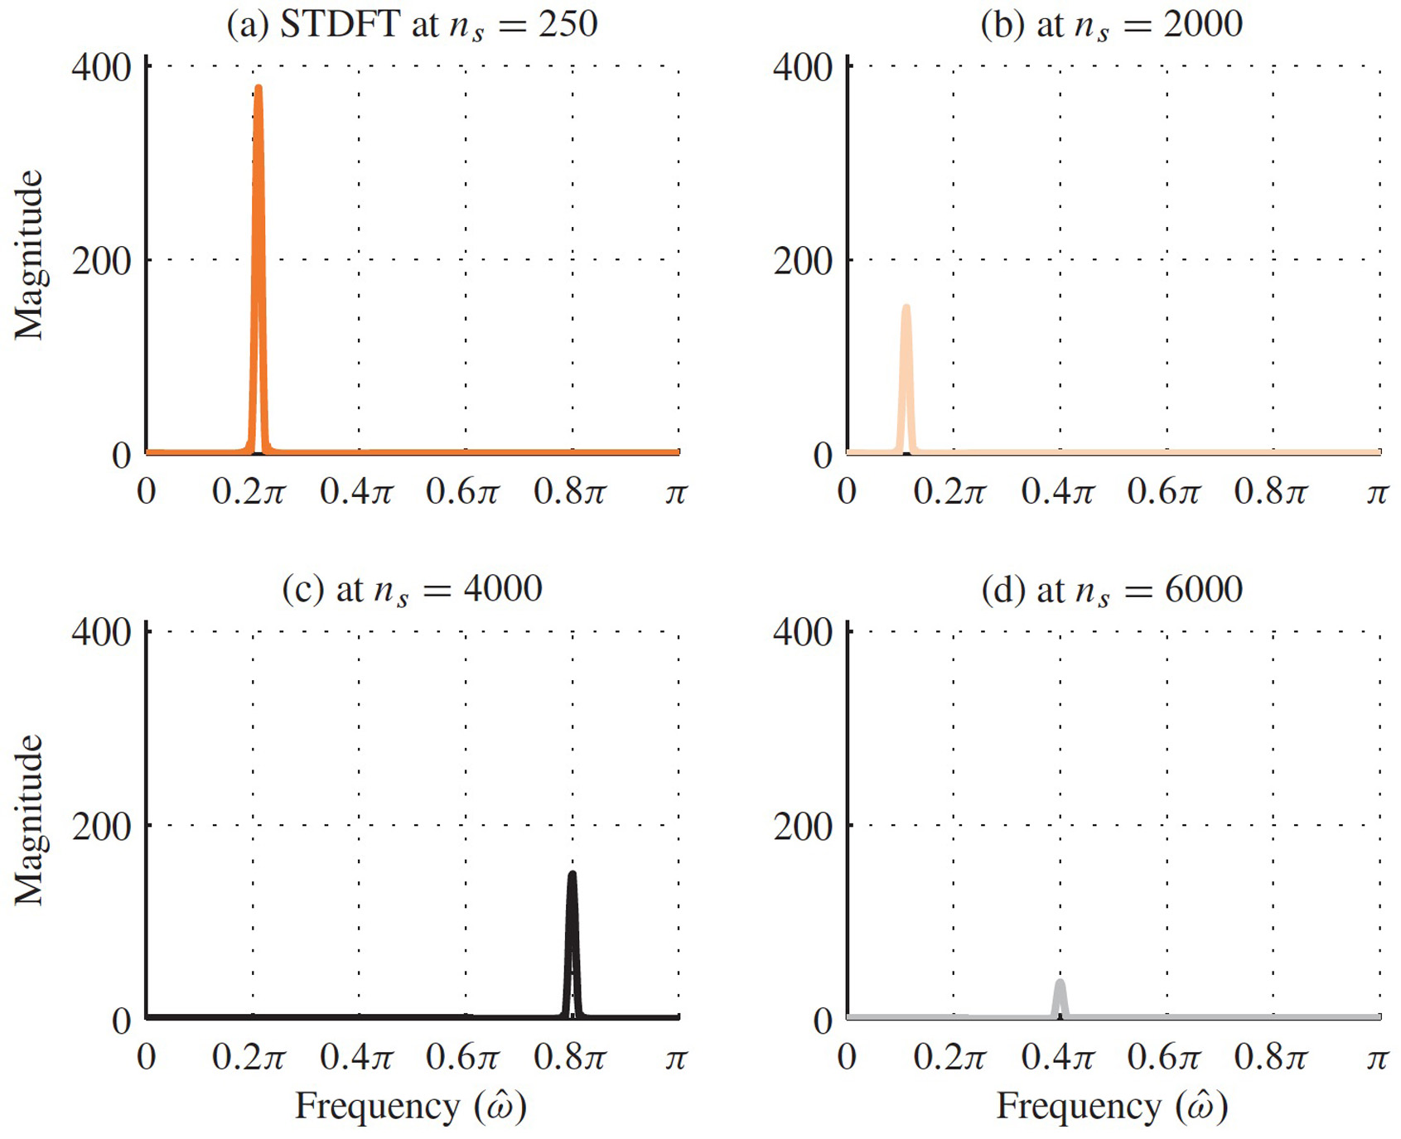
Short DFTs of Windowed Sections (L=301)
301-pt Hann window. 1024-pt DFT (zero-padded)

Slide 25
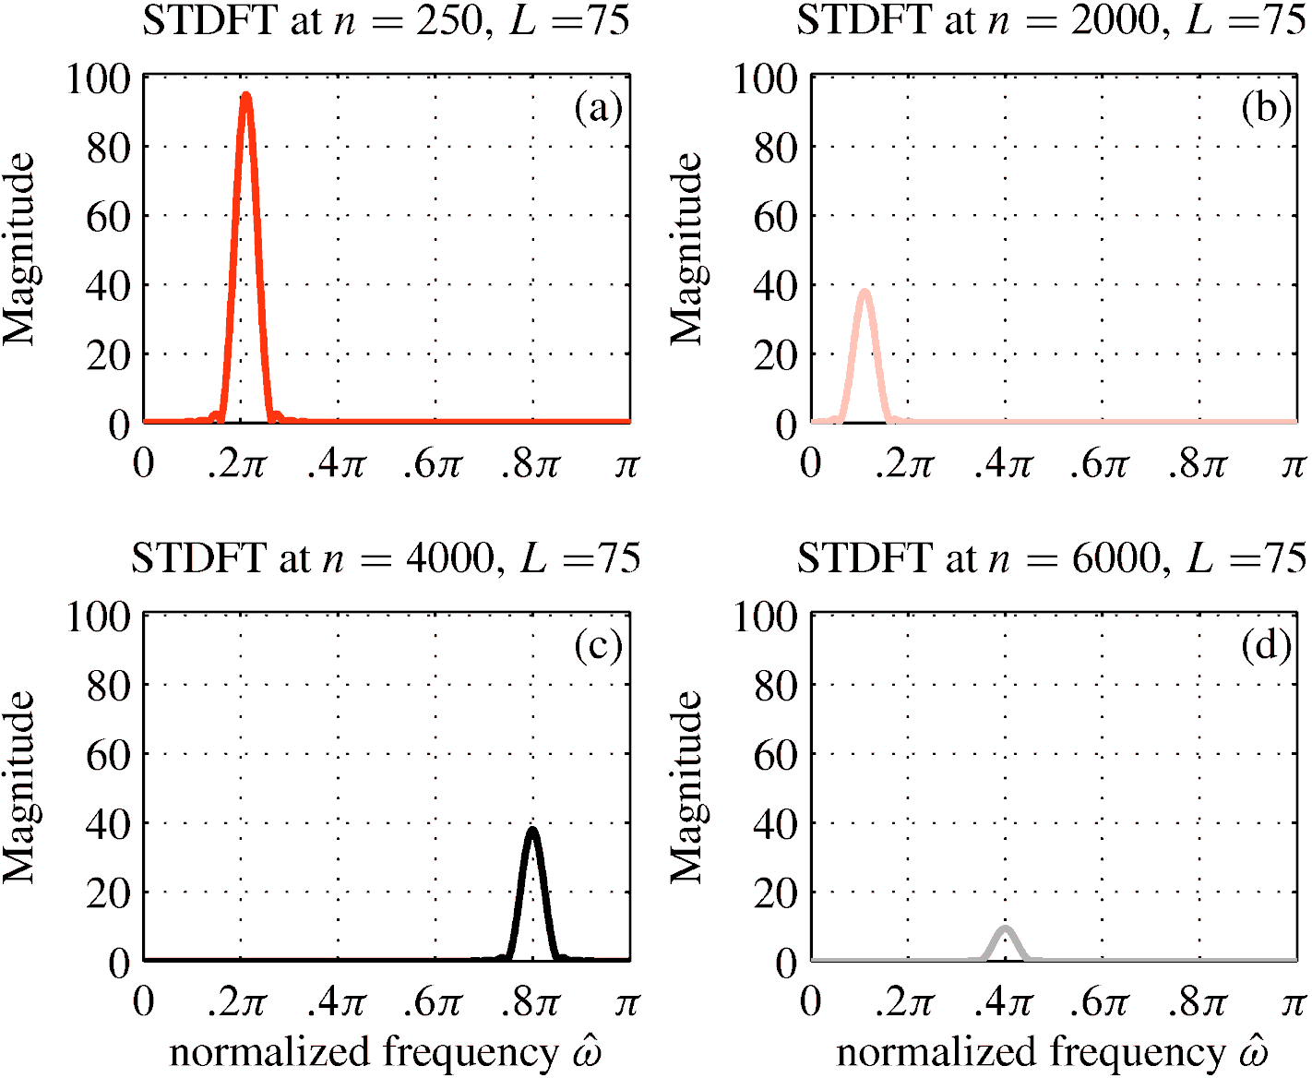
Short DFTs of Windowed Sections (L=75)
75-pt Hann window. 1024-pt DFT (zero-padded)

Slide 26
A very long signal
Four intervals
Four spectrum lines

Slide 27
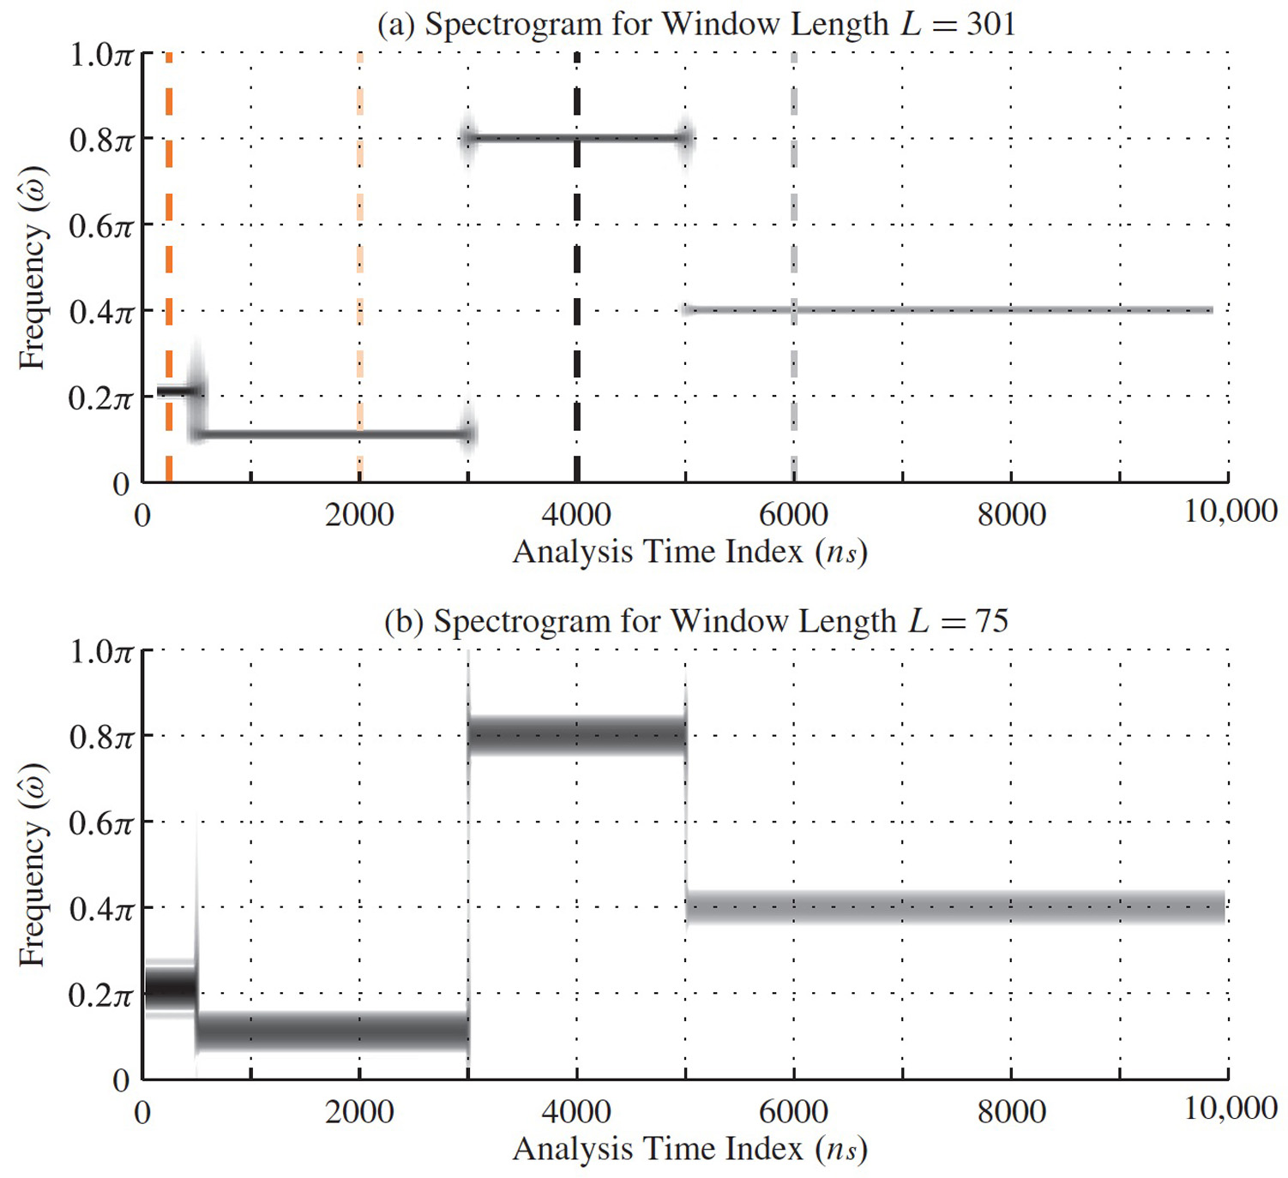
Two Spectrograms of very Long Signal
Window Lengths of L=301 and L=75; overlap 90%

Slide 28
MATLAB Spectrogram
In MATLAB, use
Fs is the sampling frequency specified in samples/s
WINDOW:
if a vector, extract segments of X of equal length, and then multiply window vector and data vector, element by element;
If an integer, same as above but use a Hamming window of the specified length
if unspecified, use default
NOVERLAP: (<WINDOW)
Number of overlapping data between successive frames
NFFT: Length of FFT
S = spectrogram(X,WINDOW,NOVERLAP,NFFT,Fs,‘yaxis’)

Slide 29
Resolution Test
Closely spaced frequency components
How close can the lines be?
Depends on window (section) length
Inverse relationship

Slide 30
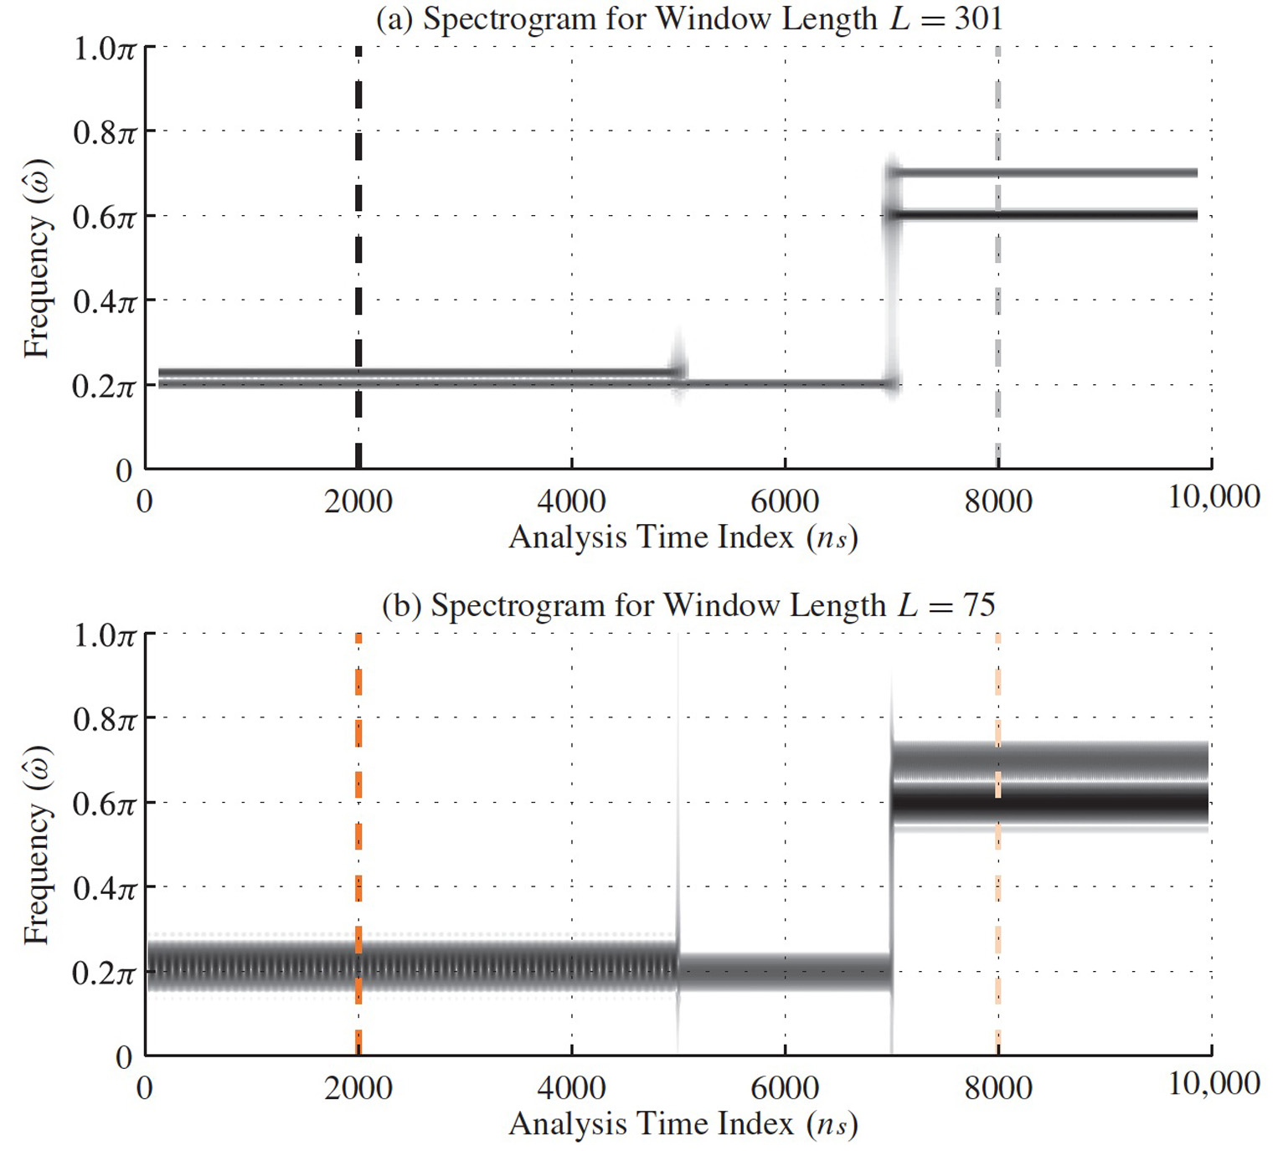
Two Spectrograms: Resolution Test
Window Lengths of L=301 and L=75, overlap 90%

Slide 31
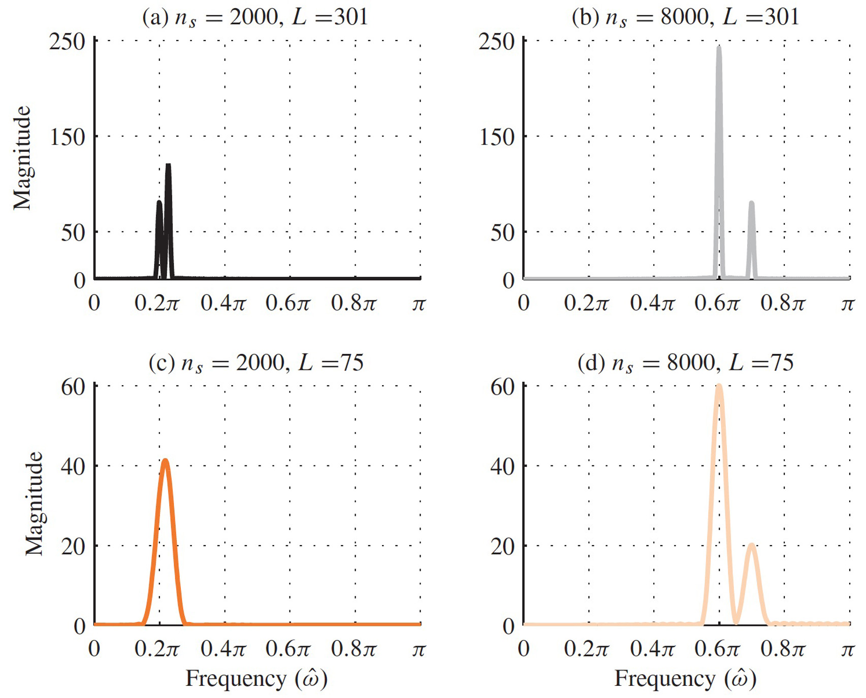
Short DFTs of Windowed Sections
75-pt and 301-pt Hann windows. 1024-pt DFT (zero-padded)

Slide 33
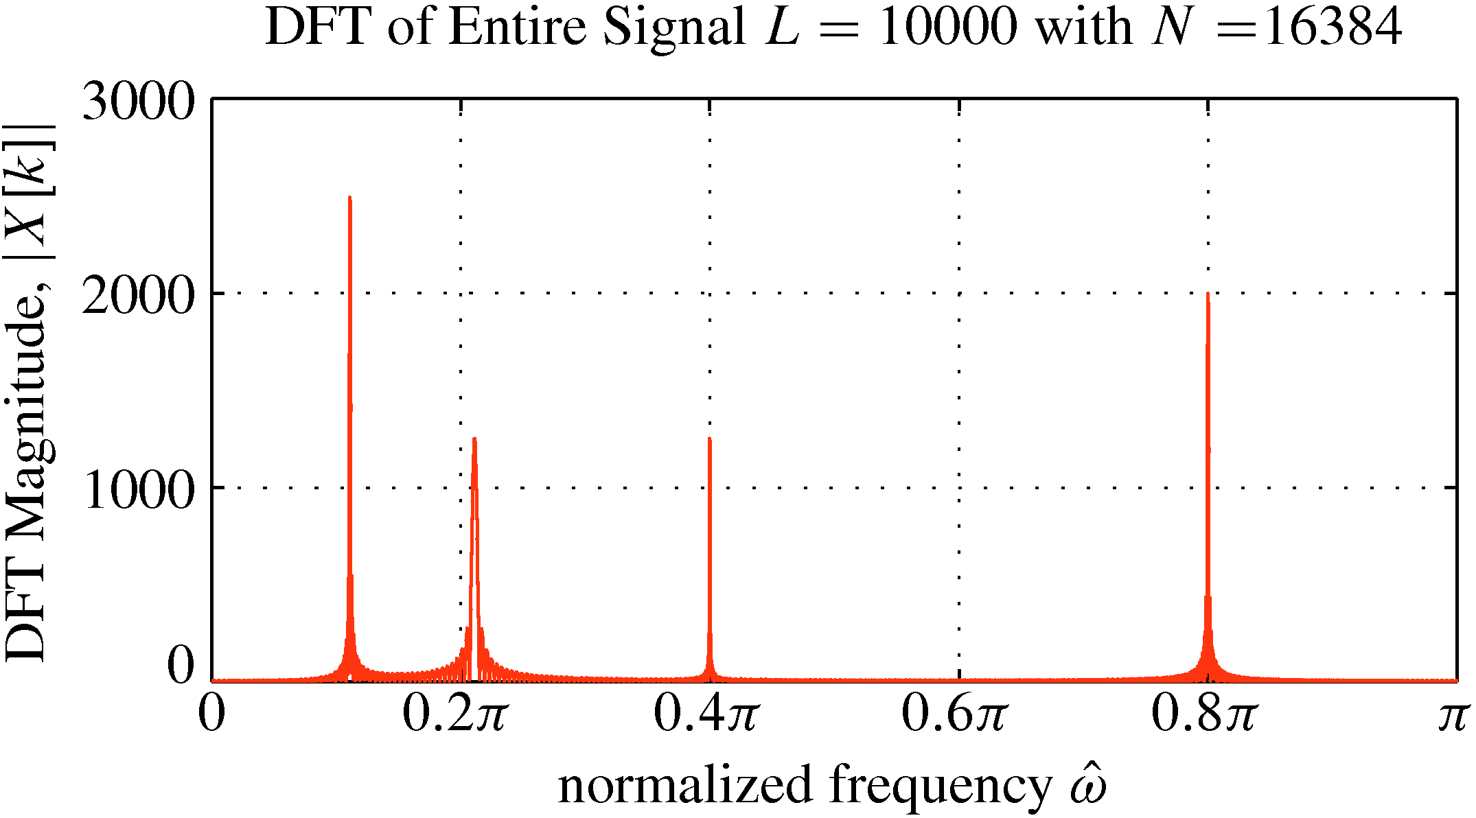
DFT of a very Long Signal (Global)
Length 10,000 signal, 16384-pt DFT

Slide 34
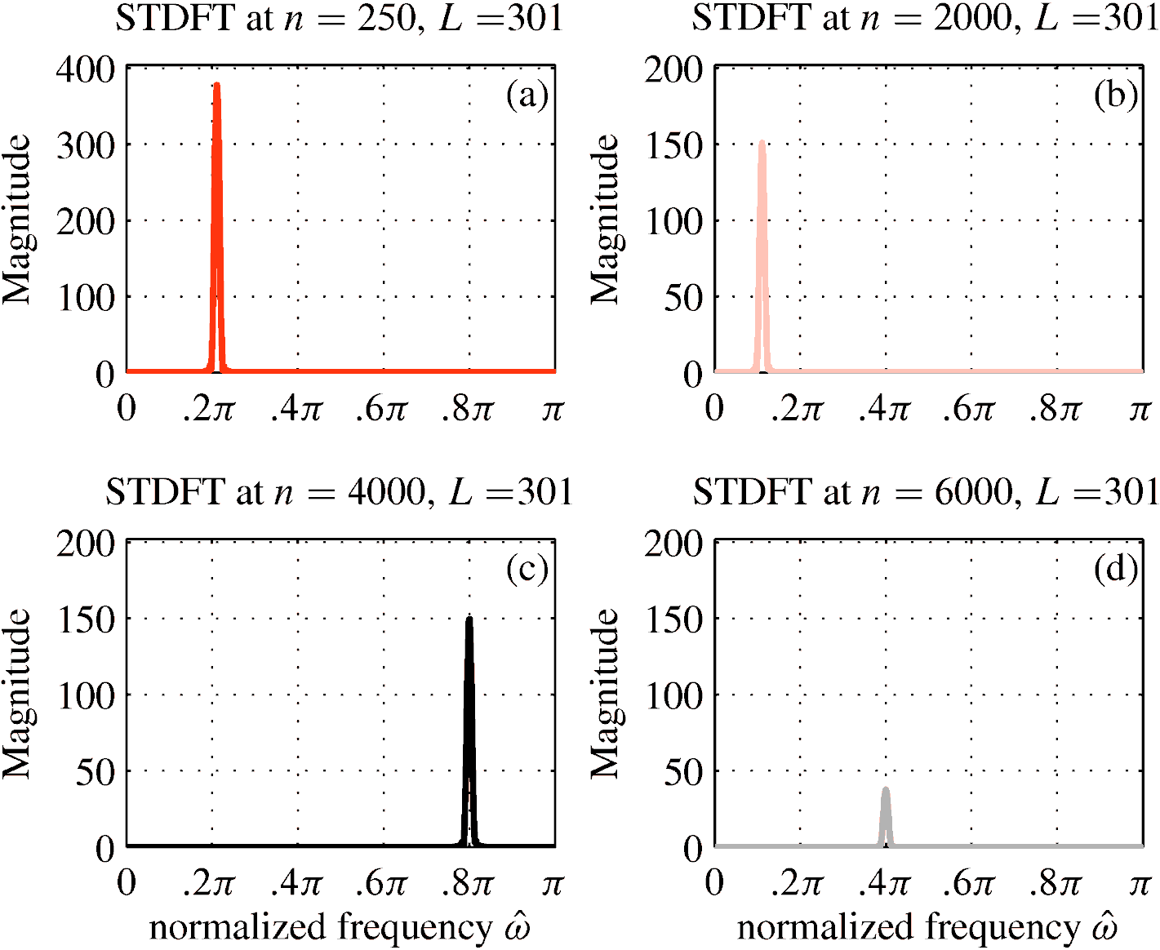
Short DFTs of Windowed Sections (L=301)
301-pt Hann window. 1024-pt DFT (zero-padded)

Slide 35
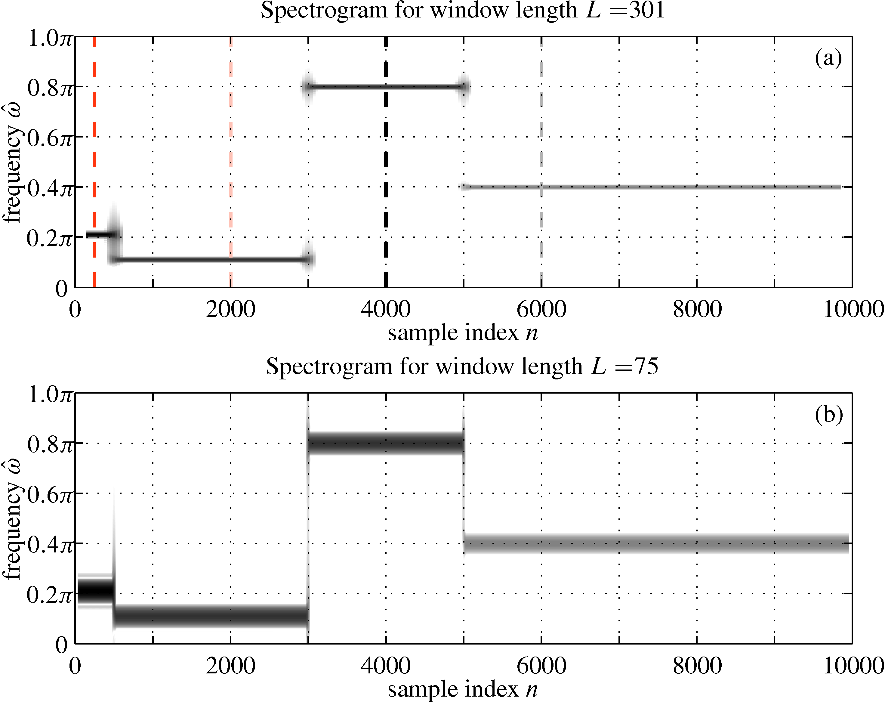
Two Spectrograms of very Long Signal
Window Lengths of L=301 and L=75; overlap 90%

Slide 36
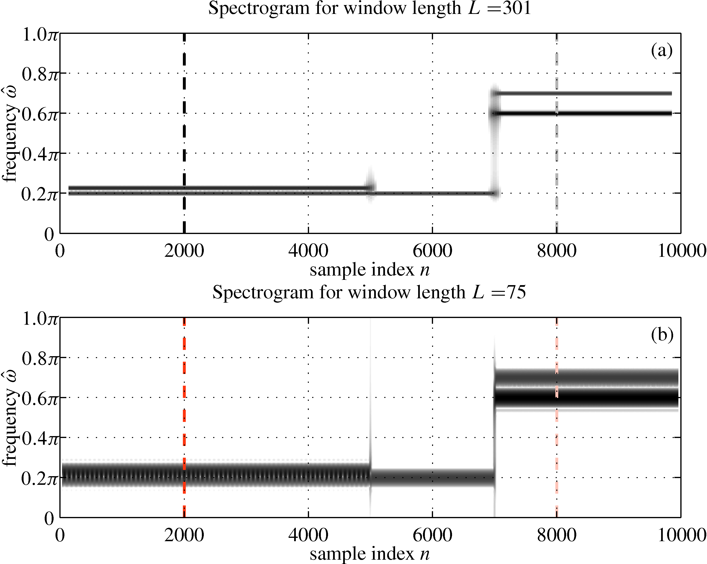
Spectrogram: Resolution Test
Window Lengths of L=301 and L=75

Slide 37
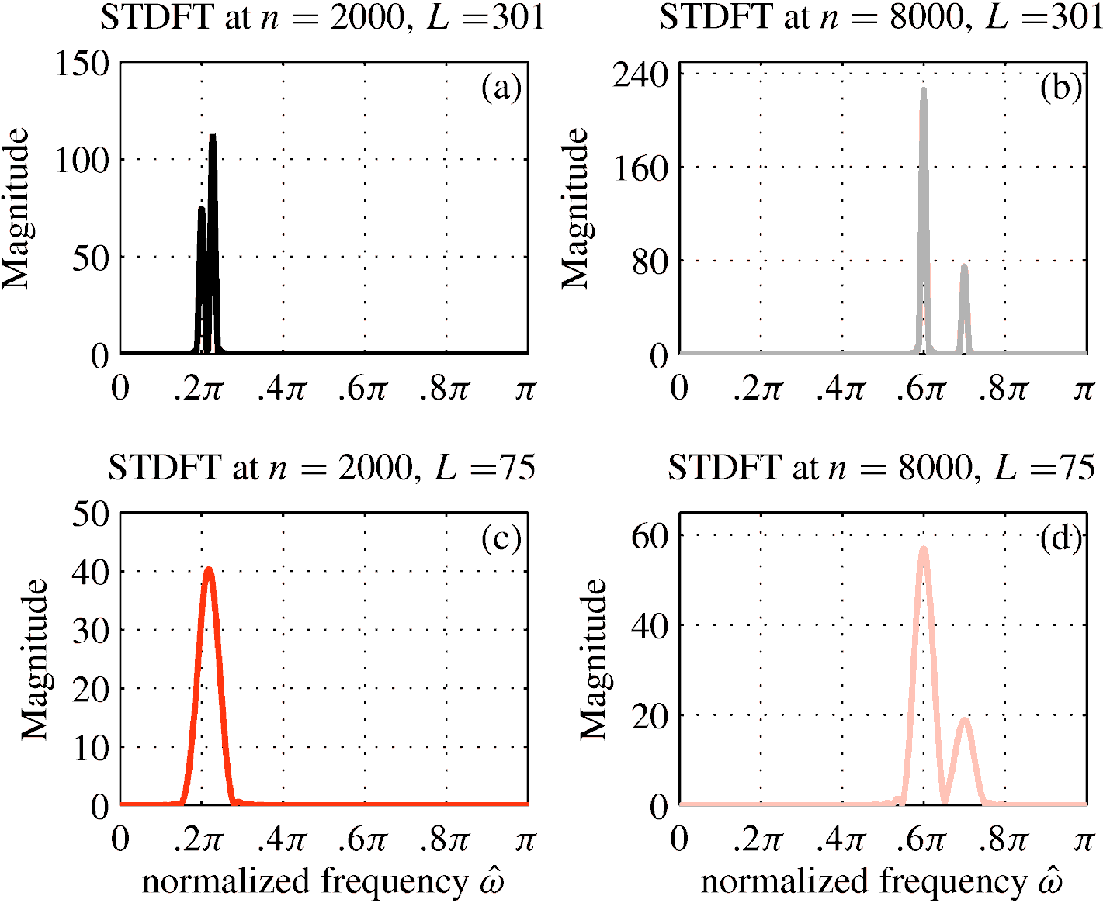
Short DFTs of Windowed Sections
75-pt and 301-pt Hann windows. 1024-pt DFT (zero-padded)

Slide 38
Windows
Finite-Length signal (L) with positive values
Extractor
Truncator

Slide 39
Von Hann Window (Time Domain)
Plot of Length-20 von Hann window

Slide 40
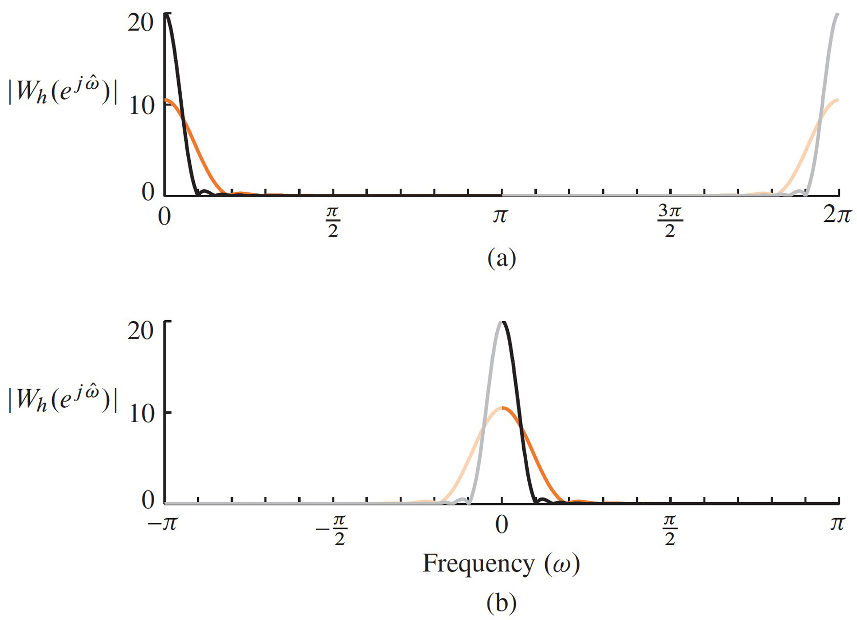
Von Hann Window (Frequency Domain)
DTFT (magnitude) of Length-20 Hann window

Slide 41
Window section of sinusoid, then DFT
Multiply the very long sinusoid by a window
Take the N-pt DFT
Finite number of frequencies (N)
Finite signal length (L) = window length
Expectation: 2 narrow spectrum lines

Slide 42
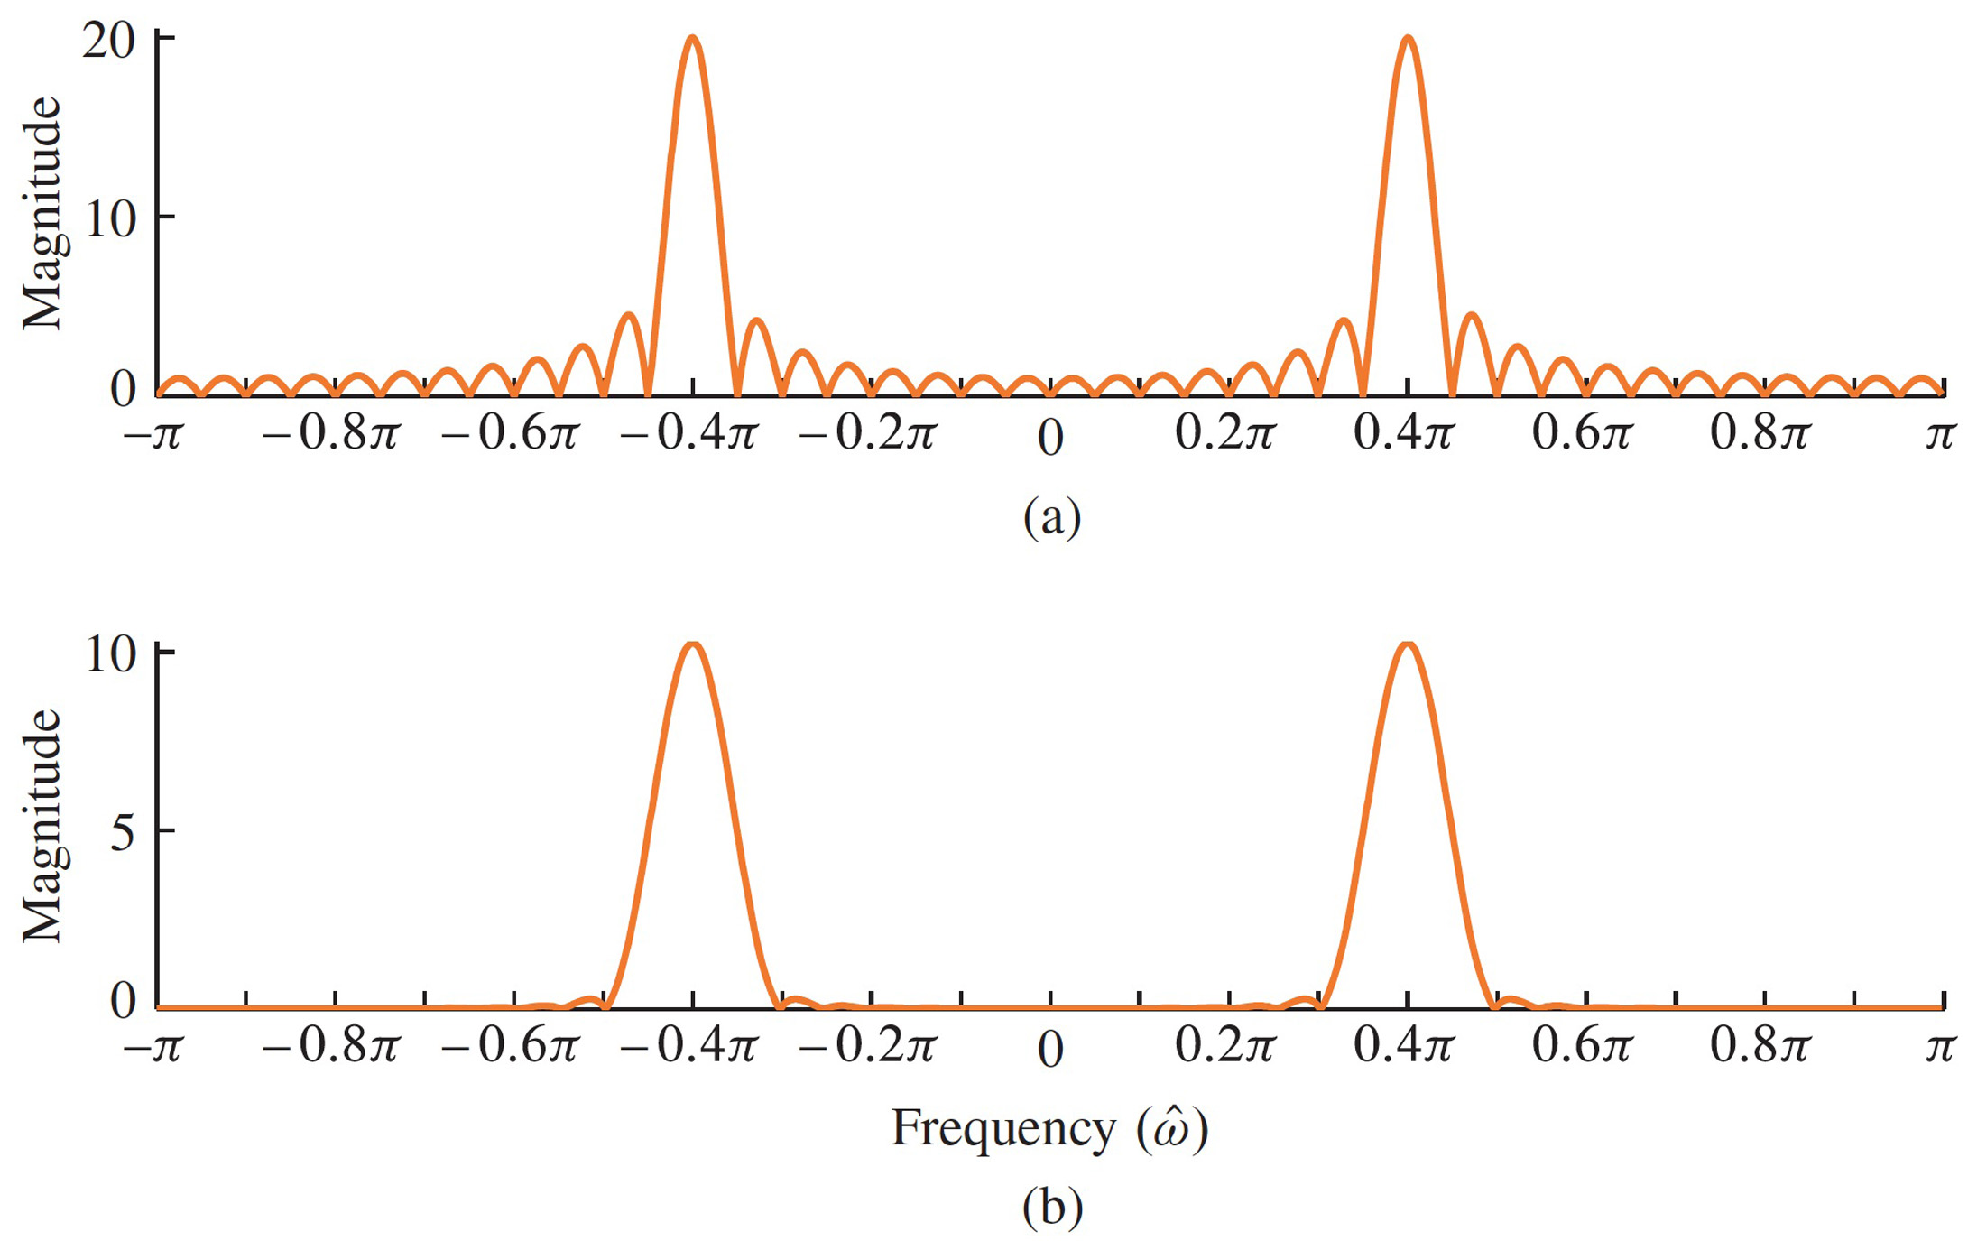
DTFT of Windowed Sinusoid (with different windows)
DTFT (magnitude) of windowed sinusoid
Length-40 Hann window vs Length-40 Rectangular window
UnWeighted
Hann Window

Slide 43
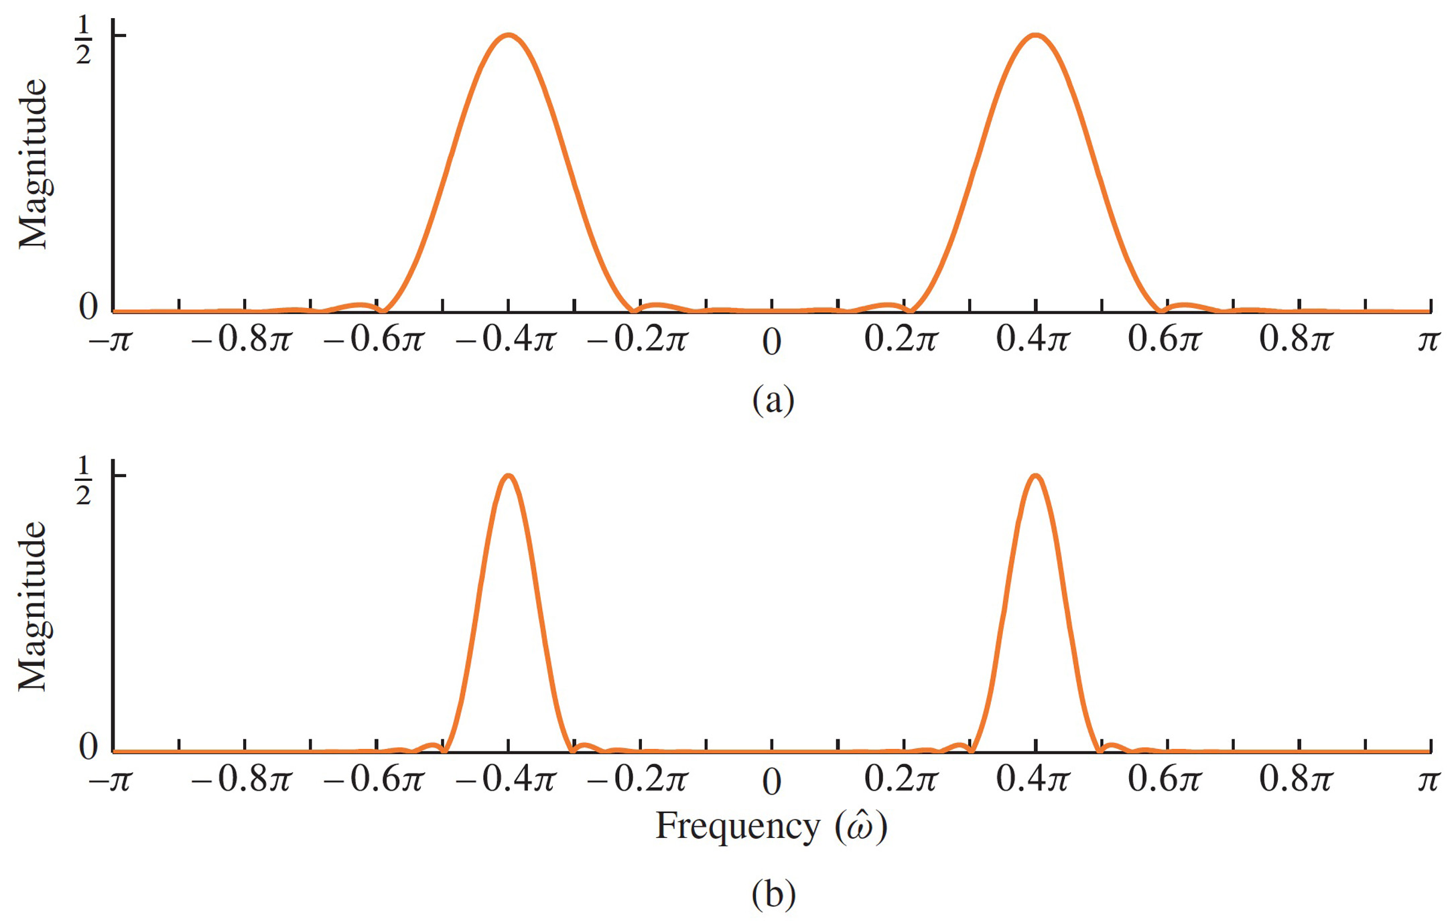
Change Window Length
DTFT (magnitude) of windowed sinusoid.
Length-20 Hann window vs. Length-40 Hann window

Slide 45
Short DFTs of Windowed Sections
301-pt Hann window. 1024-pt DFT (zero-padded)

Slide 46
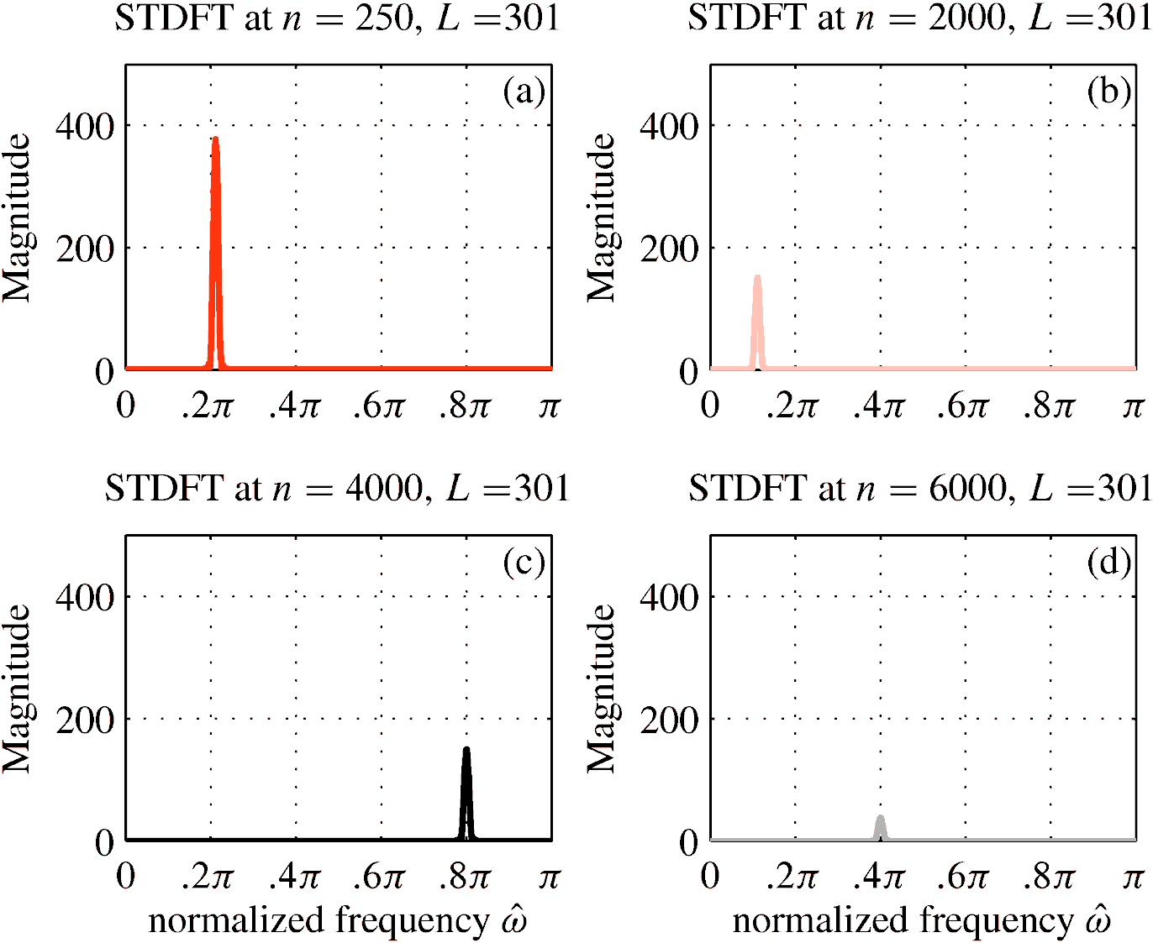
Short DFTs of Windowed Sections
301-pt Hann window. 1024-pt DFT (zero-padded)

Slide 47
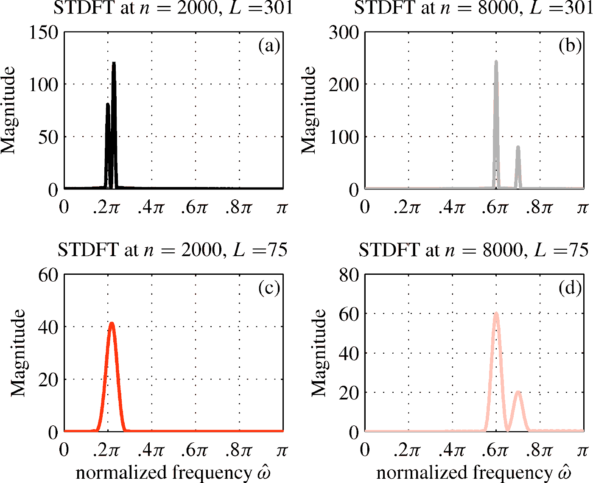
Short DFTs of Windowed Sections
301-pt Hann window. 1024-pt DFT (zero-padded)

Slide 48
Short time ANALYSIS of General Signal
Present focus
x(t)
BREAK
INTO
FRAMES
DFT:
DO FOURIER
ANALYSIS
Amp
Phase
Freq
Per Frame
Short-time analysis
Amp
Phase
Freq
Per Frame
ADD UP
the SINUSOIDS
add_cos( )
PUT FRAMES
BACK TOGETHER
SMOOTHLY
y(t)
Short-time synthesis

