Slide 1
DSP First, 2/e
Lecture 20
Z Transforms: Introduction

Slide 2
License Info for DSPFirst Slides
This work released under a Creative Commons License with the following terms:
Attribution
The licensor permits others to copy, distribute, display, and perform the work. In return, licensees must give the original authors credit.
Non-Commercial
The licensor permits others to copy, distribute, display, and perform the work. In return, licensees may not use the work for commercial purposes—unless they get the licensor's permission.
Share Alike
The licensor permits others to distribute derivative works only under a license identical to the one that governs the licensor's work.
Full Text of the License
This (hidden) page should be kept with the presentation

Slide 3
READING ASSIGNMENTS
This Lecture:
Chapter 9, Sects 9-1 through 9-5
Other Reading:
Recitation: CASCADING SYSTEMS

Slide 4
LECTURE OBJECTIVES
INTRODUCE the Z-TRANSFORM
Give Mathematical Definition
Show how the H(z) POLYNOMIAL simplifies analysis
CONVOLUTION is SIMPLIFIED !
Z-Transform can be applied to
FIR Filter: h[n] --> H(z)
Signals: x[n] --> X(z)

Slide 5
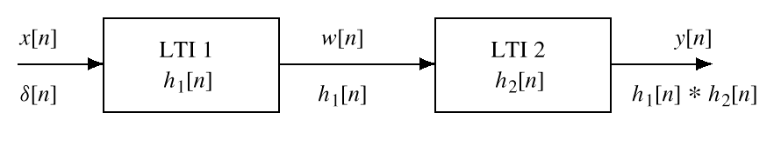
MOTIVATION: CASCADE SYSTEMS
Remember: h₁[n] * h₂[n]
Would rather do MULTIPLICATION
Can rearrange the order of S₁ and S₂
Convolution is Commutative
S₁
S₂

Slide 6
CASCADE EQUIVALENT
MULTIPLY the Frequency Responses
x[n]
y[n]
x[n]
y[n]
EQUIVALENT
SYSTEM

Slide 7
A TALE OF TWO DOMAINS
Time domain:
Can use with ANY signal
Difficult to work with (e.g., cascade=convolve)
Frequency domain:
Easy to work with (e.g., cascade=multiply)
Can only use with sinusoids
TIME-DOMAIN
FREQ-DOMAIN

Slide 8
TWO (no, THREE) DOMAINS
Z-TRANSFORM-DOMAIN
Algebra Domain:
Best of both worlds?
POLYNOMIALS: H(z)
TIME-DOMAIN
FREQ-DOMAIN

Slide 9
TRANSFORM CONCEPT
Move to a new domain where
OPERATIONS are EASIER & FAMILIAR
Use POLYNOMIALS
TRANSFORM both ways
x[n] ---> X(z) (into the z domain)
X(z) ---> x[n] (back to the time domain)

Slide 10
Z-Transform DEFINITION
POLYNOMIAL Representation of LTI SYSTEM:
EXAMPLE:
APPLIES to
any SIGNAL
POLYNOMIAL in z⁻¹

Slide 11
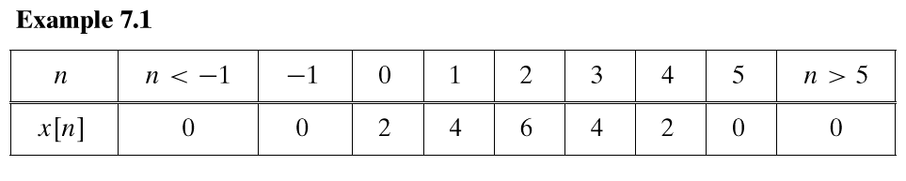
Z-Transform EXAMPLE
ANY SIGNAL has a z-Transform:

Slide 12
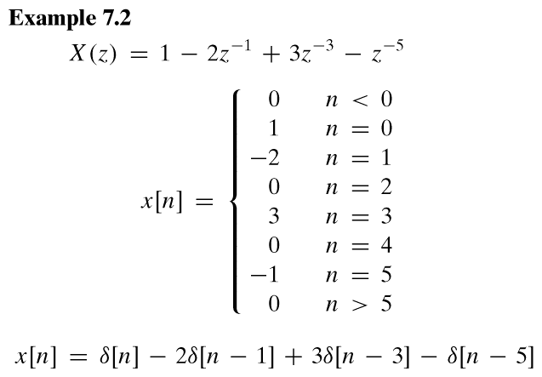
Example 9.2
EXPONENT GIVES
TIME LOCATION

Slide 13
Z-TRANSFORM OF DELAYED SIGNAL
What happens to X(z) if we delay x[n]?
Consider the signal:
Same signal, delayed by one:

Slide 14
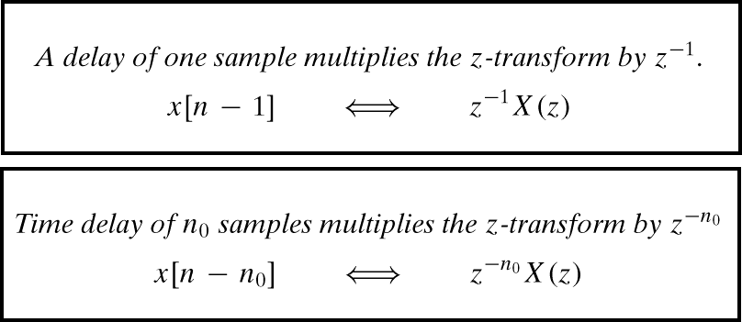
Z-Transform Property: DELAY PROPERTY

Slide 15
Ex. DELAY SYSTEM
UNIT DELAY: find h[n] and H(z)
x[n]
y[n] = x[n-1]
x[n]
y[n]

Slide 16
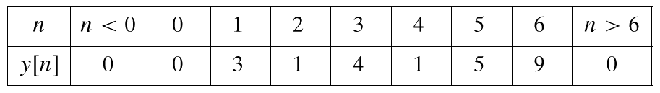
DELAY EXAMPLE
UNIT DELAY: find y[n] via polynomials
x[n] = {3,1,4,1,5,9,0,0,0,...}

Slide 17
Z-Transform of FIR Filter
CALLED the SYSTEM FUNCTION
because h[n] is same as {b_{k}}
SYSTEM
FUNCTION
CONVOLUTION
FIR DIFFERENCE EQUATION

Slide 18
Z-Transform of FIR Filter
Get H(z) DIRECTLY from the {b_{k}}
Example 7.3 in the book:

Slide 19
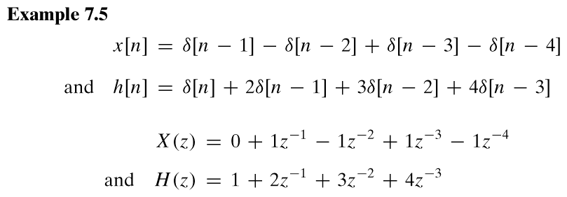
GENERAL I/O PROBLEM
Input is x[n], find y[n] (for FIR, h[n])
How to combine X(z) and H(z) ?

Slide 20
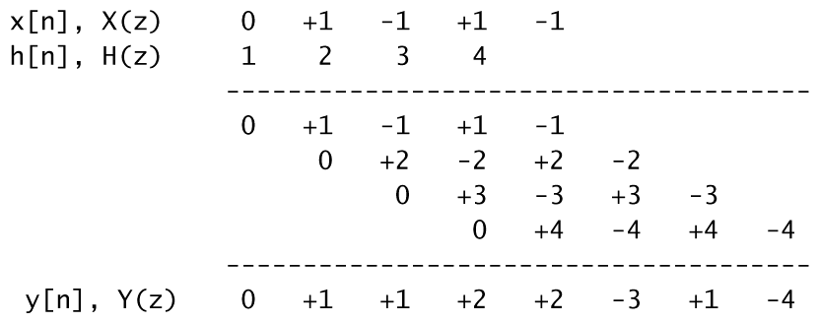
FIR Filter = CONVOLUTION
CONVOLUTION

Slide 21
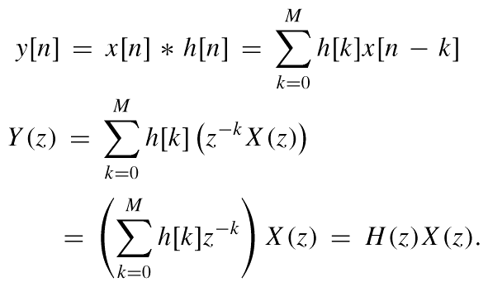
CONVOLUTION PROPERTY
PROOF:
MULTIPLY
z-TRANSFORMS

Slide 22
CONVOLUTION EXAMPLE
MULTIPLY the z-TRANSFORMS:
MULTIPLY H(z)X(z)

Slide 23
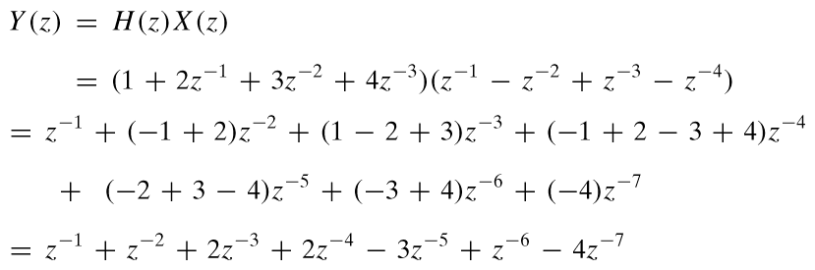
CONVOLUTION EXAMPLE
Finite-Length input x[n]
FIR Filter (L=4)
MULTIPLY
Z-TRANSFORMS
y[n] = ?

Slide 24
Z-Transform Property: CASCADE EQUIVALENT
Multiply the System Functions
x[n]
y[n]
x[n]
y[n]
EQUIVALENT
SYSTEM

Slide 25
CASCADE EXAMPLE
x[n]
w[n]
y[n]
x[n]
y[n]

Slide 26
Frequency Response from H(z)
Same Form:
SAME COEFFICIENTS

Slide 27
Frequency Response
FREQUENCY RESPONSE is H(z) evaluated on the unit circle
EXAMPLE: First Difference {1, -1}

Slide 28
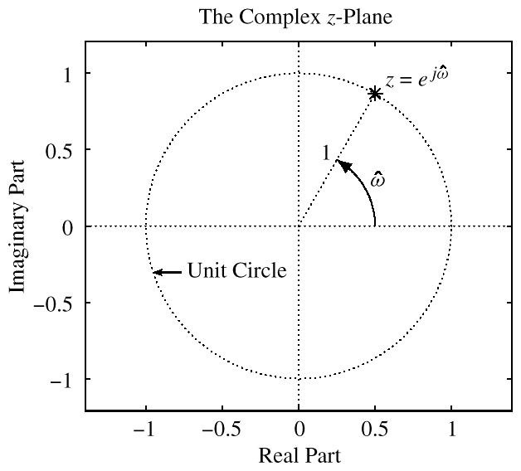
ANGLE is FREQUENCY

Slide 29
“TRANSFORM” EXAMPLE
Equivalent Representations
x[n]
y[n]
x[n]
y[n]

Slide 30
Z-TRANSFORM IDEA
POLYNOMIAL REPRESENTATION
x[n]
y[n]
x[n]
y[n]

