Slide 1
DSP First, 2/e
Lecture 21
Zeros of H(z) and the Frequency Domain

Slide 2
License Info for DSPFirst Slides
This work released under a Creative Commons License with the following terms:
Attribution
The licensor permits others to copy, distribute, display, and perform the work. In return, licensees must give the original authors credit.
Non-Commercial
The licensor permits others to copy, distribute, display, and perform the work. In return, licensees may not use the work for commercial purposes—unless they get the licensor's permission.
Share Alike
The licensor permits others to distribute derivative works only under a license identical to the one that governs the licensor's work.
Full Text of the License
This (hidden) page should be kept with the presentation

Slide 3
READING ASSIGNMENTS
This Lecture:
Chapter 9, Sects. 9-5 & 9-6
Other Reading:
Examples: Chapter 9, Sects. 9-7 & 9-8
ZEROS (and POLES)
Practical Bandpass Filters

Slide 4
LECTURE OBJECTIVES
ZEROS and POLES
Relate H(z) to FREQUENCY RESPONSE
THREE DOMAINS:
Show Relationship for FIR:

Slide 5
DESIGN PROBLEM
Example:
Design a Lowpass FIR filter (Find b_{k})
Reject completely 0.7π, 0.8π, and 0.9π
This is NULLING
Estimate the filter length needed to accomplish this task. How many b_{k} ?
Z POLYNOMIALS provide the TOOLS

Slide 6
Z-Transform DEFINITION
POLYNOMIAL Representation of LTI SYSTEM:
EXAMPLE:
APPLIES to
Any SIGNAL
POLYNOMIAL in z⁻¹

Slide 7
CONVOLUTION PROPERTY
Convolution in the n-domain
SAME AS
Multiplication in the z-domain
MULTIPLY
z-TRANSFORMS
FIR Filter

Slide 8
CONVOLUTION EXAMPLE
x[n]
y[n]

Slide 9
THREE DOMAINS
Z-TRANSFORM-DOMAIN
POLYNOMIALS: H(z)
TIME-DOMAIN
FREQ-DOMAIN

Slide 10
FREQUENCY RESPONSE ?
Same Form:
SAME COEFFICIENTS

Slide 11
H(z) as ANALYSIS TOOL
H(z) is a COMPLEX-VALUED function of a COMPLEX VARIABLE z.
Shape of H(z), and the Frequency Response, is dominated by zeros (H(z)=0) and poles (H(z)=∞)
Can we use tools of POLYNOMIALS (e.g., roots and factoring) to make analysis easier?

Slide 12
ZEROS of H(z)
Find z, where H(z)=0
zero

Slide 13
ZEROS of H(z) – example 2
Find z, where H(z)=0
Interesting when z is ON the unit circle.
Recall: Roots occur in Conjugate pairs when coefficients are real

Slide 14
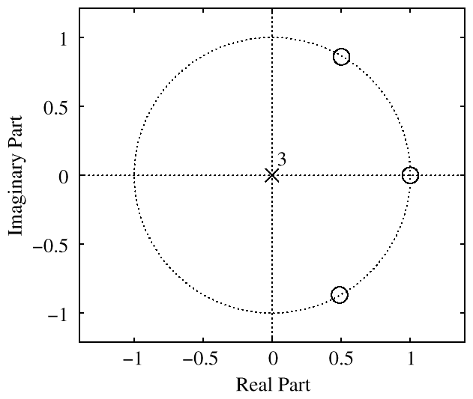
PLOT ZEROS in z-DOMAIN
UNIT
CIRCLE
3 ZEROS
H(z) = 0
3 POLES

Slide 15
POLES of H(z)
Find z, where
FIR only has poles at z=0

Slide 16
FREQUENCY RESPONSE ?
Same Form:
SAME COEFFICIENTS

Slide 17
FREQ RESPONSE from System Function
Relate H(z) to FREQUENCY RESPONSE
EVALUATE H(z) on the UNIT CIRCLE
ANGLE is same as FREQUENCY

Slide 18
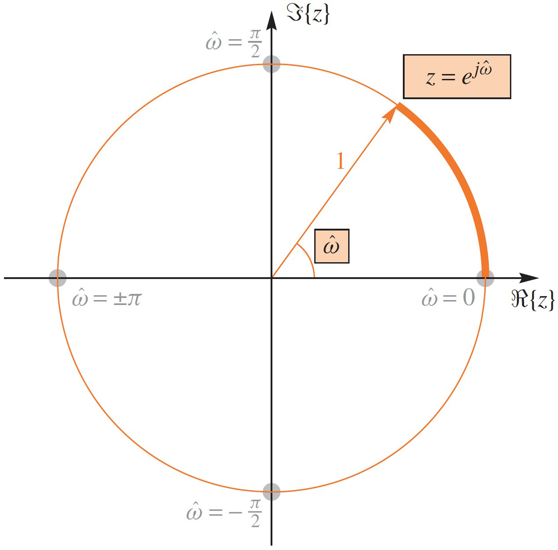
ANGLE is FREQUENCY

Slide 19
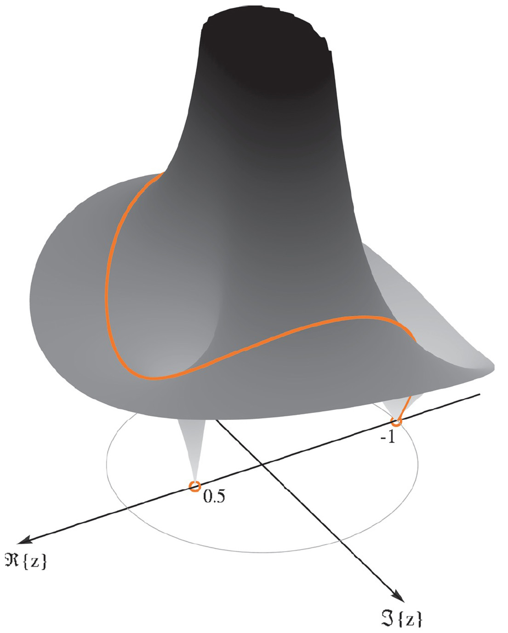
Evaluate H(z) on Unit Circle

Slide 20
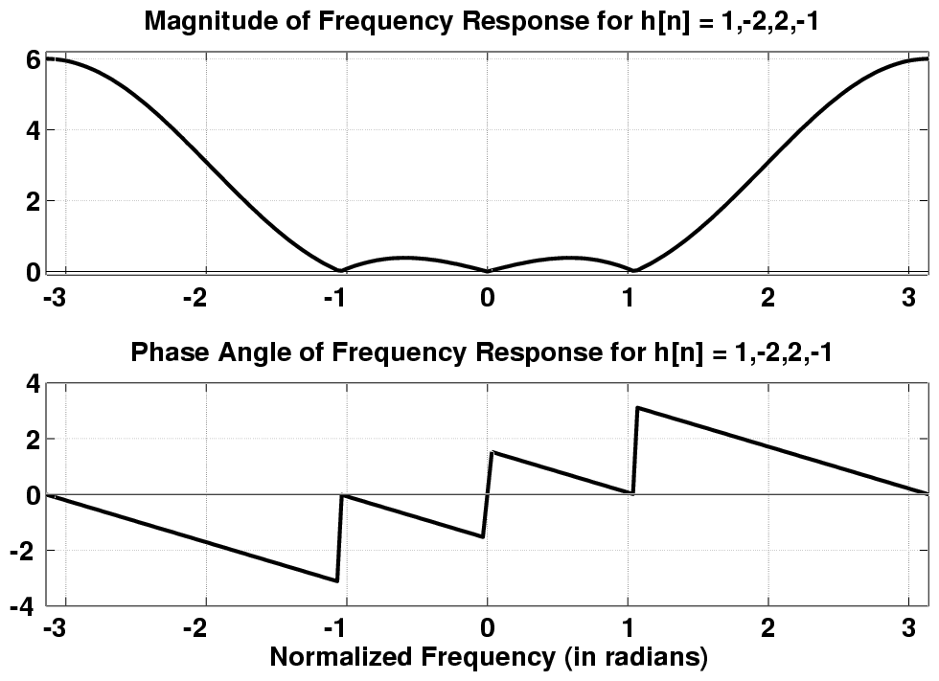
FIR Frequency Response

Slide 21
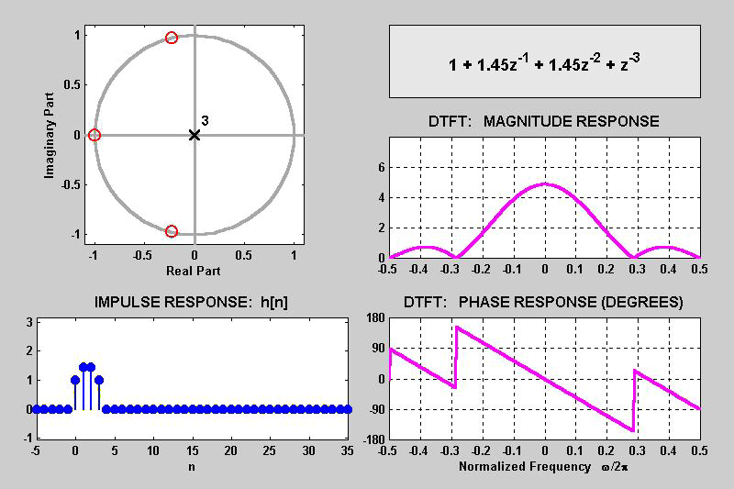
3 DOMAINS MOVIE: FIR
ZEROS MOVE

Slide 22
4 MOVIES @ WEBSITE
http://dspfirst.gatech.edu/chapters/07ztrans/demos/3_domain/index.html
3 DOMAINS MOVIES: FIR Filters
Two zeros moving around UC and inside
Three zeros; one held fixed at z=−1
Ten zeros; 9 equally spaced around UC; one moving
Ten zeros; 8 equally spaced around UC; two moving

Slide 23
NULLING PROPERTY of H(z)
When H(z)=0 on the unit circle.
Find inputs x[n] that give zero output
x[n]
y[n]

Slide 24
NULLING PROPERTY of H(z)
Evaluate H(z) at the input “frequency”

Slide 25
FIR Frequency Response

Slide 26
DESIGN PROBLEM
Example:
Design a Lowpass FIR filter (Find b_{k})
Reject completely 0.7π, 0.8π, and 0.9π
Estimate the filter length needed to accomplish this task. How many b_{k} ?
Z POLYNOMIALS provide the TOOLS

Slide 27
NULLING FILTER DESIGN
PLACE ZEROS to make y[n] = 0
6th order FIR has 7 filter coefficients
Need 6 ZEROS
where H(z) = 0

Slide 28
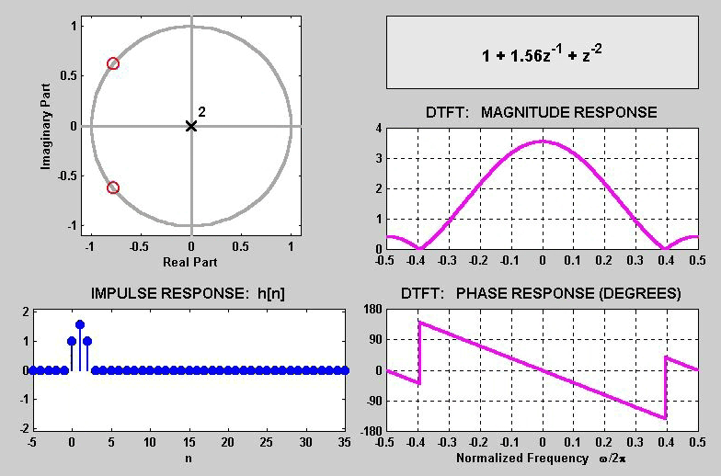
3 DOMAINS MOVIE: FIR
ZEROS on
UNIT-CIRCLE
NULL
NULL

Slide 29
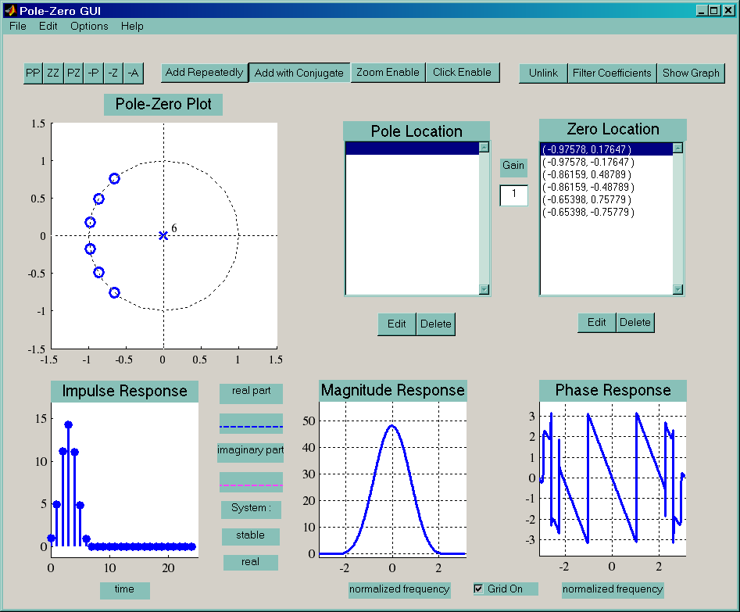
PeZ Demo: Zero Placing

Slide 30
One zero, two zeros, …
We usually want filters with real coefficients
If we want to block sinusoid with
z⁻² needed for causality

Slide 31
Block Multiple Frequencies
Want to totally block:
H(z) must have zeros at:
To block
must have zero at z =1 or -1
So, the general form becomes:
to block DC
to block f_{s} /2
On the other hand: Not much control over other frequencies

Slide 32
L-pt RUNNING SUM H(z)
ZEROS on
UNIT CIRCLE
(z-1) in
denominator
cancels k=0 term

Slide 33
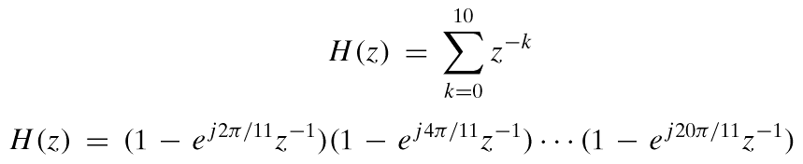
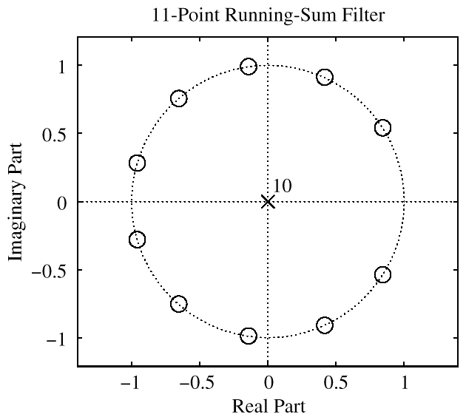
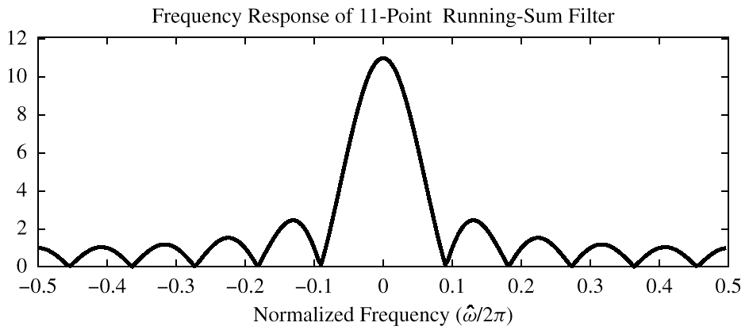
11-pt RUNNING SUM H(z)
NO zero at z=1

Slide 34
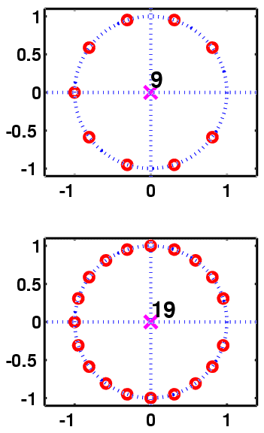
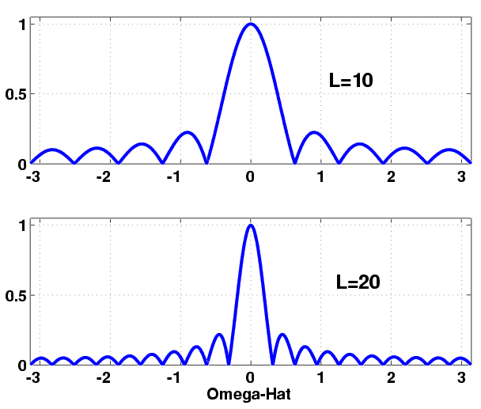
FILTER DESIGN: CHANGE L
Running
Average
Filter
Passband is
Narrower
for L bigger

Slide 35
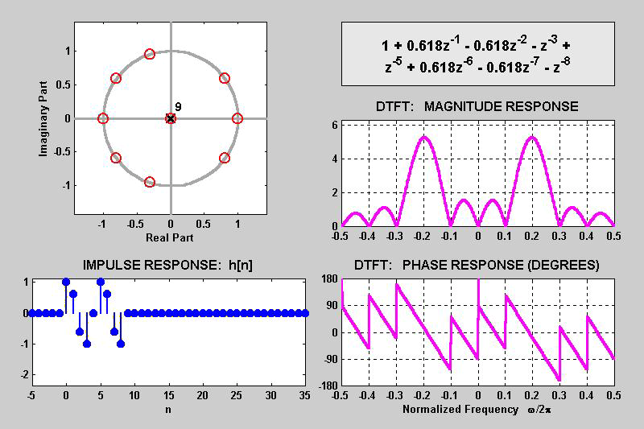
3 DOMAINS MOVIE: FIR BPF
ZEROS MISSING

Slide 36
CONVOLUTION PROPERTY
MULTIPLICATION of z-TRANSFORMS
CONVOLUTION in TIME-DOMAIN
IMPULSE RESPONSE

Slide 37
MATH FORMULA for h[n]
Use SHIFTED IMPULSES to write h[n]
0.2
0
4
n

Slide 38
LTI: Convolution
Output = Convolution of x[n] & h[n]
NOTATION: y[n] = x[n]*h[n]
Here is the FIR case:
FINITE LIMITS
Same as b_{k}
FINITE LIMITS

Slide 39
L-pt RUNNING AVG H(z)
ZEROS on
UNIT CIRCLE
(z-1) in
denominator
cancels k=0 term

Slide 40
L-pt RUNNING AVG: Step Response
STEP RESPONSE

Slide 41
POP QUIZ
Given:
Plot the Magnitude and Phase
Find the output, y[n]
When

Slide 42
POP QUIZ: MAG & PHASE
Given:
Derive Magnitude and Phase

Slide 43
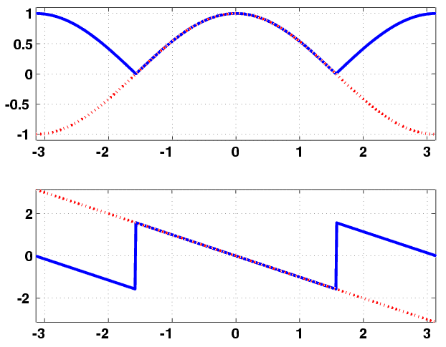
Ans: FREQ RESPONSE

Slide 44
POP QUIZ : Answer #2
Find y[n] when

Slide 45
POP QUIZ: MAG & PHASE
Given:
Derive Magnitude and Phase

Slide 46
Ans: FREQ RESPONSE

Slide 47
POP QUIZ : Answer #2
Find y[n] when

Slide 48
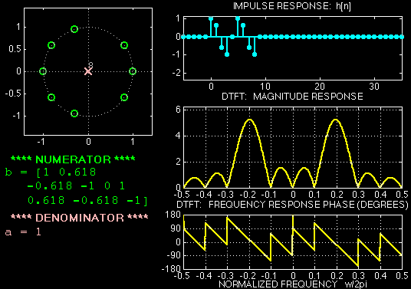
3 DOMAINS MOVIE: FIR
H(z)
h[n]
H(ω)
ZEROS MISSING

Slide 49
PLOT ZEROS in z-DOMAIN
UNIT
CIRCLE
3 ZEROS
H(z) = 0
3 POLES

Slide 50
CASCADE EQUIVALENT
Multiply the System Functions
x[n]
y[n]
x[n]
y[n]
EQUIVALENT
SYSTEM

Slide 51
CASCADE EXAMPLE
x[n]
w[n]
y[n]
x[n]
y[n]

Slide 52
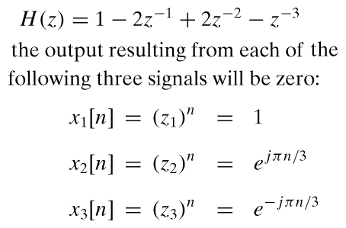
NULLING FILTER
PLACE ZEROS to make y[n] = 0
3 ZEROS
H(z) = 0
H(z₁) = 0
H(z₂) = 0
H(z₃) = 0

Slide 53
CHANGE in NOTATION
Relate H(z) to FREQUENCY RESPONSE
NEW NOTATION for FREQUENCY RESPONSE

