Slide 1
DSP First, 2/e
Lecture 23
Frequency Response, H(z), Poles and Zeros
for IIR and FIR Systems

Slide 2
License Info for DSPFirst Slides
This work released under a Creative Commons License with the following terms:
Attribution
The licensor permits others to copy, distribute, display, and perform the work. In return, licensees must give the original authors credit.
Non-Commercial
The licensor permits others to copy, distribute, display, and perform the work. In return, licensees may not use the work for commercial purposes—unless they get the licensor's permission.
Share Alike
The licensor permits others to distribute derivative works only under a license identical to the one that governs the licensor's work.
Full Text of the License
This (hidden) page should be kept with the presentation

Slide 3
READING ASSIGNMENTS
This Lecture:
Chapter 9, Sects. 9-5 and 9-6
Chapter 10, Sects. 10-5 and 10-7

Slide 4
LECTURE OBJECTIVES
ZEROS and POLES
Relate H(z) to FREQUENCY RESPONSE
Four demos: PeZ, 3-Domain movies
Placing Poles and Zeros
Bandpass Filters: IIR
Nulling Filters: FIR Notch Filters: IIR

Slide 5
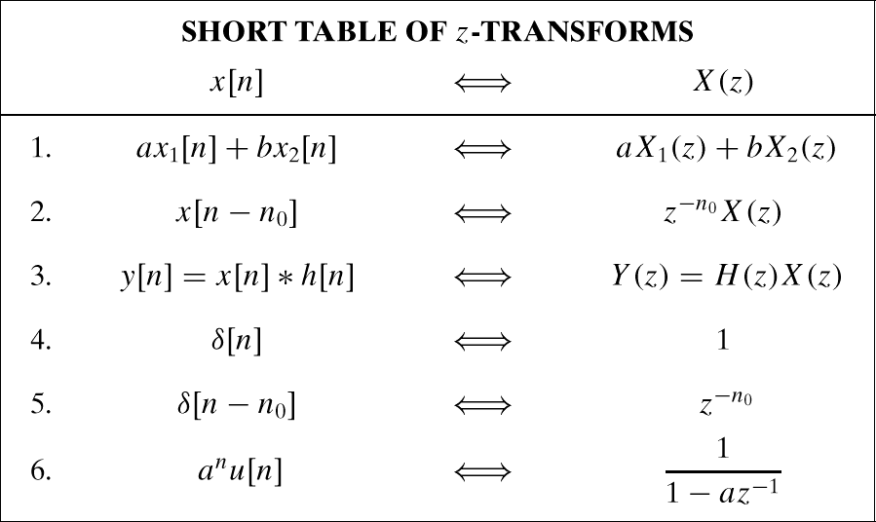
Z-TRANSFORM TABLES

Slide 6
THREE DOMAINS:
Z-TRANSFORM-DOMAIN
POLYNOMIALS: H(z)
TIME-DOMAIN
FREQ-DOMAIN
Impulse response, h[n]

Slide 7
Motivation: Filter Design
Some tasks/analysis easier in one domain
Freq domain: system response to sinusoids
Time domain: calculate output to any signal
Z-domain: given specs, build a filter
Can we design a filter that removes DC and sinusoids at frequency ?
Z-domain reduces this to polynomial roots

Slide 8
H(z) = Rational Function
First Order:
We can also study Second-Order Systems:
Numerator & Denominator Polynomials

Slide 9
POLES & ZEROS of H(z)
Zeros of H(z), i.e., where is H(z)=0?
Look for Roots of Numerator Polynomial
Poles of H(z), i.e., where is H(z)=infinity?
Look for Roots of Denominator Polynomial

Slide 10
Poles/Zeros of 1st-order H(z)
Roots of Numerator & Denominator Polys:

Slide 11
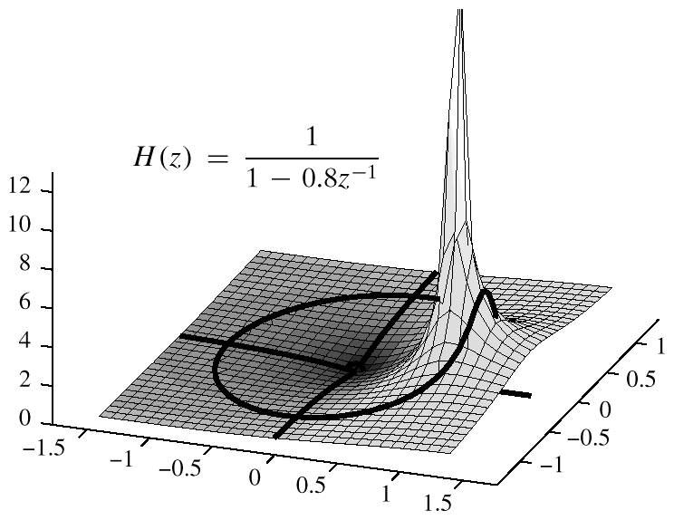
3-D VIEW
3-D VIEWPOINT:
EVALUATE H(z) EVERYWHERE
UNIT CIRCLE

Slide 12
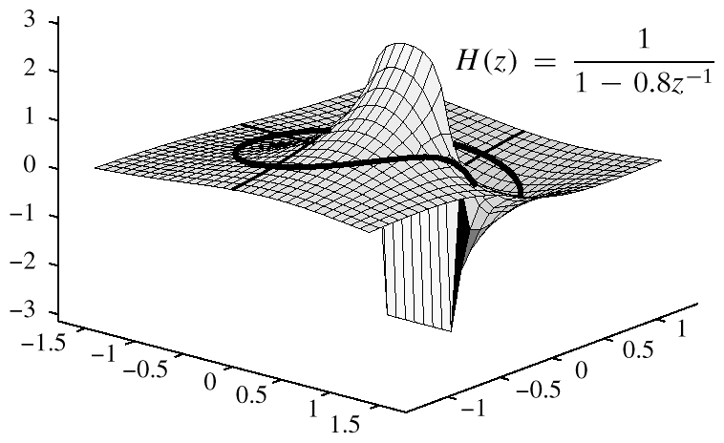
PHASE from 3-D PLOT

Slide 13
FREQ. RESPONSE from H(z)
Relate H(z) to FREQUENCY RESPONSE
EVALUATE H(z) on the UNIT CIRCLE
ANGLE is same as FREQUENCY

Slide 14
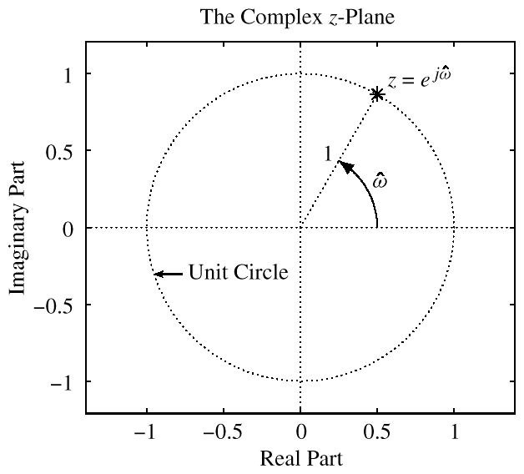
UNIT CIRCLE: RECAP
MAPPING BETWEEN

Slide 15
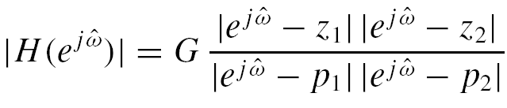
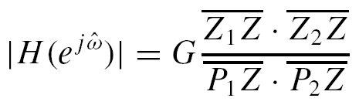
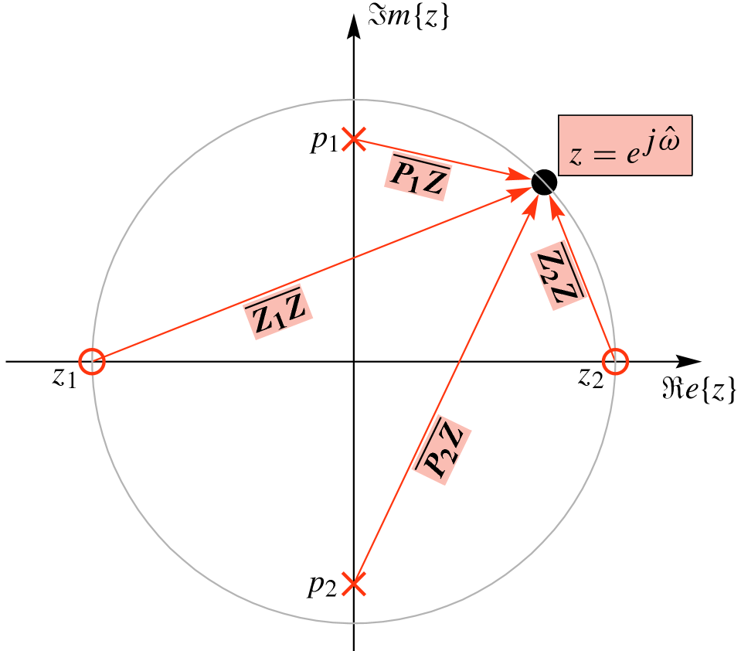
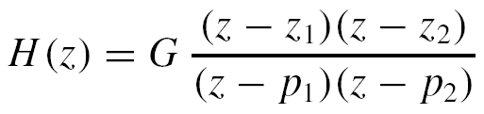
Frequency Response from poles and zeros

Slide 16
IIR H(z) example: two poles
Poles just inside the unit circle (for stability)
MATLAB: roots( ) and poly( )
roots( [1, 0.97, 0.9409] )
poly( 0.97*exp(j*2*pi*[1,-1]/3) )

Slide 17
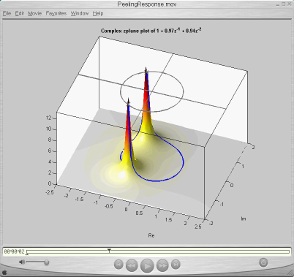
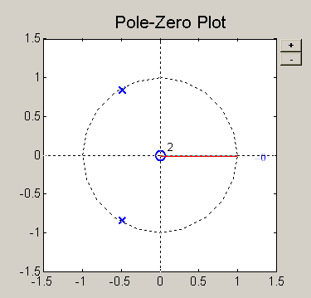
MOVIE for H(z) in 3-D
POLES to H(z) to Frequency Reponse
TWO POLES SHOWN

Slide 18
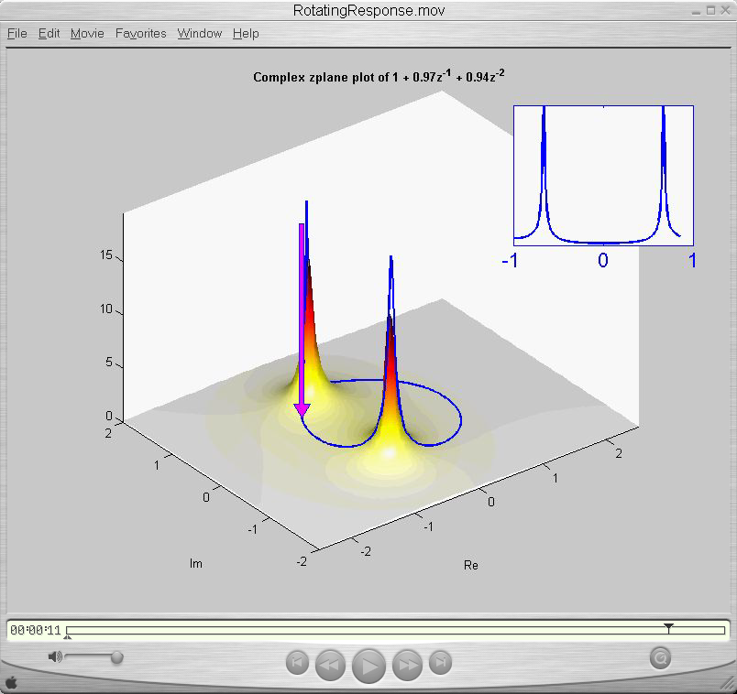
Frequency Response from H(z)
Walking around the Unit Circle

Slide 19
THREE DOMAINS:
Z-TRANSFORM-DOMAIN
POLYNOMIALS: H(z)
TIME-DOMAIN
FREQ-DOMAIN
Impulse response, h[n]

Slide 20
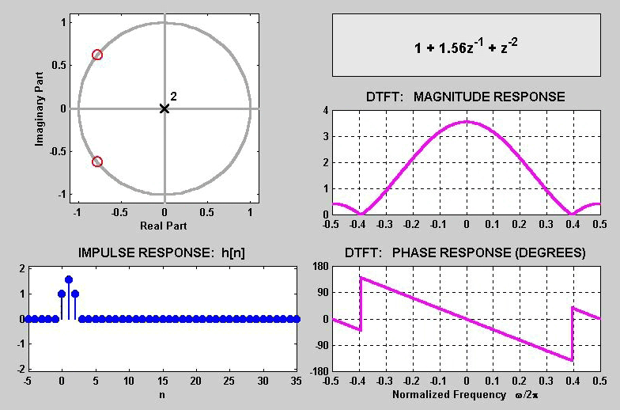
3 DOMAINS MOVIE: FIR
ZEROS on
UNIT-CIRCLE
NULL
NULL

Slide 21
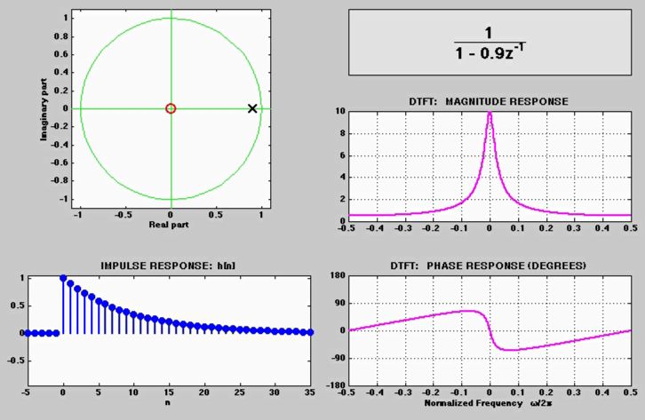
3 DOMAINS MOVIE: IIR
H(z)
POLE MOVES
h[n]

Slide 22
7 IIR MOVIES @ WEBSITE
http://dspfirst.gatech.edu/chapters/08feedbac/demos/3_domain/index.html
3 DOMAINS MOVIES: IIR Filters
One pole moving and a zero at the origin
One pole and one zero; both moving
Two complex-conjugate poles moving radially
Two complex-conjugate poles moving in angle
Movement of a zero in a two-pole Filter
Radial Movement of Two out of Four Poles
Angular Movement of Two out of Four Poles

Slide 23
Reminder: 4 FIR MOVIES @ WEBSITE
http://dspfirst.gatech.edu/chapters/08feedbac/demos/3_domain/index.html
3 DOMAINS MOVIES: FIR Filters
Two zeros moving around UC and inside
Three zeros; one held fixed at z = −1
Ten zeros; 9 equally spaced around UC; one moving
Ten zeros; 8 equally spaced around UC; two moving

Slide 24
Remove Interference
Design a NOTCH filter (Find a_{k} and b_{k})
To Reject completely 0.7π
This is NULLING
Zeros on UC
Make the frequency response magnitude FLAT away from the notch.
Use poles at the same angle
Z-POLYNOMIALS provide the TOOLS
PEZDEMO GUI

Slide 25
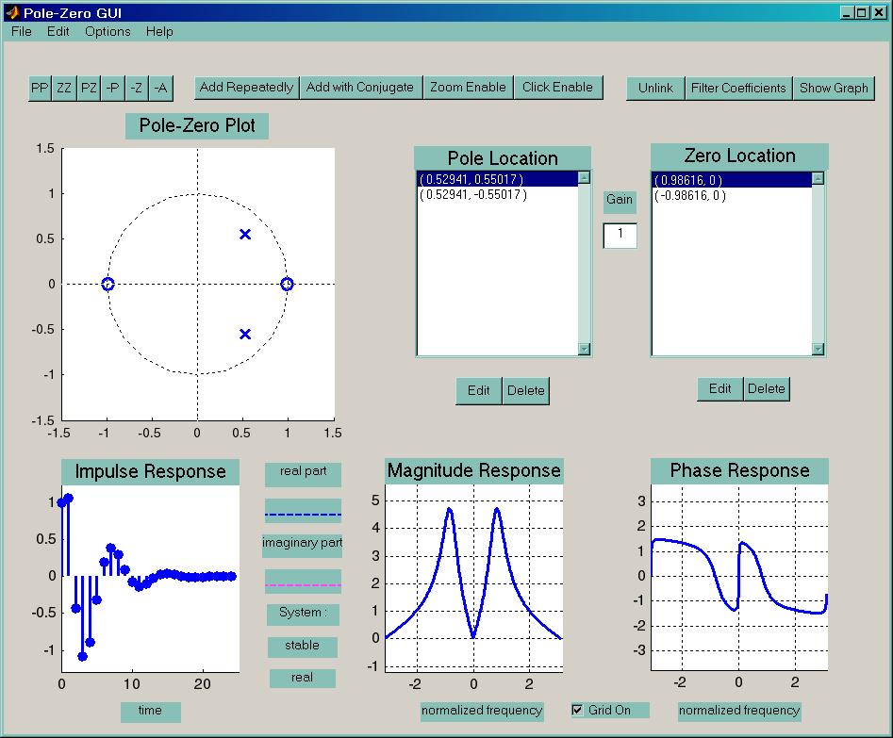
PeZ Demo: Pole-Zero Placing

Slide 26
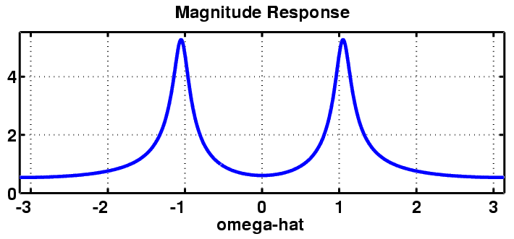
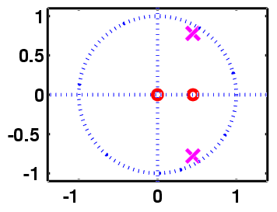
Complex POLE-ZERO PLOT
Where is
the peak?

Slide 27
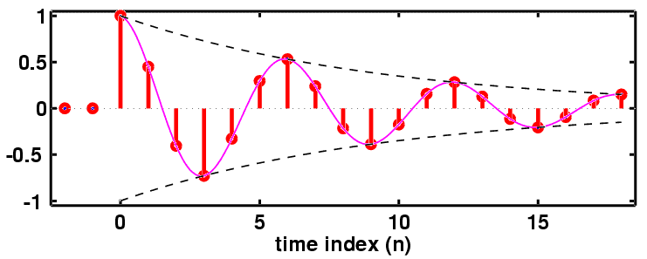
h[n]: Decays & Oscillates
“PERIOD”=6

Slide 28
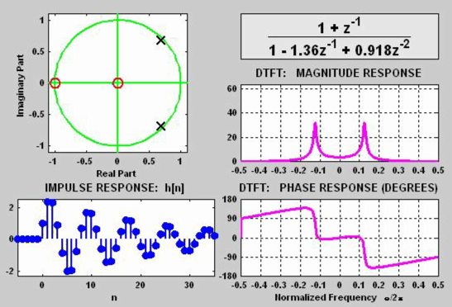
3 DOMAINS MOVIE: IIR
POLE MOVES
H(z)
H(ω)
h[n]

Slide 29
SINUSOIDAL RESPONSE
x[n] = SINUSOID => y[n] is SINUSOID
Get MAGNITUDE & PHASE from H(z)

Slide 30
POP QUIZ
Given:
Find the Impulse Response, h[n]
Find the output, y[n]
When

Slide 31
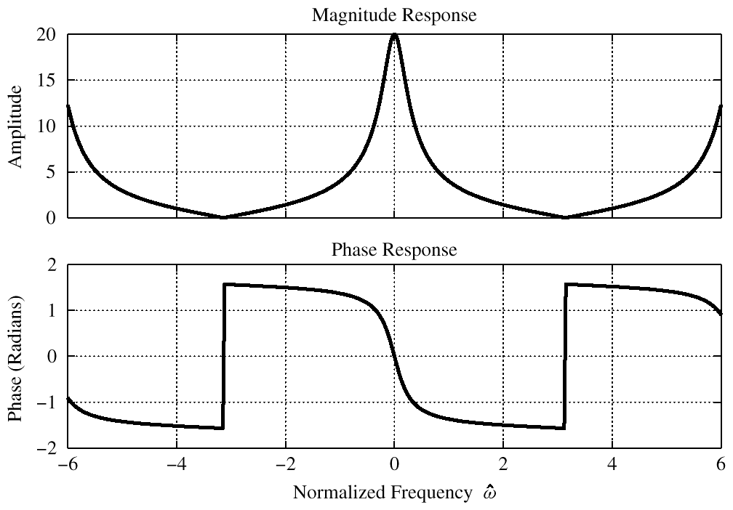
Evaluate FREQ. RESPONSE
zero at ω=π

Slide 32
POP QUIZ: Eval Freq. Resp.
Given:
Find output, y[n], when
Evaluate at

Slide 33
PeZ Demo: Pole-Zero Placing

