Slide 1
DSP First, 2/e
Lecture 25
Second-Order IIR
Filters: 3-Domains

Slide 2
License Info for DSPFirst Slides
This work released under a Creative Commons License with the following terms:
Attribution
The licensor permits others to copy, distribute, display, and perform the work. In return, licensees must give the original authors credit.
Non-Commercial
The licensor permits others to copy, distribute, display, and perform the work. In return, licensees may not use the work for commercial purposes—unless they get the licensor's permission.
Share Alike
The licensor permits others to distribute derivative works only under a license identical to the one that governs the licensor's work.
Full Text of the License
This (hidden) page should be kept with the presentation

Slide 3
READING ASSIGNMENTS
This Lecture:
Chapter 10, Sects. 10-11 and 10-12
Other Reading:
Example of IIR LPF in Sect. 10-13
POLES & ZEROS
Frequency Response
Impulse Response

Slide 4
LECTURE OBJECTIVES
SECOND-ORDER IIR FILTERS
TWO FEEDBACK TERMS
H(z) can have COMPLEX POLES & ZEROS
THREE-DOMAIN APPROACH
BPFs have POLES NEAR THE UNIT CIRCLE

Slide 5
THREE DOMAINS for IIR
Z-TRANSFORM-DOMAIN: poles & zeros
POLYNOMIALS: H(z)
Use H(z) to get
Freq. Response
TIME-DOMAIN
DIFFERENCE EQN
FREQ-DOMAIN

Slide 6
SECOND-ORDER FILTERS
Two FEEDBACK TERMS

Slide 7
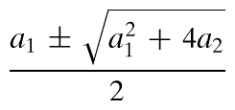
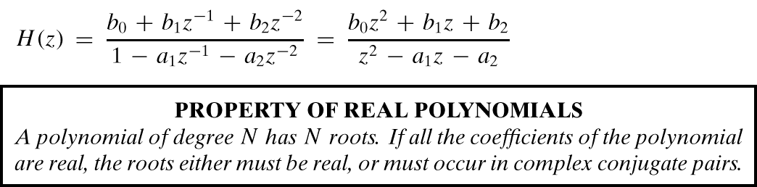
MORE POLES
Denominator is QUADRATIC
2 Poles: REAL
or COMPLEX CONJUGATES

Slide 8
TWO COMPLEX POLES
Find Impulse Response ?
Can OSCILLATE vs. n
“RESONANCE”
Find FREQUENCY RESPONSE
Depends on Pole Location
Close to the Unit Circle?
Make BANDPASS FILTER

Slide 9
Inverse z-Transform?
SECOND-ORDER IIR FILTERS
H(z) can have COMPLEX POLES & ZEROS

Slide 10
2nd ORDER EXAMPLE

Slide 11
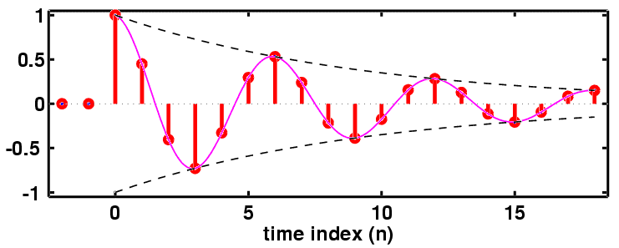
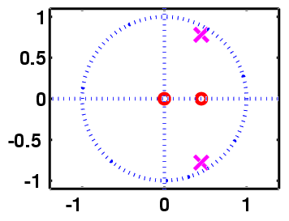
h[n]: Decays & Oscillates
“PERIOD”=6

Slide 12
2nd ORDER EX: n-Domain
aa = [ 1, -0.9, 0.81 ];
bb = [ 1, -0.45 ];
nn = -2:19;
hh = filter( bb, aa, (nn==0) );
HH = freqz( bb, aa, [-pi,pi/100:pi] );

Slide 13
2nd ORDER Z-transform PAIRS
GENERAL ENTRY for
z-Transform TABLE

Slide 14
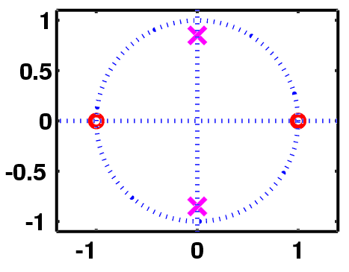
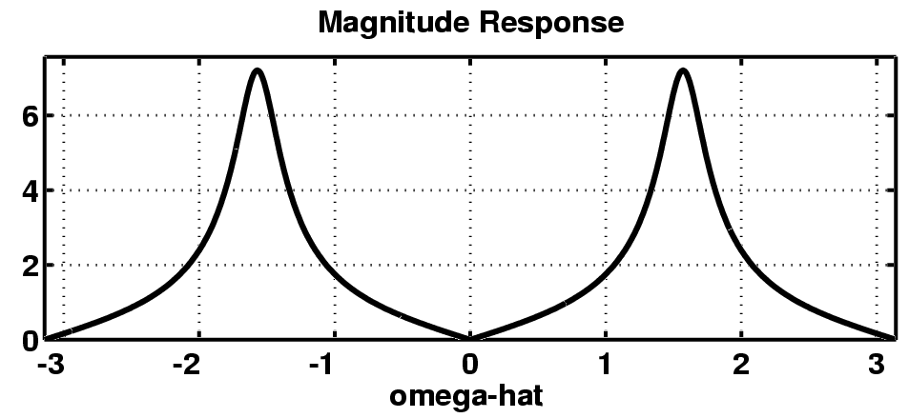
Complex POLE-ZERO PLOT

Slide 15
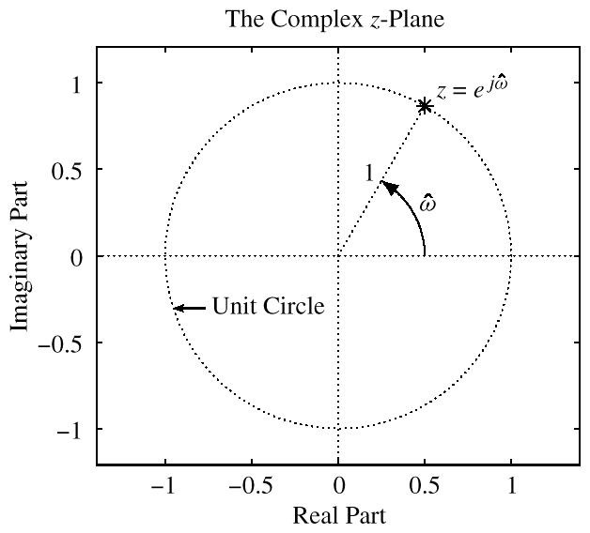
UNIT CIRCLE
MAPPING BETWEEN

Slide 16
FREQUENCY RESPONSE from POLE-ZERO PLOT

Slide 17
h[n]: Decays & Oscillates
“PERIOD”=6

Slide 18
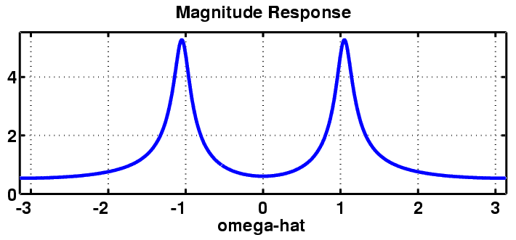
Complex POLE-ZERO PLOT
Where is
the peak?

Slide 19
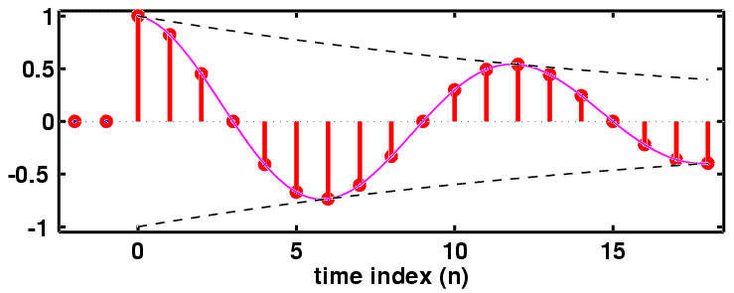
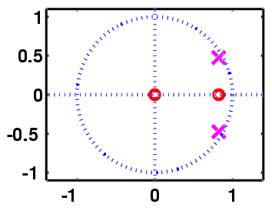
h[n]: Decays & Oscillates
“PERIOD”=12

Slide 20
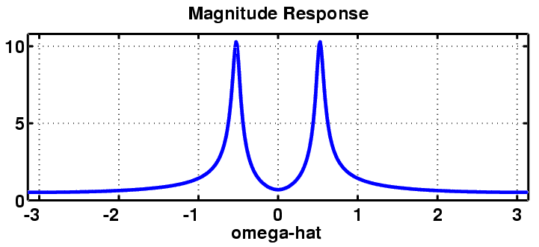
Complex POLE-ZERO PLOT
Where is
the peak?

Slide 21
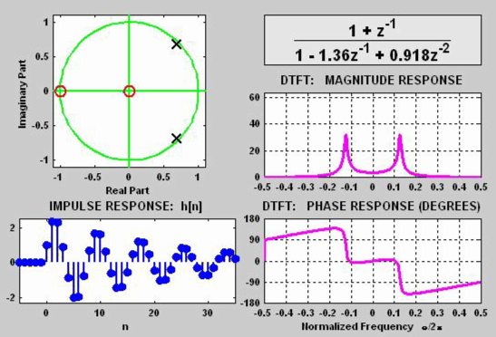
3 DOMAINS MOVIE: IIR
POLE MOVES
H(z)
H(ω)
h[n]

Slide 22
CASCADE: Pole-Zero Cancellation
Multiply the z-transforms
x[n]
v[n]
y[n]

Slide 23
YouTube Links: h(t)
Follow some links, and see h(t) in action
----------------
Maf Lewis films - Voice Breaks Glass w/ Tara Busch
http://www.youtube.com/watch?v=amuPoPkAlx8&feature=related
----------------
Show the video above first, then the “lab measurements” below
----------------
How to break a wine glass with sound – Lab Measurements
http://www.youtube.com/watch?v=JiM6AtNLXX4&feature=related
------------------------
Indian Temple (Demo of changing frequency content in an image):
http://www.youtube.com/watch?v=EaRj0q3YoGM&feature=related
----------------------------

Slide 24
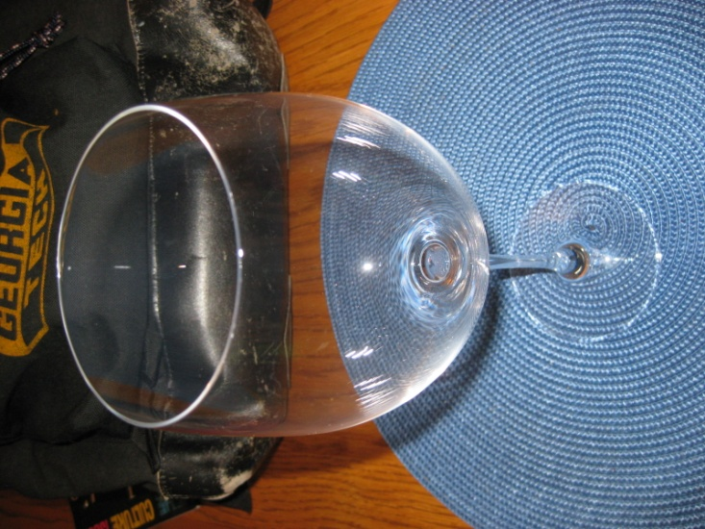
Ping, Ring & Sing
Breaking a Wine Glass by Singing
Ping
What is the input?
Ring
What are you measuring?
Thinking (Processing)
Sing
What is the input?

Slide 25
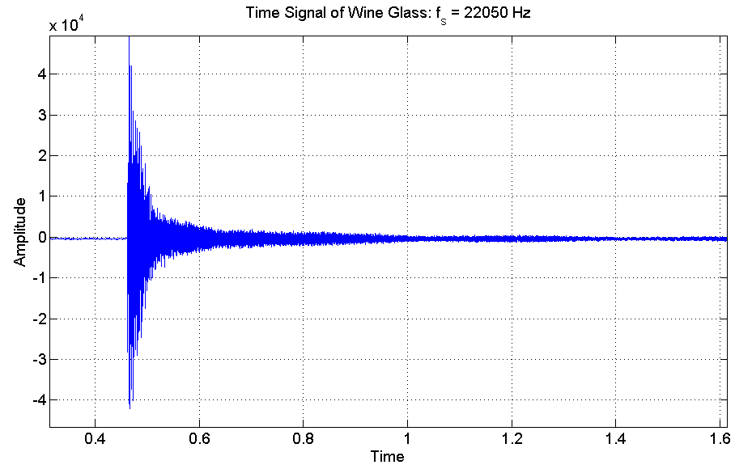
Time Domain (then FFT)

Slide 26
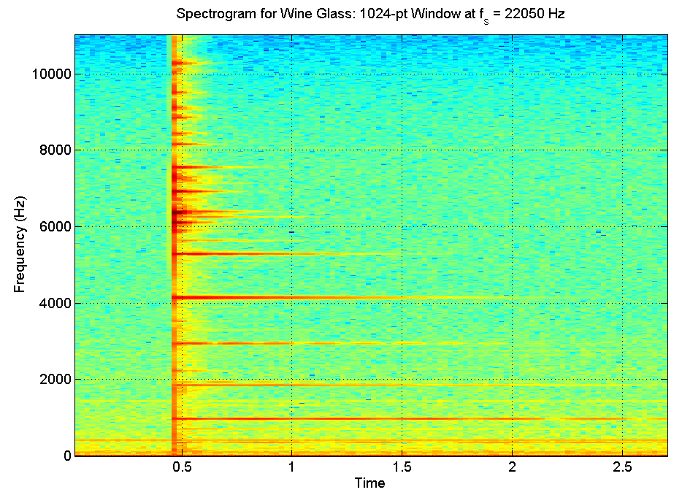
Fourier Domain (FFT)

Slide 27
Recall Frequency Response
Sinusoid-in gives sinusoid-out
True for LTI systems
Seems to require an infinite-length sinusoid
Output is
Similar for real-world sinusoids starting at n=0

