Slide 1
Ch02 Sinusoid
http://dspfirst.gatech.edu/
ipynb:
https://1drv.ms/u/s!AjlltK85sd7qkaITuf_f9z7t4tbwYg
https://1drv.ms/u/s!AjlltK85sd7qitF8IpmfPqCWZ8bBIw
ppt:
http://dspfirst.gatech.edu/database/?d=lectures&chap=2
HomeWork
http://dspfirst.gatech.edu/database/?d=homework&chap=2

Slide 2


Sinusoids

Slide 3
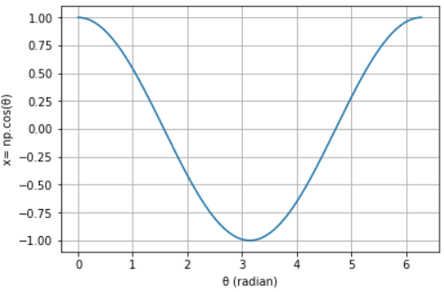
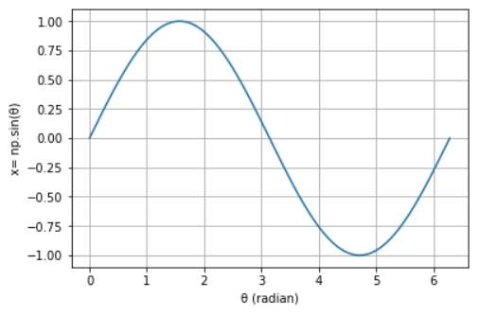

Slide 4
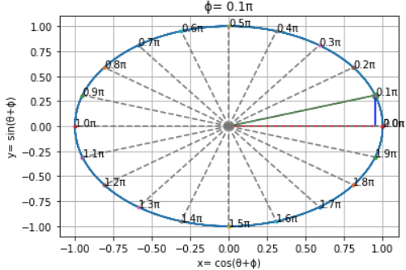
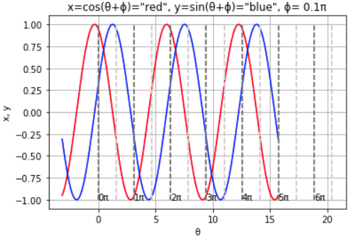

Slide 5

Sec.2-4 Sampling and Plotting Sinusoids

Slide 6
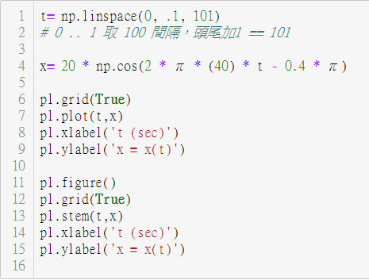
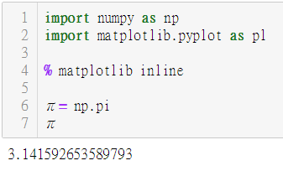
Plotting in Python, with numpy, matplotlib

Slide 7
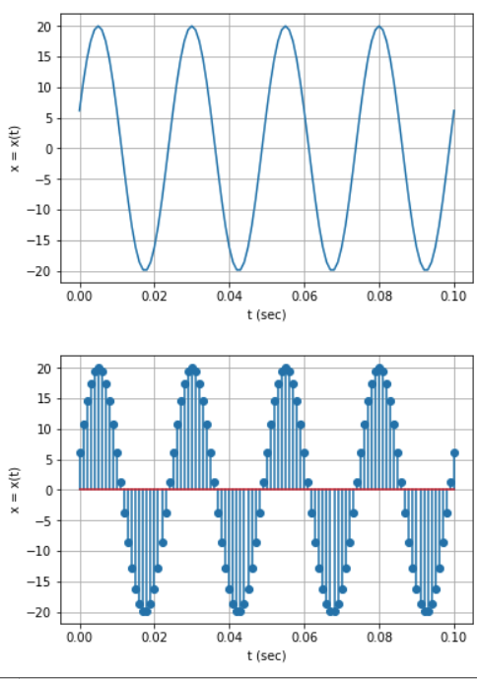

Slide 8
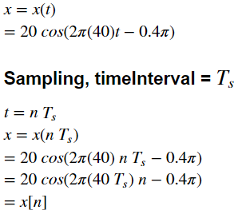

Slide 9
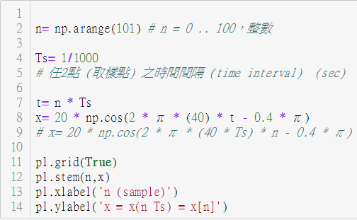
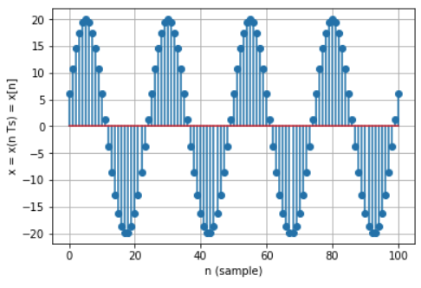

Slide 10
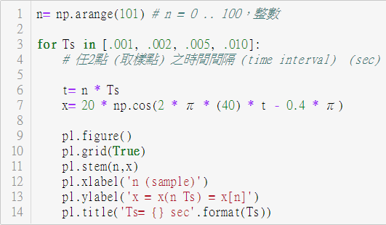
Changing Ts, Plotting…

Slide 11
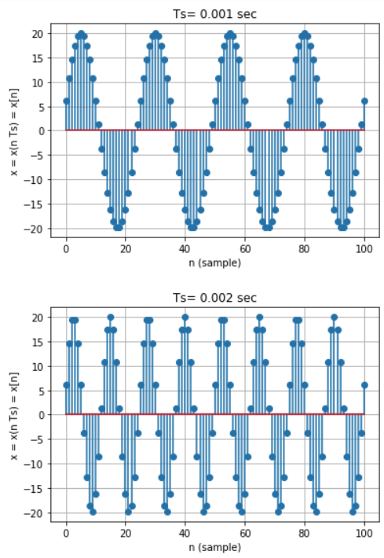
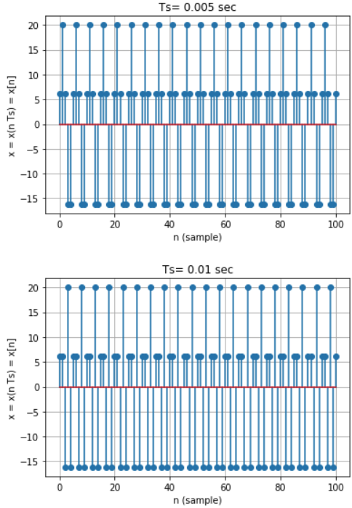

Slide 12
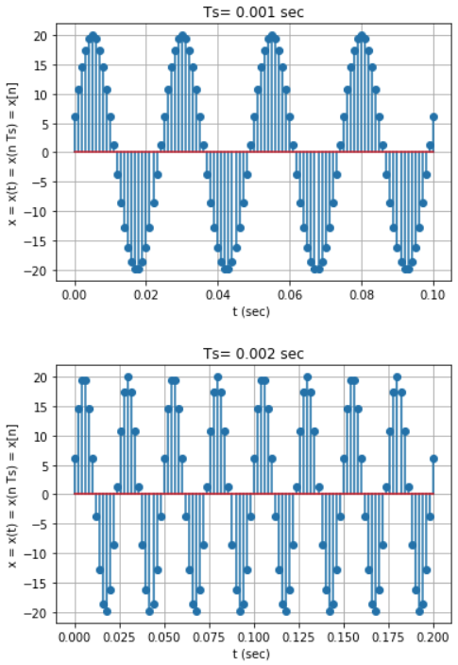
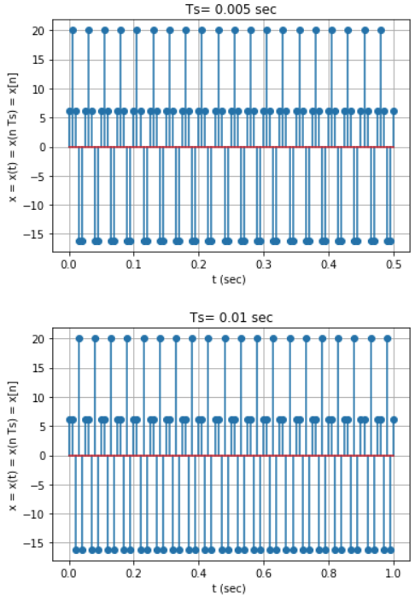

Slide 13
