Slide 1
LECTURE #1
Sinusoids

Slide 2
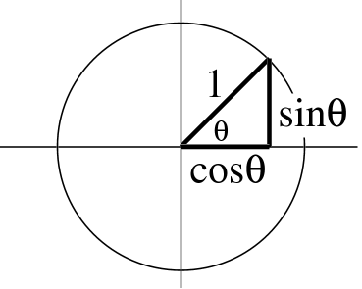
TRIG FUNCTIONS
Circular Functions
Common Values
sin(kπ) = 0
cos(0) = 1
cos(2kπ) = 1 and cos((2k+1) π) = -1
cos((k+0.5) π) = 0

Slide 3
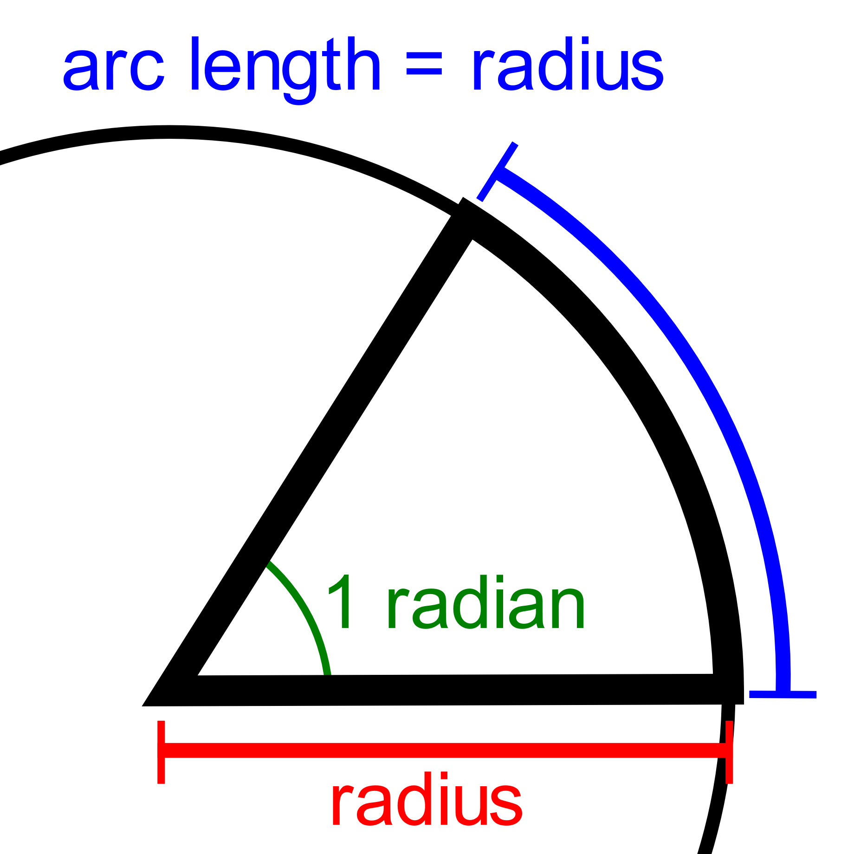
Radian
https://en.wikipedia.org/wiki/Radian
https://en.wikipedia.org/wiki/Radian#/media/File:Circle_radians.gif

Slide 4
Problems:
http://dspfirst.gatech.edu/database/?d=homework&chap=2

