Slide 1
ryProb01 Introduction to Statistics and Data Analysis
Renyuan Lyu
ryTeach2019@cgu

Slide 2
1.1 Overview:
Statistical Inference (統計の推論)
Samples
Populations
The Role of Probability

Slide 3
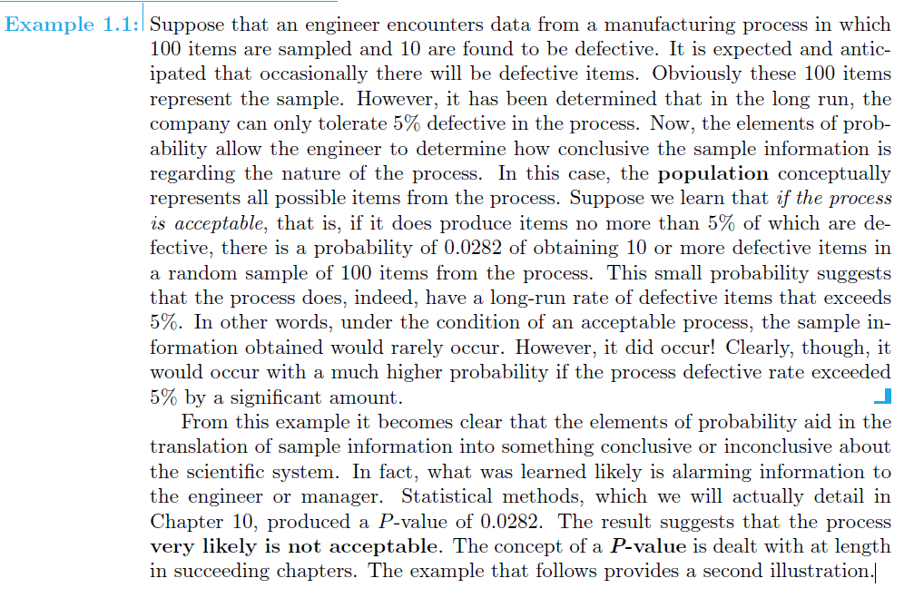
Ex 1.1

Slide 4
Example 1.1:
Suppose that an engineer encounters data
from a manufacturing process
in which 100 items are sampled
and 10 are found to be defective.

Slide 5
It is expected and anticipated
that occasionally there will be defective items.
Obviously these 100 items represent the 【sample】.
-------------

Slide 6
However, it has been determined
that in the long run,
the company can only tolerate 5% defective
in the process.

Slide 7
Now, the elements of probability
allow the engineer to determine
how conclusive the sample information is
regarding the nature of the process.

Slide 8
In this case, the 【population】
conceptually represents 【all possible items】
from the process.
-----------------

Slide 9
Suppose we learn that
if “the process is acceptable”, that is,
if “it does produce items no more than 5% of which are defective”,

Slide 10
then, (在經過精密的計算之後….)
there is a probability of 【0.0282】(= 2.82%)
of obtaining 10 or more defective items
in a random sample of 100 items from the process.

Slide 11
This 【small probability】 suggests
(如果大家約定俗成公認 5% 以下都算是 small prob 的話…)
that the process does, indeed,
have a long-run rate of defective items that 【exceeds 5%】.

Slide 12
In other words,
under the condition of an “acceptable process”,
the sample information obtained would “rarely occur”.
However, it did occur! !!!!!!!!

Slide 13
Clearly, though, it would occur with a much higher probability
if the process defective rate exceeded 5% by a significant amount.

Slide 14
(若最初的假設正確，
則會推論至本事件發生之機率極低，
但本事件居然會發生，
可見...

Slide 15
最初的假設有問題，
不能接受，
必須拒絕最初的假設！！)
=======================

Slide 16
From this example it becomes clear
that the elements of probability
aid in the translation of sample information
into something conclusive or inconclusive
about the scientific system.

Slide 17
In fact, what was learned likely is alarming information to the engineer or manager.

Slide 18
Statistical methods,
which we will actually detail in Chapter 10,
produced a 【P-value】 of 0.0282.

Slide 19
The result suggests
that the process very likely is not acceptable.
(最初的假設是 它 可被接受 (acceptable) )
========================

Slide 20
1.2 Sampling Procedures
Collection of Data

Slide 21
1.3 Measures of Location:
The Sample Mean and Median

Slide 22
Exercises

Slide 23
1.4 Measures of Variability. . . . . . . . . . . . . . . . . . . . . . . . . . . . . . . . . . . . . . . . . . 14
Exercises . . . . . . . . . . . . . . . . . . . . . . . . . . . . . . . . . . . . . . . . . . . . . . . . . . . 17

Slide 24
1.5 Discrete and Continuous Data. . . . . . . . . . . . . . . . . . . . . . . . . . . . . . . . . . . 17

Slide 25
1.6 Statistical Modeling, Scientific Inspection, and Graphical Diagnostics
. . . . . . . . . . . . . . . . . . . . . . . . . . . . . . . . . . . . . . . . . . . . . . . . . . . . . . . . . . 18

Slide 26
1.7 General Types of Statistical Studies: Designed Experiment, Observational Study, and Retrospective Study . . . . . . . . . . . . . . . . . . 27
Exercises . . . . . . . . . . . . . . . . . . . . . . . . . . . . . . . . . . . . . . . . . . . . . . . . . . . 30

