Slide 1
ryProb01_02
~
Renyuan Lyu
ryTeach2019@cgu

Slide 2
Descriptive Statistics using Excel

Slide 3
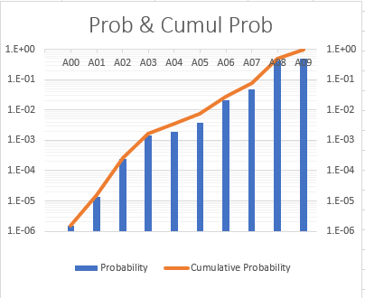
Prob & Cumul Prob
for x in {‘A00’, ‘A01’, …., ‘A09’}:
Prob(x) = Frequency(x) / Total
CulmulProb(x) += Prob(x)

Slide 4
邀你來做莊家
根據這張機率分析表，邀你來做莊家，設計一個中獎獎金分配表。
訂定抽一手牌(5支牌)的玩家須支付的費用。你要根據玩家抽中的牌型(A00,A01,…, A09)，支付玩家獎金。
分析一下：若每天有100人來玩你的遊戲，100天下來，作為莊家的你，會賺多少錢？
寫一篇小報告來描述整個分析過程。

Slide 5
ry公益撲克 .....
金豬年，玩家中獎發大財，沒中獎本公司也幫你做公益。
每抽1手牌(5支)，只要10元，就有機會中大獎 $320,000元。
本公司每年營業額 10% 捐出來 給慈善機構 或政府機構 做公益。

Slide 6
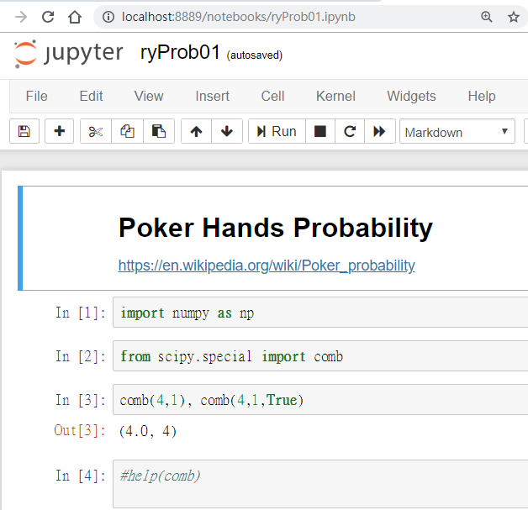
Python, numpy, scipy, matplotlib,
Jupyter,
Anaconda
ryProb01.ipynb
https://1drv.ms/u/s!AjlltK85sd7qkaFCZ3LjrFaZOh1seQ

Slide 9
1.2 Sampling Procedures
Collection of Data
  Simple Random Sampling
  Experimental Design
  Why Assign Experimental Units Randomly?

Slide 10
Simple Random Sampling
The importance of proper sampling revolves around the degree of confidence with which the analyst is able to answer the questions being asked. Let us assume that only a single population exists in the problem. Recall that in Example 1.2 two populations were involved. Simple random sampling implies that any particular sample of a specified sample size has the same chance of being selected as any other sample of the same size. The term sample size simply means the number of elements in the sample. Obviously, a table of random numbers can be utilized in sample selection in many instances. The virtue of simple random sampling is that it aids in the elimination of the problem of having the sample reflect a different (possibly more confined) population than the one about which inferences need to be made. For example, a sample is to be chosen to answer certain questions regarding political preferences in a certain state in the United States. The sample involves the choice of, say, 1000 families, and a survey is to be conducted. Now, suppose it turns out that random sampling is not used. Rather, all or nearly all of the 1000 families chosen live in an urban setting. It is believed that political preferences in rural areas differ from those in urban areas. In other words, the sample drawn actually confined the population and thus the inferences need to be confined to the “limited population,” and in this case confining may be undesirable. If, indeed, the inferences need to be made about the state as a whole, the sample of size 1000 described here is often referred to as a biased sample.

Slide 11
Experimental Design
The concept of randomness or random assignment plays a huge role in the area of experimental design, which was introduced very briefly in Section 1.1 and is an important staple in almost any area of engineering or experimental science. This will be discussed at length in Chapters 13 through 15. However, it is instructive to give a brief presentation here in the context of random sampling. A set of so-called treatments or treatment combinations becomes the populations to be studied or compared in some sense. An example is the nitrogen versus no-nitrogen treatments in Example 1.2. Another simple example would be “placebo” versus “active drug,” or in a corrosion fatigue study we might have treatment combinations that involve specimens that are coated or uncoated as well as conditions of low or high humidity to which the specimens are exposed. In fact, there are four treatment or factor combinations (i.e., 4 populations), and many scientific questions may be asked and answered through statistical and inferential methods.

Slide 12
Why Assign Experimental Units Randomly?
What is the possible negative impact of not randomly assigning experimental units to the treatments or treatment combinations? This is seen most clearly in the case of the drug study. Among the characteristics of the patients that produce variability in the results are age, gender, and weight. Suppose merely by chance the placebo group contains a sample of people that are predominately heavier than those in the treatment group. Perhaps heavier individuals have a tendency to have a higher blood pressure. This clearly biases the result, and indeed, any result obtained through the application of statistical inference may have little to do with the drug and more to do with differences in weights among the two samples of patients.

Slide 13
We should emphasize the attachment of importance to the term variability. Excessive variability among experimental units “camouflages” scientific findings. In future sections, we attempt to characterize and quantify measures of variability. In sections that follow, we introduce and discuss specific quantities that can be computed in samples; the quantities give a sense of the nature of the sample with respect to center of location of the data and variability in the data. A discussion of several of these single-number measures serves to provide a preview of what statistical information will be important components of the statistical methods that are used in future chapters. These measures that help characterize the nature of the data set fall into the category of descriptive statistics. This material is a prelude to a brief presentation of pictorial and graphical methods that go even further in characterization of the data set.
The reader should understand that the statistical methods illustrated here will be used throughout the text. In order to offer the reader a clearer picture of what is involved in experimental design studies, we offer Example 1.3.

Slide 14
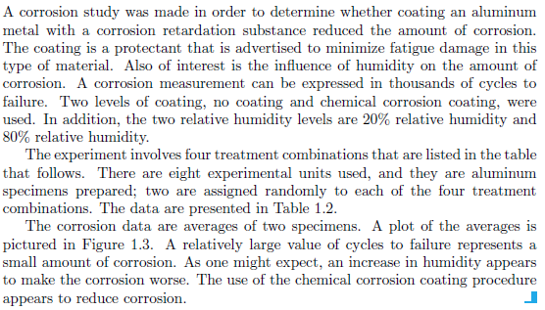
Example 1.3

Slide 15
A corrosion study was made in order to determine whether coating an aluminum metal with a corrosion retardation substance reduced the amount of corrosion. The coating is a protectant that is advertised to minimize fatigue damage in this type of material. Also of interest is the influence of humidity on the amount of corrosion. A corrosion measurement can be expressed in thousands of cycles to failure. Two levels of coating, no coating and chemical corrosion coating, were used.
In addition, the two relative humidity levels are 20% relative humidity and 80% relative humidity. The experiment involves four treatment combinations that are listed in the table that follows. There are eight experimental units used, and they are aluminum specimens prepared; two are assigned randomly to each of the four treatment combinations. The data are presented in Table 1.2.
The corrosion data are averages of two specimens. A plot of the averages is pictured in Figure 1.3. A relatively large value of cycles to failure represents a small amount of corrosion. As one might expect, an increase in humidity appears to make the corrosion worse. The use of the chemical corrosion coating procedure appears to reduce corrosion.

Slide 16
Sentence cut into segments……
A corrosion study was made
in order to determine
whether coating an aluminum metal
with a corrosion retardation substance
reduced the amount of corrosion.
The coating is a protectant
that is advertised to minimize fatigue damage
in this type of material.

Slide 17
Also of interest is the influence
of humidity
on the amount of corrosion.
A corrosion measurement
can be expressed
in thousands of cycles to failure.

Slide 18
Two levels of coating,
no coating
and chemical corrosion coating,
were used.
In addition,
the two relative humidity levels
are 20% relative humidity
and 80% relative humidity.

Slide 19
The experiment involves
four treatment combinations
that are listed in the table that follows.
There are eight experimental units used,
and they are aluminum specimens prepared;
two are assigned randomly
to each of the four treatment combinations.

Slide 20
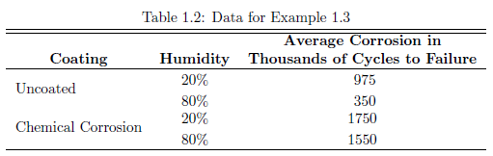
The data are presented in Table 1.2.

Slide 21
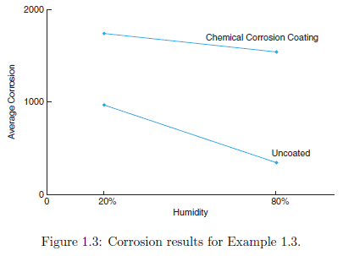
The corrosion data are averages of two specimens.
A plot of the averages is pictured in Figure 1.3.

Slide 22
A relatively large value of cycles to failure
represents a small amount of corrosion.
As one might expect,
an increase in humidity
appears to make the corrosion worse.
➔ Conclusion
The use of the chemical corrosion coating procedure
appears to reduce corrosion.

Slide 23
英翻中 (1)
進行了腐蝕研究
為了確定
是否塗鋁金屬
含有緩蝕物質
減少腐蝕量。
塗層是一種保護劑
廣告宣傳，以盡量減少疲勞損傷
在這種類型的材料。
同樣令人感興趣的是影響力
濕度
關於腐蝕量。
腐蝕測量
可以表達
在數千個週期中失敗。
兩層塗層，
沒有塗層
和化學腐蝕塗層，
被使用了。
A corrosion study was made
in order to determine
whether coating an aluminum metal
with a corrosion retardation substance
reduced the amount of corrosion.
The coating is a protectant
that is advertised to minimize fatigue damage
in this type of material.
Also of interest is the influence
of humidity
on the amount of corrosion.
A corrosion measurement
can be expressed
in thousands of cycles to failure.
Two levels of coating,
no coating
and chemical corrosion coating,
were used.

Slide 24
(2)
In addition,
the two relative humidity levels
are 20% relative humidity
and 80% relative humidity.
The experiment involves
four treatment combinations
that are listed in the table that follows.
There are eight experimental units used,
and they are aluminum specimens prepared;
two are assigned randomly
to each of the four treatment combinations.
The data are presented in Table 1.2.
The corrosion data
are averages of two specimens.
A plot of the averages
is pictured in Figure 1.3.
此外，
兩個相對濕度水平
相對濕度為20％
和80％的相對濕度。
實驗涉及到
四種治療組合
在下表中列出。
使用了八個實驗單位，
它們是製備的鋁樣品;
兩個是隨機分配的
四種治療組合中的每一種。
數據見表1.2。
腐蝕數據
是兩個標本的平均值。
平均值的圖
如圖1.3所示。

Slide 25
(3)
A relatively large value of cycles to failure
represents a small amount of corrosion.
As one might expect,
an increase in humidity
appears to make the corrosion worse.
The use of the chemical corrosion coating procedure
appears to reduce corrosion.
失敗的周期值相對較大
代表少量腐蝕。
正如人們所料，
濕度增加
似乎使腐蝕變得更糟。
使用化學腐蝕塗層程序
似乎可以減少腐蝕。

Slide 27
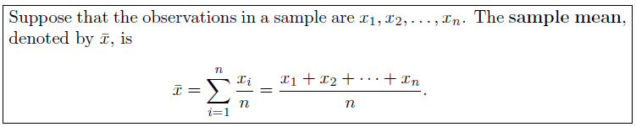
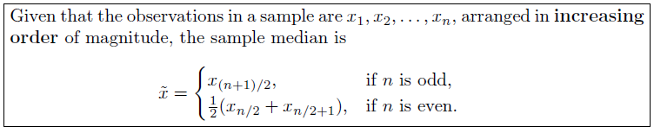
1.3 Measures of Location:
The Sample Mean and Median

Slide 28
Other Measures of Locations
  trimmed means.
    A trimmed mean is computed by “trimming away” a certain percent of both the largest and the smallest set of values.
    For example,
      the 10% trimmed mean
      is found by eliminating the largest 10%
      and smallest 10%
      and computing the average of the remaining values.

Slide 29
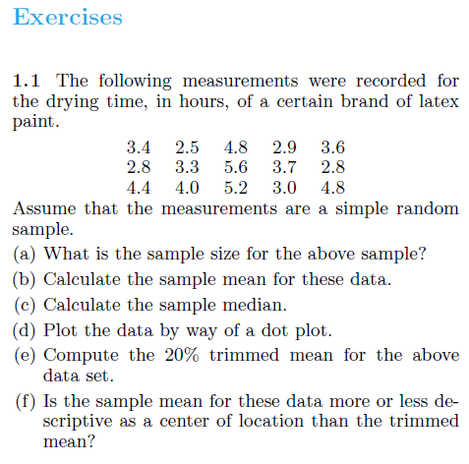
Exercises

Slide 30
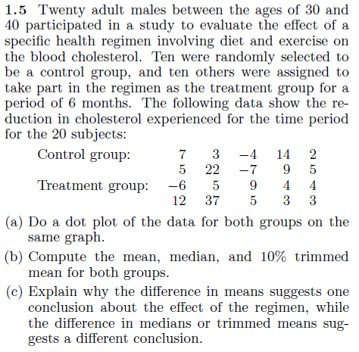

Slide 31
1.4 Measures of Variability. . . . . . . . . . . . . . . . . . . . . . . . . . . . . . . . . . . . . . . . . . 14
Exercises . . . . . . . . . . . . . . . . . . . . . . . . . . . . . . . . . . . . . . . . . . . . . . . . . . . 17

Slide 32
1.5 Discrete and Continuous Data. . . . . . . . . . . . . . . . . . . . . . . . . . . . . . . . . . . 17

Slide 33
1.6 Statistical Modeling, Scientific Inspection, and Graphical Diagnostics
. . . . . . . . . . . . . . . . . . . . . . . . . . . . . . . . . . . . . . . . . . . . . . . . . . . . . . . . . . 18

Slide 34
1.7 General Types of Statistical Studies: Designed Experiment, Observational Study, and Retrospective Study . . . . . . . . . . . . . . . . . . 27
Exercises . . . . . . . . . . . . . . . . . . . . . . . . . . . . . . . . . . . . . . . . . . . . . . . . . . . 30

