Slide 1
ryProb01_03 ~
Renyuan Lyu
ryTeach2019@cgu

Slide 2
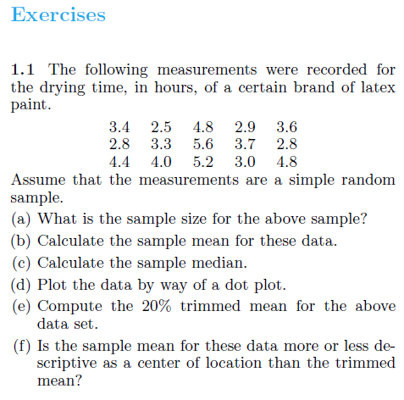
Exercises

Slide 3
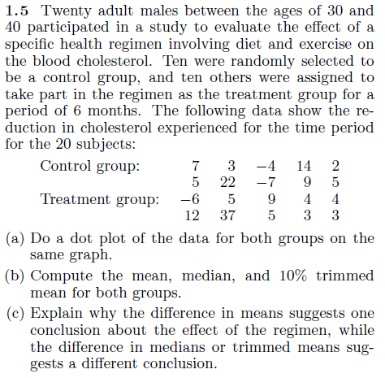

Slide 5
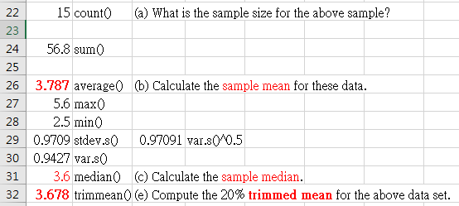
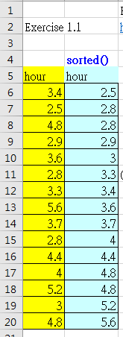
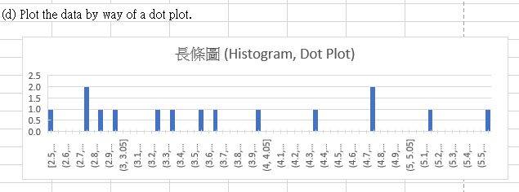
Ex 1.1 using Excel
https://1drv.ms/x/s!AjlltK85sd7qis5p7KckDZazNMgAUQ

Slide 6
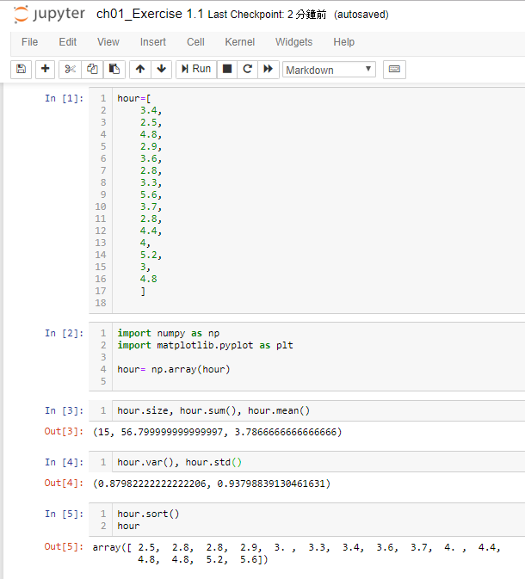
Ex 1.1 using Python
https://1drv.ms/u/s!AjlltK85sd7qkaFHeDiA8JWLK8WH_A

Slide 7
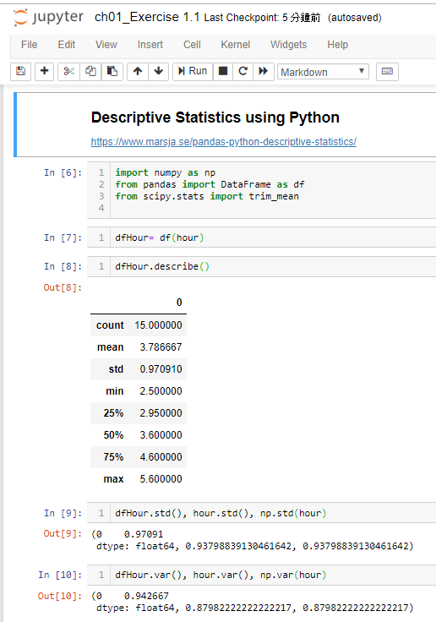

Slide 8
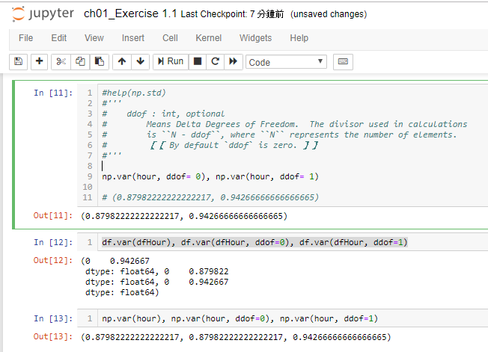

Slide 9
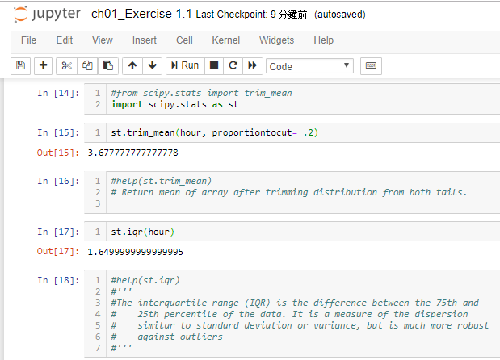

Slide 10
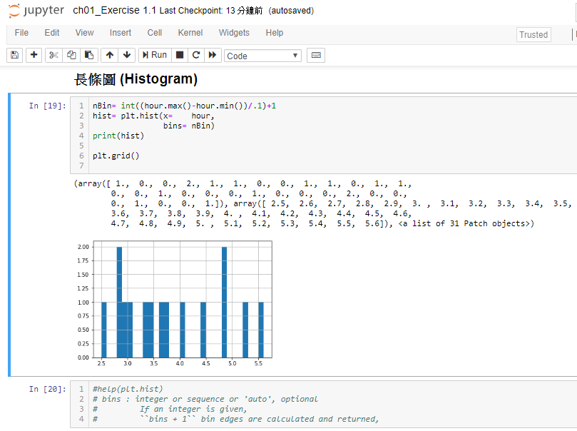

Slide 11
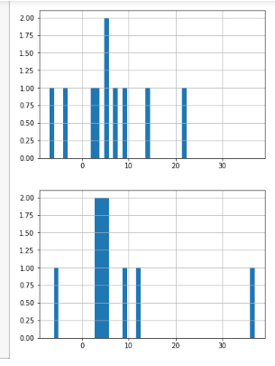
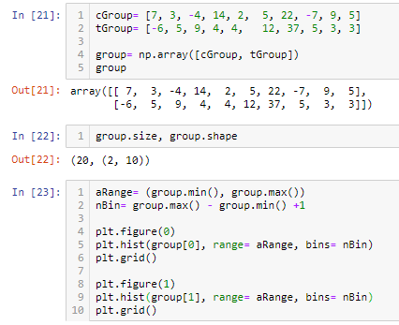
Ex 1.5

Slide 12
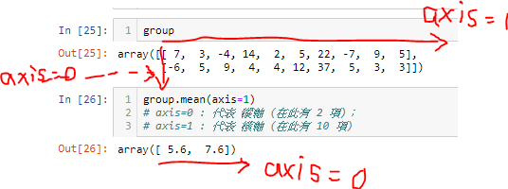

Slide 13
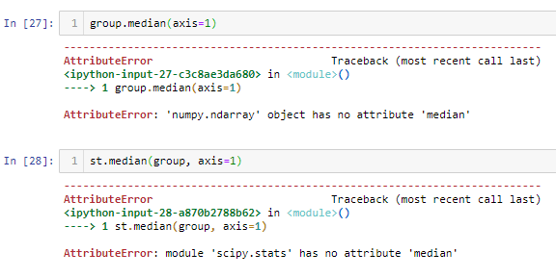

Slide 14
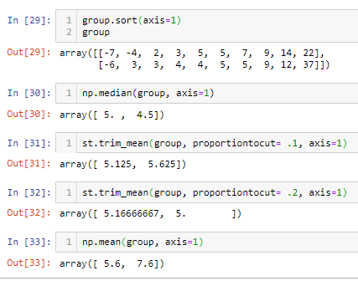

Slide 15
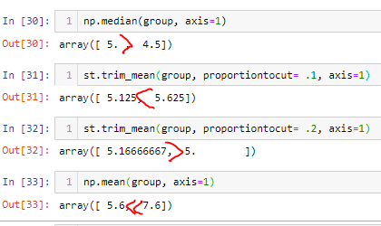

Slide 16
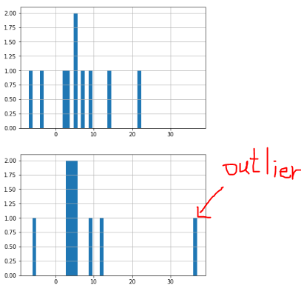

Slide 17
10 Top Entrepreneurs Reveal Their Health Regimen Secrets
https://www.entrepreneur.com/article/288545
1. Juice up.
2. Focus on the most important 80 percent.
3. Compress your eating window.
4. Attack your health from all angles.
5. Fuel your productivity. Prioritize sleep.
6. Discipline your diet, discipline your life.
7. Engineer energy and focus.
8. Eat light and drink phytoplankton.
9. Everything in moderation.
10. Get outside first thing.

Slide 18
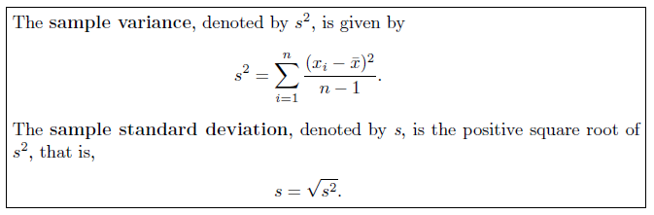
1.4 Measures of Variability
Sample Range and Sample Standard Deviation

Slide 19
Example 1.4:
In an example discussed extensively in Chapter 10,
an engineer is interested in testing the “bias” in a pH meter.
Data are collected on the meter by measuring the pH
of a neutral substance (pH = 7.0).
A sample of size 10 is taken, with results given by
7.07, 7.00, 7.10, 6.97, 7.00,
7.03, 7.01, 7.01, 6.98, 7.08.

Slide 20



sol
So the sample standard deviation (std)
is 0.0440
with n − 1 = 9 degrees of freedom (dof).

Slide 21
Units for Standard Deviation and Variance
Which Variability Measure Is More Important?
Exercises
1.7 Consider the drying time data for Exercise 1.1 on page 13.
Compute the sample variance and sample standard deviation.
1.11 Consider the data in Exercise 1.5 on page 13.
Compute the sample variance and the sample standard deviation for both control and treatment groups.

Slide 23
HomeWork #4
Reading the following sections
1.5 Discrete and Continuous Data
1.6 Statistical Modeling, Scientific Inspection, and Graphical Diagnostics
1.7 General Types of Statistical Studies: Designed Experiment, Observational Study, and Retrospective Study

Slide 24
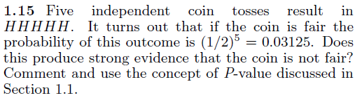
Exercises

Slide 25
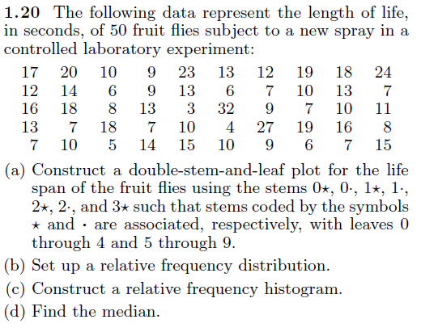

Slide 26
