Slide 1
Chapter 1. Giving Computers the Ability to Learn from Data
Renyuan Lyu
all materials mainly from
Sebastian Raschka

Slide 2
In this Chapters….
The general concepts of machine learning
The three types of learning and basic terminology
The building blocks for successfully designing machine learning systems
Installing and setting up Python for data analysis and machine learning
Anaconda distribution of Python 3

Slide 3
Building intelligent machines to transform data into knowledge
In this age of modern technology, there is one resource that we have in abundance:
a large amount of structured and unstructured data.
In the second half of the twentieth century, machine learning evolved as a subfield of Artificial Intelligence (AI) that involved self-learning algorithms that derived knowledge from data in order to make predictions.

Slide 4
Instead of requiring humans to manually derive rules and build models from analyzing large amounts of data, machine learning offers a more efficient alternative for capturing the knowledge in data to gradually improve the performance of predictive models and make data-driven decisions.
Not only is machine learning becoming increasingly important in computer science research, but it also plays an ever greater role in our everyday lives.

Slide 5
Thanks to machine learning, we enjoy
robust email spam filters,
convenient text and voice recognition software,
reliable web search engines,
challenging chess-playing programs,
(and, hopefully soon), safe and efficient self-driving cars.

Slide 6
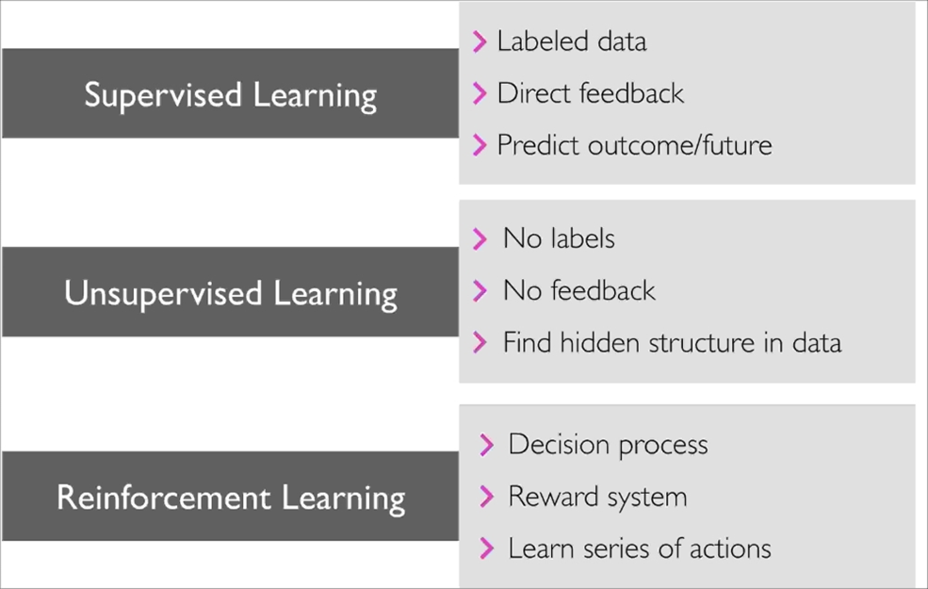
The three different types of machine learning

Slide 7
Making predictions about the future with supervised learning
Classification for predicting class labels
Regression for predicting continuous outcomes
Discovering hidden structures with unsupervised learning
Finding subgroups with clustering
Dimensionality reduction for data compression
Solving interactive problems with reinforcement learning

Slide 8
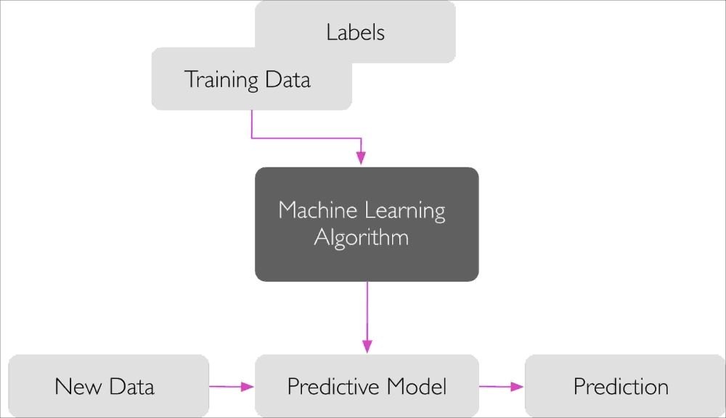
supervised learning

Slide 9
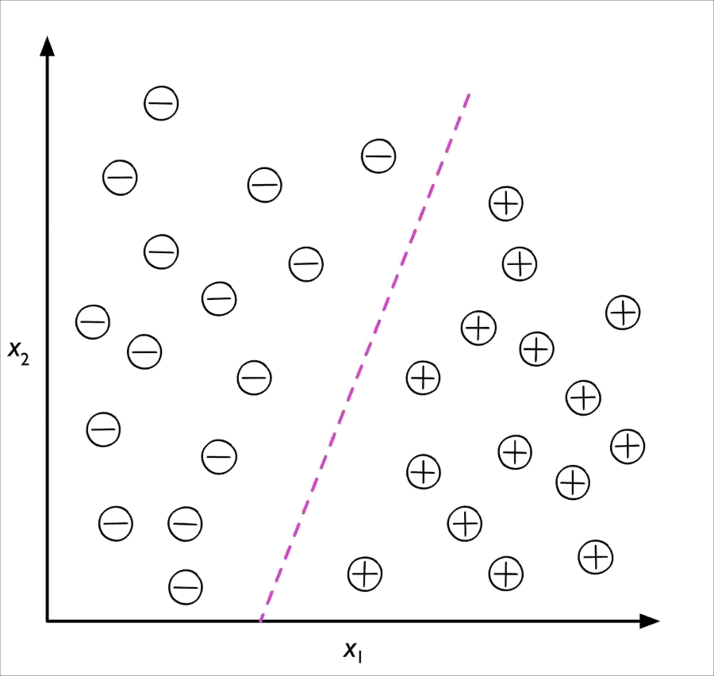
supervised learning
Classification

Slide 10
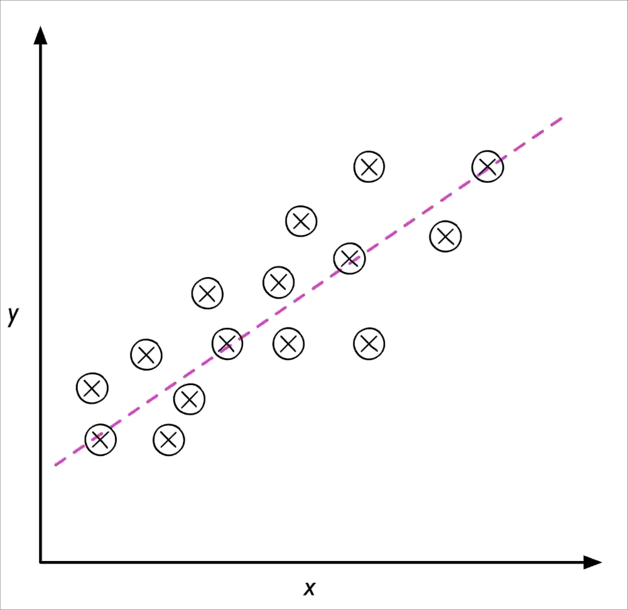
supervised learning
Regression

Slide 11
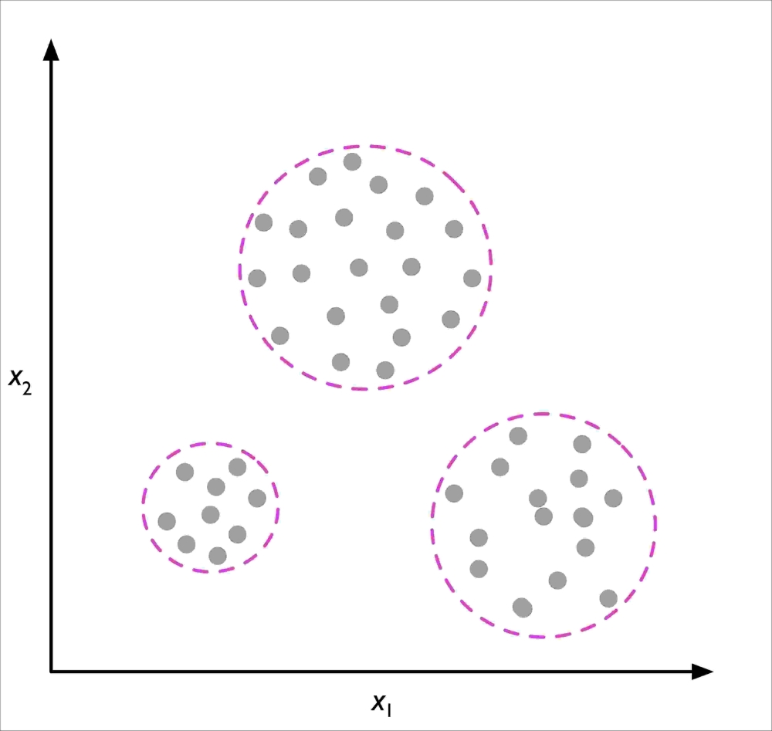
unsupervised learning
clustering

Slide 12
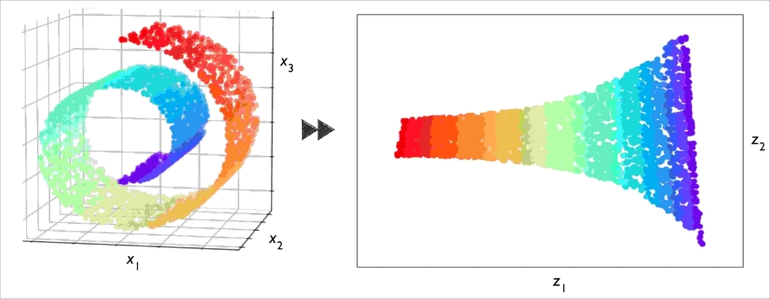
unsupervised learning
Dimensionality reduction

Slide 13
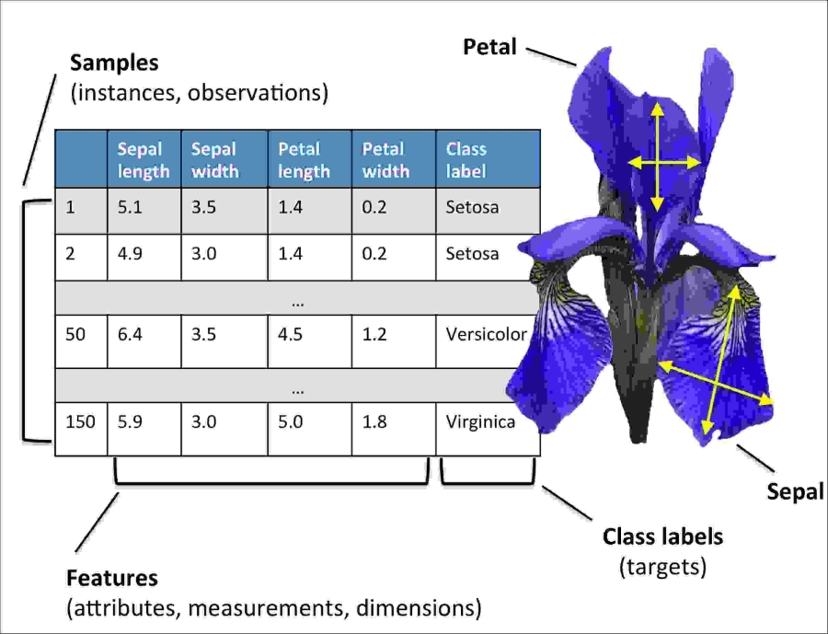



Introduction to the basic terminology and notations
the Iris dataset
https://en.wikipedia.org/wiki/Iris_flower_data_set
Iris setosa
Iris versicolor
Iris virginica

Slide 14
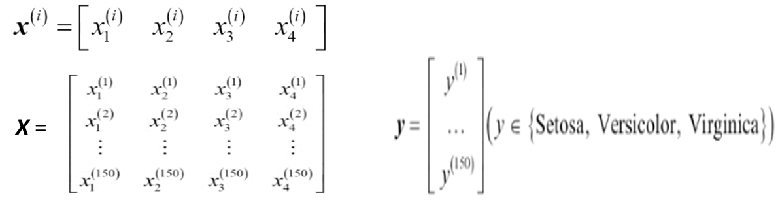
the Iris dataset
a classic example
in the field of pattern recognition and also machine learning
containing
the measurements (as features) of 150 Iris flowers
3 different species (as labels)—Setosa, Versicolor, and Virginica.
using matrix and vector
as notations to refer to our data

Slide 15


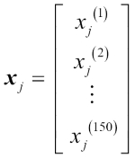

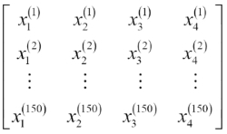

Notations in vector & matrix
A (column) vector represent a feature dimention (j) of 150 samples
A feature (row) vector of a sample (i)
A feature Matrix of 150 samples
A (column) vector represent labels of 150 samples

Slide 16
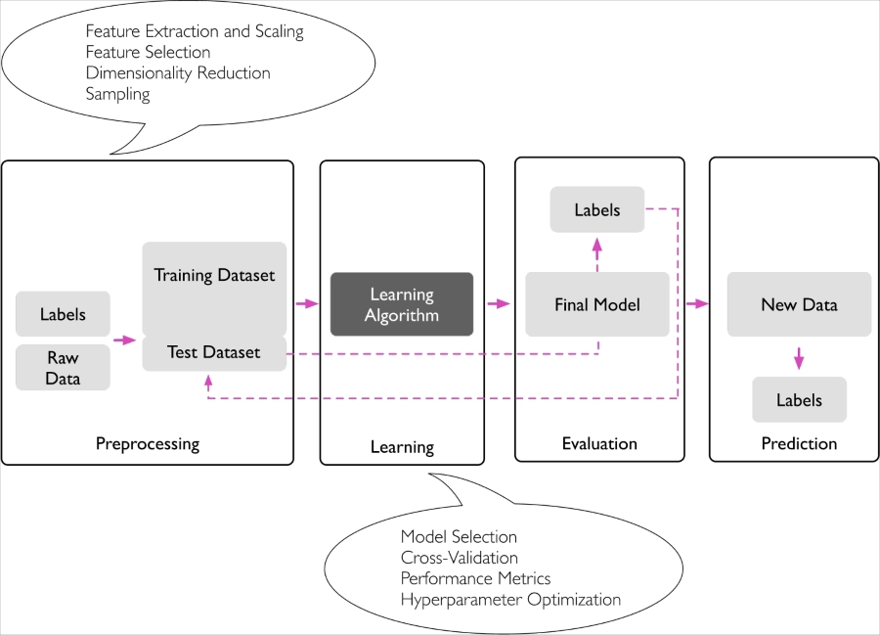
A roadmap for building machine learning systems

Slide 17
Preprocessing – getting data into shape
Learning (training) and selecting a predictive model
Evaluating (testing) models
Predicting (recognizing) unseen data instances

Slide 18
Using Python for machine learning
Python is one of the most popular programming languages for data science
and therefore enjoys a large number of useful add-on libraries developed by its great developer and open-source community.
Extension libraries such as NumPy and SciPy have been developed
that build upon lower-layer Fortran and C implementations for fast and vectorized operations on multidimensional arrays.
although the performance of interpreted languages, such as Python, for computation-intensive tasks is inferior to lower-level programming languages,
We will mostly refer to the scikit-learn library,
which is currently one of the most popular and accessible open source machine learning libraries.

Slide 19
Installing Python and packages from the Python Package Index
the official Python website: https://www.python.org
Python3 vs Python2
A good summary of the differences between Python 3.x and 2.x can be found at https://wiki.python.org/moin/Python2orPython3.
additional packages
The installer program: pip
pip install SomePackage
https://docs.python.org/3/installing/index.html

Slide 20
Using the Anaconda Python distribution and package manager
Anaconda by Continuum Analytics
A highly recommended alternative Python distribution for scientific computing
Anaconda is a free—including for commercial use—enterprise-ready Python distribution
that bundles all the essential Python packages for data science, math, and engineering in one user-friendly cross-platform distribution.
The Anaconda installer can be downloaded at http://continuum.io/downloads,
an Anaconda quick-start guide is available at https://conda.io/docs/test-drive.html.

Slide 21
Packages for scientific computing, data science, and machine learning
Throughout this book, we will mainly use NumPy's multidimensional arrays to store and manipulate data.
Occasionally, we will make use of pandas, which is a library built on top of NumPy that provides additional higher-level data manipulation tools that make working with tabular data even more convenient.
To augment our learning experience and visualize quantitative data, which is often extremely useful to intuitively make sense of it, we will use the very customizable Matplotlib library.

Slide 22
The version numbers of the major Python packages that were used for writing this book are mentioned in the following list.
Please make sure that the version numbers of your installed packages are equal to, or greater than, those version numbers to ensure the code examples run correctly:
NumPy 1.12.1
SciPy 0.19.0
scikit-learn 0.18.1
Matplotlib 2.0.2
pandas 0.20.1

Slide 23
Summary
In this chapter, we explored machine learning at a very high level and familiarized ourselves with the big picture and major concepts that we are going to explore in the following chapters in more detail.
We learned that supervised learning is composed of two important subfields: classification and regression.
While classification models allow us to categorize objects into known classes, we can use regression analysis to predict the continuous outcomes of target variables.

Slide 24
Unsupervised learning not only offers useful techniques for discovering structures in unlabeled data, but it can also be useful for data compression in feature preprocessing steps.
We briefly went over the typical roadmap for applying machine learning to problem tasks, which we will use as a foundation for deeper discussions and hands-on examples in the following chapters.
Eventually, we set up our Python environment and installed and updated the required packages to get ready to see machine learning in action.

Slide 25
Later in this book, in addition to machine learning itself, we will also introduce different techniques to preprocess our dataset, which will help us to get the best performance out of different machine learning algorithms.
While we will cover classification algorithms quite extensively throughout the book, we will also explore different techniques for regression analysis and clustering.

Slide 26
We have an exciting journey ahead, covering many powerful techniques in the vast field of machine learning.
However, we will approach machine learning one step at a time, building upon our knowledge gradually throughout the chapters of this book.

Slide 27
In the following chapter, Chapter 2, we will start this journey by implementing one of the earliest machine learning algorithms for classification,
which will prepare us for Chapter 3,
A Tour of Machine Learning Classifiers Using scikit-learn,
where we cover more advanced machine learning algorithms using the scikit-learn open source machine learning library.

Slide 28
The author’s official sites
https://github.com/rasbt/python-machine-learning-book-2nd-edition
https://sebastianraschka.com/

Slide 29
Chinese Translation
Python機器學習(第二版)
Python Machine Learning – Second Edition
作者： Sebastian Raschka, Vahid Mirjalili
譯者： 劉立民, 吳建華
出版社：博碩
出版日期：2018/08/30
語言：繁體中文
https://www.books.com.tw/products/0010797010

Slide 30
The author’s course @ UW-Madison
STAT 479 -- Machine Learning (Fall 2018)
http://pages.stat.wisc.edu/~sraschka/teaching/stat479-fs2018/
https://github.com/rasbt/stat479-machine-learning-fs18
Lecture 01
https://github.com/rasbt/stat479-machine-learning-fs18/blob/master/01_overview/01_ml-overview_notes.pdf
https://github.com/rasbt/stat479-machine-learning-fs18/blob/master/01_overview/01_ml-overview_slides.pdf

Slide 31
The author’s short course @Youtube
Machine Learning Part 1 | SciPy 2016 Tutorial | Andreas Mueller & Sebastian Raschka
https://youtu.be/OB1reY6IX-o
All the slides and codes
https://github.com/amueller/scipy-2016-sklearn

Slide 32
HomeWork #1
Install Anaconda Python
At your own computer
And the computer in the lab
Get all the course materials mentioned in this ppt
Using GitHub to clone them
Or Just Downloading them
Check the Python codes (inside Jupyter)
make sure they can run.

