Slide 1
Chapter 3. A Tour of Machine Learning Classifiers Using scikit-learn
Renyuan Lyu
@2018/10/25

Slide 2
Introduction
In this chapter, we will take a tour through a selection of popular and powerful machine learning algorithms that are commonly used in academia as well as in industry.
While learning about the differences between several supervised learning algorithms for classification, we will also develop an intuitive appreciation of their individual strengths and weaknesses.
In addition, we will take our first step with the scikit-learn library, which offers a user-friendly interface for using those algorithms efficiently and productively.

Slide 3
The topics that we will learn about throughout this chapter are as follows:
Introduction to robust and popular algorithms for classification, such as
logistic regression,
support vector machines,
decision trees
Examples and explanations using the scikit-learn machine learning library, which provides a wide variety of machine learning algorithms via a user-friendly Python API
Discussions about the strengths and weaknesses of classifiers with linear and non-linear decision boundaries

Slide 4
First steps with scikit-learn – training a perceptron
http://scikit-learn.org/stable/modules/generated/sklearn.linear_model.Perceptron.html#examples-using-sklearn-linear-model-perceptron
sklearn.linear_model.Perceptron
decision_function(X) | Predict confidence scores for samples.
densify() | Convert coefficient matrix to dense array format.
fit(X, y [, coef_init, intercept_init, …]) | Fit linear model with Stochastic Gradient Descent.
get_params([deep]) | Get parameters for this estimator.
partial_fit(X, y[, classes, sample_weight]) | Fit linear model with Stochastic Gradient Descent.
predict(X) | Predict class labels for samples in X.
score(X, y [, sample_weight]) | Returns the mean accuracy on the given test data and labels.
set_params(*args, **kwargs)
sparsify() | Convert coefficient matrix to sparse format.

Slide 5
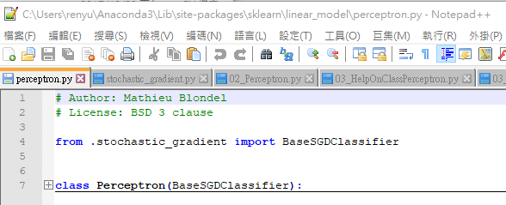
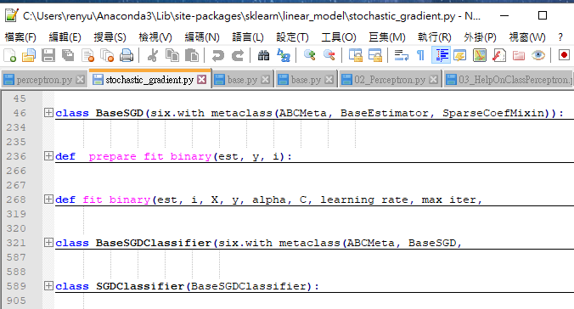
Where is the source code for Perceptron
C:\….\Anaconda3\Lib\site-packages\sklearn\linear_model

Slide 6
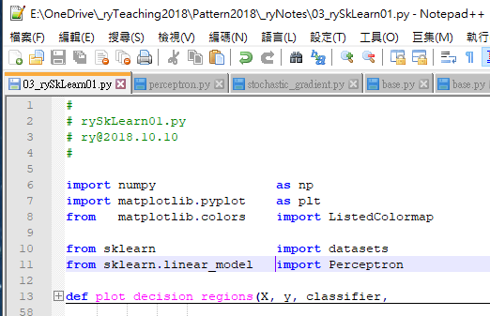
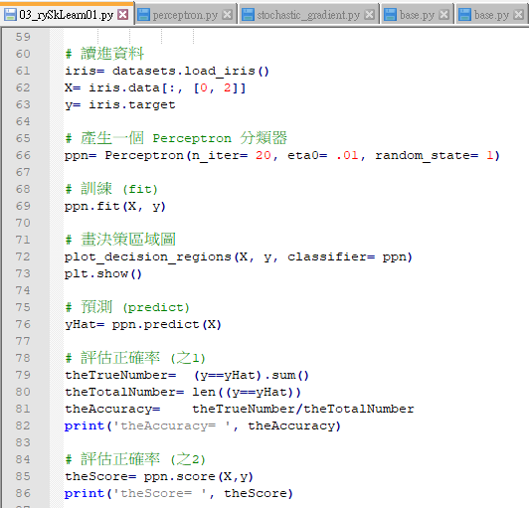
rySkLearn01.py
試用 sklearn ，重作 Perceptron。
https://1drv.ms/u/s!AjlltK85sd7qhscnhD87OA1d4pzsGw

Slide 7
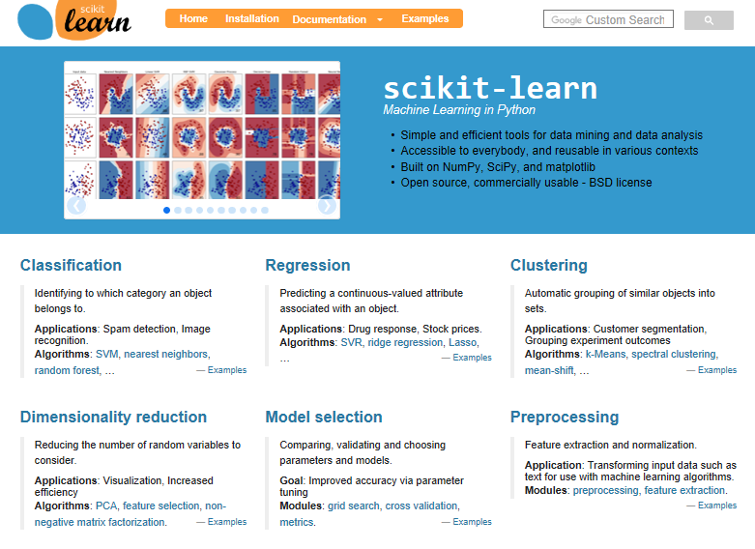
Note
The Perceptron, as well as other scikit-learn functions and classes, often have additional parameters that we omit for clarity.
You can read more about those parameters using the help function in Python (for instance, help(Perceptron) )
or by going through the excellent scikit-learn online documentation at http://scikit-learn.org/stable/

Slide 8
First steps with scikit-learn
In Chapter 2, Training Machine Learning Algorithms for Classification, you learned about two related learning algorithms for classification: the Perceptron rule and Adaline, which we implemented in Python by ourselves.
Now we will take a look at the scikit-learn API, which combines a user-friendly interface with a highly optimized implementation of several classification algorithms.
However, the scikit-learn library offers not only a large variety of learning algorithms, but also many convenient functions to preprocess data and to fine-tune and evaluate our models.

Slide 9
Training a perceptron via scikit-learn
To get started with the scikit-learn library, we will train a perceptron model similar to the one that we implemented in Chapter 2, Training Machine Learning Algorithms for Classification.
For simplicity, we will use the already familiar Iris dataset throughout the following sections.
Conveniently, the Iris dataset is already available via scikit-learn, since it is a simple yet popular dataset that is frequently used for testing and experimenting with algorithms.
Also, we will only use two features from the Iris flower dataset for visualization purposes.

Slide 10
We will assign the petal length [2] and petal width [3] of the 150 flower samples to the feature matrix X and the corresponding class labels of the flower species to the vector y:
>>> from sklearn import datasets
>>> iris= datasets.load_iris()
>>> X= iris.data[:, [2, 3]]
>>> y= iris.target

Slide 11
Training vs. Test
To evaluate how well a trained model performs on unseen data, we will further split the dataset into separate training and test datasets.
>>> nTrain= int(len(X)*0.7)
>>> nTest= len(X) - nTrain
>>> X_train, X_test= X[0:nTrain], X[nTrain:]
>>> y_train, y_test= y[0:nTrain], y[nTrain:]
>>> len(X_train), len(X_test)
### (105, 45)

Slide 12
Using the train_test_split function
from scikit-learn.cross_validation module,
we randomly split the X and y arrays
into 30 percent test data (45 samples)
and 70 percent training data (105 samples)
>>> from sklearn.cross_validation import train_test_split
>>> X_train, X_test, y_train, y_test= train_test_split(
... X, y,
... test_size= 0.3,
... random_state= 0)

Slide 13
Feature Scaling
Many machine learning and optimization algorithms also require feature scaling for optimal performance
Here, we will standardize the features using
StandardScaler class
from sklearn.preprocessing module
>>> from sklearn.preprocessing import StandardScaler
>>> sc= StandardScaler()
>>> sc.fit(X_train)
>>> X_train_std= sc.transform(X_train)
>>> X_test_std= sc.transform(X_test)
>>> X_train.mean(axis=0), X_train.std(axis=0)
### array([ 2.99619048, 0.84761905]),
### array([ 1.53082137, 0.61938452])
>>> X_train_std.mean(axis=0), X_train_std.std(axis=0)
### array([ -5.07530526e-17, 4.22942105e-17]),
### array([ 1., 1.])

Slide 14
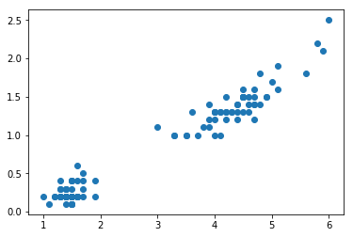
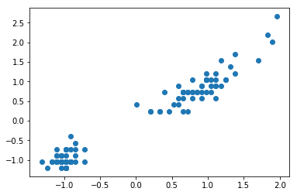
Plot
>>> import matplotlib.pyplot as plt
>>> plt.scatter(X_train[:,0], X_train[:,1])
>>> plt.show()
>>> plt.scatter(X_train_std[:,0], X_train_std[:,1])
>>> plt.show()

Slide 15
Do the Feature Scaling by ourselves
運用 np.array 之 BroadCasting 特性
>>> X_train_std= (X_train - X_train.mean(axis=0))
... / X_train.std(axis=0)
>>> X_train_std.mean(axis=0), X_train_std.std(axis=0)
### array([ -5.07530526e-17, 4.22942105e-17]),
### array([ 1., 1.])
>>> X_train.shape,
... X_train.mean(axis=0).shape,
... X_train.std(axis=0).shape
### (105, 2),
### (2,),
### (2,)

Slide 16
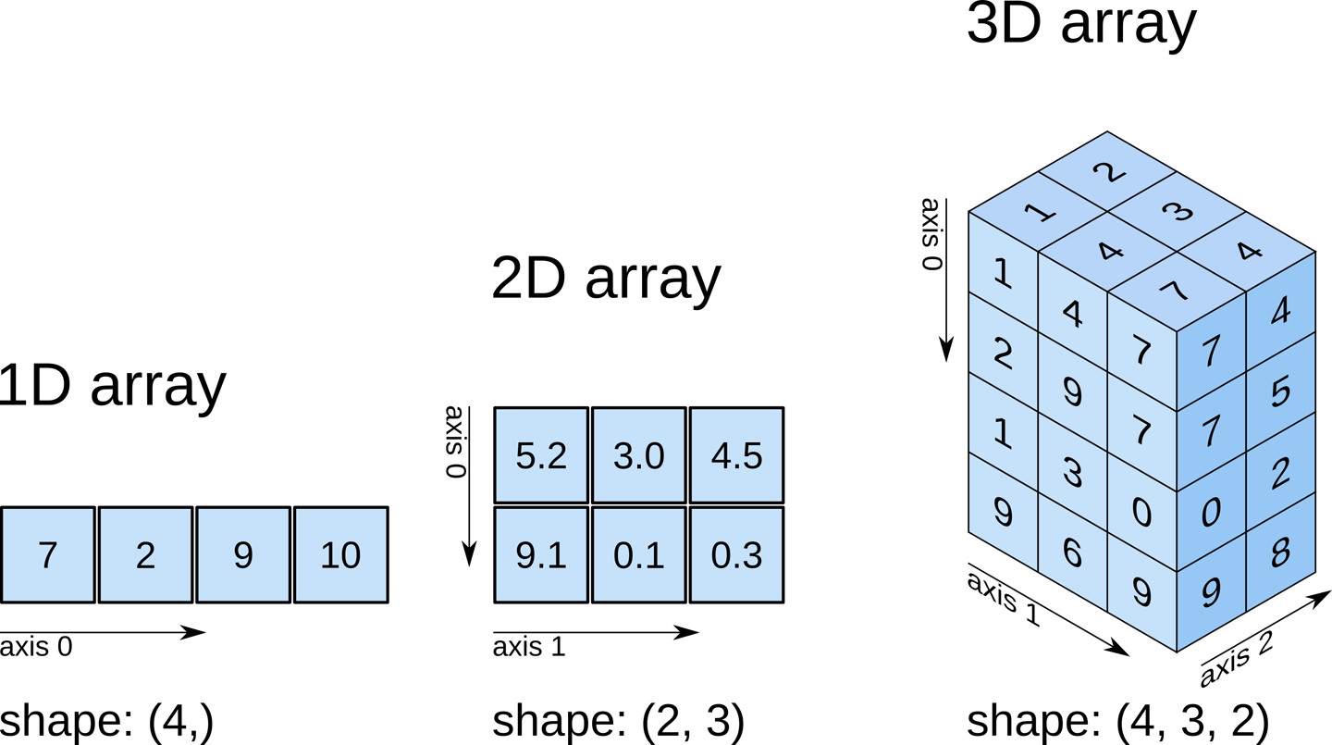
ndarray
https://www.oreilly.com/library/view/elegant-scipy/9781491922927/ch01.html
https://1drv.ms/u/s!AjlltK85sd7qhsc4CxNxIR5fA0sl5g

Slide 17
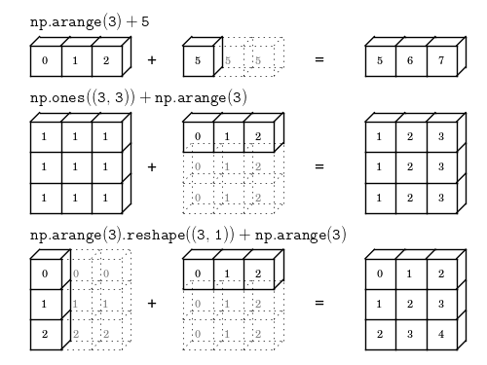
Broadcasting
http://www.astroml.org/book_figures/appendix/fig_broadcast_visual.html
https://docs.scipy.org/doc/numpy/user/basics.broadcasting.html

Slide 19
performance
Misclassification (Error) Rate = 4/45 = .089 = 8.9 %
Accuracy = 1 - .089 = .911 = 91.1%
>>> from sklearn.metrics import accuracy_score
>>> print('Accuracy: %.2f’ %
... accuracy_score(y_test, y_pred))
### 0.91

Slide 20
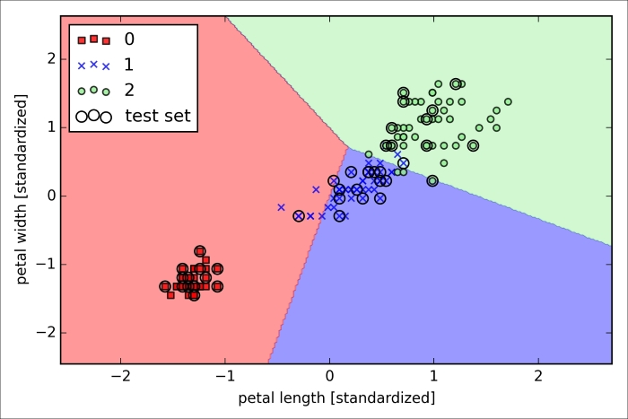
Plot the decision regions
As we can see in the plot,
the three flower classes
cannot be perfectly separated
by a linear decision boundaries
the perceptron algorithm never converges on datasets
that aren't perfectly linearly separable

Slide 21
the help function in Python
>>> help(Perceptron)

Slide 23
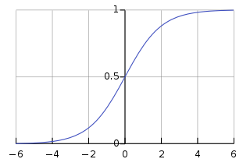
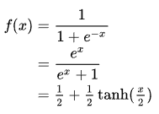


Logistic Function
A typical application of the logistic equation is a common model of population growth
The standard logistic function
The logistic function is an offset and scaled hyperbolic tangent function

Slide 24
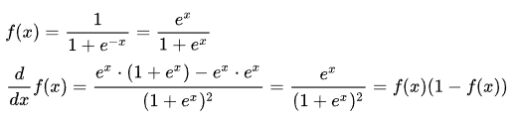


Derivative & Integral
known as the softplus function

Slide 25
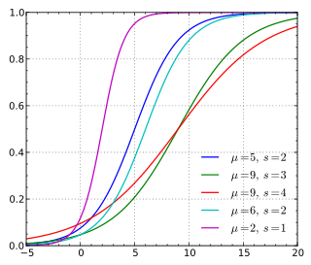

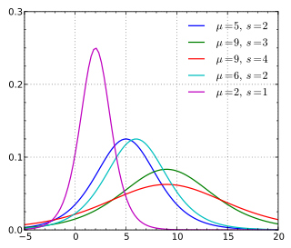

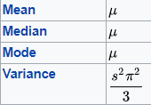
Logistic distribution
令 Logistic function 作為 一種機率分布的 cdf
與 Normal distribution 有得拚！！！
Cumulative distribution function, cdf
Probability density function, pdf

Slide 26

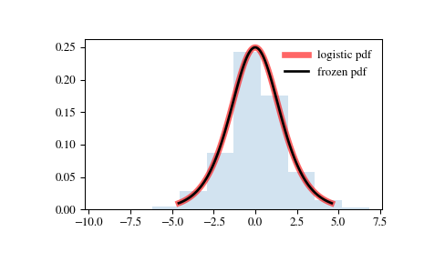
scipy.stats.logistic
https://docs.scipy.org/doc/scipy/reference/generated/scipy.stats.logistic.html
>>> from scipy.stats import logistic

Slide 27
Training a logistic regression model with scikit-learn
from sklearn.linear_model import LogisticRegression
aLR= LogisticRegression(C= 100.0, random_state= 1)
aLR.fit(X_train_std, y_train)
>>> aLR.classes_, aLR.classes_.shape
### (array([0, 1, 2]), (3,)) # 3 個類別
>>> aLR.coef_, aLR.coef_.shape
###
### (array([[ 0.24371528, -9.04339848],
### [ -1.75877444, 2.05838824],
### [ -1.23329674, 14.43953705]]), (3, 2))
###
# 每1個類別，有 1個 w[0:2] # 3個類別，需要 W[0:3, 0:2]
>>> aLR.intercept_, aLR.intercept_.shape
### (array([-5.11569391, -0.8458902 , -8.43062833]), (3,))
# 每1個類別，有 1個 b # 3個類別，需要 B[0:3]

Slide 28
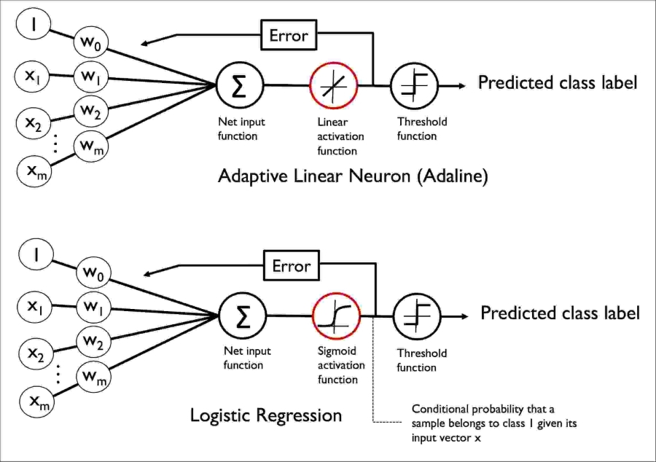




z
$$φ\left(z\right)$$
$$φ\left(z\right)$$
z

Slide 29



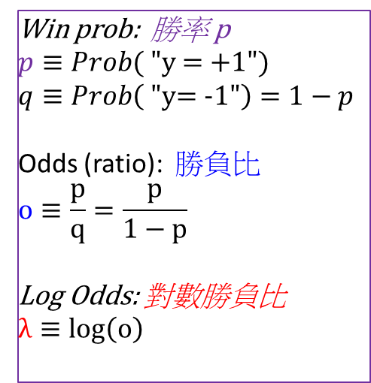
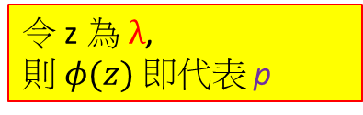

Odds Ratio: 勝負比= p/q
o
Win prob: 勝率 p
$$p≡Prob( "\text{y} \text{=}\text{ +}\text{1}")$$
$$q≡Prob\left( \text{"}\text{y}\text{= −1"}\right)=1−p$$
Odds (ratio): 勝負比
$$o≡\frac{p}{q}=\frac{p}{1−p}$$
Log Odds: 對數勝負比
$$λ≡log\left(o\right)$$
$$λ$$
+1
p
0
.5
1.
-1
令 z 為 $λ$,
則 $φ(z)$ 即代表 p

Slide 30

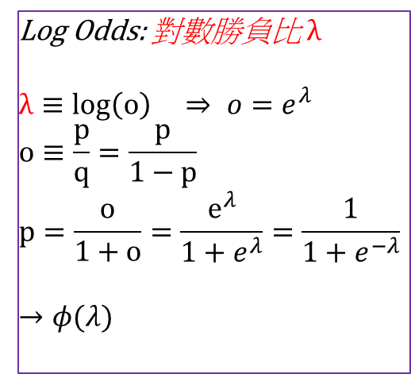
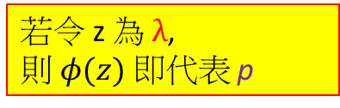
o
$$λ$$
若令 z 為 $λ$,
則 $φ(z)$ 即代表 p
+1
Log Odds: 對數勝負比 $λ$
$$λ≡log\left(o\right) ⇒ o=e^{λ }$$
$$o≡\frac{p}{q}=\frac{p}{1−p}$$
$$p=\frac{o}{1+o}=\frac{e^{λ}}{1+e^{λ}}=\frac{1}{1+e^{−λ}}$$
$$→φ(λ)$$
p
0
.5
1.
-1

Slide 31
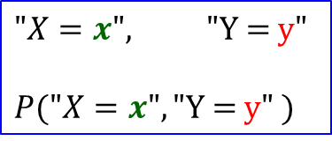

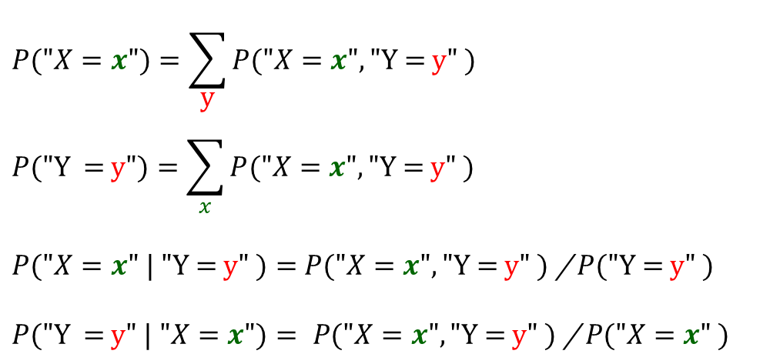
Decision Rule:
Maximize the (Posterior) Probability
$$\hat{y}= \underset{forAll possible y }{Argmax}{P(\text{"}\text{Y}\text{ = }\text{y}" | "X=x")}$$
$$P("X=x")=\sum_{\text{y}}{P("X=x", \text{"}\text{Y}\text{ = }\text{y}" ) }$$
$$P(\text{"}\text{Y} \text{= }\text{y}")=\sum_{x}{P("X=x", \text{"}\text{Y}\text{ = }\text{y}" ) }$$
$P("X=x" | \text{"}\text{Y}\text{ = }\text{y}" )=$ $P("X=x", \text{"}\text{Y}\text{ = }\text{y}" )$/ $P(\text{"}\text{Y}\text{ = }\text{y}" )$
$$P(\text{"}\text{Y}\text{ = }\text{y}" | "X=x")= P("X=x", \text{"}\text{Y}\text{ = }\text{y}" ) \text{/} P(\text{"}X=x" )$$
$$"X=x", \text{"}\text{Y}\text{ = }\text{y}"$$
$$P("X=x", \text{"}\text{Y}\text{ = }\text{y}" )$$
the (Prior) Probability
the (Posterior) Probability

Slide 32




Learning the weights of the Logistic cost function
1. Define the Likelihood L(..)
of observing the set of all training data X, y
as a function of w ➔ L(w)
2. To maximize L(w)
Compare with
minimal Sum of Squared Difference
between y and φ
To maximize l(w) ➔ To minimize –l(w) ➔ Let J(w) = – l(w)
3. To minimize J(w)

Slide 33
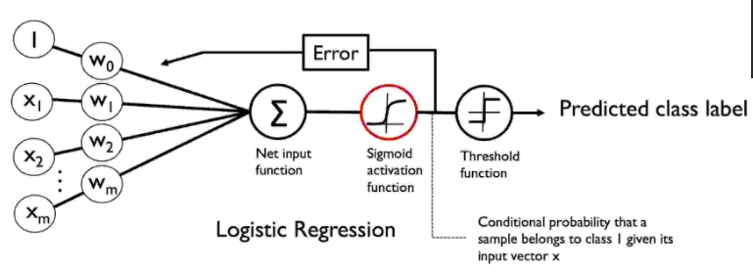
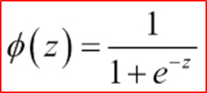

=?
= ?

Slide 34
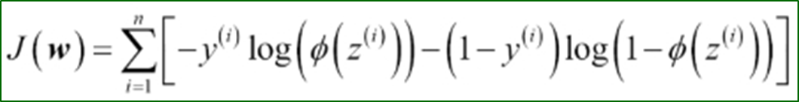

For Maximal Likelihood Training

Slide 35
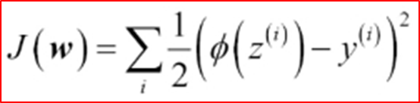
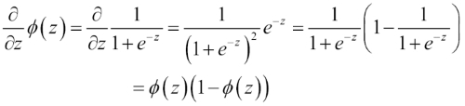
For minimal Sum of Squared Difference
推導公式時的重要參考：
= ?

Slide 36
Support vector machine (SVM)
Support vector machine
https://en.wikipedia.org/wiki/Support_vector_machine
Hinge loss
https://en.wikipedia.org/wiki/Hinge_loss

Slide 37
林智仁教授 的 SVM
https://www.csie.ntu.edu.tw/~cjlin/libsvm/
https://www.csie.ntu.edu.tw/~cjlin/papers/libsvm.pdf
https://www.csie.ntu.edu.tw/~cjlin/papers/guide/guide.pdf

Slide 38

Multiclass classification
https://en.wikipedia.org/wiki/Multiclass_classification
One-vs.-rest
One-vs.-one
K (K − 1) / 2 binary classifiers for a K-way multiclass problem
At prediction time, a voting scheme is applied

Slide 39
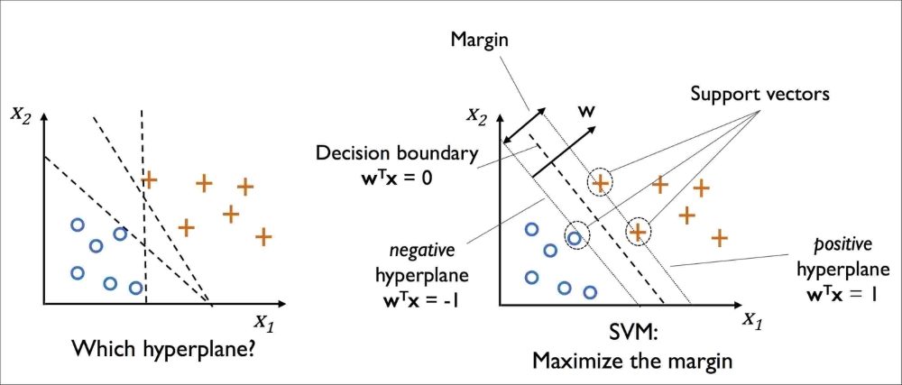
Support vector machine (SVM)
https://en.wikipedia.org/wiki/Support_vector_machine
Maximum margin classification
SVM can be considered an extension of the perceptron.
In perceptron (ADLINE), to minimize misclassification errors.
in SVM, to maximize the margin.
margin
= distance
between the separating hyperplane (decision boundary)
and the training samples
that are closest to this hyperplane,
which are the so-called support vectors.

Slide 40
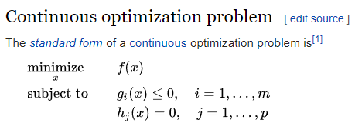
Optimization problem
https://en.wikipedia.org/wiki/Optimization_problem

Slide 41
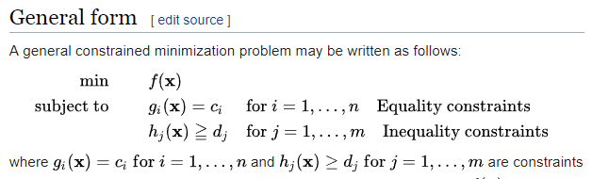
Constrained optimization
https://en.wikipedia.org/wiki/Constrained_optimization

Slide 42
Lagrange Multiplier Method
http://episte.math.ntu.edu.tw/entries/en_lagrange_mul/index.html

Slide 43
Support Vector Machines 簡介
http://www.cmlab.csie.ntu.edu.tw/~cyy/learning/tutorials/SVM2.pdf
by 林宗勳
我們希望能找出一條線能夠將黑點和白點分開，
而且我們還希望這條線距離這兩個集合的邊界(margin)越大越好。

