Slide 1
Chapter 2. Training Simple Machine Learning Algorithms for Classification
Renyuan Lyu

Slide 2
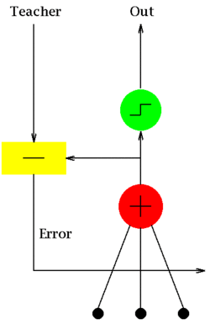
2 machine learning algorithms for classification
Perceptron
https://en.wikipedia.org/wiki/Perceptron
Adaptive linear neurons
ADALINE
https://en.wikipedia.org/wiki/ADALINE

Slide 3
In this chapter …
Building an intuition for machine learning algorithms
Using pandas, NumPy, and Matplotlib to read in, process, and visualize data
Implementing linear classification algorithms in Python

Slide 4
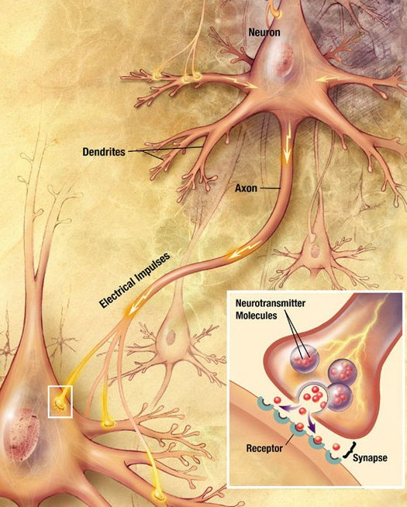
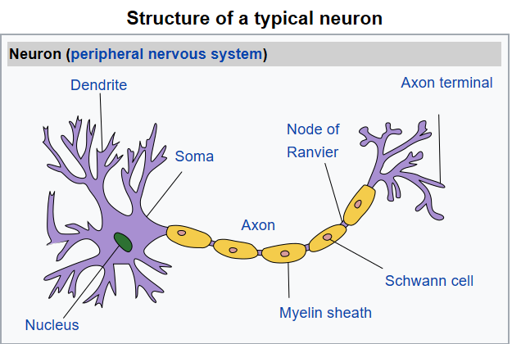
Neuron
A signal propagating down an axon to the cell body and dendrites of the next cell
A neuron,
also known as a nerve cell,
is an electrically excitable cell
that receives, processes, and transmits information
through electrical and chemical signals.

Slide 5
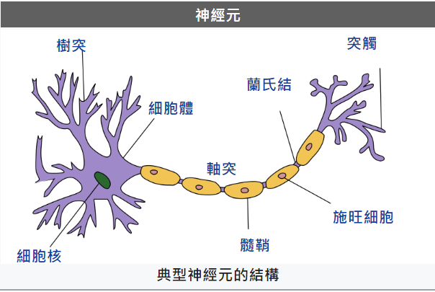
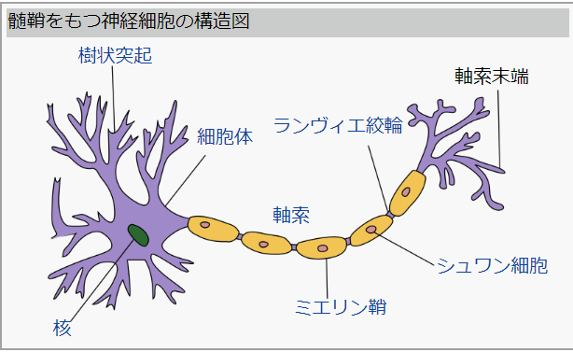
神經元（neuron），
又名神經原或神經細胞（nerve cell），
是神經系統的結構與功能單位之一。
能感知環境的變化，再將信息傳遞給其他的神經元，並指令集體做出反應。
佔了神經系統約10%，
其他大部分由膠狀細胞所構成。
基本構造由樹突、軸突、髓鞘、細胞核組成。
傳遞形成電流，
在其尾端為受體，
藉由化學物質（化學遞質）傳導(多巴胺、乙醯膽鹼)，
在適當的量傳遞後在兩個突觸間形成電流傳導。

Slide 6
神經細胞包含
細胞本體（soma）
樹突（dendrites）
軸突（axon）
軸突丘（hillock）
突觸（synapse）
人腦中，神經細胞約有860億個。
86 billion = 86 x 10⁹= 86 Giga

Slide 7
Neuron
神經元, 神經細胞
https://en.wikipedia.org/wiki/Neuron
A neuron, also known as nerve cell, is an electrically excitable cell
that receives, processes, and transmits information
through electrical and chemical signals.
These signals between neurons occur via specialized connections called synapses.
Neurons can connect to each other to form neural circuits.
Neurons are the primary components
of the central nervous system,
which includes the brain and spinal cord,
of the peripheral nervous system,
which comprises the autonomic nervous system and the somatic nervous system.

Slide 8
There are many types of specialized neurons.
Sensory neurons respond to one particular type of stimulus
such as touch,
sound,
or light
and all other stimuli
affecting the cells of the sensory organs,
and converts it into an electrical signal via transduction,
which is then sent to the spinal cord or brain.
Motor neurons receive signals from the brain and spinal cord to control everything from muscle contractions to glandular output.
Interneurons connect neurons to other neurons within the same region of the brain or spinal cord in neural networks.

Slide 9
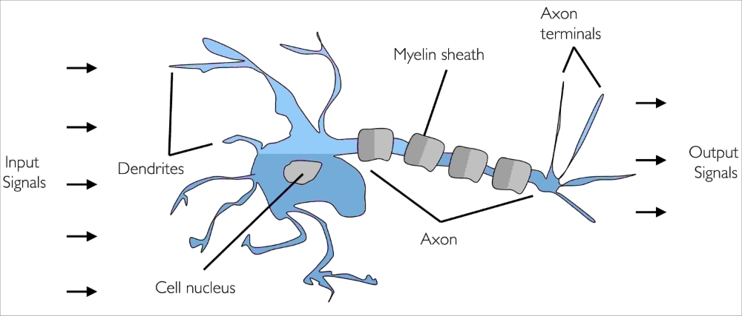
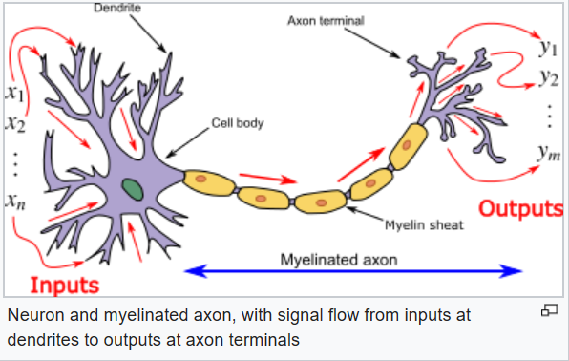
Artificial neuron
a brief glimpse into the early history of machine learning
in 1943 , Warren McCulloch and Walter Pitts
published the first concept of a simplified brain cell,
the so-called McCulloch-Pitts (MCP) neuron
McCulloch-Pitts (MCP) neuron
a simple logic gate with binary outputs;
multiple signals arrive at the dendrites,
are integrated into the cell body,
an output signal is generated
that will be passed on by the axon.
if the accumulated signal exceeds a certain threshold.

Slide 10

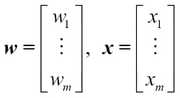
1=x₀
w₀
x₁
w₁
w₂
z
x₂
∑()
φ()
y
w_{j}
x_{j}
w_{m}
x_{m}
φ(z)
w₀
x₀
z
y = φ(z)

Slide 11
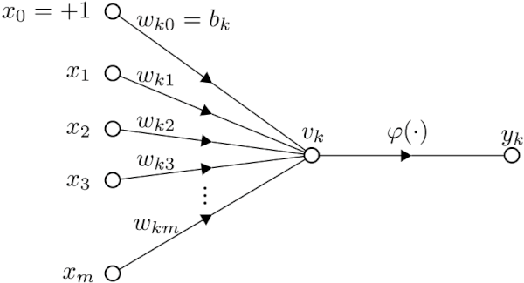
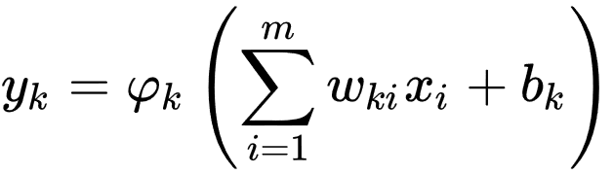
The formal definition of an artificial neuron

Slide 12
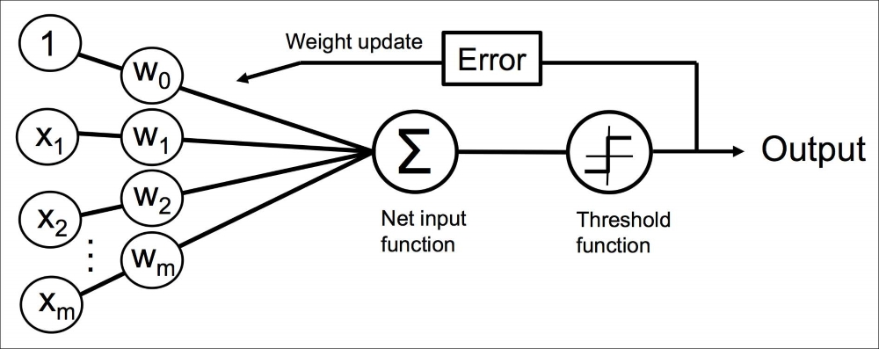
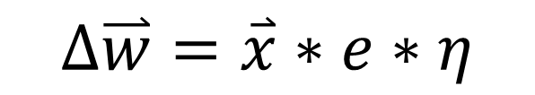
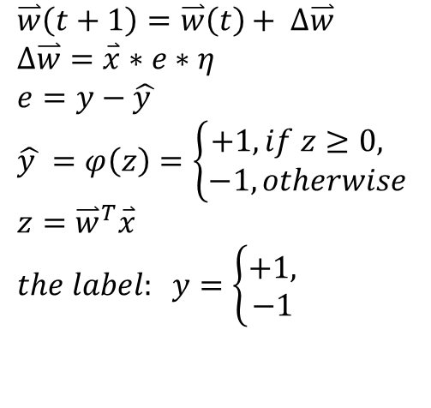
The perceptron learning rule by Rosenblatt, in 1957
$$\overset{⃑}{w}\left(t+1\right)=\overset{⃑}{w}\left(t\right)+ ∆\overset{⃑}{w} \\ ∆\overset{⃑}{w}=\overset{⃑}{x}∗e∗η \\ e=y−\hat{y } \\ \hat{y }=φ\left(z\right)=\left\{\begin{aligned}+1, if z≥0, \\ −1, otherwise \end{aligned}\right. \\ z={\overset{⃑}{w}}^{T}\overset{⃑}{x} \\ the label: y=\left\{\begin{aligned}+1, \\ −1 \end{aligned}\right.$$
$$∆\overset{⃑}{w}=\overset{⃑}{x}∗e∗η$$

Slide 13

Implementing a perceptron learning algorithm in Python
class Perceptron:
def __init__(self, eta= 0.01, n_iter= 100, random_state= 1):
def fit(self, X, y):
def net_input(self, X):
def predict(self, X):
z
x
net_input
predict
$$\hat{y}$$
w_
fit
y

Slide 14
class Perceptron:
"""Perceptron classifier.
Parameters
------------
eta : float
Learning rate (between 0.0 and 1.0)
n_iter : int
Passes over the training dataset.
random_state : int
Random number generator seed for random weight
initialization.
Attributes
-----------
w_ : 1d-array
Weights after fitting.
errors_ : list
Number of misclassifications (updates, errors) in each epoch.
"""

Slide 15
def __init__(self, eta= 0.01, n_iter= 100, random_state= 1):
self.eta= eta
self.n_iter= n_iter
self.random_state= random_state
self.w_= None
self.error_= None
def net_input(self, X):
"""Calculate net input"""
z= np.dot(X, self.w_[1:]) + self.w_[0]
return z
def predict(self, X):
"""Return class label (+1/-1) after unit step"""
z= self.net_input(X)
yHat= np.where(z >= 0.0, +1, -1)
return yHat

Slide 16
def fit(self, X, y):
"""Fit training data.
Parameters
----------
X : {array-like}, shape = [n_samples, n_features]
Training vectors, where n_samples is the number of samples and
n_features is the number of features.
y : array-like, shape = [n_samples]
Target values.
Returns
-------
self : object
"""

Slide 17
rgen= np.random.RandomState(self.random_state)
self.w_ = rgen.normal(loc= 0.0,
scale= 0.01,
size= 1 + X.shape[1])
self.errors_= []
for i in range(self.n_iter):
errors = 0
for xi, yi in zip(X, y):
### Rosenblatt's Perceptron Learning Rule:
e= yi - self.predict(xi)
self.w_[0] += 1 * e * self.eta
self.w_[1:] += xi * e * self.eta
#x= np.append([1], xi)
#self.w_ += x * e * self.eta
errors += int(e != 0)
self.errors_.append(errors)
return self

Slide 18
nbviewer
https://nbviewer.jupyter.org/

Slide 19
_ryTeach2018 @ GitHub
https://github.com/renyuanL/_ryTeach2018
https://github.com/renyuanL/_ryTeach2018/blob/master/_Chapter02/ch02.ipynb
https://github.com/renyuanL/_ryTeach2018/blob/master/_Chapter02/ch02_ryTeach.ipynb
https://github.com/renyuanL/_ryTeach2018/blob/master/_Chapter02/Ch02_ryTeach01.ipynb

Slide 20
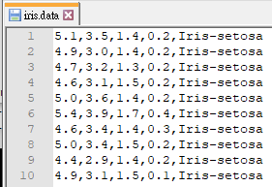
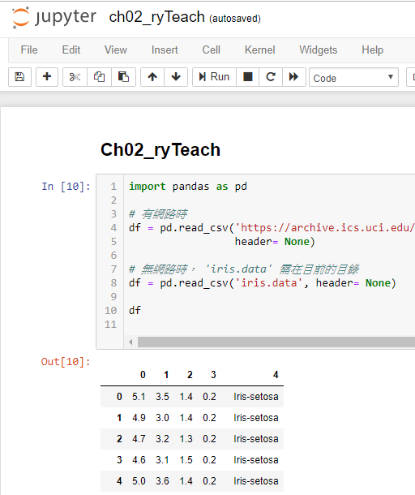
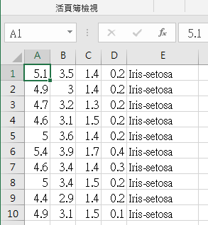
https://pandas.pydata.org/pandas-docs/stable/generated/pandas.DataFrame.html
Reading the Iris dataset
pandas.DataFrame
https://goo.gl/MbLNYf

Slide 21
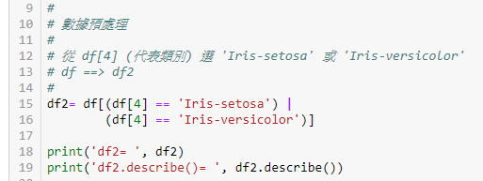
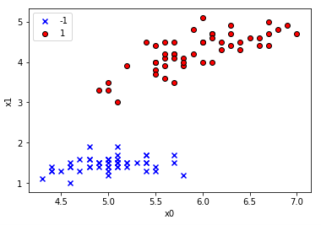
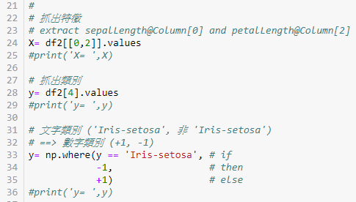
Visualizing the data

Slide 22
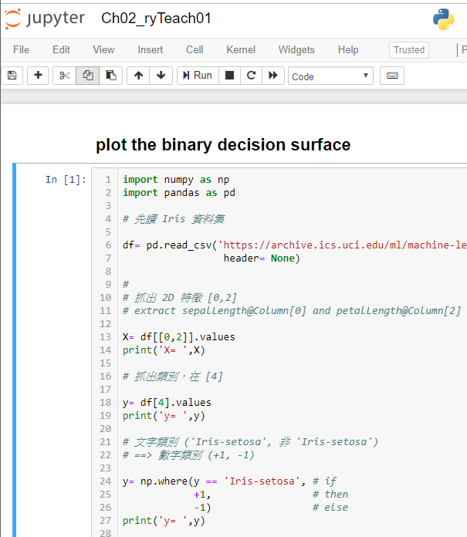
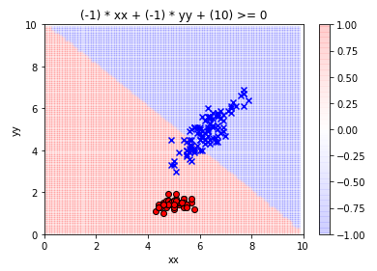
plotting the binary decision surface

Slide 23
Training a perceptron model on the Iris dataset

Slide 24
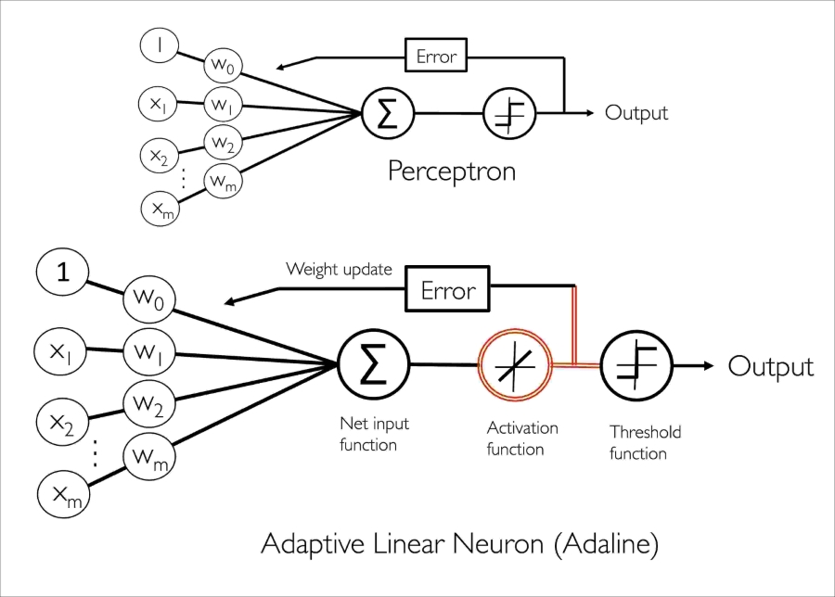
Adaptive linear neurons and the convergence of learning

Slide 25

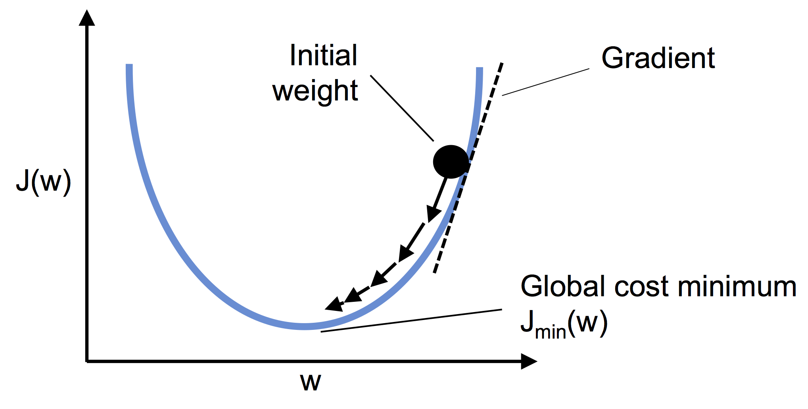




Minimizing cost functions with gradient descent
$$z^{(i)}={\overset{⃑}{w}}^{T}{\overset{⃑}{x}}^{(i)}$$
$∇\text{J}$ 指向函數 J() 上升的方向。

Slide 26

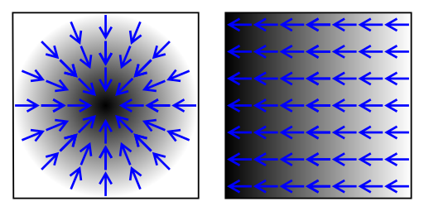







$$\text{J}\text{(}\overset{⃑}{w}\text{)}$$
【純量場】
用黑白的灰度來表示，
愈黑表示愈大的數值。
其相應的【梯度】
用藍色箭頭表示。
$$∇\text{J}\text{(}\overset{⃑}{w}\text{)}$$

Slide 27
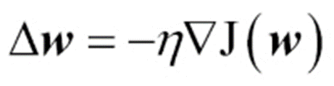

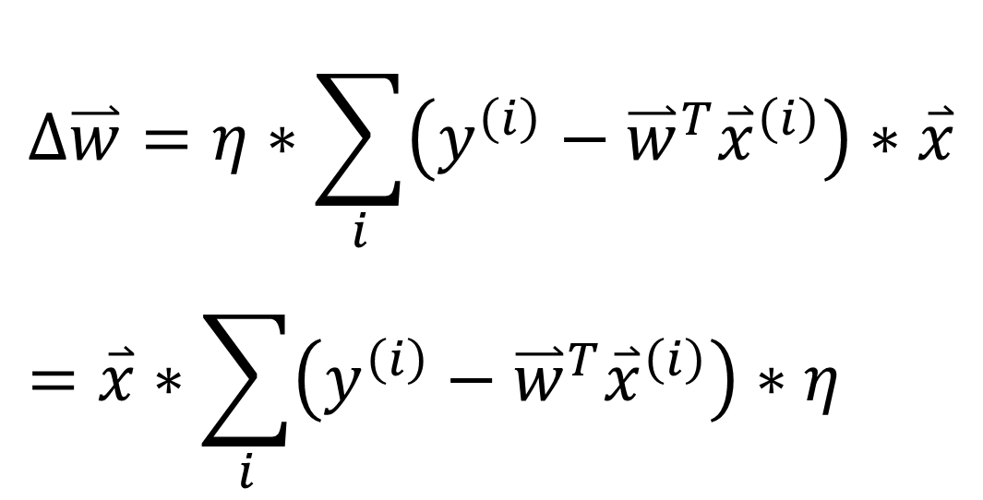
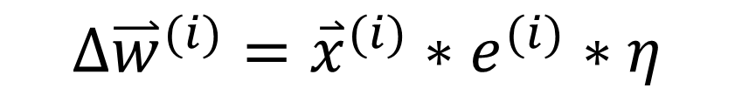
$$∆\overset{⃑}{w}=η∗\sum_{i}{\left(y^{\left(i\right)}−{\overset{⃑}{w}}^{T}{\overset{⃑}{x}}^{\left(i\right)}\right)∗\overset{⃑}{x}} \\ =\overset{⃑}{x}∗\sum_{i}{\left(y^{\left(i\right)}−{\overset{⃑}{w}}^{T}{\overset{⃑}{x}}^{\left(i\right)}\right)}∗η$$
Adaptive linear neurons Learning (Adaline Learning)
Compared with Rosenblatt’s Perceptron Learning:
$$∆{\overset{⃑}{w}}^{(i)}={\overset{⃑}{x}}^{(i)}∗e^{(i)}∗η$$
$$\left(y^{\left(i\right)}−φ({\overset{⃑}{w}}^{T}{\overset{⃑}{x}}^{\left(i\right)})\right)$$

Slide 28

Implementing Adaline in Python
for i in range(self.n_iter):
net_input= self.net_input(X)
output= self.activation(net_input)
errors= (y - output)
self.w_[1:] += self.eta * X.T.dot(errors)
self.w_[0] += self.eta * errors.sum()
cost= (errors**2).sum() / 2.0
self.cost_.append(cost)

Slide 29
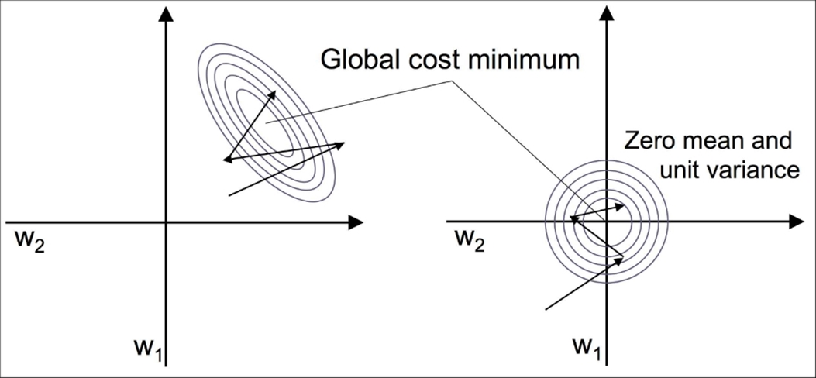

Improving gradient descent through feature scaling
we will use a feature scaling method called standardization,
which gives our data the property of a standard normal distribution,
which helps gradient descent learning to converge more quickly.
Standardization
mean == 0
standard deviation == 1.
# standardize features
X_std = np.copy(X)
# 特別注意一下上面指令 np.copy()，
# 若沒使用它，而僅用 X_std = X 的話，會如何呢？
X_std[:, 0] = (X[:, 0] - X[:, 0].mean()) / X[:, 0].std()
X_std[:, 1] = (X[:, 1] - X[:, 1].mean()) / X[:, 1].std()

Slide 30
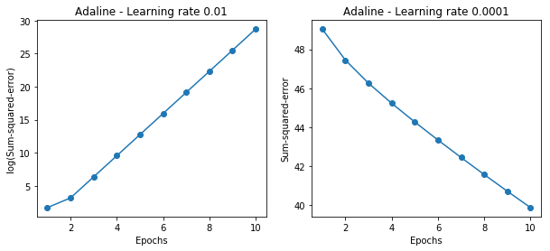
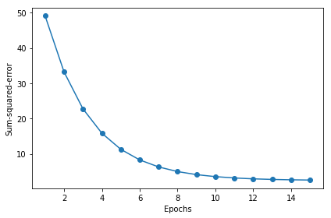
Standardization (Normalization)
AdalineGD(
n_iter=15,
eta=0.01)
.fit(X, y)
AdalineGD(
n_iter=15,
eta=0.0001)
.fit(X, y)
AdalineGD(
n_iter=15,
eta=0.0001)
.fit(X_std, y)

Slide 31



Large-scale machine learning and stochastic gradient descent
A popular alternative to the batch gradient descent algorithm is stochastic gradient descent,
also called iterative or online gradient descent.
Not updating over all samples,
we update for each training sample

Slide 32
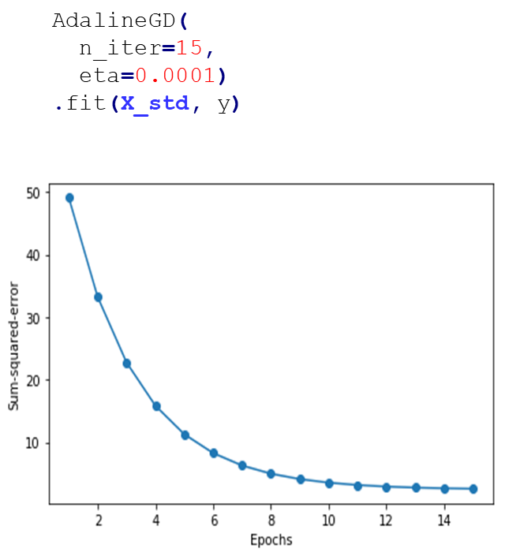
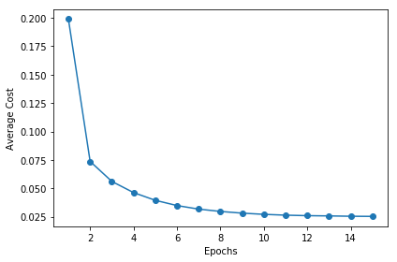
AdalineSGD(
n_iter=15,
eta=0.0001)
.fit(X_std, y)

Slide 33
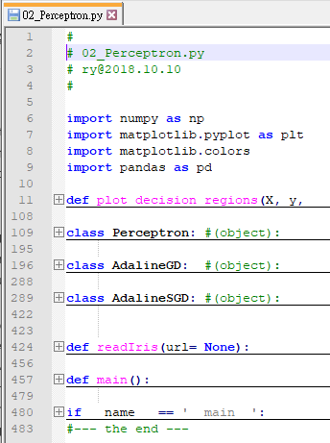
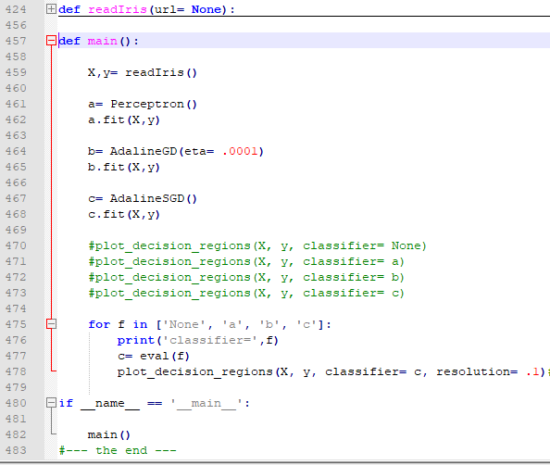
02_Perceptron.py
https://1drv.ms/u/s!AjlltK85sd7qhscLGqIlwcZe6l8IRg

Slide 34
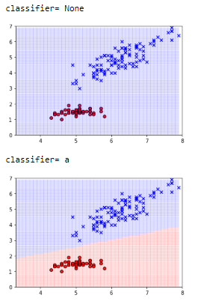
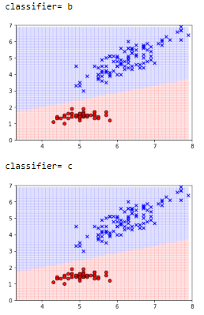

Slide 35
Summary
In this chapter, we gained a good understanding of the basic concepts of linear classifiers for supervised learning.
After we implemented a perceptron,
we saw how we can train adaptive linear neurons efficiently
via a vectorized implementation
of gradient descent
and online learning via stochastic gradient descent.

Slide 36
Now that we have seen how to implement simple classifiers in Python, we are ready to move on to the next chapter,
where we will use the Python scikit-learn machine learning library
to get access to more advanced and powerful machine learning classifiers that are commonly used in academia as well as in industry.
The object-oriented approach that we used to implement the perceptron and Adaline algorithms will help with understanding the scikit-learn API,
which is implemented based on the same core concepts that we used in this chapter:
the fit and predict methods.

Slide 37
Based on these core concepts, we will learn
about logistic regression
for modeling class probabilities
and support vector machines
for working with nonlinear decision boundaries.
In addition, we will introduce a different class of supervised learning algorithms,
tree-based algorithms,
which are commonly combined into robust ensemble classifiers.

