Slide 1
Multilingual Speech Recognition using Python and Google Speech API (en)
Renyuan Lyu
Chang Gung University, TAIWAN
renyuan.lyu@gmail.com
Twitter: @RenyuanLyu
Facebook: Renyuan Lyu

Slide 2
Speech Recognition has been more popular during the past decade since the appearance of Apple Siri.
However, it is still a computationally expensive technology.
This is why less programmers can use it fluently in their daily jobs.
In this proposal, the speaker will share his experience in using Python SpeechRecognition module, which includes multiple speech recognition engines for online applications in games, linguistic tutoring and the other applications, such as bilingual translation and so on.
The speaker will invite the audience to test the real-time system in multiple languages, such as English, Japanese and Mandarin Chinese.

Slide 3
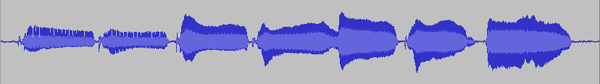
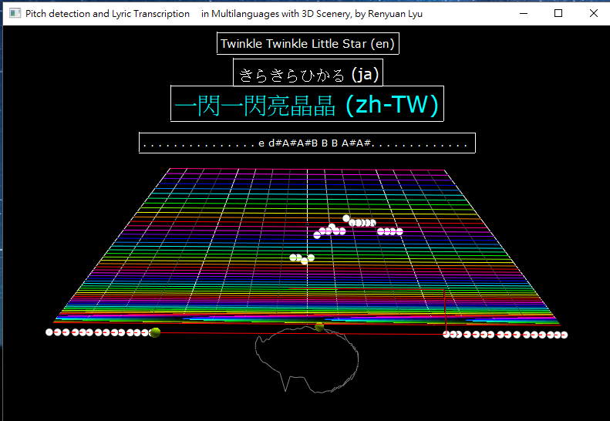
Singing
Voice
Multilingual
ASR
“Twinkle Twinkle Little Star”
“きらきらひかる”
“一閃一閃亮晶晶”
Pitch
Detection
“C C G G A A C –”

Slide 4
import speech_recognition
import visual
import pyaudio
import numpy
import threading
import ryF0Estimate000
https://pypi.python.org/pypi/SpeechRecognition/
http://vpython.org/
https://people.csail.mit.edu/hubert/pyaudio/

Slide 5
class Ry音類: # the AudioClass
def start(self):
self.錄音線.start() # recording_Thread
self.能量線.start() # energy_Thread
self.基頻線.start() # F0_Thread
self.語音辨認線.start() # ASR_Thread

Slide 6
def 語音辨認(self):
辨= sr.Recognizer()
while self.語音辨認中==True:
#
# Get x as "singingVoice" to be 音
#
音= sr.AudioData(x, self.取樣率, self.樣本寬)
#
# Do ASR to get recognition Result as 文
#
try:
if lang=='ja':
文= 辨.recognize_google(音, language='ja')
elif lang=='en':
文= 辨.recognize_google(音, language='en')
elif lang= 'zh-TW'
文= 辨.recognize_google(音, language='zh-TW')
else:
self.文= '{} ({})'.format(文, lang)
except:
self.文= 'exceptionOccurs!!'
pass
return
Singing
Voice
Multilingual
ASR
“Twinkle Twinkle Little Star”
“きらきらひかる”
“一閃一閃亮晶晶”
Pitch
Detection
“C C G G A A C –”

