Slide 1
Multilingual Speech Recognition using Python and Google Speech API (en)
Renyuan Lyu
Chang Gung University, TAIWAN
renyuan.lyu@gmail.com
Twitter: @RenyuanLyu
Facebook: Renyuan Lyu
The Source Code on Github
https://github.com/renyuanL/multilingualASR
A demo on Youtube
https://youtu.be/DmwsR7rVonE

Slide 2
Abstract
Speech Recognition has been more popular during the past decade since the appearance of Apple Siri, Google Translate
Using Python SpeechRecognition module, which includes multiple speech recognition engines for online applications in games, linguistic tutoring and the other applications, such as bilingual translation and so on.
A real-time system in multiple languages, such as English, Japanese and Mandarin Chinese.

Slide 3
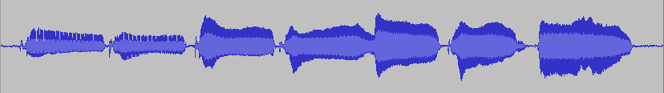
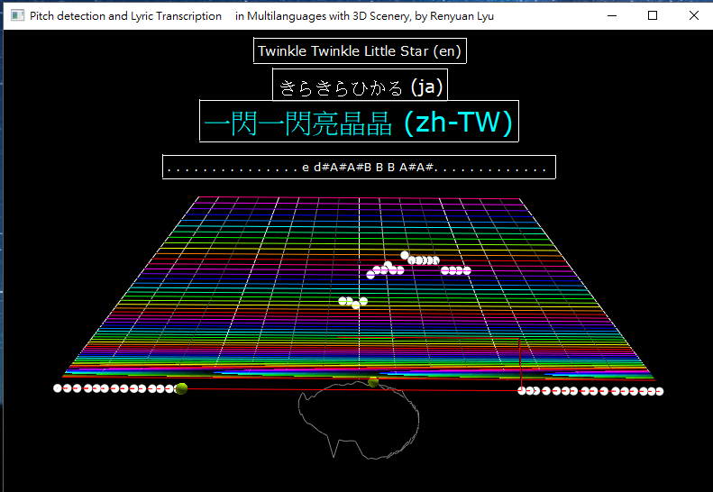
Concept Block
Singing
Voice
Multilingual
ASR
“Twinkle Twinkle Little Star”
“きらきらひかる”
“一閃一閃亮晶晶”
Pitch
Detection
“C C G G A A C –”

Slide 4
Using Modules
import speech_recognition
import visual
import pyaudio
import numpy
import threading
import ryF0Estimate
https://pypi.python.org/pypi/SpeechRecognition/
http://vpython.org/
https://people.csail.mit.edu/hubert/pyaudio/

Slide 5
The AudioClass
class Ry音類: # the AudioClass
def __init__(self):
self.音= pyaudio.PyAudio()
self.樣本格式= pyaudio.paInt16
self.樣本寬= self.音.get_sample_size(self.樣本格式)
self.通道數= 1 # 道
self.取樣率= 16000 # 點/秒
self.框長= 256 # 點/框
self.總秒數= 16 # 秒
self.流= self.音.open(
format= self.樣本格式,
channels= self.通道數,
rate= self.取樣率,
frames_per_buffer= self.框長,
input= True,
output= True)
self.框數= int(self.取樣率 *self.總秒數 /self.框長 )
self.錄音框們= [[] for i in range(self.框數)]

Slide 6
Using Threading
def init(self):
self.錄音線= threading.Thread(target= self.錄音線程)
self.能量線= threading.Thread(target= self.f1_能量)
self.基頻線= threading.Thread(target= self.f4_基頻)
self.語音辨認線= threading.Thread(target= self.f6_語音辨認)
def start(self):
self.錄音線.start()
self.能量線.start()
self.基頻線.start()
self.語音辨認線.start()

Slide 7

The Recording Thread
def 錄音線程(self):
while (self.錄音中==True):
框= self.流.read(self.框長)
self.錄音框們[self.i現框%self.框數]= 框
self.i現框 += 1

Slide 8
The ASR Thread
def 語音辨認(self):
辨= sr.Recognizer()
while self.語音辨認中==True:
#
# Get x as "singingVoice" to be 音
#
音= sr.AudioData(x, self.取樣率, self.樣本寬)
#
# Do ASR to get recognition Result as 文
#
try:
if lang=='ja':
文= 辨.recognize_google(音, language='ja')
elif lang=='en':
文= 辨.recognize_google(音, language='en')
elif lang= 'zh-TW'
文= 辨.recognize_google(音, language='zh-TW')
else:
self.文= '{} ({})'.format(文, lang)
except:
self.文= 'exceptionOccurs!!'
pass
return
Singing
Voice
Multilingual
ASR
“Twinkle Twinkle Little Star”
“きらきらひかる”
“一閃一閃亮晶晶”
Pitch
Detection
“C C G G A A C –”

Slide 9
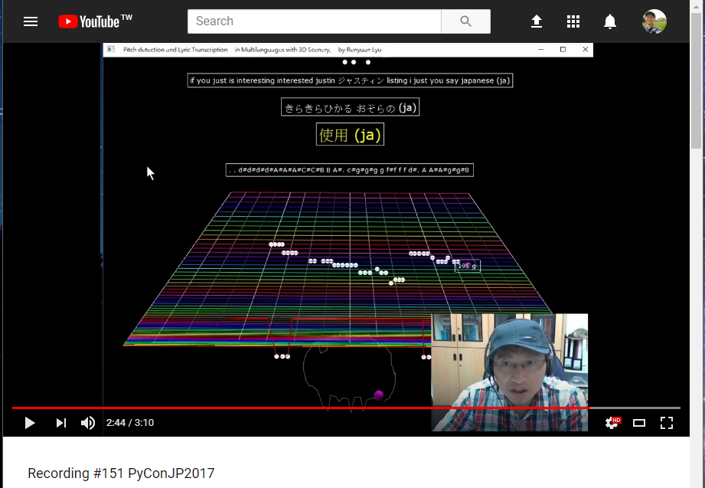
A Test
きらきら光る お空の星よ
瞬きしては 皆を見てる
きらきら光る お空の星よ
きらきらひかる おそらのほしよ
まばたきしては みんなをみてる
きらきらひかる おそらのほしよ
一閃一閃亮晶晶，滿天都是小星星
掛在天上放光明，好像許多小眼睛
一閃一閃亮晶晶，滿天都是小星星
Twinkle, twinkle, little star,
How I wonder what you are.
Up above the world so high,
Like a diamond in the sky.
Twinkle, twinkle, little star,
How I wonder what you are!
https://youtu.be/DmwsR7rVonE

