Slide 1

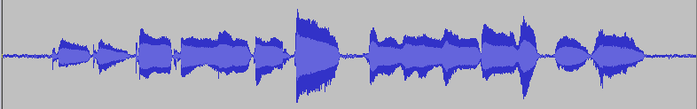
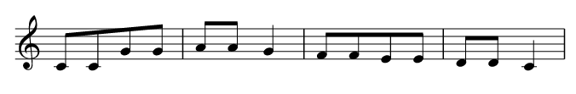

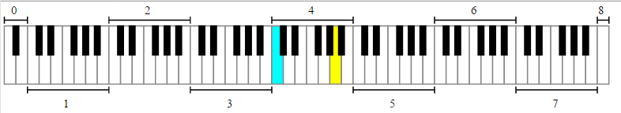
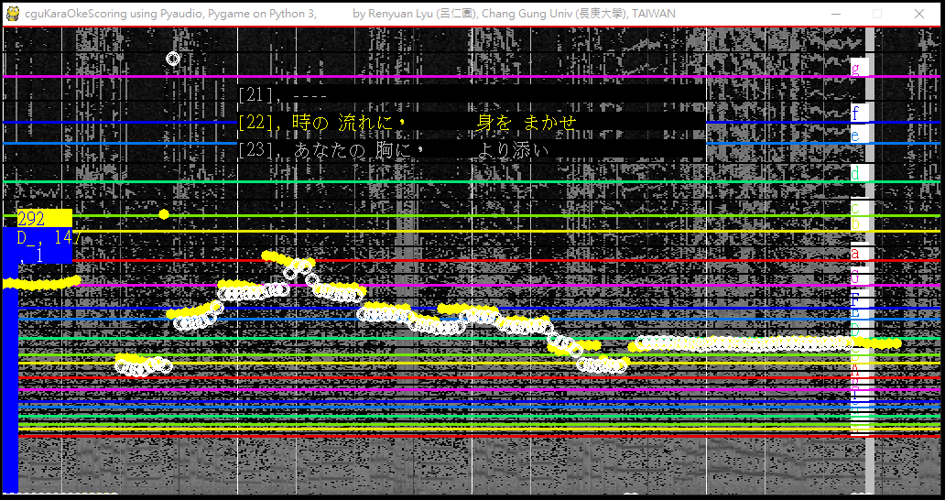

Pitch Detection in Singing Evaluation (Scoring, 採点) in Karaoke using Pyaudio, Pygame and VPython
00. Introduction
04. The Evaluation/Scoring method
Sequence comparison based on dynamic programming
Deal with the insertion, and deletion types of error
Pitch detection in human singing signal has
a popular application in a KaraOke machine
with scoring function.
(eg.精密採点 in カラオケ＠DAM)
import difflib
sm= difflib.SequenceMatcher()
x= [69, 70, 71, 72]
y= [69, 70, 80, 71, 72]
sm.set_seqs(x,y)
r= sm.ratio()
mb= sm.get_matching_blocks()
op= sm.get_opcodes()
r, mb, op
r == 0.89,
mb== [
Match(a=0, b=0, size=2),
Match(a=2, b=3, size=2),
Match(a=4, b=5, size=0)],
op=[
('equal', 0, 2, 0, 2),
('insert', 2, 2, 2, 3),
('equal', 2, 4, 3, 5)])
01. Task Definition
Teacher’s singing
Student’s singing
Pitch Detection
05. The Modules
Karaoke
PitchScoring
difflib
Evaluation
A Score for Pitch Correctness
Vpython
Tkinter
Pygame
02. Fundamental music theory
threading
A frequency of 440 Hz was recommended as the standard pitch for Concert A tone. [https://en.wikipedia.org/wiki/Music_theory]
the frequency f of the n^{th} key, where A440 is the 49th key (the yellow key) on the idealized piano
FFTConve
Pitch
ASR
Spectrogram
FFT
Mic, WavFile
06. Prototype
03. Kernel code for Pitch Detection
https://gist.github.com/endolith/255291
It estimated fundamental frequency using autocorrelation method in spectrum domain.
Although there were some bugs in this gist, it helped me to have a good start points.
@PyConJp 2016, Tokyo
Renyuan Lyu, Chang Gung Univ, Taoyuan, TAIWAN

