Slide 1
形态学操作
图像连接
讲师：李立宗

Slide 2

本节目标
理解膨胀操作的基本原理
掌握膨胀操作的实现方法

Slide 3
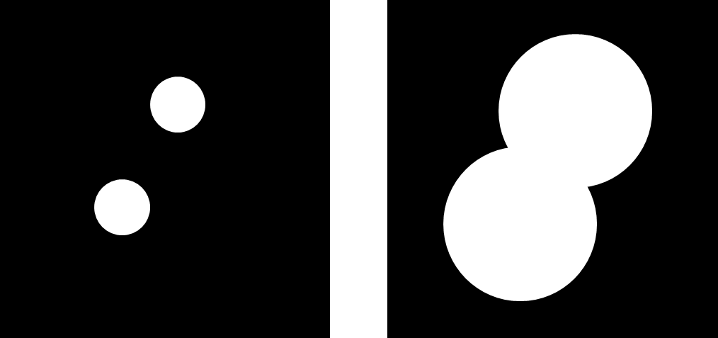
膨胀

Slide 4
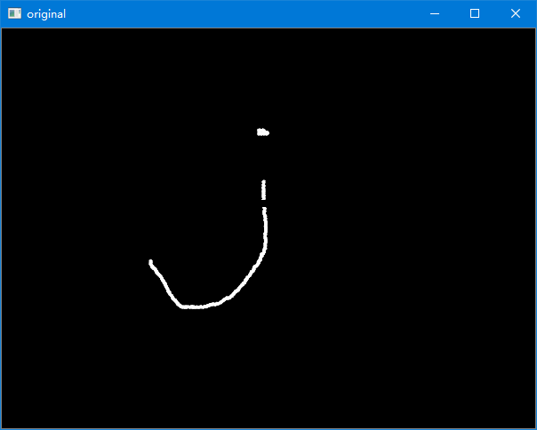
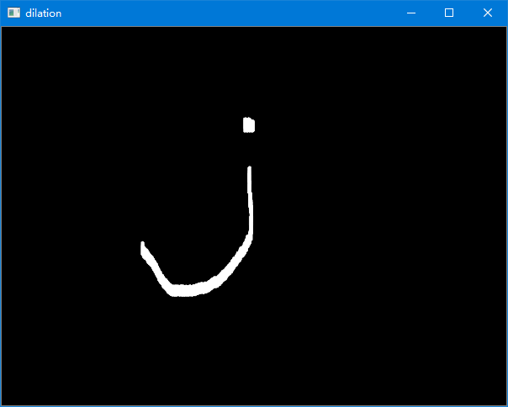
膨胀

Slide 5
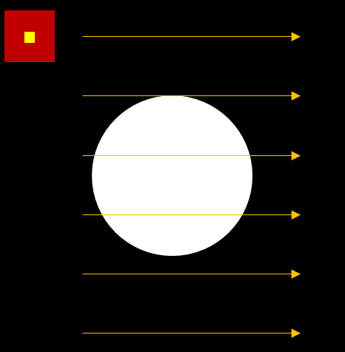

膨胀

Slide 6
膨胀
1
1
1
0 | 0 | 0 | 0 | 0
0 | 0 | 0 | 0 | 0
0 | 1 | 1 | 1 | 0
0 | 1 | 1 | 1 | 0
0 | 1 | 1 | 1 | 0
0 | 0 | 0 | 0 | 0
0 | 0 | 0 | 0 | 0

Slide 7
膨胀
1
1
1
0 | 0 | 0 | 0 | 0
0 | 0 | 0 | 0 | 0
0 | 1 | 1 | 1 | 0
0 | 1 | 1 | 1 | 0
0 | 1 | 1 | 1 | 0
0 | 0 | 0 | 0 | 0
0 | 0 | 0 | 0 | 0
0 | 0 | 0 | 0 | 0

Slide 8
膨胀
1
1
1
0 | 0 | 0 | 0 | 0
0 | 0 | 0 | 0 | 0
0 | 1 | 1 | 1 | 0
0 | 1 | 1 | 1 | 0
0 | 1 | 1 | 1 | 0
0 | 0 | 0 | 0 | 0
0 | 0 | 0 | 0 | 0
0 | 0 | 0 | 0 | 0

Slide 9
膨胀
1
1
1
0 | 0 | 0 | 0 | 0
0 | 0 | 0 | 0 | 0
0 | 1 | 1 | 1 | 0
0 | 1 | 1 | 1 | 0
0 | 1 | 1 | 1 | 0
0 | 0 | 0 | 0 | 0
0 | 0 | 0 | 0 | 0
0 | 0 | 0 | 0 | 0
0

Slide 10
膨胀
1
1
1
0 | 0 | 0 | 0 | 0
0 | 0 | 0 | 0 | 0
0 | 1 | 1 | 1 | 0
0 | 1 | 1 | 1 | 0
0 | 1 | 1 | 1 | 0
0 | 0 | 0 | 0 | 0
0 | 0 | 0 | 0 | 0
0 | 0 | 0 | 0 | 0
0 | 1

Slide 11
膨胀
1
1
1
0 | 0 | 0 | 0 | 0
0 | 0 | 0 | 0 | 0
0 | 1 | 1 | 1 | 0
0 | 1 | 1 | 1 | 0
0 | 1 | 1 | 1 | 0
0 | 0 | 0 | 0 | 0
0 | 0 | 0 | 0 | 0
0 | 0 | 0 | 0 | 0
0 | 1 | 1

Slide 12
膨胀
1
1
1
0 | 0 | 0 | 0 | 0
0 | 0 | 0 | 0 | 0
0 | 1 | 1 | 1 | 0
0 | 1 | 1 | 1 | 0
0 | 1 | 1 | 1 | 0
0 | 0 | 0 | 0 | 0
0 | 0 | 0 | 0 | 0
0 | 0 | 0 | 0 | 0
0 | 1 | 1 | 1

Slide 13
膨胀
1
1
1
0 | 0 | 0 | 0 | 0
0 | 0 | 0 | 0 | 0
0 | 1 | 1 | 1 | 0
0 | 1 | 1 | 1 | 0
0 | 1 | 1 | 1 | 0
0 | 0 | 0 | 0 | 0
0 | 0 | 0 | 0 | 0
0 | 0 | 0 | 0 | 0
0 | 1 | 1 | 1 | 0

Slide 14
膨胀
1
1
1
0 | 0 | 0 | 0 | 0
0 | 0 | 0 | 0 | 0
0 | 1 | 1 | 1 | 0
0 | 1 | 1 | 1 | 0
0 | 1 | 1 | 1 | 0
0 | 0 | 0 | 0 | 0
0 | 0 | 0 | 0 | 0
0 | 0 | 0 | 0 | 0
0 | 1 | 1 | 1 | 0
0

Slide 15
膨胀
1
1
1
0 | 0 | 0 | 0 | 0
0 | 0 | 0 | 0 | 0
0 | 1 | 1 | 1 | 0
0 | 1 | 1 | 1 | 0
0 | 1 | 1 | 1 | 0
0 | 0 | 0 | 0 | 0
0 | 0 | 0 | 0 | 0
0 | 0 | 0 | 0 | 0
0 | 1 | 1 | 1 | 0
0 | 1

Slide 16
膨胀
1
1
1
0 | 0 | 0 | 0 | 0
0 | 0 | 0 | 0 | 0
0 | 1 | 1 | 1 | 0
0 | 1 | 1 | 1 | 0
0 | 1 | 1 | 1 | 0
0 | 0 | 0 | 0 | 0
0 | 0 | 0 | 0 | 0
0 | 0 | 0 | 0 | 0
0 | 1 | 1 | 1 | 0
0 | 1 | 1

Slide 17
膨胀
1
1
1
0 | 0 | 0 | 0 | 0
0 | 0 | 0 | 0 | 0
0 | 1 | 1 | 1 | 0
0 | 1 | 1 | 1 | 0
0 | 1 | 1 | 1 | 0
0 | 0 | 0 | 0 | 0
0 | 0 | 0 | 0 | 0
0 | 0 | 0 | 0 | 0
0 | 1 | 1 | 1 | 0
0 | 1 | 1 | 1

Slide 18
膨胀
1
1
1
0 | 0 | 0 | 0 | 0
0 | 0 | 0 | 0 | 0
0 | 1 | 1 | 1 | 0
0 | 1 | 1 | 1 | 0
0 | 1 | 1 | 1 | 0
0 | 0 | 0 | 0 | 0
0 | 0 | 0 | 0 | 0
0 | 0 | 0 | 0 | 0
0 | 1 | 1 | 1 | 0
0 | 1 | 1 | 1 | 0

Slide 19
膨胀
1
1
1
0 | 0 | 0 | 0 | 0
0 | 0 | 0 | 0 | 0
0 | 1 | 1 | 1 | 0
0 | 1 | 1 | 1 | 0
0 | 1 | 1 | 1 | 0
0 | 0 | 0 | 0 | 0
0 | 0 | 0 | 0 | 0
0 | 0 | 0 | 0 | 0
0 | 1 | 1 | 1 | 0
0 | 1 | 1 | 1 | 0
0

Slide 20
膨胀
1
1
1
0 | 0 | 0 | 0 | 0
0 | 0 | 0 | 0 | 0
0 | 1 | 1 | 1 | 0
0 | 1 | 1 | 1 | 0
0 | 1 | 1 | 1 | 0
0 | 0 | 0 | 0 | 0
0 | 0 | 0 | 0 | 0
0 | 0 | 0 | 0 | 0
0 | 1 | 1 | 1 | 0
0 | 1 | 1 | 1 | 0
0 | 1

Slide 21
膨胀
1
1
1
0 | 0 | 0 | 0 | 0
0 | 0 | 0 | 0 | 0
0 | 1 | 1 | 1 | 0
0 | 1 | 1 | 1 | 0
0 | 1 | 1 | 1 | 0
0 | 0 | 0 | 0 | 0
0 | 0 | 0 | 0 | 0
0 | 0 | 0 | 0 | 0
0 | 1 | 1 | 1 | 0
0 | 1 | 1 | 1 | 0
0 | 1 | 1

Slide 22
膨胀
1
1
1
0 | 0 | 0 | 0 | 0
0 | 0 | 0 | 0 | 0
0 | 1 | 1 | 1 | 0
0 | 1 | 1 | 1 | 0
0 | 1 | 1 | 1 | 0
0 | 0 | 0 | 0 | 0
0 | 0 | 0 | 0 | 0
0 | 0 | 0 | 0 | 0
0 | 1 | 1 | 1 | 0
0 | 1 | 1 | 1 | 0
0 | 1 | 1 | 1

Slide 23
膨胀
1
1
1
0 | 0 | 0 | 0 | 0
0 | 0 | 0 | 0 | 0
0 | 1 | 1 | 1 | 0
0 | 1 | 1 | 1 | 0
0 | 1 | 1 | 1 | 0
0 | 0 | 0 | 0 | 0
0 | 0 | 0 | 0 | 0
0 | 0 | 0 | 0 | 0
0 | 1 | 1 | 1 | 0
0 | 1 | 1 | 1 | 0
0 | 1 | 1 | 1 | 0

Slide 24
膨胀
1
1
1
0 | 0 | 0 | 0 | 0
0 | 0 | 0 | 0 | 0
0 | 1 | 1 | 1 | 0
0 | 1 | 1 | 1 | 0
0 | 1 | 1 | 1 | 0
0 | 0 | 0 | 0 | 0
0 | 0 | 0 | 0 | 0
0 | 0 | 0 | 0 | 0
0 | 1 | 1 | 1 | 0
0 | 1 | 1 | 1 | 0
0 | 1 | 1 | 1 | 0
0

Slide 25
膨胀
1
1
1
0 | 0 | 0 | 0 | 0
0 | 0 | 0 | 0 | 0
0 | 1 | 1 | 1 | 0
0 | 1 | 1 | 1 | 0
0 | 1 | 1 | 1 | 0
0 | 0 | 0 | 0 | 0
0 | 0 | 0 | 0 | 0
0 | 0 | 0 | 0 | 0
0 | 1 | 1 | 1 | 0
0 | 1 | 1 | 1 | 0
0 | 1 | 1 | 1 | 0
0 | 1

Slide 26
膨胀
1
1
1
0 | 0 | 0 | 0 | 0
0 | 0 | 0 | 0 | 0
0 | 1 | 1 | 1 | 0
0 | 1 | 1 | 1 | 0
0 | 1 | 1 | 1 | 0
0 | 0 | 0 | 0 | 0
0 | 0 | 0 | 0 | 0
0 | 0 | 0 | 0 | 0
0 | 1 | 1 | 1 | 0
0 | 1 | 1 | 1 | 0
0 | 1 | 1 | 1 | 0
0 | 1 | 1

Slide 27
膨胀
1
1
1
0 | 0 | 0 | 0 | 0
0 | 0 | 0 | 0 | 0
0 | 1 | 1 | 1 | 0
0 | 1 | 1 | 1 | 0
0 | 1 | 1 | 1 | 0
0 | 0 | 0 | 0 | 0
0 | 0 | 0 | 0 | 0
0 | 0 | 0 | 0 | 0
0 | 1 | 1 | 1 | 0
0 | 1 | 1 | 1 | 0
0 | 1 | 1 | 1 | 0
0 | 1 | 1 | 1

Slide 28
膨胀
1
1
1
0 | 0 | 0 | 0 | 0
0 | 0 | 0 | 0 | 0
0 | 1 | 1 | 1 | 0
0 | 1 | 1 | 1 | 0
0 | 1 | 1 | 1 | 0
0 | 0 | 0 | 0 | 0
0 | 0 | 0 | 0 | 0
0 | 0 | 0 | 0 | 0
0 | 1 | 1 | 1 | 0
0 | 1 | 1 | 1 | 0
0 | 1 | 1 | 1 | 0
0 | 1 | 1 | 1 | 0

Slide 29
膨胀
1
1
1
0 | 0 | 0 | 0 | 0
0 | 0 | 0 | 0 | 0
0 | 1 | 1 | 1 | 0
0 | 1 | 1 | 1 | 0
0 | 1 | 1 | 1 | 0
0 | 0 | 0 | 0 | 0
0 | 0 | 0 | 0 | 0
0 | 0 | 0 | 0 | 0
0 | 1 | 1 | 1 | 0
0 | 1 | 1 | 1 | 0
0 | 1 | 1 | 1 | 0
0 | 1 | 1 | 1 | 0
0

Slide 30
膨胀
1
1
1
0 | 0 | 0 | 0 | 0
0 | 0 | 0 | 0 | 0
0 | 1 | 1 | 1 | 0
0 | 1 | 1 | 1 | 0
0 | 1 | 1 | 1 | 0
0 | 0 | 0 | 0 | 0
0 | 0 | 0 | 0 | 0
0 | 0 | 0 | 0 | 0
0 | 1 | 1 | 1 | 0
0 | 1 | 1 | 1 | 0
0 | 1 | 1 | 1 | 0
0 | 1 | 1 | 1 | 0
0 | 1

Slide 31
膨胀
1
1
1
0 | 0 | 0 | 0 | 0
0 | 0 | 0 | 0 | 0
0 | 1 | 1 | 1 | 0
0 | 1 | 1 | 1 | 0
0 | 1 | 1 | 1 | 0
0 | 0 | 0 | 0 | 0
0 | 0 | 0 | 0 | 0
0 | 0 | 0 | 0 | 0
0 | 1 | 1 | 1 | 0
0 | 1 | 1 | 1 | 0
0 | 1 | 1 | 1 | 0
0 | 1 | 1 | 1 | 0
0 | 1 | 1

Slide 32
膨胀
1
1
1
0 | 0 | 0 | 0 | 0
0 | 0 | 0 | 0 | 0
0 | 1 | 1 | 1 | 0
0 | 1 | 1 | 1 | 0
0 | 1 | 1 | 1 | 0
0 | 0 | 0 | 0 | 0
0 | 0 | 0 | 0 | 0
0 | 0 | 0 | 0 | 0
0 | 1 | 1 | 1 | 0
0 | 1 | 1 | 1 | 0
0 | 1 | 1 | 1 | 0
0 | 1 | 1 | 1 | 0
0 | 1 | 1 | 1

Slide 33
膨胀
1
1
1
0 | 0 | 0 | 0 | 0
0 | 0 | 0 | 0 | 0
0 | 1 | 1 | 1 | 0
0 | 1 | 1 | 1 | 0
0 | 1 | 1 | 1 | 0
0 | 0 | 0 | 0 | 0
0 | 0 | 0 | 0 | 0
0 | 0 | 0 | 0 | 0
0 | 1 | 1 | 1 | 0
0 | 1 | 1 | 1 | 0
0 | 1 | 1 | 1 | 0
0 | 1 | 1 | 1 | 0
0 | 1 | 1 | 1 | 0

Slide 34
膨胀
1
1
1
0 | 0 | 0 | 0 | 0
0 | 0 | 0 | 0 | 0
0 | 1 | 1 | 1 | 0
0 | 1 | 1 | 1 | 0
0 | 1 | 1 | 1 | 0
0 | 0 | 0 | 0 | 0
0 | 0 | 0 | 0 | 0
0 | 0 | 0 | 0 | 0
0 | 1 | 1 | 1 | 0
0 | 1 | 1 | 1 | 0
0 | 1 | 1 | 1 | 0
0 | 1 | 1 | 1 | 0
0 | 1 | 1 | 1 | 0

Slide 35
膨胀
1
1
1
0 | 0 | 0 | 0 | 0
0 | 0 | 0 | 0 | 0
0 | 1 | 1 | 1 | 0
0 | 1 | 1 | 1 | 0
0 | 1 | 1 | 1 | 0
0 | 0 | 0 | 0 | 0
0 | 0 | 0 | 0 | 0
0 | 1 | 1 | 1 | 0
0 | 1 | 1 | 1 | 0
0 | 1 | 1 | 1 | 0
0 | 1 | 1 | 1 | 0
0 | 1 | 1 | 1 | 0

Slide 36
膨胀
知识点
核在膨胀过程中发挥着重要作用。

Slide 37
膨胀
dst = cv2.dilate( src, kernel[, anchor[, iterations[, borderType[, borderValue]]]])
dst – 膨胀后所输出的目标图像。
src – 需要进行膨胀操作的原始图像。
kernel – 膨胀操作时所采用的结构类型。
参数anchor、iterations、borderType、borderValue与函数cv2.erode()内参数的含义一致。

Slide 38
膨胀
dst = cv2.dilate( src, kernel[, anchor[, iterations[, borderType[, borderValue]]]])
dst – 膨胀后所输出的目标图像。
src – 需要进行膨胀操作的原始图像。
kernel – 膨胀操作时所采用的结构类型。
参数anchor、iterations、borderType、borderValue与函数cv2.erode()内参数的含义一致。

Slide 39
膨胀
dst = cv2.dilate( src, kernel[, anchor[, iterations[, borderType[, borderValue]]]])
dst – 膨胀后所输出的目标图像。
src – 需要进行膨胀操作的原始图像。
kernel – 膨胀操作时所采用的结构类型。
参数anchor、iterations、borderType、borderValue与函数cv2.erode()内参数的含义一致。

Slide 40
膨胀
dst = cv2.dilate( src, kernel[, anchor[, iterations[, borderType[, borderValue]]]])
dst – 膨胀后所输出的目标图像。
src – 需要进行膨胀操作的原始图像。
kernel – 膨胀操作时所采用的结构类型。
参数anchor、iterations、borderType、borderValue与函数cv2.erode()内参数的含义一致。

Slide 41
膨胀
dst = cv2.dilate( src, kernel[, anchor[, iterations[, borderType[, borderValue]]]])
dst – 膨胀后所输出的目标图像。
src – 需要进行膨胀操作的原始图像。
kernel – 膨胀操作时所采用的结构类型。
参数anchor、iterations、borderType、borderValue与函数cv2.erode()内参数的含义一致。

Slide 42

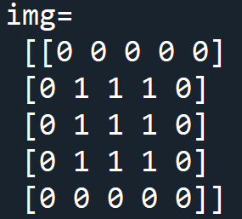
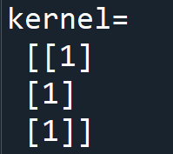
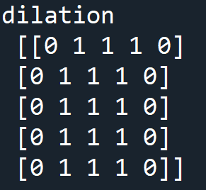
膨胀
案例1：使用数组验证dilate函数。
import cv2
import numpy as np
img=np.zeros((5,5),np.uint8)
img[1:4,1:4]=1
kernel = np.ones((3,1),np.uint8)
dilation = cv2.dilate(img,kernel)
print("img=\n",img)
print("kernel=\n",kernel)
print("dilation\n",dilation)

Slide 43
膨胀
案例2：使用函数cv2.dilate()完成图像膨胀。
import cv2
import numpy as np
o=cv2.imread("image/connection.bmp",0)
kernel = np.array([[1],[1],[1]])
dilation = cv2.dilate(o,kernel,iterations = 5)
cv2.imshow("original",o)
cv2.imshow("dilation", dilation)
cv2.waitKey()
cv2.destroyAllWindows()

Slide 44
膨胀
案例2：使用函数cv2.dilate()完成图像膨胀。
import cv2
import numpy as np
o=cv2.imread("image/connection.bmp",0)
kernel = np.array([[1],[1],[1]])
dilation = cv2.dilate(o,kernel,iterations = 5)
cv2.imshow("original",o)
cv2.imshow("dilation", dilation)
cv2.waitKey()
cv2.destroyAllWindows()
图像连接

Slide 45
总结
膨胀原理
膨胀操作

