Slide 1
Some
Practical Knowledge
of
Chinese

Slide 2

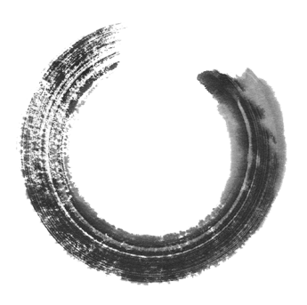
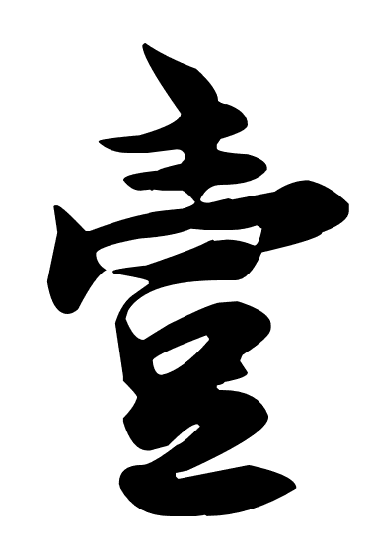
主
Main
·

Slide 3
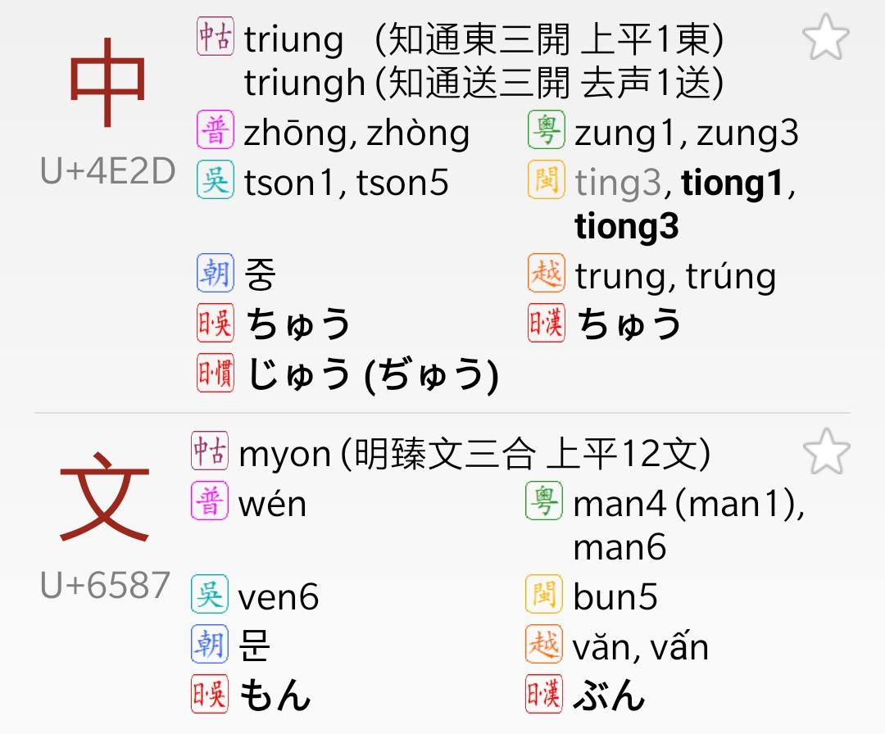
Spoken & Written form
語(言) & 文(字)
Mandarin
Cantonese
Wu
(Shanghainese,
Suzhou Dialect)
Min /Minnan
Vietnamese
Korean
Japanese

Slide 4
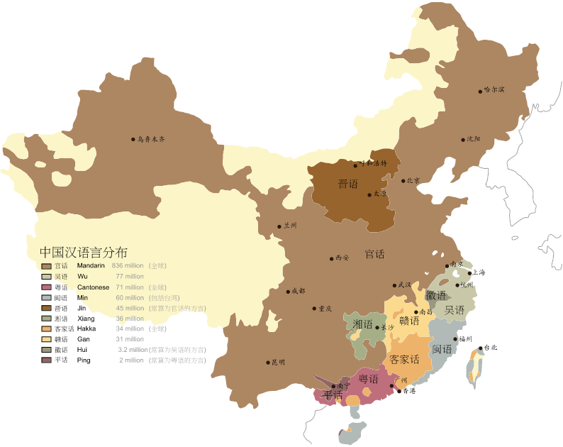
Dialects
方言
yunhe - File:Map of sinitic languages-zh.svg，CC BY-SA 3.0，
https://commons.wikimedia.org/w/index.php?curid=15163655

Slide 5
Chinese → Latin characters
Pinyin (1958 by PRC; 1979 by UN)
Chinese postal romanization (based on Wade-Giles) (1906 - 1979)
Wade–Giles (20 century)
北京
Beijing
Peking
Pei-ching
清華 {清华}
Qinghua
Tsinghua
Chʻing-hua
餃子{饺子}
  Jiaozi
  Gyoza
  Dumpling

Slide 6
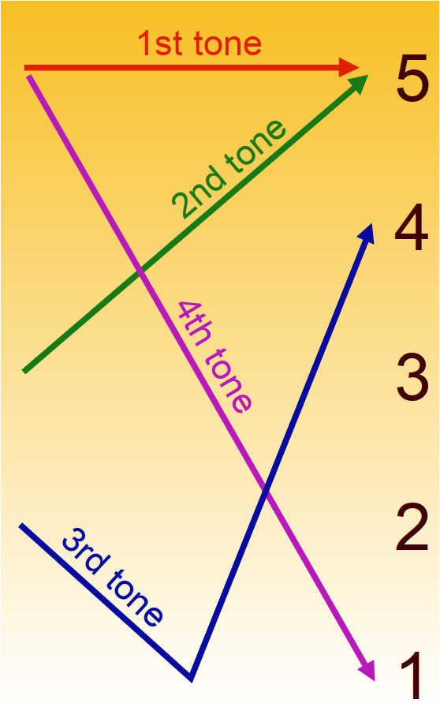
Pronunciation in/of Mandarin
zhōng wén
中 文
Pinyin
  https://www.learn-chinese.com/pinyin-lesson-1-introduction-to-pinyin/
Bopomofo (Annotated Phonetic Letters)
陰平
{阴平}
陽平
{阳平}
上
ㄓㄨㄥ ㄨㄣˊ
中 文
去
By Wereon - Self-published work by Wereon，CC BY-SA 3.0，
https://commons.wikimedia.org/w/index.php?curid=1234099

Slide 7
Homophone (Homonym)
Rui:
  Ruí 蕤: [overladen with flowers]
  Ruǐ 蕊: stamen & pistil
  Ruì:
    瑞: lucky
    銳{锐}: sharp
    睿: clever / wise
    芮: (the form of) small grass
    蚋: blackfly
    枘: tenon
Yuyan
  語言(32): language
  預言(42): prophecy
  寓言(42): fable (story)
  雨燕(34): swift (bird)
  預演(43): rehearsal (practise)
  浴鹽(42): bath salt
  玉顏(42): Pretty (jade-like) face
  魚雁(24): mail / messenger
    Derived meaning (from poems)

Slide 8
Shi Shi Shi Shi Shi
《施氏食獅史》
石室詩士施氏，嗜獅，誓食十獅。施氏時時適市視獅。十時，適十獅市。是時，適施氏適市。施氏視十獅，恃矢勢，使是十獅逝世。氏拾是十獅屍，適石室。石室溼，施氏使侍拭石室。石室拭，施氏始試食十獅屍。食時，始識十獅實十石獅屍。試釋是事。
{石室诗士施氏，嗜狮，誓食十狮。施氏时时适市视狮。十时，适十狮市。是时，适施氏适市。施氏视十狮，恃矢势，使是十狮逝世。氏拾是十狮尸，适石室。石室湿，施氏使侍拭石室。石室拭，施氏始试食十狮尸。食时，始识十狮实十石狮尸。试释是事。}

Slide 9
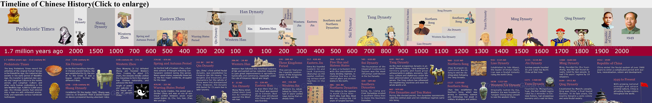

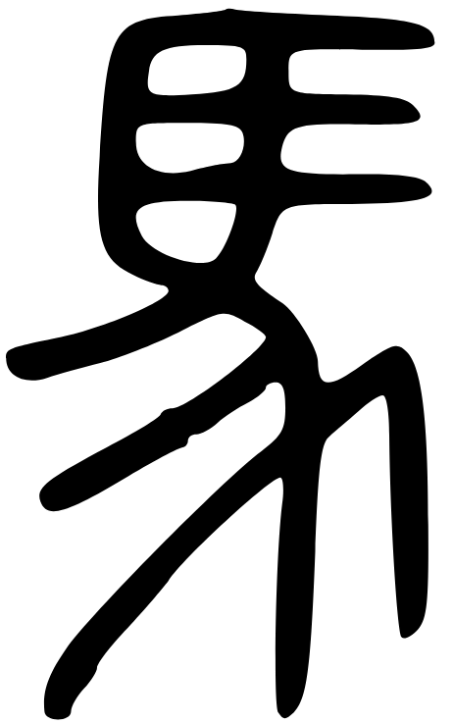
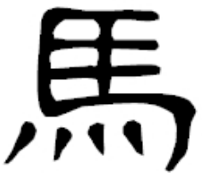
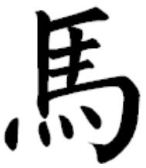

Spoken /
Pronunciation
Archaic Chinese
上古漢語
Middle Chinese
中古漢語
Mandarin
官話/國語/普通話
Bronzeware Script
金文
Clerical Script
隸書{隶书}
Small Seal Script
小篆
Regular Script
楷書{楷书}
Oracle Bone Script
甲骨文
Characters
https://hanziyuan.net/#%E9%A6%AC

Slide 10

Chinese characters of Empress Wu
則天文字{则天文字}
0 1 2 3 4 5 6 7 8 9 10
零一二三四五六七八九十
零壹貳叁肆伍陸柒捌玖拾
{贰} {陆}

Slide 11
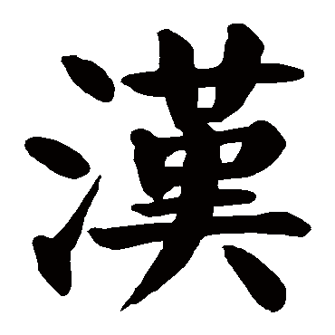
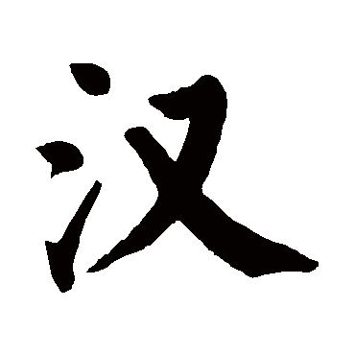
Traditional vs Simplified Chinese
Characters
  Regular Script
  Mostly the same
    ~2000 simplified
    47035 in Kangxi Dictionary (Qing Dynasty)
  Not entirely systematic
  Not 1 to 1 (e.g. 幹乾干 → 干)
Wording
  Different localisation-al terms / translations

Slide 12
Trad. vs Simp. Chinese (technical)
Different code points in Unicode
Auto-converting doesn’t work well
  Not 1 to 1
I18n: usually treat as two languages
  I.e. different string resources
  Wikipedia doesn’t (great!)

Slide 13
Variants
 | Traditional | Simplified | Japanese (Kanji)
To sell | 賣 | 卖 | 売
Shell | 殼 | 壳 | 殼
Art / Skill | 藝 | 艺 | 芸
Rapeseed (?) / To weed | 芸 | 芸 | ？

Slide 14

Input Chinese
Draw !
Type Unicode !
Talk / ASR !
Phonetic-based
  Pinyin
  Bopomofo
  ...
Shape-based
  Stroke (筆畫{笔画})
  Cangjie (倉頡{仓颉})
  Wubi (五筆{五笔})
  ...

Slide 15
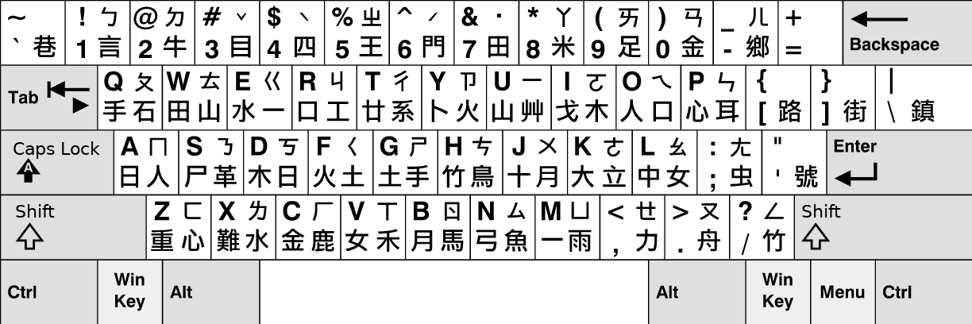
Input Chinese (special keyboards)

Slide 16
Classical Chinese
文言
Classical Chinese = Literary Chinese
文言
Written Vernacular Chinese
白話
Interlingua across East Asian cultural sphere (before 20 century)

Slide 17
石室詩士施氏，嗜獅，誓食十獅。施氏時時適市視獅。十時，適十獅市。是時，適施氏適市。施氏視十獅，恃矢勢，使是十獅逝世。氏拾是十獅屍，適石室。石室溼，施氏使侍拭石室。石室拭，施氏始試食十獅屍。食時，始識十獅實十石獅屍。試釋是事。
石頭屋子裏有一個詩人姓施，喜歡獅子，發誓要吃掉十頭獅子。這位先生經常去市場尋找獅子。這一天十點鐘的時候他到了市場，正好有十頭大獅子也到了市場。於是，這位先生注視着這十頭獅子，憑藉着自己的十把石頭弓箭，把這十頭獅子殺死了。先生扛起獅子的屍體走回石頭屋子。石頭屋子很潮溼，先生讓僕人擦拭石頭屋子。擦好以後，先生開始嘗試吃這十頭獅子的屍體。當他吃的時候,才識破這十頭獅屍,並非真的獅屍,而是十頭用石頭做的獅子。先生這才意識到這就是事情的真相。請嘗試解釋這件事情。

Slide 18
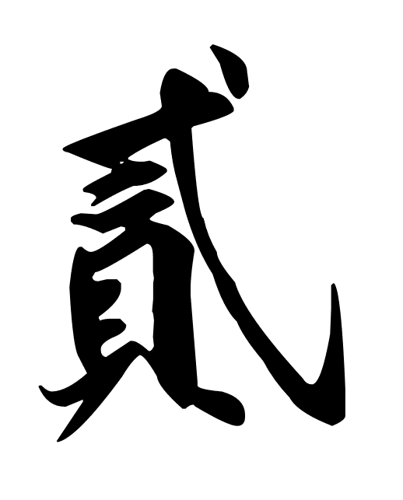
逸事
Fun things
·

Slide 19
Erhua
兒化{儿化}
e.g.
  哪（兒） Nǎr
  一點（兒） Yì Diǎnr
Common in North China
Often difficult for South China people

Slide 20
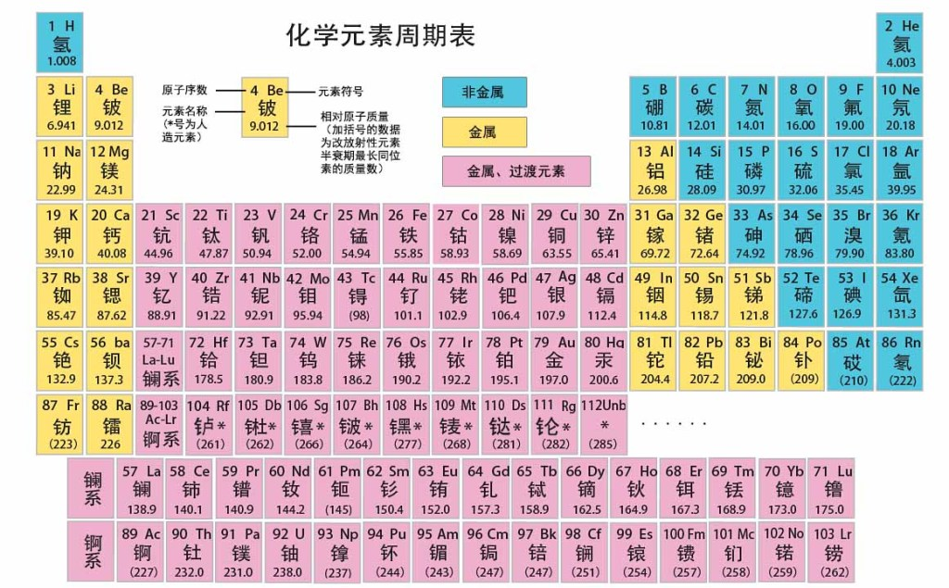
Periodic table

Slide 21
New characters in/for science
砼tóng : Concrete
  人工石
羥{羟} qiǎng : Hydroxy group
  氫氧{氢氧}
瓩 qiānwǎ : Kilowatt
  千瓦
  Not often seen

Slide 22
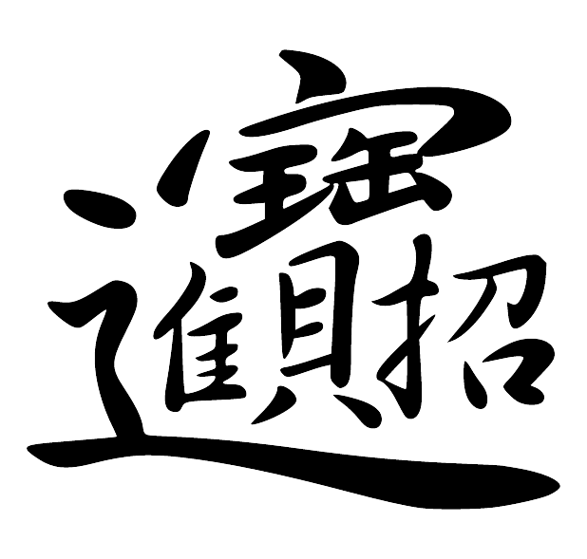
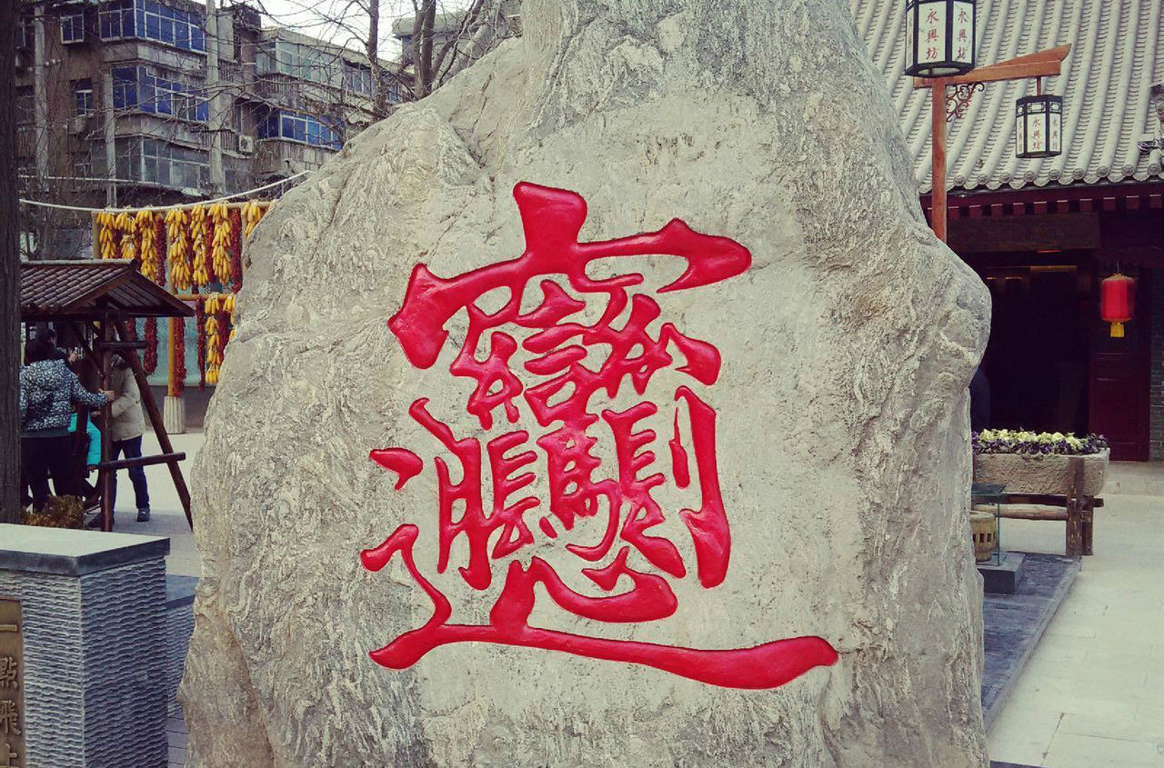
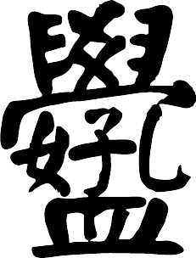
Compound

Slide 23
That’s all
Thank you

