Slide 1
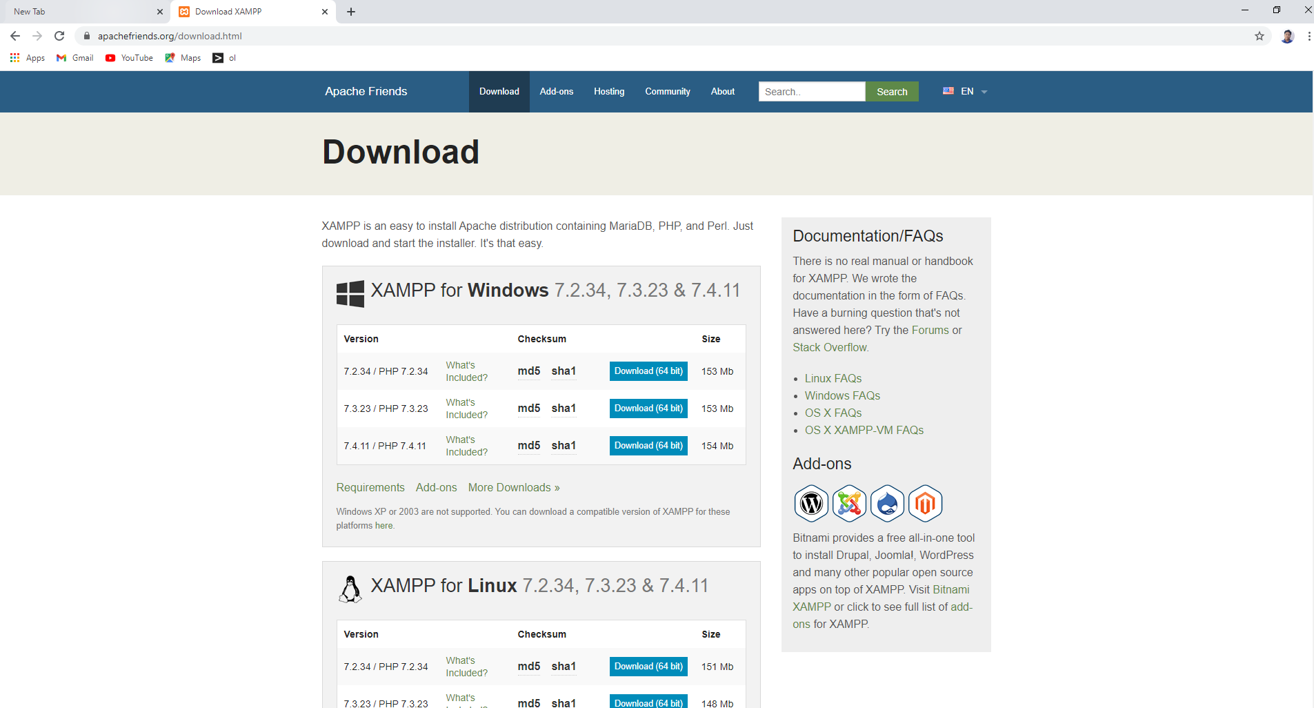
Exam 1
Go to the link to download xampp https://www.apachefriends.org/download.html

Slide 2
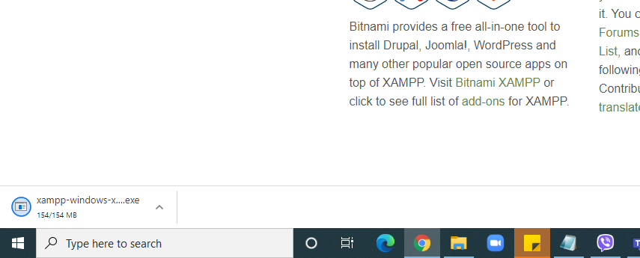
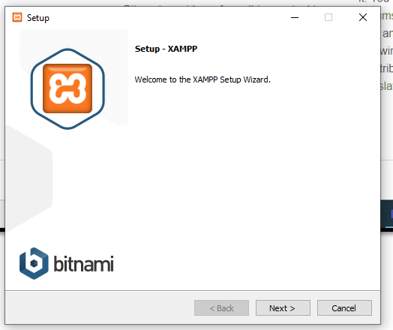
Run the program and install

Slide 3
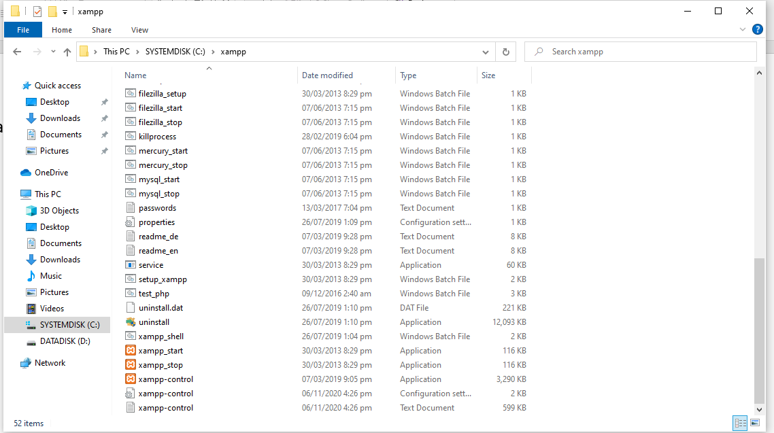
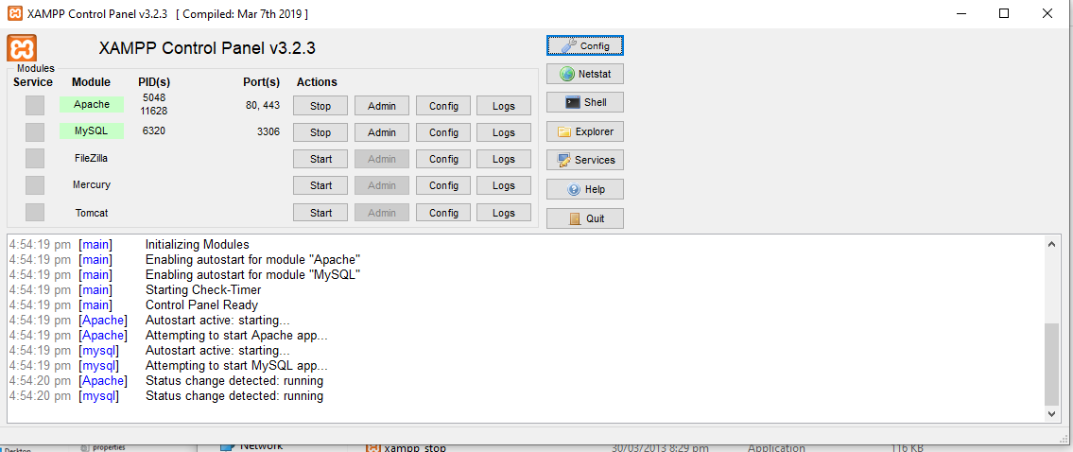
Go to the folder c://xampp/ and find “xampp-control application” and run make sure apache and mysql is running.

Slide 4
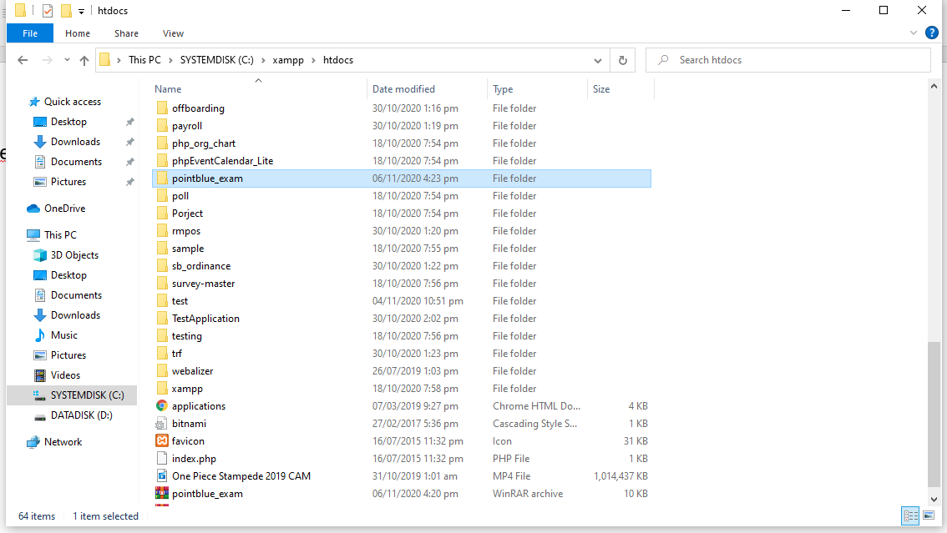
Copy folder “pointblue_exam” inside C://xampp/htdocs

Slide 5
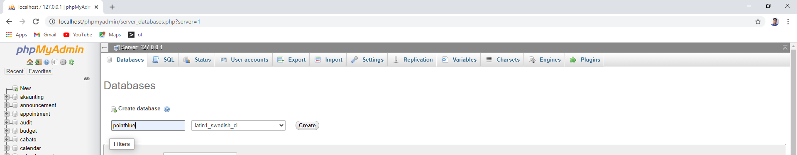
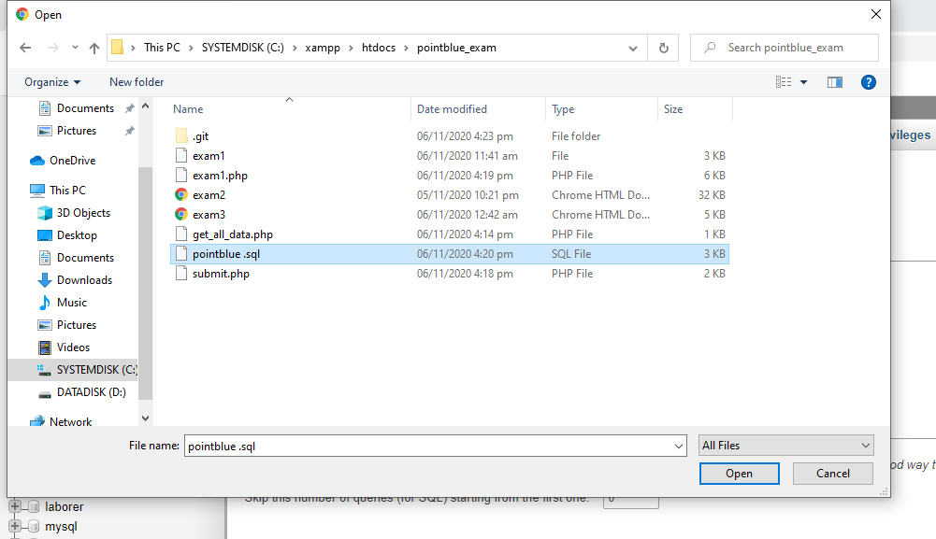
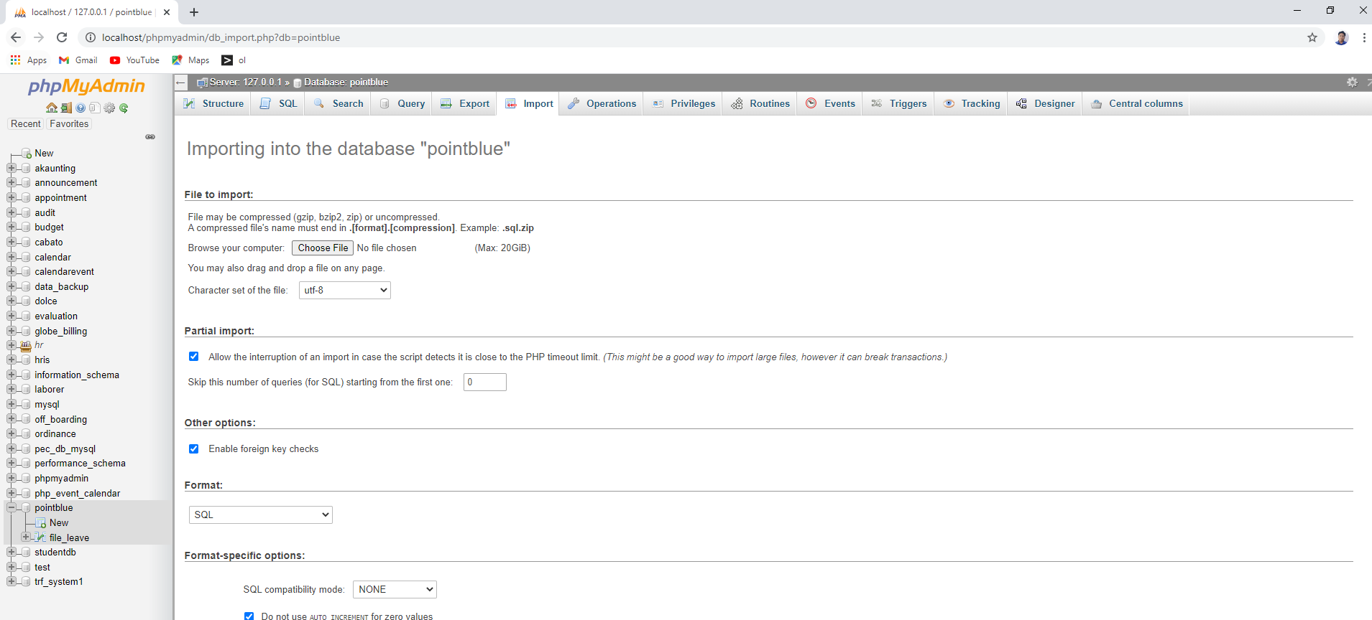
- Type “localhost/phpmyadmin”
- created database pointblue
- import "pointblue.sql" from folder of pointblue exam
5
1
2
4
3

Slide 6
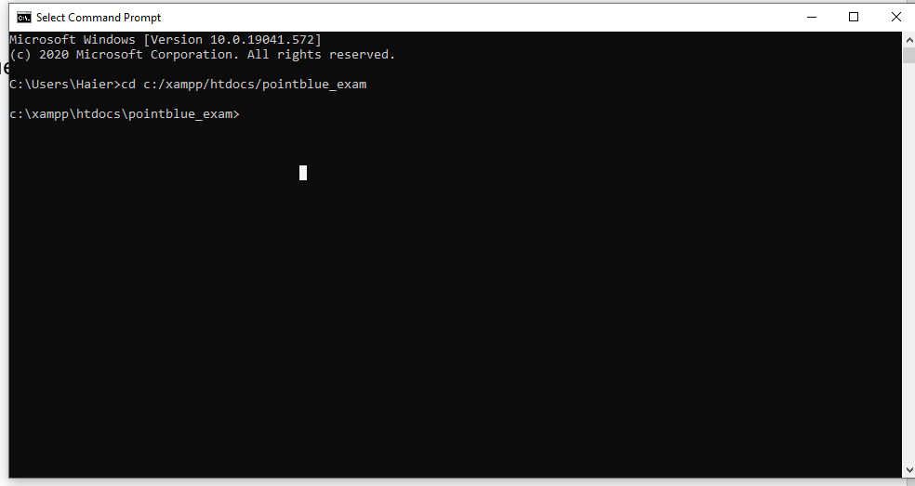
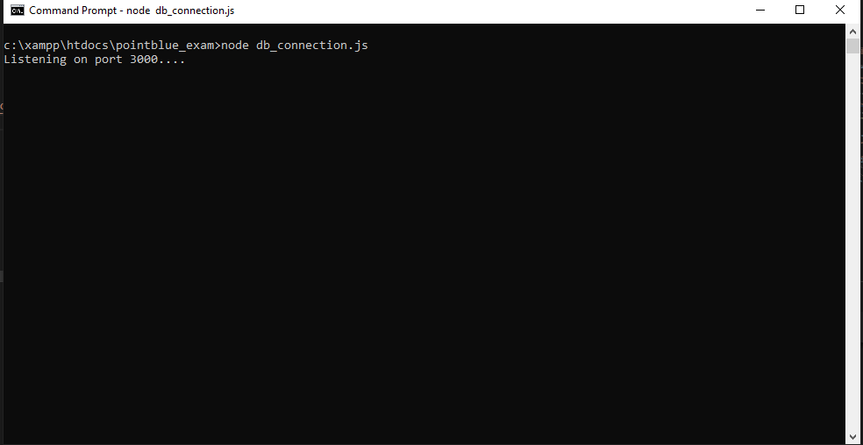
Open cmd
Type “cd c:/xampp/htdocs/pointblue_exam/
Type “node db_connection.js” this is to run the API.
Then click the file “exam1.html”

Slide 7
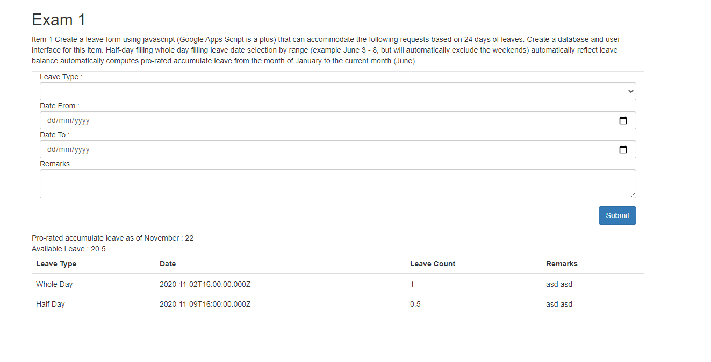
Open cmd
Type “cd c:/xampp/htdocs/pointblue_exam/
Type “node db_connection.js” this is to run the API.
Then click the file “exam1.html”

Slide 8
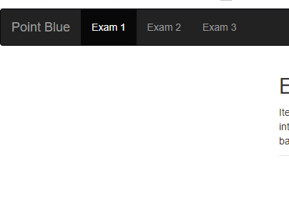
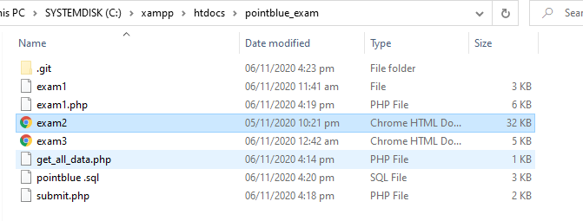
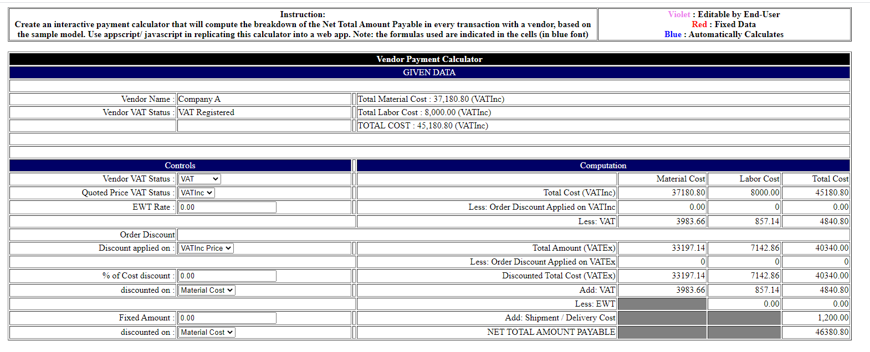
Exam 2 Click Exam 2 from exam 1 or Just click exam2.html

Slide 9
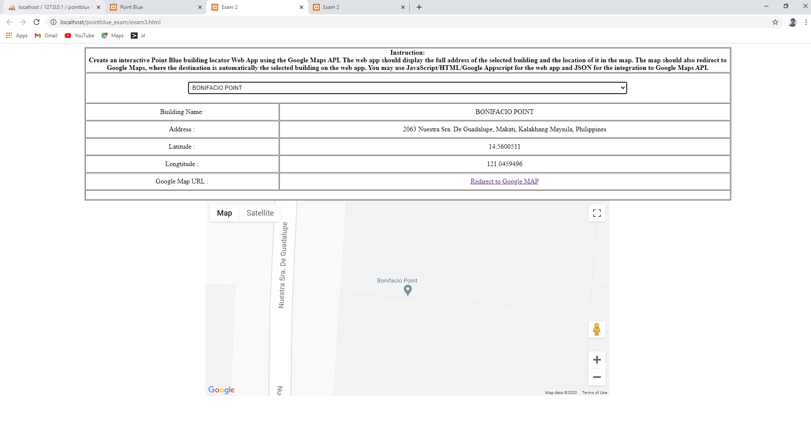
Exam 3 Click Exam 3 from exam 1 or Just click exam3.html

