Slide 1
Chapter 4 Anti-Virus

Slide 2
Anti-Virus
Three tasks for anti-virus
Detection
Infected or not? Provably undecidable…
Identification
May be separate from detection, depending on detection method used
Disinfection
Remove the virus

Slide 3
Detection: Static Methods
Generic methods
Detects known and unknown viruses
For example, anomaly detection
Virus-specific methods
Detects known viruses
For example, signature detection
Static --- virus code not running
Dynamic --- virus code running

Slide 4
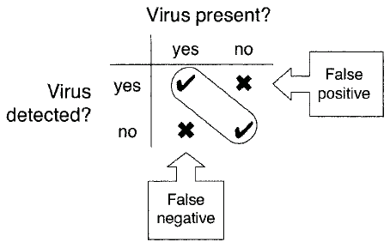
Detection Outcomes

Slide 5
Detection Outcomes
Also can have ghost positive
Virus remnant “detected”
But virus is no longer there
How can this happen?
Previous disinfection was incomplete

Slide 6
Static Detection
Detection without running virus code
Three approaches…
Scanners
Signature
Heuristics
Look for “virus-like” code
Integrity Checkers
Hash/checksum

Slide 7
Scanners
On-demand
Files scanned when you say so
On-access
Constant scanning in background
Whenever file is accessed, it’s scanned

Slide 8
Scanners
Signature scanning
Viruses represented by “signature”
Signature == pattern of bits in a virus (might include wildcards)
“Hundreds of thousands of signatures”
Not feasible to scan one-by-one
Multiple pattern search
Efficiency is critical
We look in detail at several algorithms

Slide 9
Algorithm: Aho-Corasick
Developed 1975, bibliographic search
Based on finite automaton (graph)
Circles are search states
Edges are transitions
Double circles are final states/output
And a failure function
What to do when no suitable transition
I.e., where to resume “matching”

Slide 10
Algorithm: Aho-Corasick
When virus scanning, search for virus signature, which is bit string
For simplicity, illustrate algorithm using English words
For our example…
Scan for any of the following words:
hi, hips, hip, hit, chip

Slide 11
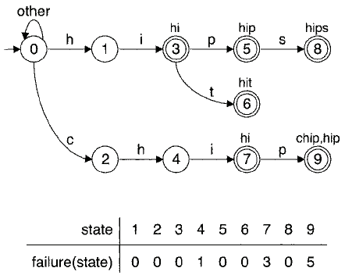
Algorithm: Aho-Corasick

Slide 12
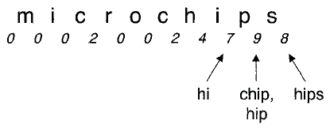
Aho-Corasick Example

Slide 13
Algorithm: Aho-Corasick
How to construct automaton?
And failure function
Build the automaton --- next slide
A “trie”, also known as a “prefix tree”
Then determine failure function
Two slides ahead

Slide 14
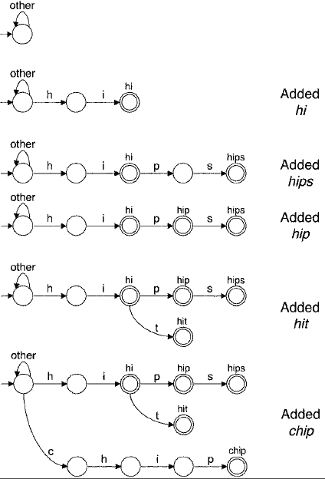
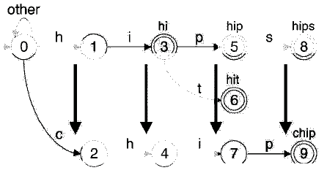
Aho-Corasick: Trie
Labels added in breadth-first order
Closest to root get smallest numbers

Slide 15
Aho-Corasick: Failure Function
Depth 1 nodes
Fail goes back to start state
For other states
Go back to earliest place where search can resume
Pseudo-code is in the book

Slide 16
Aho-Corasick
The bottom line…
Linear search that can find multiple signatures
Like searching in parallel for related signatures
Efficient representation of automaton is the challenge
Both time and space issues

Slide 17
Algorithm: Veldman
Linear search on “reduced” signatures
Sequential search on reduced set
From each signature, select 4 adjacent non-wildcard bytes
Want as many signatures as possible to have each selected 4-byte pattern
Then use 2 hash tables to filter…
Hash tables: 1st 2 bytes & 2nd 2 bytes

Slide 18
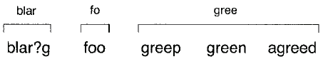
Algorithm: Veldman
Example
Suppose the following 5 signatures
blar?g, foo, greep, green, agreed
Select 4-byte patterns, no wildcards:

Slide 19
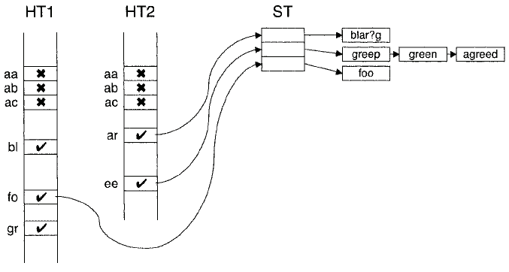
Algorithm: Veldman
Hashes act as filters
Test things that pass thru both filters
In this example, get things like “grar”

Slide 20
Algorithm: Veldman
Veldman allows for wildcards and complex signatures
Aho-Corasick does not
But both algorithms analyze every byte of input
Is it possible to do better?
That is, can we skip some of the input?

Slide 21
Algorithm: Wu-Manber
Like Veldman’s algorithm
But can skip over bytes that can’t possibly match
Faster, improved performance
Illustrate algorithm with same signatures used for Veldman’s:
blar?g, foo, greep, green, agreed

Slide 22
Algorithm: Wu-Manber
Calculate MINLEN
Min length of any pattern substring
Two hash tables
SHIFT --- number of bytes that can safely be skipped
HASH --- mapping to signatures
Input bytes denoted b₁,b₂,…,b_{n}
Start at b_{MINLEN} consider byte pairs

Slide 23
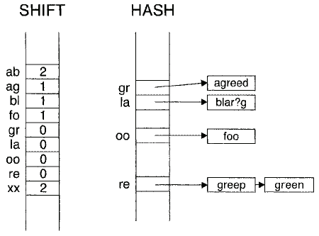
Algorithm: Wu-Manber
Example: Suppose hash tables are…

Slide 24
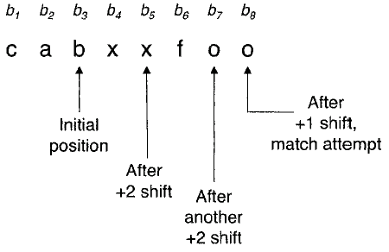
Wu-Manber Example
Here, MINLEN = 3
Start at b_{MINLEN}

Slide 25
Algorithm: Wu-Manber
How to construct hash tables?
It’s a 4-step process
Calculate MINLEN
Initialize SHIFT table
Fill SHIFT table
Fill HASH table

Slide 26
Algorithm: Wu-Manber
Calculate MINLEN
Minimum number of adjacent, non-wildcard bytes in any signature
For this example, we have
blar?g 4 foo 3
greep 5 green 5
agreed 6
So we have MINLEN = 3

Slide 27
Algorithm: Wu-Manber
SHIFT table
Extract MINLEN pattern substrings
blar?g bla foo foo
greep gre green gre
agreed agr
Extract all distinct 2-byte sequences
bl, la, fo, oo, gr, re, ag
If input pair is not one of these, safe to skip MINLEN - 1 bytes

Slide 28
Algorithm: Wu-Manber
SHIFT table
Initialize SHIFT table to MINLEN – 1
For 2-byte pairs: bl, la, fo, oo, gr, re, ag
Denote as xy
Let q_{xy} be rightmost ending position of xy in any pattern substring
For example, gr in agr and gre, but bl in bla
So, q_{gr} = 3 while q_{bl} = 2
Then set SHIFT[xy] = MINLEN – q_{xy}
Note: Wildcard matches everything…

Slide 29
Algorithm: Wu-Manber
HASH table
If SHIFT[xy] = MINLEN – q_{xy} = 0
Then we are at right edge of a pattern
So, set HASH[xy] to all signatures with pattern substring ending xy
For example
HASH[gr] → agreed
HASH[re] → greep, green

Slide 30
Algorithm: Wu-Manber
Here, we illustrated simplest form of the algorithm
More advanced forms can handle 10s of thousands of signatures
Worst case performance is terrible
Sequential search thru every byte of input for every signature…
But tests show it’s good in practice

Slide 31
Testing
How can we know if scanner works?
Test on live viruses?
Might not be a good idea
EICAR standard antivirus test file
Not too useful either
So, what to do?
Author doesn’t have any suggestions!

Slide 32
Improving Performance
“Grunt scanning” --- scan everything
Slow slow slow
Search only beginning and end of files
Scan code entry point
And points reachable from entry point
If position of virus in file is known…
Make it part of the “signature”
Limit scans to size of virus(es)

Slide 33
Improving Performance
Only scan certain types of files
Not so viable today
Only rescan files that have changed
How to detect change?
Where to store this info? Cache? Database? Tagged to file?
Updates to signatures? Must rescan…
How to checksum efficiently?

Slide 34
Improving Performance
How to checksum efficiently?
Checksum entire file might take longer than scanning it
Only checksum parts that are scanned
How to avoid checksum tampering?
Encrypt? Where to store the key?
Checksum the checksums?
Other?

Slide 35
Improving Performance
Improve the algorithm
Maybe tailor algorithms to file type
Optimize implementation
May be of limited value
Other?

Slide 36
Static Heuristics
Like having expert look at code…
Look for “virus-like” code
Static, so we don’t execute the code
2 step process
Gather data
Analyze data

Slide 37
Static Heuristics
What data to gather?
“Short signatures” or boosters
Junk code
Decryption loop
Self-modifying code
Undocumented API calls
Unusual/non-compiler instructions
Strings containing obscenities or “virus”
Stopper --- thing virus would not do

Slide 38
Static Heuristics
Other heuristics include…
Length of code
Too short? May be appended virus
Statistical analysis of instructions
Handwritten assembly
Encrypted code
Might look for signature heuristics
Common characteristics of signatures

Slide 39
Static Heuristics
Analysis phase
May be simple…
Weighted sum of various factors
Unusual opcodes, etc.
…or complex
Machine learning (HMM, neural nets, etc.)
Data mining
Heuristic search (genetic algorithm, etc.)

Slide 40
Integrity Checkers
Look for unauthorized change to files
Start with 100% clean files
Compute checksums/hashes
Store checksums
Recompute checksums and compare
If they differ, a change has occurred

Slide 41
Integrity Checkers
3 types of integrity checkers
Offline --- recompute checksums periodically (e.g., once/week)
Self-checking --- modify file to check itself when run
Essentially, a beneficial “virus”
For example, virus scanner self-checks
Integrity shell --- OS performs checksum before file executed

Slide 42
Detection: Dynamic Methods
Detection based on running the code
Observe the “behavior”
Two type of dynamic methods
Behavior monitor/blockers
Emulation

Slide 43
Behavior Monitor/Blocker
Monitor program as running
Watch for “suspicious” behavior
What is suspicious?
It’s too far from “normal”
What is normal?
A statistical measure --- mean, average
How far is too far?
Depends on variance, standard deviation

Slide 44
Behavior Monitor/Blocker
“Normal” monitored in 3 ways…
Actions that are permitted
White list, positive detection
Actions that are not permitted
Black list, negative detection
Some combination of these two
Analogies to immune system
Distinguish self from non-self

Slide 45
Behavior Monitor/Blocker
“Care must be taken… because anomalous behavior does not automatically imply viral behavior”
That’s an understatement!
This is the fundamental problem in anomaly detection
Potential for lots of false positives

Slide 46
Behavior Monitor/Blocker
Look for short “dynamic signatures”
Like signature detection, but input string generated dynamically
But what to monitor?
Infection-like behavior?
Open an exe for read/write
Read code start address from header
Write start address to header
Seek to end of exe, append to exe, etc.

Slide 47
Behavior Monitor/Blocker
How to reduce false positives?
Consider “ownership” --- some apps get more leeway (e.g., browser clearing cache)
How to prevent damage?
“Dynamic” implies code actually running…
System undo capability?
How long to monitor?
Monitoring increases overhead
Can virus outlast monitor?

Slide 48
Emulation
Execute code, but not for real…
Instead, emulate execution
Emulation can provide all of the info gotten thru code execution
But much safer
“Execute” code in emulator
Gather info for static/dynamic signatures or heuristics
Behavior blocker stuff applies too

Slide 49
Emulation
Emulation and polymorphic detection
Let virus decrypt itself
Then use ordinary signature scan
When has decryption occurred?
Use some heuristics…
Execution of code that was modified (decrypted) or in such a memory location
More than N bytes of modified code, etc.

Slide 50
Emulator Anatomy
Emulate by single-stepping thru code?
Easily detected by viruses (???)
Danger of virus “escaping” emulator
“A more elaborate emulation mechanism is needed”
Why?
Conceptually, 5 parts to an emulator
Next slide please…

Slide 51
Emulator Anatomy
5 parts to new-and-improved emulator
CPU emulation --- nothing more to say
Memory emulation
Hardware and OS emulation
Emulation controller
Extra analyses

Slide 52
Memory Emulation
This could be difficult…
32-bit addressing, so 4G of “memory”
Do we need to emulate all of this?
No, most apps only uses small amount
Keep track of memory that’s modified and where it is located
Only need to deal with memory that is modified by a specific app/virus

Slide 53
Hardware/OS Emulation
Use stripped-down, fake OS, due to…
Copyright issues
Size
Startup time
Emulator needs additional monitoring
What about OS system calls?
Return faked/fixed values
Don’t faithfully emulate some low-level stuff

Slide 54
Emulation Controller
When does emulation stop?
Can’t expect to run code to completion…
Use heuristics to decide when to stop
Number of instructions?
Amount of time?
Threshold on percent of instructions that modify memory?
“Stoppers”? E.g., assume virus wouldn’t write output before being malicious

Slide 55
Emulator: Extra Analyses
Post-emulation analysis
For example, look at histogram of instructions
Does it match typical polymorphic?
Does it match a metamorphic family?
Other examples of post-emulation analysis???

Slide 56
If at First You Don’t Succeed
Emulation controller may re-invoke emulator for the following reasons
Rerun with different CPU parameters
Test interrupt handlers
Test multiple possible entry points
Test for self-replication on “goat” files
Test untaken branches in code
Test “unused” memory locations

Slide 57
Emulator Optimizations
Improve performance, reduce size and/or complexity
Use the real file system (with caution)
“Data” files must be checked for malware, use lots of stoppers
Cache state --- if match is found to previous (non-virus) run, goto next file
Cache register values, size, stack pointer and contents, number of writes, checksums, etc.

Slide 58
Comparison of Techniques
Recall, the techniques considered…
Scanning
Static heuristics
Integrity check
Behavior blocker
Emulation

Slide 59
Comparison of Techniques
Scanning
Pros:
Precise ID of malware
Cons:
Requires up-to-date signatures
Cannot detect new/unknown malware

Slide 60
Comparison of Techniques
Static heuristics
Pros:
Detect known and unknown malware
Cons:
Detected malware not identified
False positives

Slide 61
Comparison of Techniques
Integrity check
Pros:
Can be efficient and fast
Detect known and unknown malware
Cons:
Detected after infection & not identified
Can’t detect in new/modified file
Heavy burden on users/admins

Slide 62
Comparison of Techniques
Behavior blocker
Pros:
Known and unknown malware detected
Cons:
Probably won’t identify malware
High overhead
False positives
Malware runs on system before detected

Slide 63
Comparison of Techniques
Emulation
Pros:
Known, unknown, polymorphic detection
Malware executed in “safe” environment
Cons:
Slow
Malware might outlast emulator
Might not provide identification

Slide 64
Detection: Bottom Line
Static analysis is fast
Good approach when it works
Dynamic analysis can “peel away a layer of obfuscation”
Dynamic analysis is relatively costly

Slide 65
Verification, Quarantine, Disinfect
What to do after virus detected?
Verify that it really is a virus
Quarantine infected code
Disinfect --- remove infection
These are done rarely, so can be slow and costly in comparison to detection

Slide 66
Verification
After detection comes verification
Why verify?
Secondary test needed due to short, general signature, or…
…no signature, due to detection method
Behavior, heuristic, emulation, etc.
Do not usually provide identification
Writer might try to make virus look like some other virus

Slide 67
Verification
How to verify?
“X-ray” the virus
If encrypted, decrypt it, or frequency analysis might suffice
Like simple substitution cipher
Extract info/stats, etc.

Slide 68
Verification
After x-ray analysis…
Longer virus-specific signatures
Checksum all or part of virus
Call special-purpose verification code
Note that these probably won’t work on (good) metamorphic code

Slide 69
Quarantine
Isolate detected virus from system
Then ask user if it’s OK to disinfect
Or do further analysis of virus
How to quarantine virus?
Copy to a “quarantine” directory?
Hide it in “invisible” location?
Encrypt it?

Slide 70
Disinfect
Disinfect == remove infection
Not always possible to return file to it’s original state
E.g., file might have been overwritten
Disinfection methods…
Delete the infected file
Pros and cons?

Slide 71
Disinfect
Disinfection methods…
Restore files from backup
Pros and cons?
Use virus-specific info
Info may be found automatically --- compare infected files with uninfected
E.g., appended virus, changes start address, appends itself to file, etc.
Like a chosen plaintext attack

Slide 72
Disinfect
Disinfection methods…
Use virus-behavior specific info
E.g., prepended virus changes header
Save some info about files
Headers info, for example
Then changed parts can be restored
Integrates well with integrity checker
Restore parts until checksum matches…

Slide 73
Disinfect
Disinfection methods…
Use the virus to disinfect
Stealth virus may give original code
Generic disinfection
Virus may restore code when executed
Might be dangerous to run virus code…
…emulation is a better strategy, maybe even disinfect as part of detection

Slide 74
Virus Databases
What to put in a virus database?
Name of virus?
Characteristics of virus?
Signatures?
Encrypted/hashed signatures?
Disinfection info?
Other info?

Slide 75
Virus Databases
How to update database/signatures?
Push or pull?
Automatic or manual?
How often to update?
How to distribute updates?
Distribute entire database or deltas?
Also must be able to update AV software

Slide 76
Virus Updates
Update process is a BIG target
AV’s machines that distribute updates
Insider attack at AV site
Trick user to getting “AV” from attacker
Man-in-the-middle attack on communications between user/AV

Slide 77
Virus Description Languages
AV vendors have specialized virus description languages
2 examples given in the book

Slide 78
Short Subjects
A few quick points…
Anti-stealth techniques
Macro viruses
Compiler optimizations and detection

Slide 79
Anti-Stealth Techniques
Recall, stealth viruses hide presence
Anti-stealth as part of AV?
Detect and disable stealth --- check that OS calls go to right place
Bypass usual OS features --- direct calls to BIOS, for example

Slide 80
Macro Virus Detection
Macro viruses tricky to detect
Macros are in source code
Easy to change source
Robust execution when errors occur
So, any changes can create new virus
AV might create a new virus
Eg, incomplete disinfection
Macro virus can infect other macros

Slide 81
Macro Viruses
One redeeming feature…
They operate in restricted domain
So easier to determine “normal”
Reduces number of false positives
Most/all are not parasitic
More like companion viruses
All the usual detection techniques can be applied

Slide 82
Macro Viruses: Disinfection
Delete all macros in infected document
Delete all associated macros
Delete macro if in doubt (heuristic)
Emulation to find all macros used by infected macro, and delete them
Basic idea?
Err on side of caution/deletion
Macro viruses not so common today

Slide 83
Compiler Optimization
Compilers use similar techniques as AV
“Optimizing compiler” for detection??
Constant propagation – reduces variables
Dead code (executed, but not needed)
Polymorphics may have lots of dead code
If used, efficiency could be an issue
Compilers extensively studied
Bad cases well-known, so virus writers might take advantage of these

