Slide 1
Emporium sales analysis
Regional Director: Andy Gisselquist
Sales Manager: Lana Ilana
Territory: Florida
Region: South
Analysis by: Marenza Santarin

Slide 2
Introduction
This project analyzes sales performance for the Florida territory managed by Lana Ilana. Using SQL and Excel, I examined key data aspects: total revenue, monthly trends, regional performance, product categories, and store-level results. The goal is to identify meaningful patterns and insights to guide data-driven decisions and highlight opportunities to improve sales performance next quarter.

Slide 3
Sales Analysis
What is total revenue overall for sales in the assigned territory, plus the start date and end date that tell you what period the data covers?
What is the month-by-month revenue breakdown for the sales territory?
Provide a comparison of total revenue for the specific sales territory and the region it belongs to.
What is the number of transactions per month and average transaction size by product category for the sales territory?
Can you provide a ranking of in-store sales performance by each store in the sales territory, or a ranking of online sales performance by state within an online sales territory?
What is your recommendation for where to focus sales attention in the next quarter?

Slide 4

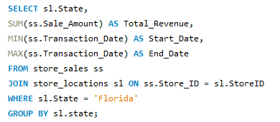
What is total revenue overall for sales in the assigned territory, plus the start date and end date that tell you what period the data covers?
Result
Query

Slide 5
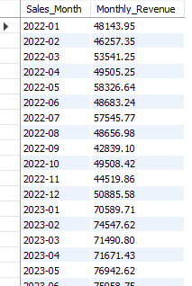
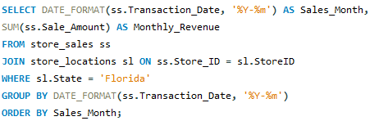
What is the month-by-month revenue breakdown for the sales territory?
Result
Query

Slide 6

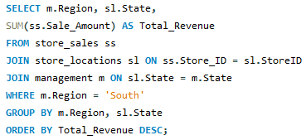
Provide a comparison of total revenue for the specific sales territory and the region it belongs to.
Result
Query

Slide 7
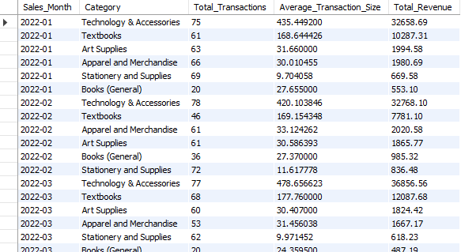
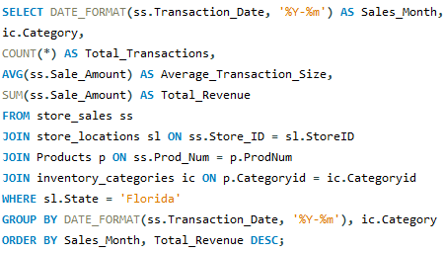
What is the number of transactions per month and average transaction size by product category for the sales territory?
Result
Query

Slide 8
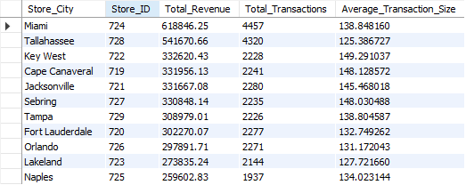
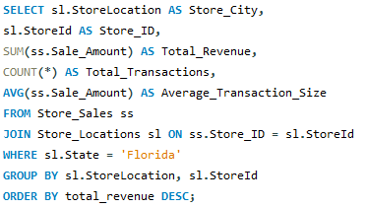
Can you provide a ranking of in-store sales performance by each store in the sales territory, or a ranking of online sales performance by state within an online sales territory?
Result
Query

Slide 9
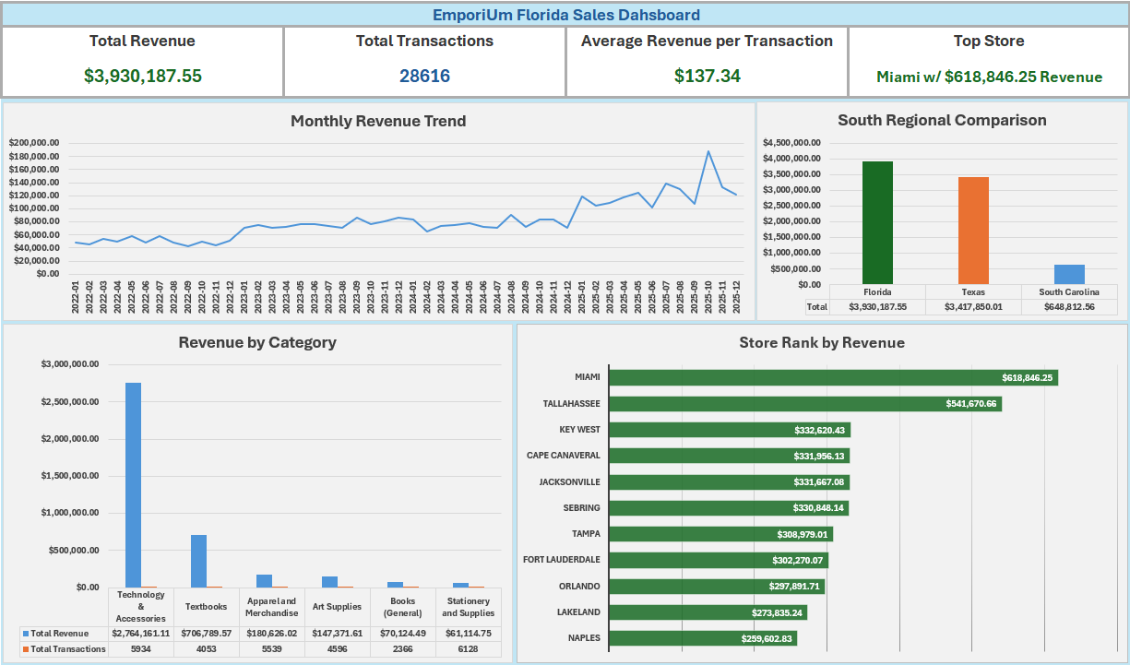

Slide 10
What is your recommendation for where to focus sales attention in the next quarter?
INSIGHTS:
Revenue is strong but inconsistent.
Growth is driven by one product category.
Store performance is concentrated among two locations.
RECOMMENDATION:
Increase transactions through targeted promotions to stabilize monthly revenue. For example, having limited time offers during low-performing months to reduce revenue fluctuations, offering bundle deals, like pairing a book with stationery, or encouraging cross-selling during checkout to help with low-performing categories.
Invest more in the top-performing category to maximize what’s already working. We can do this by making sure we are promoting it more for visibility and keeping a well-stocked inventory, especially during peak seasons.
Support lower-performing stores by applying strategies used by top-performing locations, whether it be providing more training or using the same marketing strategy as the top stores.

Slide 11
EXECUTIVE SUMMARY
The Florida territory generated approximately $3.93M in revenue, supported by strong transaction volume and led by high-performing stores and the Technology & Accessories category. Although revenue grew overall, there were ups and downs from month to month, and some stores and categories did not perform as well as others. To keep growth steady, I suggest focusing sales efforts on the best-performing stores and categories, while also working to boost transaction volume and support areas that are not doing as well.

Slide 12
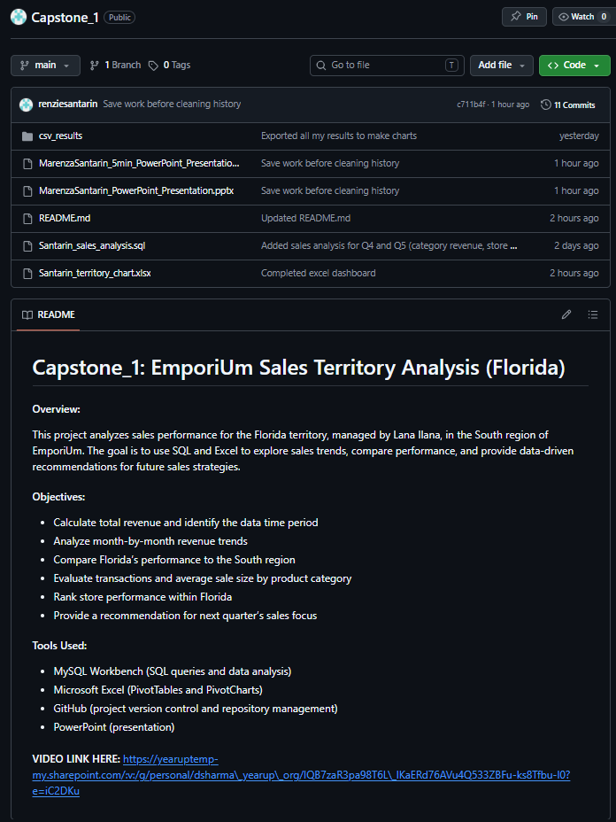
GitHub Repository
https://github.com/renziesantarin/Capstone_1

