Slide 1
EmporiUm Sales Territory Analysis
Analysis by: Marenza Santarin
Territories:
Colorado (West Region)
Manager: Jim Heck
New Jersey (Northeast Region)
Manager: Miami Vue

Slide 2
Core Marketing Questions
Which territory performed stronger over time?
Which stores and customers drove sales?
Which product categories generated the most revenue?
Where should marketing focus next quarter?
Territory | Manager | Region | Stores Analyzed
Colorado | Jim Heck | West | 18
New Jersey | Miami Vue | Northeast | 16

Slide 3
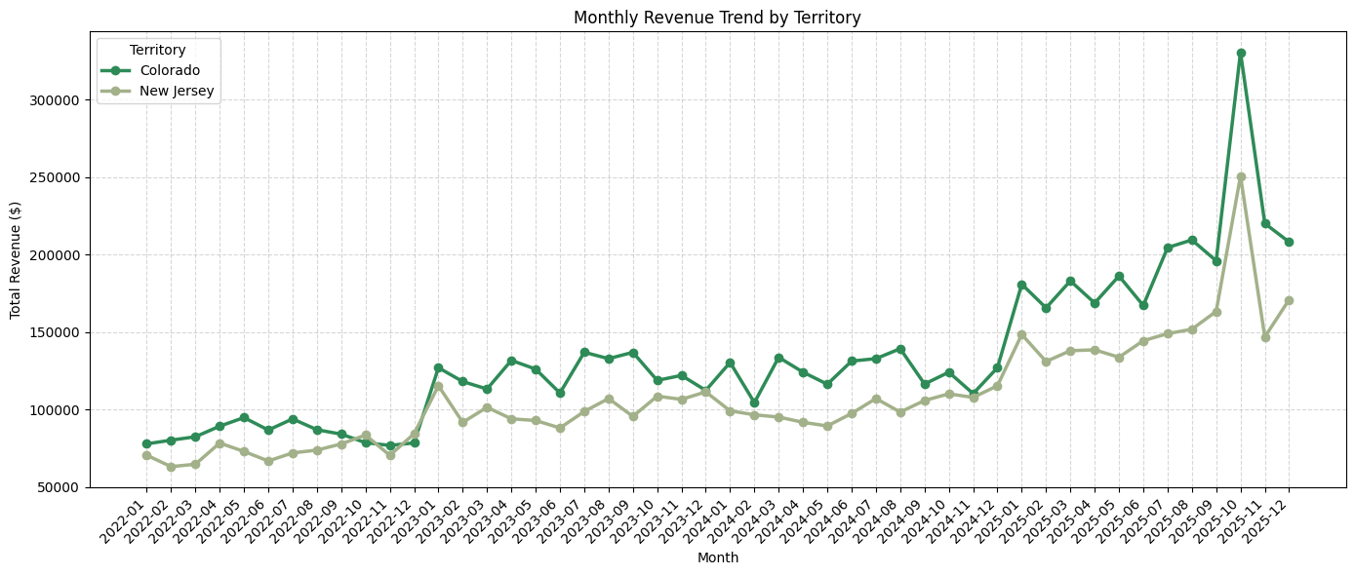
Monthly Revenue Trend
Which territory performed stronger over time?

Slide 4
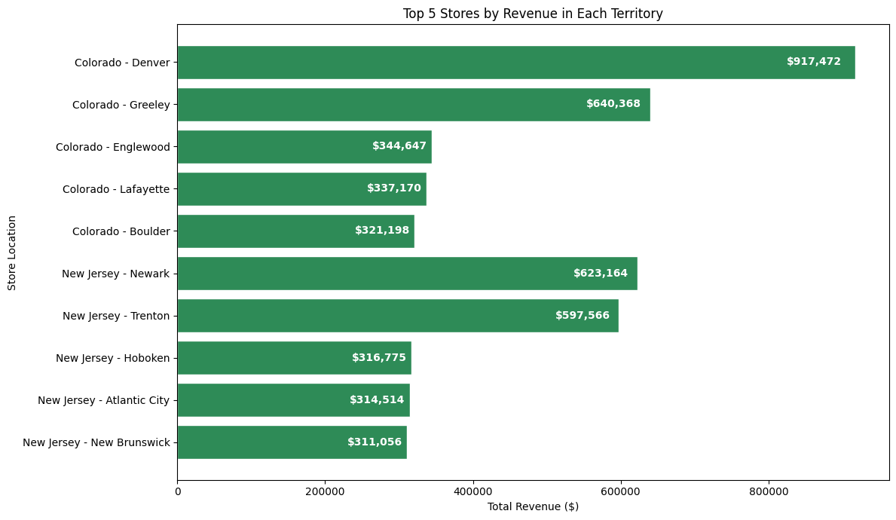
Top-performing Stores
Which stores are driving territory performance in each territory?

Slide 5
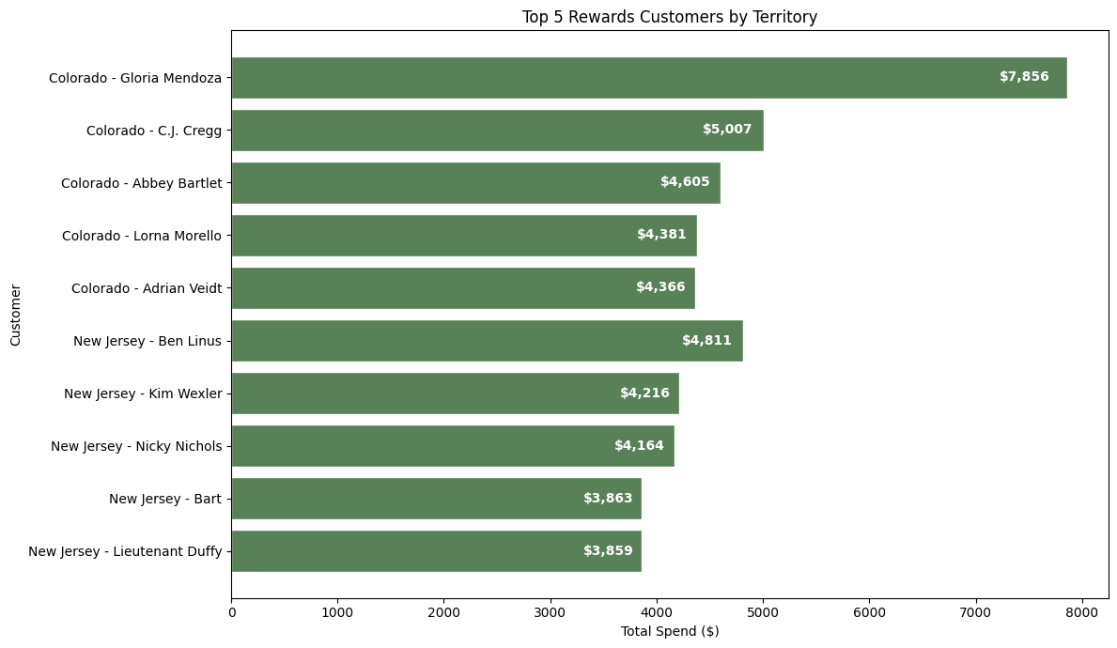
Top Customers Chart
Who are the most valuable customers?

Slide 6
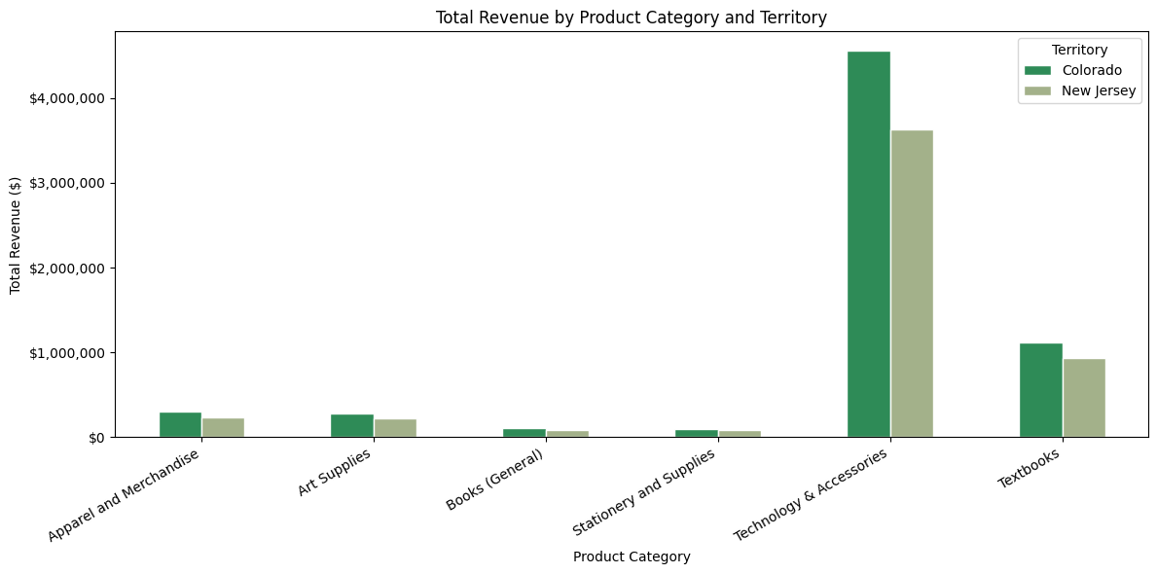
Product Category Analysis
What products are driving sales?

Slide 7
Recommendation
Focus: Technology & Accessories + Textbooks
Highest revenue and transaction volume across both territories
Colorado: Protect & Grow (Denver, Greeley)
Build an ecosystem: pair tech products with stationery, tote bags, and collectibles
Cross-sell study bundles during textbook purchase (back-to-school season)
New Jersey: Retain & Re-engage (Newark, Trenton)
Launch personalized "we miss you" emails, rewards, and loyalty discounts
Drive repeat visits through targeted promotions
Lower-Performing Categories: Test Small Promotions
Books (General), Stationery & Supplies, Apparel & Merchandise
"Buy more, save more" deals or semester bundles paired with top sellers
Overall Goal:
Maximize top-category revenue + test targeted promotions to grow New Jersey

Slide 8
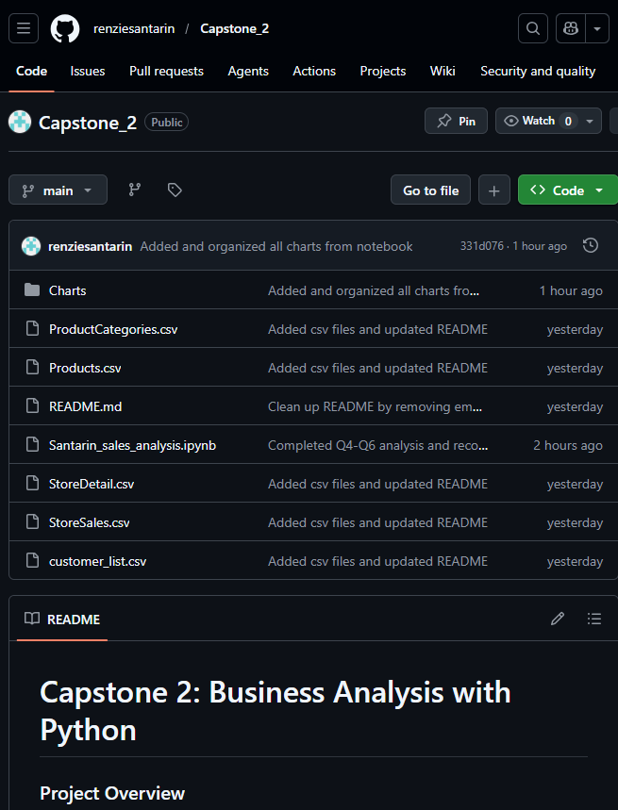
GitHub Repository
https://github.com/renziesantarin/Capstone_2

