Slide 1


Capstone 3: Emporium east region sales analysis 2022 - 2025
By: Marenza Santarin

Slide 2
Project Overview
SCOPE & TIMEFRAME
EmporiUm East Region
Physical Store Sales · 2022-2025
ANALYSIS FOCUS AREAS
Sales Trends · Category Performance
State & Store Performance · Top-Selling Books
—— Behind the Scenes ——
01
Data Sources
Raw source Excel & txt files provided
02
Load
Loaded files into Power Query
03
Data Cleaning
Cleaned & merged source files
04
Data Modeling
Star schema connecting all tables
05
DAX Measures
Sales, YoY & store metrics
06
Visuals
Built the Power BI dashboard

Slide 3


Slide 6
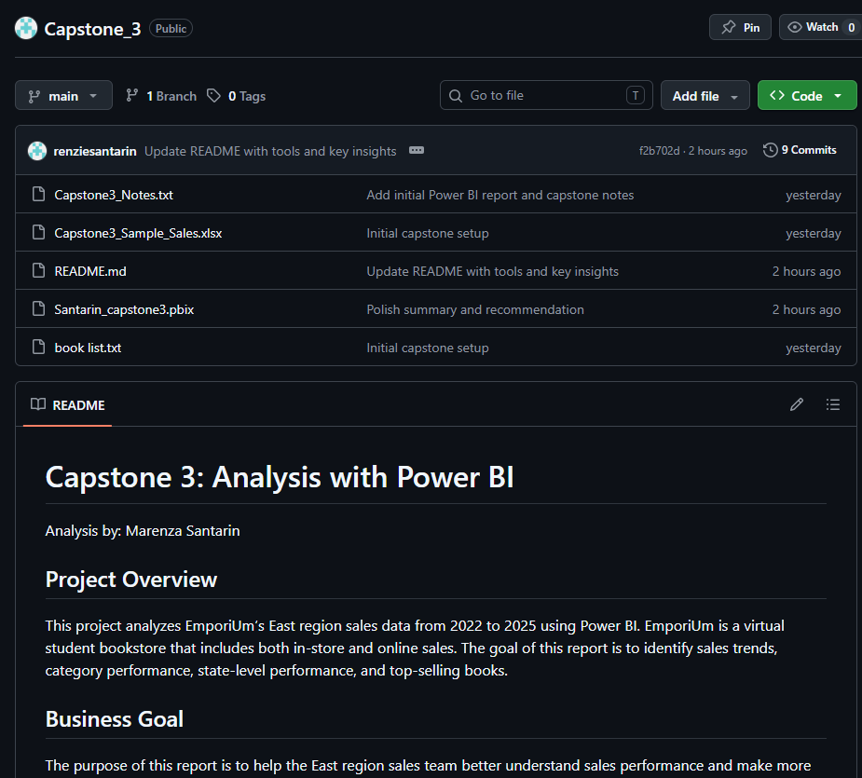
GitHub Link
https://github.com/renziesantarin/Capstone_3

