Slide 1


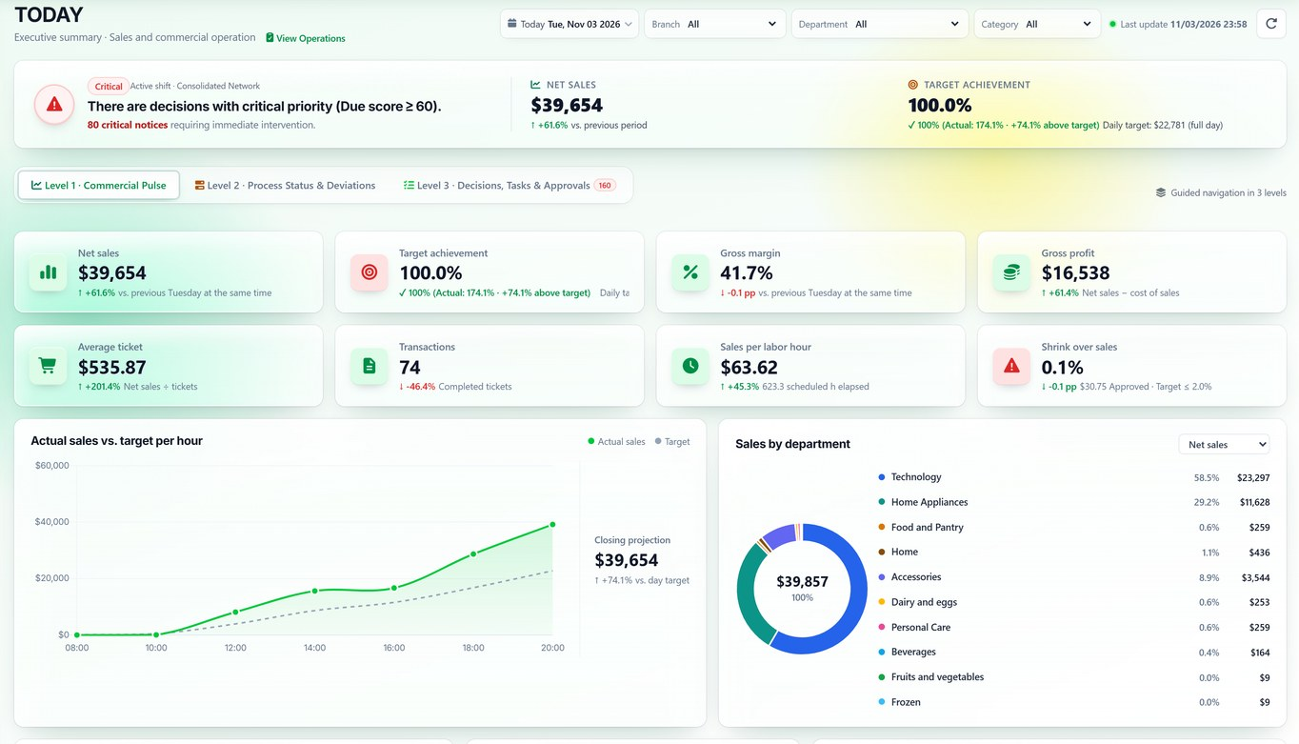
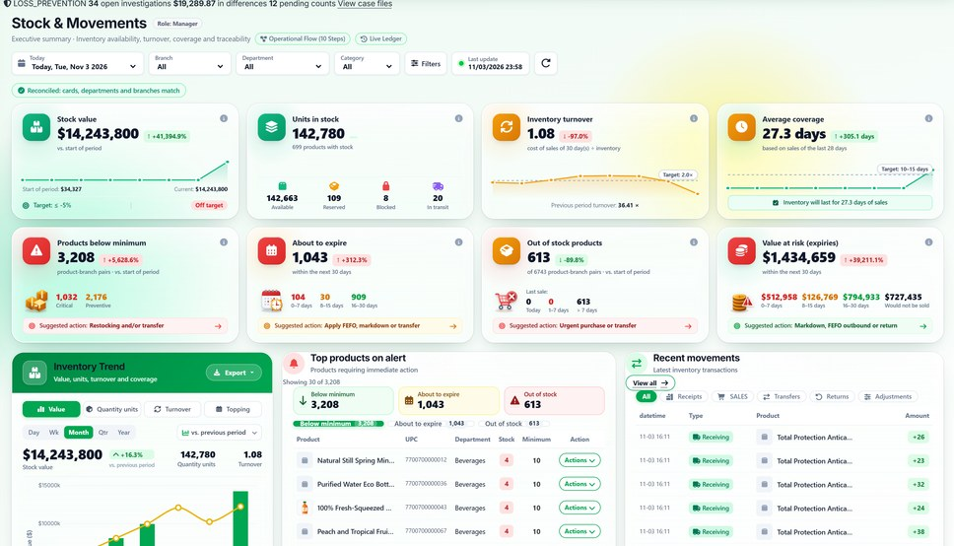
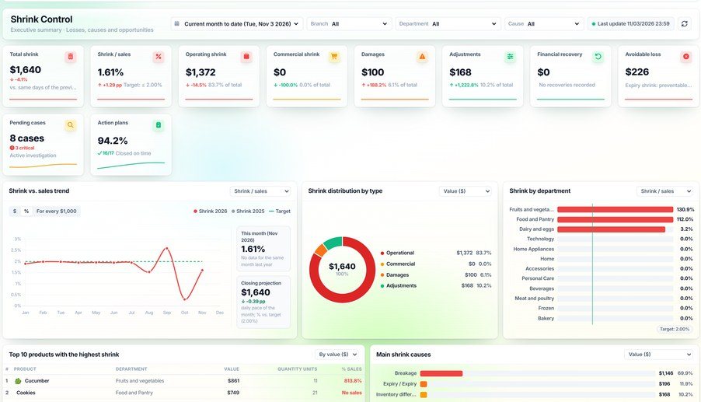
TODAY · Daily Operations
DAILY
DAILY — Operational supervision, control and management for retail
Inventory, sales, shrink, loss prevention, staff and purchasing in a single system.
Real screens · English interface · demo data
Inventory
Shrinkage & Waste
Notes:
SAY: "DAILY brings into one platform what many chains keep in spreadsheets and separate systems: inventory, sales, shrink, loss prevention, staff and purchasing." SHOW: the three screens; they are real, running a demo company with ten branches. The interface is shown in English; DAILY runs in English or Spanish per user. BENEFIT: one version of the numbers for the whole operation. COMMON QUESTION: "Is it an ERP?" → It does not replace your ERP or POS; it adds operational supervision and control, and receives data through import or API.

Slide 2








What erodes margin in a retail chain today
THE PROBLEM
Illustrative scenario
Undetected losses
Physical ≠ system
Expired products
Mismatched staffing
Found too late to act on
Stockouts, overbuying and lost sales
Waste and customer risk
Queues at peak, idle hours off-peak
Manual processes
Fragmented information
Cases with no owner
Margin lost without knowing where or why
Spreadsheets, signatures, supervision hours
Every area with its own numbers
Alerts nobody closes
Notes:
SAY: walk through the cards and ask which ones the client recognizes. SHOW: the red card sums up the consequence. BENEFIT: name the problem before talking about software. ASK THE CLIENT: "When do you find out about an inventory difference today: the same day or at month end?"

Slide 3








How DAILY connects the operation
THE SOLUTION
Available feature
Storage
Inventory
Replenishment
DAILY
One stock ledger · alerts · cases · KPIs
Receiving
Sale
Corrective actions
Reconciliation
Alerts
Notes:
SAY: "Every step of the merchandise leaves a movement in a single stock ledger. When something does not reconcile, DAILY turns it into an alert or a case with an owner." SHOW: follow the ring from Receiving to Corrective actions. BENEFIT: end-to-end traceability. COMMON QUESTION: "Do I need to change my POS?" → No. Sales can be recorded in the DAILY POS or loaded through import or API; the exact integration is validated during the assessment.

Slide 4










Ten work areas, one shared data set
THE PLATFORM
Available + in development
1. Planning & Procurement
2. Inventory & Warehousing
3. Sales & Profitability
4. Dispatches & Returns
5. Quality & Expiration
MRP, suppliers, orders
Stock, ledger, reconciliation, locations
Sales, margin, POS, orders
Dispatches, customer returns
Lots, FEFO, cold chain, recalls
Partly in development
Partly in development
6. Shrinkage & Waste
7. Loss Prevention
8. Workforce Operations
9. Reports & Analytics
10. Administration
Recording, approval, causes
Cases, mobile device control, counts
Schedules, attendance, tasks
Executive report, reports
Branches, users, access, audit
Notes:
SAY: "This is the real DAILY menu, grouped the way a chain works: plan and buy, receive and store, sell, dispatch, protect quality, control shrink, prevent loss, organize staff, report and administer." SHOW: the ten areas; the yellow tag marks the parts still in development. BENEFIT: the client sees the full scope before the detail. CLARIFY: what is available, in development and proposed is on the feature status slide.

Slide 5
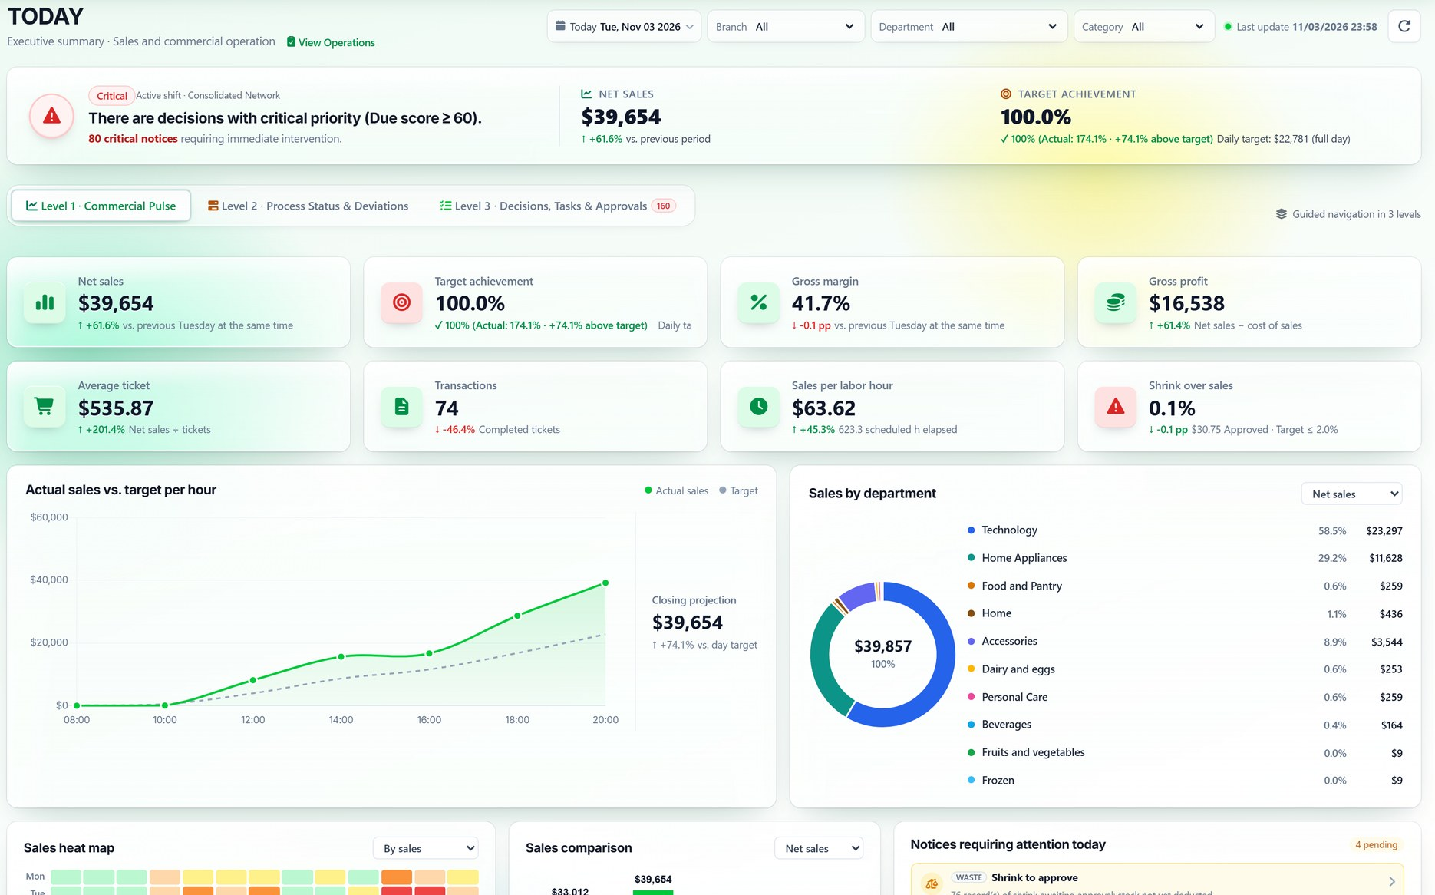
TODAY: how the operation is doing, hour by hour
EXECUTIVE VIEW OF THE DAY
Available feature
1
Critical decisions
1
What needs intervention this shift.
2
2
KPIs
Sales, target, margin, ticket and shrink.
3
3
Actual vs. target by hour
With a projected close for the day.
4
Actionable notices
Shrink to approve, alerts and overdue tasks.
4
Notes:
SAY: "A manager opens TODAY and sees sales, target attainment, margin, average ticket and shrink as a share of sales, with the actual curve against the hourly target and the notices that need attention." SHOW: (1) critical decisions for the shift; (2) KPIs against the previous period; (3) actual sales vs. target; (4) notices with direct access. BENEFIT: decide during the day, not at close. CLARIFY: the monthly Executive Dashboard is being redesigned; for the demo we use TODAY and the Executive Loss Report, which read recorded data.

Slide 6





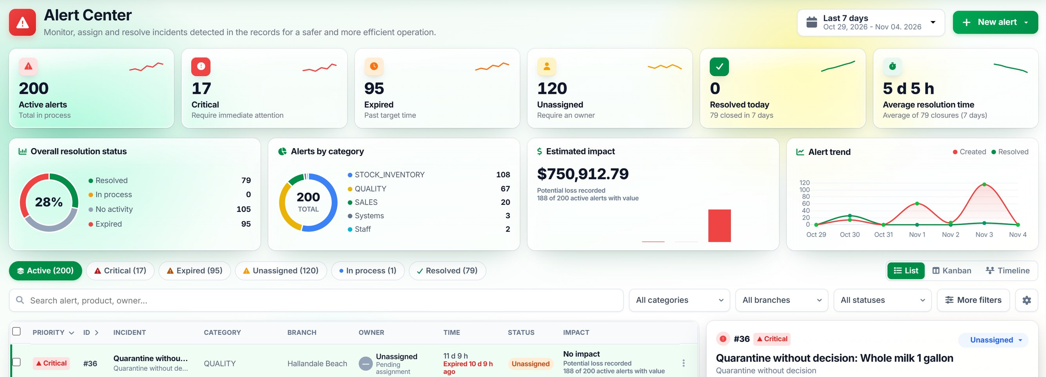
Every deviation with an owner, a deadline and an impact
ALERT CENTER
Available feature
Detection
Assignment
Investigation
Validation
Closure
Notes:
SAY: "Each alert has a severity, an owner, a time limit and an estimated impact. The right panel shows progress: detected, assigned, investigation, validation and closure." SHOW: the summary at the top, the list and the panel of the selected alert. BENEFIT: nothing is left without an owner and delays are visible. COMMON QUESTION: "Who receives the alerts?" → They are assigned to an owner and also appear in the mobile web app.

Slide 7
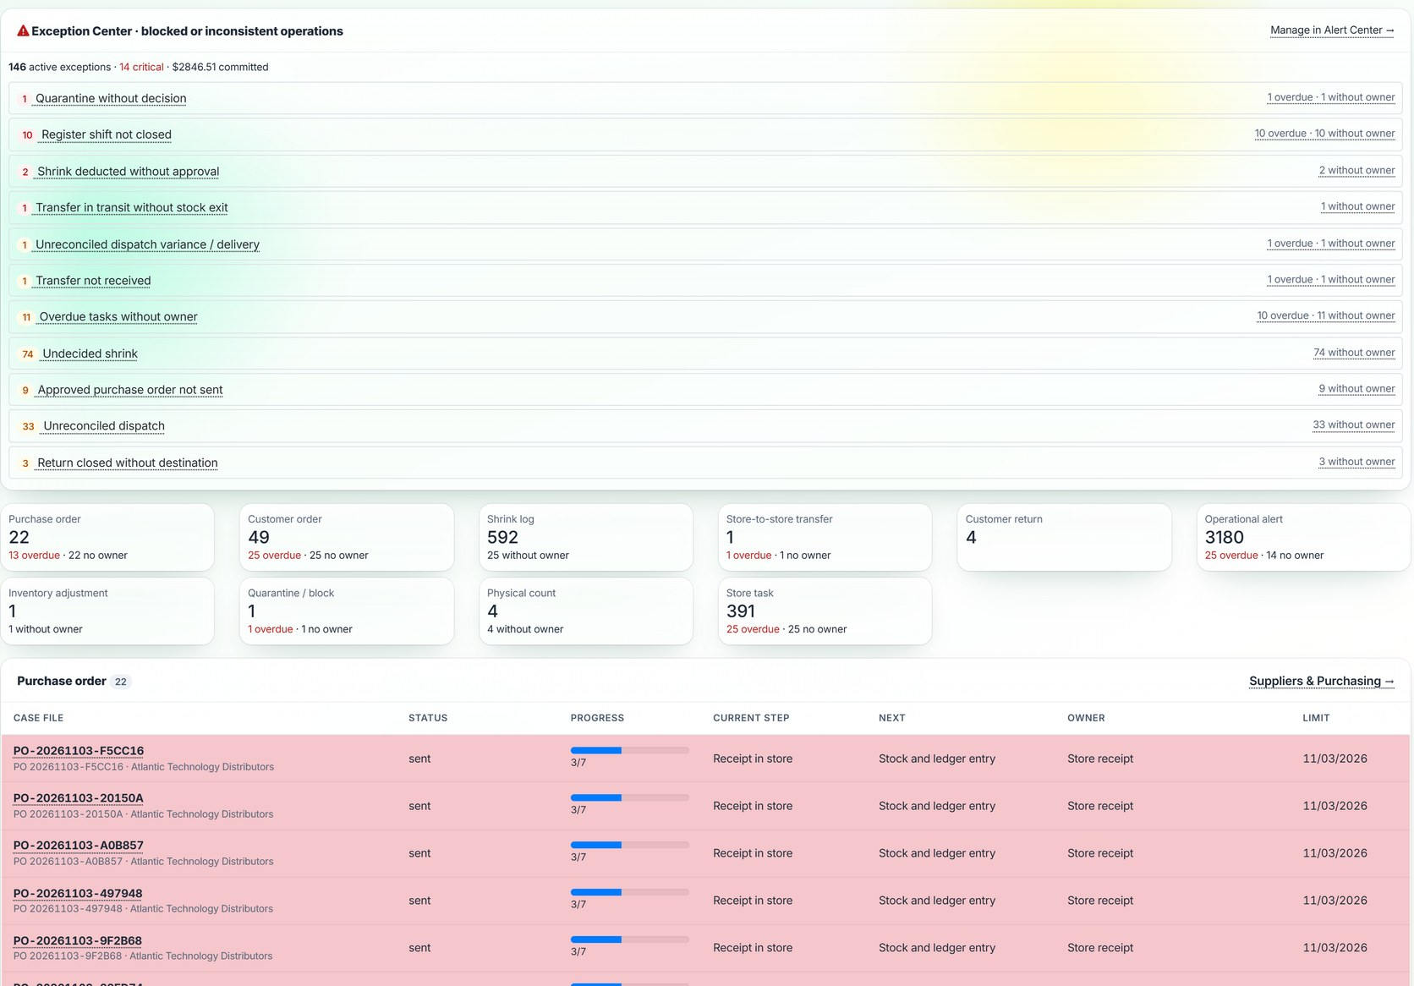
Every open document: which step it is in and who has it
CASES AND PROCESSES
Available feature
1
Exception Center
Blocked or inconsistent operations, with value at stake.
2
Ten case types
Purchase, order, shrink, transfer, return, adjustment, count, task and more.
3
Step, owner and deadline
Overdue items are flagged in red.
Progress comes from the real state of each document.
Notes:
SAY: "DAILY tracks every operational document —purchase order, customer order, shrink, transfer, return, adjustment, count, task— and shows its current step, the next one, the owner and the due date. At the top, the Exception Center groups what got blocked or inconsistent: a cash shift left open, shrink deducted without approval, a transfer never received." SHOW: the exceptions and the counters by case type. BENEFIT: processes stop depending on people's memory. CLARIFY: progress is derived from the real state of each document; it is not a manual log.

Slide 8
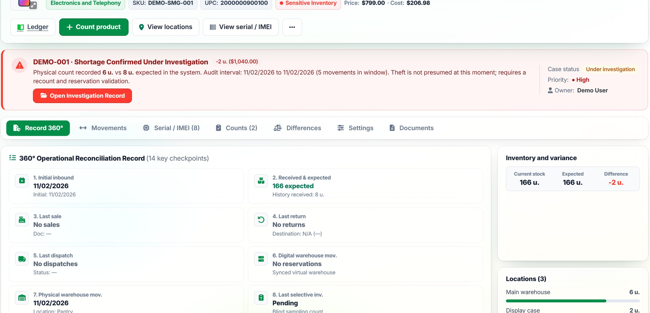
8 phones expected; the count found 6
CASE 1 · HIGH-VALUE PRODUCT
Available feature
1. Detect
2. Review
3. Investigate
4. Resolve
8
Real screen · EN interface · demo data
expected
6
counted
−2
difference
$1,040
value at risk
Notes:
SAY: "Let's follow a case from start to finish. The system expects 8 units of a high-value phone in the store; the physical count records 6. When the count is saved, DAILY calculates the difference and its value and opens case DEMO-001." SHOW: the red notice on the product record: difference, value, audit interval, priority and owner. BENEFIT: the difference appears when counting, not at close. CLARIFY: demo case on fictitious data, executed with the real logic. The difference appears when the count is recorded; it is not automatic real-time tracking.

Slide 9
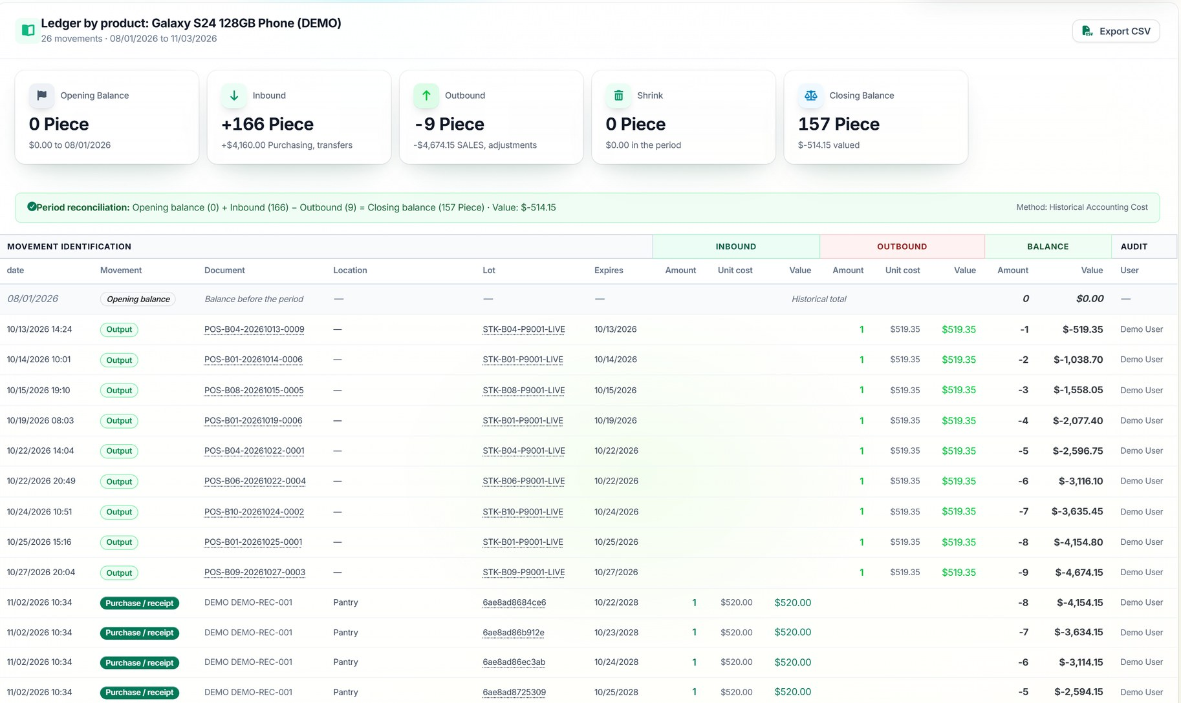
Every product movement, with document and user
CASE 1 · HIGH-VALUE PRODUCT
Available feature
1. Detect
2. Review
3. Investigate
4. Resolve
1
Valuated Inventory Ledger
Inflows, outflows and balance, at cost.
2
Source document
POS ticket, receipt or adjustment: one click.
3
Findings
Possible duplicates, shrink with no case, off-hours.
4
Sealed history
Integrity verification on demand.
Notes:
SAY: "The owner does not search through spreadsheets: they open the product ledger. They see receipts, POS sales, transfers and adjustments, with date, document, lot, user and valued balance, plus the reconciliation for the period." SHOW: the period summary and the ledger lines. BENEFIT: the investigation starts from recorded movements. COMMON QUESTION: "Can movements be altered?" → The history is sealed and its integrity can be verified on demand.

Slide 10
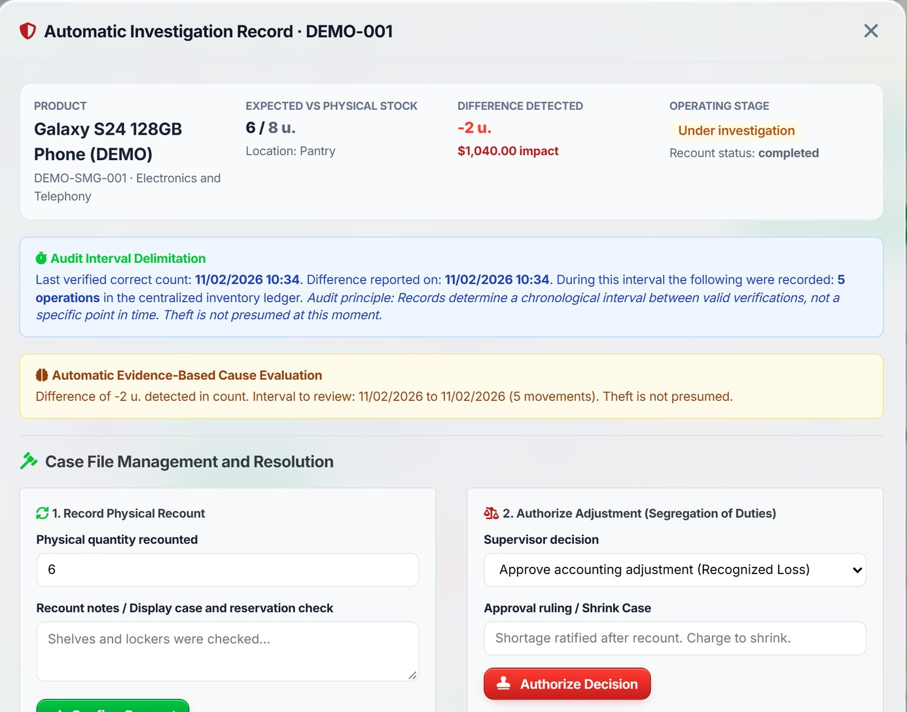
Investigation record: interval, causes and recount
CASE 1 · HIGH-VALUE PRODUCT
Available feature
1. Detect
2. Review
3. Investigate
4. Resolve
1
Audited interval
From the last verified count to the current one, with the movements in that window.
2
Evidence-based evaluation
Cause hypotheses; it does not presume theft.
3
Independent recount
Confirms or rules out the difference.
4
Separate authorization
A different supervisor approves the adjustment.
Notes:
SAY: "The record bounds the audited interval between the last correct count and the current one, counts the movements in that window and evaluates causes against the evidence. It does not presume theft. It asks for an independent recount and, if confirmed, a different supervisor authorizes the adjustment." SHOW: the interval, the cause evaluation and the two resolution blocks. BENEFIT: documented causes instead of assumptions, with segregation of duties. CLARIFY: DAILY guides the investigation; a person decides the cause and the adjustment.

Slide 11
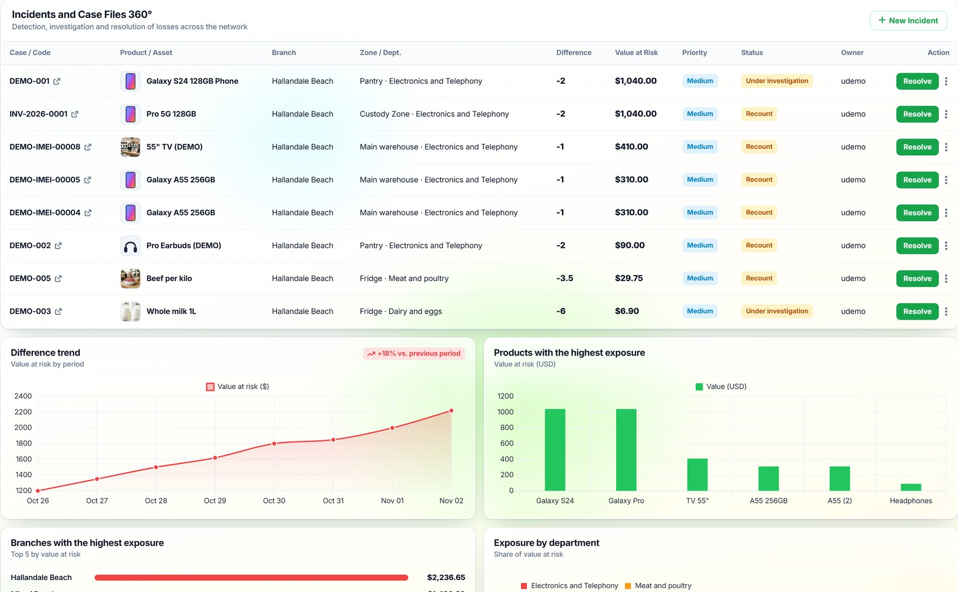
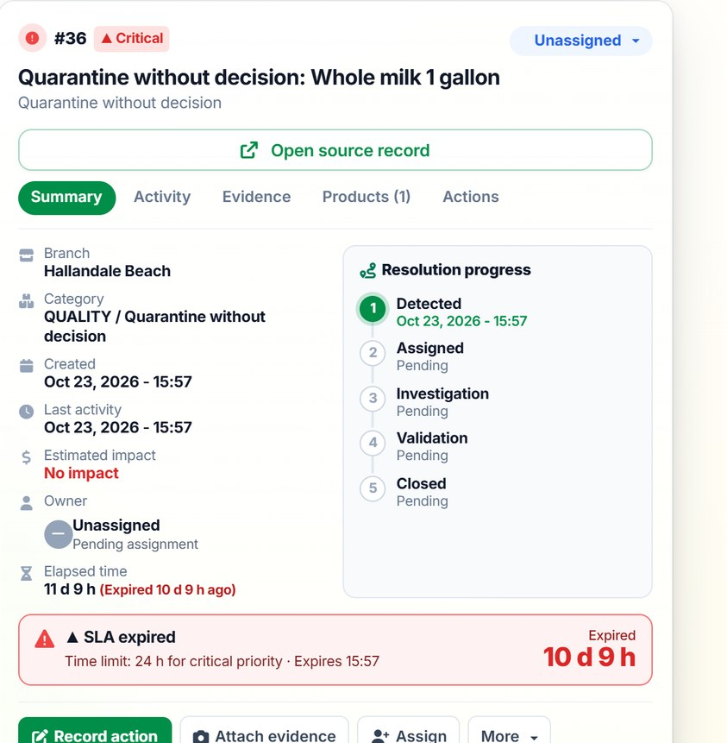
The case stays in a file until it is closed
CASE 1 · HIGH-VALUE PRODUCT
Available feature
1. Detect
2. Review
3. Investigate
4. Resolve
Progress of each alert
Detected → assigned → investigation → validation → closed.
Notes:
SAY: "The case enters the Loss Prevention Center along with the others: product, store, zone, difference, value at risk, priority, status and owner. It can be resolved, sent to recount or escalated, and every step is kept in the case history." SHOW: the incidents and cases table; on the right, the progress of an alert. BENEFIT: nobody adjusts inventory without leaving a trail. CLARIFY: the header KPIs of the Loss Prevention Center still show sample values; the cases table does read the recorded cases.

Slide 12




From count to closure: six steps, four modules
CASE 1 · SUMMARY
Available feature
1
2
3
4
5
6
Physical count
Difference & value
Movements
Investigation
Authorization
Closure
Physical Inventory Counts
Inventory Reconciliation
Inventory Ledger
Case record
Different supervisor
Loss Prevention
DEMO-001
−2 u. · $1,040
2 controls
case file
difference and value
recount and approval before adjusting
Notes:
SAY: "In short: the count detects, reconciliation calculates, the ledger explains, the record investigates, the supervisor authorizes and the case closes. Four modules working on the same data." SHOW: the sequence and the module involved in each step. BENEFIT: a repeatable, auditable process for every difference. ASK THE CLIENT: "How many steps of this process do you do outside the system today?"

Slide 13
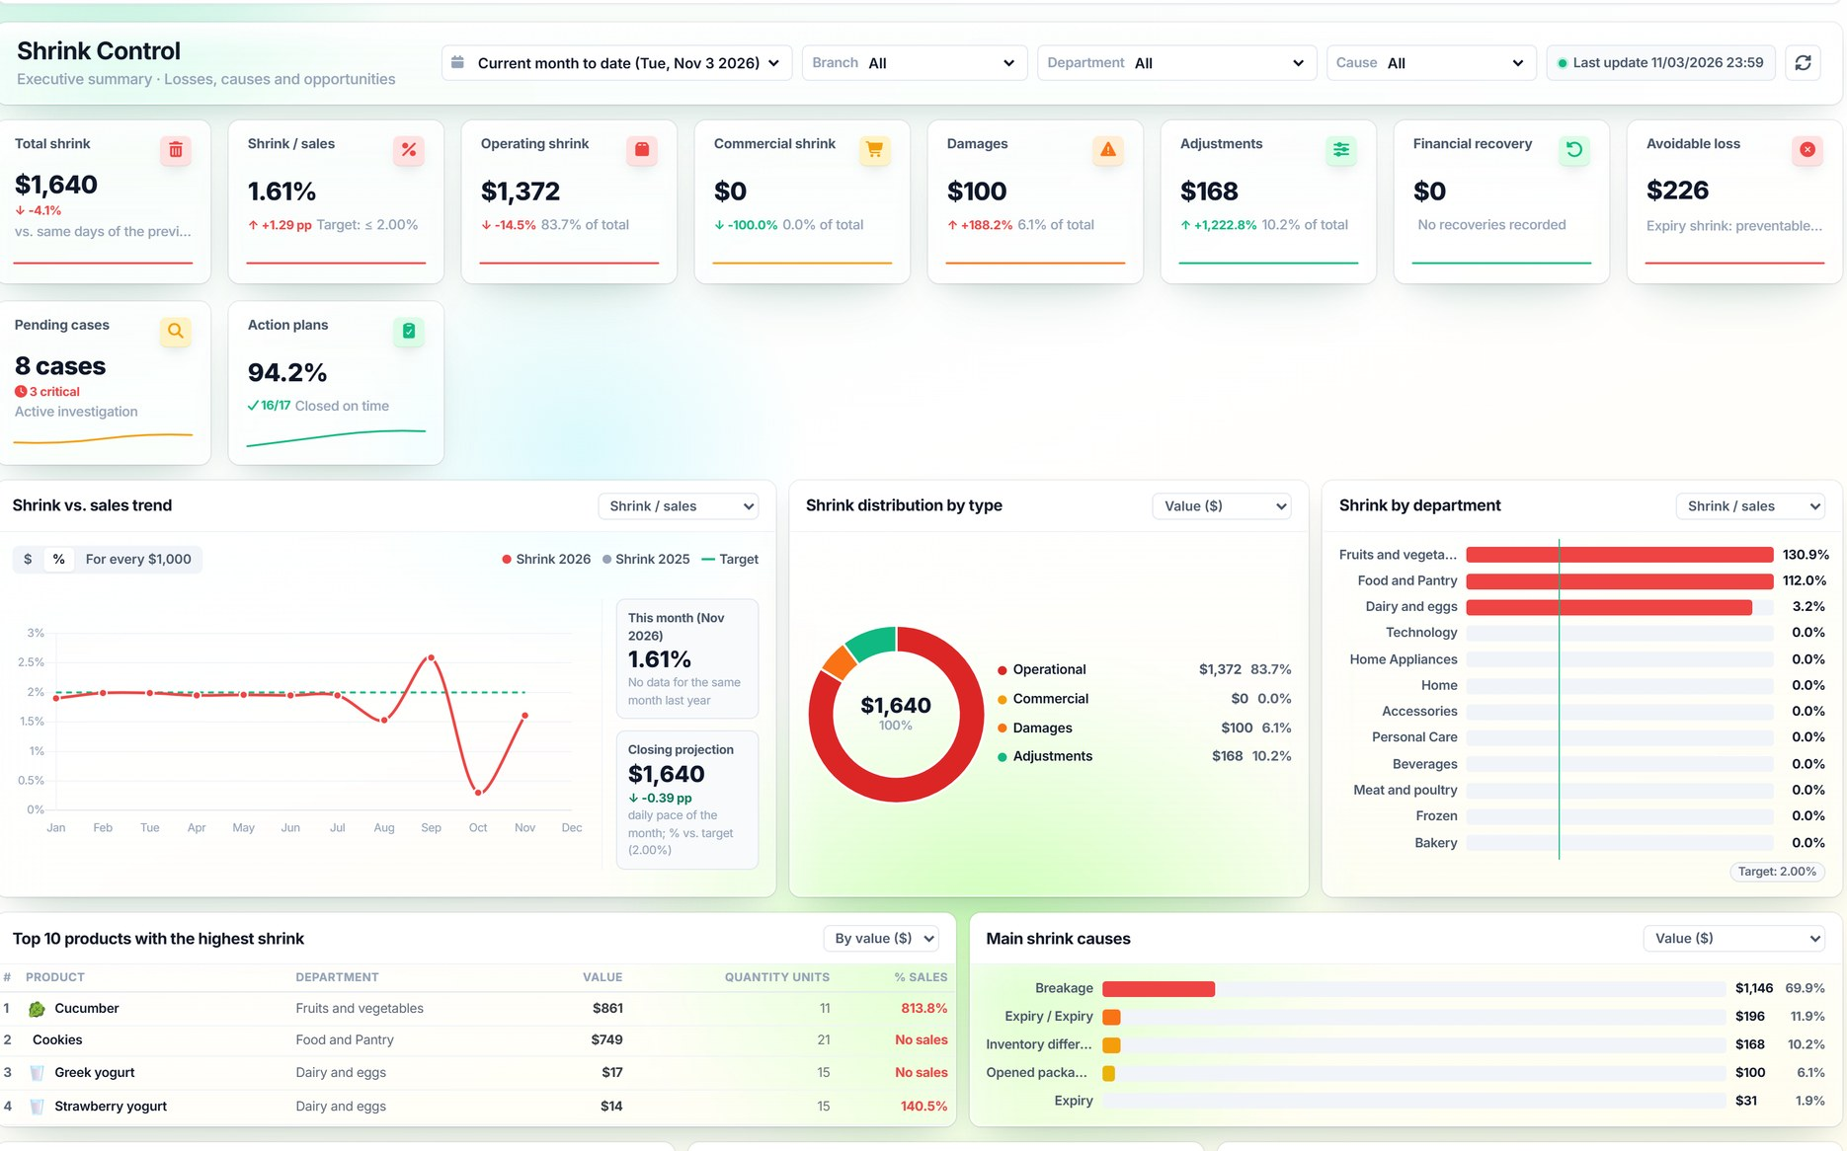
How much is lost, where and why
SHRINKAGE & WASTE
Available feature
1
Shrink vs. target
Total, as % of sales and avoidable.
2
By type and area
Operational, commercial, damage, adjustments.
3
Products and causes
Top 10 and main causes.
4
By branch
Trend against the previous period.
Notes:
SAY: "The Shrinkage & Waste control board shows total shrink and shrink as a share of sales against target, by type, department, product and cause, plus the trend by branch." SHOW: KPIs, evolution against target, breakdown by type and by department. BENEFIT: attack the causes that cost the most. COMMON QUESTION: "Who approves shrink?" → Someone other than the person who records it; until then, stock is not deducted.

Slide 14
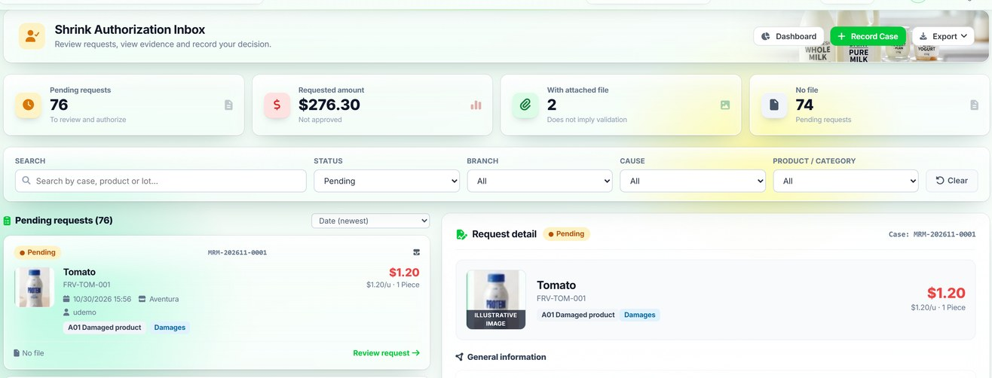
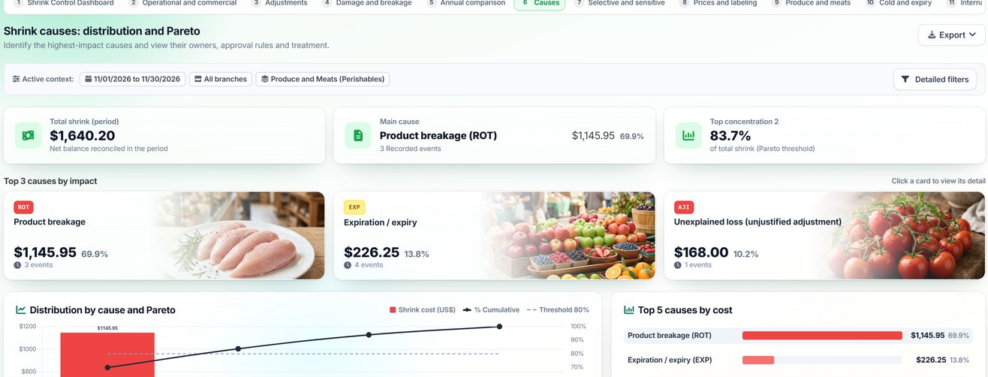
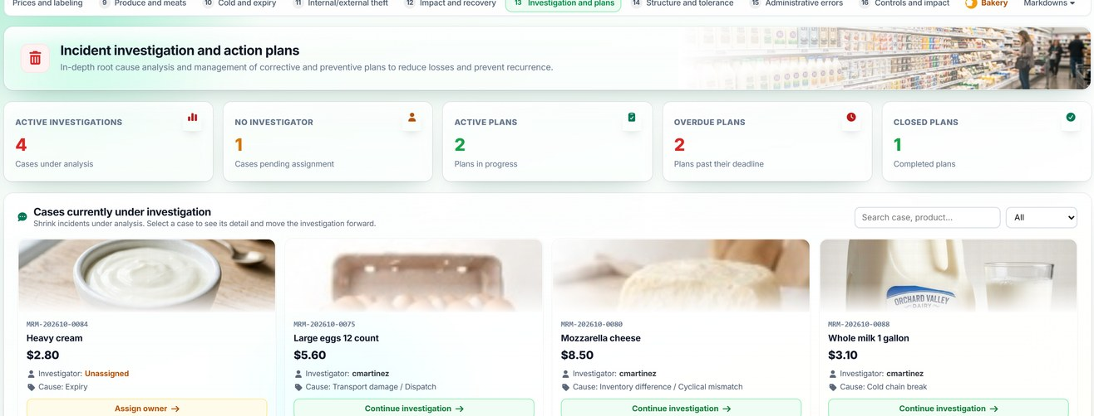
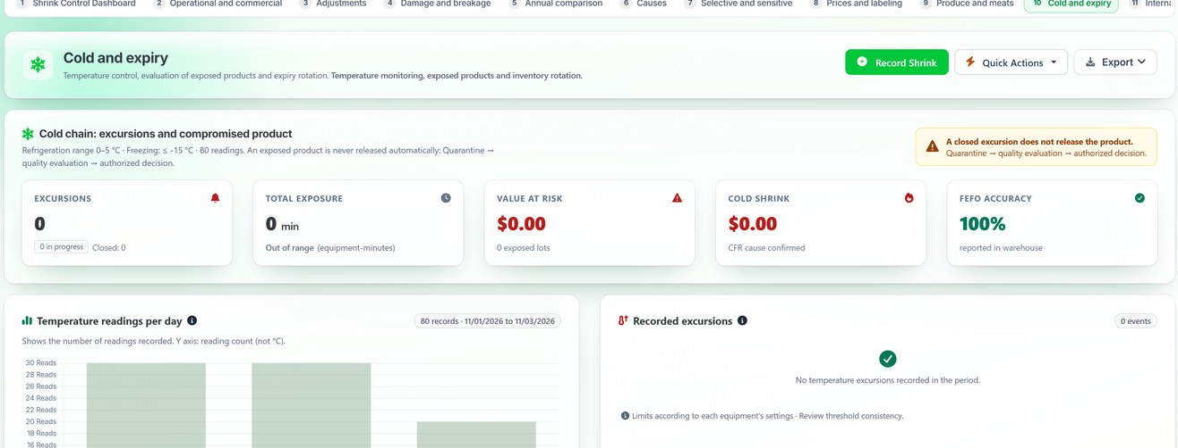
Approval, causes, investigation and prevention
SHRINKAGE & WASTE
Available feature
Approvals
Causes and Pareto
Investigations and action plans
Expiry prevention (FEFO)
Notes:
SAY: "Around the board there are four tools: the approvals inbox, the cause matrix with Pareto, investigations with action plans and expiry prevention with FEFO." SHOW: the four screens. BENEFIT: shrink records turn into decisions. ASK THE CLIENT: "Who approves shrink today, and how long does it take?"

Slide 15
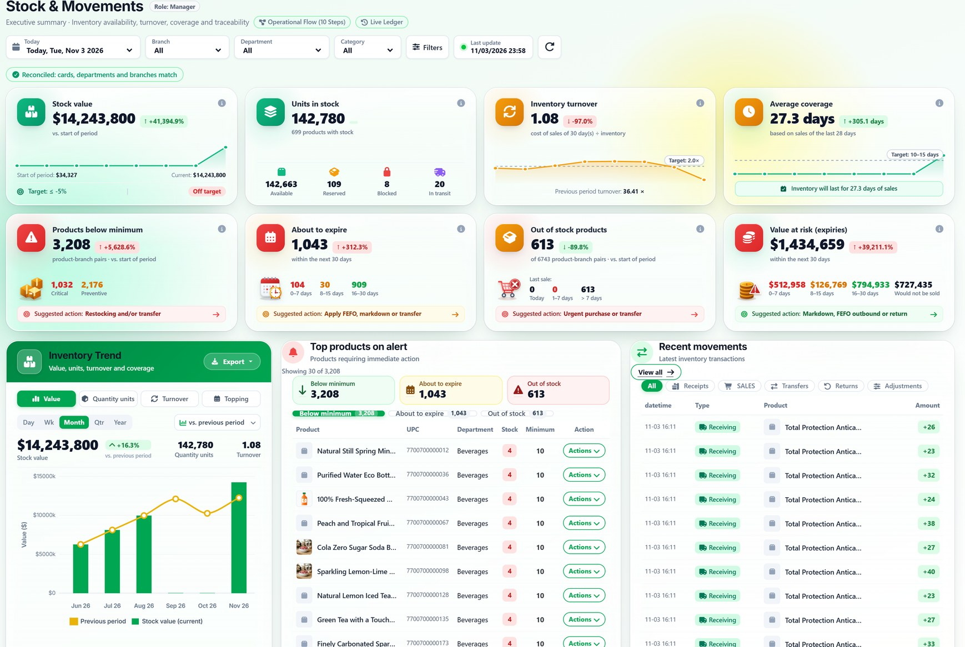
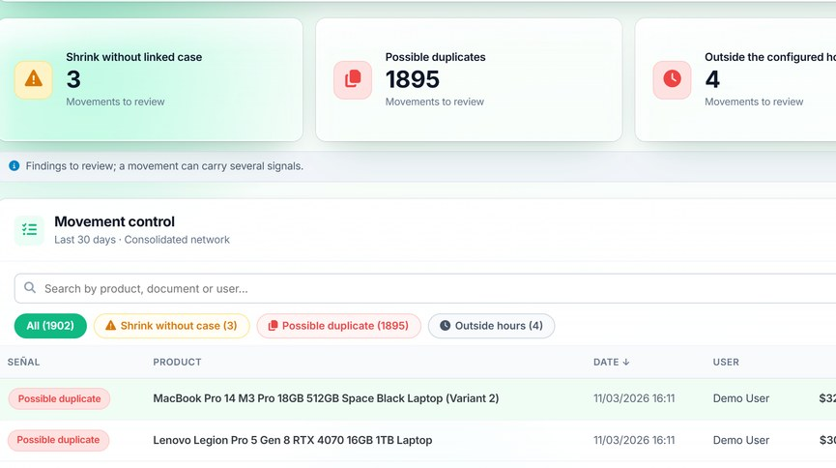
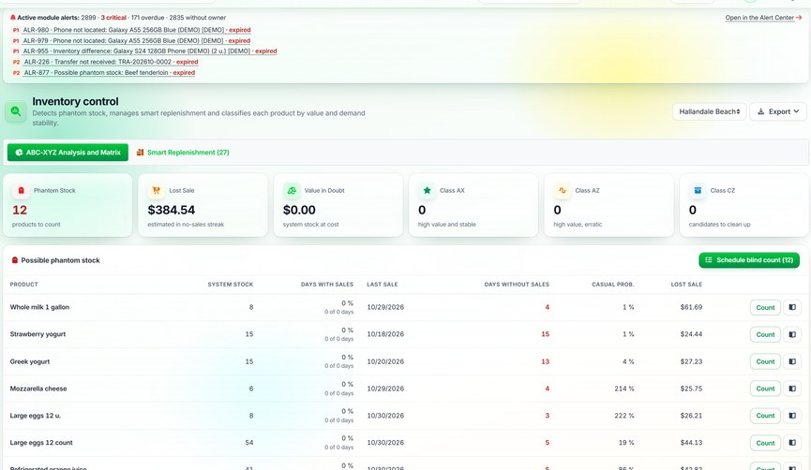
What is on hand, what it is worth and what is at risk
INVENTORY & WAREHOUSING
Available feature
Valuated Inventory Ledger
Inventory control
Notes:
SAY: "Stock & Movements shows value, units, turnover and coverage; below, items under minimum, close to expiry, out of stock and value at risk, each with a suggested action." SHOW: the risk cards and recent movements. BENEFIT: the inventory owner prioritizes with data. COMMON QUESTION: "Can I see it by branch?" → Yes, with filters by branch, department and category.

Slide 16
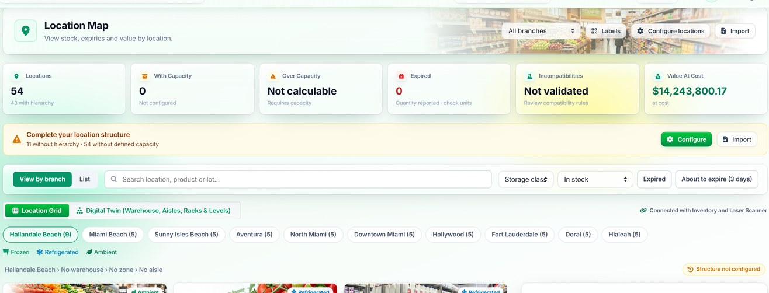
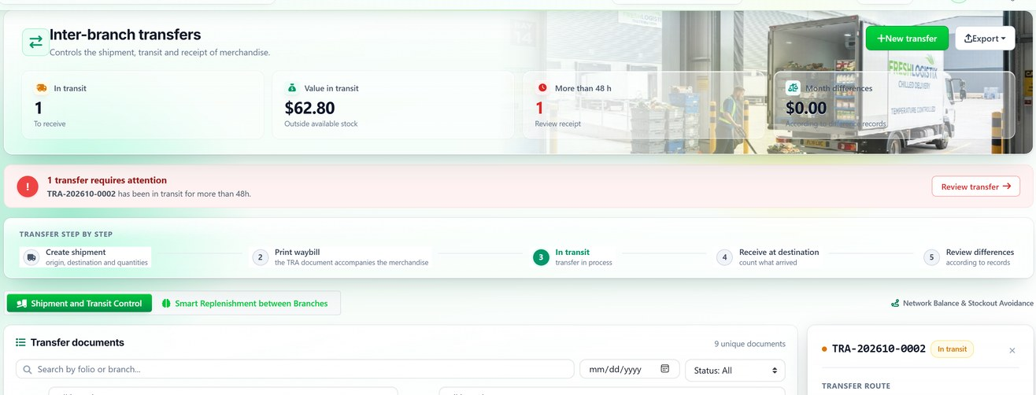
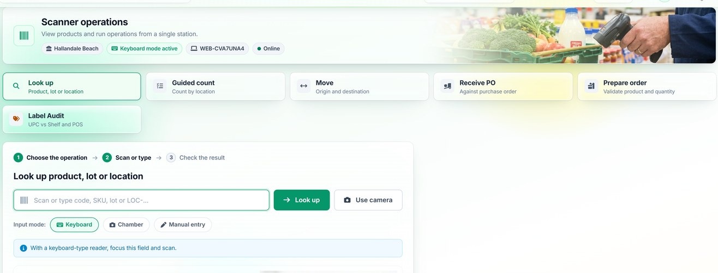
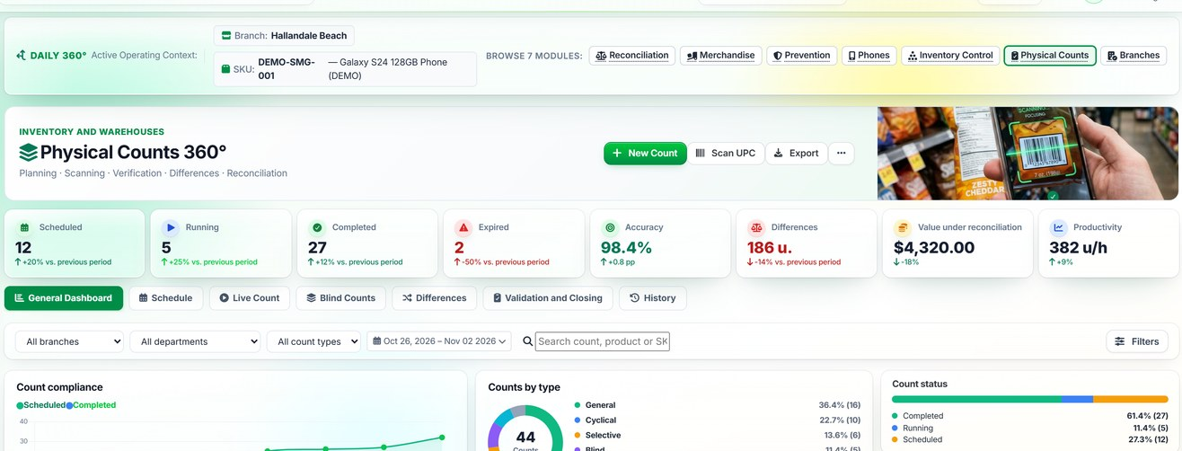
Locations, transfers, counts and scanning
WAREHOUSING
Available feature
Location map
Store-to-store transfers
Scanner operations
Physical Inventory Counts
Notes:
SAY: "The warehouse is run by location: zone map, store-to-store transfers with verification, physical counts and scanner operations." SHOW: the four tools. BENEFIT: every movement is tied to a location and an owner. COMMON QUESTION: "Which scanners does it support?" → Phone camera and keyboard-mode scanners; the exact model is validated in the pilot.

Slide 17
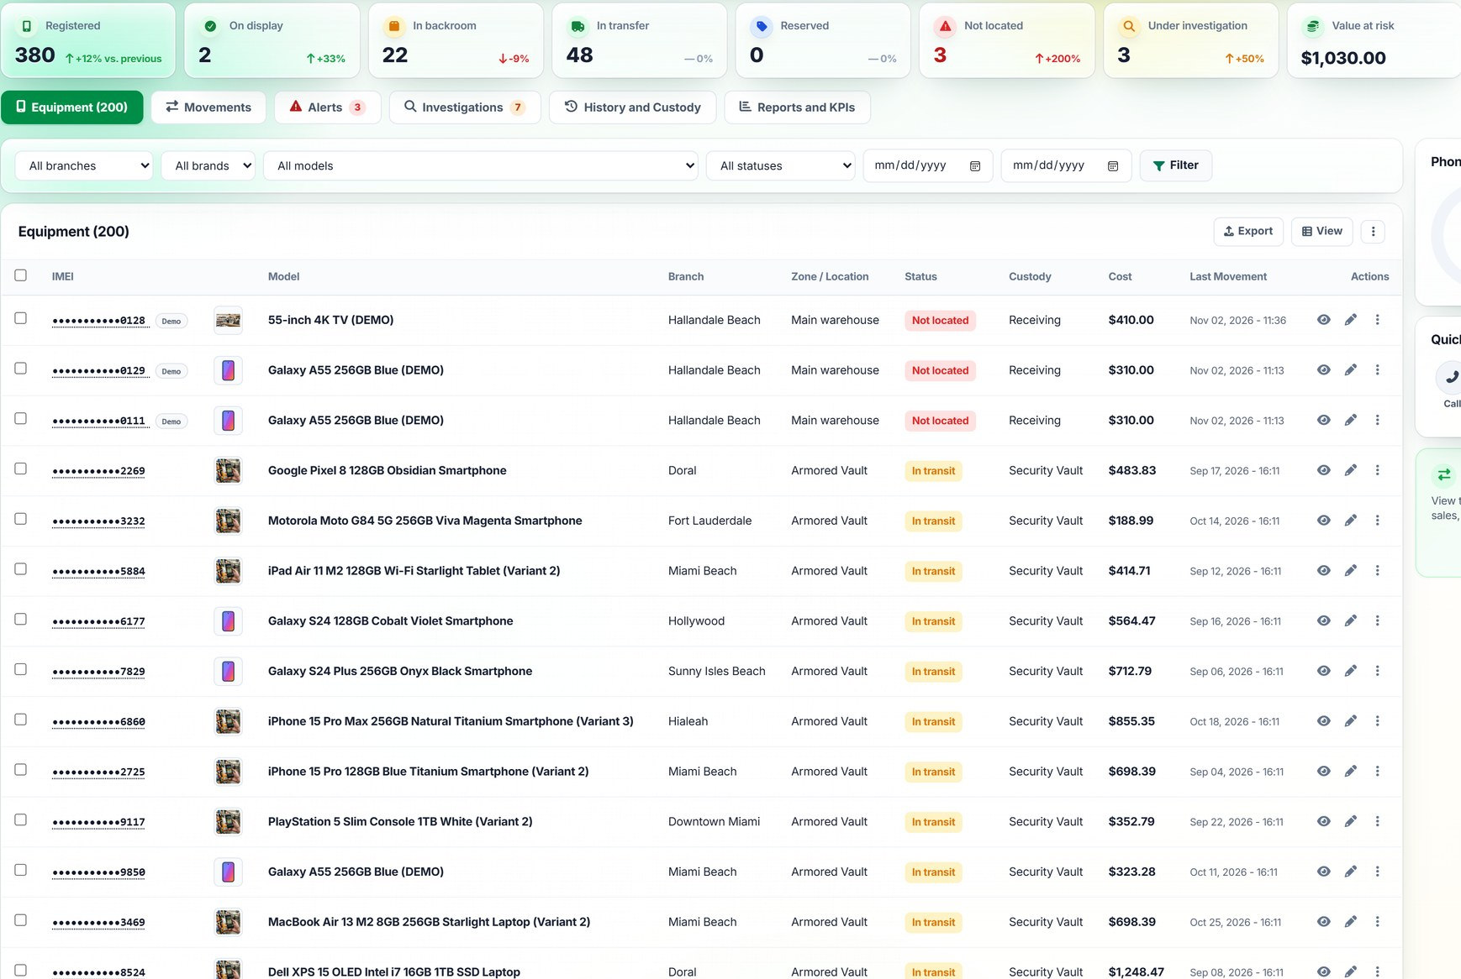
High-value products, controlled unit by unit
LOSS PREVENTION · MOBILE DEVICE CONTROL
Available + in development
1
Custody by IMEI
Location, status and owner of each device.
2
Not located
Flagged and sent to investigation.
3
Sensitive counts
Tasks with due dates; overdue ones in view.
4
Evidence in the case
Notes, photos and CCTV references.
In development: header KPIs of the Loss Prevention Center.
Notes:
SAY: "For phones and other high-value products, DAILY tracks each unit by IMEI or serial number: where it is, its status and who holds it. Units not located open an investigation. It also schedules sensitive counts with due dates and recounts." SHOW: the device statuses and the table with custody and last movement. BENEFIT: unit-level control where a single loss is costly. CLARIFY: cases accept CCTV references as evidence, but there is no camera integration. Some header KPIs of the Loss Prevention Center still show sample values.

Slide 18
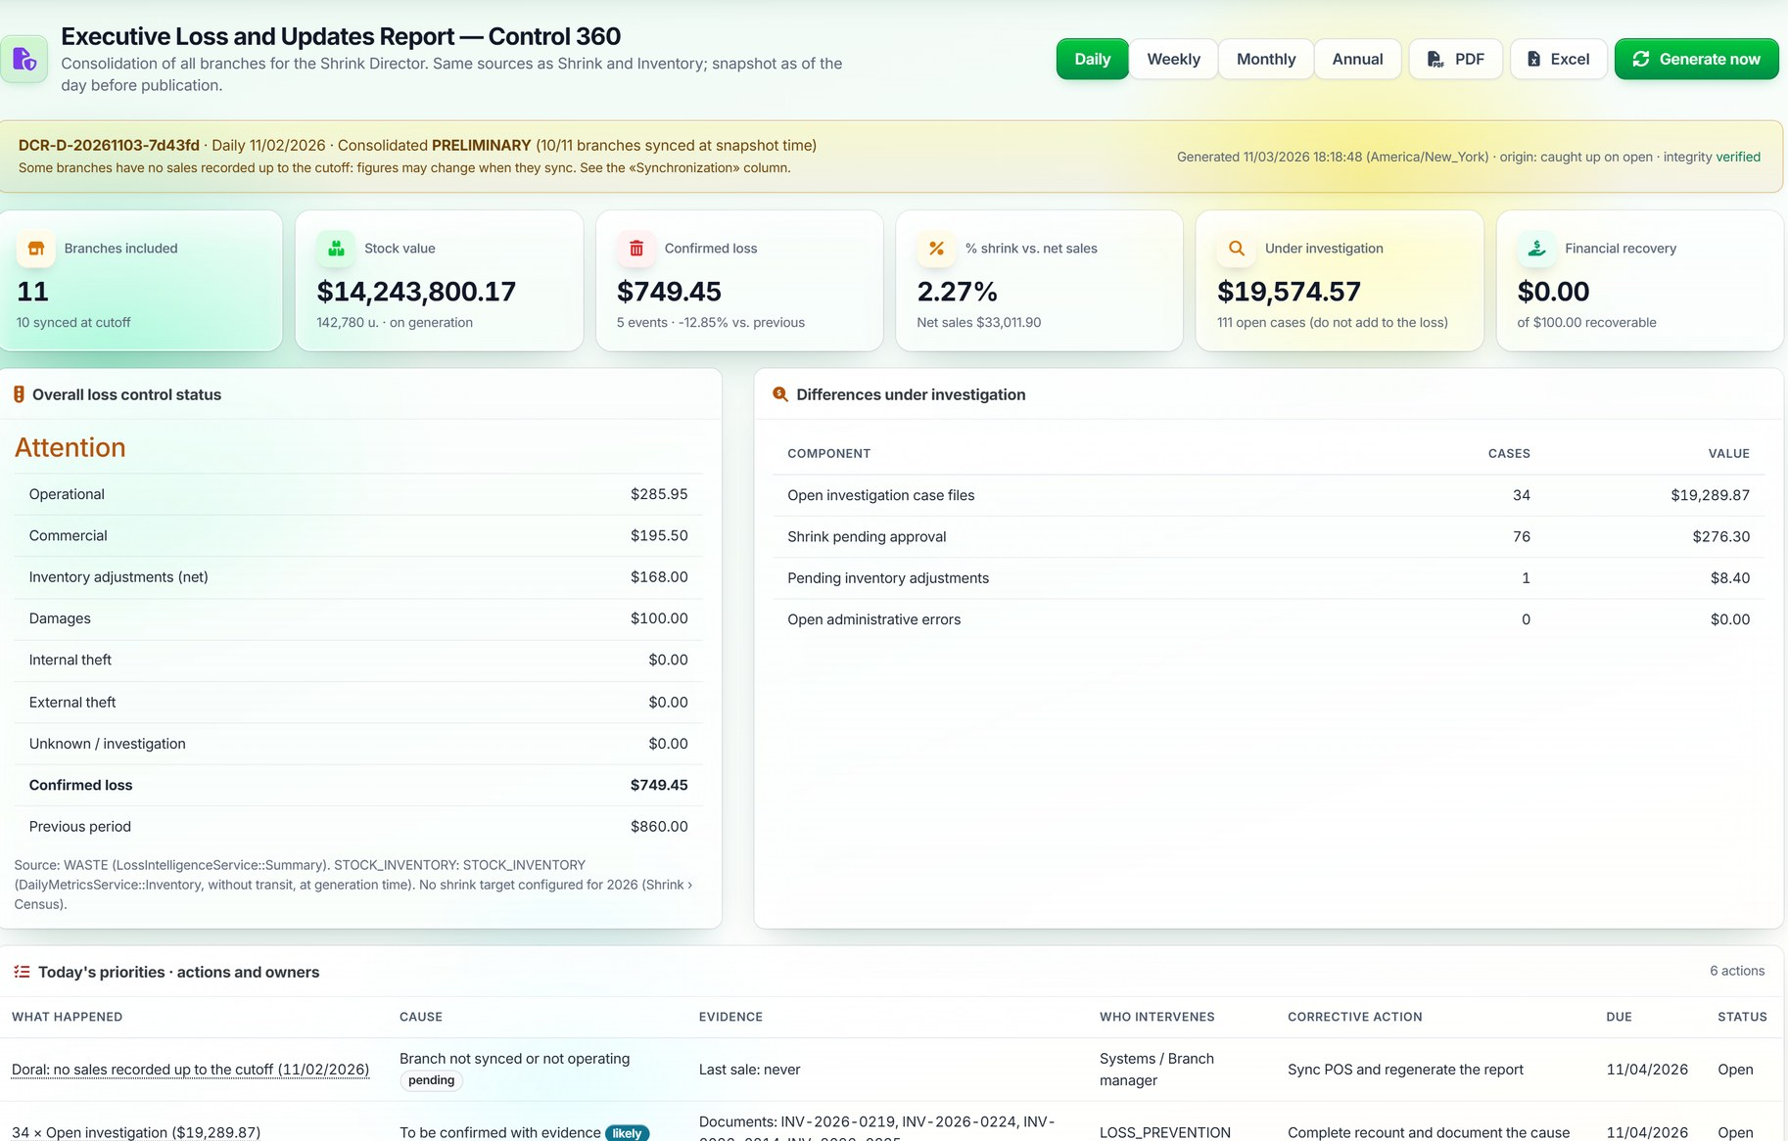
Executive Loss Report: a daily snapshot for leadership
REPORTS
Available feature
1
Traceable snapshot
States source, time and synced stores.
2
Loss by component
Operational, commercial, adjustments, theft.
3
Priorities of the day
What happened, cause, evidence and owner.
Daily · weekly · monthly · yearly · PDF and Excel
Notes:
SAY: "Every day a consolidated loss report is produced from the same sources as Shrink and Inventory: confirmed loss, shrink as a share of sales, differences under investigation, priorities with owners and branch comparison. It states whether the cut is preliminary and which stores did not sync." SHOW: the KPIs, the priorities table and the sync status. BENEFIT: leadership gets the same number the operation sees. COMMON QUESTION: "Can it be exported?" → Yes, as PDF and Excel; daily, weekly, monthly or yearly.

Slide 19
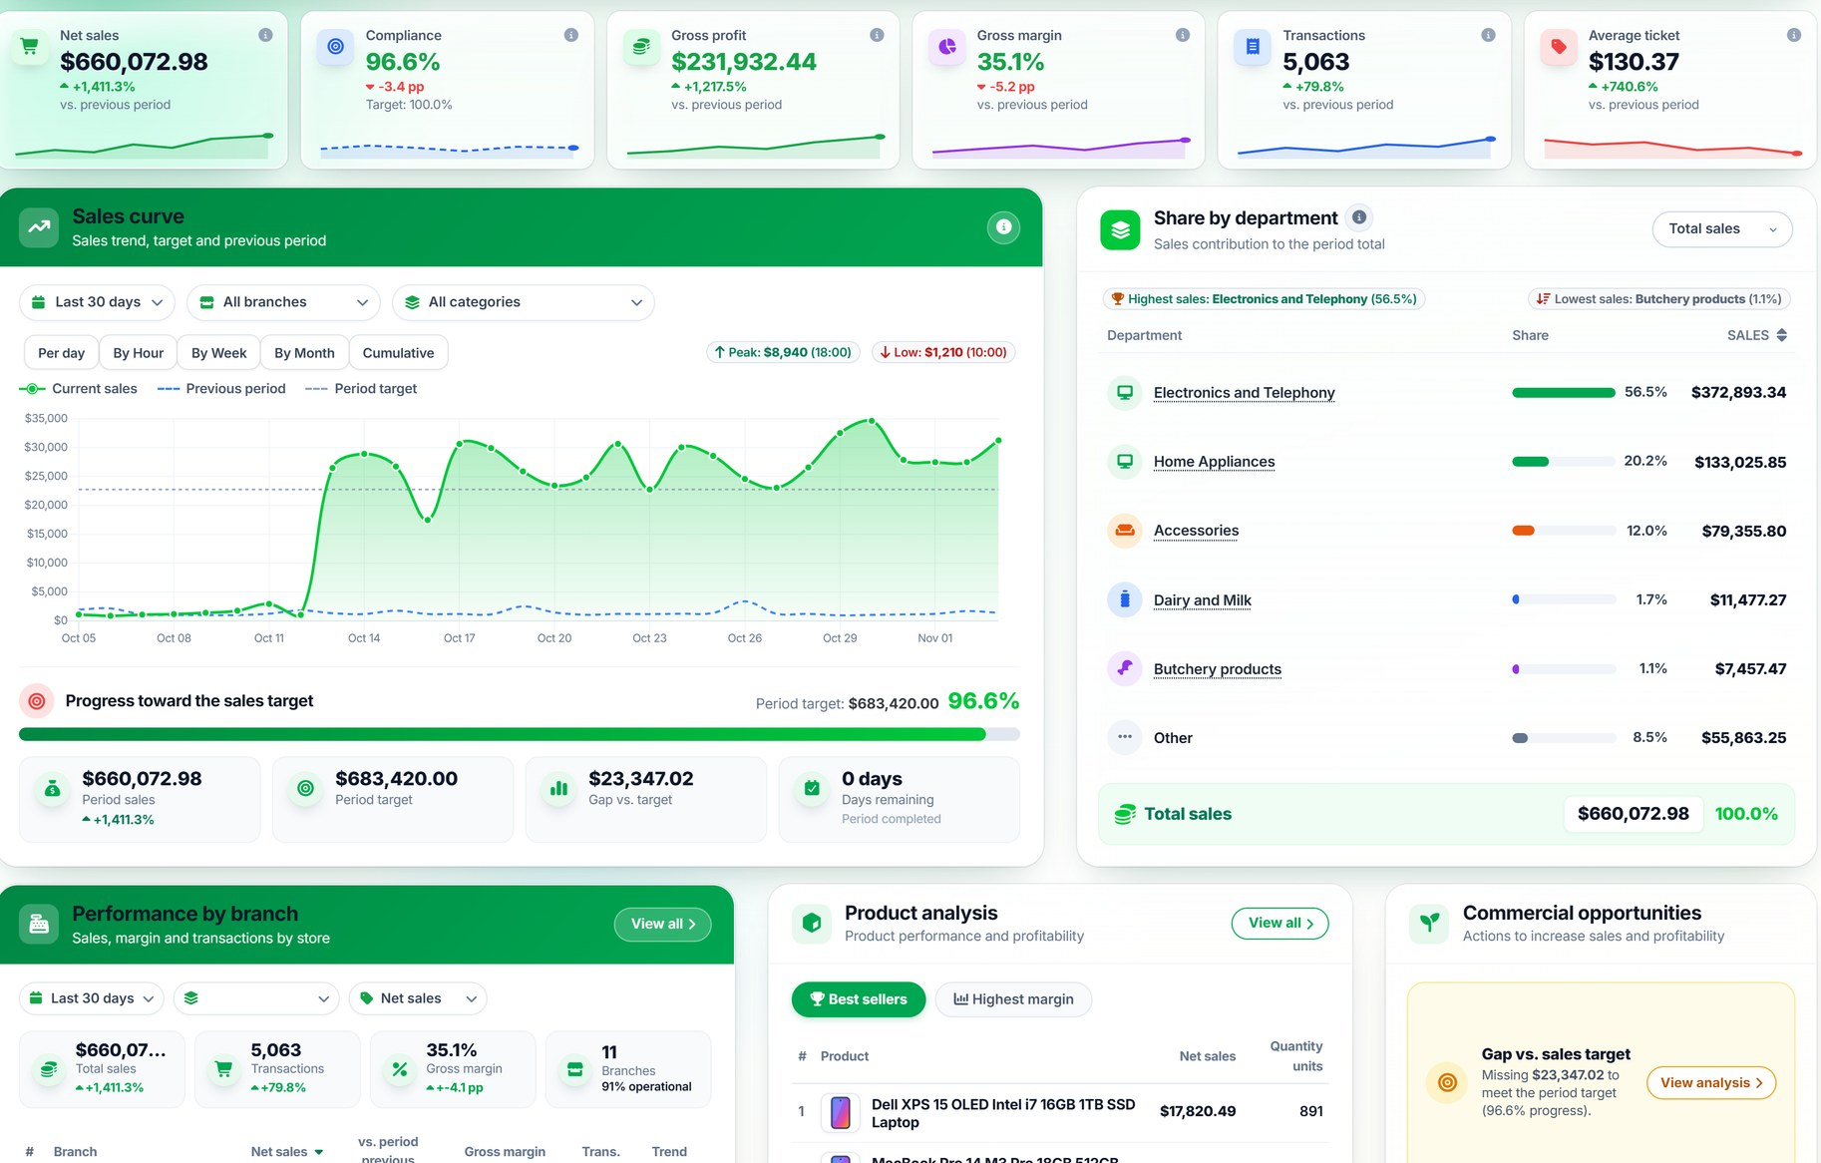
What sells, what it earns and where the gap is
SALES & PROFITABILITY
Available feature
1
Sales and margin
Against previous period and target.
2
Curve and progress
Daily evolution and gap to target.
3
Departments
What drives sales and what does not.
Sales reconciled with cost and inventory movement.
Notes:
SAY: "Net sales, target attainment, profit, margin, transactions and ticket, against the previous period; below, the curve against target, the share by department and performance by branch." SHOW: KPIs, curve and departments. BENEFIT: see the gap to target in time. COMMON QUESTION: "Does it reconcile with inventory?" → Yes; the data quality block shows whether each sale has a cost and a reconciled movement.

Slide 20
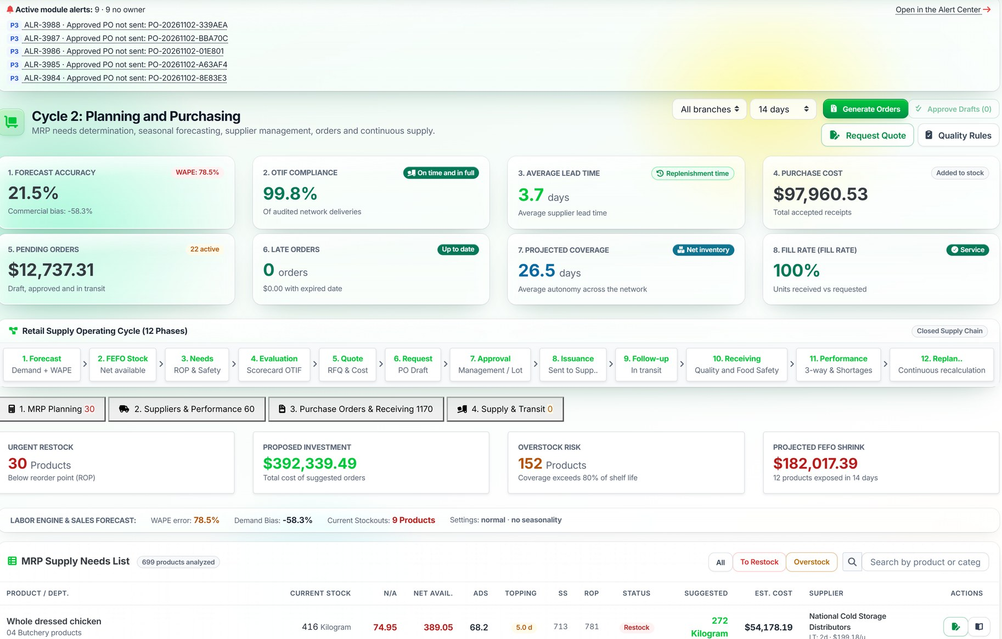
From need to purchase order, in a 12-phase cycle
PLANNING & PROCUREMENT
Available feature
1
MRP needs
Coverage, safety stock and reorder point.
2
Orders with approval
Draft, approval, issue and follow-up.
3
Measured suppliers
On-time delivery, lead time and fill rate.
Notes:
SAY: "The MRP calculates, product by product, net stock, daily sales, coverage, safety stock and reorder point, and suggests quantity, cost and supplier. Orders go through approval, issue, follow-up and receiving, and supplier performance is measured on lead time and fulfilment." SHOW: the cycle KPIs, the 12 phases and the list of needs. BENEFIT: buy what is needed, on time. CLARIFY: suggested orders require approval by a person; forecast accuracy is shown as is, to be improved with the client's data.

Slide 21
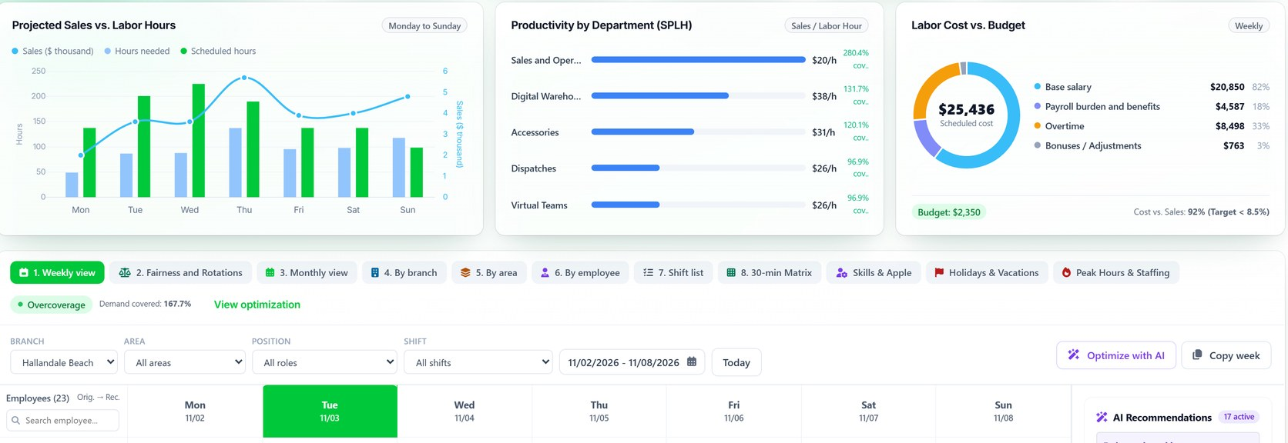
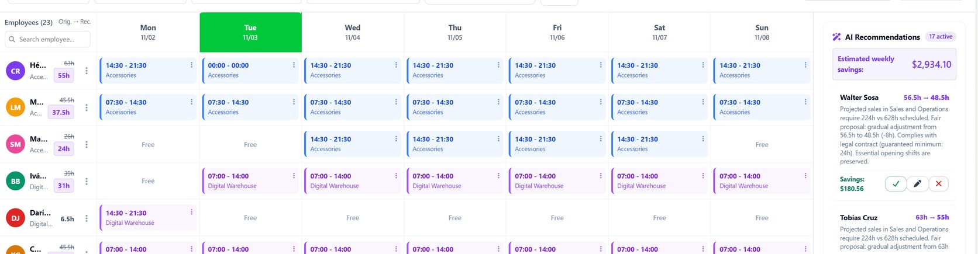
Shifts, coverage and labor cost on one board
WORKFORCE OPERATIONS
Available feature
Projected sales vs. hours, productivity and labor cost
1
Demand vs. hours
Projected sales against scheduled hours.
2
Cost vs. budget
Wages, burden and overtime.
3
Coverage by area
Weekly schedule
Minimum staffing alerts.
4
Configurable rules
To be validated with legal.
Notes:
SAY: "Schedules & Coverage compares projected sales with labor hours, measures productivity by department and labor cost against budget, and shows the weekly and monthly schedule." SHOW: the chart and the schedule. BENEFIT: spot overstaffing and coverage gaps before publishing the schedule. CLARIFY: the generator rules are configurable and must be validated with the client's legal team.

Slide 22
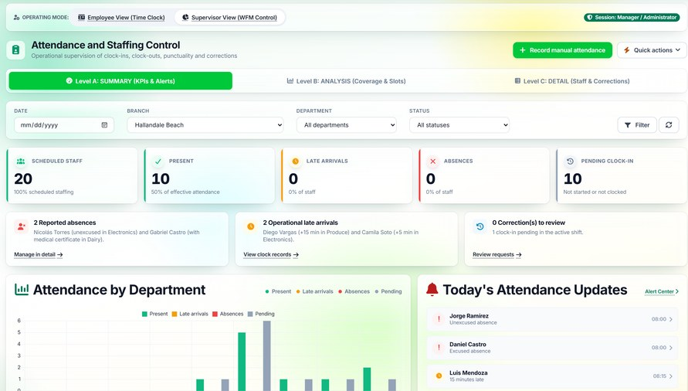
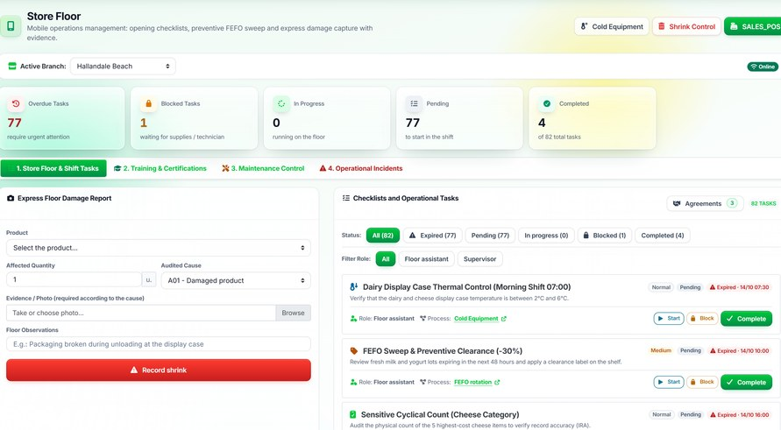
Attendance, tasks and demand-based planning
PRODUCTIVITY
Available + projected
Attendance and clock-ins
Available today
Projected (concept)
Scheduled and worked hours
Late arrivals and absences
Tasks with owners
Productivity by department
Projected sales vs. hours
Time-and-motion study
Shifts generated from demand
Floor tasks
Example: extra staff at peak hours
9h
11h
13h
15h
17h
19h
Notes:
SAY: "Today DAILY records attendance, late arrivals and floor tasks, and compares projected sales with labor hours. What does not exist yet is a time-and-motion study or automatic shift generation straight from demand." SHOW: on the left what is available; on the right the concept. BENEFIT: daily follow-up of the real work. CLARIFY: the projected column is a concept; do not present it as a finished feature.

Slide 23



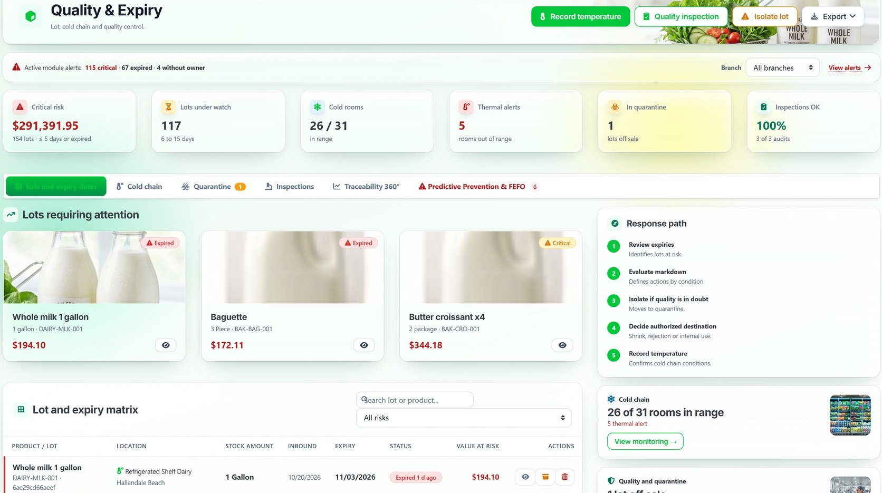
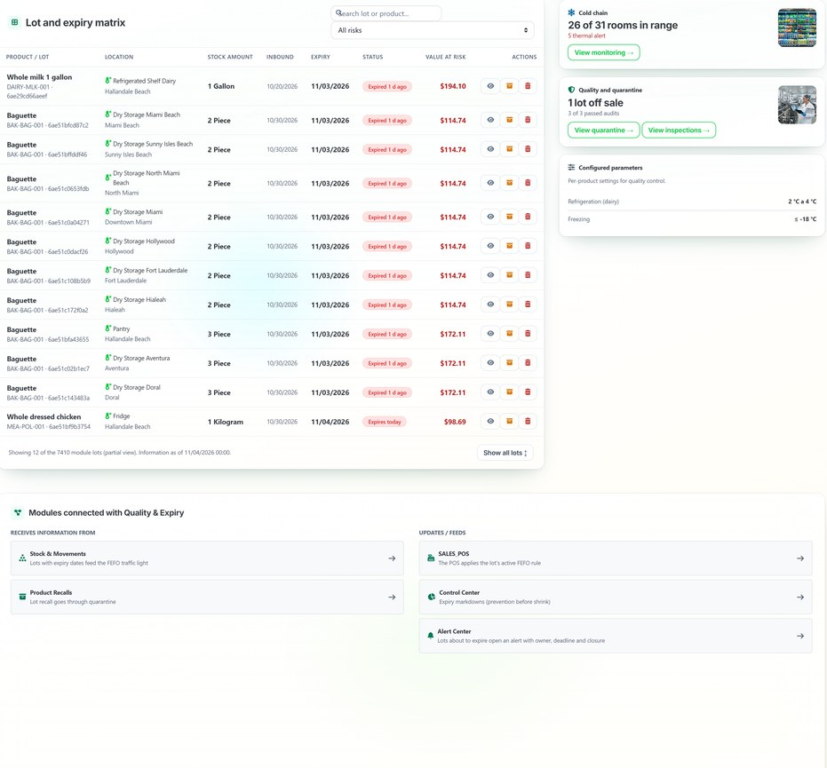
Act before the product expires
QUALITY & EXPIRATION MANAGEMENT
Available feature
Close to expiry
Identification
Markdown or isolation
Authorized disposition
Shrink record
Lot matrix and cold chain
Notes:
SAY: "DAILY identifies expired or soon-to-expire lots, with location and value at risk, and follows a handling path: review, consider markdown, isolate, decide disposition and log temperature." SHOW: lots that need attention, the matrix and the path. BENEFIT: less waste and better customer protection. COMMON QUESTION: "Does it monitor the cold chain?" → It records temperatures and excursions per cold room; automatic capture with sensors is defined per project.

Slide 24
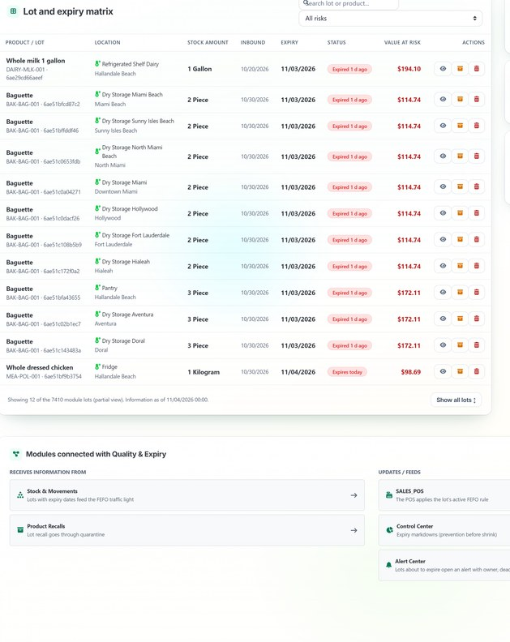
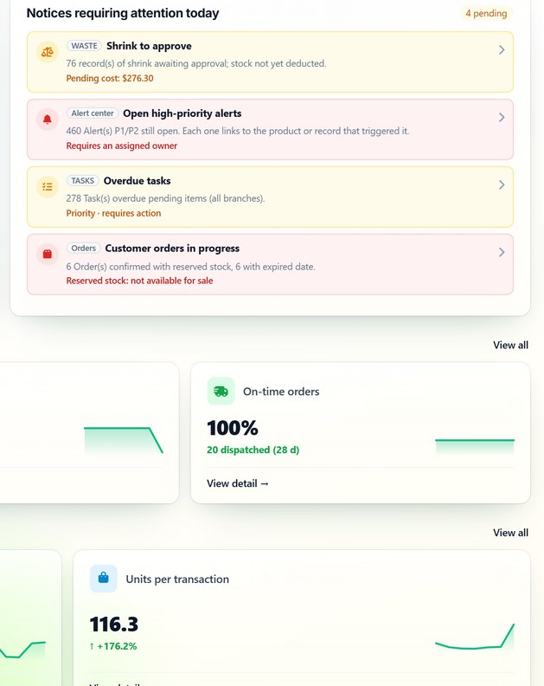
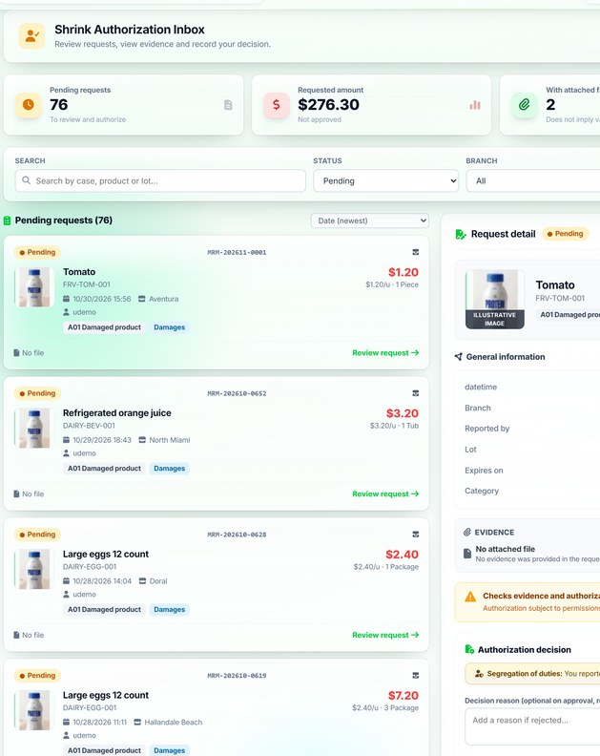
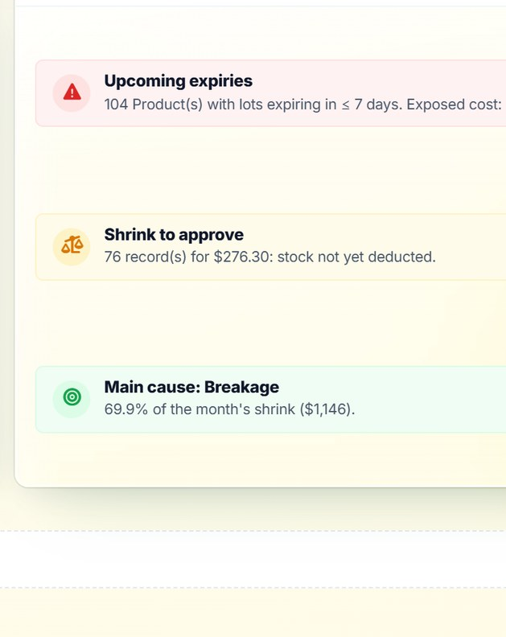
From a lot about to expire to an approved shrink record
CASE 2 · PERISHABLE PRODUCT
Available feature
1. Expired lot
2. Notice with owner
3. Shrink to approve
4. Decision and cause
Quality
TODAY
Approvals
Shrinkage & Waste
One rule: shrink does not reduce stock until someone other than the recorder approves it.
Notes:
SAY: "Second case: a lot of milk expires. Quality flags it in the matrix; TODAY and the Alert Center show it as a notice with an owner; if it does not sell at a markdown, shrink is recorded; a different person approves it and only then is it deducted from stock; the shrink board and the executive report reflect it." SHOW: the four screens, left to right. BENEFIT: expiry is managed as a process, not a surprise. CLARIFY: automatic blocking of expired lots at the POS exists as a rule, but it is disabled until defined with each client.

Slide 25
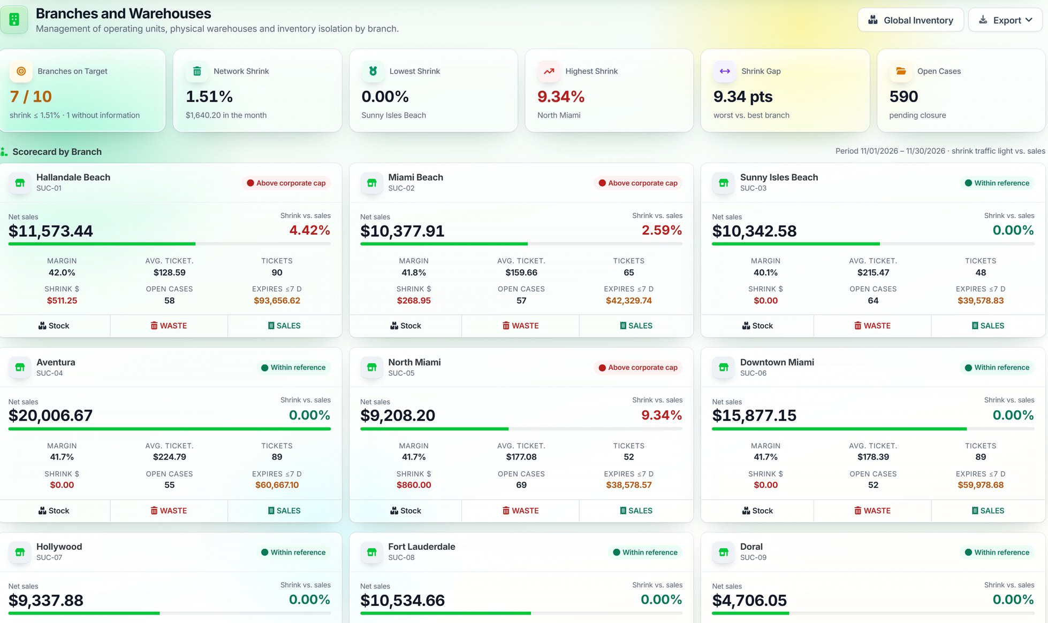
Every store, measured with the same KPIs
MULTI-BRANCH OPERATIONS
Available feature
1
Same metrics
Sales, margin, shrink, cases and expiry.
2
Corporate cap
Stores above it are flagged.
3
From total to detail
From branch to stock, shrink and sales.
Fictitious demo branches
Notes:
SAY: "Each branch is compared on the same KPIs: sales, margin, ticket, shrink as a share of sales, open cases and value about to expire. A branch above the corporate shrink cap is flagged in red." SHOW: the cards; the demo network has ten stores. BENEFIT: management sees the network on one screen. CLARIFY: fictitious branches and figures; these are not client results.

Slide 26
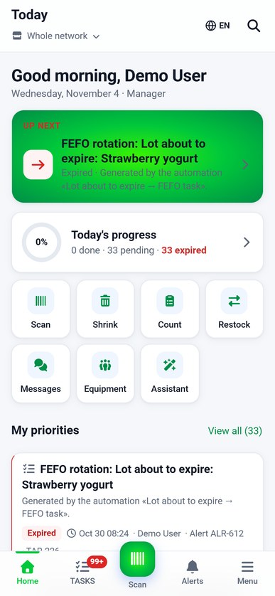
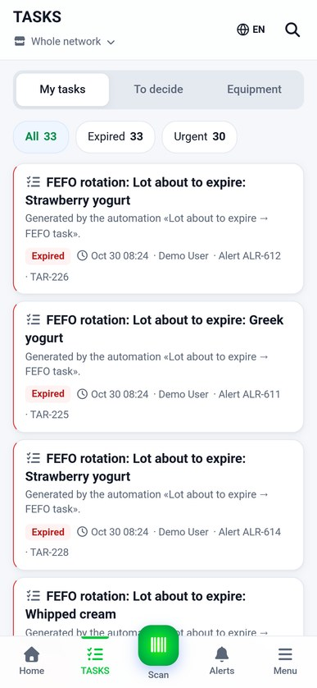
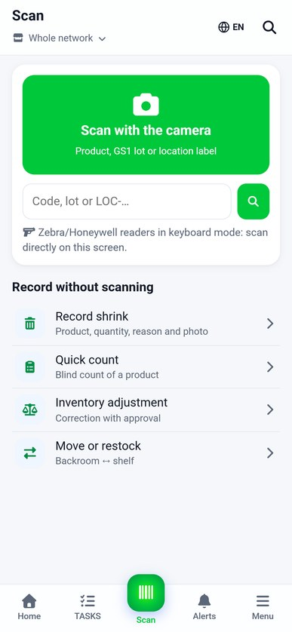
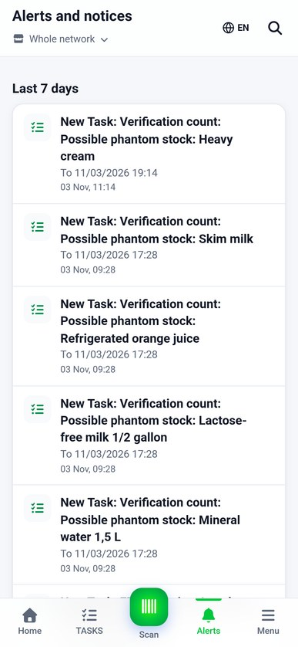
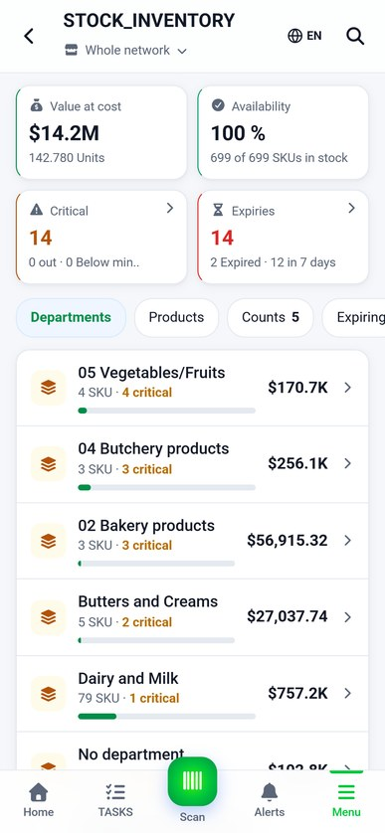
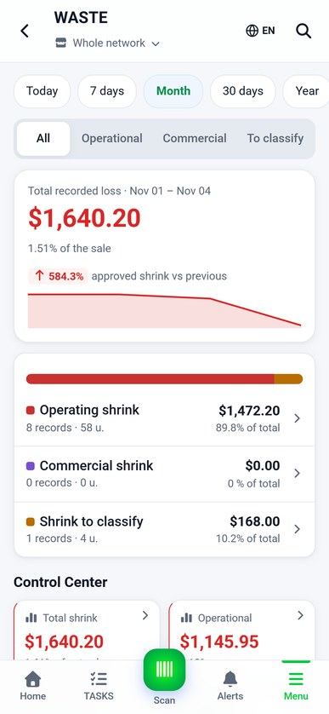
The operation, from the team's phone
MOBILE EXPERIENCE
Available feature
Today
Tasks
Scanner
Alerts
Inventory
Shrink
Subject to the features enabled for each role. Mobile web app; not published in app stores.
Notes:
SAY: "Employees see their priorities, tasks and alerts, scan products, check inventory and handle cases from the mobile web app." SHOW: the six screens. BENEFIT: records are made where the work happens. COMMON QUESTION: "Is it in the app stores?" → Today it runs in the phone's browser; app store publishing is not included.

Slide 27





One movement feeds every module
CONNECTED MODULES
Available feature
Procurement → Inventory
The order receipt enters stock and the ledger.
Procurement
Sales → Inventory
Each ticket deducts its lot; FEFO at the POS.
Reports
Inventory
Inventory → Shrinkage
Approved shrink adjusts stock and enters the report.
One stock ledger
+ alerts and cases
Inventory → Loss Prevention
A count difference opens a case.
Workforce
Sales
Sales → Workforce
Projected sales against scheduled hours.
All → Reports
TODAY, alerts and the executive report read the same data.
Loss Prev.
Shrinkage
Notes:
SAY: "What sets DAILY apart is that modules are not islands. Receiving enters the ledger; a sale deducts it; approved shrink adjusts stock and appears in the report; a difference opens a case; projected sales feed the comparison with hours; and everything reaches TODAY and the reports." SHOW: the diagram and the six connections. BENEFIT: one data set, without manual reconciliations between areas. ASK THE CLIENT: "How many spreadsheets do you cross-check today to close the month?"

Slide 28
Capabilities large chains rely on, and where DAILY stands
MARKET REFERENCE
Available + projected
Common practices in large-scale chains (e.g., Walmart, Costco), based on general public information.
Capability
How DAILY handles it today
Status
Perpetual inventory by store
Stock and valued ledger per branch, with verifiable history
Available
Cycle and high-value counts
Physical counts, sensitive counts and IMEI custody
Available
Loss prevention
Cases, recount and authorization; CCTV as reference only
Partial
Forecast-based replenishment
MRP with reorder point and suggested orders with approval
Partial
Demand-based staffing
Hours vs. projected sales; shifts from demand: not yet
Partial
Freshness and expiry
Lots, FEFO, quarantine and recalls
Available
Leadership dashboards
TODAY and Executive Report; Executive Dashboard in redesign
Partial
Scale and integrations
10 demo branches; import and API
Partial
DAILY is not integrated, partnered or affiliated with the companies mentioned. Trademarks belong to their respective owners.
Notes:
SAY: "Large chains —for example Walmart or Costco— operate with well-known practices: perpetual inventory, cycle counts, loss prevention teams, forecast-based replenishment, workforce planning and freshness control. This table compares capabilities, not products: it shows what DAILY covers today and what is missing." SHOW: the status column. BENEFIT: an honest conversation about scope. CLARIFY: DAILY has no integration, partnership or relationship with those companies; we make no claims about how their internal systems are implemented. Their trademarks belong to their owners.

Slide 29
What exists, what is in development and what is proposed
TRANSPARENCY
Available + projected
Available today
In development
Proposed
TODAY, Alert Center, Cases
Stock, ledger, reconciliation, warehouse
Shrinkage & Waste: board, approval, causes
Loss Prevention: cases, IMEI, counts
Executive loss report
Sales, POS, MRP and suppliers
Schedules, attendance and tasks
Quality, FEFO and recalls
Multi-branch and mobile web
English and Spanish interface
Monthly Executive Dashboard (redesign)
Header KPIs: Loss Prevention, Merchandise Control
Workflow engine (no UI yet)
Unified Action Center
Expired-lot blocking at POS (rule inactive)
Live POS integration (today import and API)
Occupational health and safety
Time-and-motion study
Shifts generated from demand
Automatic cold-chain sensors
CCTV integration
App-store mobile app
Notes:
SAY: "So the decision is informed: on the left what works today and you saw on screen; in the middle what is in development; on the right what we propose to build with the client." SHOW: the three columns. BENEFIT: trust; we do not sell what does not exist. CLARIFY: nothing in the right column should be presented as available.

Slide 30
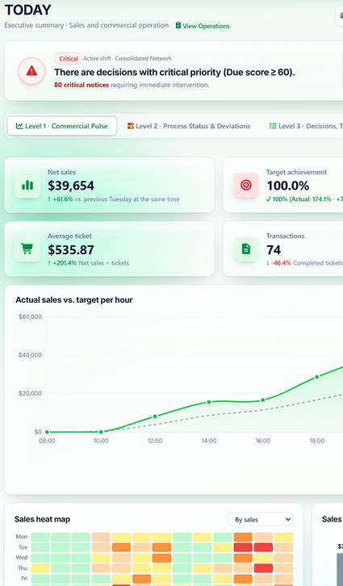
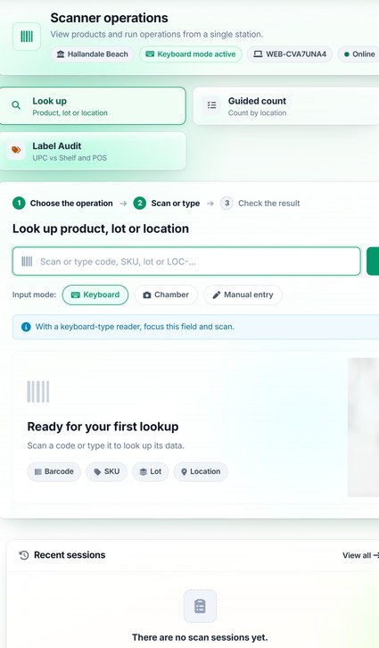
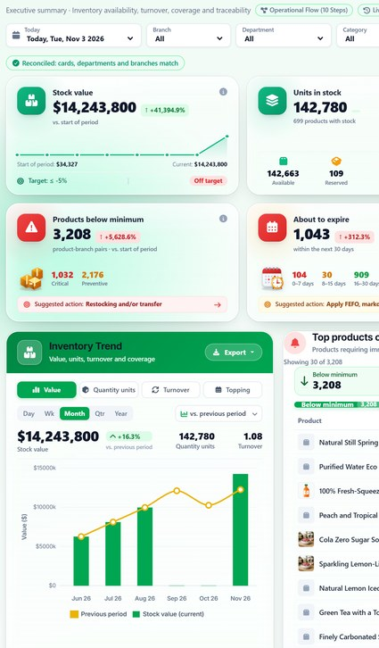
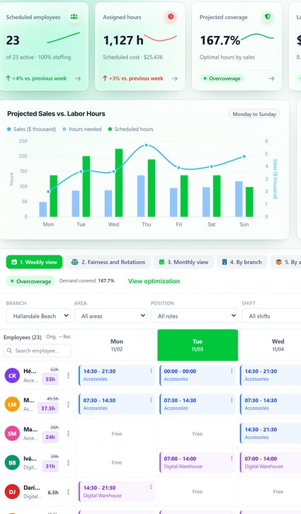
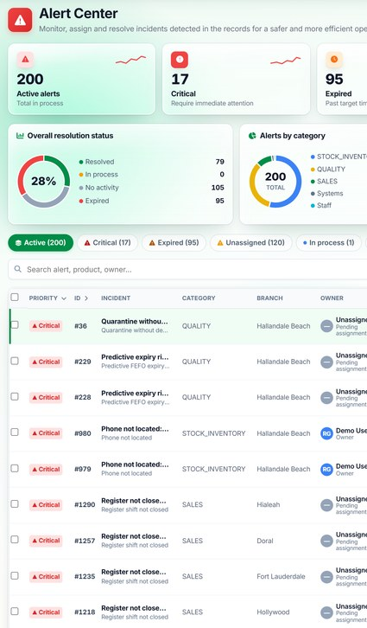
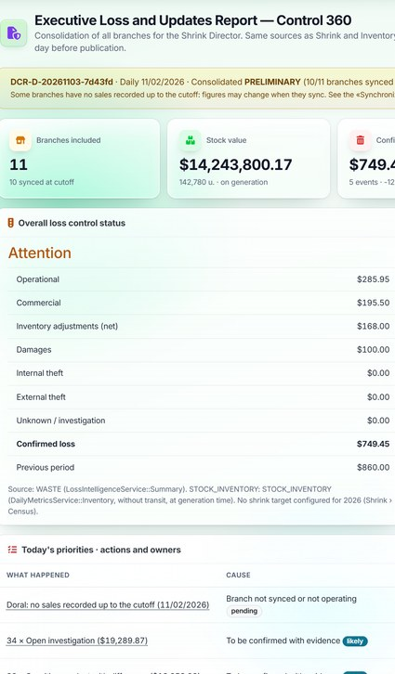
A day with DAILY
ILLUSTRATIVE SCENARIO
Illustrative scenario
07:00
09:00
11:00
13:00
15:00
18:00
Start of operations
Receiving and scanning
Inventory at risk
Shifts and coverage
Alert review
Daily report
Illustrative scenario.
Notes:
SAY: walk through the day left to right, one screen per moment. SHOW: that the manager and the team use the same information. BENEFIT: DAILY supports the whole working day, not just the close. CLARIFY: this is an illustrative scenario; times and sequence vary in each company.

Slide 31






Six benefits, six real tools
BENEFITS
Available feature
Loss reduction
End-to-end traceability
Team productivity
Shrinkage and Loss Prevention
Ledger and Reconciliation
Workforce Operations
Financial control
Expiration prevention
KPI-driven decisions
Sales and Loss report
Quality and FEFO
TODAY and alerts
Notes:
SAY: each benefit rests on a tool already shown: loss reduction, traceability, productivity, financial control, expiry prevention and KPI-driven decisions. SHOW: the screen on each card. BENEFIT: value tied to the product, without abstract promises. ASK THE CLIENT: "Which of these six is most urgent for you?"

Slide 32







From scattered records to operational control
BEFORE AND AFTER
Illustrative scenario
Before
With DAILY
Separate records
One stock ledger
Manual validations
Traceability by document
Differences at month end
Differences when counting
Cases with no owner
Cases with owner and deadline
Notes:
SAY: "We do not promise a figure. We show the change in the way of working: from separate records to centralized information, with owners." SHOW: the two columns, row by row. BENEFIT: a process change that is then measured in the pilot. CLARIFY: no financial results are guaranteed.

Slide 33
Half a point of shrinkage: $5,000 a month in this example
FINANCIAL IMPACT
Illustrative scenario
$1,000,000
monthly sales in the example
$20,000 → $15,000
estimated monthly loss
$5,000
estimated monthly difference
Illustrative example. Does not represent real results or guarantee savings.
Notes:
SAY: "A hypothetical company with $1,000,000 in monthly sales. At 2% shrink it loses $20,000; at 1.5%, $15,000. The difference is $5,000 a month." SHOW: the chart; it is editable in PowerPoint to use the client's figures. BENEFIT: a simple way to estimate what a point of shrink is worth. CLARIFY: this is an illustrative example; it does not represent real results or guarantee savings.

Slide 34




Four ways to start working together
COMMERCIAL PROPOSAL
Commercial proposal
SaaS licensing
Enterprise pilot
Multi-branch rollout
Strategic partnership
Subscription by branches, users and modules
One or two stores, measured against a baseline
Deployment by stages and regions
Joint development of proposed modules
Terms and pricing are defined after the assessment.
Notes:
SAY: "There are four ways to work together; we choose after the assessment." SHOW: the four options. BENEFIT: flexibility according to the size and stage of the company. COMMON QUESTION: "How much does it cost?" → It depends on branches, users and modules; it is quoted after the assessment.

Slide 35




A 60-minute demo built around your questions
DEMONSTRATION
Commercial proposal
10 min
TODAY and Alert Center
What we need
One hour with operations, inventory and loss prevention
Your top three problems
Optional: an anonymized data sample for the assessment
15 min
Case 1: inventory difference
10 min
Case 2: expiration and shrinkage
10 min
Sales, procurement and workforce
15 min
Client questions
Notes:
SAY: "We propose a live guided demo on the demo company, following the two end-to-end cases and answering your questions." SHOW: the agenda. BENEFIT: the client sees the product working, not just slides. ASK THE CLIENT: "Which process would you like to see first?"

Slide 36




From assessment to expansion, in eight stages
IMPLEMENTATION
Commercial proposal
1
2
3
4
Operational assessment
Scope definition
Configuration
Data load and integration
5
6
7
8
Training
Pilot
Results measurement
Branch expansion
Proposed stages. No client implementations to date.
Notes:
SAY: "We start by understanding the operation and finish by measuring." SHOW: the eight stages. BENEFIT: contained risk: expansion happens only if results justify it. CLARIFY: these are proposed stages; there are no client implementations to date.

Slide 37

A 30-day pilot, measured with six KPIs
PILOT
Commercial proposal
30
Inventory accuracy
Differences detected and closed
day pilot
Baseline, supported operation and final measurement.
Investigation time
Shrink as % of sales
Expiries handled on time
Task completion
Subject to agreement. No testimonials or prior results.
Notes:
SAY: "We propose a 30-day pilot in one or two stores, subject to agreement, with a baseline and six KPIs." SHOW: the KPIs. BENEFIT: decide with data from your own operation. COMMON QUESTION: "Do you have success stories?" → We propose a measured pilot as the first step; we do not cite testimonials.

Slide 38

From this meeting to a decision, in nine weeks
NEXT STEPS
Commercial proposal
Week 1
Week 2
Weeks 3–4
Weeks 5–8
Week 9
Guided demo
Assessment and scope
Configuration and data load
30-day pilot
Results and decision
Today: agree on the demo date and the participants.
Notes:
SAY: "If you are interested, this is the path: demo, assessment, configuration, 30-day pilot and a results meeting to decide." SHOW: the timeline. BENEFIT: a limited commitment with a decision date. CALL TO ACTION: agree on the demo date today.

Slide 39






DAILY
DAILY — From data to decisions. From decisions to results.
Request a demo or start a pilot.
DAILY | Enterprise Commercial Presentation
Notes:
SAY: "DAILY turns operational data into daily decisions, and those decisions into results you can measure." CALL TO ACTION: propose a date for the guided demo. BENEFIT: the next step is limited and measurable.

