Slide 1


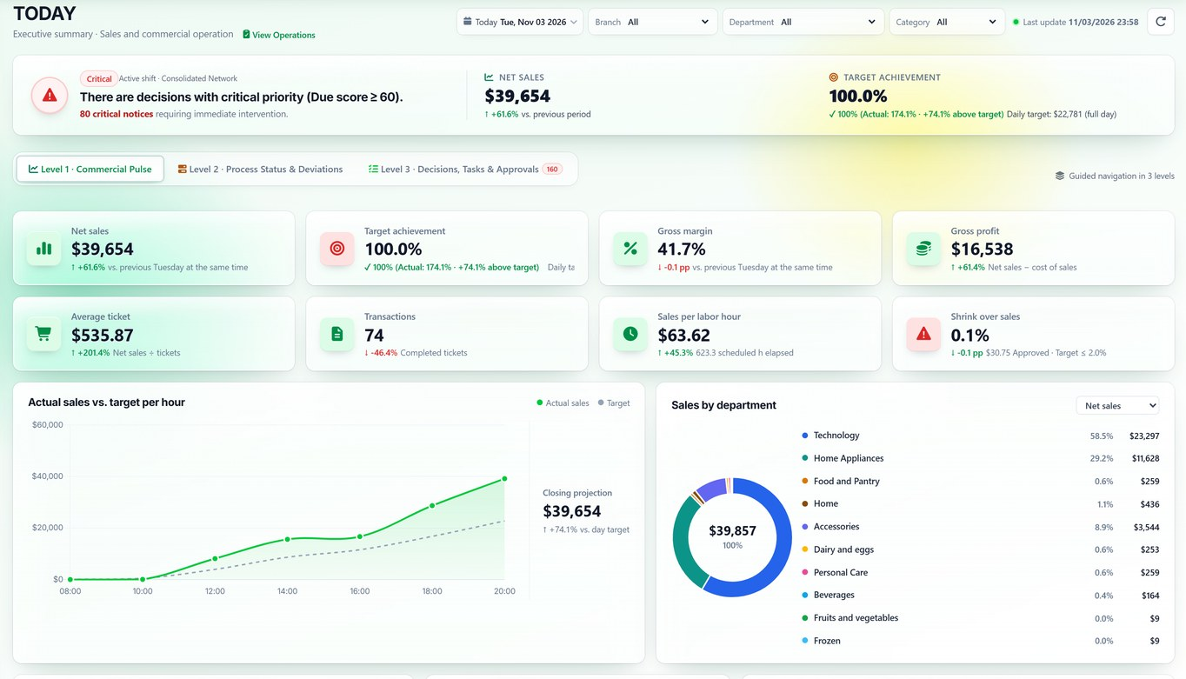
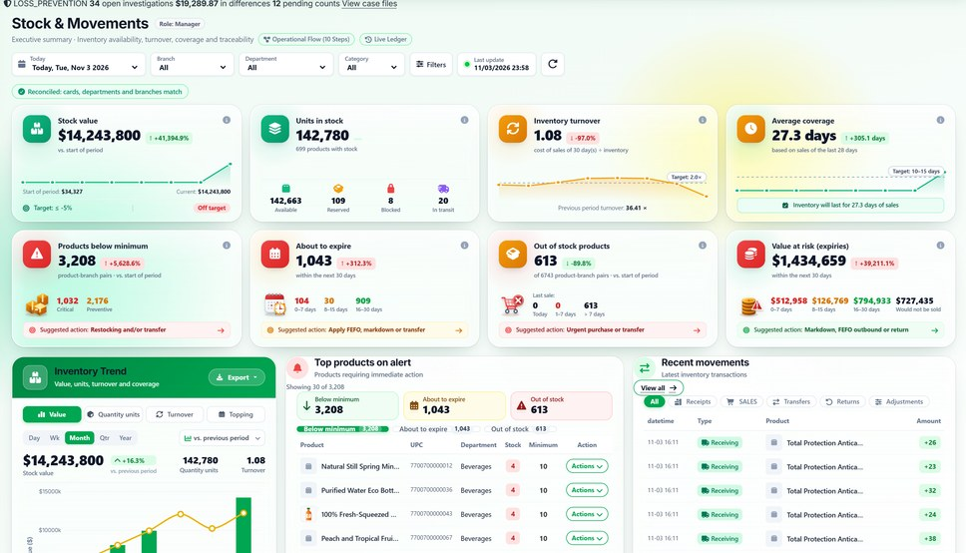
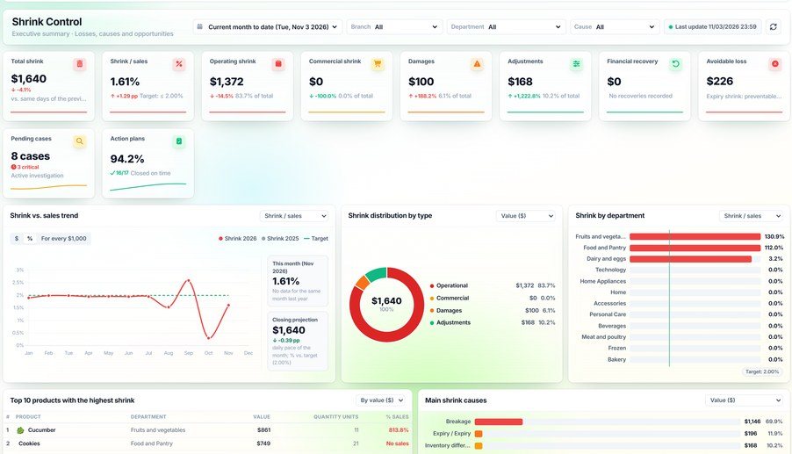
TODAY · Daily Operations
DAILY
DAILY — Operational supervision, control and management for retail
Inventory, sales, shrink, loss prevention, staff and purchasing in a single system.
Real screens · English interface · demo data
Inventory
Shrinkage & Waste
Notes:
SAY: "DAILY brings into one platform what many chains keep in spreadsheets and separate systems: inventory, sales, shrink, loss prevention, staff and purchasing." SHOW: the three screens; they are real, running a demo company with ten branches. The interface is shown in English; DAILY runs in English or Spanish per user. BENEFIT: one version of the numbers for the whole operation. COMMON QUESTION: "Is it an ERP?" → It does not replace your ERP or POS; it adds operational supervision and control, and receives data through import or API.

Slide 2
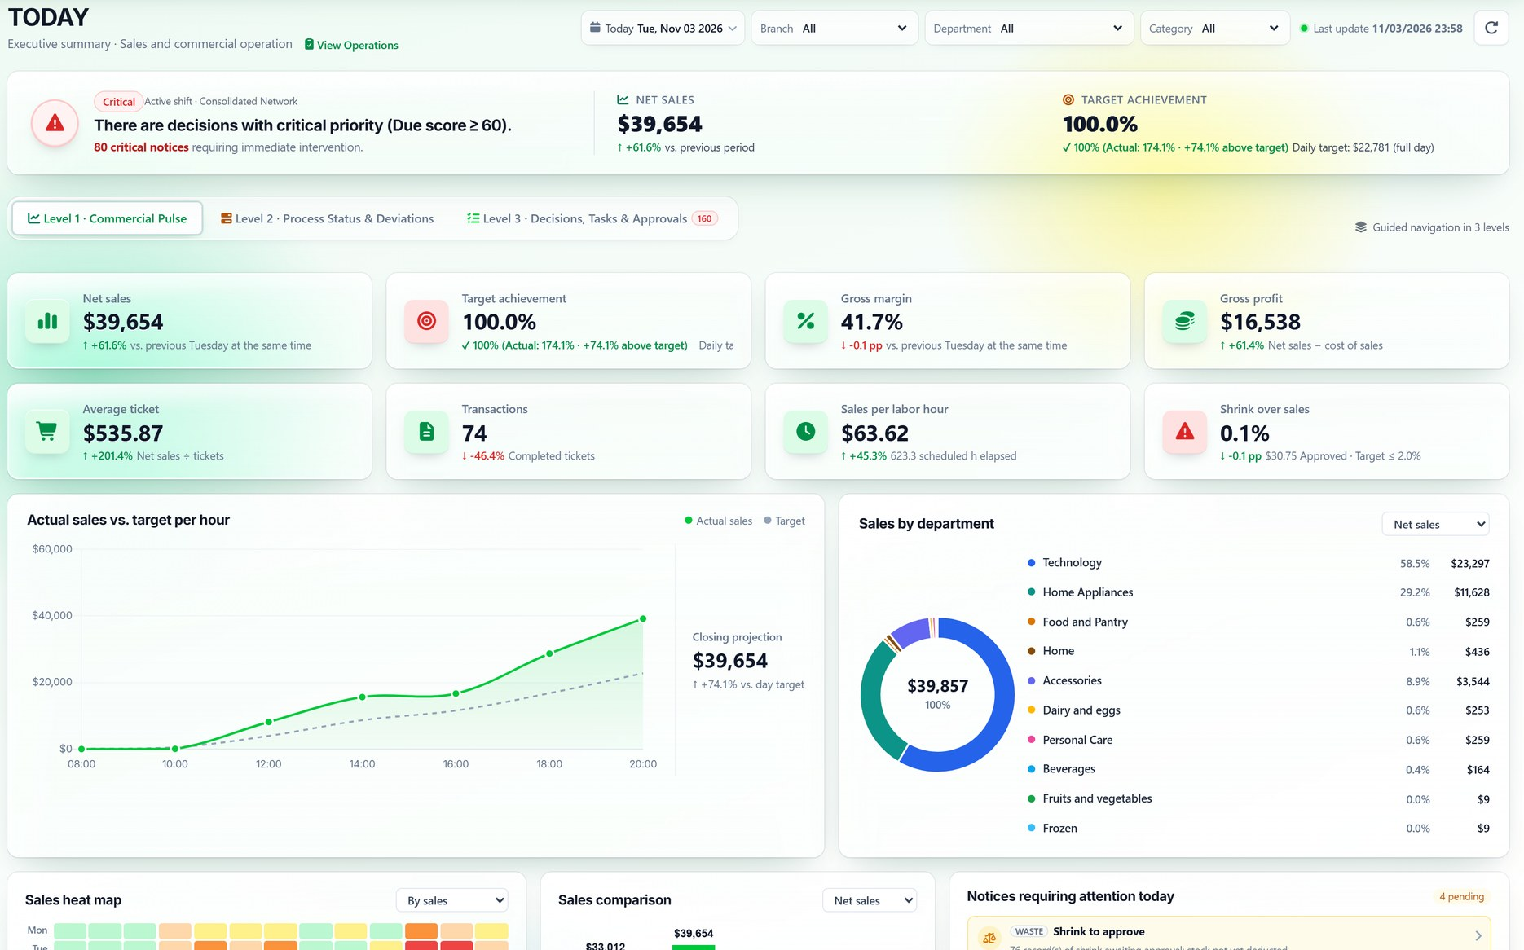
TODAY: how the operation is doing, hour by hour
EXECUTIVE VIEW OF THE DAY
Available feature
1
Critical decisions
1
What needs intervention this shift.
2
2
KPIs
Sales, target, margin, ticket and shrink.
3
3
Actual vs. target by hour
With a projected close for the day.
4
Actionable notices
Shrink to approve, alerts and overdue tasks.
4
Notes:
SAY: "A manager opens TODAY and sees sales, target attainment, margin, average ticket and shrink as a share of sales, with the actual curve against the hourly target and the notices that need attention." SHOW: (1) critical decisions for the shift; (2) KPIs against the previous period; (3) actual sales vs. target; (4) notices with direct access. BENEFIT: decide during the day, not at close. CLARIFY: the monthly Executive Dashboard is being redesigned; for the demo we use TODAY and the Executive Loss Report, which read recorded data.

Slide 3






From count to closure: six steps, four modules
CASE 1 · SUMMARY
Available feature
1
2
3
4
5
6
Physical count
Difference & value
Movements
Investigation
Authorization
Closure
Physical Inventory Counts
Inventory Reconciliation
Inventory Ledger
Case record
Different supervisor
Loss Prevention
DEMO-001
−2 u. · $1,040
2 controls
case file
difference and value
recount and approval before adjusting
Notes:
SAY: "In short: the count detects, reconciliation calculates, the ledger explains, the record investigates, the supervisor authorizes and the case closes. Four modules working on the same data." SHOW: the sequence and the module involved in each step. BENEFIT: a repeatable, auditable process for every difference. ASK THE CLIENT: "How many steps of this process do you do outside the system today?"

Slide 4







One movement feeds every module
CONNECTED MODULES
Available feature
Procurement → Inventory
The order receipt enters stock and the ledger.
Procurement
Sales → Inventory
Each ticket deducts its lot; FEFO at the POS.
Reports
Inventory
Inventory → Shrinkage
Approved shrink adjusts stock and enters the report.
One stock ledger
+ alerts and cases
Inventory → Loss Prevention
A count difference opens a case.
Workforce
Sales
Sales → Workforce
Projected sales against scheduled hours.
All → Reports
TODAY, alerts and the executive report read the same data.
Loss Prev.
Shrinkage
Notes:
SAY: "What sets DAILY apart is that modules are not islands. Receiving enters the ledger; a sale deducts it; approved shrink adjusts stock and appears in the report; a difference opens a case; projected sales feed the comparison with hours; and everything reaches TODAY and the reports." SHOW: the diagram and the six connections. BENEFIT: one data set, without manual reconciliations between areas. ASK THE CLIENT: "How many spreadsheets do you cross-check today to close the month?"

Slide 5





From this meeting to a decision, in nine weeks
NEXT STEPS
Commercial proposal
Week 1
Week 2
Weeks 3–4
Weeks 5–8
Week 9
Guided demo
Assessment and scope
Configuration and data load
30-day pilot
Results and decision
Today: agree on the demo date and the participants.
Notes:
SAY: "If you are interested, this is the path: demo, assessment, configuration, 30-day pilot and a results meeting to decide." SHOW: the timeline. BENEFIT: a limited commitment with a decision date. CALL TO ACTION: agree on the demo date today.

