Slide 1
CodeTest Role Playing Game

Slide 2
Abstract:
Is a web based coding RPG which will test your coding skills in various languages such that each level of difficulty will be based on different coding languages. To defeat your enemies and proceed on, you must put on your coding skills on the test with this RPG game. Difficulty increases as you progress on and the higher the difficulty the more complicated the coding gets and also provides hints and teaches you if ever you do fail to give the write answers. This game targets the college IT students which aims to test their coding skills on various languages while having fun with the game.

Slide 3
Overview of the current state of technology:
The development of the technology and communication has also changed the traditional learning concept and provided the verification of learning independent from time and place. It’s known that web-based educational software, which provides motivation to learners, makes contributions to meaningful learning as well.
Web based educational software, exercises and repeats have an important role in reinforcement of learning. At the same time, learners spend time and efforts to learn something when they are motivated and they have the will to learn and to use them in the future.

Slide 4
Research Objectives

Slide 5
General Objectives:
To develop a web based educational role-playing game.

Slide 6
Specific objectives:
To develop a system that will educate IT students through a web based game.
To develop a web based game that allows users to defeat enemies by answering the given coding problems.
To develop a web based game that will let students be tested with various programming languages in a form of a role-playing game.
To develop a web based game that will test the IT student’s skills in coding, debugging, completing lines and etc.
To develop a web based game that will record a player’s progress on the game.
To develop a web based game that can entertain IT students and have them learn from coding errors at the same time.

Slide 7
Scope and delimitations:
This web based role-playing game is aimed to the IT students who wants to test their coding skills in a more amusing way. The game is limited to the IT students of the La Salle University (Ozamiz) to play this game. The user must first register with a valid student ID to determine that he/she is a student of the College of Computer Studies.

Slide 8
Significance of the Study:
This web based role-playing game is intended to educate the students of the College of Computer Studies of La Salle University by testing their coding skills with various challenges given at them and as the player progresses, so does the difficulty of the challenges given. If ever the student does give the wrong answer, he/she will be provided with hints to learn to. The game is intended to be of an alternative way in testing the student’s knowledge in coding, debugging, completing lines etc.

Slide 9
User Interface/Experience

Slide 10
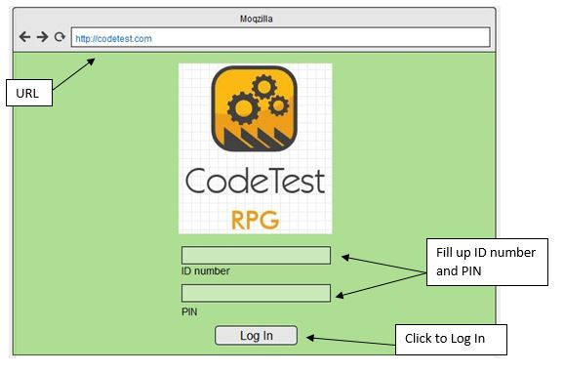
Log in Page:

Slide 11
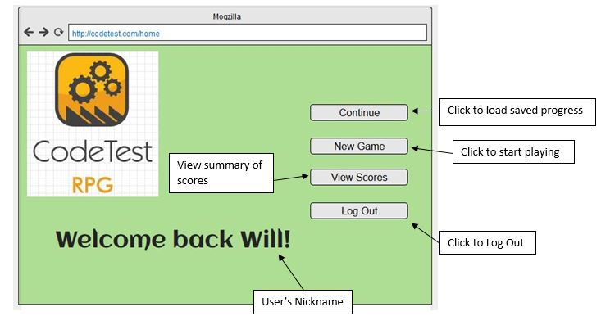
Home Page:

Slide 12
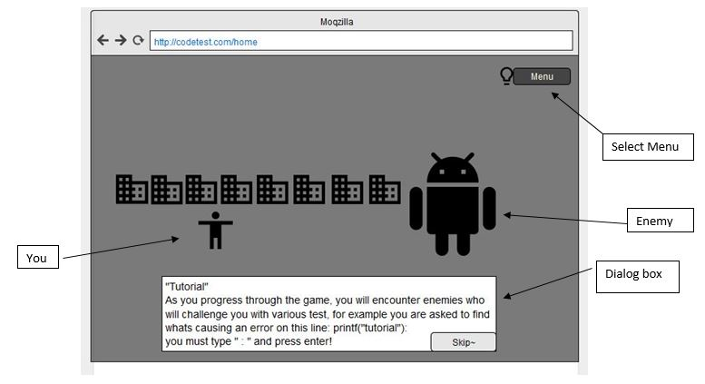
Gameplay(tutorial):

