Slide 1
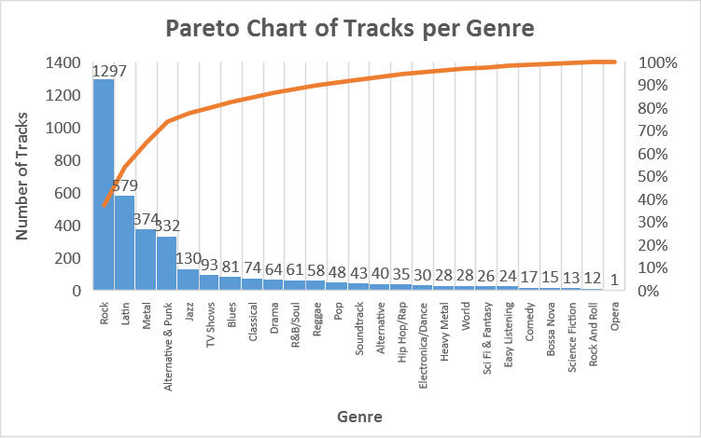
Which genres have the most number of tracks?
First, I wanted to check which genres have the most number of tracks. I used a Pareto Chart to determine the number of tracks each genre contains in the database. The chart shows that Rock has the most number of tracks and it constitutes about 40% of all tracks among the 25 genres. It is followed by Latin, Metal, Alternative & Punk and Jazz. Together, the five top genres comprise about 80% of tracks in the database.
Notes:
SELECT g.Name, COUNT(t.TrackId)
FROM Genre g
JOIN Track t
ON g.GenreId = t.GenreId
GROUP BY 1
ORDER BY 2 DESC;

Slide 2
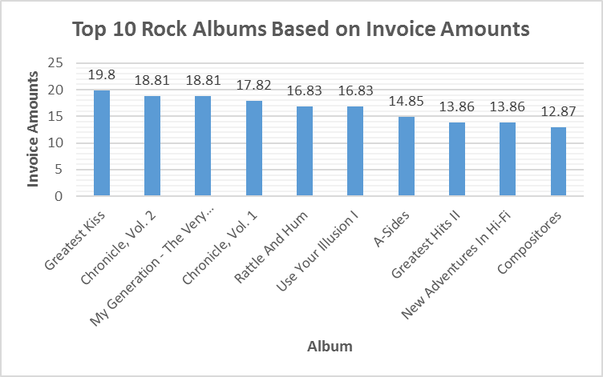
Which rock albums have earned the most?
Since I know that Rock is the most popular genre, I wanted to find out which rock albums in the database have earned the most. The earnings are based on invoice amounts and the clustered column chart shows the top 10 rock albums. It shows that the Greatest Kiss album by Kiss has the most number of invoice amounts. The second and third albums are not far behind. It can be inferred that no rock album has truly earned significantly more than its peers.
Notes:
SELECT al.Title Album, ar.Name Artist, SUM(il.UnitPrice*il.Quantity) AmountSpent
FROM Artist ar
JOIN Album al
ON ar.ArtistId = al.ArtistId
JOIN Track t
ON al.AlbumId = t.AlbumId
JOIN InvoiceLine il
ON t.TrackID = il.TrackId
JOIN Genre g
ON t.GenreID = g.GenreId
WHERE g.Name = 'Rock'
GROUP BY 1, 2
ORDER BY 3 DESC
LIMIT 10;

Slide 3
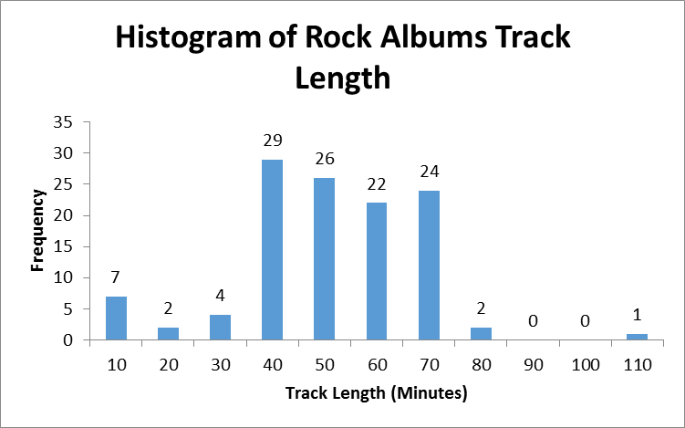
What is the distribution of track lengths for rock albums?
Next, I wanted to see the distribution of the track lengths (in minutes) of the rock albums. The histogram shows a nearly normal distribution with one outlier at the right. Most track albums are between 40-70 minutes long. The mean and median are around 46 and 48 minutes respectively. Because of this, rock albums can be classified as short if they are less than 40 minutes while they can be classified as long if they are greater than 70 minutes.
Notes:
SELECT al.Title Album, ar.Name Artist, SUM(t.milliseconds/1000/60) Minutes,
CASE WHEN SUM(t.milliseconds/1000/60) > 70 THEN 'Long'
WHEN SUM(t.milliseconds/1000/60) > 40 THEN 'Normal'
ELSE 'Short' END AS Length
FROM Album al
JOIN Track t
ON al.AlbumId = t.AlbumId
JOIN Genre g
ON t.GenreId = g.GenreId
JOIN Artist ar
ON al.ArtistId = ar.ArtistId
WHERE g.Name = 'Rock'
GROUP BY 1
ORDER BY 3 DESC

Slide 4
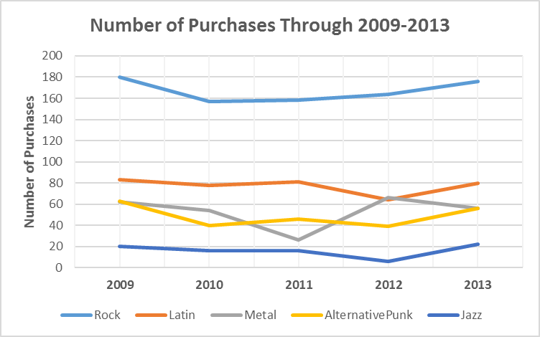
How did the popularity of rock songs and the next four genres change from 2009-2013?
Finally, I wanted to check the popularity of rock songs and the next four genres from 2009-2013 through their number of purchases. Rock tracks remain popular through the years with a slight dip in the 2nd year. Latin, Metal and Alternative & Punk have swapped positions in some years while Jazz has remained in the bottom. Latin and A&P remain fairly consistent while Metal has suffered the most drastic changes.
Notes:
SELECT sub1.Year, Rock, Latin, Metal, AlternativePunk, Jazz
FROM(SELECT STRFTIME('%Y', i.InvoiceDate) Year, COUNT(il.InvoiceLineId) Rock, NULL, NULL, NULL, NULL
FROM Invoice i
JOIN InvoiceLine il
ON i.InvoiceId = il.InvoiceId
JOIN Track t
ON il.TrackId = t.TrackId
JOIN Genre g
ON g.GenreId = t.GenreId
WHERE g.Name = 'Rock'
GROUP BY 1) as sub1
JOIN(SELECT STRFTIME('%Y', i.InvoiceDate) Year, NULL, COUNT(il.InvoiceLineId) Latin, NULL, NULL, NULL
FROM Invoice i
JOIN InvoiceLine il
ON i.InvoiceId = il.InvoiceId
JOIN Track t
ON il.TrackId = t.TrackId
JOIN Genre g
ON g.GenreId = t.GenreId
WHERE g.Name = 'Latin'
GROUP BY 1) as sub2
ON sub1.Year = sub2.Year
JOIN(SELECT STRFTIME('%Y', i.InvoiceDate) Year, NULL, NULL, COUNT(il.InvoiceLineId) Metal, NULL, NULL
FROM Invoice i
JOIN InvoiceLine il
ON i.InvoiceId = il.InvoiceId
JOIN Track t
ON il.TrackId = t.TrackId
JOIN Genre g
ON g.GenreId = t.GenreId
WHERE g.Name = 'Metal'
GROUP BY 1) as sub3
ON sub2.Year = sub3.Year
JOIN(SELECT STRFTIME('%Y', i.InvoiceDate) Year, NULL, NULL, NULL, COUNT(il.InvoiceLineId) AlternativePunk, NULL
FROM Invoice i
JOIN InvoiceLine il
ON i.InvoiceId = il.InvoiceId
JOIN Track t
ON il.TrackId = t.TrackId
JOIN Genre g
ON g.GenreId = t.GenreId
WHERE g.Name = 'Alternative & Punk'
GROUP BY 1) as sub4
ON sub3.Year = sub4.Year
JOIN(SELECT STRFTIME('%Y', i.InvoiceDate) Year, NULL, NULL, NULL, NULL, COUNT(il.InvoiceLineId) Jazz
FROM Invoice i
JOIN InvoiceLine il
ON i.InvoiceId = il.InvoiceId
JOIN Track t
ON il.TrackId = t.TrackId
JOIN Genre g
ON g.GenreId = t.GenreId
WHERE g.Name = 'Jazz'
GROUP BY 1) as sub5
ON sub4.Year = sub5.Year

