Slide 1
Spelling Bee App
Patrick Lisiecki, Robert Ortiz, Nicolas Talledo

Slide 2
Overview
The Spelling Bee App is a fun and immersive way to improve vocabulary and communication skills for all ages. It enhances spelling, pronunciation, and word comprehension by transforming traditional spelling bee competitions into interactive and educational games.

Slide 3
Value Proposition
The application aims to provide a broad audience, including multilingual users, with a learning tool that can help them enhance their vocabulary and communication skills. The tool should focus on dividing a spelling bee competition into exciting and challenging games that offer users a fun and engaging learning experience.

Slide 4
MoSCoW MVP

Slide 5
Must Have
User Authentication
Registration
Login
Logout
Randomized Mini Games (Destructured Spelling Bee)
Random game generation (Fisher-Yates)
Choose the correct word that matches the definition
Listen and spell the word correctly to gain points
Fill in the blanks to complete the sentence correctly
Game History & Persistent Data
User can review previous games and see what they got right/wrong

Slide 6
Should Have
Language Selector
Users from around the world should be able to view the page in their language
Game Support for Multiple Languages
Each mini game should be playable in other languages
Requires lots of language data (definitions, audio samples, examples)
Forgot My Password
Password reset feature with OTP and email reset

Slide 7
Could Have
Advanced Game Creation Controls
Choosing a source and target language for each game (definitions are in English and answer choices are in Spanish)
Choosing number of questions and time limit
Resume Games
Saving game progress and allowing the user to resume at a later time
Profile Feature
Each user can have a profile that displays basic information about themselves

Slide 8
Won't Have (this time)
Multiplayer Spelling Bee Game
Create a room and invite other users to compete in a virtual spelling bee with lifelines
Personal dictionary which stores any words and definitions that they have encountered by playing the games
Stats Page
Users have a stats page which shows their average scores for each game and/or performance in online spelling bees
Mobile app implementation with React Native

Slide 9
Basic Functions
User Authentication
Register, Login, Logout, Form Validation, Session Based
Language Selector
English and Spanish language selector
Choose the Correct Word (English, Spanish)
Choose the correct word that matches the definition
Spell by Hearing (English)
Listen and spell the word correctly to gain points
Complete the Sentence (English)
Fill in the blanks to complete the sentence correctly
Game History
View past games and view individual games with choices and user response

Slide 10
Architecture

Slide 11
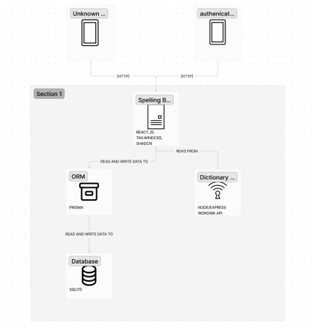
Container Diagram

Slide 12
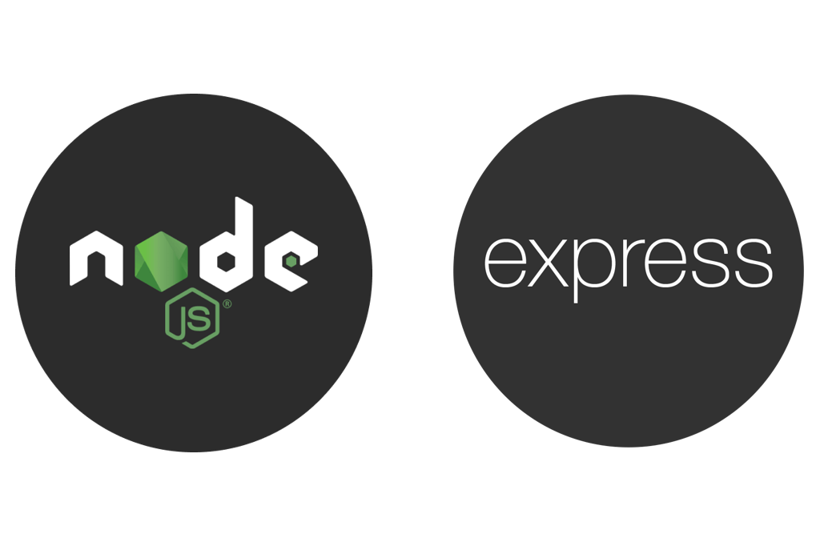



Tech Stack
Prisma: ORM for SQLite database.
Wordnik API: Access to audio files and examples.
Tailwind CSS: Open source CSS framework for styling.
react-i18next: Internationalization framework for React.

Slide 13

Design Pattern
Our games were developed using the creational method.

Slide 14
Tools

Slide 15
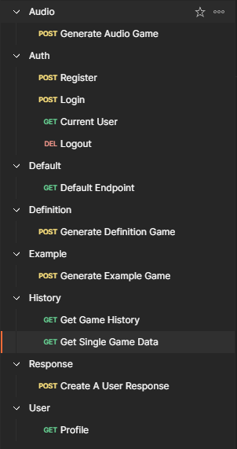
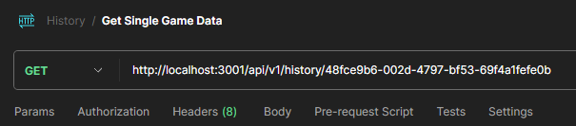

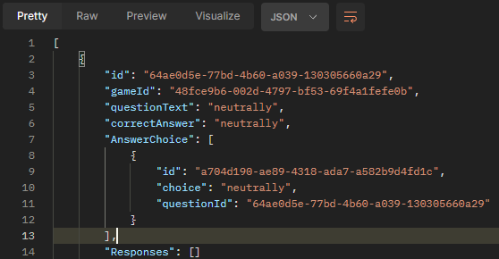

API Testing

Slide 16
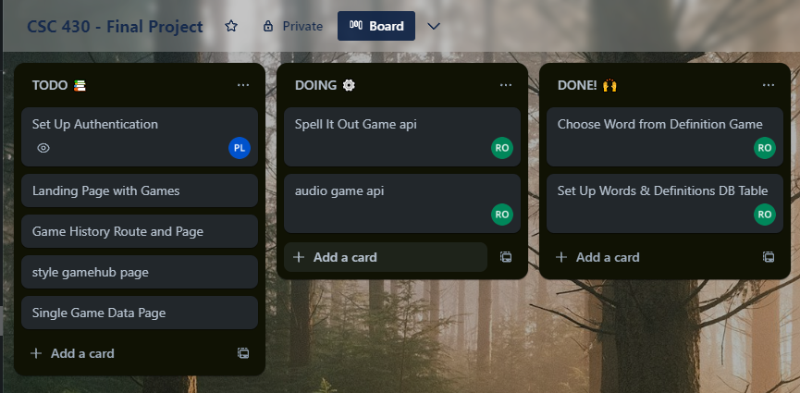
Project Management

Slide 17
Demo

Slide 18
Version 2.0
Support for More Languages
French, Italian, and more
Eleven Labs AI Text to Speech API Integration
Integrate API to generate audio samples for 20+ languages
Multiplayer Spelling Bee
User created rooms for spelling bee competitions
Clean DataBase

