Slide 1
Security and Protection

Slide 2
Introduction
Overview of Security and Protection
Security Attacks
Formal Aspects of Security
Encryption
Authentication and Password Security
Protection Structures
Protection Domain
Capabilities
Classifications of Computer Security
Case Studies in Security and Protection
15.<number>

Slide 3
Concepts
Protection:
    Mechanisms and policy to keep programs and users from accessing or changing stuff they should not do
    Internal to OS
Security:
    Issues external to OS
    Authentication of user, validation of messages, malicious or accidental introduction of flaws, etc.
15.<number>

Slide 4
Guiding Principles of Protection
Principle of least privilege
  Programs, users and systems should be given just enough privileges to perform their tasks
Separate policy from mechanism
  Mechanism: the stuff built into the OS to make protection work
  Policy: the data that says who can do what to whom
15.<number>

Slide 5
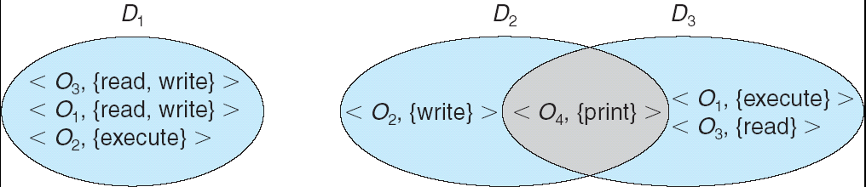
Domain Structure
Access-right = <object-name, rights-set>
where rights-set is a subset of all valid operations that can be performed on the object.
Domain = set of access-rights
15.<number>

Slide 6
How to Track Objects/Rights in Domains?
View protection as a matrix (protection matrix)
  Rows represent domains
  Columns represent objects
Access(i, j) is the set of operations that a process executing in Domain i can invoke on Object j
15.<number>

Slide 7
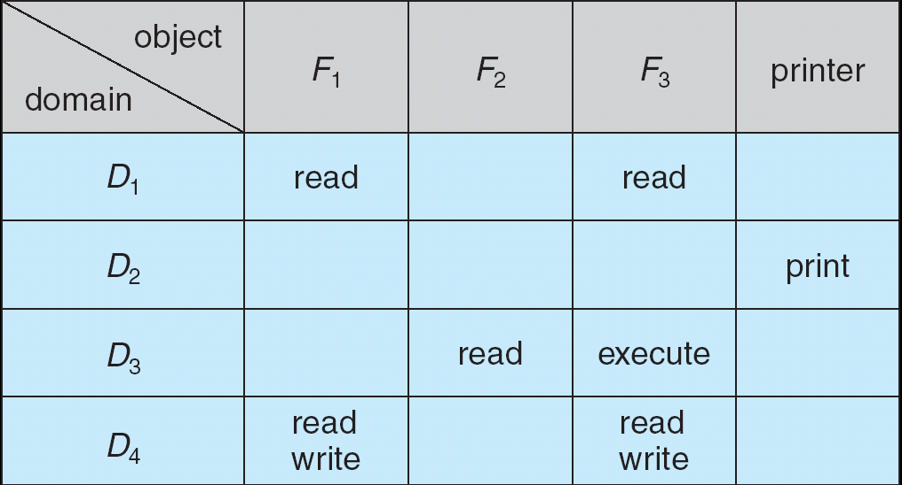
Access Matrix
Columns are access control lists (ACLs)
    Associated with each object
Rows are capabilities
    Associated with each user, group, or domain
15.<number>

Slide 8
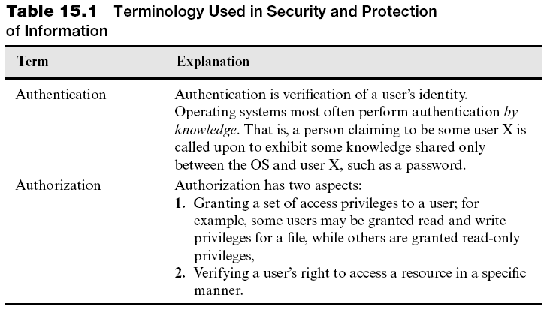
Overview of Security and Protection
A threat is a possible form of interference
  Security: threats to resources from nonusers
  Protection: threats from users
15.<number>

Slide 9
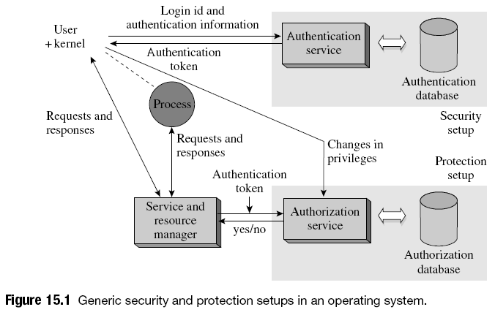
Overview of Security and Protection
15.<number>

Slide 10
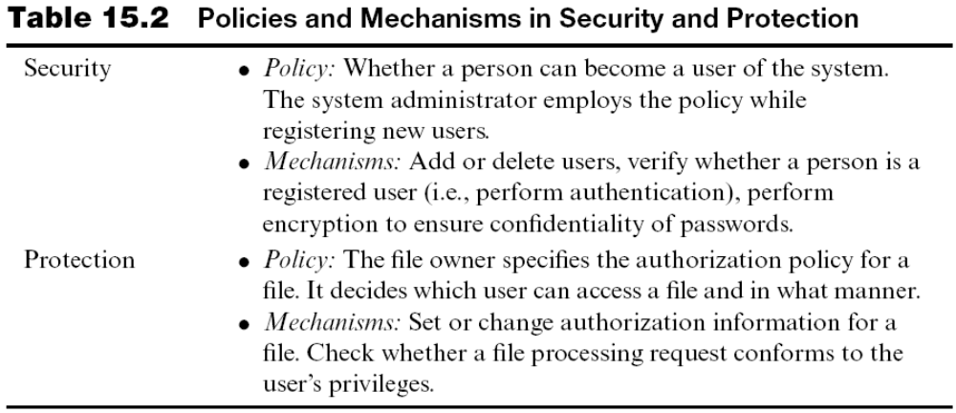
Overview of Security and Protection
15.<number>

Slide 11
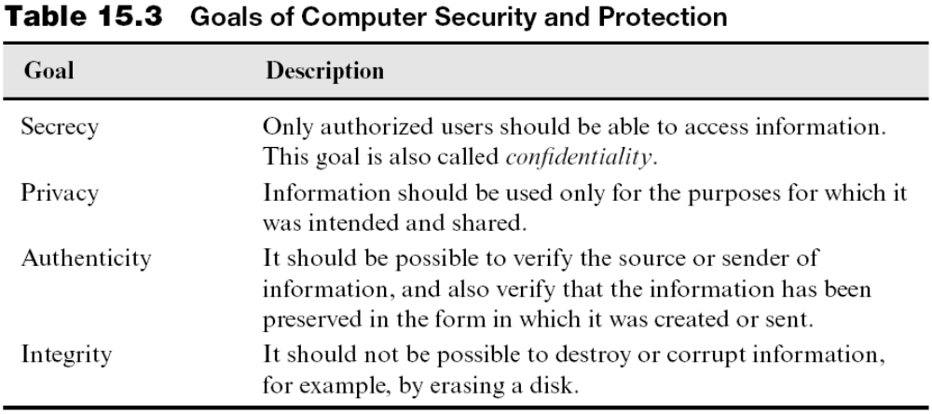
Goals of Security and Protection
Only privacy is exclusively a protection concern
  Controlled sharing based on need-to-know principle
15.<number>

Slide 12
Security and Protection Threats
Examples of security threats:
  Threats raised by data and programs downloaded from the Internet
Examples of protection threats:
  Illegal access to a resource or a service by a process
  An attempt to tamper with messages
Security threats can arise more easily in a distributed OS
15.<number>

Slide 13
Security Attacks
Security attack: attempt to breach security of a system
Terminology: security attacks, adversary, intruder
Two common forms of security attacks are:
  Masquerading: assume identity of a registered user through illegitimate means
  Denial of service (DoS)
    Prevent users from accessing resources for which they possess access privileges
      Network DoS attack, distributed DoS attack
Other types of attacks:
  Message eavesdropping
  Tampering with messages
15.<number>

Slide 14
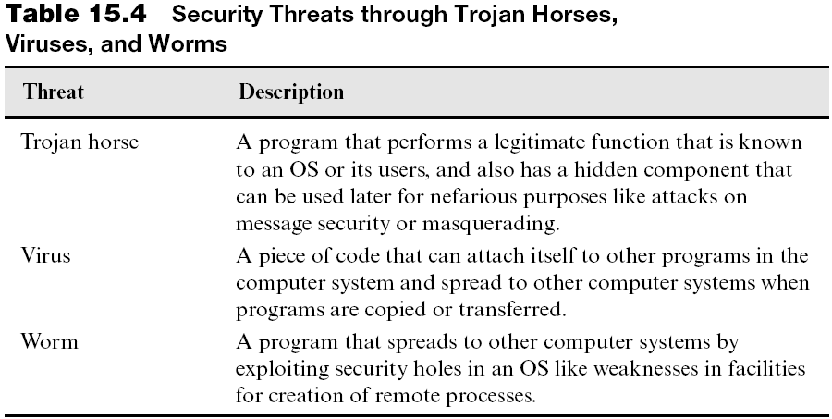
Trojan Horses, Viruses, and Worms
Trojan horses, viruses, and worms contain code that can launch a security attack when activated
15.<number>

Slide 15
Trojan Horses, Viruses, and Worms (continued)
A virus typically sets up a back door that can be exploited for a destructive purpose at a later date
  E.g., executable virus, boot-sector virus, e-mail virus
Worms may spread using buffer overflow technique
Measures to halt security attacks:
  Using caution while loading new programs into a computer
  Using antivirus programs
  Plugging security holes
15.<number>

Slide 16
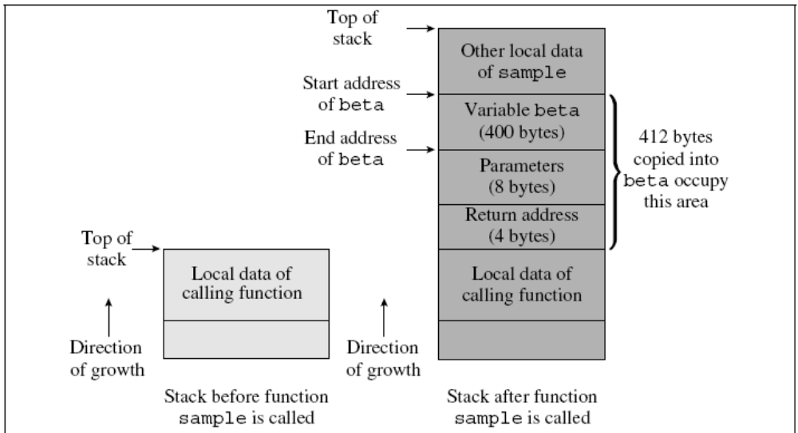
The Buffer Overflow Technique
15.<number>

Slide 17
Formal Aspects of Security
To formally prove a system is secure, we need:
  A security model comprising security policies and mechanisms
  A list of threats
  A list of fundamental attacks
  A proof methodology
Manual procedures can discover security flaws
  But procedures become less reliable as systems grow
Formal approach constructs feasible sequences of operations and deduces their consequences
  But hard to develop specification of a system and threats
15.<number>

Slide 18
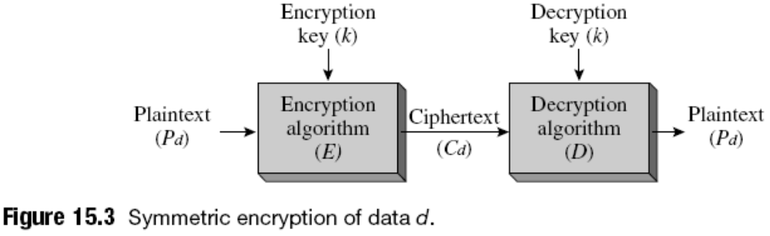
Encryption
Encryption: application of an algorithmic transformation to data
  Cryptography deals with encryption techniques
  Plaintext is transformed to encrypted/ciphertext form
  Confidentiality provided through encryption also helps to verify integrity of data
  Two types: symmetric and asymmetric
15.<number>

Slide 19
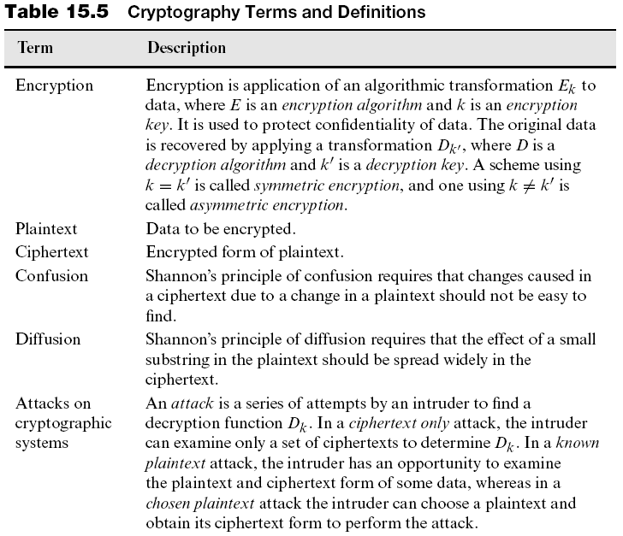
15.<number>

Slide 20

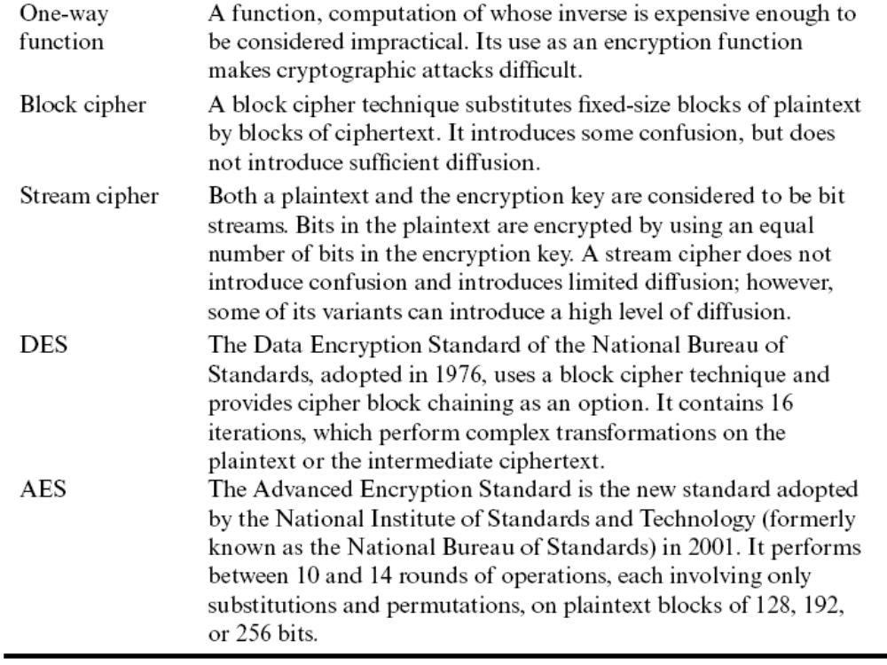
15.<number>

Slide 21
Attacks on Cryptographic Systems
An attack on a cryptographic system consists of a series of attempts to find the decryption function D_{k}
Quality of encryption: ability to withstand attacks
  Aim: perform high-quality encryption at a low cost
  Encryption quality is best if E_{k} is a one-way function
Attacks:
  Exhaustive attack
  Ciphertext only attack
  Known plaintext attack
  Chosen plaintext attack
15.<number>

Slide 22
Encryption Techniques
Simplest encryption technique: substitution cipher
  Can be broken using a frequency analysis
How to mask features of plaintext during encryption?
  Use Shannon’s principles of
    Confusion
    Diffusion
15.<number>

Slide 23
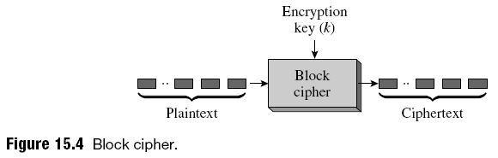
Encryption Techniques (continued)
Block cipher:
  A block of plaintext replaced by a block of ciphertext
  Extension of the classical substitution cipher
  Simple to implement
  Vulnerable to:
    Frequency analysis
    Known plaintext
    Chosen plaintext attacks
15.<number>

Slide 24
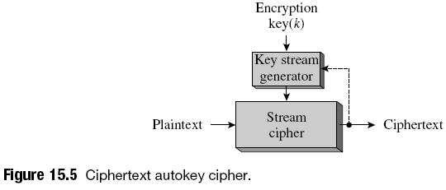
Encryption Techniques (continued)
Stream cipher:
  Transformation involves a few bits of the plaintext and an equal number of bits of the encryption key
  Faster than a block cipher
  Examples: vernam cipher, one-time pad, ciphertext autokey, self-synchronizing cipher, RC4
15.<number>

Slide 25
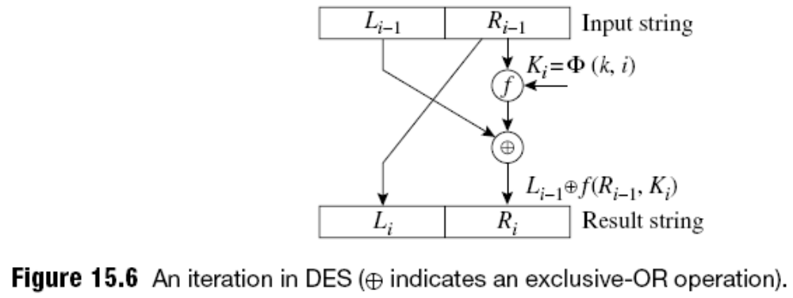
Encryption Techniques (continued)
Data Encryption Standard (DES)
  56-bit key to encrypt 64-bit data blocks
  Cipher block chaining (CBC) mode used to overcome problem of poor diffusion
  Steps: permutation, transformation, permutation
  Triple DES contains three applications of DES
15.<number>

Slide 26
Encryption Techniques (continued)
Advanced Encryption Standard (AES)
  Variant of Rijndael
  Uses only substitutions and permutations
  Block size of 128 bits
  Keys of 128, 192, or 256 bits
  Each round consists of:
    Byte substitution
    Shifting of rows
    Mixing of columns
    Key addition
15.<number>

Slide 27
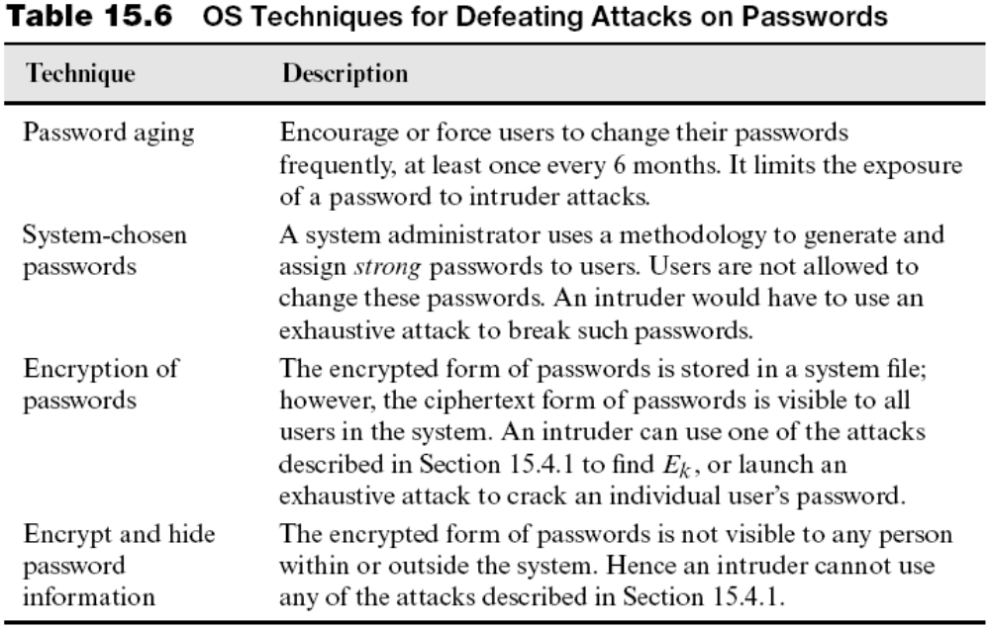
Authentication and Password Security
Authentication typically performed using passwords
15.<number>

Slide 28
Protection Structures
Protection structure: classical name for the authorization database
Access privilege (for a file): right to make a specific form of access to the file
Access descriptor: representation of a collection of access privileges for a file
  Access control information (for a file): collection of access descriptors
15.<number>

Slide 29
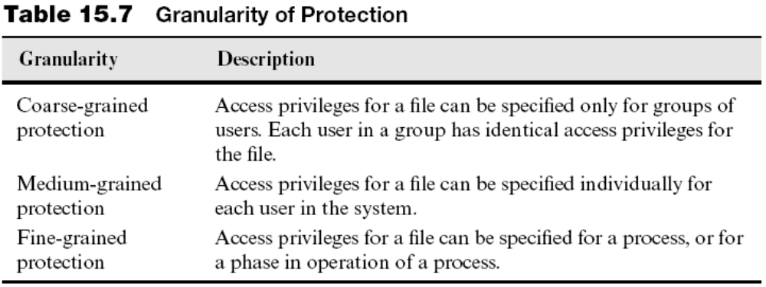
Granularity of Protection
Users desire medium- or fine-grained protection
  Lead to a large size of the protection structure
OSs resort to coarse-grained protection to reduce size of the protection structure
15.<number>

Slide 30
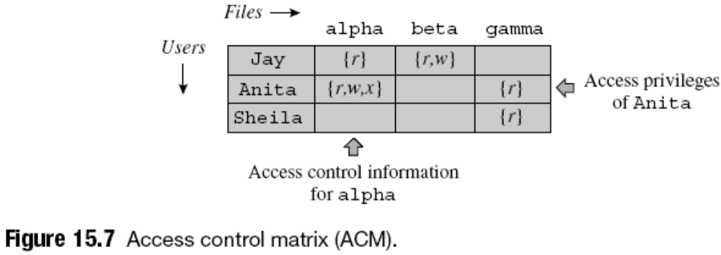
Access Control Matrix
An access control matrix is a protection structure that provides efficient access to:
  Access privileges of users to various files
  Access control information for files
15.<number>

Slide 31
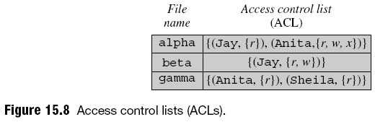
Access Control Lists (ACLs)
ACL of a file is a representation of its access control information
  Contains the non-null entries that the file’s column would have contained in the ACM
15.<number>

Slide 32
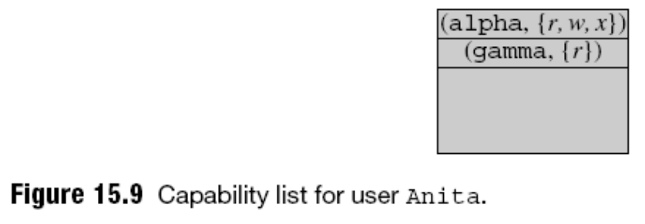
Capability Lists (C-lists)
A C-list represents access privileges of a user to various files in the system
  Contains the non-null entries that the user’s row in the ACM would have contained
15.<number>

Slide 33
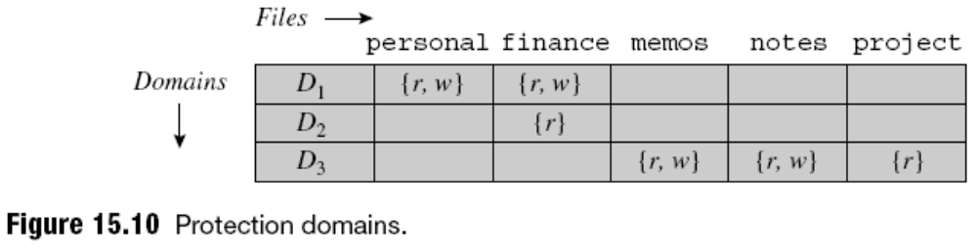
Protection Domain
Use of access control matrix, ACL, or C-list used to confer access privileges on users achieves secrecy
Privacy goal requires that information should be used only for intended purposes
  Access privileges granted to a protection domain
  A process operates “within” a protection domain
  It can switch domains during operation
15.<number>

Slide 34
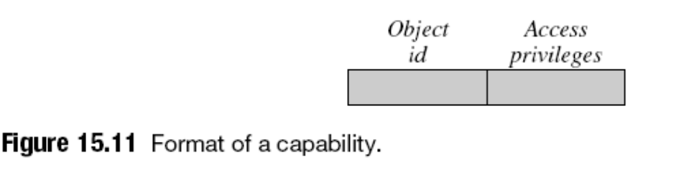
Capabilities
A capability is a token representing some access privileges for an object
  An object is any HW or SW entity in the system
15.<number>

Slide 35
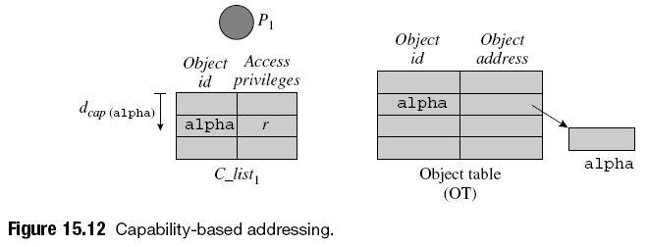
Capability-Based Computer Systems
Capability-based computer systems implement capability-based addressing and protection for all objects in system
  Many capability-based systems built for research
  Intel iapx-432 was a capability-based commercial system
15.<number>

Slide 36
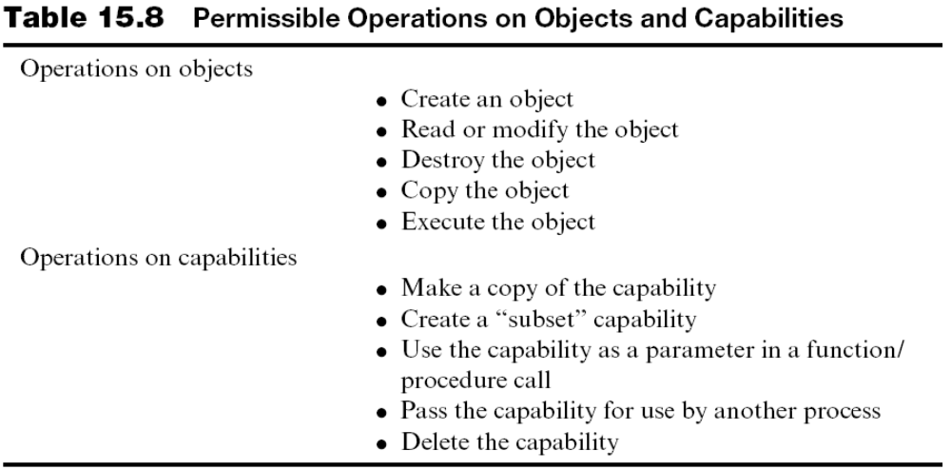
Capability-Based Computer Systems (continued)
15.<number>

Slide 37
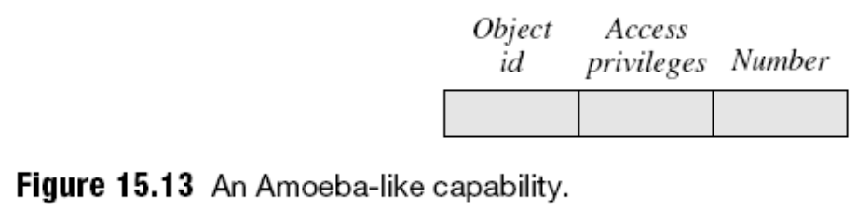
Software Capabilities
The OS for a non-capability-based computer can implement capabilities in software
  Manipulation and protection of objects performed by part of kernel called object manager (OM)
  Two problems:
    Process may be able to bypass the capability-based protection arrangement while accessing objects
    It may be able to tamper with or fabricate capabilities
  Problems solved through encryption of object table and capabilities
15.<number>

Slide 38
Problem Areas in the Use of Capabilities
Use of capabilities has three practical problems:
  Need for garbage collection
  Confinement of capabilities
  Revocation of capabilities
15.<number>

Slide 39
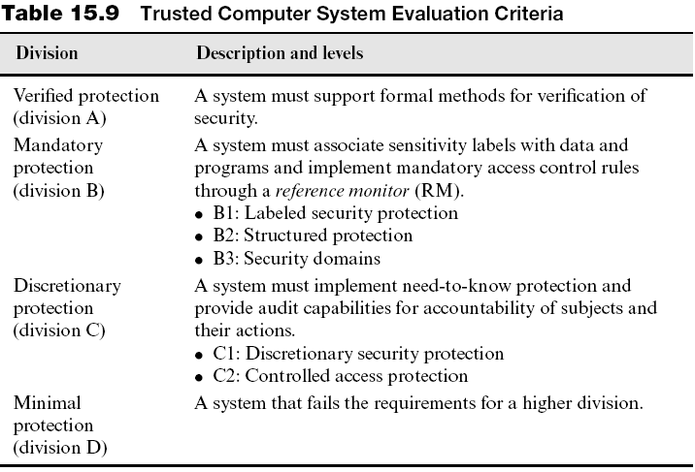
Classifications of Computer Security
15.<number>

Slide 40
Case Studies in Security and Protection
MULTICS
Unix
Linux
Security and Protection in Windows
15.<number>

Slide 41
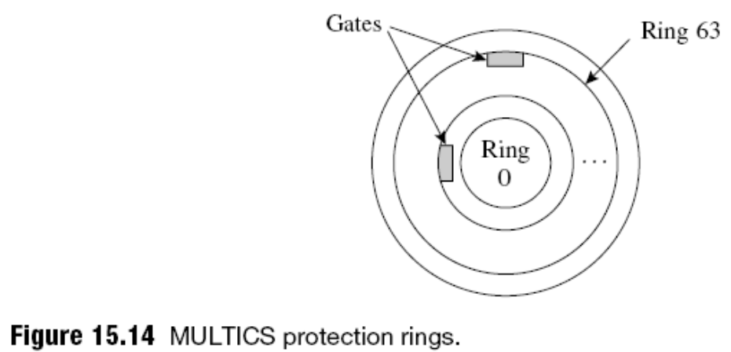
MULTICS
Multiplexed Information and Computing Service - mainframe timesharing OS developed by MIT as a research project in 1965. Influenced OS development.
64 protection domains organized as concentric rings
Complex protection structure
  Incurs substantial execution overhead due to checks made at a procedure call
15.<number>

Slide 42
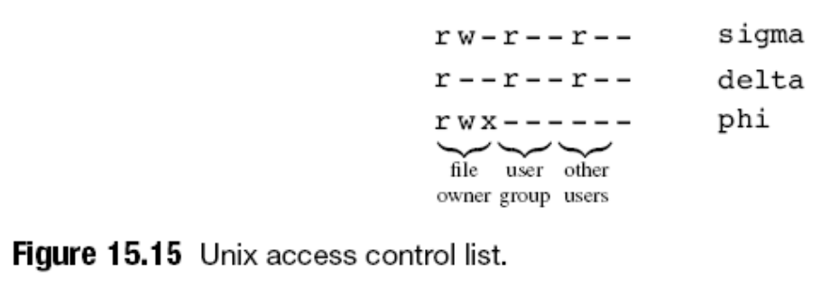
Unix
Employs encryption for password security
Can use shadow passwords file accessible only to root
Three user classes: owner, group, and other users
  3-bit bit-encoded access descriptor for each user class
Setuid permits change of protection domain
15.<number>

Slide 43
Linux
Authenticates user at login time by adding a “salt” value to password and encrypting result with MD5
May use a shadow passwords file only to the root
Provides pluggable authentication modules (PAMs)
File access protection based on user id and group id of a process
System calls fsuid and fsgid can be used by server to temporarily assume identity of its client
Supports Linux security modules (LSM)
Security Enhanced Linux (SELinux)
15.<number>

Slide 44
Security and Protection in Windows
Several elements of C2- and B2-class systems
  Discretionary access control
  Object reuse protection
  Auditing of security-related events
  Security reference monitor (SRM) that enforces access control
  Trusted path for authentication
    Defeats masquerading attacks through a Trojan horse
An object file has a security descriptor
  ID, DACL, and SACL
15.<number>

Slide 45
Security and Protection in Windows (continued)
DACL, SACL are lists of access control entries (ACEs)
  An ACE allows or disallows certain kinds of accesses
  SACL is used to generate an audit log
Client–server security through access tokens
  Impersonation feature using impersonation tokens
Security features added in Vista:
  Defeats buffer overflow attacks in X-86 architectures
  Detecting heap corruption
  Preventing access to system code
  Preventing misuse of privileges
  Network access protection
15.<number>

Slide 46
Summary
Security and protection measures are used to counter interference threats
  Use authentication and authorization techniques
Threats launched using Trojan horses, viruses, worms, and exploitation of buffer overflows
Encryption is an algorithmic transformation of data
  Block ciphers and stream ciphers
  Widely used encryption standards: DES and AES
Access control lists, capability lists, and protection domains are protection structures
TCSEC is a security classification
15.<number>

