Slide 1
Test
Rafael Ospina

Slide 2
Datasheet
a total of 116,201 transactions
data from 10 accounts
transactions from 2015-01-01 to 2019-03-05, i.e. 4y + 2m +4d
44,806 different transaction details
905 (0.78%) transaction were made using check
18 categories:
'Transfer', 'Investment', 'Miscellaneous', 'Loan Payment',
'Subscriptions', 'Pets & Pet Care', 'Food & Dining',
'Utility Bill', 'Electronics & Gadgets', 'Insurance', 'Travel',
'Shopping', 'Education', 'Health & Wellness',
'Charity & Donations', 'Entertainment', 'Transportation',
'Childcare & Parenting'
- 10 source cities (all in USA):
'New York', 'Phoenix', 'Dallas', 'San Jose', 'Philadelphia',
'San Antonio', 'San Diego', 'Houston', 'Los Angeles', 'Chicago'
3 device types: 'Tablet', 'Mobile', 'Desktop'

Slide 3
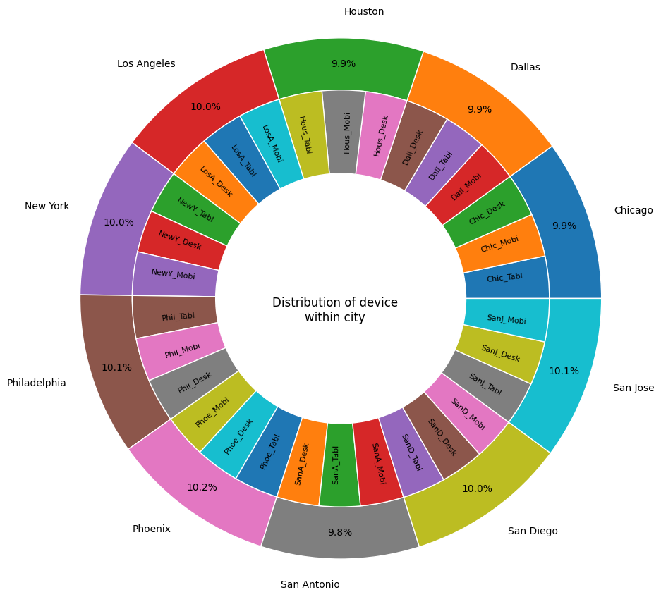
Device and city distributions
We can see that city and device have very nice distributions, i.e. almost equal data distribution for device per city.
This device distribution keeps their behavior from 2015 to 2019

Slide 4
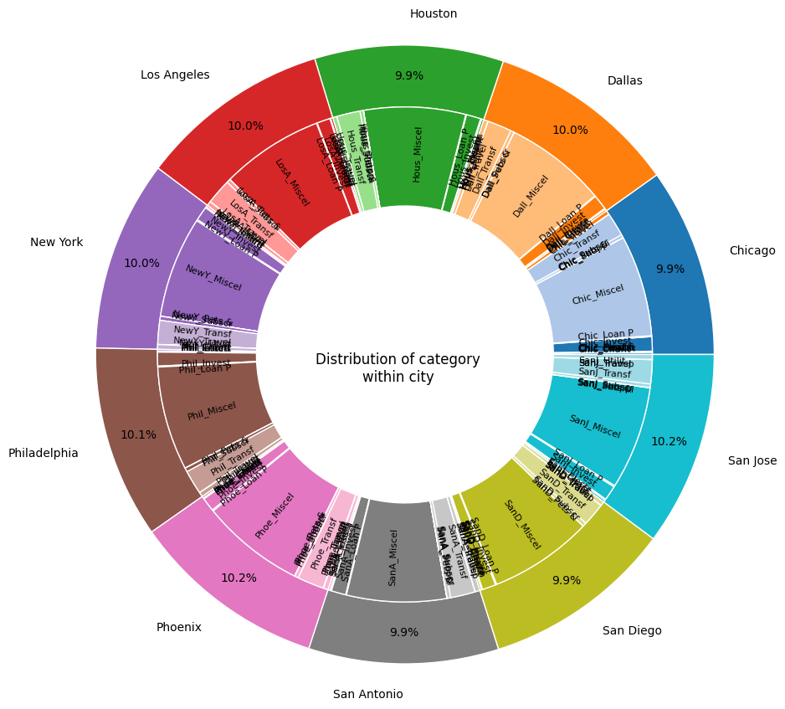
Withdrawals per city
For all cities the main category for withdrawals and deposits is Miscellaneus

Slide 5
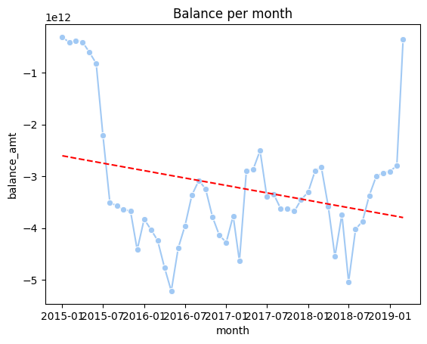
Balance
We can see that the bank balance is always negative, and it is in average decreasing at a speed of
-23,865,986,426 per month!
For several months, it was a warning, just last month, 2019-march increased

Slide 6
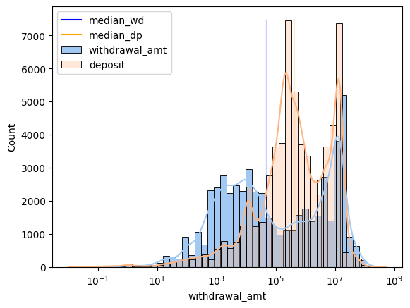
Withdrawals vs deposits
the tendency (using median) is that transactions for deposits (426,500) are higher than withdrawals (47,083)
- if this were in cash, one may have the first impression that the market will distribute the cash in the amts and we just need to pay attention to collect the money from amts, not placing it.

Slide 7
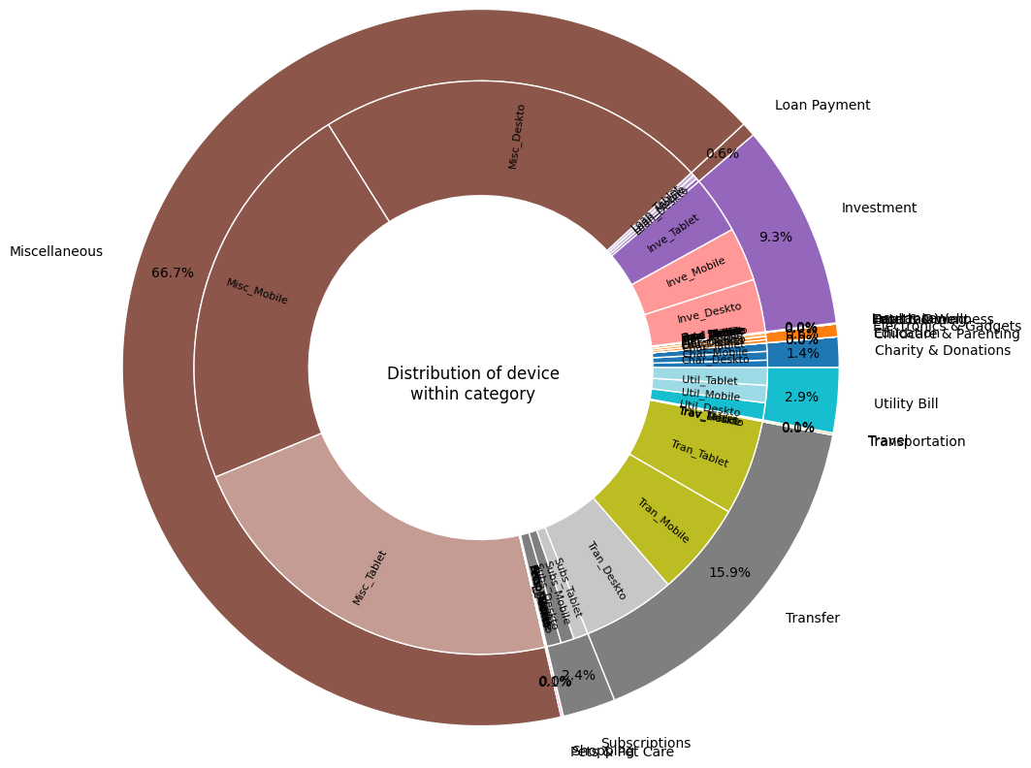
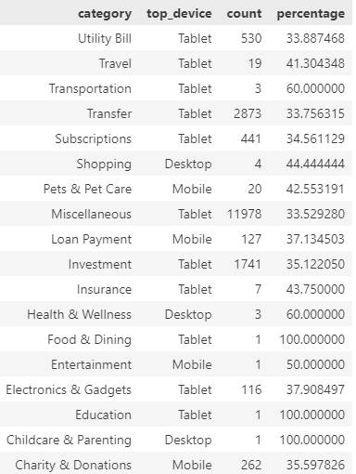
Withdrawals
More than 60% of the withdrawals are made for miscellaneous. 25% are made for transfers.
Depending on the business, there is a device people use more frequently. Thus, any digital development for payment could be address to the device improving user experience
For travel, for example, 41% of the withdrawals were made by Tablet
For loan payment, 37% are made by mobile

Slide 8
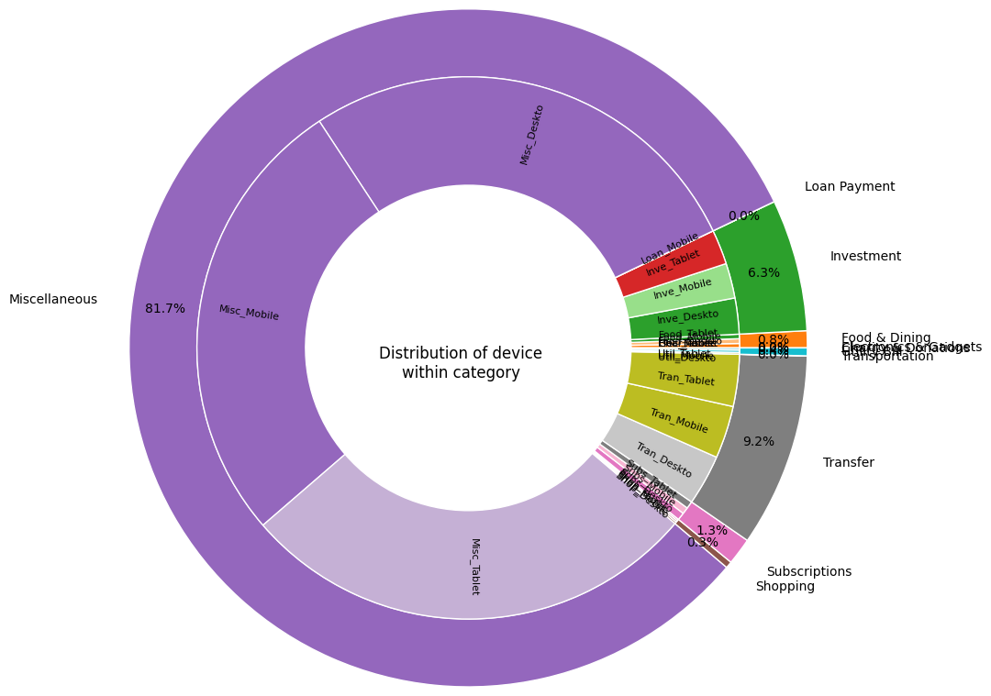
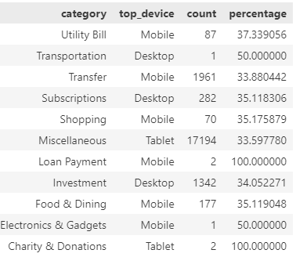
Deposits
80% of the deposits are made under the concept of miscellaneous. Followed by 9% of transfers
Each category has their main device.
For miscellaneous, 34% were made with tables
For transfers, 33% were made with mobiles

Slide 9
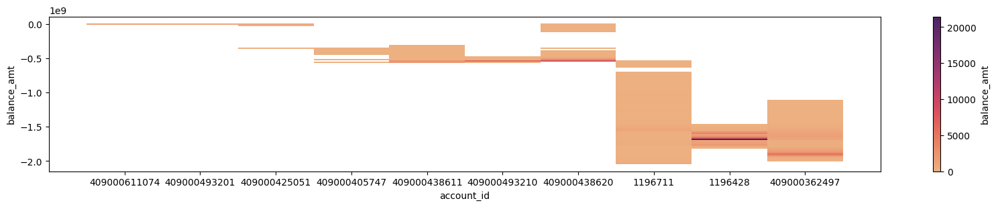
Grouping data by account_id
balance

Slide 10
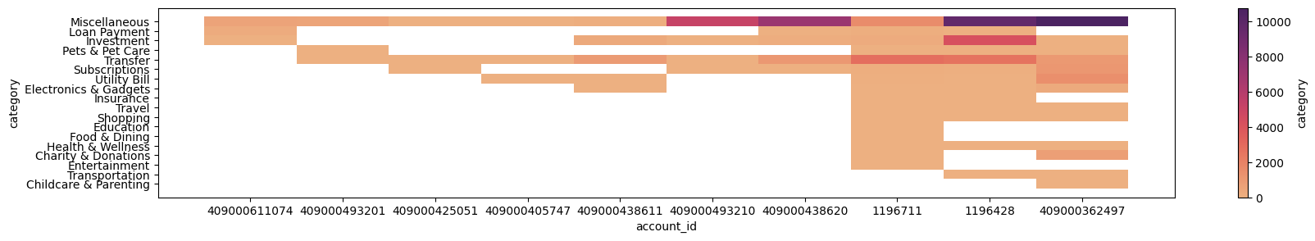
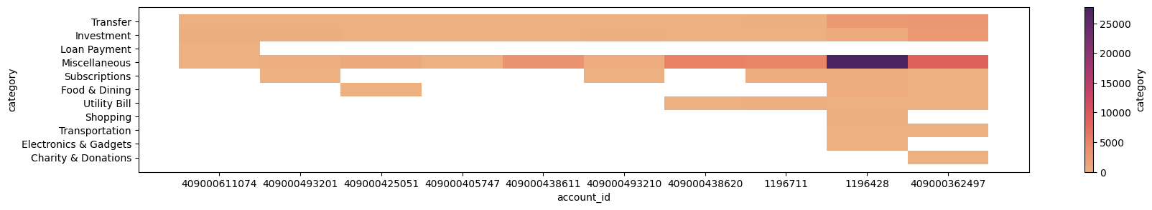
Grouping data by account_id
withdrawals
deposits
The account 409000611074 may own to someone (person, company) which works similar to a bank
The accounts 1196428 and 409000362497 may own to big business. They have presence in multiple cities and move their money in multiple categories

Slide 11
Feature Engineering
Grouping by month and year
Computing delta, i.e. values difference from current month and previous months (-1 month, -2 months). Thus, those delta values can show how that account is growing up

Slide 12
Use cases
Analyze what devices are used per category, city, etc. Thus any software development and service can be focus on that device to improve the user experience
Analyze transactions per city. Thus, the bank could know how to prepare their digital and physical resources.
Detect possible fraudulent transactions: outlier values, fast location change.

Slide 13
Desirable Features
Some extra features would be desirable to make a better user classification:
Company or person account
Age
Gender
Time for transaction (including hour and minutes)
Account destination or bank destination

Slide 14
Model prediction
Train a model to forecast loan payments/deposits/withdrawals. Thus, the bank will know how much money will have to project future investements, etc.
Prophet by Facebook could work

