Slide 1
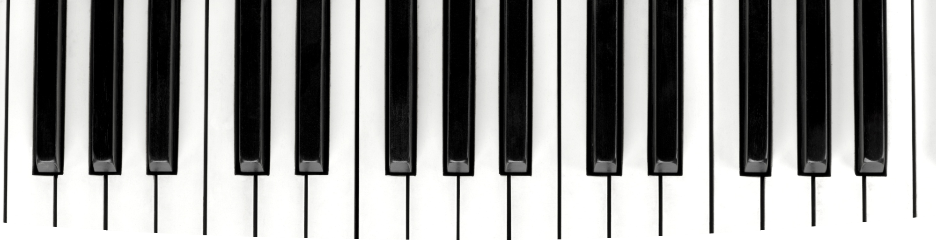
Melodic Chains
Music Generation using Markov Chains
REOF-MAS

Slide 2
Goal of the project
Algorithmic composition using Markov chains from MIDIs
  Current focus on generating short melodies
  Making a whole song based on those
Something definetly NOT mere generation
  Agents collaborate to generate valuable/novel/surprising artefacts
  Robust evaluation methods

Slide 3
Objectives – Environment setup
Repository setup ✓
  Source and Documentation separation, all works fine..
Virtual environment ✓
3rd Party Library Installations ✓
Boilerplate structure of project ✓
  Thanks to Creamas

Slide 4
Objectives – Inspiration set, MCs
Parsing compositions from MIDI files ✓
  Music21 library and some problems - manual installation ☹
Representation of the musical composition is HARD!
  There are many variables to consider:
    Note, duration, pitch, motif, chroma, key, loudness, mode, tempo, timbre ... and possibly more.
  Current FOCUS (one step a time) ✓
    Markov Chain states = Note & Duration ✓
    All songs are transposed to the same key ✓
    Transformational creativity - mutable chains

Slide 5
Objectives – Artefact Evaluation
By Agents – (ComposerAgent, AudienceAgent, CoordinatorAgent?)
  Value: Zipf’s Law (Monterey Mirror, Manaris et al.) ✓
  Novelty: String comparison methods, pseudo-likelihood?
    Pitch interval, note duration, similarity score ...
  Possible different method to measure surprisingness (Auidience Agent)
By Human judges (external feedback)
  After some iterations evaluate the artefact and transform it accordingly
  Still under consideration

Slide 6
Possible Improvements
There are endless possibilities...
Preprocess - Select what you need from MIDIs!
  Staccato filter, Allegro filter ...
  Avoid repetitive patterns (let the agents select different states – mutate)
Setting a theme
Hard-coded rhytms
LIMITED TIME – reconsider wisely
  ...

Slide 7
Any questions/suggestions?

