Slide 1
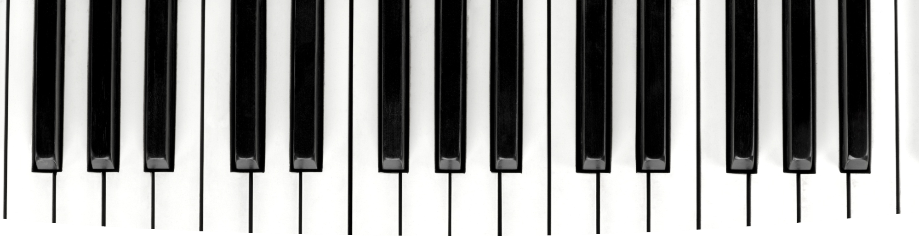
Melodic Chains
Music Generation using Markov Chains
REOF-MAS

Slide 2
Goal of the project
General-To-Specific-Order
Algorithmic composition from MIDIs
Multi-agent system that generate polyphonic songs with structure resembling compositions devised by human composers.

Slide 3
System Overview
Bach themes database
Composer
Select a theme into song generation
Mozart themes database
Environment
Song generator
Composer
Vote
Theme
Best Theme
Theme inversion,
transposition,
Retrograding,
inversion+retrograding
Schubert themes database
Composer
Eval.
Opinion asking
Audience
agent

Slide 4





System Overview cont.
Introduction
Development
Conclusion
Theme is reintroduced after transformation
Theme is presented
Theme is transformed
original
retrograde
transposition
+
inversed
retrograde inversed

Slide 5
Design Choices– Agent POV
Why not direct interaction between Composer Agents?
  Themes, style, harmony may be DIFFERENT
  Leads to Cacophony Generator
Instead, indirect interaction while voting
Why Audience Agent?
  What we wanted to do
  What we have

Slide 6
Design Choices – Artefact Evaluation
Value of the artefact
  Zipf’s Law
  Introduced in the lecture slides (thank you ☺ )
    Monterey Mirror, Manaris et al.
Novelty of the artefact
  Levenshtein distance
  Edit distance of the steps between notes
Surprisingness of the artefact
  Based on the pseudo-likelihood

Slide 7
Design Choices – Song Generation
Selection of the best themes in the artefact set
  Self similarity measure, Murray and Ventura (2012)
  Simple, Complex melody
Forming the theme into a song
  Transpose
  Retrograde
  Inverse

Slide 8
Possible Improvements
Make a song in every iteration now
  NOT at the end of the program
Possibly evaluate the whole song at each iteration
Improve ties between both voices of the generated song

Slide 9
A few comments
Music21 is NOT the greatest library ever made
  Poor documentation
Forming the song is HARD
Maybe the Markov Chain is not the best option for this system?
  Answer Set Programming (ASP) , Boenn et al. 2010, ANTON
We actually learned lots of things
  All things that matter -> Learning for Good

Slide 10
Any questions?

Slide 11
Demo

