Slide 1
Method and apparatus for service mesh in cloud-native mobile core network
Quang Tung Thai, Namseok Ko

Slide 2
5G core network deployment challenges
The SBA decomposes the core network into small software components:
Supports horizontal scaling, flexible deployments for network slicing
But, introduces deployment challenges:
We may have 100x, 1000x instances of AMF, SMF in multiple clouds
PCF
AMF
SMF
UDR
AUSF
UDM
Conceptual network composition
Having various service discovery implementations at NFs creates a huge challenge for network deployments
AMF
SMF
AMF
SMF
UDM
AMF
AMF
PCF
AUSF
UDR
PCF
AMF
AMF
SMF
PCF
SMF
SMF
Service registration and discovery
Service registration and discovery
Service registration and discovery
NRF
NRF
NRF

Slide 3
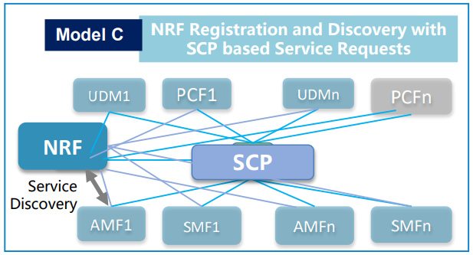
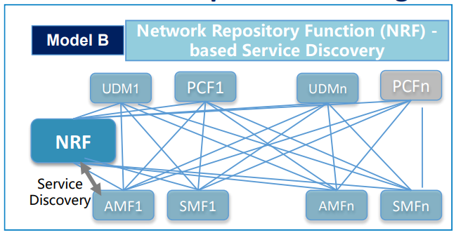
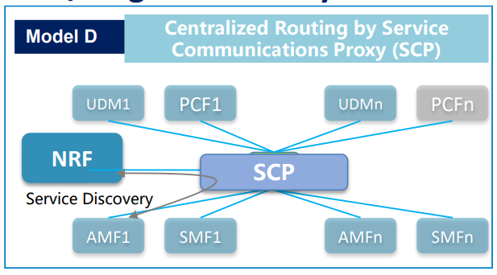
The root of this mess
Current architecture tries to solve two problems at the same time:
Mobile applications (access, mobility, session management, charging etc .)
Application deployment (service registration and discovery, slicing, security, scaling etc)
Consequences:
Create confusions in deployment with four models (REL 16) (model A is not shown)
Cumbersome signaling procedures:
mixing service discovery logic with application signaling procedures
leaving many gaps for custom of implementations -> vendor lock-in problems

Slide 4
Complex signaling procedures
Without SCP (TS 23.501 - model B)
With SCP (TS 23.501 - model D)
NF
NRF
NF
SCP
NRF
register
register
ack
ack
nf-query
request + nf-query
nf-query
Introduction of SCP (REL 16) confirms the existence of the deployment challenges
NF profiles
NF profiles
request
Select NF
request
X
Select NF
X
NF1
NF1
request
request
response
response
NF2
response
NF2
Complex signaling procedures
Vendor-lockin (load balancing, telemetry, security, fault recovery)
Simplified signaling at the cost of extra delivery hop (at SCP)
Unified load balancing, telemetry, security, fault recovery
NRF bottleneck
NRF protocol-lock-in

Slide 5
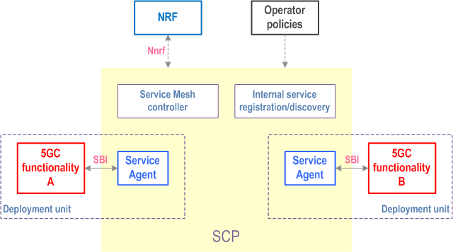
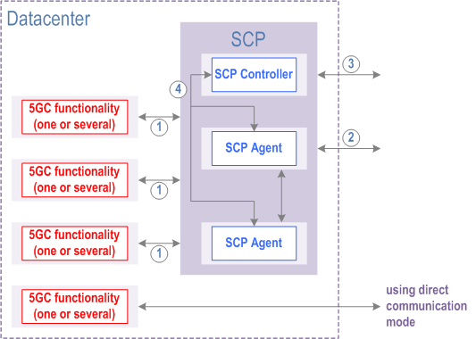
SCP Deployment Options
SCP based on service mesh
SCP based on independent deployment

Slide 6
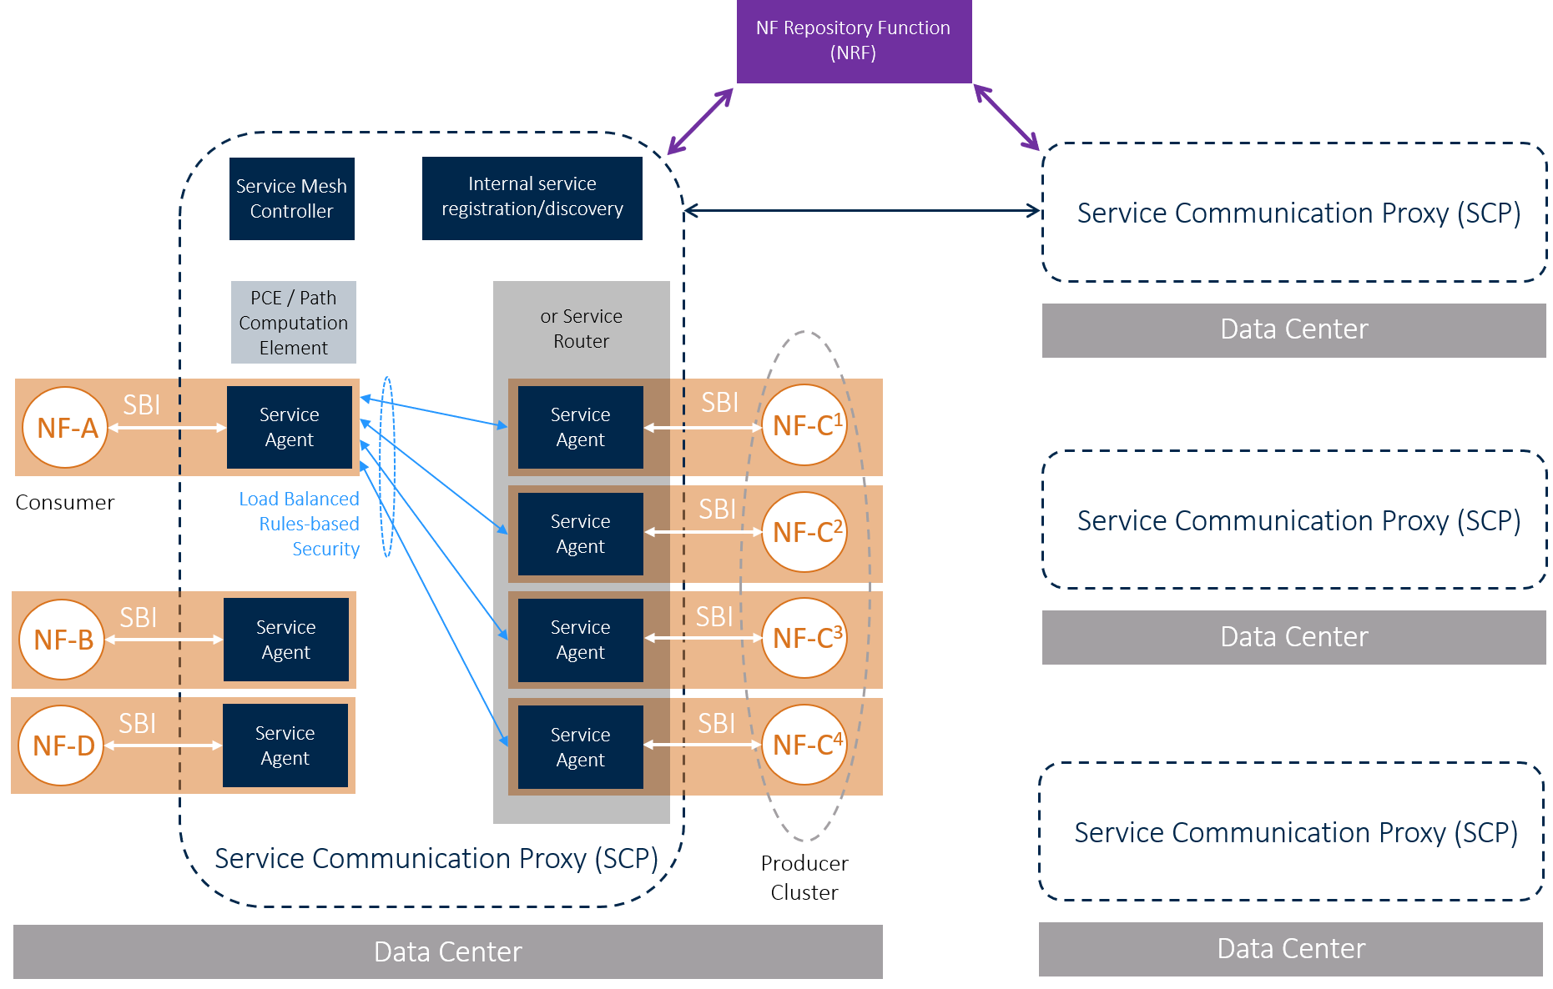
Service mesh SCP-based deployment

Slide 7
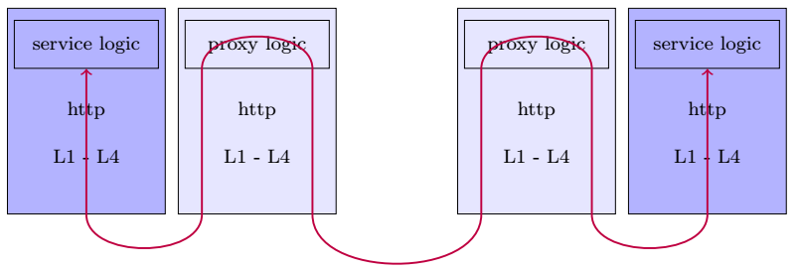
What are the issues on the SCP
SCP is an optional (logical) component - no standardization
Incurs latency due to additional processing hops
Relying on NRF for service discovery, not using the same feature supported natively by the service mesh. Why?
In cloud-native service mesh: find an instance of a service named http://example.com/web/backend
In 5G: find and SMF in slice A, B that serves data network ‘named etri’
NRF is a bottleneck.
NFs are bound to NRF. (NRF is in the application scope)

Slide 8
Our solution
AMF1
PCF1
SMF1
SMF2
PCFn
Creates an abstraction layer for handling service deployment logic
The integration fabric is a black-box that implements service registration/discovery, connection security, fault –tolerance, traffic controlling etc.
Unified APIs to NFs for simplifying signaling procedures
Replace centralized NRF with a generic distributed registry.
Scalable
Extendable to deploy new services
)
Integration fabric
(service registration, discovery, selection, fault detection
AMFn
UDM1
UDMn
New NF
New NF
NF’s signaling logic
Fabric – a black-box
Send a request to SMF in slice A, connecting to DN “etri-net”
Let me find all running instances that meet requirements
Let me do load balancing
Let me select the one is not dead
Here is a response
Send another request
Here is a response
Ok, just forward

Slide 9
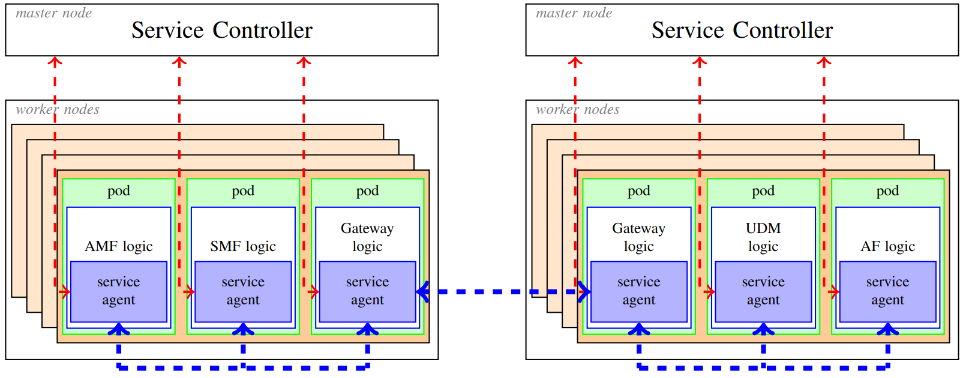
The integration fabric (a service mesh)
NFs are containerized and deployed in cloud platforms dynamically. The address of their running instances are ephemeral.
The service mesh allows NFs (same domain or cross-domain) can find each other seamlessly to request services.
The service mesh consists of a service controller and service agents. A service agent lives within an NF. Through the controller, agents learn each other locations which help them to direct service requests/responses to appropriate destinations.
AMF logic
SMF logic
Service agent
Service agent
http
http
L1…L4
L1…L4

Slide 10
NF identification for discovery
Network operators
defines
Context dictionary book
configures
NfType: amf,smf,udm, new-nf-type
PLMN: x,y,z
DNN: internet, etri, kisti
Slice: A, B, C, D
Region: Daejeon, Seoul, Busan
SubcriberGroup: g1,g2,g3
VerticalId: v1, v2, v3
(extendable dictionary)
NF operating context
PLMN: x
Slice: A, B
Region: Daejeon
VerticalId: v1
AMF
conforms to
NF operating context
PLMN: x
Slice: A
Region: Seoul
VerticalId: v1
AMF
Identifies an NF with an
NF query
Current architecture: NRF defines data models for each type of NFs; they are tightly coupled. NRF is within the application realm.
The fabric is application neutral. Network operators can defines contexts to deploy new applications. The registry system is outside of the application realm
Find AMF
NF operating context
PLMN: x
Slice: A
Region: Daejeon
VerticalId: v1
PLMN: x
Slice: A
Region: *
VerticalId: *
SMF
Service consumer

Slide 11
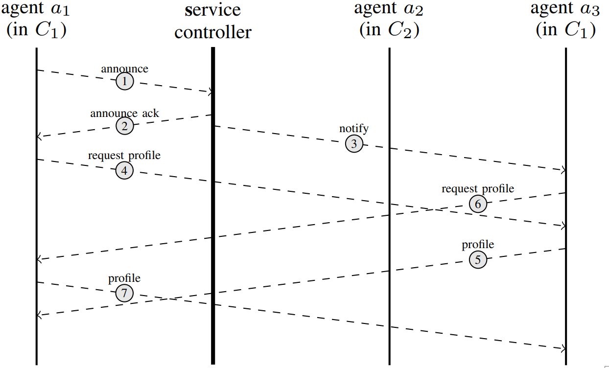
Distributed registry
Controller is a registry broker that notifies agents of new updates.
New agent announced its operating context, its location, and its contexts of interests (NF queries) to the broker
The broker notifies only agents which are relevant to the announced updates
Agents fetch full NF profiles from each other directly
Agents keep a local partial registry database
Registry DB is updated pro-actively
Discovery can be done instantly (NF logic and agent operate in the same process)
No bottleneck (as the case of using a centralized NRF)

Slide 12
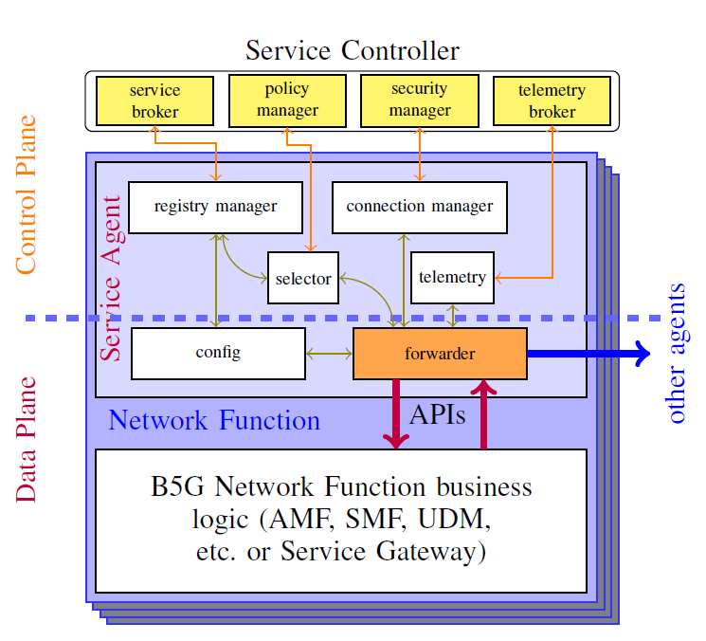
The fabric composition

Slide 13
Service requesting
NF signaling logic
NF signaling logic layer
registry manager
connection manager
remote agent
Agent
forwarder
selector
telemetry
start NF
start agent
1: request + nf-query
Announce
Update registry
2: nf-query
request 1 + nf-query
3: nf-query
4: nf profiles
Select NF
6: selected agent-id
request 1
Agent1
X
request 1
7: get a connection to agent-id
Agent2
8: a connection to agent-id
response 1
response 1
9: request
request 2
request 2
response 2
response 2
10: update telemetry data
11: response
5G/6G scope
12: response
13: update telemetry data
Network function boundary
Simplified signaling logic
(focusing on application business logic)
Integration Fabric
Service discovery, security, signaling traffic steering, telemetry are handled by the integration fabric; transparently from the NFs’ perspective.
Complexity is moved into the agent module

Slide 14
Significances the invention
Summary
Proposed the integration fabric - encapsulating service discovery and routing
A generic NF identification scheme for ease of integration of new applications
Scalable instant service discovery with a distributed service registry
6G core will be a service-oriented network.
Network functions should be plug-and-play
Having an integration fabric is indispensable
The fabric enables additional features : security, fault-tolerance, telemetry for the network operators.
Observability is crucial to support native-AI 6G

