Slide 1


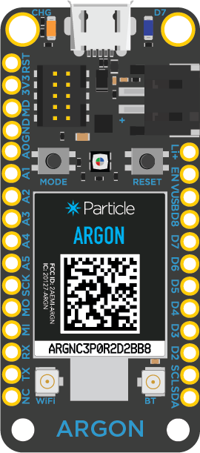


Argon
Particle Cloud
Weather API

Slide 2
Send request via Particle.publish() to webhook
Argon
Particle Cloud
Weather API

Slide 3
Send request via Particle.publish() to webhook
Particle webhook connects to API endpoint
Argon
Particle Cloud
Weather API

Slide 4
Send request via Particle.publish() to webhook
Particle webhook connects to API endpoint
API responds with request JSON-formatted data
Argon
Particle Cloud
Weather API

Slide 5
Send request via Particle.publish() to webhook
Particle webhook connects to API endpoint
API responds with request JSON-formatted data
Argon receives JSON data via Particle.subscribe()
Argon
Particle Cloud
Weather API

Slide 6
Send request via Particle.publish() to webhook
Let's focus in on the JSON
Particle webhook connects to API endpoint
API responds with request JSON-formatted data
Argon receives JSON data via Particle.subscribe()
Argon
Particle Cloud
Weather API

Slide 7
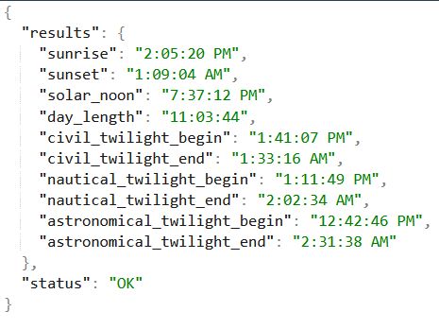
JSON from Weatherstack
Argon
Particle Cloud
Weather API

Slide 8
JSON from Weatherstack
But we only want some of the values…
Argon
Particle Cloud
Weather API

Slide 9
JSON from Weatherstack
But we only want some of the values…
So we have the webhook only send us what we want using Mustache
Argon
Particle Cloud
Weather API

Slide 10
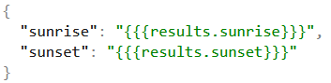
JSON from Weatherstack
JSON from Particle Cloud
Argon
Particle Cloud
Weather API

Slide 11
Send request via Particle.publish() to webhook
Particle webhook connects to API endpoint
API responds with request JSON-formatted data
Argon receives JSON data via Particle.subscribe()
Argon
Particle Cloud
Weather API

