Slide 1


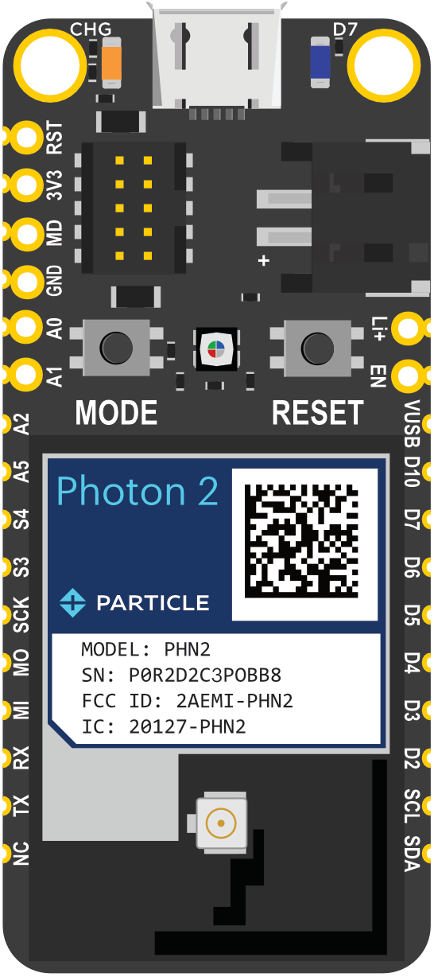


Photon
Particle Cloud
Weather API

Slide 2
Send request via Particle.publish() to webhook
Photon
Particle Cloud
Weather API

Slide 3
Send request via Particle.publish() to webhook
Particle webhook connects to API endpoint
Photon
Particle Cloud
Weather API

Slide 4
Send request via Particle.publish() to webhook
Particle webhook connects to API endpoint
API responds with request JSON-formatted data
Photon
Particle Cloud
Weather API

Slide 5
Send request via Particle.publish() to webhook
Particle webhook connects to API endpoint
API responds with request JSON-formatted data
Photon receives JSON data via Particle.subscribe()
Photon
Particle Cloud
Weather API

Slide 6
Send request via Particle.publish() to webhook
Let's focus in on the JSON
Particle webhook connects to API endpoint
API responds with request JSON-formatted data
Photon receives JSON data via Particle.subscribe()
Photon
Particle Cloud
Weather API

Slide 7
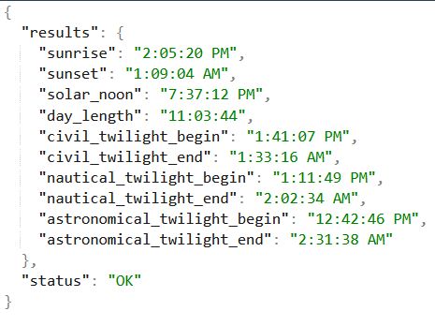
JSON from Weatherstack
Photon
Particle Cloud
Weather API

Slide 8
JSON from Weatherstack
But we only want some of the values…
Photon
Particle Cloud
Weather API

Slide 9
JSON from Weatherstack
But we only want some of the values…
So we have the webhook only send us what we want using Mustache
Photon
Particle Cloud
Weather API

Slide 10
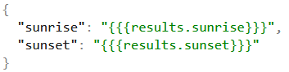
JSON from Weatherstack
JSON from Particle Cloud
Photon
Particle Cloud
Weather API

Slide 11
Send request via Particle.publish() to webhook
Particle webhook connects to API endpoint
API responds with request JSON-formatted data
Photon receives JSON data via Particle.subscribe()
Photon
Particle Cloud
Weather API

